Slide 1
Consumer attitude towards fish sauce products
Xuan Pham

Slide 2
1. Setting up the working environment

Slide 3
2. Import data

Slide 4
3. Sample structure understanding
3.1 Categorical variables
Majority of respondents are female in their 20s (20-24 yo), obtained University degree, having full-time jobs and originally from the South.
3.1.1 Sample structure table summary
Variable
Level
No. of respondents
% Respondents
Age range
20-24 yo
173
57.67
Age range
Above 35 yo
71
23.67
Age range
25-35 yo
56
18.67
Education level
University
267
89.00
Education level
High school
31
10.33
Education level
Below high school
2
0.67
Gender
Female
199
66.33
Gender
Male
101
33.67
Job
Full-time
155
51.67
Job
Student
103
34.33
Job
Part-time
33
11.00
Job
Housework
9
3.00
Native village
South
195
65.00
Native village
Central
66
22.00
Native village
North
39
13.00
3.1.2 Sample structure plot

Slide 5
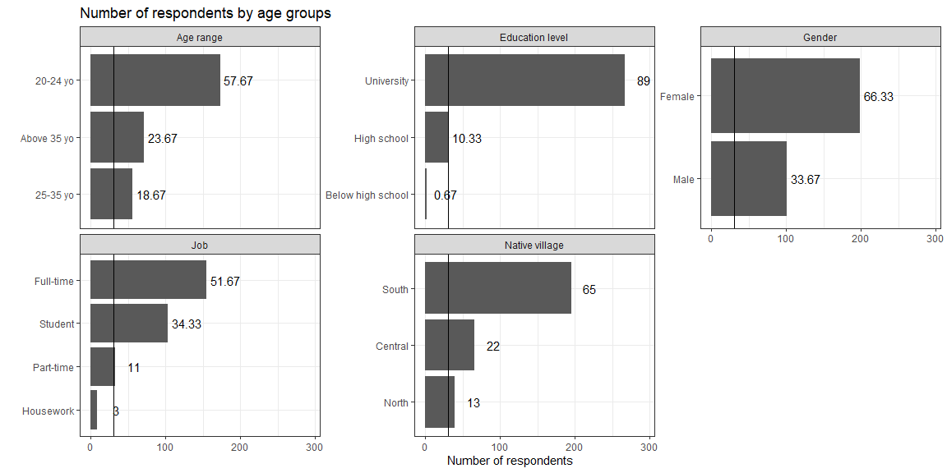

Slide 6
3.2 Continuous variables
Respondent age is not normally distributed. 1/3 respondents are 22 years old.

Slide 7
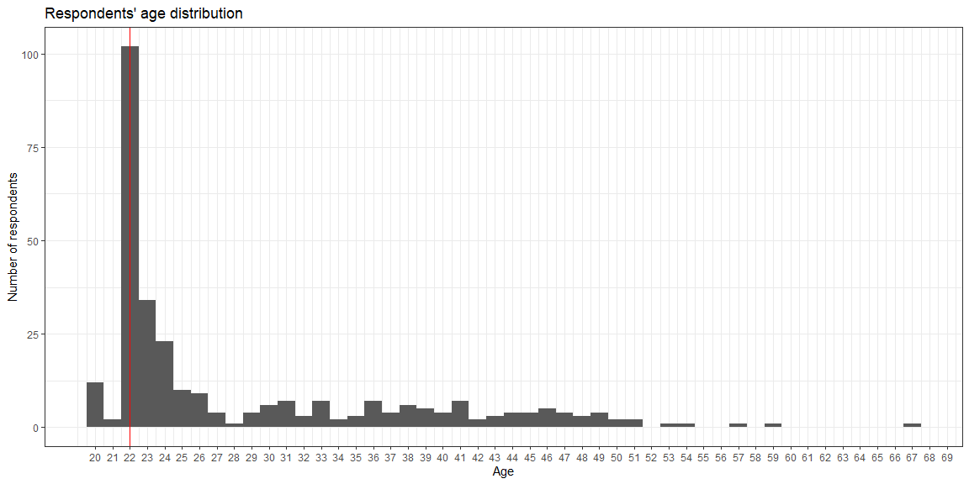

Slide 8
3.3 Continuous vs. categorical variables
Female respondents age is extremely right skewed.
Age distributions of those who are from the South and Central are wider spread than the North group.

Slide 9
4. Data cleaning
Coding error is spotted! Each variable in brand section should have two levels only. Khai hoan brand has 4 levels.
ID phu.quoc phan.thiet nam.ngu Length:300 kh.pq :256 kh.pt :282 kh.nn :150 Class :character phu.quoc: 44 phan.thiet: 18 nam.ngu:150 Mode :character hanh.phuc thanh.phong de.nhi chinsu co.hau hanh.phuc: 19 kh.tp :299 de.nhi : 25 chinsu: 56 co.hau: 1 kh.hp :281 thanh.phong: 1 kh.dnhi:275 kh.cs :244 kh.ch :299 hung.thinh ba.mien cholimex nha.trang hong.thanh hung.thinh: 39 ba.mien: 2 cholimex: 3 kh.nt :292 hong.thanh: 4 kh.ht :261 kh.bm :298 kh.cho :297 nha.trang: 8 kh.hthanh :296 khai.hoan thien.huong tu.tuyet lien.thanh k : 7 kh.th :298 kh.tt :298 kh.lt :283 kh.kh :259 thien.huong: 2 tu.tuyet: 2 lien.thanh: 17 khai.hoan: 5 NA's : 29
Nam Ngu is the most popular brand and almost triple the second player - Chinsu in terms of the number of responses.

Slide 10
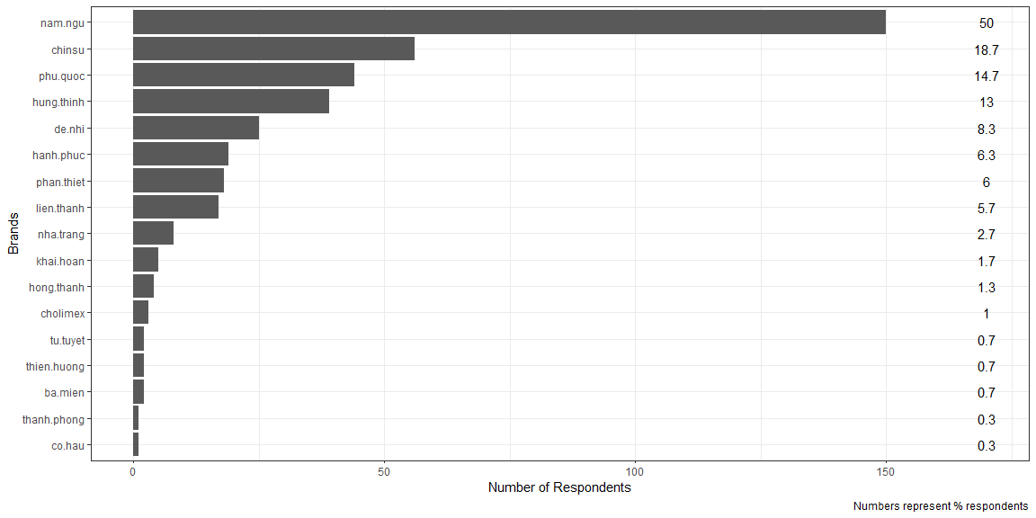

Slide 11
There are few respondents gave more than required number of responses (maximum is 2).
Respondent ID
Brand 1
Brand 2
Brand 3
Brand 4
Number of brands declared
KS2_29
phu.quoc
phan.thiet
nam.ngu
hung.thinh
4
KS2_111
phu.quoc
nam.ngu
nha.trang
NA
3
KS2_130
nam.ngu
chinsu
cholimex
NA
3
KS2_181
hanh.phuc
chinsu
hung.thinh
NA
3
KS2_224
phu.quoc
nam.ngu
lien.thanh
NA
3
KS2_255
hung.thinh
tu.tuyet
lien.thanh
NA
3
KS2_109
phu.quoc
hung.thinh
NA
NA
2
KS2_110
hung.thinh
cholimex
NA
NA
2
KS2_113
de.nhi
hung.thinh
NA
NA
2
KS2_115
nam.ngu
de.nhi
NA
NA
2

Slide 12
5. Data exploration
5.1 Key influencing factors
Health
Sensory
Tradition
Quality
Price
Convenience
3.95
4.09
3.98
4.16
4
4.08

Slide 13
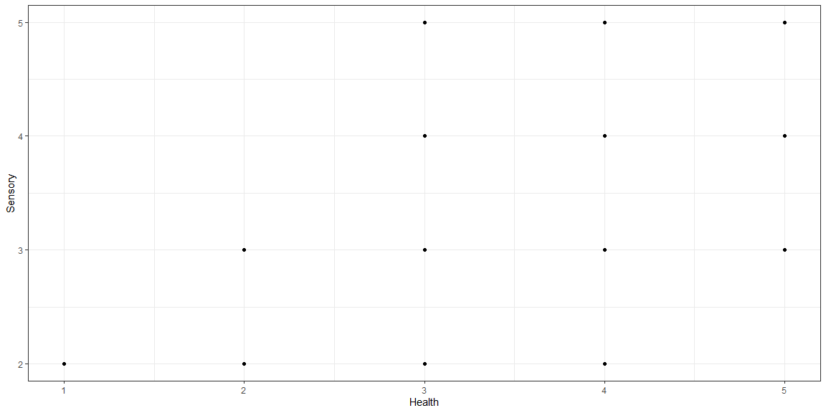

Slide 14
Health
Sensory
Tradition
Quality
Price
Convenience
1
2
2
3
4
4
Health
Sensory
Tradition
Quality
Price
Convenience
5
5
5
5
1
1
5.2 Important factors
Factors
Value
Convenience
Can be bought in shops close to where I live or work
3.85
Is easily available in shops and supermarkets
4.04
Is easy to prepare
3.83
Takes no time to prepare
3.91
Health
Contains lots of protein, vitamins, omega-3, iron and lysine
3.9
Eating with fish sauce will help us eat more, thus providing more active energy
3.68
Keeps me healthy
3.82
Price
Is cheap
3.25
Is good value for money
4.02
Is not expensive
3.65
Quality and safety
Conform to Vietnam or global quality standard
3.8
Get certification of Vietnam high quality goods by consumers
3.8
Has a clear origin of production
4.18
Has Eco-friendly packaging
3.57
Sensory appeal
Distinctive brownish color
3.7
Eye-catching packaging
3.58
Has a pleasant texture
3.7
Smells nice
3.91
Tastes good
4.03
Traditional value
Be processed/prepared in a special way
3.9
Has origin of materials (geographical indications)
4.23
Is associated to specific celebrations of my country/family
3.55
Is familiar with me and my family
3.74
Is special product that reflects the nation or local culture
4.06
Factors
Male
Female
Convenience
Can be bought in shops close to where I live or work
3.89
3.83
Is easily available in shops and supermarkets
3.99
4.07
Is easy to prepare
3.84
3.82
Takes no time to prepare
3.94
3.9
Health
Contains lots of protein, vitamins, omega-3, iron and lysine
4.06
3.82
Eating with fish sauce will help us eat more, thus providing more active energy
3.74
3.65
Keeps me healthy
3.76
3.85
Price
Is cheap
3.18
3.28
Is good value for money
4.05
4.01
Is not expensive
3.66
3.64
Quality and safety
Conform to Vietnam or global quality standard
3.9
3.74
Get certification of Vietnam high quality goods by consumers
3.9
3.75
Has a clear origin of production
4.2
4.17
Has Eco-friendly packaging
3.58
3.56
Sensory appeal
Distinctive brownish color
3.66
3.71
Eye-catching packaging
3.65
3.55
Has a pleasant texture
3.76
3.67
Smells nice
4.03
3.85
Tastes good
4.12
3.98
Traditional value
Be processed/prepared in a special way
3.91
3.89
Has origin of materials (geographical indications)
4.24
4.23
Is associated to specific celebrations of my country/family
3.53
3.56
Is familiar with me and my family
3.71
3.75
Is special product that reflects the nation or local culture
3.99
4.09

Slide 15
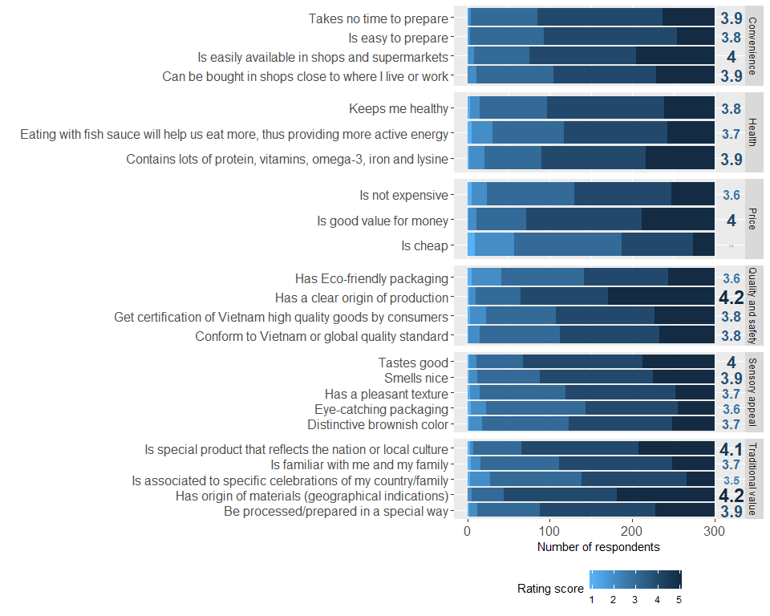

Slide 16
