Slide 1
Homework 4
Apostolopoulou Ioanna
Toloudis Panagiotis

Slide 2
Environment
Run
  Runs programs requested and places them in groups
List
  Prints all running processes and threads at the momet in the Workspace
Kill
  Kills all process in group requested
Migrate
  Takes a process form 1 machine to another by sending its data over network
Help
  Prints instructions on how to use our workspace

Slide 3
Parser
Opens files requested to run
Checks from line 0 to end of file for syntax errors
  If syntax errors are found terminates the procedure.
  If loop in labels is detected, exits the runing program with error code.

Slide 4
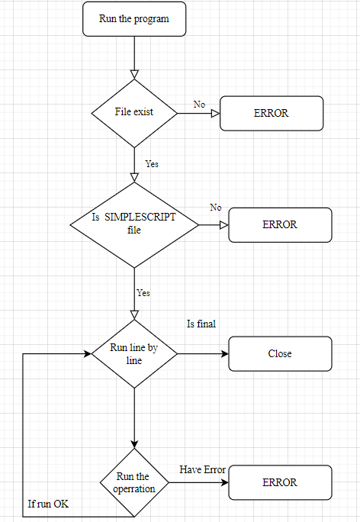

Slide 5
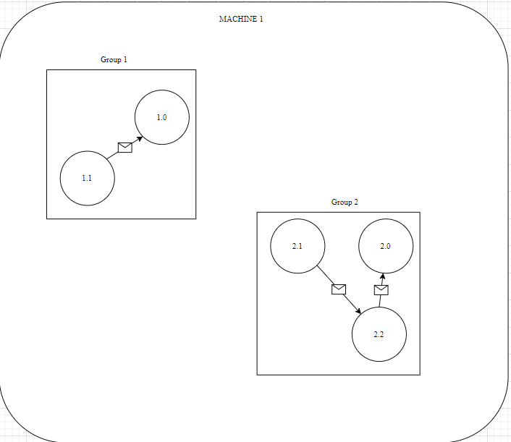

Slide 6
MIGRATION
THE MIGRATION FROM ONE MACHINE TO OTHER IS DONE BY :
  Tcp/ip protocol
  User defines the ip and port for the new host machine
Messages sent between menbers of the same group in which some processes migrated into other machine :
  Find the machine that hosts the process by using multicast
  Sends message or data over tcp/ip protocol

Slide 7
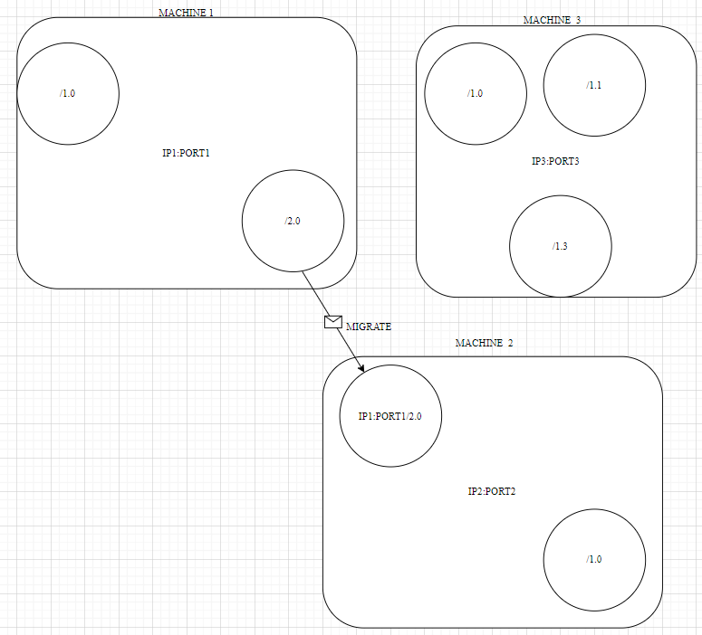

Slide 8
Load balance (Theoretically)
1 machine is defined as the co-ordinator
  Sends a multicast request to every active machine runing the workspace asking for their load
  When data are collected places them into a global distributed buffer that every machine has access to
  Buffer is consisted of the name_of_machine (ip.port) and the counter of load
  Sum of loads is calculated
  And then the average number of processes per machine is calculated
THEN THE CO-ORDINATOR INFORMS EACH MACHINE OF THE MIGRATIONS NEEDED TO BE DONE SO IT IS BALANCED

Slide 9
ProBLEMS DETECTED IN DISTRIBUTED LOAD BALANCE
Who can be the co-oridinator ?
How can we Elect co-ordinator between machines that can be all around the global network and not in a specific group ?
If a random Machine decides to send multicast request, because the system is not synchronous 2 or more multicasts can be happening simultaneously and dictated migrations might vary
What is the T(max) we should wait for replies of multicast?
Huge overhead due to continious updates of load_buffer

Slide 10
ProBLEMS DETECTED IN DISTRIBUTED LOAD BALANCE
What if we do not update the load_buffer and info do not correspond at the specific time?
Asynchronous clocks == wrong load ?

Slide 11
References:
https://www.researchgate.net/publication/342709018_LOad_balancing_research_paper
https://www.sciencedirect.com/science/article/pii/S131915782100046X
https://arxiv.org/abs/2007.07515

