Slide 1
Getting Started with Cloud Foundry
Deploying your First Application
Setup, Deploy and Manage

Slide 2
Overview
After completing this lesson, you should be able to:
  Deploy an application to CloudFoundry using CLI
  Manage application instances using App Manager
Notes:
This section is designed to be interactive. They type whilst you talk. Get them to execute all the commands as we come to them. They should have a PWS account by now. If not, get that sorted out now.
Tell them that they will be typing as they go and not to be impatient, but to go through things with everyone else – saves explaining the same errors over and over.

Slide 3
PCF Environment
Option 1 – PWS
Pivotal Web Services (PWS)
  Public PCF Installation running at: http://run.pivotal.io/
Sign up NOW
  Apps Manager URL: console.run.pivotal.io
    Click “SIGN UP FOR FREE” to setup a new account and your username/password
  API URL: api.run.pivotal.io
  Create an “org”, give it a suitable identifying name
  Create a “space” within your org named “development”
Notes:
If using PWS, students should sign up now if they do not already have a account.

Slide 4
PCF Environment
Option 2 – Company PCF Account
Using your company’s own PCF setup
You should know
  Apps Manager URL: login.???
  API URL: api.???
  Create an “org” for the course, if you wish
    Give it a suitable identifying name
  Create a “space” within your org named “development”
Notes:
They should already know this information. Make sure they do. No point carrying on otherwise.

Slide 5
Roadmap
Getting Started with the Command Line Interface
Login
Deploying an Application
Managing Application Instances

Slide 6
The Command Line Interface
Several interface options exist for Cloud Foundry
  Command Line Interface (CLI)
  Web-based Application Manager Console
  IDE Plugin: Eclipse, STS, IntelliJ, etc
Primary access is done via the CLI
  Make sure you have it installed
    Installation was covered in the “Welcome” module
Notes:
Again, students should install cf now if they haven’t already.
IMPORTANT: If they have a terminal or shell open, after installation they will need to close it and open another because the PATH will have changed.
Two ways to install:
If they have just successfully logged into PWS, look for the tools option on the left hand side panel and the resulting page contains download links.
If they are still waiting for authorization passwords/SMS, in the meantime they can download cf from the github repository at https://github.com/cloudfoundry/cli – they need to scroll down quite a way to find the links. 64bit versions are on this page – there is a link for 32 bit if needed. They should download the zipped installer, unpack it and run – especially on Windows.

Slide 7
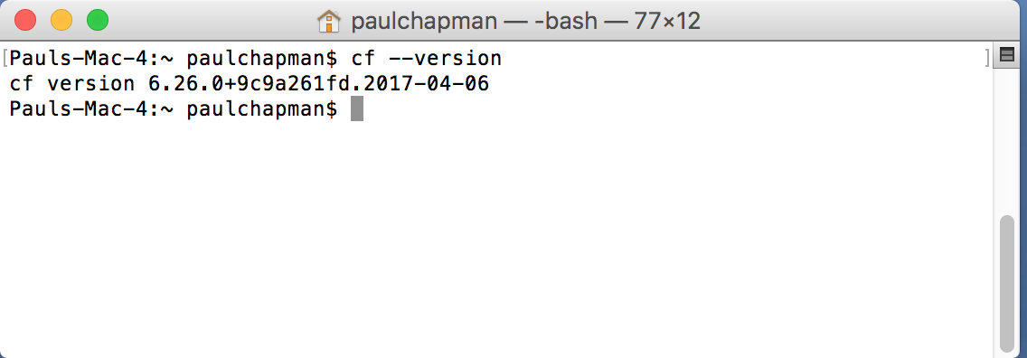
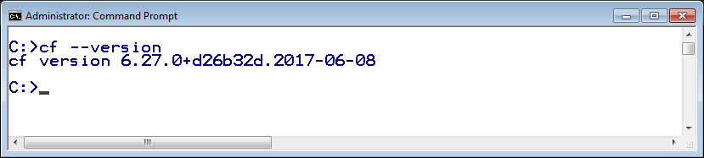
DO NOW – Test the CLI Utility
It is called cf
  Open a Command/Shell window
  At the prompt type: cf --version
Notes:
INTERACTIVE: This “DO NOW” is like a quick “mini-lab”.
This is where we go interactive. Get them to run the version command. This will also show if cf is installed correctly.

Slide 8
DO NOW – Getting Help
Get help at any time via cf help
  Or for a particular command: cf help <command>
Perform these steps on your computer:
  Open a Command prompt or Terminal window
  Issue the cf help command
  What about cf help –a?
  Get help on the login command: cf help login
Answer these questions:
  What option do you use to specify username?
  Is specifying the password option encouraged?
Notes:
INTERACTIVE. The point is to get the students to work on their keyboards for just a second to make sure they know how to get help.
A nice feature of the help output is that it is grouped by functionality which makes it easier to find what you want.
Note that (as at June 2017) the Windows version of cf still shows all commands. On MacOS and Linux, it just shows a summary and you need to use the –a flag to show the same output as Windows.
Answers: 1) –u 2) It is not recommended to avoid it ending up in your shell history.

Slide 9
Roadmap
Getting Started with the Command Line Interface
Login
Deploying an Application
Managing Application Instances

Slide 10
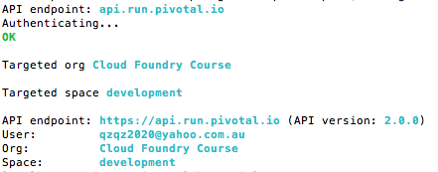
Login to Cloud Foundry
Need to tell cf
  What cloud foundry instance you are using
  What your account details are
  Use cf login
Color highlighting
MacOS, Linux only
>
Will prompt for anything you
don't specify
No -p? Prompts for password

Slide 11
Cloud Foundry URLs
To access CF you need to know 3 URLs
  API Endpoint
    Identifies your CF instance
    Used to deploy applications, manage spaces, routes …
    The cf utility makes RESTful requests to this URL
      Actually to the Cloud Controller
  Apps Manager
    Application management dashboard (console)
    Pivotal CF only
  Apps Domain
    Used to access deployed applications
    May be same as System Domain
Notes:
Commands sent to the API URL are actually sent to the Cloud Controller.
The API Endpoint and Apps Manager URL are sub.domains of the System Domain (see next slide)

Slide 12


Cloud Foundry URLs
For simplicity, most examples
in this section show PWS URLs
System & App domains defined when CF was installed
If using PWS
  System domain: run.pivotal.io
    API Endpoint: api.run.pivotal.io
    Apps Manager: console.run.pivotal.io
  Apps domain: cfapps.io
Your own CF installation
  System domain: <your-cf-system-domain>
    API Endpoint: api.<your-cf-system-domain>
    Apps Manager: login.<your-cf-system.domain>
  Apps domain: <your-cf-apps-domain>

Slide 13
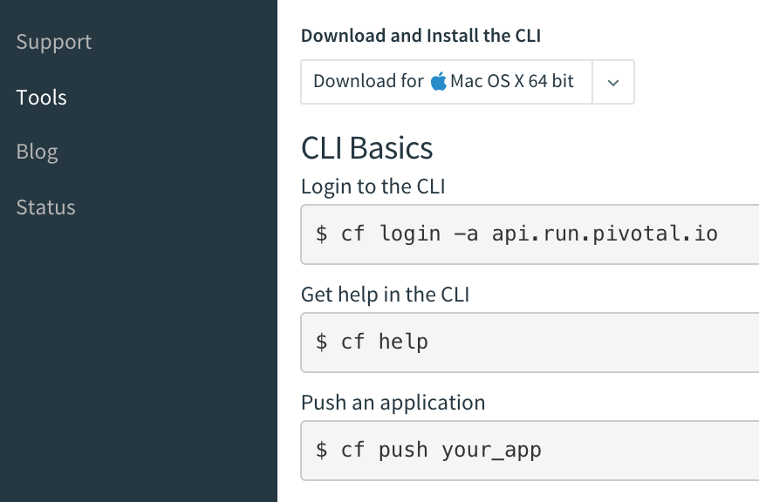
Finding the API Endpoint URL
URL of Cloud Controller in your Cloud Foundry instance
  On Apps Manager home-page on first login
  Or click Tools
  Shows how to run cf login, including the API Endpoint

Slide 14
DO NOW – Login
Perform these steps on your computer:
  Login with cf login command
    Specify CF instance using -a <API-URL>
      For PWS: -a api.run.pivotal.io
    Specify email / password
    If prompted, select an organization and space
    Firewall issues?
$> cf login -a <API-URL> -u <your-email-or-username>
API endpoint: api.run.pivotal.io
...
http://docs.cloudfoundry.org/devguide/installcf/http-proxy.html
Notes:
INTERACTIVE: This “DO NOW” is another “mini-lab”.
If doing this on-site, there my be firewall issues. To get cf to use an HTTP proxy, set the HTTP_PROXY environment variable in the shell. Equally if running off-site with company laptops, they may need to disable their proxy.

Slide 15
The .cf Directory
cf creates a .cf directory in your home directory
  Remembers your CF API Endpoint
    Don't need to specify -a option at next login
C:>dir .cf
Volume in drive C is VMWARE-QVTRTJ6E
Volume Serial Number is E8C5-12AF
Directory of C:\Users\paulchapman\.cf
12/21/2015 04:51 PM <DIR> .
12/21/2015 04:51 PM <DIR> ..
07/01/2017 02:58 AM 1,070 config.json
12/21/2015 04:51 PM <DIR> plugins
1 File(s) 1,070 bytes
3 Dir(s) 3,632,525,312 bytes free
Notes:
One confusion with cf is that it is not a shell. When a command ends, you are returned to the normal command line. So it keeps information in here for use each time you invoke it. More details on next slide.

Slide 16
DO NOW – Viewing .cf folder
Perform these steps on your computer:
  Find the .cf folder / directory on your computer
    You won't (yet) have all the files shown on previous slide
  Open the config.json file, observe the contents
    Note the tokens
To override the location, set CF_HOME
Notes:
INTERACTIVE: This “DO NOW” is a mini-lab.
They should go take a look now. For a new user they may only have config.json. They should edit it with their favourite editor (Windows: wordpad will do, Notepad++ recommended – they can download it now).
In particular notice the tokens in config.json. This is how you stay logged in. We use OAuth to provide an identity token after successfully logging in and keep It in config.json. Every command includes the token (this is simply standard HTTP authorization). There is a refresh token, so if your token times out you will be given a new one without logging in gain. The refresh token expires after a day or two. So you will stay logged in if you use cf every day. There is a cf logout. We can see this token exchange happening soon.
Some companies mount remote user-home directories for their employees, that may not work with the cf CLI. Use CF_HOME to specify an alternative directory. It doesn’t matter if this directory is lost – you just have to log in again.

Slide 17
DO NOW – Current Target
When you first login you see output like this:
  Notice it shows current organization and space
  At any time, run cf target to get same information
By default your organization only has one space
  Development
Note: On PWS you are setup as your own organization
API endpoint: https://api.run.pivotal.io (API version: 2.6.0)
User: pchapman@pivotal.io
Org: pivotaledu
Space: development
Notes:
INTERACTIVE: Run cf target now.
When a new account is created on PWS, you have to create a new organization before you can do anything else.

Slide 18

DO NOW – Viewing Organization(s)
Commands
  cf orgs All orgs for current user
  cf org <org-name> Shows specified org
>$ cf org pivotaledu
Getting info for org myorg as user@somedomain.com...
OK
pivotaledu:
domains: cfapps.io
quota: paid (10240M memory limit, Unlimited instance
memory limit, 1000 routes, -1 services,
paid services allowed)
spaces: development, production, staging
space quotas:
>$
Notes:
INTERACTIVE: Run these commands now.

Slide 19

Managing Spaces
To see all the spaces in an organization
  cf spaces
Create a new space (in current organization by default)
  cf create-space <space-name>
  cf create-space <space-name> -o <org-name>
Use target command to change space (or organization)
  cf target -s <space-name>
  cf target -o <org-name>
Notes:
If someone asks, there is a cf create-org command, but only admin users are authorized to run it.
They should already have a development space. There is no need to create a new space – they won’t need it for the course. If they do, they must use cf target to retarget development.

Slide 20
Do NOW – Seeing cf Work
Makes requests of Cloud Foundry using REST HTTP
To see this use cf –v <command>
C:> cf -v orgs
REQUEST: [2017-06-11T01:24:22+10:00]
GET /v2/info HTTP/1.1
Host: api.run.pivotal.io
Accept: application/json
Authorization: [PRIVATE DATA HIDDEN]
Connection: close
Content-Type: application/json
User-Agent: cf/6.27.0+d26b32d.2017-06-08 (go1.8.3; 386 windows)
Token passed to prove your identity
Notes:
INTERACTIVE: Run cf –v orgs now.
You can use the “-v” option on a command to print the actual API request diagnostics to STDOUT.
The Authorization HTTP request header is set to your token (from config.json) so that you can be identified as a logged in user by CF. It is hidden in the output for security.

Slide 21
Response from Cloud Foundry
RESPONSE: [2017-06-11T01:32:17+10:00]
HTTP/1.1 200 OK
Connection: close
Content-Length: 3050
Content-Type: application/json;charset=utf-8
Date: Sat, 10 Jun 2017 15:32:15 GMT
Server: nginx
X-Content-Type-Options: nosniff
X-Ratelimit-Limit: 20000
X-Ratelimit-Remaining: 19997
X-Ratelimit-Reset: 1497112254
X-Vcap-Request-Id: fbbbc027-901b-4a23-6e76-dfefc1a92995
X-Vcap-Request-Id: 8b57571a-d0c1-491a-62e3-2496d50e48ce::c36971b5…
{
"total_results": 1,
"total_pages": 1,
"prev_url": null,
"next_url": null,
"resources": [ { … organiszation data here } ]
}
JSON data returned
Notes:
INTERACTIVE: Run cf –v orgs now.
The Authorization HTTP request header is set to your token so that you can be identified as a logged in user by CF. It is hidden in the output for security.

Slide 22
Roadmap
Get Setup
Login
Deploying an Application
Managing Application Instances

Slide 23
Deploy Using the CLI
You need a deployable application
  For example with Java: a jar or war
    Ant, Maven or Gradle build-tools can make it for us
    Cloud Foundry doesn't care how you build your application
  Other languages (Ruby, Node.js, etc.): the source will do
Notes:
Finally we get to run an application. At this point this is no longer interactive – pushing an application is the next lab.

Slide 24

The cf push Philosophy
Onsi Fakhouri (Cloud Foundry PM)
  Here is my source code
  Run it on the cloud for me
  I do not care how
The architecture of CF is fascinating
  And we will cover it
  But ultimately irrelevant
I just want to push an application
  I no longer need to know
    how that happens, how it is packaged or how it is run
Haiku
Notes:
This Haiku or philosophy is particularly important when contrasted with Docker. With Docker I have to know exactly what I am packaging. There are advantages to this for testing and CI, but it sucks for deployment. Why should the developer dictate how the app is deployed into production, on what OS and so on. None of their concern – basic Spring principle: separation of concerns applies.

Slide 25
Deploy (push) to Cloud Foundry
Deploy by running cf push <name-of-your-app>
  Many options
    -i Number of instances
    -m Memory limit (e.g. 256M, 1024M, 1G)
    -n hostName (application subdomain)
    -p Local path to app directory, jar, war, zip file …
    … Others will be covered later
Your application appears in Cloud Foundry
under the name you specify here
Notes:
Note the –p option. By default cf push uploads the entire contents of the current directory and any sib-directories. This makes sense for Node or Ruby which are interpreted – there are no compiled files to upload. You just run cf in the root directory of the Ruby/Node project.
Java is very different. It has to be compiled and packaged – the output of maven package or gradle assemble. Use –p to specify the name of the JAR or WAR File to upload. Note: cf push will not fail immediately without –p. It will upload the entire project – including all the source and compiled classes. And then fail because you didn't’t tell it where the War/Jar is.

Slide 26
Domains and URLs
Every CF instance is assigned a domain at installation
  Known as the Apps Domain
  For PWS this is cfapps.io
When you deploy, your application gets a unique route (URL) to access it: hostname + app domain name
  By default, hostname = application name
  Make sure hostname is unique
    cf push returns an HTTP 400 error if not
PWS example:
  cf push spring-music ...
  gets route: spring-music.cfapps.io
Notes:
We already saw the App Domain.
Each application has a sub-domain so its unique URL is sub-domain.apps-domain.

Slide 27
Examples of Using cf push
Specify unique sub-domain
by adding numbers, initials ...
Fully specified (recommended)
  Deploys war file (specify path if needed)
  1 instance, 750M memory
  Name: spring-music
    Appears as spring-music in Cloud Foundry
  Hostname: spring-music-678
    Creates URL (PWS): spring-music-678.cfapps.io
cf push spring-music -i 1
-m 750M
-n spring-music-678
-p build/libs/spring-music.war
Or use
--random-route
Notes:
Every student who has done a CF course had probably pushed spring-music. Each must map to a unique URL. Since all PWS applications share cfapps.io, they must have a unique sub-domain. They can’t all ne called spring-music.
The –n option overrides the default to set a custom sub-domain name. Students should use their initials, their dogs name – anything unique to them. The random-route option prepends two random words from the Unix dictionary to make a unique hostname (but these names are long and horrible to use … and occasionally some “interesting” words are chosen!).

Slide 28
What Happens ?
cf connects to Cloud Foundry using your credentials
It 'pushes' your application to CF and tells it to deploy it
  The whole application is uploaded – takes a while
  CF “stages” your application
    Recognizes Java WAR file, prepares a “droplet” with a JRE and Tomcat server
  “Droplet” is deployed to a container and starts running
  All requests to the Deployed URL route to your application
Whole process logged on screen
  See next 3 slides
Notes:
Avoid the gory details of the push process for the moment.
“Takes a while” - We will discuss some ways to mitigate this later in the course. There are ways you can 'ignore' files you don't want to send each time. You can also use a technology like Spring Boot to build a jar that has only the “real” dependencies.
A Java application is subject to the rules of the Java build pack, and by default will get a Tomcat server. There are ways to alter this; the Websphere Liberty buildpack would obviously use Websphere Liberty. Java apps can run from the main method and use an embedded tomcat or Jetty instance. Node and Ruby apps are completely different, subject to their buildpacks.

Slide 29
What Happens - 1
URL: spring-music-678.cfapps.io
cf push spring-music -n spring-music-678 -i 1 -m 750M
-p pre-built/spring-music.war
> cf push spring-music -n spring-music-678 -p build/libs/spring-music.war -i 1 –m 750M
Creating app spring-music in org your-org / space development as your-id@company.io...
OK
Using route spring-music-678.cfapps.io
Binding spring-music-678.cfapps.io to spring-music...
Uploading spring-music...
Uploading app files from: pre-built/spring-music.war
Uploading 574.8K, 95 files
Done uploading
OK
Starting app spring-music in org your-org / space development as your-id@company.io...
...
Updates CF metadata
(app name, instances, memory)
Establish & bind route
Uploads war
Next ...
Notes:
What happens when you execute this push command. Keep this high-level; the student will not be able to absorb all of the architecture yet. We will return to this process several times in the course, so stay high-level yet be factually accurate:
First thing to note is that, because we are declaring the host specifically, this will result in spring-music-678.cfapps.io when deployed on PWS. Students will need to use their own host in the exercise as spring-music-678 will be taken
Second, the cloud controller updates metadata: app name, host, instances, memory, etc. Students don't need to know anything more than “CF updates metadata”, the rest will be explained later
Third, the route is established. If not unique (or already belonging to this app), error.
Fourth, upload. Note that we were specific about the file being uploaded. If we weren't, the entire directory contents would be uploaded.
And now, on to the next step, the staging process...

Slide 30
What Happens - “Staging”
CF must prepare the app before its first run
...
Starting app spring-music in org your-org / space development as your-id@company.io...
OK
Downloading dotnet_core_buildpack_beta...
Downloading java_buildpack...
... lots more buildpacks ...
-----> Java Buildpack Version: v2.7.1 | https://github.com/cloudfoundry/java-buildpack#fee275a
-----> Downloading Open Jdk JRE 1.8.0_XX from https://download.run.pivotal.io/.../openjdk-1.8.0_XXX.tar.gz (6.1s)
Expanding Open Jdk JRE to .java-buildpack/open_jdk_jre (1.3s)
-----> Downloading Open JDK Like Memory Calculator 2.0.2_RELEASE from https://java-buildpack.cloudfoundry.org/memory-calculator/trusty/x86_64/memory-calculator-...(found in cache)
Memory Settings: -Xss228K -Xmx317161K -XX:MaxMetaspaceSize=64M -Xms317161K ...
-----> Downloading Spring Auto Reconfiguration 1.7.0_RELEASE from https://download.run.pivotal.io/auto-reconfiguration/auto-reconfiguration-1.7.0_RELEASE.jar (0.2s)
-----> Downloading Tomcat Instance 8.XXX from https://download.run.pivotal.io/tomcat/tomcat-8.XXX.tar.gz (1.1s)
Expanding Tomcat to .java-buildpack/tomcat (0.1s)
-----> Downloading Tomcat Lifecycle Support 2.4.0_RELEASE from https://download.run.pivotal.io/tomcat-lifecycle-support/tomcat-lifecycle-support-XXX.jar (0.0s)
...
-----> Uploading droplet (73M)
...
“Buildpack” selected and executed
Buildpack configures Java
Reconfigure Spring
for cloud environment
creates “Droplet”, uploads to blobstore
Buildpack
obtains Tomcat
Next ...
Notes:
Without overwhelming the student with details: after the application artifacts are uploaded, CF will try to start the application, but before it can 'start' an application is must go through a “staging” process. Staging is the process of building a deployable archive (a tarball). It’s not quite building the container – but everything that will be run in the container.
First, it tries to select a matching buildpack for this artifact. This is a WAR, so Java buildpack is selected. (Note that the “app package” is “downloaded”. This is the same artifact that was just uploaded from client to CF. This download is from blobstore to staging Cell. Students don't need to be overwhelmed with this detail for right now)
Second, the Java buildpack runs. The steps you see here are specific to the Java buildpack, Ruby and Node (and anything else) will be different. The buildpack, running on a staging Cell, is gathering all of the artifacts to build a 'droplet', which is everything needed to run this kind of app. WARs will require Java and Tomcat, and this particular one is Spring so an auto-configure framework is brought in too. The droplet is created. Note the size of the original WAR (20MB) and the finished droplet (60mb).
A Java application is subject to the rules of the Java build pack, and by default will get a Tomcat server. There are ways to customize this (later). Java apps can run from the main method and use an embedded tomcat or Jetty instance. Node and Ruby apps are completely different, subject to their buildpacks.
Once droplet is created (and stored in blobstore) staging is complete. Note that Downloading and Uploading refer to downloading or uploading to/from the Cell (staging runs in a Container in a Cell just like an application) . NONE OF THIS runs on your computer – its all running at CF.
Next, start the app..

Slide 31
What Happens - “Start”
...
0 of 1 instances running, 1 starting
0 of 1 instances running, 1 starting
1 of 1 instances running
App started
OK
App spring-music was started using this command `JAVA_HOME=$PWD/.java-buildpack/open_jdk_jre JAVA_OPTS="-Djava.io.tmpdir=$TMPDIR -XX:OnOutOfMemoryError=$PWD/.java-buildpack/open_jdk_jre/bin/killjava.sh -Xmx382293K -Xms382293K -XX:MaxMetaspaceSize=64M -XX:MetaspaceSize=64M -Xss995K -Daccess.logging.enabled=false -Dhttp.port=$PORT" $PWD/.java-buildpack/tomcat/bin/catalina.sh run`
Showing health and status for app spring-music in org your-org as your-id@company.io...
OK
requested state: started
instances: 1/1
usage: 750M x 1 instances
urls: spring-music-678.cfapps.io
last uploaded: Tue Mar 17 17:58:35 UTC 2015
buildpack: java-buildpack=v3.9-offline-https://github.com/cloudfoundry/java-buildpack.git#b050954 open-jdk-like-jre=1.8.0_101 open-jdk-like-memory-calculator=2.0.2_RELEASE spring-auto...
state since cpu memory disk
#0 running 2015-03-17 01:59:35 PM 0.0% 474.4M of 750M 150.3M of 1G
Cloud Foundry runs the “Droplet” on a “container”
Command that was executed
Health Check
Done! 1 application instance running on spring-music-678.cfapps.io
Notes:
CF tries to run your application – as many instances as you have asked for. Each instance will get its own Container to run in.
Eventually you will get n of n instances running – indicating success.
It tells you the command used to run the application – nothing magic, this is a java application so we run it using the java executable and many, many flags!
Then we get the status report.
If the application can’t start, CF tries a few times (4?) and then gives up. The status may be marked as flapping (came up, went down, came up, went down …) Usually this means the –m meory option ws too small. Often occurs i nthe labs when students are trying to squeeze more apps into their PWS quota.

Slide 32
Application State and Logs
Run cf apps
cf logs spring-music
> cf apps
Getting apps in org pivotaledu / space development as kkrueger@pivotal.io...
OK
name requested state instances memory disk urls
spring-music started 1/1 750M 1G spring-music-678.cfapps.io
> cf logs spring-music
Connected, tailing logs for app spring-music in org pivotaledu / space development as kkrueger@gopivotal.com...
2014-06-07T23:01:47.68-0400 [RTR] OUT spring-music-678.cfapps.io - [08/06/2014:03:01:47 +0000] "GET /assets/js/status.js HTTP/1.1" 200 844 "http://spring-music-678.cfapps.io/" "Mozilla/5.0 (Macintosh; Intel Mac OS X 10_7_5) AppleWebKit/537.73.11 (KHTML, like Gecko) Version/6.1.1 Safari/537.73.11" 10.10.66.34:64401 vcap_request_id:73037523-63ef-498f-6cd8-d3b48fe69e84 response_time:0.003693009 app_id:314f0434-d2c9-446c-ab4a-6c310878ca80
2014-06-07T23:01:48.47-0400 [RTR] OUT spring-music-678.cfapps.io - [08/06/2014:03:01:48 +0000] "GET /assets/templates/header.html HTTP/1.1" 200 1060 "http://spring-music-678.cfapps.io/" "Mozilla/5.0 (Macintosh; Intel Mac OS X 10_7_5) AppleWebKit/537.73.11 (KHTML, like Gecko) Version/6.1.1 Safari/537.73.11" 10.10.66.34:64324 vcap_request_id:39fbb3f2-46fb-4bd7-78d6-8994fafade9f response_time:0.004132254 app_id:314f0434-d2c9-446c-ab4a-6c310878ca80
Notes:
Details on debugging and tailing logs will be covered in a later chapter. For now just explain that we can tell that we are up
Incoming port 4443: cf logs receives its data via secure websocket on port 4443. Most corporate firewalls block this. Using PWS when on-site, cf logs inevitably fails unless we have specifically arranged to open up this port first.
Fortunately you can view the logs in the App Manager console without any problems (coming up).
A formal note on this issue appears in the logging and troubleshooting section – don't want to go into it here, unless it's an issue.

Slide 33
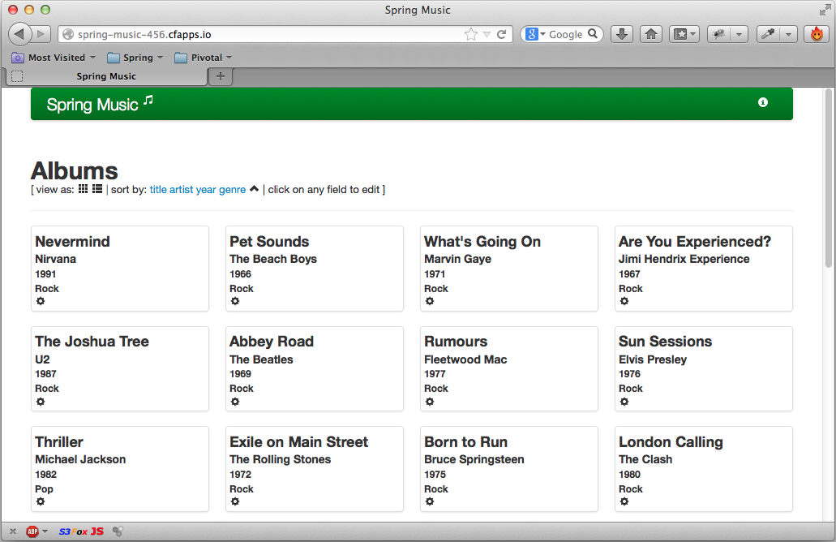
See The Application Running
Open a browser window to spring-music-678.cfapps.io
Notes:
Students may be lost on a lot of the details. That's ok, we'll be back over this. But one thing to hammer in is that the url is not spring-music.cfapps.io because we specified the host (-n) parameter.

Slide 34
Configuring a Deployed Application
Change the number of instances
  cf scale <app> -i <new-value>
  Two instances: cf scale spring-music -i 2
  New instances added, or some existing instances stopped
Change the memory allocation
  cf scale <app> -m <new-value>
  1024M: cf scale spring-music -m 1024M
  Requires a restart to take effect
Notes:
This is a long section, but you can skim a lot of what comes next because they will do it in the lab. However for reference, here are the commands they will need.

Slide 35
Stopping and Starting
cf stop
cf start
cf restart
cf restage
Sends SIGTERM message to application
Sends SIGKILL 10 seconds later if still running
Starts existing application
cf stop followed by cf start
Repeats the staging process, and starts the app.
Useful when environment variables / bound services change
  (Covered later)
Notes:
Although this seems basic there are some fundamental points here.
When stopping apps, each instance gets a SIGTERM message that indicates that you have 10 seconds before you are killed by the OS. Spring apps will get ApplicationContext.close() methods called and @PreDestroy methods invoked at this point. 10 seconds later, if the app is still running it will be killed regardless – no mercy! We will discus disposable applications soon.
Starting simply means sending a signal to the Cell to start a droplet in a container. No uploading or staging needs to take place.
Restart is a bounce, stop then start
Restaging is new. This forces CF to go through the staging/buildpack process to create a new droplet. This is useful when the buildpack itself has been changed (say the Java version), environment variables change, or bound services are changed. These all used to require a CF push, which implied waiting for an upload.

Slide 36

Adding / Removing Routes
Add a new domain mapping
  cf map-route <app> <domain> -n <hostname>
  cf map-route spring-music cfapps.io -n mymusic
    mymusic.cfapps.io also maps to spring-music
Remove mapping
  cf unmap-route <app> <domain> -n <hostname>
  cf unmap-route spring-music cfapps.io -n spring-music-678
    spring-music-678.cfapps.io no longer maps to spring-music

Slide 37
Cleaning Up Unused Routes
Routes tend to accumulate over time
  Applications in other Orgs / Spaces cannot use these routes
Find all other routes used in a space:
  cf routes
Remove route:
  cf delete-route
Very Useful! Remove unused routes:
  cf delete-orphaned-routes
Notes:
This is probably not the best time to discuss this as the student has just learned how to push an app, Cleanup is probably the last thought on their mind. But believe it or not, a small dev team doing lots of rapid experimentation can quickly consume hundreds of routes. Delete-orphaned-routes is a godsend.

Slide 38
Roadmap
Get Setup
Login
Deploying an Application
Managing Application Instances

Slide 39
Apps Manager
Login to Cloud Foundry using your web-browser
  Pivotal Web Services: http://run.pivotal.io
    Your Cloud Foundry instance URL will be different
    login.<your-cf-domain>
  Use the username and password you registered with
  Our new application should show green in the Apps Manager
Next slide ...
NOTE: Only Pivotal CF comes with the Apps Manager
Open Source Cloud Foundry does not
Notes:
Depending on your audience, they may prefer to use the Application Manager instead of cf. You can’t push using the Apps Manager, but once pushed you can do everything else. In particular it may be the only way to see logs.

Slide 40
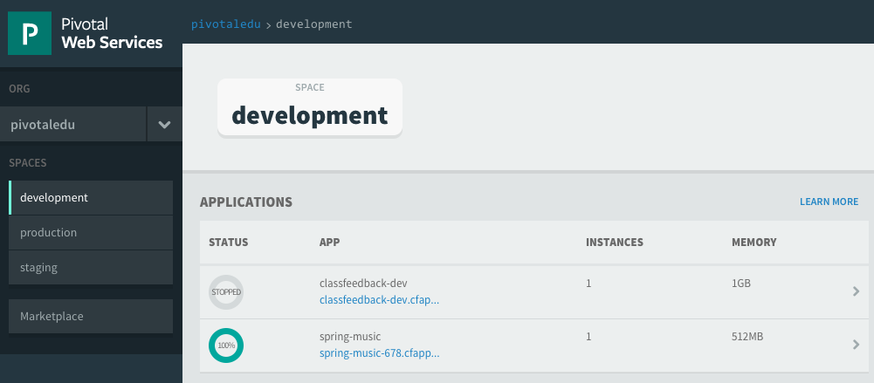
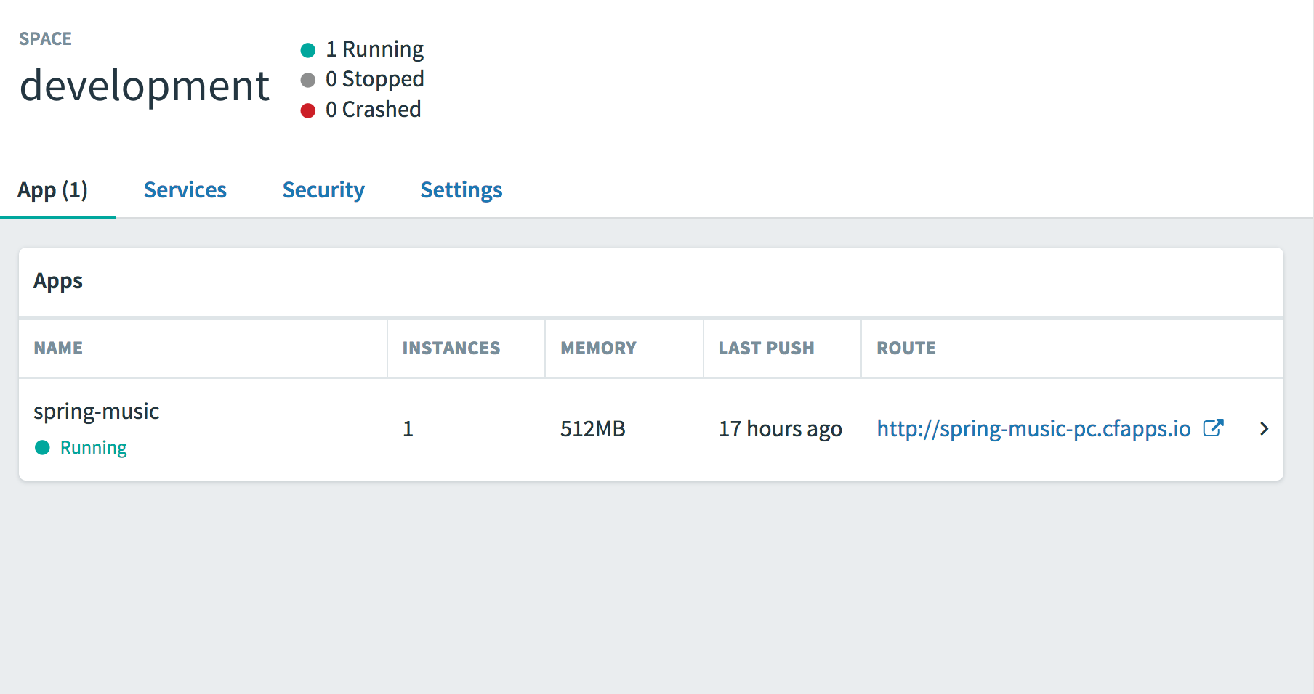
Apps Manager Home Page
At a glance view of all your applications
  Shows current space
Click application name to see its dashboard
(next slide)
URL of your application
Click to select different space

Slide 41
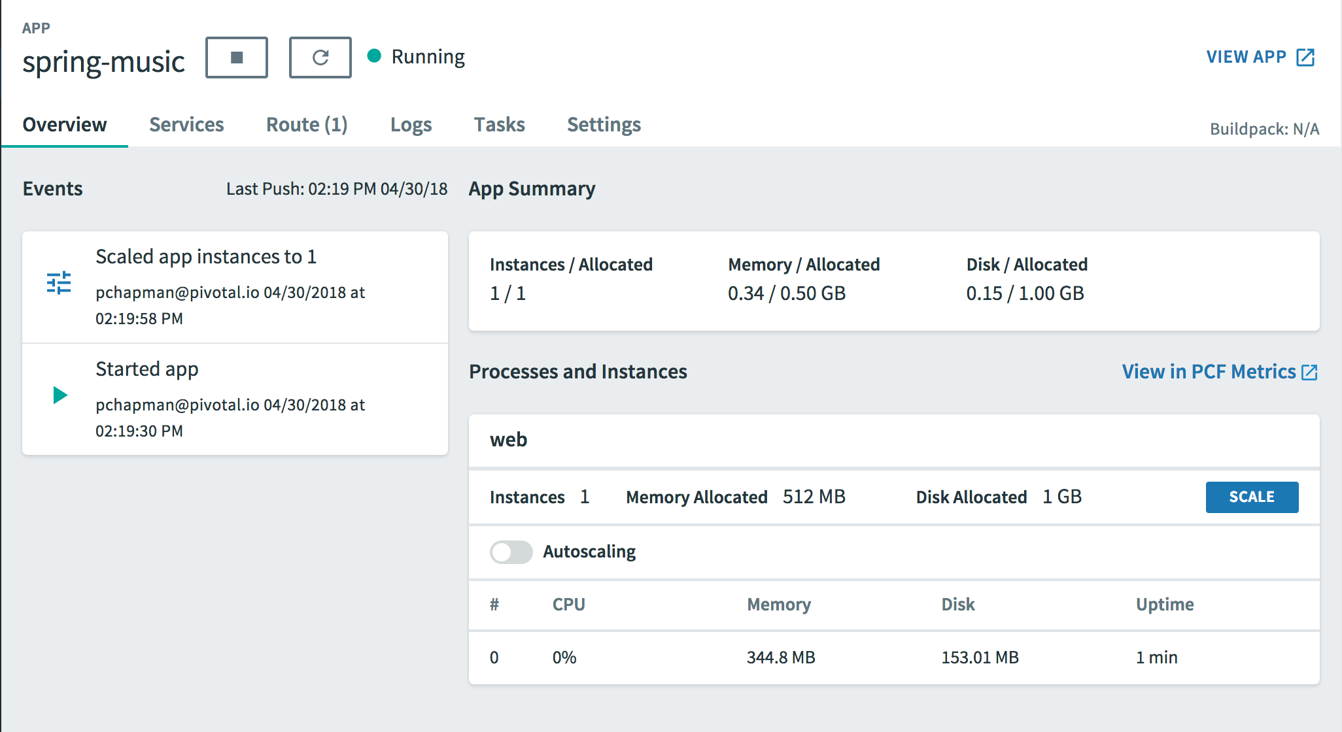
Application Dashboard
Application state
Stop Restart
Status
LOGS
Go to App
Home Page
Select tabs for more details
Application
Information
Get runtime info
Scaling control
Recent events
Notes:
No need to go into details – they can explore it in the lab.
Note all the different tabs: Overview (this screenshot), Services (none yet), Route (just the one), Env Variables (system only), Logs (the important one), Settings (hides the delete button).
This is the look as at June 2017. It changes over time so these slides may be out of date. Go to PWS and show them. The logs tab is what they should use if cf logs doesn’t work.

Slide 42
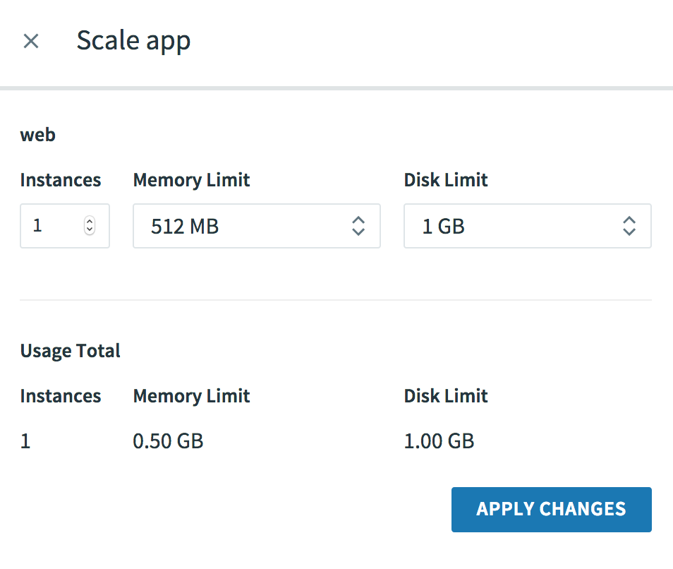
Scaling Control
Click Scale button to
reveal scaling side-panel

Slide 43
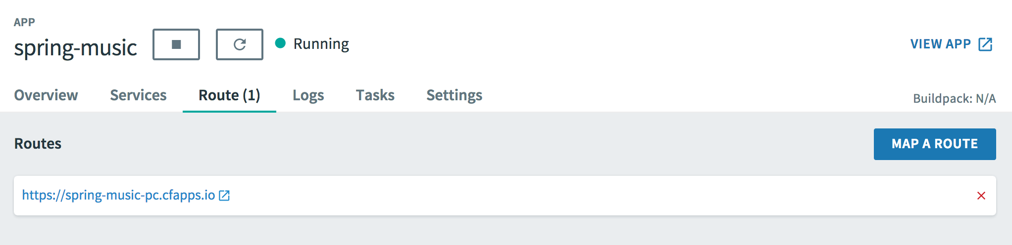
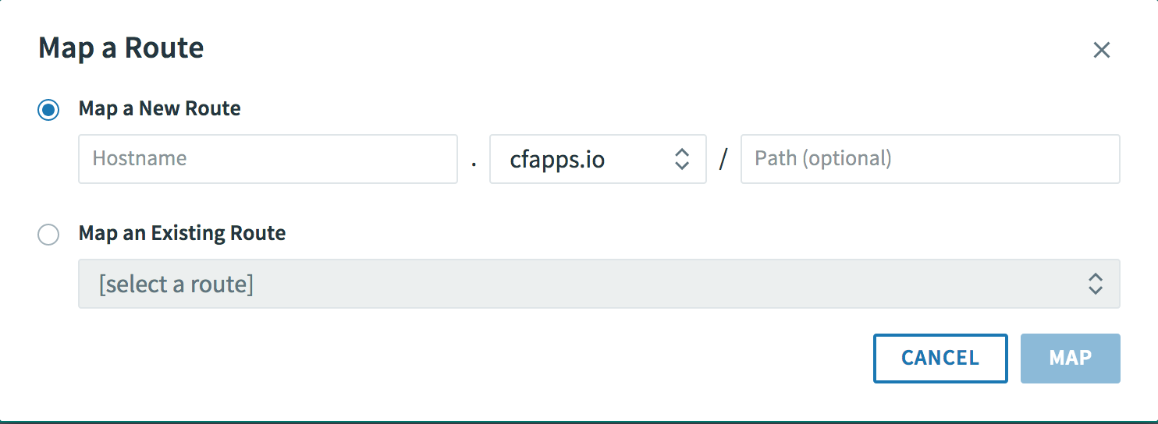
Managing Routes
Delete a mapping (1) click red cross at far right
1
2
3
Enter new domain (2) – make it unique. Click MAP (3)
Notes:
Can do everything we just saw – changing routes …

Slide 44
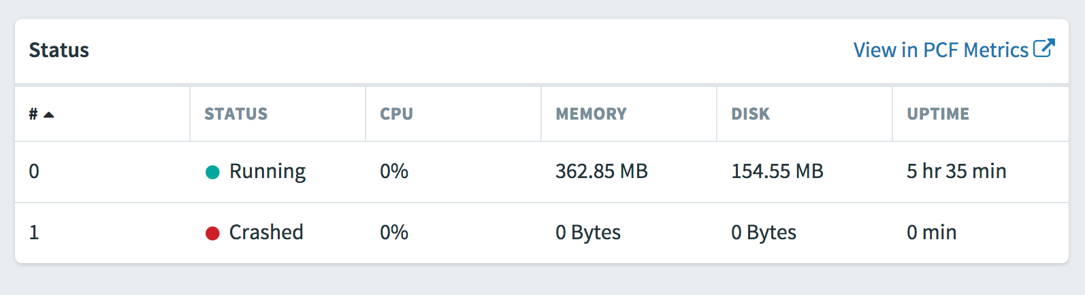
Monitoring Instances
The very bottom panel shows all your instances
  Provides statistics
  Updated live (slight time-lag)
Notes:
… viewing status

Slide 45

Summary
After completing this lesson, you should have learned:
  How to Deploy an application to CloudFoundry using CLI
  Managing application instances using Apps Manager

Slide 46
Lab
Push an existing application to Pivotal CF

