Slide 1
PCF Architecture
Production features
PCF Internal Architecture

Slide 2
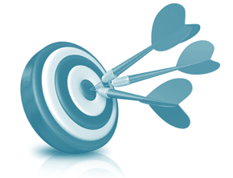
Learning Objectives
After completing this lesson, you should be able to:
  List the challenges of Cloud Native Apps
  Describe Cloud Foundry’s PAS* Architecture
* Formerly Elastic Runtime

Slide 3
Agenda
Cloud Native Apps
Elastic Runtime Architecture

Slide 4
Fundamental Changes
Cloud Native applications operate in a different environment
Notes:
These three themes will be echoed throughout all of the presentations. We can can go back to them time and time again.

Slide 5
Distributed System
Distributed systems are hard to build, test, manage, and scale
  Cloud Foundry empathizes scaling out
    Run multiple instances not bigger machines
  Applications run in “containers” for safety
worker 4
worker 3
Scale (running instances)
web 2
worker 2
web 1
worker 1
other 1
Workload diversity (process types)
Notes:
The move to distributed systems is essential if you want to modernize your application architecture.
The problem is that distributed systems are incredibly hard to build and manage.
Consider what must be be done when provisioning a systems like this (machines, app servers, databases, monitoring, routing, etc). Then handling Day 2 problems such as security patches or even just upgrading your own application while meeting business SLA (Service Level Agreements) such as no downtime.
We will see how PCF helps mitigate many of these issues so you can focus on offering true business value by creating compelling application experiences.

Slide 6
“Ephemeral” (Temporary) Infrastructure
Virtual machines and containers are temporary
  When an application dies or is scaled down, its container is destroyed
    Any in-memory state or local files (such as logs) are lost
  Do not assume the file-system is always there – it is not
    Nor is it shared by multiple instances
Notes:
Distributed systems are built on cloud infrastructure such as Amazon and OpenStack. They leverage advanced in technology such as IaaS and containers.
With regard to the applications tier (not databases) resources such as containers are ephemeral to allow for quick startup times. There is no persistent disk.
It is also expected that VM instances the application tier will come and go. This will have downstream effects on application design that we will discuss later (stateless apps, backing services).
***Don’t allow students to get confused here*** Persistent datastores are available as services.

Slide 7
Immutable Infrastructure
Updates to systems and applications are not done in-place
  New, updated instances are created instead
  Existing instances are lost, just like scaling down
Notes:
Why practice Immutable Infrastructure:
Ephemeral resources, we need to be able to rebuild from scratch
Confidence that we can rebuild the system – [good time to insert a story about not being able to rebuild a system]
Avoid configuration drift
Security repaving – see https://medium.com/built-to-adapt/the-three-r-s-of-enterprise-security-rotate-repave-and-repair-f64f6d6ba29d#.85mkrrdco

Slide 8
Agenda
Cloud Native Apps
Pivotal Application Server
  Formerly the Elastic Runtime

Slide 9
Pivotal Cloud Foundry Overview
Since PCF 2.0 three runtimes are available
  Pivotal Application Server (PAS) – runs applications
  Pivotal Kontainer Service (PKS) – runs Docker containers using Kubernetes
  Pivotal Function Service (PFS) – coming soon
What is the PAS?
  The PAS (formerly Elastic Runtime) is Cloud Foundry
  The subject of this course
Notes:
What most people think of as Cloud Foundry is really the PAS.

Slide 10





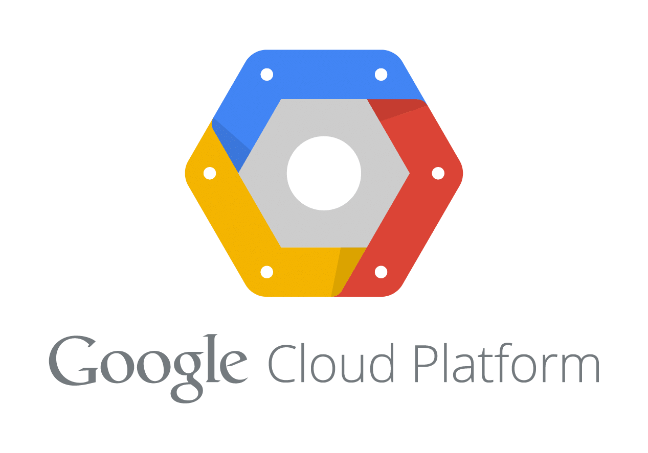
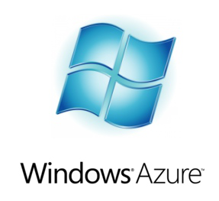
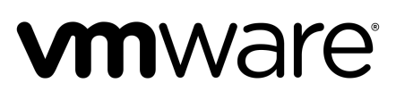
PCF Architecture
Services
Pivotal Application Service
User Interfaces
MySQL
Router
UAA
cf CLI
Service Broker
Cloud Controller
APIs
Redis, RabbitMQ, Pivotal Cloud Cache, Spring Cloud Services, etc
Buildpacks
Apps Manager
DIEGO
Cell
Extensions
Cell
PCF Metrics, Autoscaler,
SSO, Push Notification, etc
Loggregator
Operations Manager
Cloud Foundry BOSH
vSphere
Certification
Documentation
Enterprise Support
Training
Pivotal Labs
CF open source component
Pivotal commercial extension
Notes:
An application runs in one of our custom Containers which are secure, isolated “mini-VM” inside a Cell (the Execution Agent) which is a genuine virtual machine. Containers here are not JEE containers, but Linux style LXE containers. Several containers can run on each Cell, each having a different “size” (memory, disk space, CPU allocation). There are many Containers, perhaps hundreds but only a small number of Cells unless you are running very large applications.
The Cloud Controller orchestrates the routing and lifecycle of all Cells in the pool. Behind the scenes it delegates to other components to do the work (CF is a microservices architecture). These internal components constitute the full Diego sub-system. For now, only Cells are shown.
Router(s) manage application traffic. Apps are accessed directly through the router while web and CLI clients (such as cf, STS) access the Cloud Controller via HTTP REST.
The Service Broker provides an interface for provisioning and accessing services such as databases or email servers – much more on this later.
The BOSH layer provides a IaaS-specific interface to the underlying IaaS so PCF doesn’t need to know about the underlying IaaS. It also orchestrates setting up and maintaining the many VMs (approx. 30) that make PCF run.

Slide 11
Pivotal Application Server (PAS)
PAS Subsystems
  Diego (container manager)
  Loggregator
  Cloud Controller API
  Routing
Pivotal Application Server
=
Cloud Foundry OSS
~ 30 VMs
Notes:
The Elastic Runtime is a large and complex system made up of several components.
Luckily, the ER is made up of several subsystems that make it easier to divide up and understand.
We will also look at some key sequences that bring everything together to solidify understanding.

Slide 12
Diego
PAS’s internal architecture
https://docs.pivotal.io/pivotalcf/concepts/diego/diego-architecture.html

Slide 13
Diego
Schedules Tasks and Long-Running Processes (LRPs)
TASK
  Is guaranteed to run at most once.
  Example: staging an application
LRP
  Typically represented as a web app
  LRPs can have multiple instances
  PCF will attempt to keep them running forever
Notes:
Some history. The original implementation of CF was mostly written in Ruby. The intention, perhaps, was that the processes could run on multiple operating systems. In practice, until very recently, only Ubuntu Linux was supported and Ruby is not a good choice for systems programming. (The Ops Manager is written in Ruby – a prefect example of a Ruby application). So the decision was made to rewrite the application management layer in Go. The original name for the VMs running Droplets was Droplet Execution Agent or DEA. Hence the rewrite was “DEA in Go” giving DIEGO. As it turned out, DIEGO encompassed a lot more than rewriting the DEAs so the name is not really accurate. Much of what used ot be done by the Cloud Controller got refactored as [part of DIEGO. Since one goal of the work was to support other containers (such as Docker), not just Droplets, DEA was no longer a suitable name. Hence they are now called Cells.
CF has always had Tasks – it’s how the Buildpacks run. However since V1.10, tasks are available to run your own jobs/scripts/whatever.
Applications are LRPs

Slide 14
Diego: Container
An application instance is run within an immutable container
Container
App Instance
Notes:
In recent years containers have become wildly popular.
The Cloud Foundry project has been using containers to run applications for several years.
The container provides isolation in terms of disk, network, memory and CPU.
The container is immutable meaning that once it is created it cannot (should not) be modified.

Slide 15
Diego: Cell
Containers are run within a Cell (Virtual Machine)
Cell
Container
Container
Container
App Instance
App Instance
App Instance
Notes:
Containers are run within a Cell VM and many containers can run on one cell. There is a kind of prison/jail metaphor going on. The applications are secure in the Cell – each in its own container.
Running applications in containers allow better resource utilization and application density on your infrastructure..

Slide 16
Diego: Garden
Containers are managed by Garden
}
Cell
Garden is an interface.
Garden-runC is a backend implementation.
Garden
Garden-runC
Notes:
Why is Garden an interface? So that it can have multiple back-ends like RunC, Linux and Windows.
Elastic Runtime v1.8.8 and above use Garden-runC instead of Garden-Linux. RunC is a Linux-specific implementation of the Garden interface using the Open Container Interface (OCI) standard.
Garden is an odd name. Originally, using the Prison metaphor, they were Warden containers as they secured the application. As part of the DIEGO rewrite, it was refactored into an interface and the replacement implementation for the old Warden containers was written in Go – hence Garden. Sadly “Guarden” hence Guardian would have been a perfect name, but they blew it! Two other implementations exist – one using RunC for running Docker containers and one supporting Windows containers.

Slide 17
Diego: Auction
An auction is held to bid on executing a task or an LRP
Why?
  To ensure load spread evenly across Cells
  Make best use of available resources
Notes:
We will see the auctioneer soon. Essentially it tries to find the best available Cell to run each container.

Slide 18
Diego: Rep
Represents the Cell in the BBS/auctions
Cell
Garden
Garden-runC
Rep
Notes:
The rest of DIEGO needs to talk to the Cell to find out information about it. The “Rep” component provides for this and “represents” the Cell in auctions and bids on work (to run tasks and LRPs).

Slide 19
Diego: Executor
Manages container allocations on the cell
Cell
Garden
Garden-runC
}
Also streams stdout and stderr to Metron
Rep
Executor
Notes:
The Executor manages container allocations against the cell such as memory and disk. And interfaces with Garden to creates the containers.

Slide 20
Diego: Metron
Forwards logs to the Loggregator subsystem
Cell
Garden
Rep
Executor
Loggregator
Metron
Notes:
Metron is part of the Loggregrator system. It forwards logs to to the Logregator sub system. The Log Aggregator sub-system (coming up soon) uses a Weather metaphor – hence Metron and Doppler.

Slide 21
Diego: BBS
BBS (Bulletin Board System) is the API to access the Diego database for tasks and LRPs
}
BBS
etcd
Data is persisted to etcd.
Notes:
The BBS is the API to access the Diego database for tasks and LRP’s. Think of the BBS as a whiteboard with Post-It notes on. Anything that needs to happen is placed on the BBS as an Action (Post-It note) to be carried out. Different components look for the Actions that concern them and make them happen. In this way all communication is asynchronous via the central BBS. It has a database so that messages are not lost, but it is not long-term persistence. Actions should be consumed and deleted very quickly or there is something wrong with the system.

Slide 22
Diego: Brain
The Brain is composed of two components
Brain
{
}
Auctioneer
Converger
Reconciles Desired LRPs vs Actual LRPs through auctions.
Hold auctions for tasks and LRPs.
Notes:
The Converger compares the actual state of the system (derived from the monitoring components) with the desired state (derived from the CC DB). They may be different because 1) an application is scaling up, 2) scaling down, 3) an application instance has failed. If there are too many instances (scaling down) the Converger picks a victim and sends it the SIGTERM to make ti shutdown. If there are too few, it asks the Auctioneer to determine where to run the containers for the new instances.
The Auctioneer tries to be smart about where to run the new instances. The Reps in each Cell bid according to available capacity and the Auctioneer makes an informed decision.

Slide 23
Cloud Controller API
Your interface to Cloud Foundry
https://docs.pivotal.io/pivotalcf/concepts/architecture/cloud-controller.html

Slide 24

CCAPI: Cloud Controller
Cloud Controller exposes an API
  For using and managing the Elastic Runtime
Cloud Controller
cf push /
Apps Manager
REST
API
Cloud Controller
API
Notes:
When you use the cf CLI or the App Manager (or your IDE plugin) it talks to this API. It is a REST API over HTTP.

Slide 25
CCAPI: Cloud Controller Database
The Cloud Controller persists Org/Space/App data in the Cloud Controller Database
  3 node MySQL cluster (for redundancy)
Cloud Controller
CC_DB
Notes:
Contains all the meta-data about the system.
This is now a clustered MySQL database – clustered for resilience in the event of server failure. In PCF 1.5 and older PostgresSQL was used. Anyone who has PCF installed from that time will still be using Postgres. It is to be discontinued in V1.12 and V1.11 will have migration support.

Slide 26
CCAPI: Blob Store
The Cloud Controller persists app packages and droplets to the blob store
  Default: Network Addressable Storage (NAS) device
  Or use Amazon S3 if on AWS cloud
Cloud Controller
Blob Store
Notes:
We need to keep the applications you upload using cf push and the droplets we create. Rather than storing them as BLOBs in the CCDB, we chose to use a network mounted file system - the blobstore. The location of its contents are held in the CCDB. You can use Amazon S3 instead if running PCF on AWS.

Slide 27
Routing
Allowing the outside to talk to the inside
https://docs.pivotal.io/pivotalcf/concepts/architecture/router.html

Slide 28

Router
The router directs traffic to appropriate component.
Cloud Controller
cf push
Cell
Cell
Cell
http://…
Notes:
There are several “special” URLs defined by CF – the API URL for the CC, one for the UAA and so on. These are all on the System Domain. Everything else is routed to the corresponding application.

Slide 29

Router
The router routes requests to all app instances.
http://myapp.cfapps.io
Cell
Cell
Cell
http://yourapp.cfapps.io

Slide 30

Router
The router round-robins between application instances
  Typically on different Cells for redundancy
Cell
Cell
http://yourapp.cfapps.io
Cell
Cell
Notes:
For resilience, different instances of the same application are spread across different Cells – we will see more on this soon.

Slide 31

PAS Simplified Architecture
CC_DB
Cloud Controller
cf push
Blob Store
Cell
Cell
Cell
http://…
Notes:
That’s all there is to it! Actually not – see next slide.

Slide 32
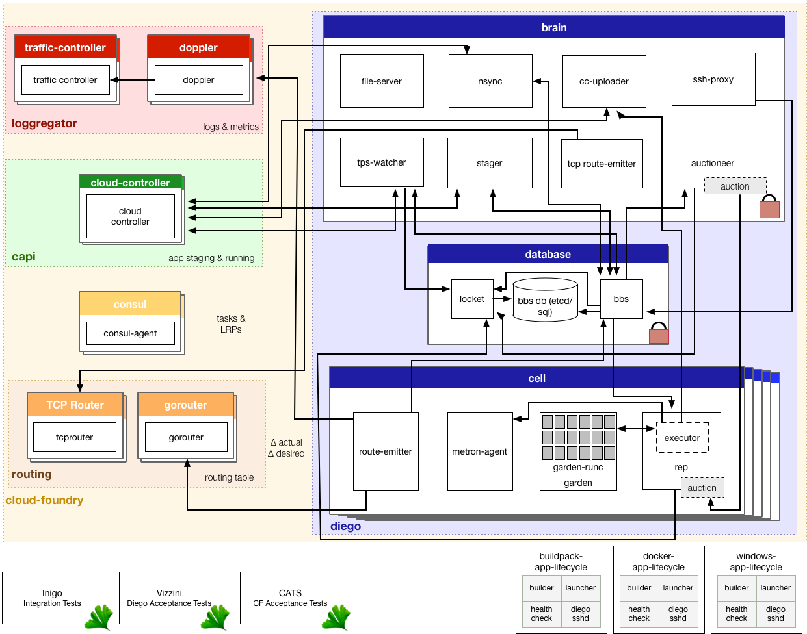
Notes:
This is the full system. There is no need to talk to this other than to make two points:
What we have seen is a simplification, just to explain the basics
In reality, recall the Haiku, you don’t need to worry about most of this, unless something goes wrong. You don’t really need to know how CF works to push an app any more than you need to know how a car works to drive one (let a alone fix it)

Slide 33
Key Flows
How things happen
https://docs.pivotal.io/pivotalcf/concepts/diego/diego-architecture.html
https://docs.pivotal.io/pivotalcf/concepts/how-applications-are-staged.html

Slide 34
Review Pushing An App
CLI
Cloud Controller
Blob Store
CC
DB
Cell
(staging)
Cell
(running)
(1) cf push
(2) Create App
(3) Store App Metadata
(4) Upload App Files
(5) Store App Files
(6) App Start
(7) Stage App
(8) Stream Staging Output
(9) Store droplet
(10) Report Staging Complete
(11) Start Staged App
(12) Report App Status

Slide 35
Topics Covered
The challenges of developing Cloud Native Apps
The Internal Architecture of the Pivotal Application Service (formerly Elastic Runtime)
How an application is Staged and Deployed

