Slide 1
Log Draining
Using a third-party log manager
Setting up a syslog drain

Slide 2
Roadmap
Log Management

Slide 3
Recall: Log Aggregation Architecture
Collects log output from app instances, CF components
Aggregates into a consolidated log
Sinks to cf logs, App Mgr, third-party log managers
Loggregator
Cell
Doppler
Traffic Controller
Metron
Nozzle
App Syslog Drains
Splunk, Papertrail …
cf logs APP_NAME
Notes:
How the logging works:
CF components and apps emit metrics (e.g. Router emits HTTP metrics such as the time taken to service a request)
These metrics are sent to agents running on the VMs called ‘Metron’
The Metron agents forward these metrics, along with application logs, to ‘Doppler’ Logging Servers
The Doppler servers collect and buffer the data
The Loggregator traffic controllers expose a new websocket endpoint ‘/firehose’
When you connect to /firehose, a connection is opened up to all Doppler servers
All logs and metrics for all apps and components are then streamed down the connection

Slide 4






Why Third-Party Log Managers?
Recommended approach
  Can store far more logging information than CF
  Allow for persistence, storage, searching, analyzing, metrics
Variety of third-party log managers supported:
Notes:
The point is to use a tool specialized in log management rather than expecting CF to provide these features. There are lots of good choices.

Slide 5
Connecting to Third-Party Log Managers
Setup Log Manager, determine HOST and PORT.
  Process varies according to vendor
Create User Provided Service with a Syslog drain:
  cf cups <SERVICE> -l syslog://<HOST>:<PORT>
Bind to application
  Cloud Foundry sinks loggregator output to this drain for this application
  See next slide ...
Notes:
The point is to use a tool specialized in log management rather than expecting CF to provide these features. There are lots of good choices.
IF the question of security comes up:
1. You can run any of these logging products in-house so that the connection with CF runs over the company Intranet, not over the public Internet.
2. Secure protocols https and syslog-tls are also supported. You need to have set up properly signed (not self-signed) certificates in the logging product.
http://docs.cloudfoundry.org/devguide/services/log-management.html

Slide 6
How It Works
1
Logging
Server(s)
All output for app collected by Logging (Doppler) server
Loggregator opens socket to HOST:PORT
  Sends all log info for app to socket in syslog format
Received by third-party syslog server
1
2
Loggregator
Traffic
Controller(s)
2
syslog
“drain”
cf
CLI
App
Mgr
3
PORT
syslog
server
3
HOST

Slide 7
Example: PWS and PaperTrail
PaperTrail: Cloud-based Log Manager
Create account at https://papertrailapp.com
Use the “Add System” button
  Papertrail will provide you the URL to use for your syslog drain
  Example: logs2.papertrailapp.com:41846
Notes:
The purpose of going through these steps is to establish a feeling of the steps involved, not to explore the capabilities of any third party tool.
First step is very easy, go to Papertrail, establish an account, add a project

Slide 8
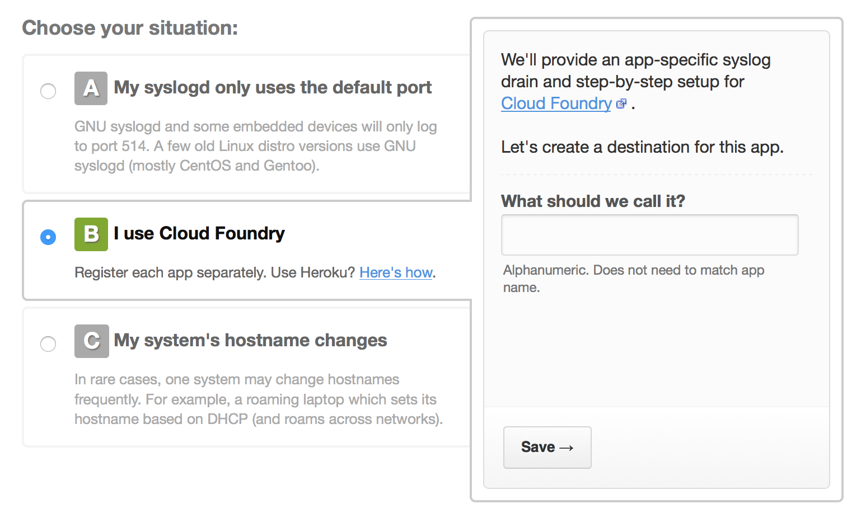
Example: PWS and Papertrail
Click the “Alternatives” link
Select “Cloud
Foundry” option
Name your
system
Notes:
Tell Papertrail to expect input data from a network source.
Papertrail will give you the TCP and UDP addresses to use (Cloud Foundry recommends the TCP). But the irritating thing is that you have to MANUALLY enter the list of IP addresses from which the log input is expected. The automatic detection doesn't work with PWS, I tried.
There are about 12 now, and you have to enter each with the “syslog” protocol:
54.84.85.220 54.84.112.162 54.85.141.236 54.86.187.144
54.86.233.33 54.88.36.32 54.88.9.119 54.88.42.21
54.88.46.179 54.208.167.186 54.209.85.236 54.236.219.204

Slide 9
Example: PWS and PaperTrail
Setup user defined service using Papertrail's URL:
Create User Provided Service with a Syslog drain:
cf cups the-drain -l
syslog://logs2.papertrailapp.com:15957
Bind to application:
cf bind-service the-app the-drain
Notes:
The common point amongst all of these tools is that they must expose a URL that a user provided service can connect to.
When creating the user provided service, be sure to use “syslog://” as the prefix before the value displayed in the Papertrail screen. The values seen here are just an example. If you see anyone copying them down they are on the wrong track!
The UPS must be bound to an app, the app does NOT need to be restarted or restaged (since the logs stream from the doppler server, not the containers directly). IMPORTANT! If you change this service you must unbind then rebind for the change to take affect.
The UPS may be bound to more than one app, but this will combine multiple apps output into one stream. You may be OK with this (blue/green deploy) or you can make separate 'projects' in Papertrail for each app.
If anyone has deeper question about the capabilities of papertrail, splunk, sumo, etc. this is out of our scope (conveniently)

Slide 10
About Syslog
De facto standard for logging on Unix/Linux
  Can log to a file or a syslogd server (via a protocol)
  Splunk, Papertrail and others provide syslog servers
To log to syslog
  Generate a TCP or UDP message in the right format
  Open a socket to your syslog server and send
Notes:
There does not seem to be a single preferred Java approach to using syslog.
The Java-Loggregator provides a dedicated option, or you can add the right output handler/appender to your logging library.

Slide 11
Lab
Configuring Third-Party Log Management Tools with
Cloud Foundry

