Slide 1
Application Security Groups
Controlling Outgoing Requests
Administration Facility

Slide 2
Agenda
Application Security Groups Overview

Slide 3
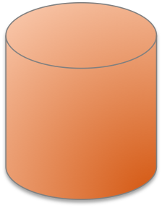
Application Security Groups
Are virtual firewalls that control egress/outbound traffic for applications.
Container
App Instance
MySQL
https://docs.pivotal.io/pivotalcf/adminguide/app-sec-groups.html

Slide 4
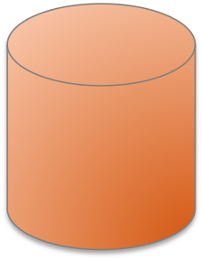
Staging Security Groups
Whitelist what the app should have access to when staging.
App Dependencies
Container
✔
Buildpack
bin/compile
MySQL
Customer
Data

Slide 5
Running Security Groups
Whitelist what all apps should have access to when running.
Internet
Container
App Instance
MySQL
Customer
Data

Slide 6
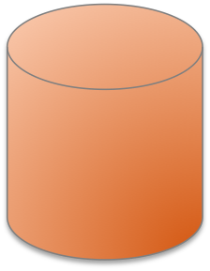
Space Security Groups
Whitelist what the apps in a space should have access to when running.
FraudulantSite
Container
App Instance
✔
MySQL
Customer
Data
Notes:
Make sure to mention that the running security group and the space security groups are evaluated as a union. Meaning that if something has been whitelisted in either place the rule will be honored.

Slide 7
Default Security Group
PCF
PWS
$> cf security-groups
Getting security groups as user@domain
OK
Name Organization Space
#0 default_security_group
$> cf security-groups
Getting security groups as user@domain
OK
Name Organization Space
#0 public_networks
Notes:
Has a different name on PCF to PWS.

Slide 8
View Default Security Group (PCF)
$> cf security-group default_security_group
Getting info for security group default_security_group as ...
OK
Name default_security_group
Rules
[
{
"destination": "0.0.0.0-169.253.255.255",
"protocol": "all"
},
{
"destination": "169.255.0.0-255.255.255.255",
"protocol": "all"
}
]
No spaces assigned

Slide 9
View Default Security Group (PWS)
$> cf security-group public_networks
Getting info for security group public_networks as user@domain
OK
Name public_networks
Rules
[
{
"destination": "0.0.0.0-9.255.255.255",
"protocol": "all"
},
... several more ...
]
No spaces assigned

Slide 10
Example JSON File
Only the protocols, IP address and ports listed are allowed
  TCP to ip-foo:3306
  TCP in IP range some-ip to another-ip on port 55882
[
{ "protocol": "tcp",
"destination": "10.0.11.0/24",
"ports": "1-65535” },
{ "protocol": "udp",
"destination": "10.0.11.0/24",
"ports": "1-65535” }
]
Notes:
“destination” uses CIDR notation, which is a shorthand method for representing a range of IP addresses.
e.g. XX.XX.XX.0/24 means take 32 bits, subtract 24 (leaving 8) and use that as the two's power i.e. 256. Hence the IP range is XX.XX.XX.0-255

Slide 11
Usage
Administrator only
Create a group and then bind to a space or globally
SECURITY GROUP:
security-group Show a single security group
security-groups List all security groups
create-security-group Create a security group
update-security-group Update a security group
delete-security-group Deletes a security group
bind-security-group Bind a security group to a space
unbind-security-group Unbind a security group from a space
bind-staging-security-group Bind a security group to the list of security groups
to be used for staging applications
staging-security-groups List security groups in the staging set for
applications
unbind-staging-security-group Unbind a security group from the set of security
groups for staging applications
bind-running-security-group Bind a security group to the list of security groups
to be used for running applications
running-security-groups List security groups in the set of security groups for
running applications
unbind-running-security-group Unbind a security group from the set of security
groups for running applications

