Slide 1
Application Performance Monitoring
Going beyond logging
Using PCF Metrics and third-party monitoring tools

Slide 2
Roadmap
PCF Metrics
3rd Party APM Tool - New Relic

Slide 3


Application Performance Monitoring
Logs and analysis only takes you so far
Important to have real-time monitoring of applications
  Uptime, performance, etc.
Application Performance Monitoring (APM) Tools
  Monitor your application while running
  Several choices available in Cloud Foundry
    New Relic, AppDynamics, Dynatrace …
Notes:
The purpose of this section is to familiarize developers with APM tools, not to promote New Relic, it is just a good example.
AppDynamics works even though it is not present in the marketplace. The javabuildpack can add the agent.

Slide 4
PCF Metrics
Pivotal Cloud Foundry comes with some metrics information built-in
  Container Metrics: CPU, memory, disk percentages
  HTTP Metrics: requests per second, HTTP errors per second, request latency
  App Events: create, update, start, stop, and crash

Slide 5
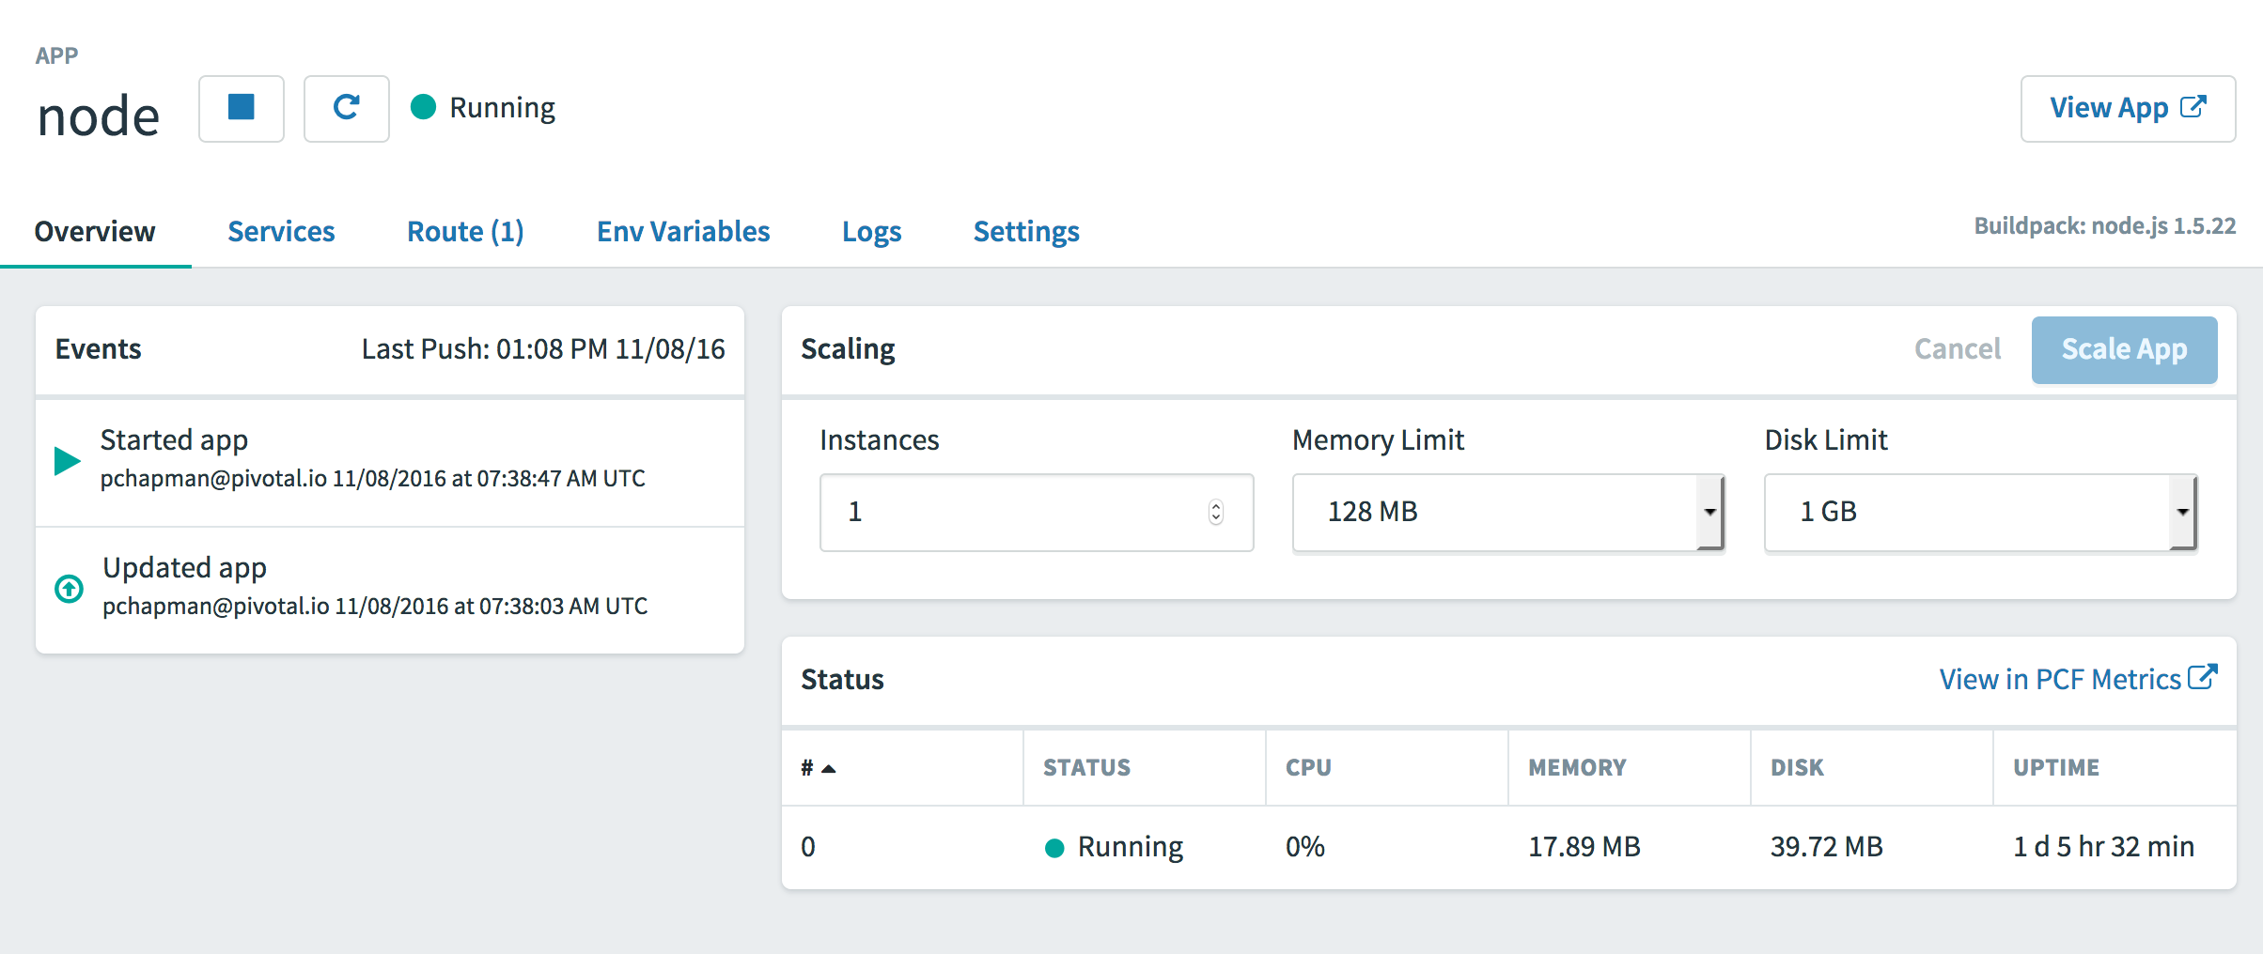
PCF Metrics
In the Application Console
  Go to dashboard page for your application

Slide 6

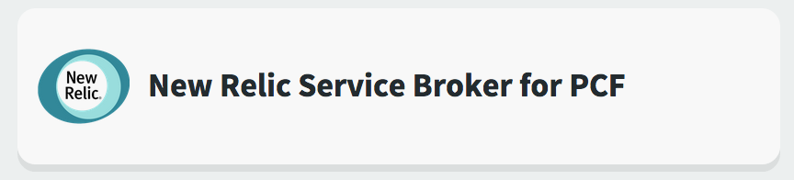
PCF and New Relic**
Available as Marketplace Service
  Install from a PCF Tile
  PWS offers it too
What it does:
  Tracks different instances of application
  Monitors down to the line of code
** "New Relic”
– anagram of the name of founder Lew Cirne
Notes:
Using New Relic via PWS is easy because of the service abstraction.
HOWEVER: Part of what makes this easy is the buildpack. The Java Buildpack includes the New Relic agent during staging. Other buildpacks may not do this. It is up to the buildpack.

Slide 7
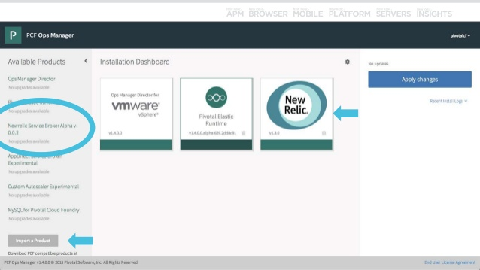
New Relic Tile in Ops Manager

Slide 8
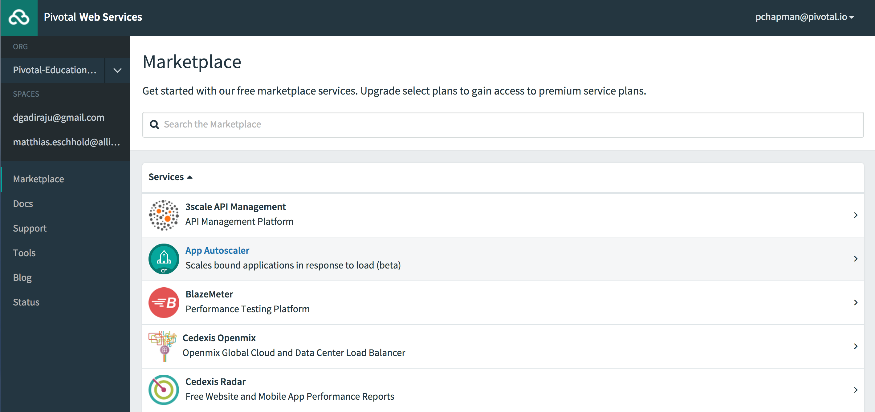

New Relic in PWS Marketplace

Slide 9
PCF and New Relic – Usage
How To Use:
  Create New Relic service in desired space
  Bind to desired Application(s)
  Increase app memory if needed (extra footprint)
  Re-stage application
    Java Buildpack includes New Relic Agent, others may not
  APM available as a link from within PWS
Notes:
Using New Relic via PWS is easy because of the service abstraction.
HOWEVER: Part of what makes this easy is the buildpack. The Java Buildpack includes the New Relic agent during staging. Other buildpacks may not do this. It is up to the buildpack.

Slide 10
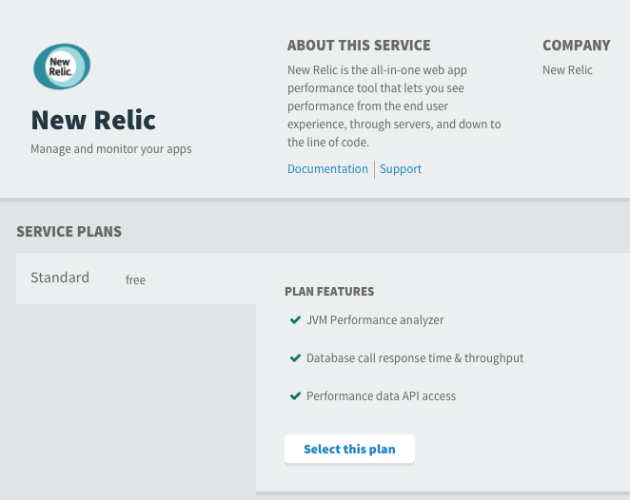
Creating the New Relic Service
Use App
Manager Console
Use cf CLI
>$ cf create-service newrelic standard apm
Notes:
You may choose to do this as a live demo if you like.

Slide 11
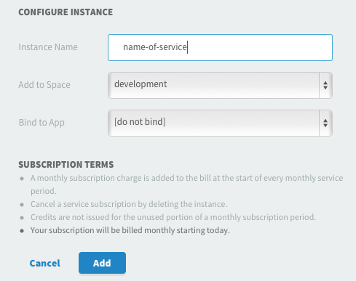
Create Service / Bind Application
Use cf CLI or App Manager Console:
>$ cf bind-service some-app apm

Slide 12

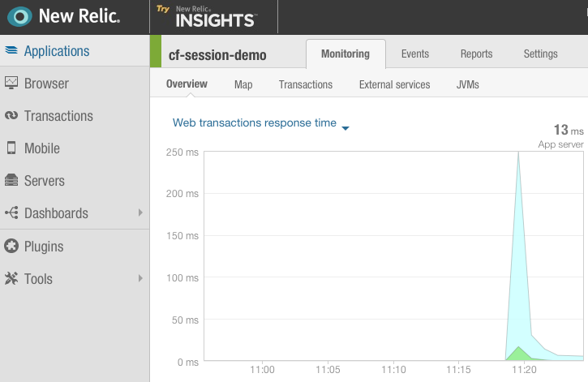
Access via Manage Link in App Manager

Slide 13
Summary
PCF metrics provides basic monitoring.
Utilize 3rd-party APM tool for full monitoring capability.

Slide 14
Two Labs
Application Performance Monitoring
Metrics (optional)

