Slide 1
Finishing Up
Course Completed
What’s next?

Slide 2

What's Next
Congratulations, we've finished the course
What to do next?
  Certification
  Other courses
  Resources
  Evaluation
Check-out optional sections on ...

Slide 3
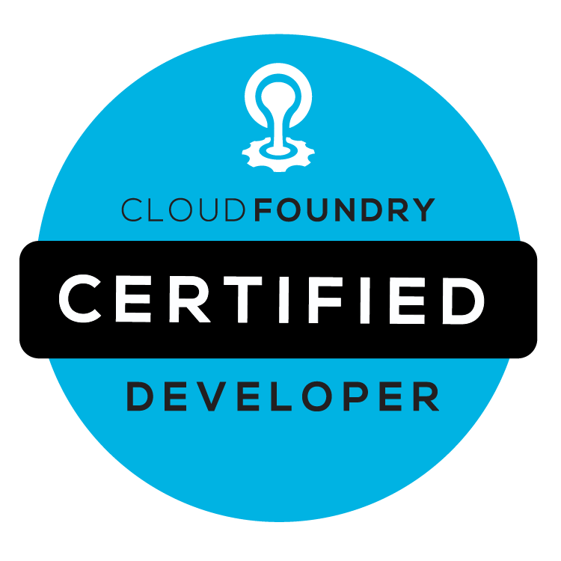
Certification
Topics Covered
  Cloud Foundry Basics
  Cloud-Native Architectural Principles
  Troubleshooting Applications on Cloud Foundry
  Cloud-Native Application Security
  Working with Services in Cloud Foundry
  Application Management on Cloud Foundry
  Container Management within Cloud Foundry
https://www.cloudfoundry.org/certification

Slide 4
Certification
Performance-based exam
  You actually use CF in the exam
  Virtual – can take the exam anywhere in the world
  Cost is $300 (April 2018)
  Log into the CFCD portal – you will need a Linux Foundation ID
Before taking the exam
  Review all the slides
  Redo the labs

Slide 5

Other courses
Many courses available
  PCF Operations (Administration)
  Core Spring
  Spring Boot Developer
  Spring Cloud Services
  Spring Cloud Data Flow
  Gemfire, Rabbit MQ …
More details here:
  http://www.pivotal.io/training
Notes:
The next slides provided detail on the above list. Not all courses need details but key next classes are good.

Slide 6
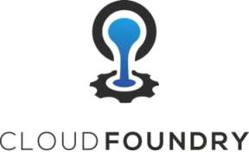
Cloud Foundry Operations
4 day course covering
  Application deployment to Cloud Foundry
    Logging, scaling, blue-green deployments
  “Day 1 Operations”
    Installation of PCF Ops Manager and Elastic Runtime
    Configuring users, roles, and quotas
    Capturing and reading logs
  “Day 2 Operations”
    Backing up and restoring an installation
    Using BOSH
    Upgrading Ops Manager and tiles.

Slide 7
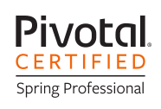
Core Spring
Four day course covering
  Application configuration using
  Java Configuration, XML and/or Annotations
  How Spring works internally and makes use of Aspect Oriented Programming
  Data persistence using JDBC and JPA
  Declarative Transaction Management
  Introduction to web-applications and Spring MVC
  Building RESTful Servers
  Spring Boot, Spring Cloud and Microservices

Slide 8

Spring Boot Developer
2 day workshop
  Getting started with Spring Boot
  Spring Boot CLI
  Configuration, auto-configuration and profiles
  Web development and REST
  Data Access: JDBC, JPA, Spring Data, NoSQL
  Testing
  Security, Messaging
  Deployment, Metrics, Actuator
  Microservices
Notes:
The name of this course is not decided at this time. It is currently known by both names.

Slide 9

Spring Cloud Services
Microservices With Spring
2 day course
  Introduction to Spring Boot
    Underpins all Spring Cloud projects
  Pushing Applications to a PaaS
    Using Pivotal Cloud Foundry
  What are Microservices?
    Architecting a microservices solution
  Cloud infrastructure services and Netflix OSS
    Service Configuration
    Service Registration
    Load-balancing and fault tollerence
Notes:
The name of this course is not decided at this time. It is currently known by both names.

Slide 10


Pivotal Support Offerings
Global organization provides 24x7 support
  How to Register: http://tinyurl.com/piv-support
Premium and Developer support offerings:
  http://www.pivotal.io/support/offerings
  http://www.pivotal.io/support/oss
  Both Pivotal App Suite and Open Source products
Support Portal: https://support.pivotal.io
  Community forums, Knowledge Base, Product documents
Notes:
Support is provided by Pivotal for both our open source products and our commercial products
Premium support is for applications in production – features 24/7 support, committed response times for different severity issues, product updates. Service SLAs are:
Critical (Severity 1) – 30 minutes or less: 24x7
Major (Severity 2) – 2 business hours
Minor (Severity 3) – 8 business hours
Cosmetic (Severity 4) – 1 business day
Developer support is for pre-production applications only – answer “how-to” questions, assistance with application configuration and performance tuning.
Pivotal Open Source support provides both Premium and Developer support for Pivotal's OSS products: Spring IO (including Groovy & Grails), RabbitMQ, Apache Tomcat, Apache HTTPD, and Redis.
This information was correct as at Dec 2014. See the support-offering URLs for latest details.

Slide 11

Pivotal Consulting
Custom consulting engagement?
  Contact us to arrange it
    http://www.pivotal.io/contact/spring-support
    Even if you don't have a support contract!
Pivotal Labs
  Agile development experts
  Assist with design, development and product management
    http://www.pivotal.io/agile
    http://pivotallabs.com
Notes:
Although a consulting engagement typically starts by going to support, you don't need a support contract at all to do this.
A consulting engagement can cover tasks like high-level architecture design/review, code-review, fixing application problems using our products, staff mentoring, help porting applications from JEE to Tomcat.
Pivotal Labs were an Agile development consultancy in SF “providing expertise in three competencies equally crucial to delivering the best product: design, development and product management”. EMC bought them and they gave Pivotal its name.
Going forward Pivotal are setting up similar labs in key cities around the world. Pivotal Labs preferred approach is to take customer staff into their environment (premises) and work with them to implement true Agile development practices. Customer and Labs staff work side-by-side (pair programming) on he Customer's software for the duration of the engagement.
Pivotal Data Labs are being setup to assist customers doing data-analytics, using the same techniques.

Slide 12

Resources
CF docs can be found on three different
sites, depending on the context:
  http://docs.cloudfoundry.org
    Open-source CF project docs
  http://docs.pivotal.io/pivotalcf
    Setting up and using Pivotal Cloud Foundry
  http://docs.run.pivotal.io
    Information about running on Pivotal Web Services
Stack Overflow – Active Forums
  http://stackoverflow.com

Slide 13
Thank You!
We hope you enjoyed the course
Your course is registered with the Pivotal Academy
  Please fill out the evaluation form
Once you've done, login to Pivotal Academy
  You can download your Attendance Certificate
Notes:
Now that Pivotal's LMS is up and running, courses should be registered in the Academy.
If so, there is a simple evaluation form for students to fill in.
Afterwards they can get an attendance certificate once the instructor has confirmed their attendance every day. See Instructor's Guide for more on this . If need be, email training@pivotal.io for more information or talk to your training co-ordinator.
Courses not registered with Pivotal Academy are typically given by Approved Partner Trainers who will have their own evaluation and registration mechanisms. Please ignore this slide – feel free to modify it to specify your own URLs or whatever you need.

