Slide 1
Conceptual Design of a ΔΣ-ADC
Presented by: Miko Kranichi
Lars Nickisch
Priyanka Toyni
Aftab Nagarji
Examination in: Concept Engineering Mixed-Technology Systems (CEMS)
Examiners: Prof. Dr.-Ing. Mirco Meiners
Dipl.-Ing. Tim Ziemann Date: 14.02.2025

Slide 2
Outline
Introducing/ Proposing the Required System
Characterize 𝛥𝛴-Modulators
Behavioural Overview
Deriving a Circuit Realization
Proposals for IC Design
Deriving the Technology-Based Requirements
Overview of Proposed Circuitries

Slide 3
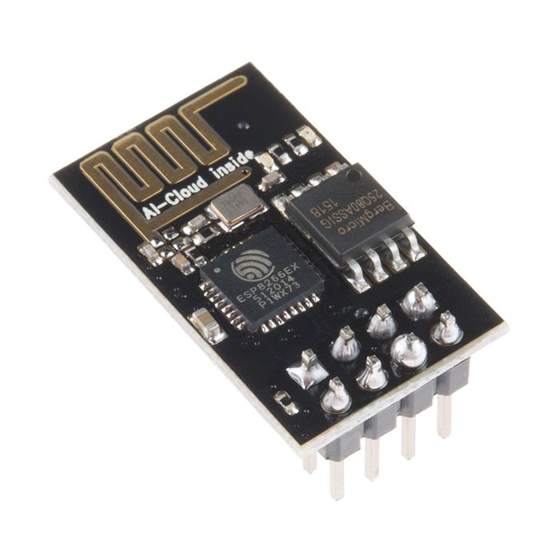
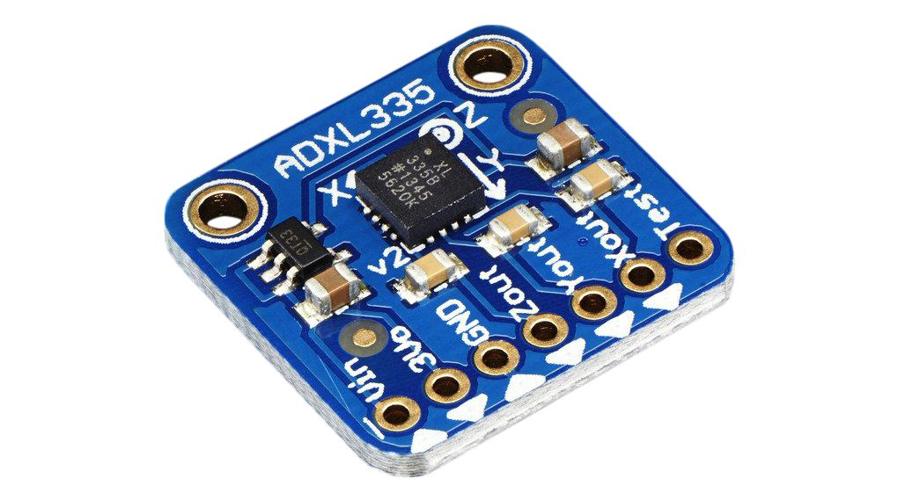
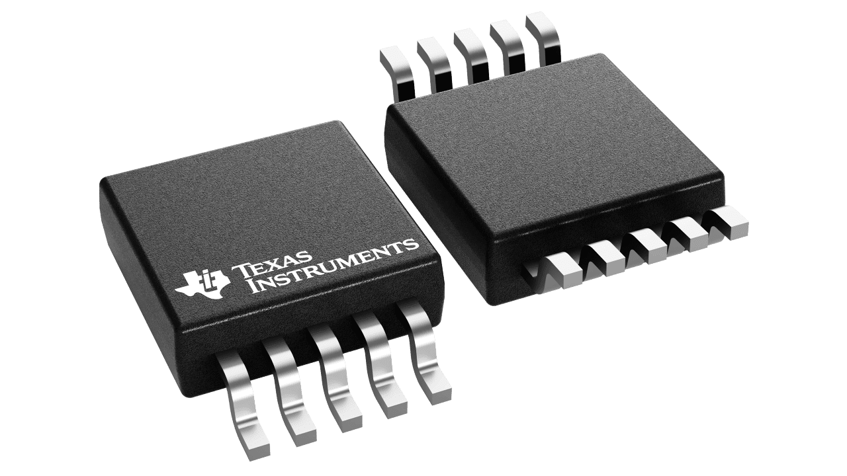
Use-Case of Analog-Digital Converter
01010110 …
Data Flow
Analog
Digital
Fig.1: Accelerometer, ADXL335 [3] Fig.2: ADC, ADS1115 [2] Fig.3: µC, ESP8266 [1]
Final Presentation, CEMS, Gr.4, Speaker: Aftab Nagarji, @HSB

Slide 4
ADS1115
The ADS1115 is a high-precision 16-bit Analog-to-Digital Converter (ADC) produced by Texas Instruments. It's widely used to interface analog signals with digital systems, such as microcontrollers or communication modules. Some notable features include:
Resolution: It provides 16-bit resolution, offering precise conversion of analog signals into digital form.
Input Channels: The ADS1115 includes 4 channels, which can be configured for single-ended or differential input modes.
Data Rate: It offers a configurable data rate of up to 860 samples per second (SPS), making it suitable for slow to medium-speed analog signals.
Low Power Consumption: It’s designed to be energy-efficient, which is ideal for battery-powered devices.
I²C Communication: The ADS1115 communicates over the I²C bus, which is a simple and commonly used interface for connecting devices.
Programmable Gain Amplifier (PGA): This feature allows you to amplify the input signal, which is useful for measuring weak signals with higher precision.
Final Presentation, CEMS, Gr.4, Speaker: Aftab Nagarji, @HSB

Slide 5
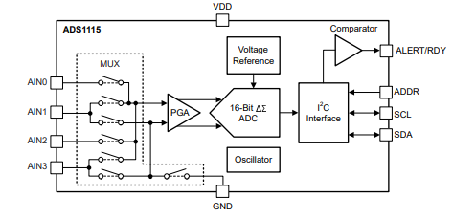
Fig:4 ADS1115 Block diagram
Final Presentation, CEMS, Gr.4, Speaker: Aftab Nagarji, @HSB

Slide 6
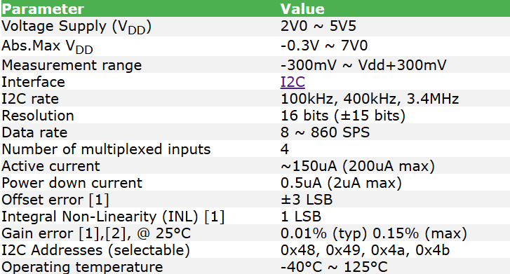
Table 1: ADS1115 Specifications
Final Presentation, CEMS, Gr.4, Speaker: Aftab Nagarji, @HSB

Slide 7
ADXL335 Accelerometer
The ADXL335 is a small, low-power, 3-axis accelerometer from Analog Devices, designed to measure acceleration along the X, Y, and Z axes. It’s ideal for applications that require motion detection, tilt measurement, or vibration analysis.
Key Specifications:
Acceleration Range: ±3g, capable of measuring acceleration up to 3 times the force of gravity.
Output: Provides analog signals for each of the three axes (X, Y, Z).
Supply Voltage: Operates within a range of 1.8V to 3.6V.
Sensitivity: 300mV per g of acceleration (a change of 1g results in a 300mV shift in output).
Low Power: Consumes just about 350 µA under typical conditions.
Compact Size: Small form factor, suitable for embedded systems and space-constrained applications.
Final Presentation, CEMS, Gr.4, Speaker: Aftab Nagarji, @HSB

Slide 8
Specification of ADXL335
Supply Voltage: 2.8V to 3.6V
Current Consumption: 320uA
Sensitivity: 300mV/g
Bandwidth: 3Hz to 5kHz
Dynamic Range: ±3g
Operating Temperature: -40°C to +85°C
Package Type: Surface Mount Plastic Package (LFCSP)
Pin Configuration: 5 Pin, 1.27mm Pitch
Output Type: Voltage Output
Interface: SPI/I2C
Output Range: 0V to Vcc
Storage Temperature: -65°C to +150°C
Final Presentation, CEMS, Gr.4, Speaker: Aftab Nagarji, @HSB

Slide 9
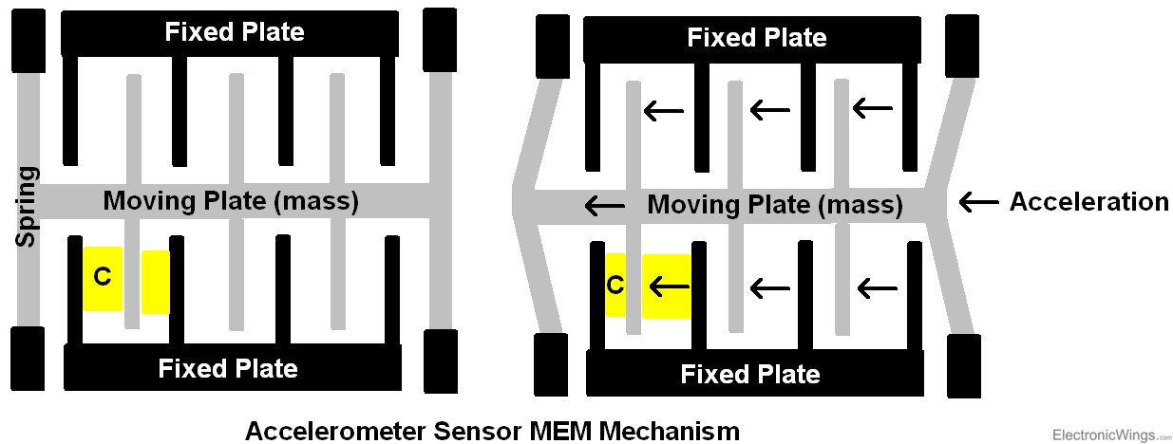
Fig.5: Accelerometer Mechanism
Final Presentation, CEMS, Gr.4, Speaker: Aftab Nagarji, @HSB

Slide 10
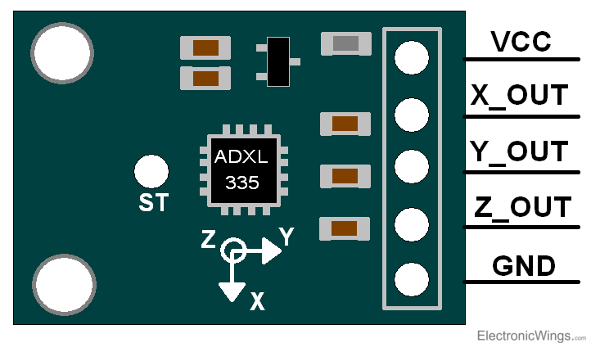
Fig.6: ADXL Block diagram
Final Presentation, CEMS, Gr.4, Speaker: Aftab Nagarji, @HSB

Slide 11
System-/ Behavioural Overview

Slide 12

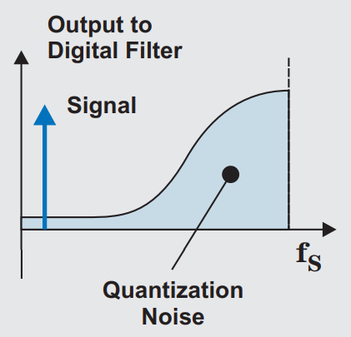
Oversampling ADCs
Sampling with:
OSR := “Oversampling Ratio”
Introduces Noise Shaping:
Noise Transfer Function (NTF) as highpass
Shift given quantization noise out of signal band
Increasing SQNR (~ OSR)
Fig. 7: Visualization of Noise Shaping [4]
Final Presentation, CEMS, Gr.4, Speaker: Lars Nickisch, @HSB

Slide 13
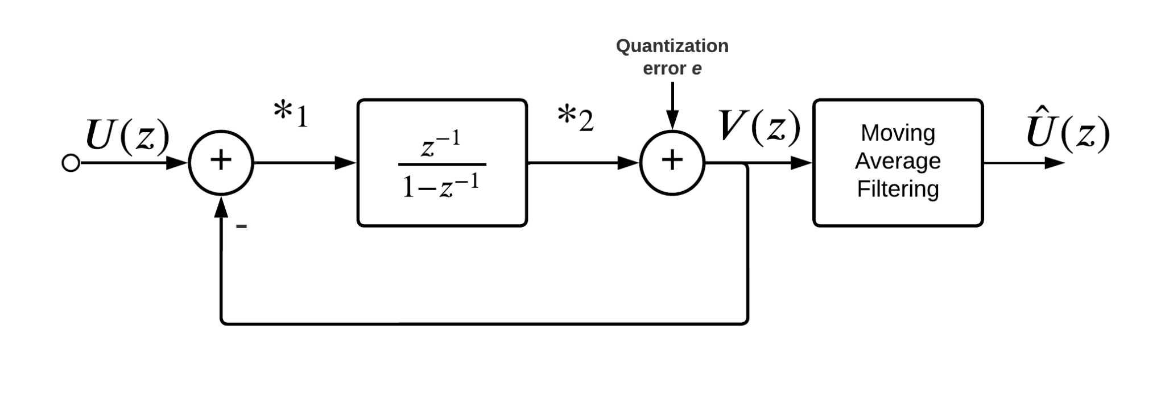
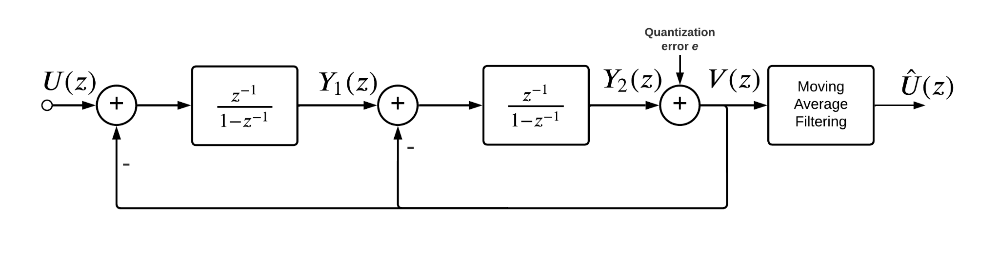

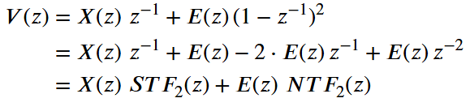
1st- vs. 2nd Order Modulator
Insert MOD1 as Quantizer
Fig. 8: Behavioural Model of MOD1
Fig. 9: Behavioural Model of MOD2
Final Presentation, CEMS, Gr.4, Speaker: Lars Nickisch, @HSB

Slide 14
1st- vs. 2nd Order Modulator
Table 2: Select few impacts of changing from L=1 to L=2
Aspect | Impact by changing from MOD1 to MOD2
Noise Shaping | 40dB/decade (previous: 20dB/decade)
SQNR/OSR trade-off | Doubling OSR: Noise Reduction: From 9 dB To 15 dB ENOB Improvement: From ≈ 1.5 bits to ≈ 2.5 bits
Stability | Reduced stability insurance (BIBO requirement)
Complexity | Increase in circuit elements (+ stability concerns)
Final Presentation, CEMS, Gr.4, Speaker: Lars Nickisch, @HSB

Slide 15
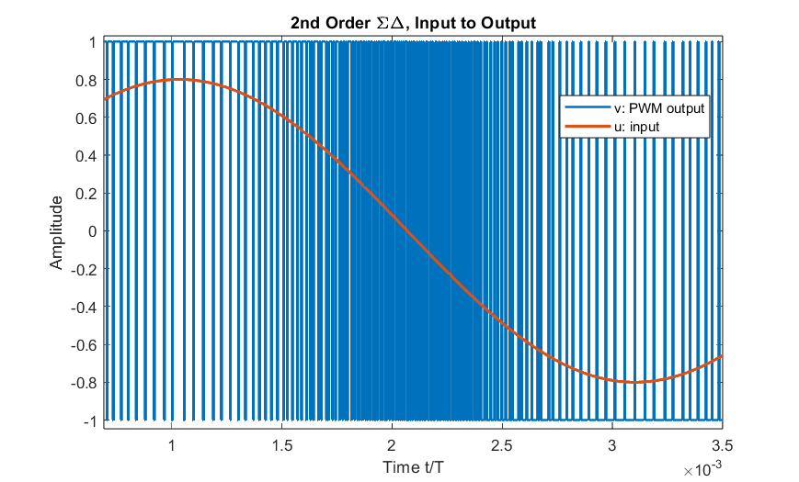
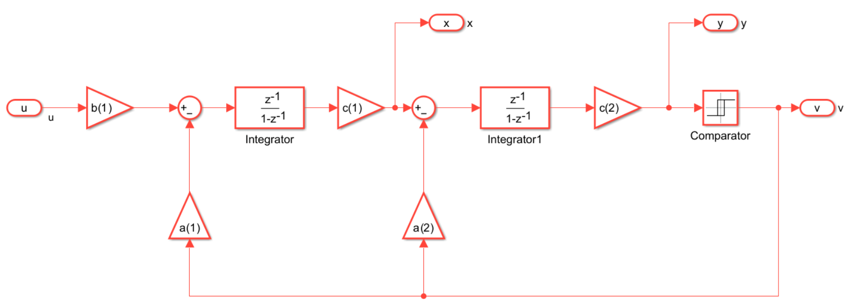
Insights from MATLAB/ Validations
Fig. 10: Utilized MATLAB model for 2nd order analysis
Fig. 11: I/O behaviour in time domain from MATLAB model
Final Presentation, CEMS, Gr.4, Speaker: Lars Nickisch, @HSB

Slide 16
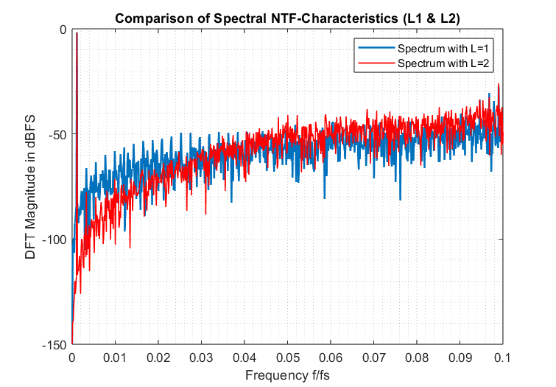
Insights from MATLAB/ Validations
Comparing PSDs of NTFs (normalized range)
Expected NTF slopes visible
Attenuation for f/fs ⇾ 0
Amplification for f/fs ⇾ 1
Increased effect for higher order
Fig. 12: Comparison of spectral outputs of MATLAB models
Final Presentation, CEMS, Gr.4, Speaker: Lars Nickisch, @HSB

Slide 17
Digital Filter

Slide 18

Digital Filter
Goal: high data rate -> low data rate
Optional goal: Keep signal quality
Solution: Band limitation and decimation
No information loss due to oversampling and Nyquist theorem
Problem: High computational complexity
Fig. 13: Block diagram decimator
Final Presentation, CEMS, Gr.4, Speaker: Miko Kranich, @HSB

Slide 19
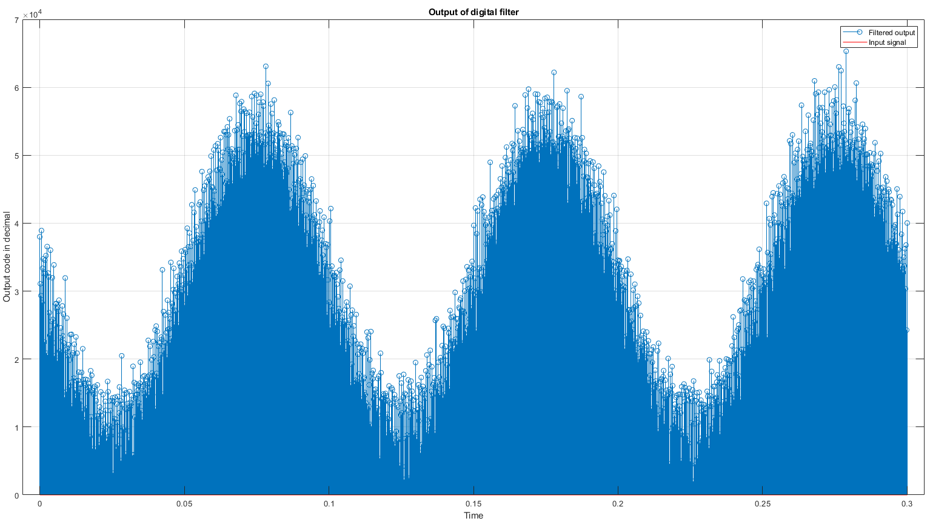
Digital Filter
output is very noisy
IIR used instead of FIR
more refined results
not possible due to time issues
Quant error variance ≈ 6.9e-3
Fig. 14: Filtered output of second order ΔΣ modulator
Final Presentation, CEMS, Gr.4, Speaker: Miko Kranich, @HSB

Slide 20
Modulator as a Circuit

Slide 21
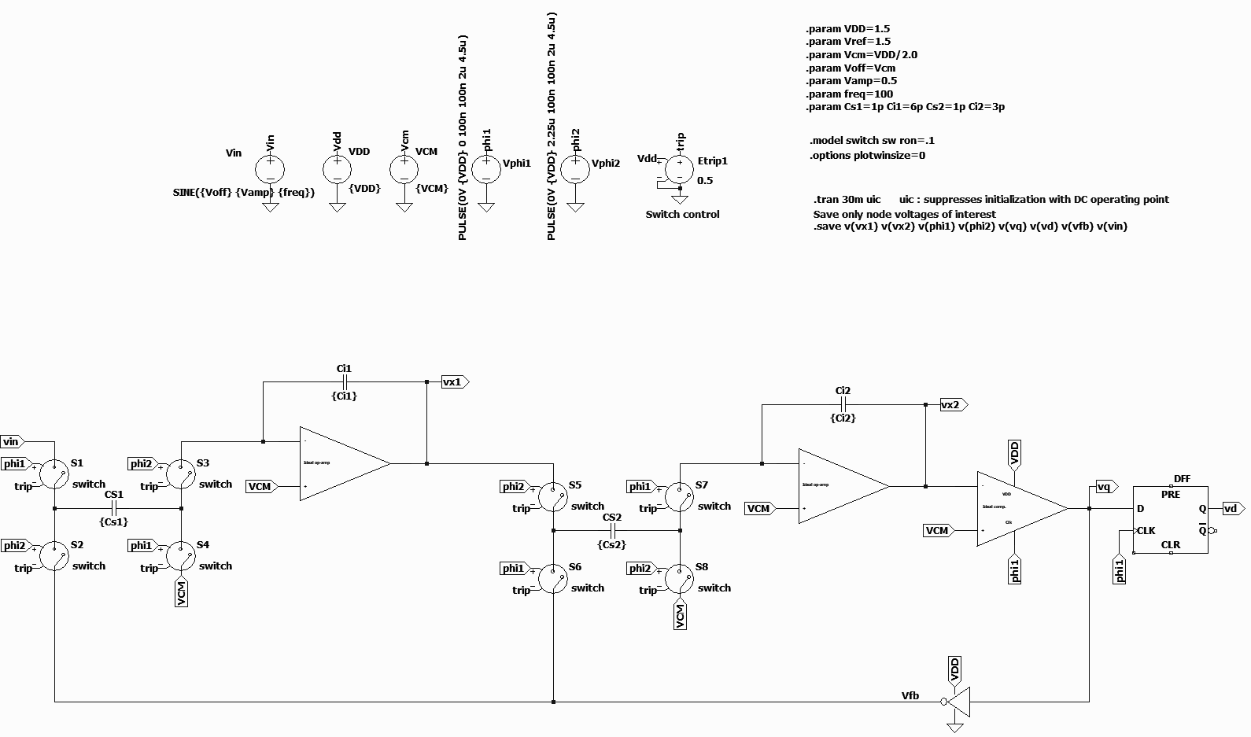
System Implementation on Circuit Level
idealized model
mirrors behaviour
second order ΔΣ modulator
Fig. 15: LTspice Simulation of second order modulator
Final Presentation, CEMS, Gr.4, Speaker: Miko Kranich, @HSB

Slide 22
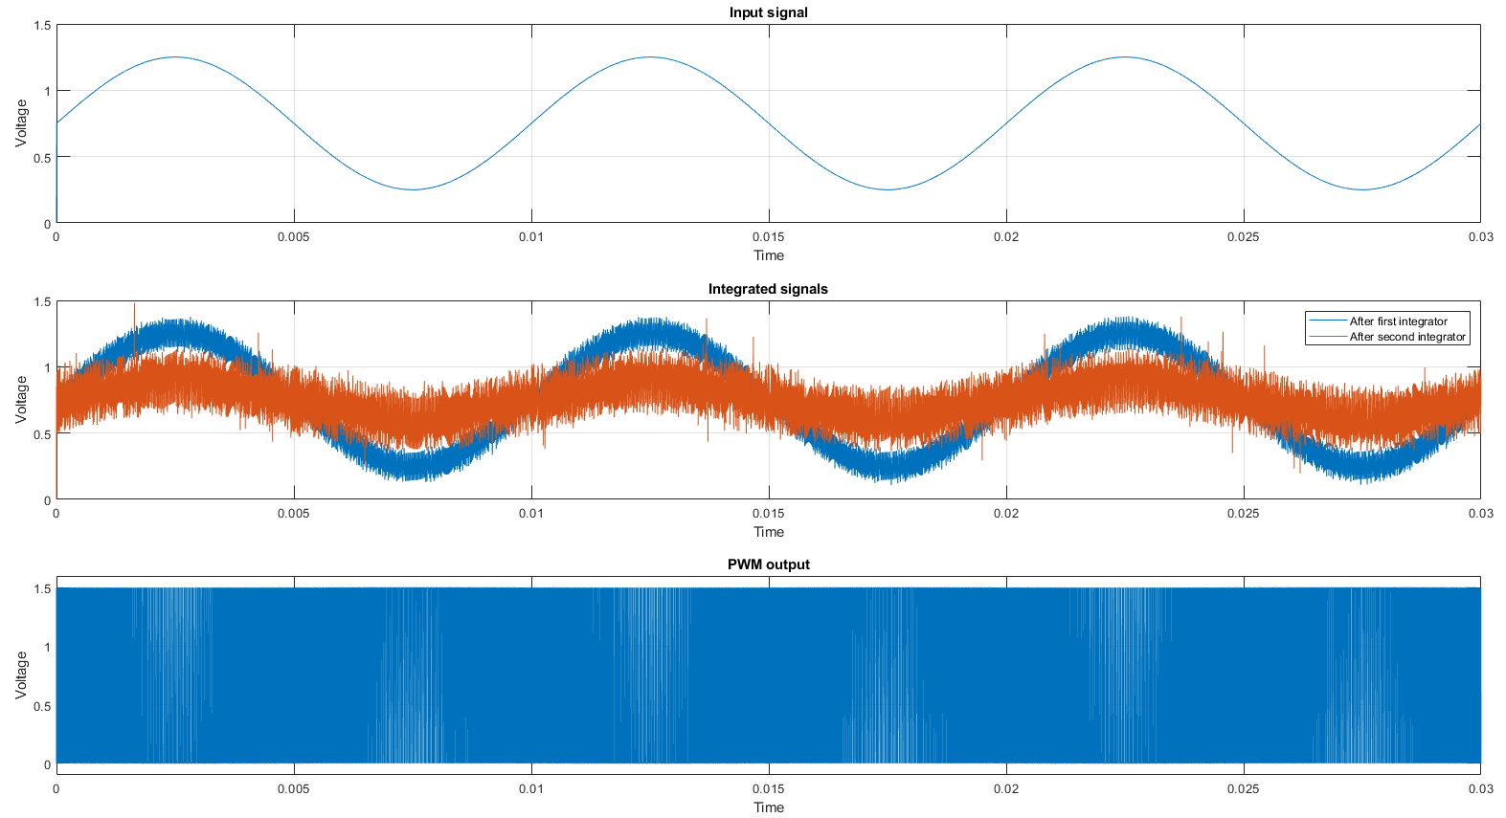
LTspice Verification
Low frequency input
Noisy output after first
integrator
Lower noise magnitude
after second integrator
High speed PWM output
Fig. 16: Output of different stages of LTspice simulation
Final Presentation, CEMS, Gr.4, Speaker: Miko Kranich, @HSB

Slide 23
Proposals for IC-Design

Slide 24
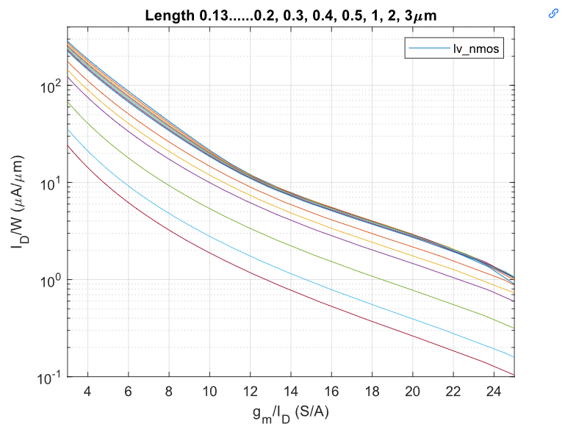
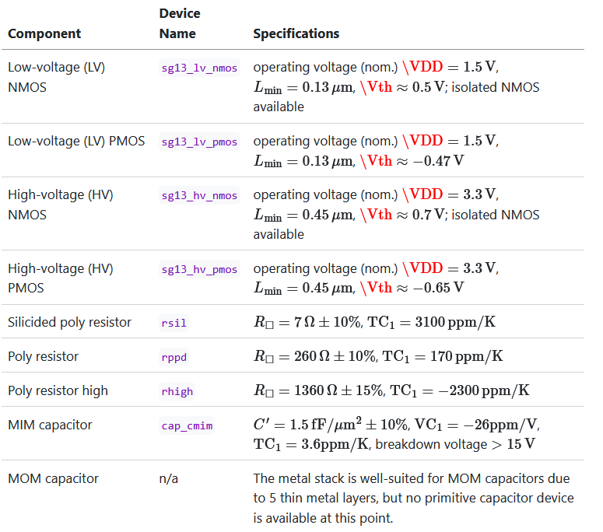
Information regarding PDK
Table 3: Devices from IHP SG13G2 PDK [5]
Fig. 17: Tech-Sweep for sg13_lv_nmos
Final Presentation, CEMS, Gr.4, Speaker: Priyanka Toyni, @HSB

Slide 25
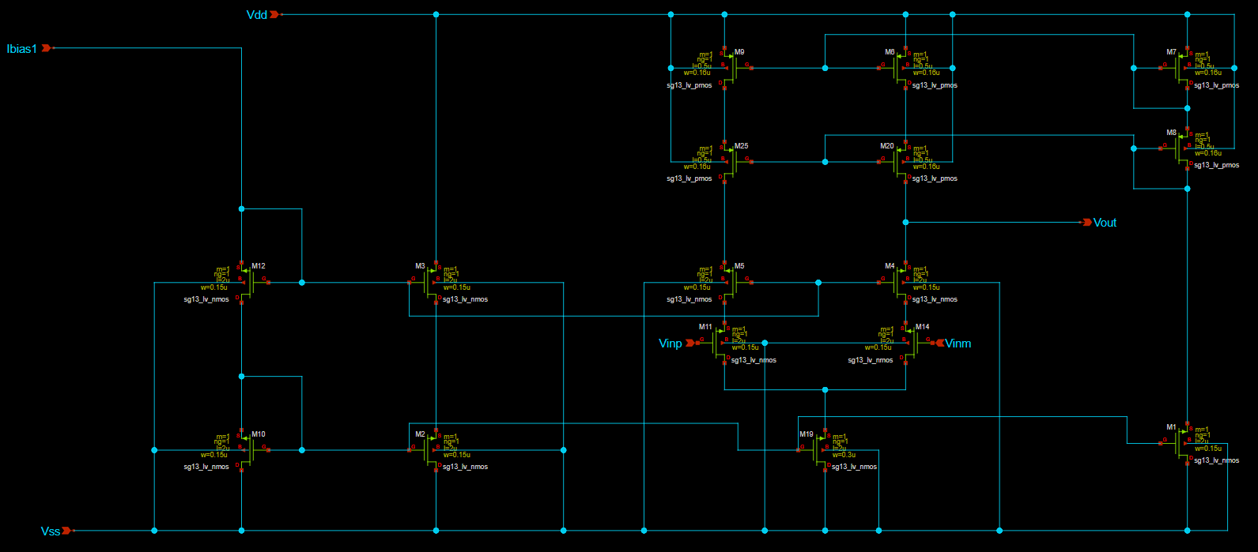
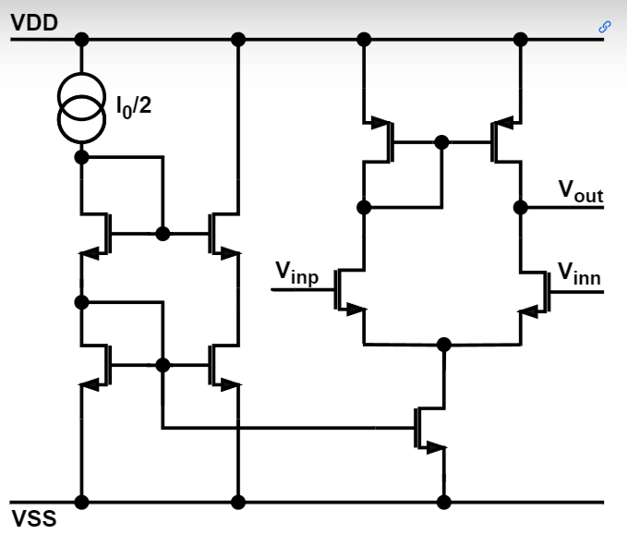
Proposed 5T-OTA
Fig. 18: Architecture of 5T-OTA-Circuit
Fig.19: Xschem Circuit of OTA
Final Presentation, CEMS, Gr.4, Speaker: Priyanka Toyni, @HSB

Slide 26
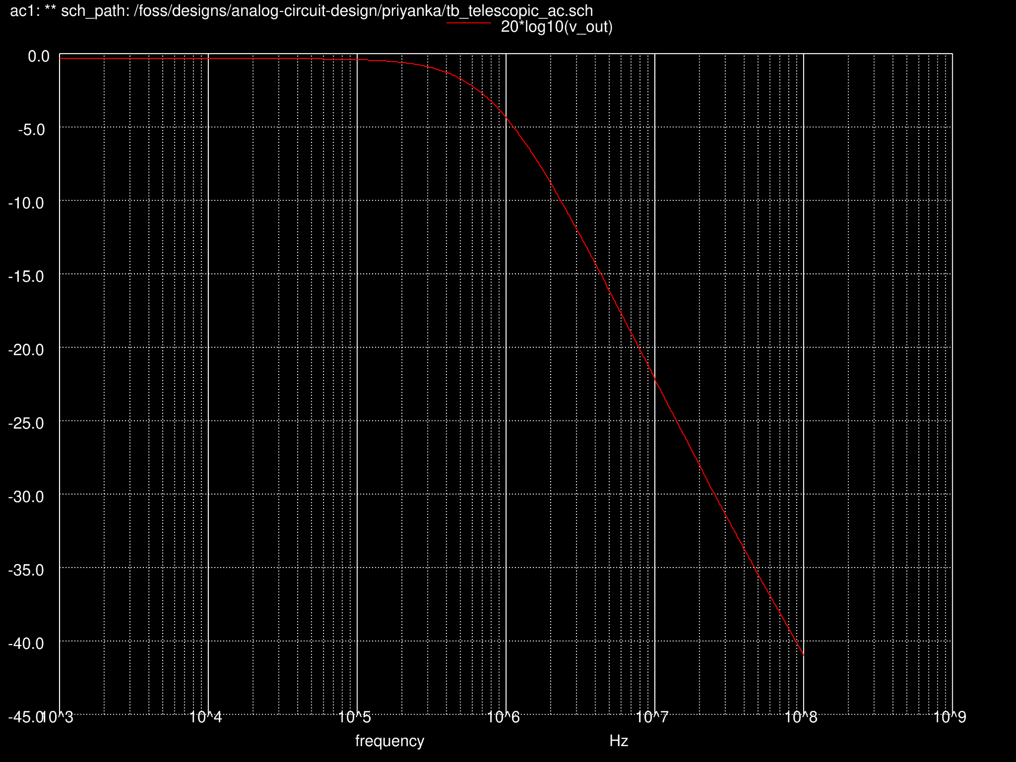
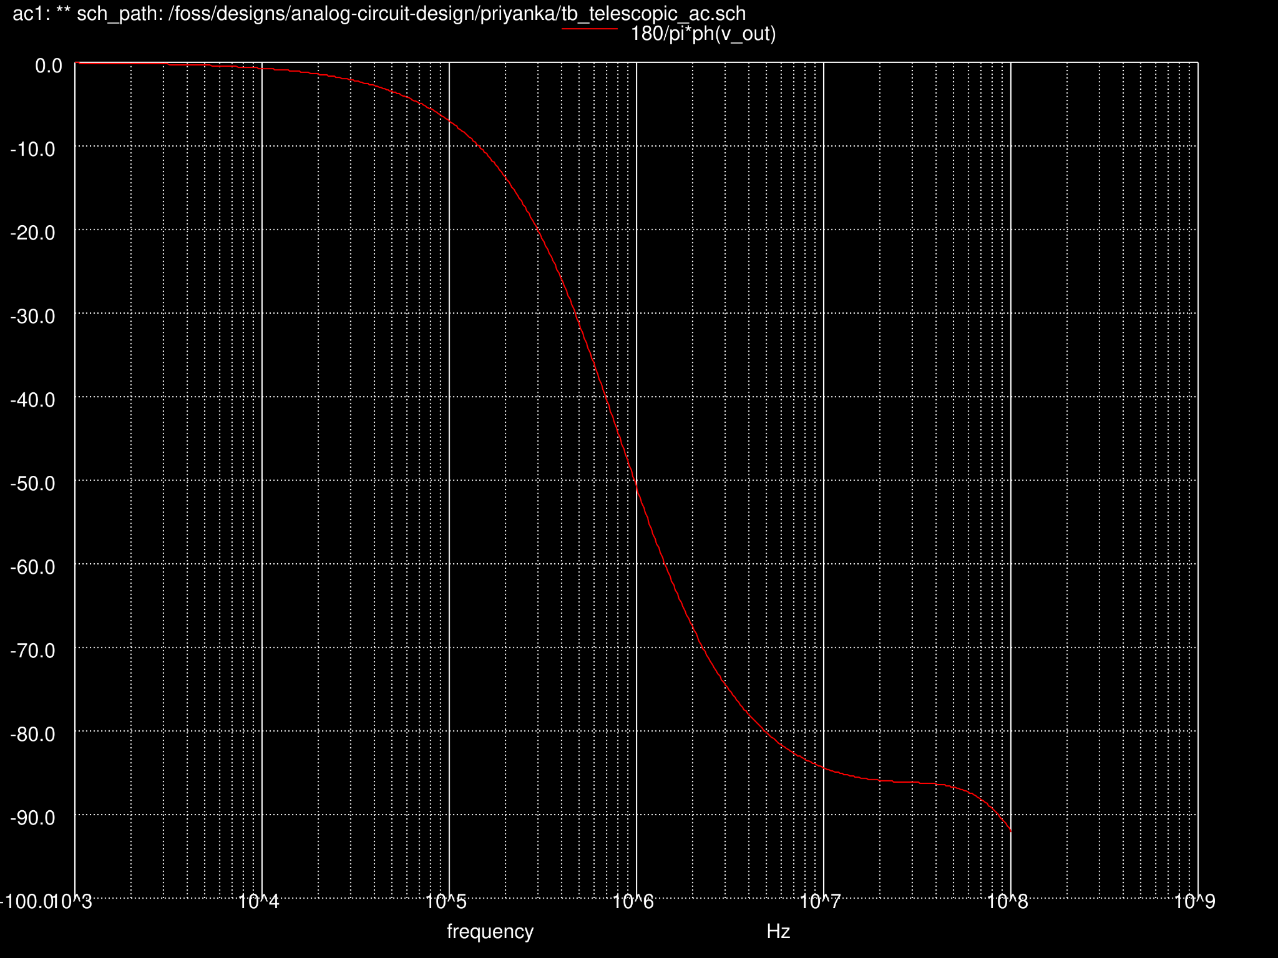
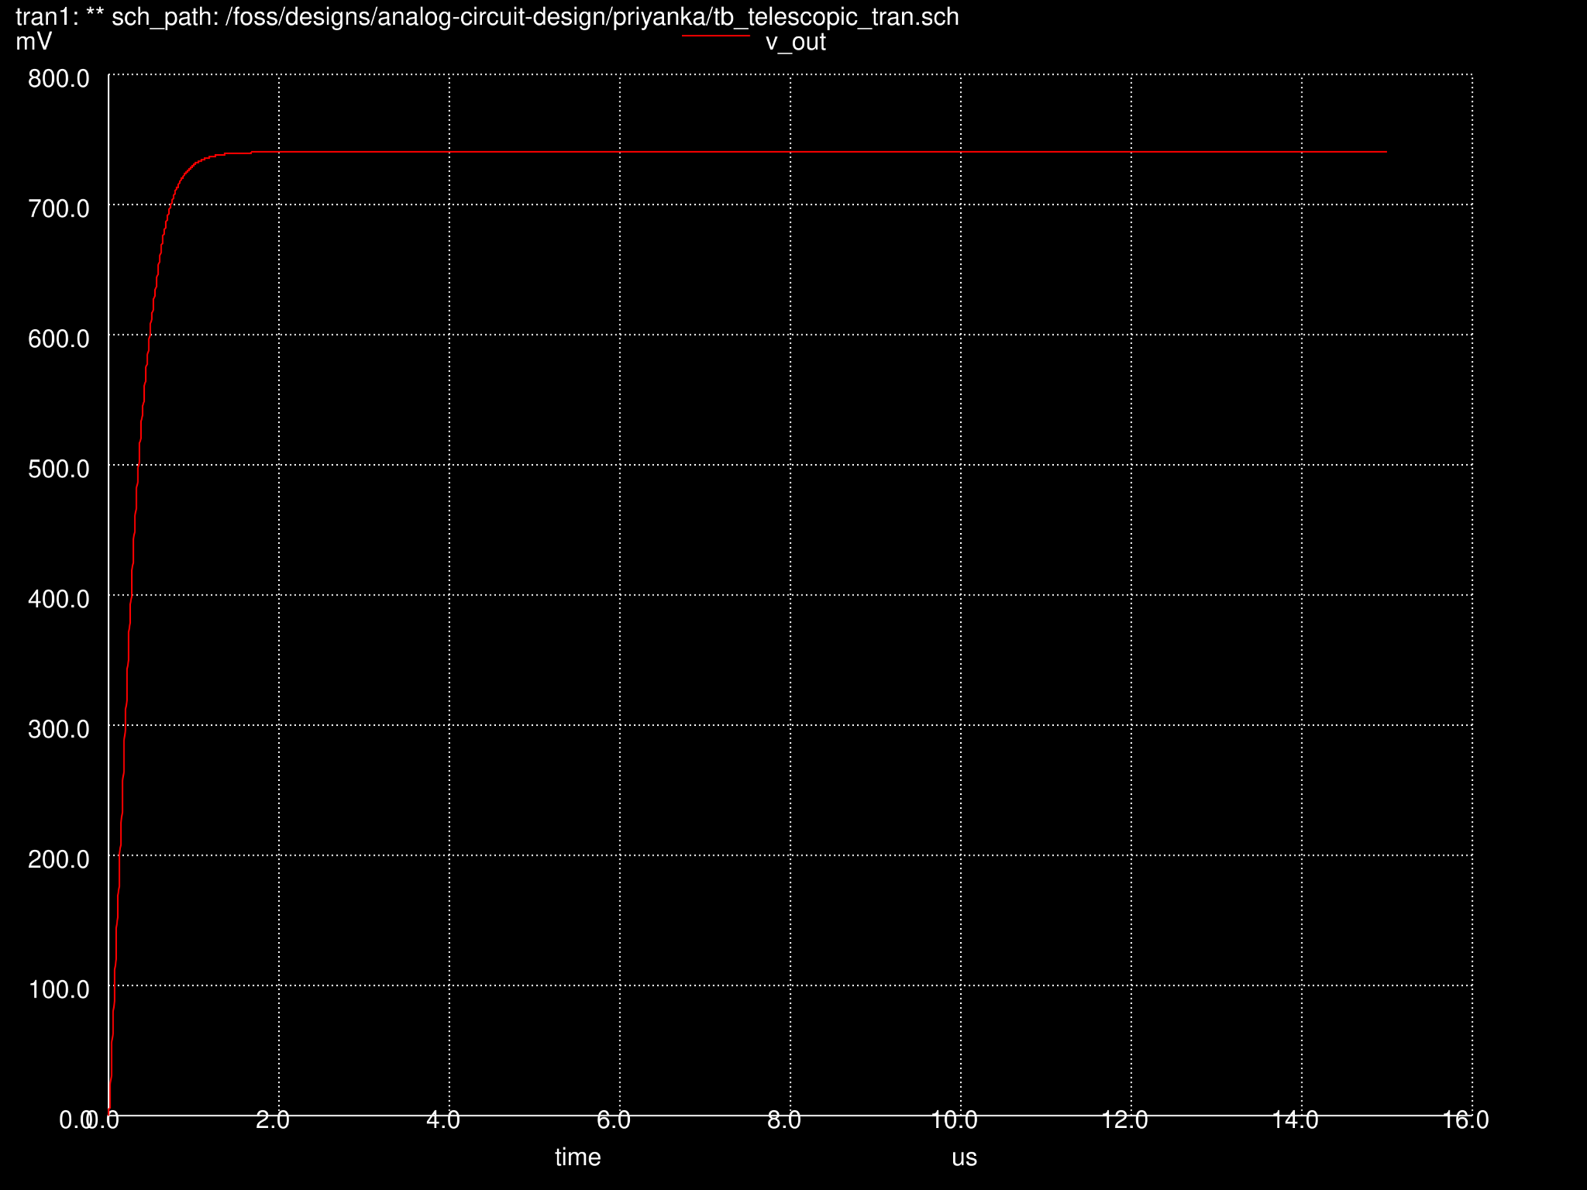
OTA Outputs
Fig. 20: OTA outputs (transient)
Fig. 21: OTA outputs (AC: magn. & phase)
Final Presentation, CEMS, Gr.4, Speaker: Priyanka Toyni, @HSB

Slide 27
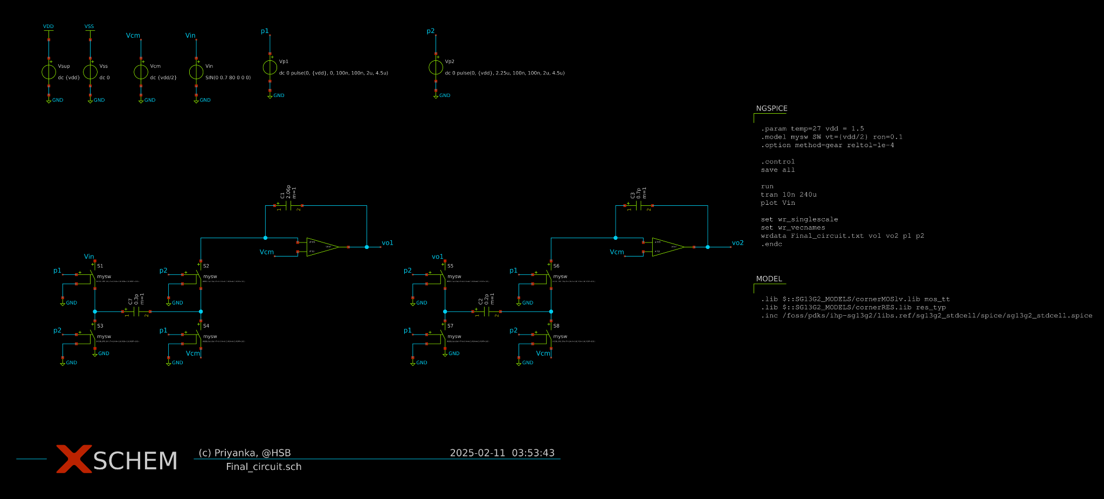
Circuit with Switched-Cap. Stages
Fig. 22: Final Top Level Circuit Schematic
Final Presentation, CEMS, Gr.4, Speaker: Priyanka Toyni, @HSB

Slide 28
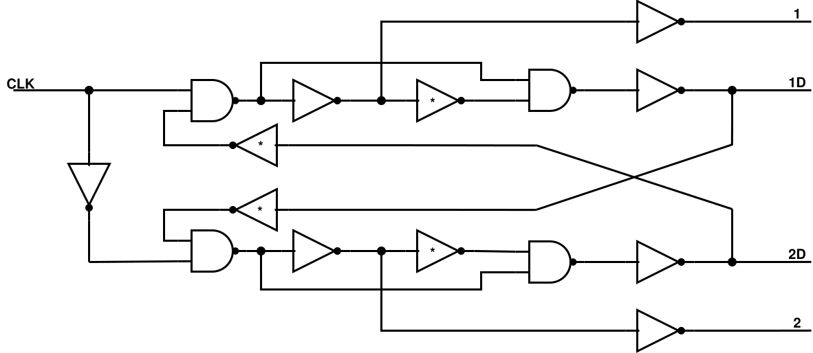
Clock generator
ensures no overlap
controllable delay
crucial for correct sampling
Fig.23: Concept for non-overlapping clock signals
Final Presentation, CEMS, Gr.4, Speaker: Miko Kranich, @HSB

Slide 29
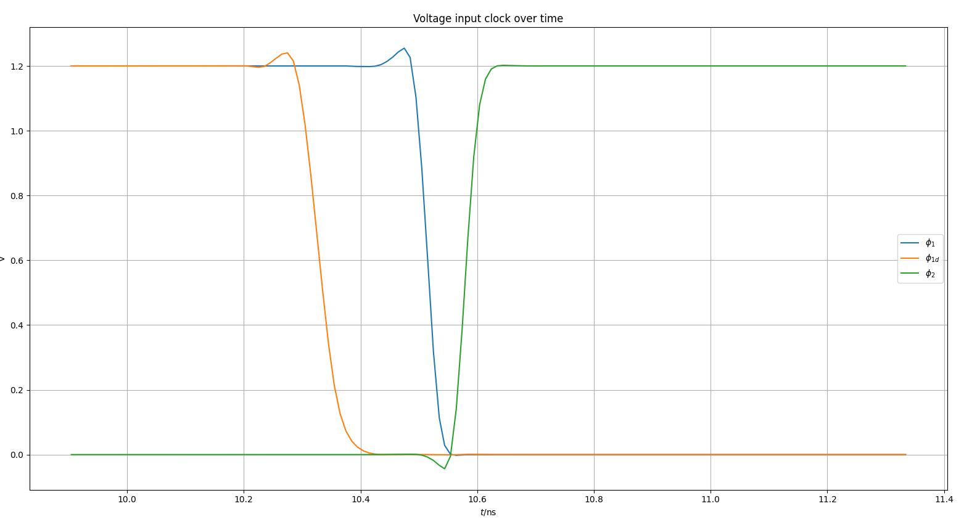
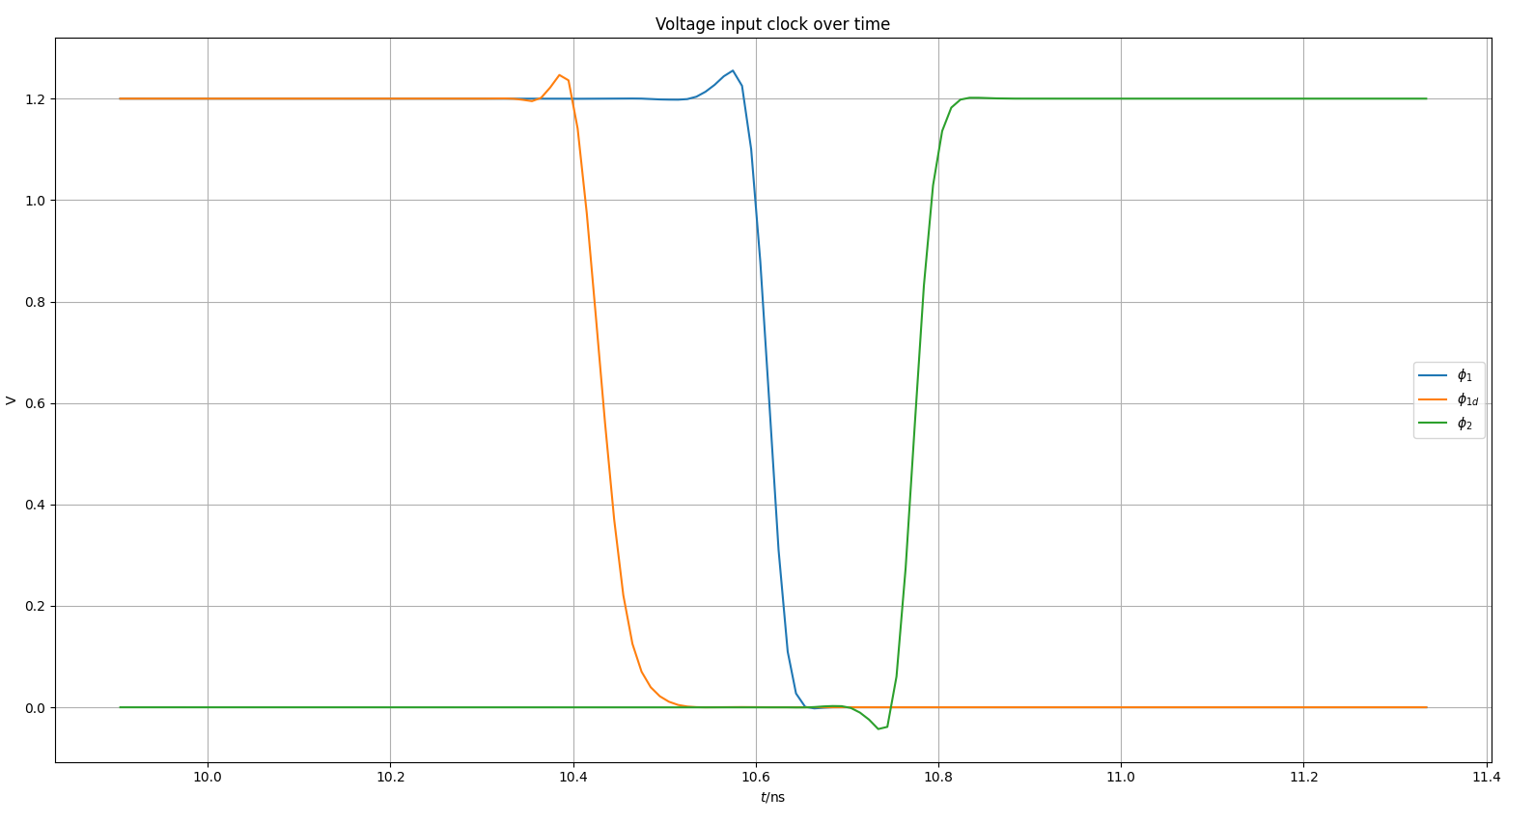
Clock generator
Fig. 24: Clock signals with poor delay
Fig. 25: Clock signals with better delay
Final Presentation, CEMS, Gr.4, Speaker: Miko Kranich, @HSB

Slide 30
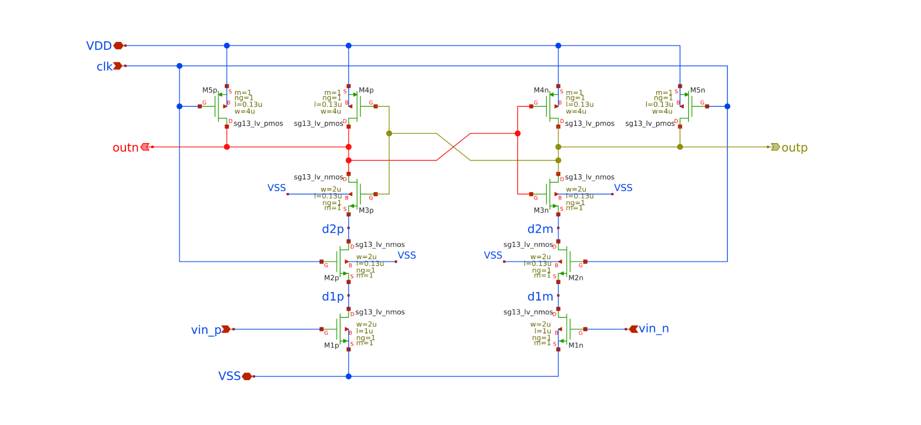
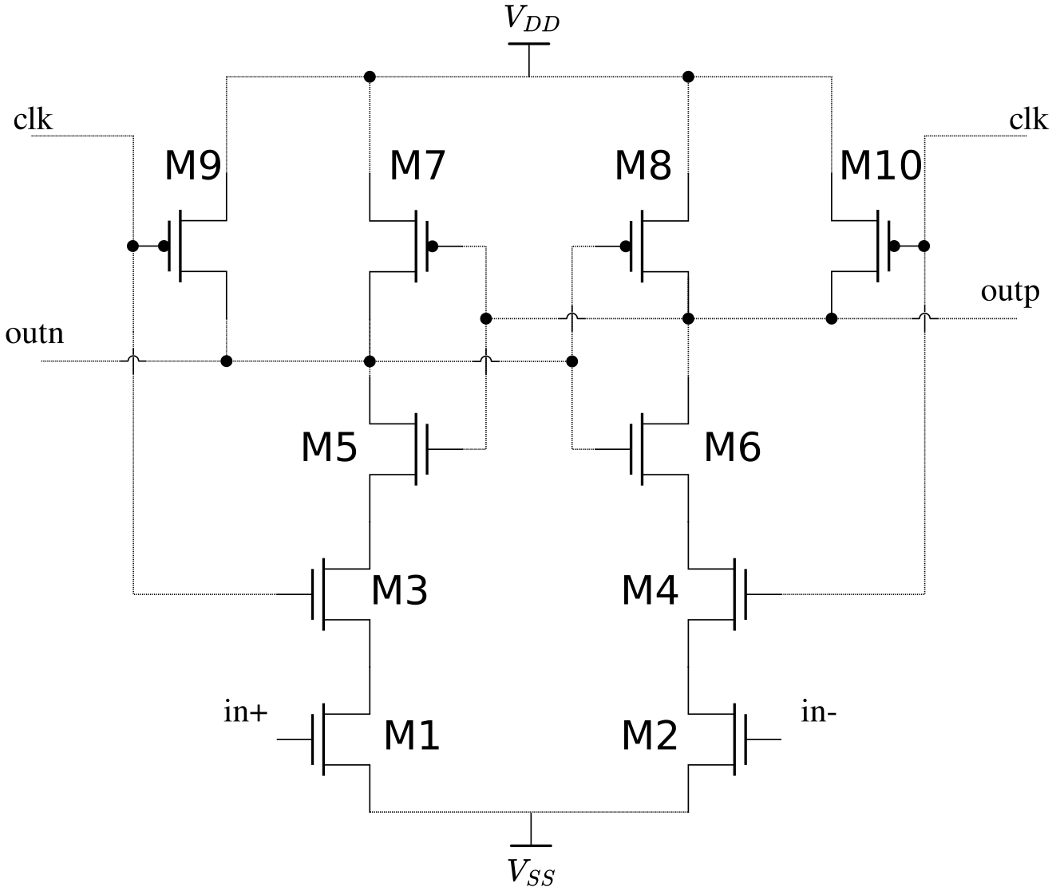
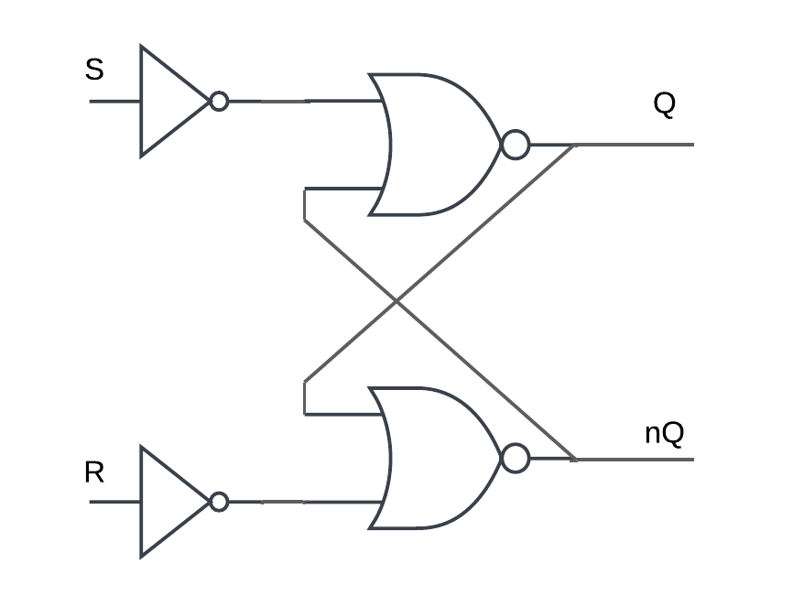
Comparator Design
Fig. 28: Xschem Schematic for Comp.
Outp ⇾ S & Outn ⇾ R
SR-Latch output to D-flip-flop
Fig. 26: Inverter-Based Comparator Architecture
Fig. 27: SR-Latch after Comp.
Final Presentation, CEMS, Gr.4, Speaker: Lars Nickisch, @HSB

Slide 31
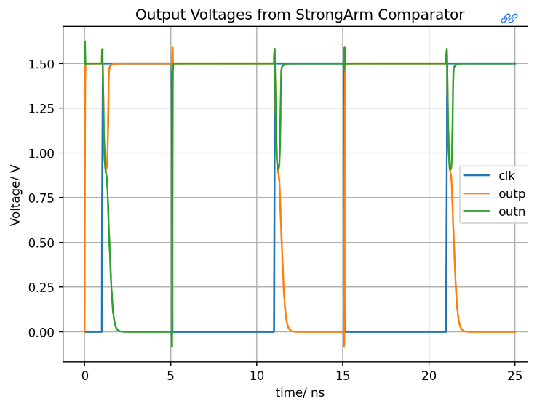
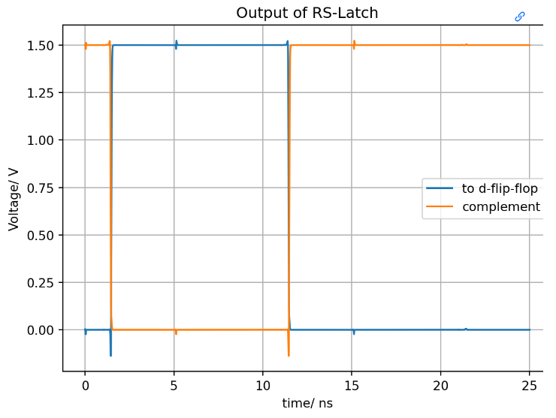
Comparator Design
Fig. 29: Simulation Results of Comparator
0-8 ns: Vin+ = Vin- + 10mV
8.1-25 ns: Vin- = Vin+ + 10mV
Final Presentation, CEMS, Gr.4, Speaker: Lars Nickisch, @HSB

Slide 32
PCB Design

Slide 33
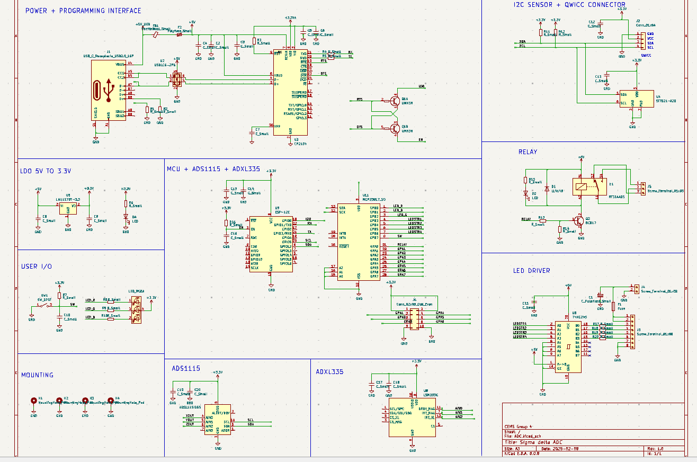
PCB Design
Fig. 30: Schematic Design of PCB
Final Presentation, CEMS, Gr.4, Speaker: Aftab Nagarji, @HSB

Slide 34
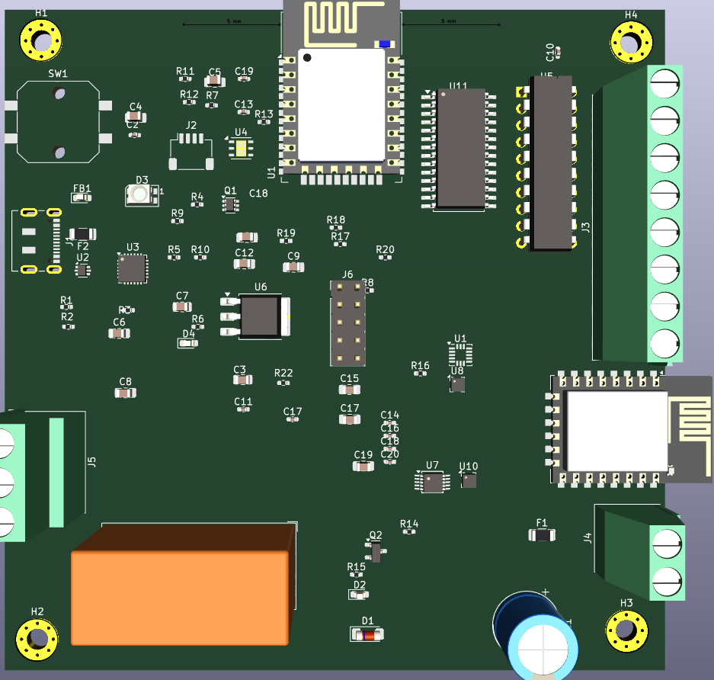
PCB Physical Design
Fig. 31: PCB Design: Layout
Final Presentation, CEMS, Gr.4, Speaker: Aftab Nagarji, @HSB

Slide 35
Source Material
[1] https://micropython.org/download/ESP8266_GENERIC/
[2] https://www.ti.com/product/ADS1115#design-development
[3] https://www.distrelec.de/de/achsen-beschleunigungsmesser-adxl335-adafruit-163/p/30129187
[4] Bonnie Baker. How delta-sigma ADCs work, Part 1. Analog Application Journal (AAJ) SLYT423a, Texas Instruments Incorporation, 2011
[5] Harald Pretl, Michael Koefinger, and Simon Dorrer. Analog Circuit Design, December 2024.
Final Presentation, CEMS, Gr.4: Miko Kranich, Aftab Nagarji, Lars Nickisch, Priyanka Toyni, @HSB

Slide 36
That’s all folks!

