Slide 1
Quarto-Jupyter-Matlab-Everything guide
Me

Slide 2
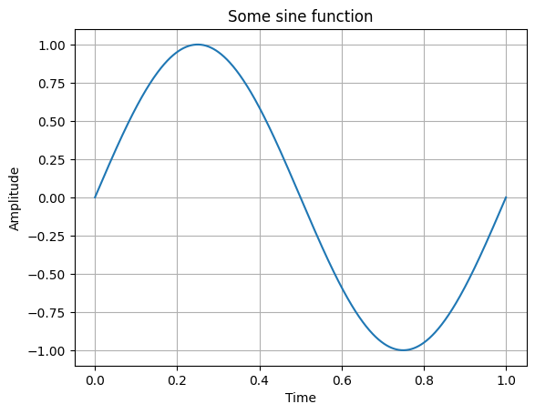
Here’s some heading
Here’s the first point of some listing
And this is the second point of this pointless listing
After this, there is some text with funny words. With a “/” or two spaces you can create a line break, as seen here. Then the text continues in the next line.
some bulletpoint
more bulletpoints

Slide 3

Then, by pressing Crtl+Shift+K (just as in a default quarto document) you can create a quarto output in the format specified in the header. It depicts everything from Text to code to figures
You can even insert funny latex formulae, no need to change the cell to latex
If you want to have a nice figure:
Title

Slide 4
Matlab calls or data calls in general
In the following, calls are made to the matlab files for first order modulator. All the data from simulation are stored in a seperate folder and can be accessed by just giving relative paths for further processing in python

