Slide 1
Human Activity Recognition
Peter Bauer
&
Kai Pan

Slide 2
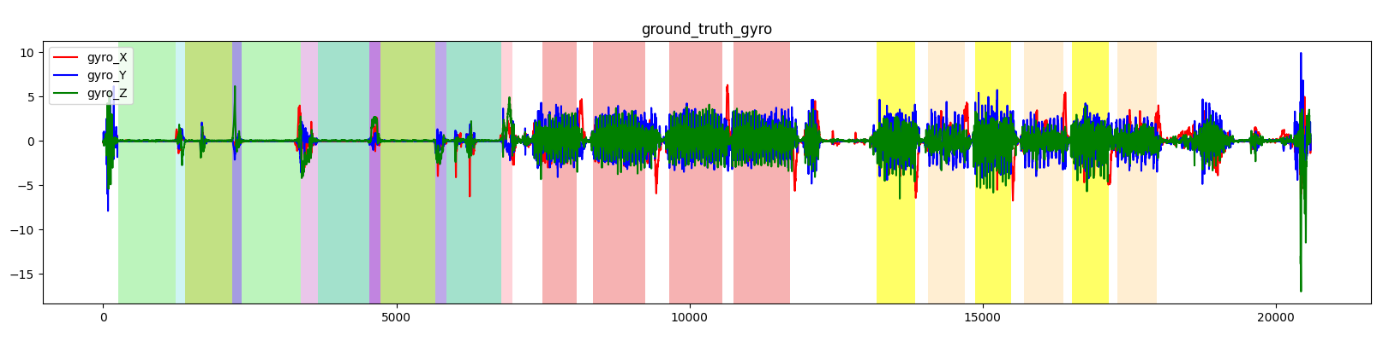
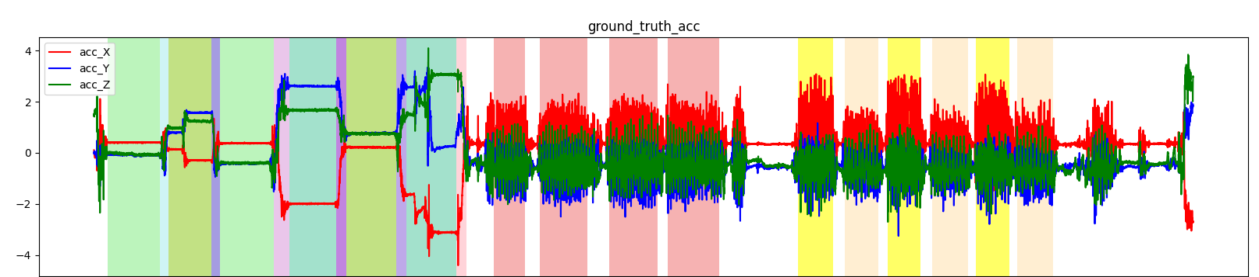
Introduction
Human Activity Recognition (HAR) aims to classify ones activity based on sensor data.
HAPT Dataset provides tri-axial smartphone data from a accelerometer and a gyroscope.
Peter Bauer & Kai Pan - 08.02.2022

Slide 3
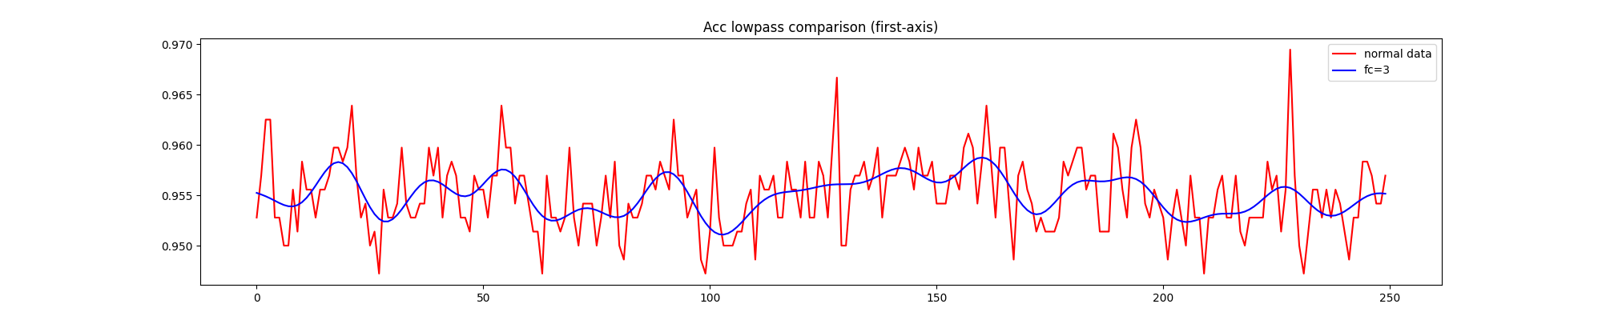
Input Pipeline
Remove unlabeled data from the dataset.
Hard coded label assignment strategy.
Z-score normalization for multi channel data.
Sliding window for data augmentation (window size: 250, window shift: 75).
Low-pass filter to eliminate high frequencies.
Dataset is resampled into two groups.
Peter Bauer & Kai Pan - 08.02.2022
Notes:
-> Hard coded label assignment strategy: sequence is assigned to mode if:
Mode is a normal actvity and more then 85% of the sequence are of that activity
Mode is a transition activity and more then 40% of the sequence are of that activity

Slide 4
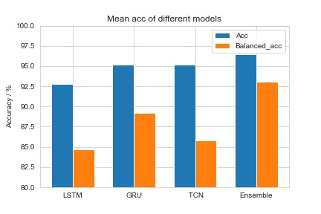
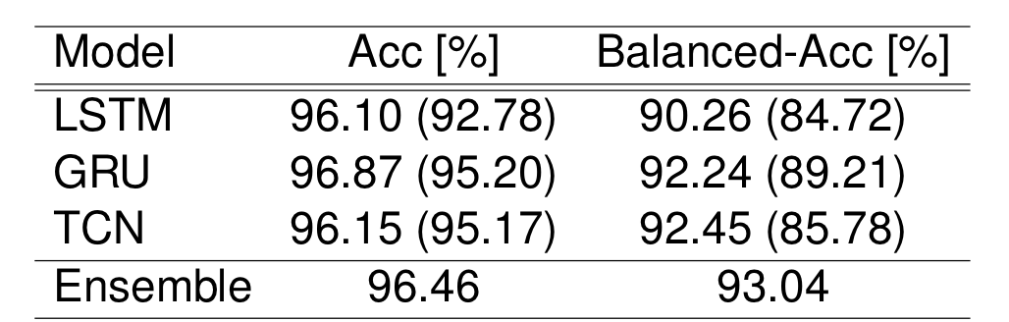
Model and Training
Models: LSTM and GRU based RNN models, Temporal Convolutional Network (TCN).
Training: Adam optimizer with cosine decay learning rate, weighted loss in sparse_categorical_entropy_loss (focus more on transition samples).
Bayesian hyperparameter optimization.
Results:
The GRU-based architectures were found to be more reliable in terms of reproducibility. The ensemble learning has further improved the result.
Peter Bauer & Kai Pan - 08.02.2022

Slide 5
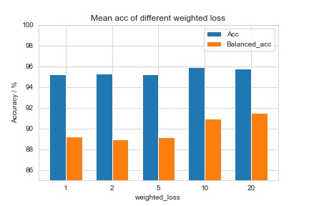
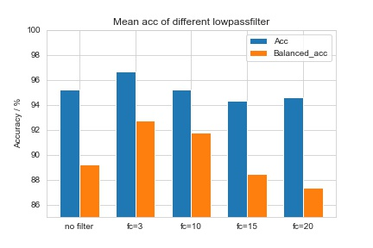
Ablation
Initialization: He_normal kernel initializer has better performance.
Bidirectional: Normal rnn layers have better performance than bidirectional layers.
Low-pass filter : Smaller cutoff frequency Fc will make signal smoother and less sensitive to noise.
Weighted loss: The weighted loss introduces better balanced acc.
Peter Bauer & Kai Pan - 08.02.2022

Slide 6
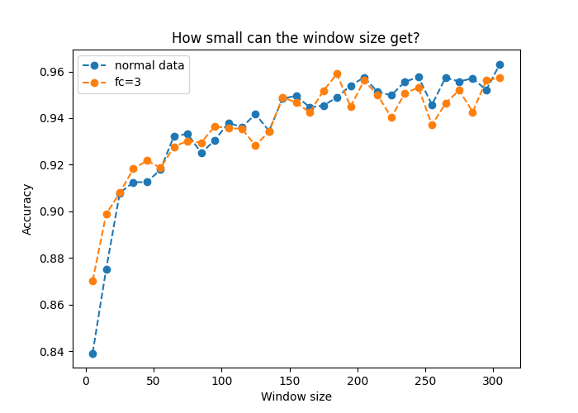
How much temporal information is needed?
In general, larger window sizes yield better accuracy scores.
For small window sizes low-pass filtering significantly increases the accuracy.
Still reasonable results for small window sizes.
Peter Bauer & Kai Pan - 08.02.2022

Slide 7
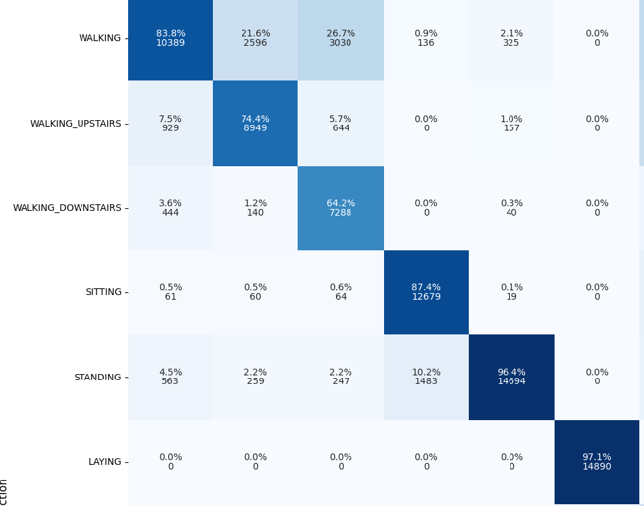

… and for which classes?
window size= 2, fc=3
Static activities are not time related and therefore can be detected very accurate without temporal information.
Peter Bauer & Kai Pan - 08.02.2022

Slide 8
Thank You !

Slide 9
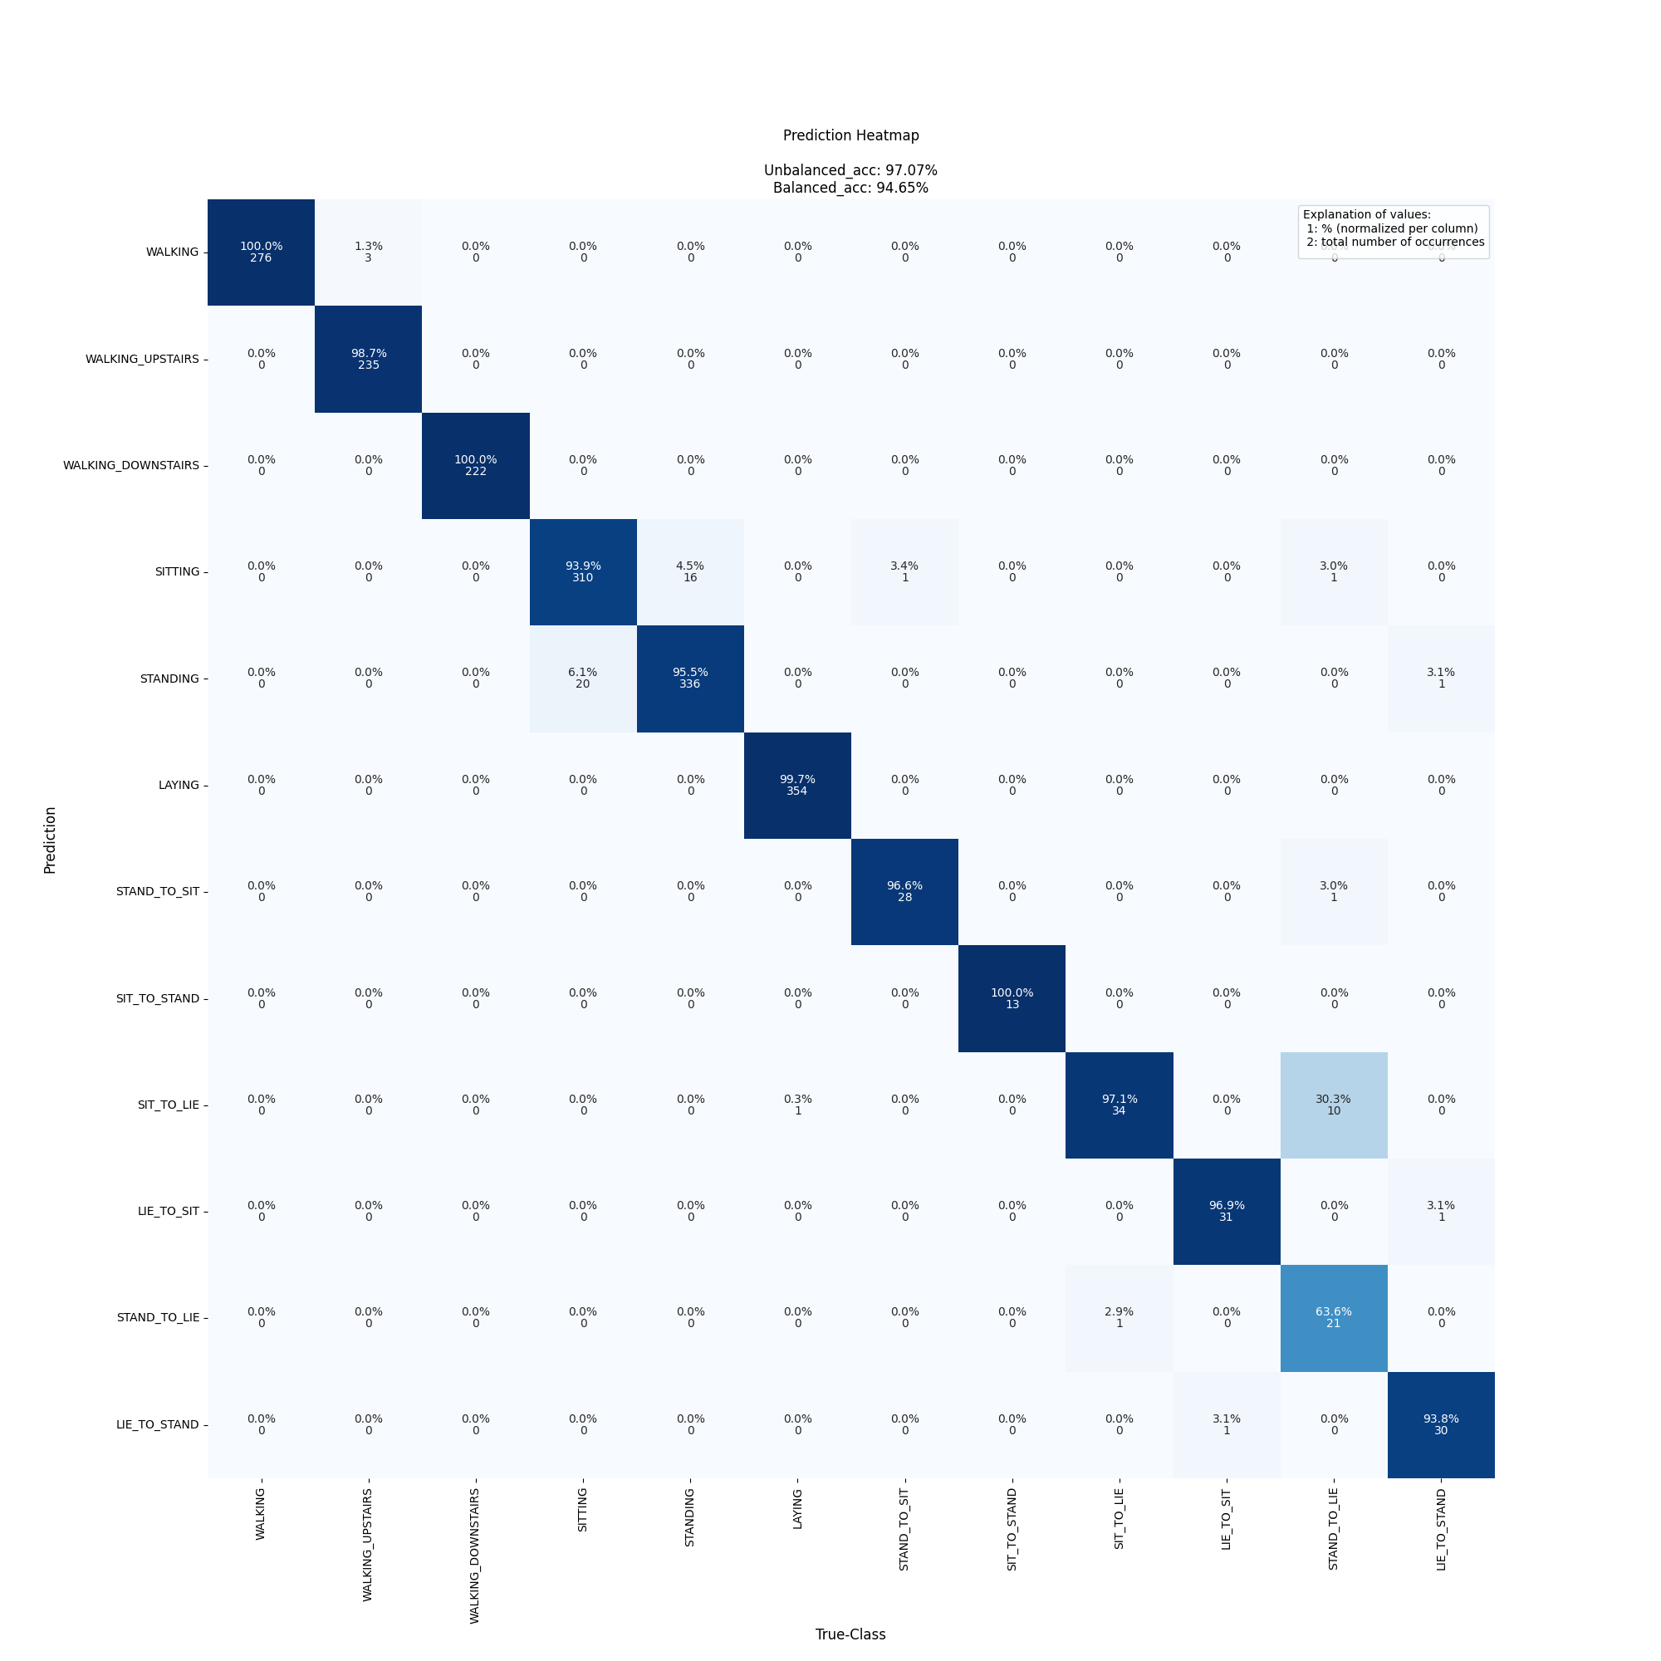
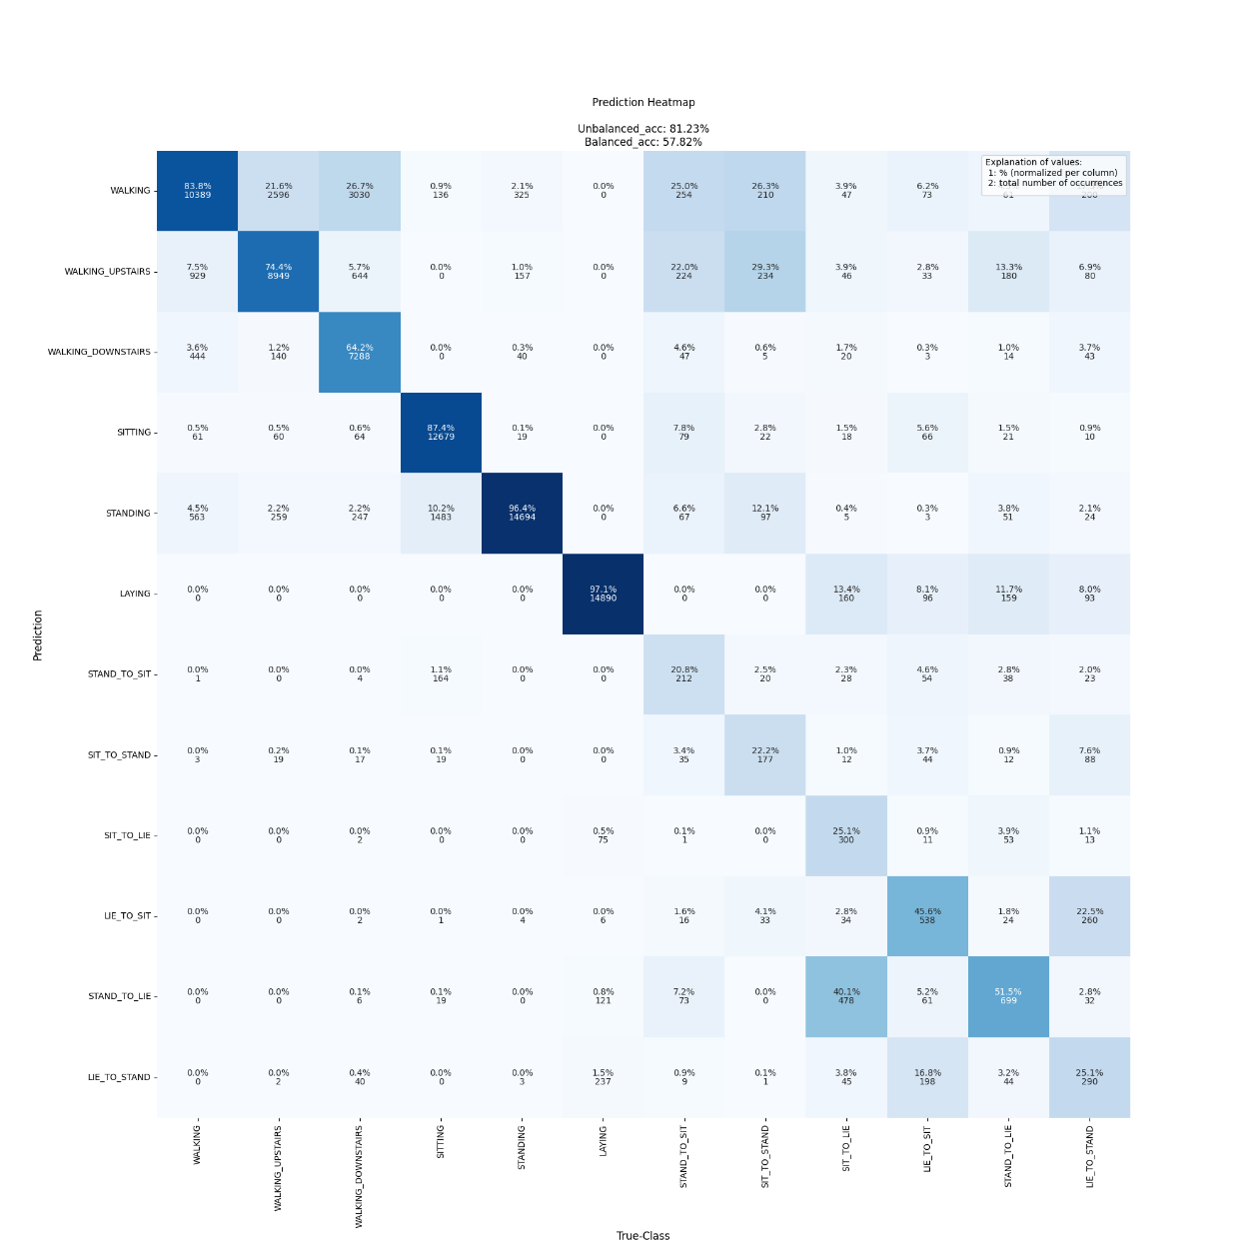
… and for which classes?
window size= 250
window size= 2
Peter Bauer & Kai Pan - 08.02.2022
Notes:
Both have use the same preprocessing (lowpass: fc=3)

