Slide 1

Investigating Amplitude Attenuation and Frequency Dispersion For a Lumped Transmission Line
Outline:
Why do we care?
Reflection of pulses
Hints of frequency attenuation
Investigating frequency relation
Data
Group velocity and further analysis
Conclusions and discussions
Leonardo Rotondi

Slide 2
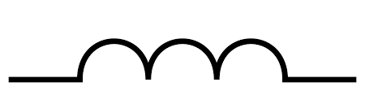
Why Do we care?
Appearance of parallel wires
Behaviour of parallel wires
Wires are everywhere!
Not as simple as they seem
The design of wires gives rise to inherent capacitance and inductance in the wires.
These can hinder our ability to send electrical signals over long distances.
1 section
Behaves as an inductor due to induced magnetic field
Parallel wires will act as capacitors
Lumped transmission line has 40 sections
10 nodes
L = 330 ± 20% μH
C = 0.015 ± 10% μF
Variable resistor placed in parallel with a switch at node 10

Slide 3
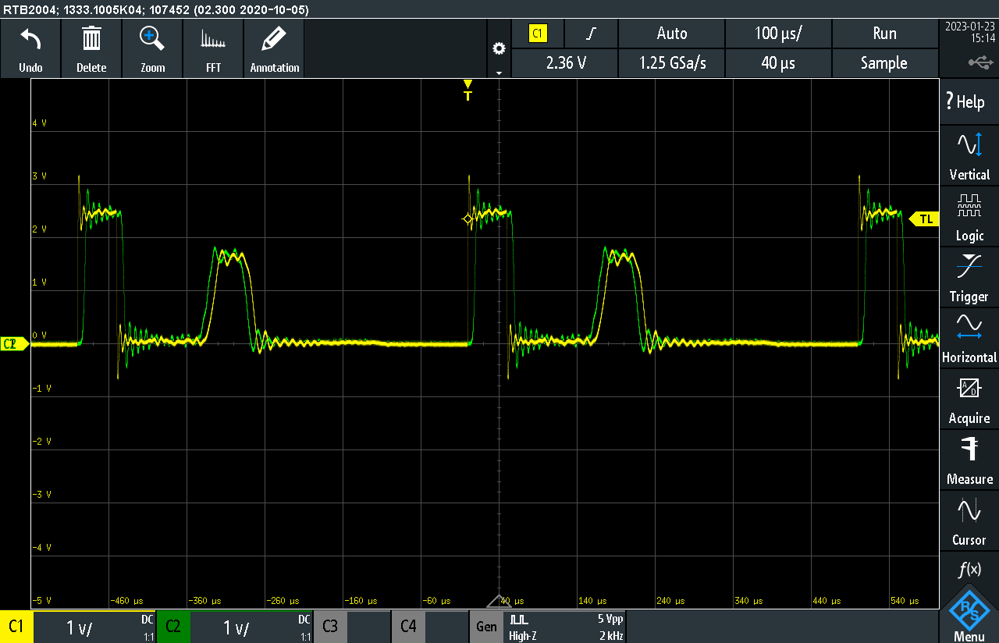
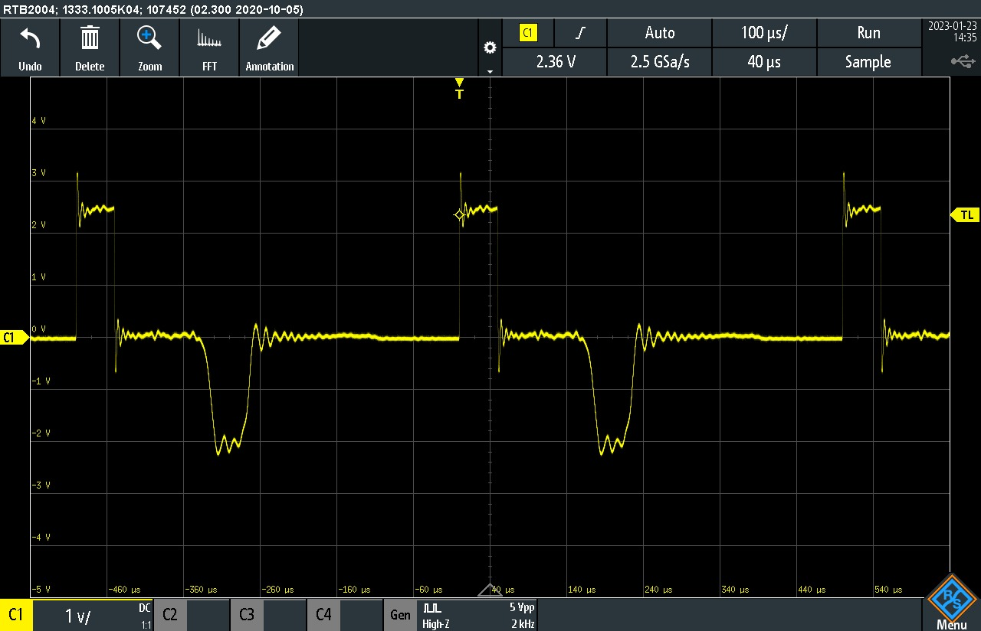

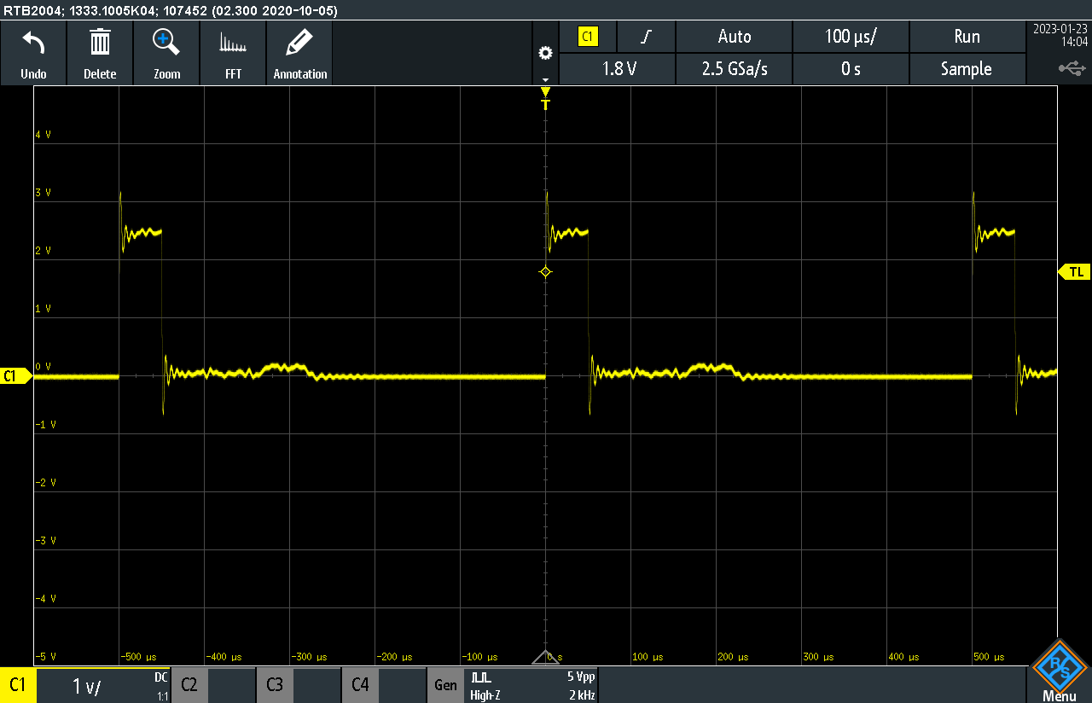

Reflection of pulses
Impedance of transmission line due to components of the line
Gives rise to reflected pulses
The cause various complications in the line
Solely reflected
Reflected and inverted
Impedances must be equal to cancel reflected signal
Variable resistor = 156.48 ± 1.73 Ω
Theoretical impedance = 148.32 ± 16.58 Ω
Expressions for the capacitor and inductor impedances contain angular frequencies (ω)
We expect the ratio of the voltages to change
No reflection
Notes:
Reduce the amount of power, and cause standing waves that damage the cables.
B is the medium of the transmission line and a is the resistor medium
In the limit where we are far below the cut-off frequency, we can use the approximation for the impedance

Slide 4



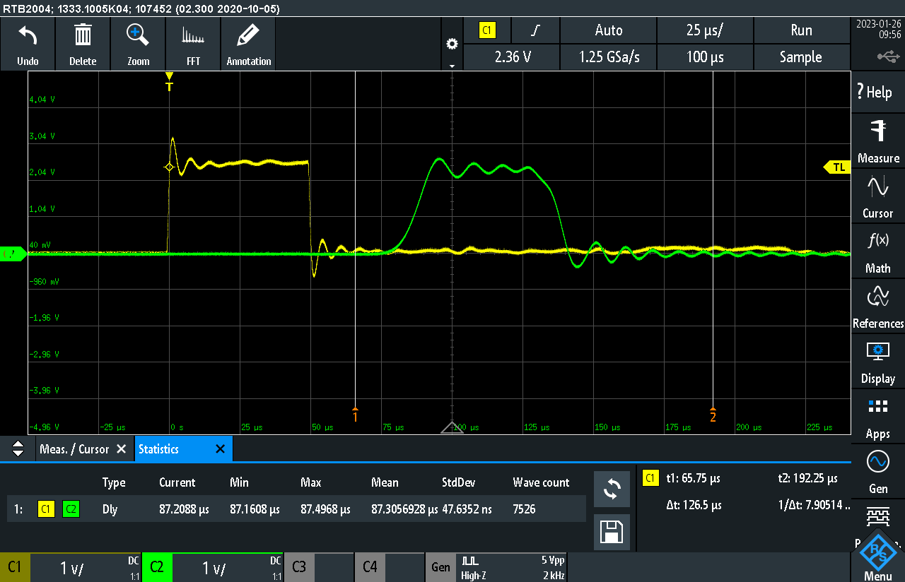
hints of frequency attenuation
Square waves appear to stretch as they propagate through the line
Square waves can be considered a Fourier series to the nth harmonic
Longer rise times imply higher frequency harmonics are supressed
Lower frequency harmonics are less affected
Effect becomes more evident further along the lumped transmission line

Slide 5
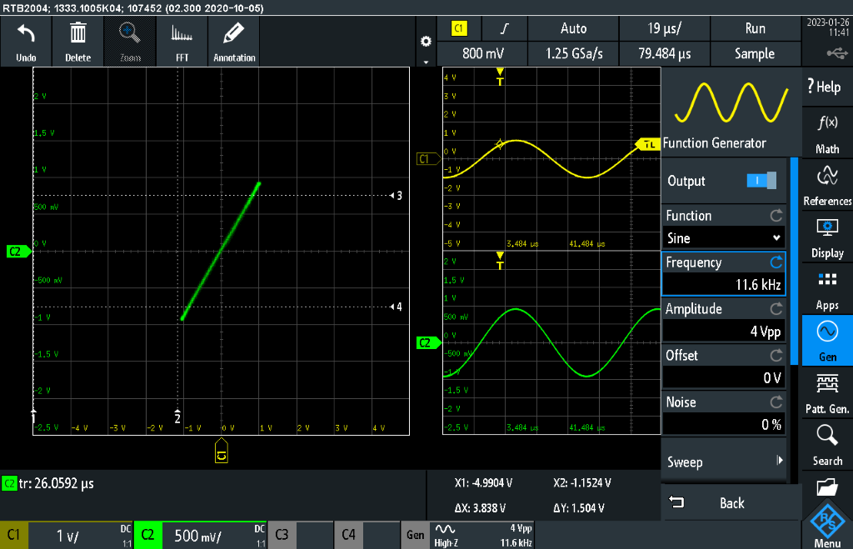
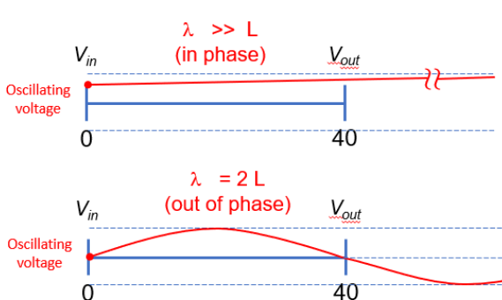
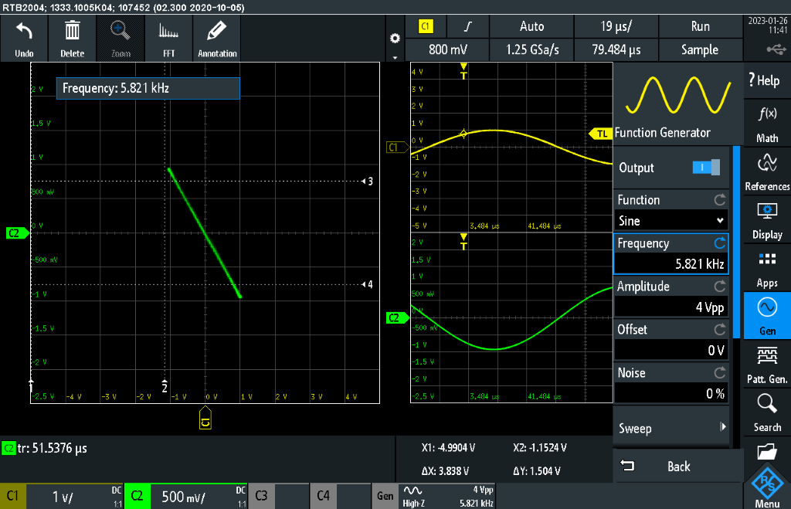
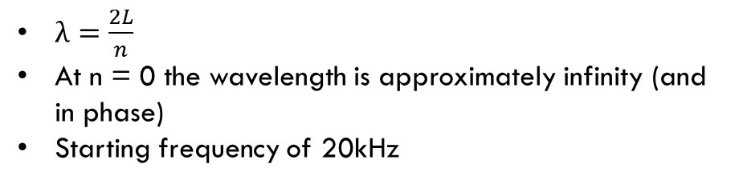
Investigating frequency relation
Square wave gave an insight on frequency attenuation
Setting up for taking data with frequency as the independent variable using sinusoidal waves
Lissajous figures allow to identify when the two waveforms are either in or out of phase.
$λ=\frac{2L}{n}$
At n = 0 the wavelength is approximately infinity (and in phase)
Starting frequency of 20kHz
Notes:
Plot of two signals against each other (XY mode)
Voltage into the transmission line and out is measured (node 0 to node 10)
Start frequency set to 20khz
Sets of data measured when the Lissajous figures alternate in and out of phase
Input of voltage form generator set to 2V. Doesn’t mean that this is the voltage when it enters the transmission line
Probes placed at node 0 and node 10
Odd n corresponds to out of phase
Even n to in phase

Slide 6
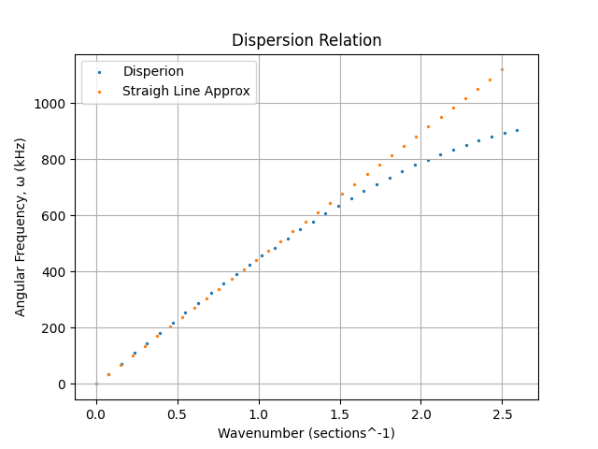
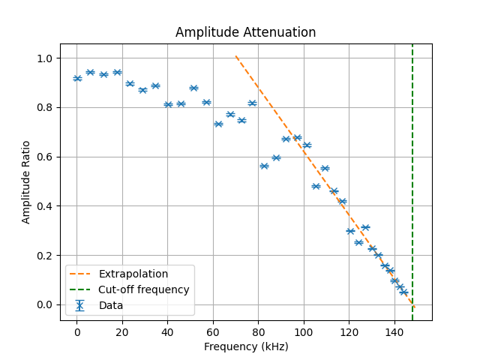
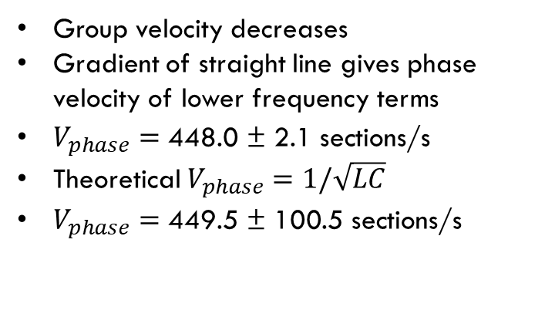
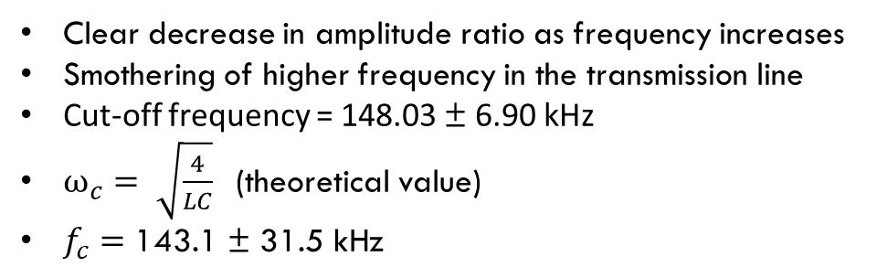
Data
Clear decrease in amplitude ratio as frequency increases
Smothering of higher frequency in the transmission line
Cut-off frequency = 148.03 ± 6.90 kHz
$ω_{c}= \sqrt{\frac{4}{LC}}$ (theoretical value)
$f_{c}=\text{143.1} \text{±} \text{31.5 }\text{kHz}$
Group velocity decreases
Gradient of straight line gives phase velocity of lower frequency terms
$V_{phase}=\text{448.0} \text{±} \text{2.1 }\text{sections}\text{/}\text{s}$
Theoretical $V_{phase}=1/\sqrt{LC}$
$V_{phase}=\text{449.5} \text{±} \text{100.5 }\text{sections}\text{/}\text{s}$
Notes:
Wavenumber = k = 2pi/lambda

Slide 7
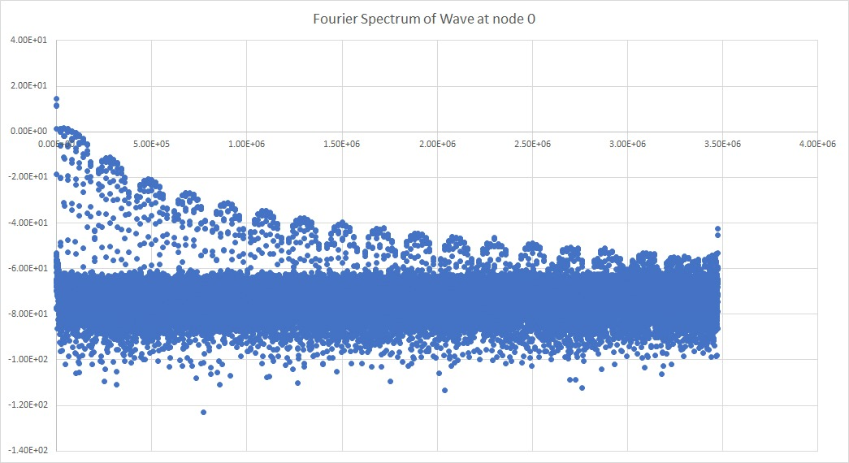
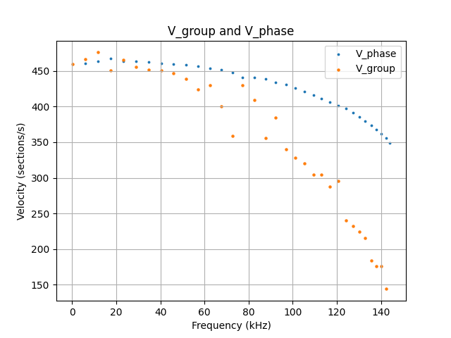
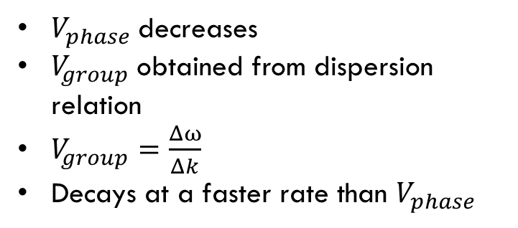
Group velocity and Further analysis
$V_{phase}$decreases
$V_{group}$obtained from dispersion relation
$V_{group}=\frac{Δω}{Δk}$
Decays at a faster rate than $V_{phase}$
Taking the Fourier transform of the signal at node 0
Shows clear amplitude attenuation
Successive spikes decrease in amplitude

Slide 8
Conclusions and Discussions
Amplitude attenuation as frequency increases
Higher frequency signals travel slower
Group velocity decreases as more frequencies are added
Short cables barely are affected
Longer cables such as transmission lines will experience these effects
Complicated signals will be smothered
Single, low frequencies are most efficient
Dimensions can change inherent characteristics of wires

