Slide 1
Portland Crime Analysis: 2004-2014
Crime statistics from data gathered by the Portland Police Bureau

Slide 2
Questions:
How has crime changed?
What factors have a significant effect on these changes?
Do different types of crime change differently?
How does geography and neighborhood composition affect crime rates?
What questions about crime might we be able to answer with more information?

Slide 3
Data Sources
http://www.civicapps.org/datasets
This is the source of crime-related data for the project. It is recorded by the Portland Police Bureau, cleaned, and made available to the public with identifying information removed from each record. Variables such as the date and time of report, major offense type, and location information for each incident are provided.
https://data.bls.gov/pdq
This dataset includes unemployment information for Portland from January 2004 to December 2014.
https://www.biggestuscities.com/city/portland-oregon
Source for population (estimates) for Portland for January 1 of each year of interest. No source of information or margin of error is given with the data, so it is accepted without total confidence in its veracity.
https://www.portlandoregon.gov/oni/56897
Neighborhood information on Portland’s 95 neighborhoods gathered from the 2010 US Census. In particular, the data on racial composition of the various neighborhoods was utilized for this project.

Slide 4
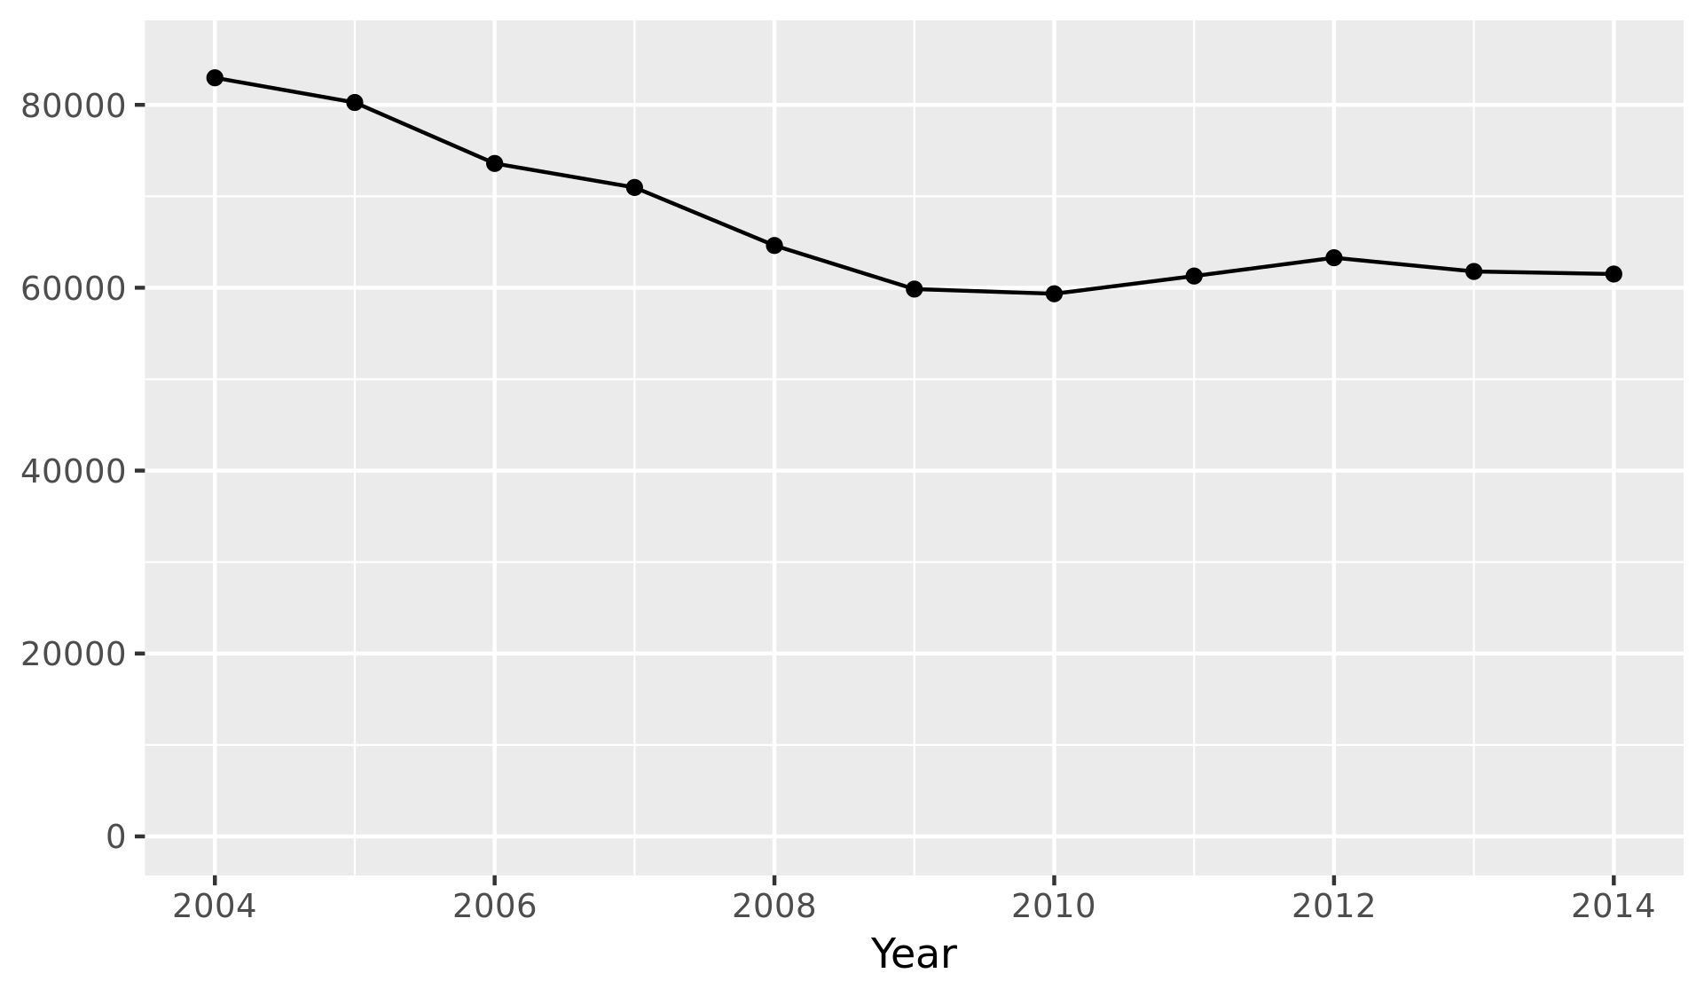
Crime Reports per Year
Correlation coefficient: r = -0.848

Slide 5
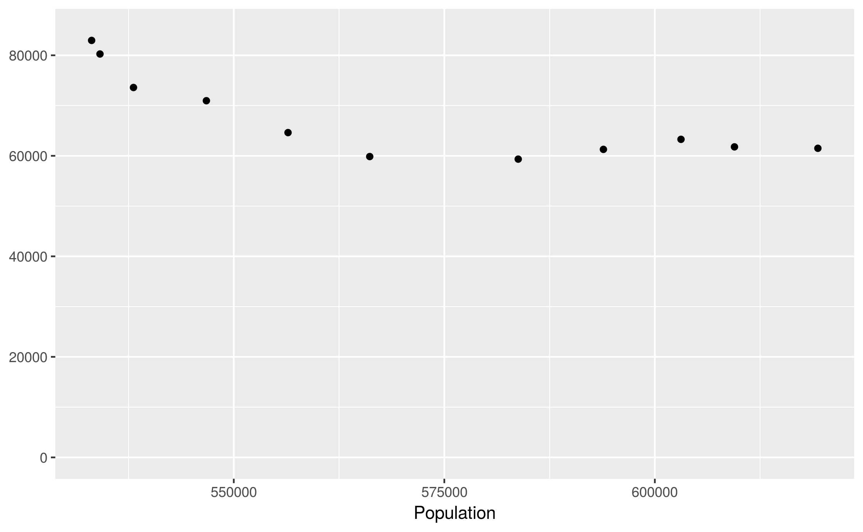
Correlation Between Crime and Population
r = -0.799

Slide 6
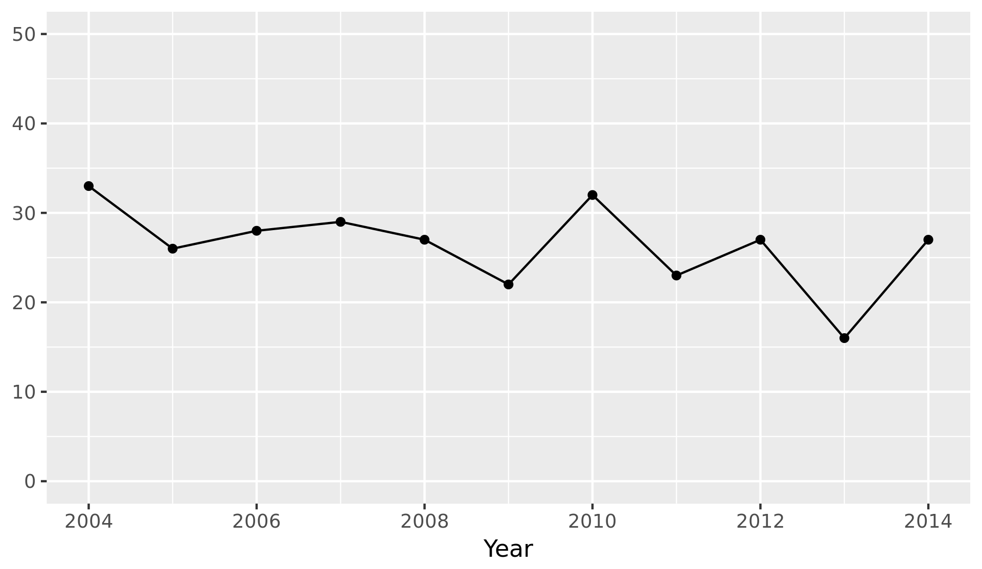
Homicides per Year
Mean homicides per year: 26.4
Standard deviation: 4.74

Slide 7
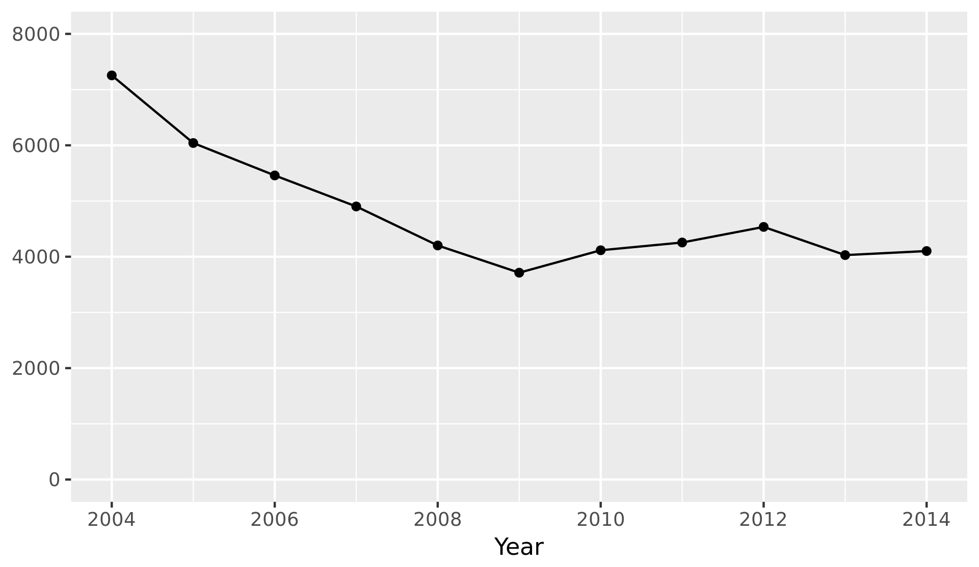
Burglaries per Year
Mean burglaries per year: 4783
Standard deviation: 1071

Slide 8
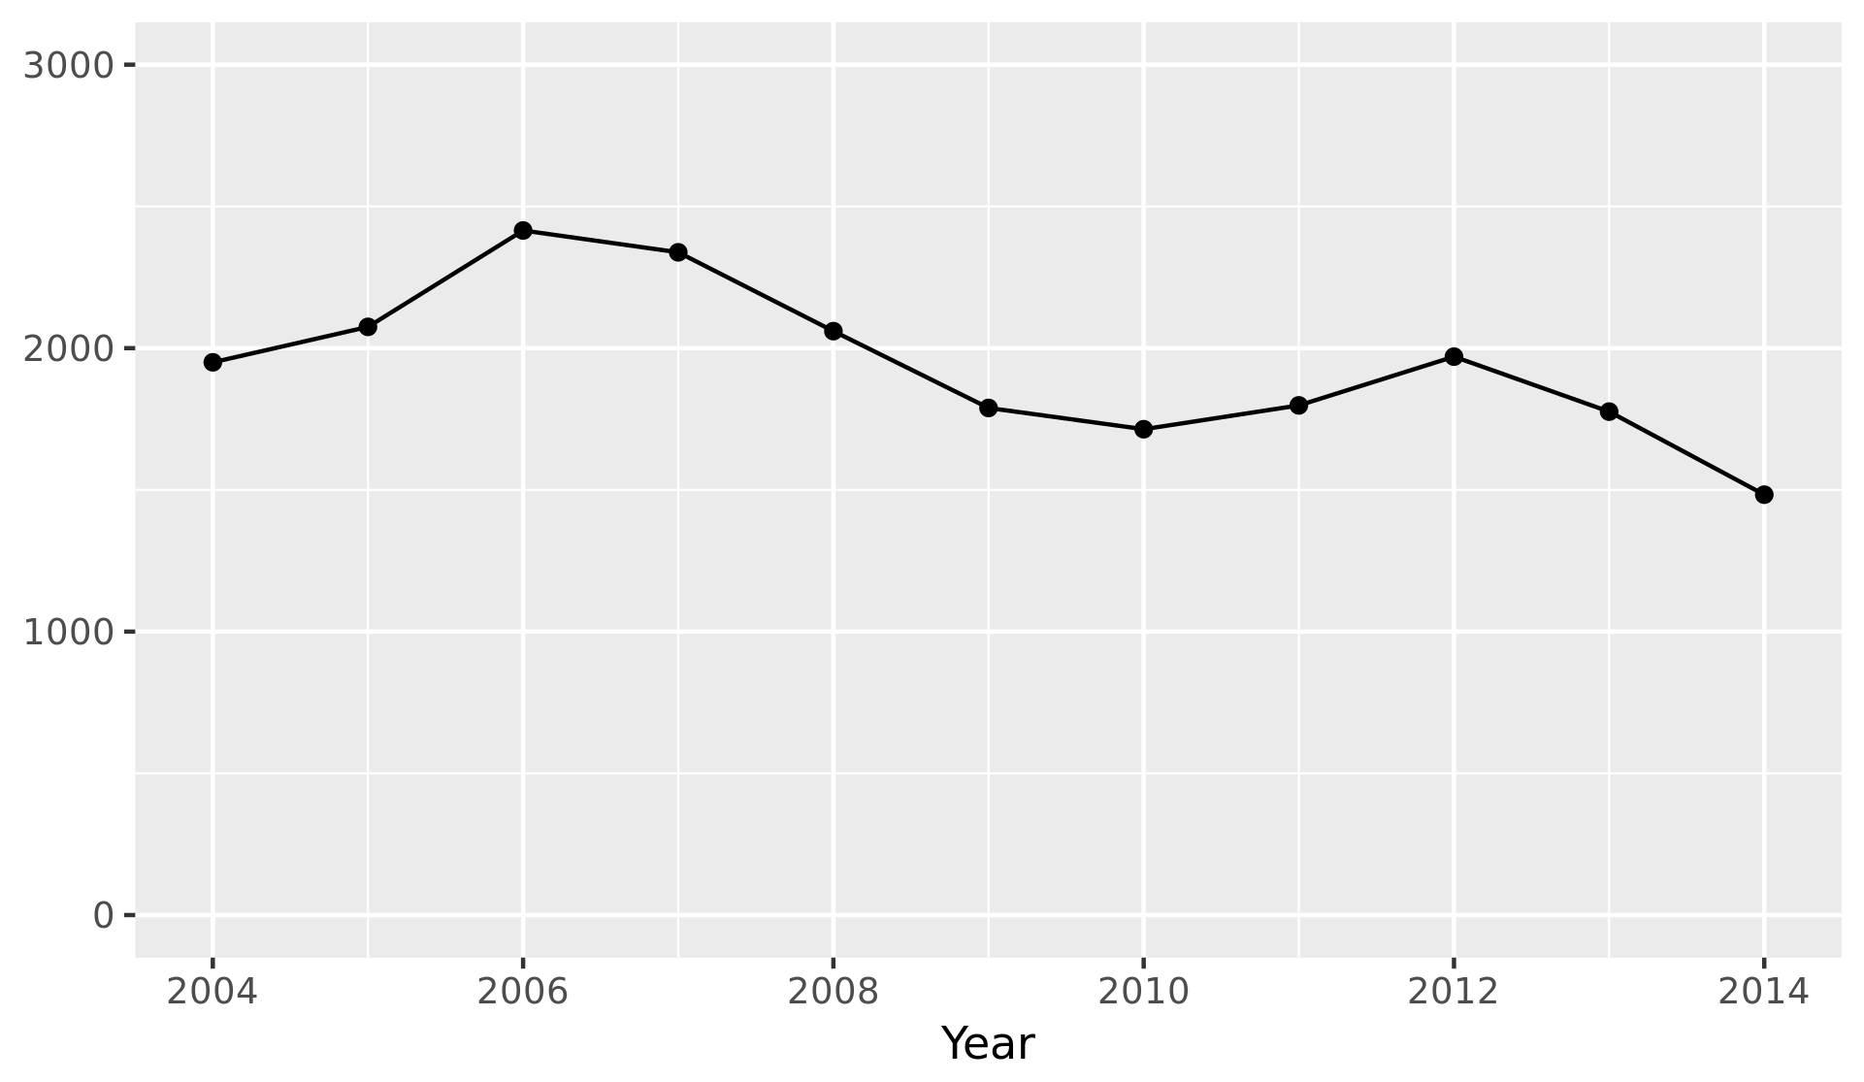
DUII Offenses per Year
Mean homicides per year: 1943
Standard deviation: 274

Slide 9
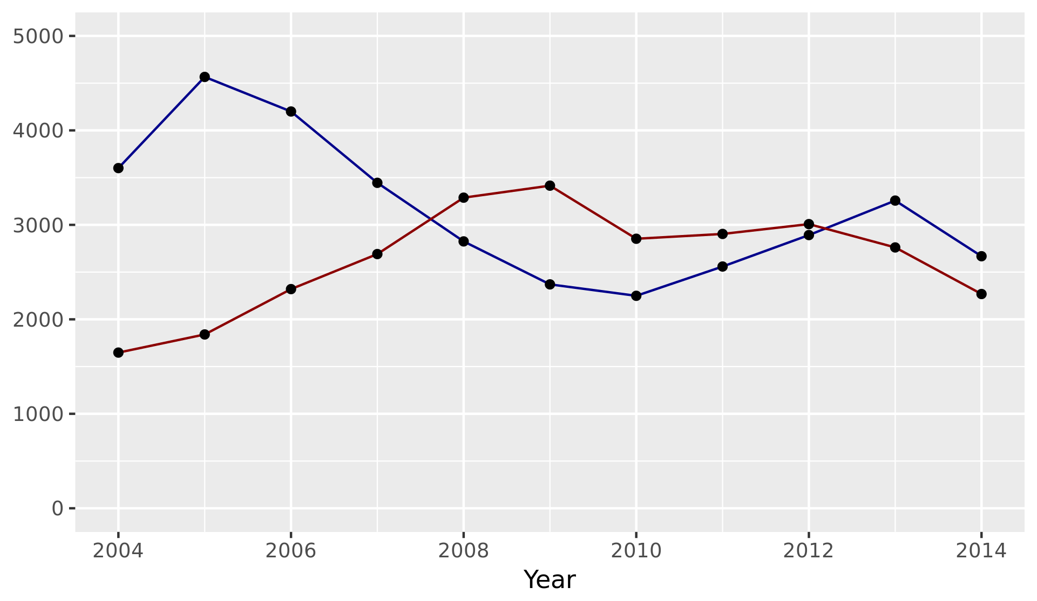
Liquor Law and Drug Offenses per Year

Slide 10
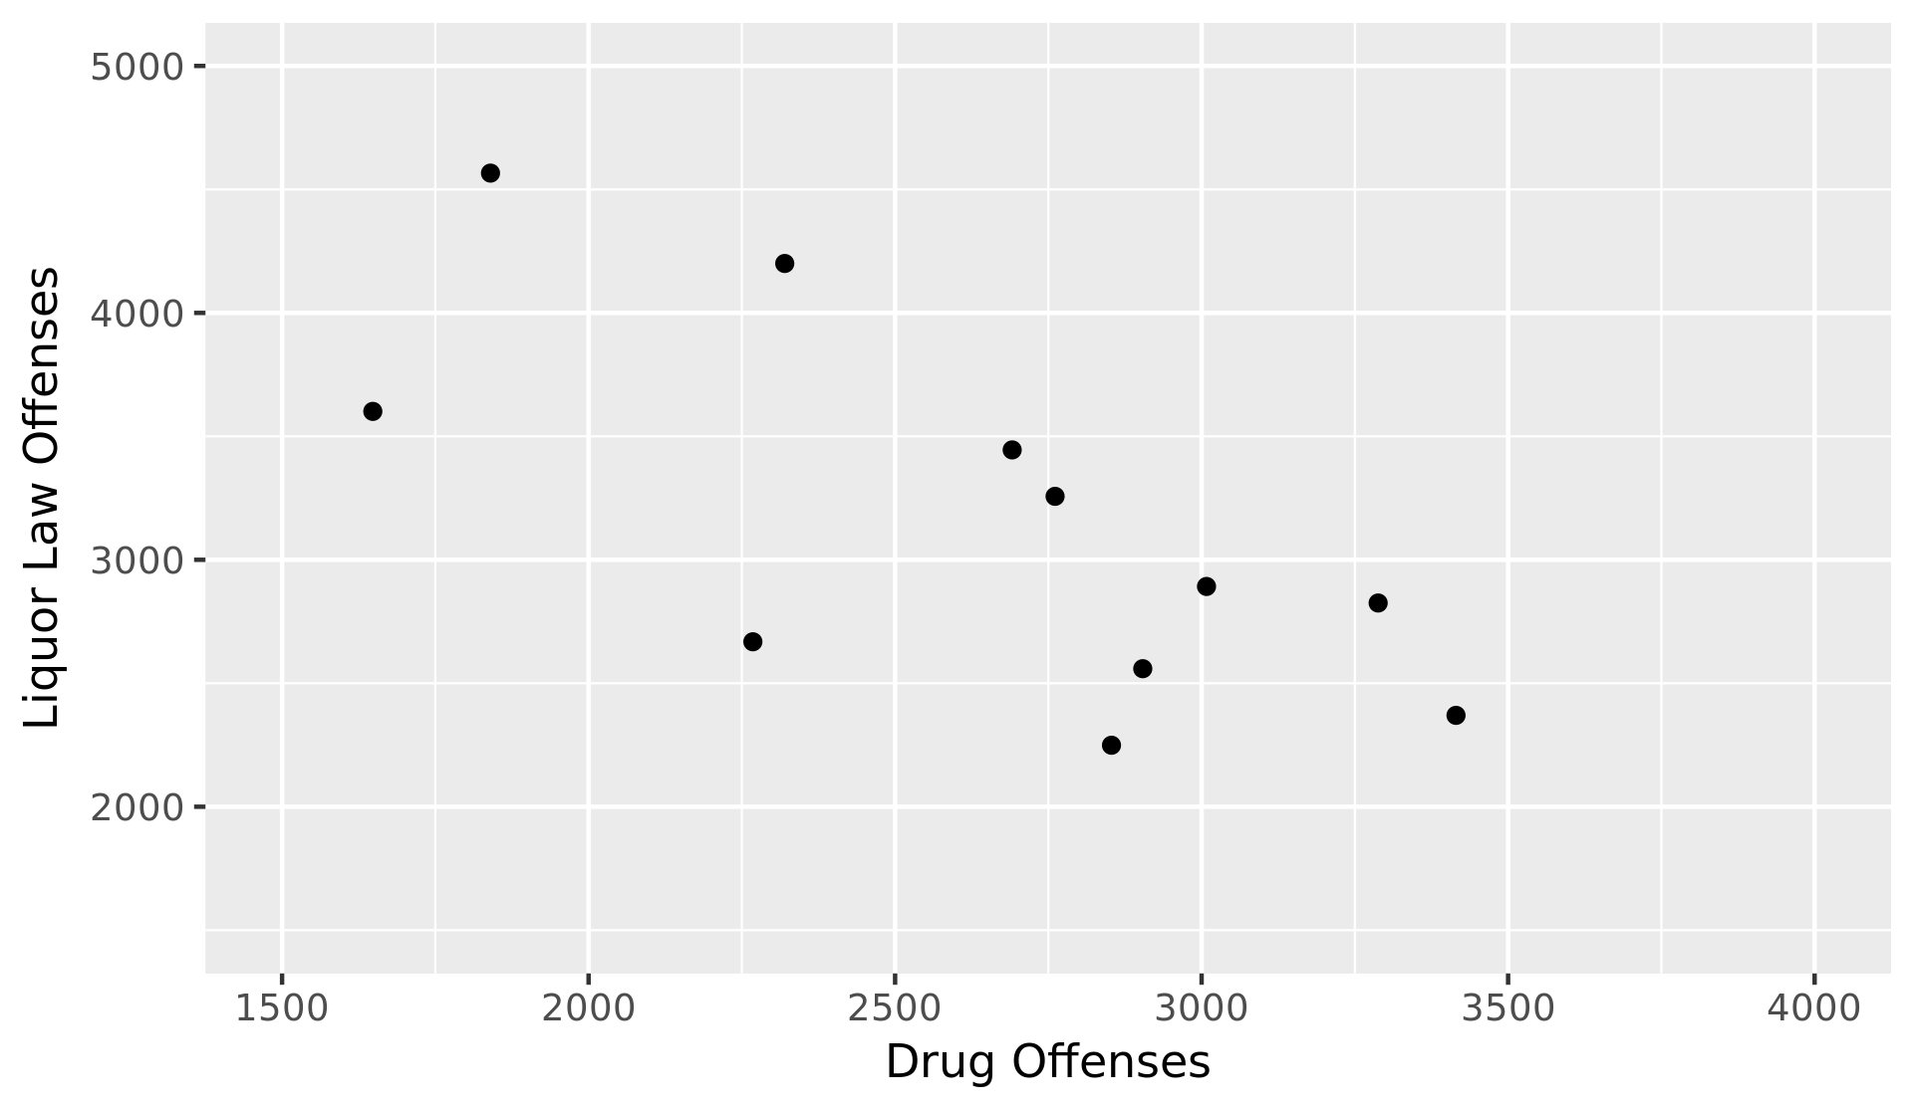
Correlation Between Liquor Law and Drug Offenses
r = -0.707

Slide 11
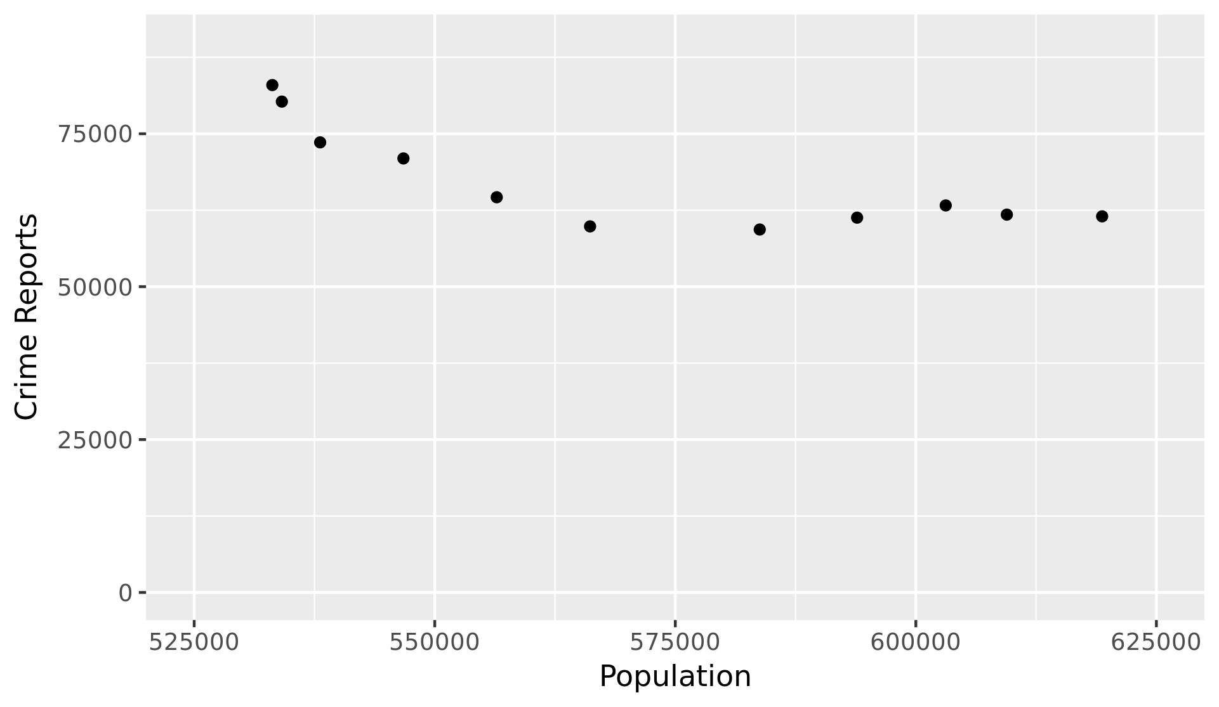
Correlation Between Population and Total Crime Reports
r = -0.799

Slide 12
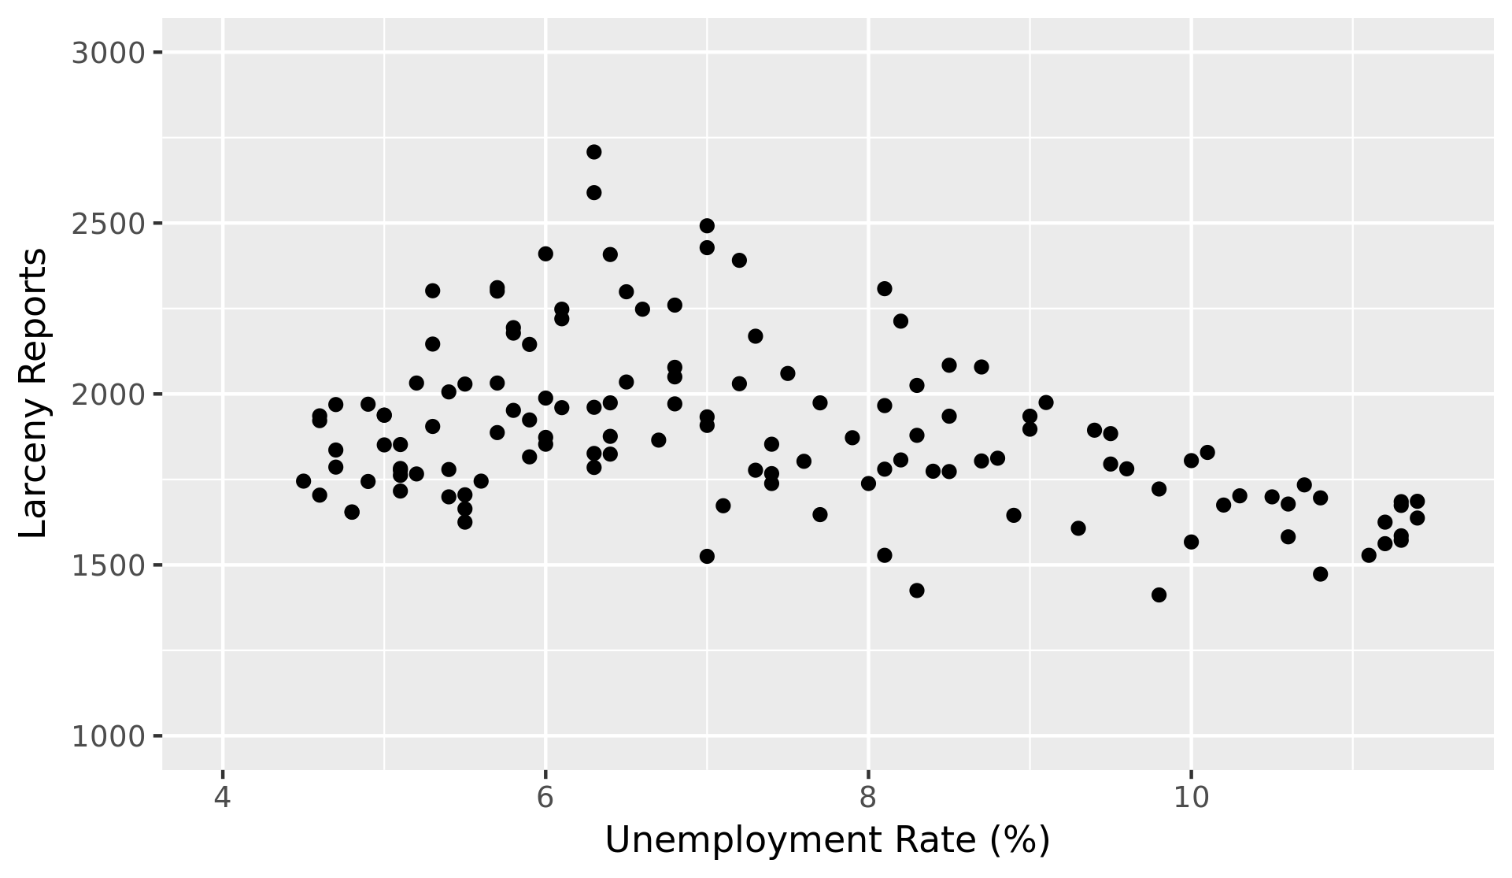
Relationship Between Unemployment and Larceny
r = -0.382

Slide 13
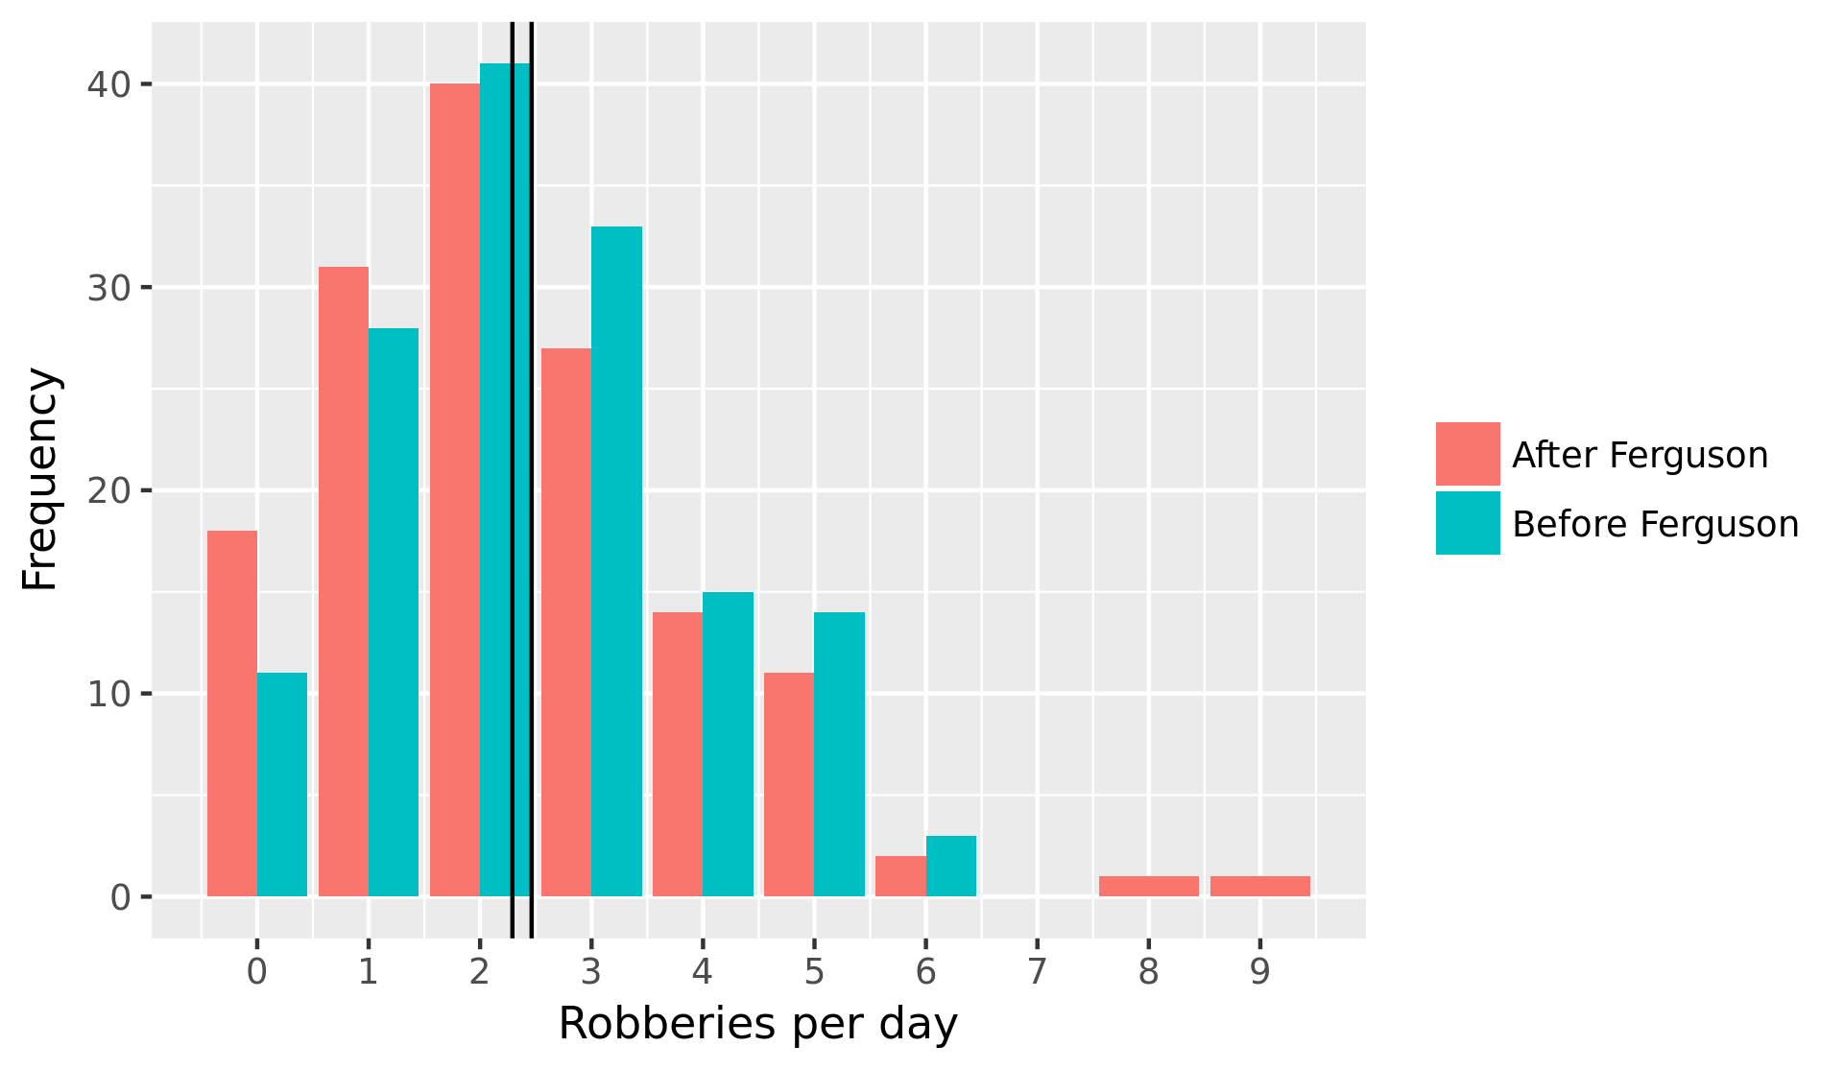
The “Ferguson Effect”
Pre-Ferguson mean: 2.46 robberies per day
Post-Ferguson mean: 2.29 robberies per day

Slide 14
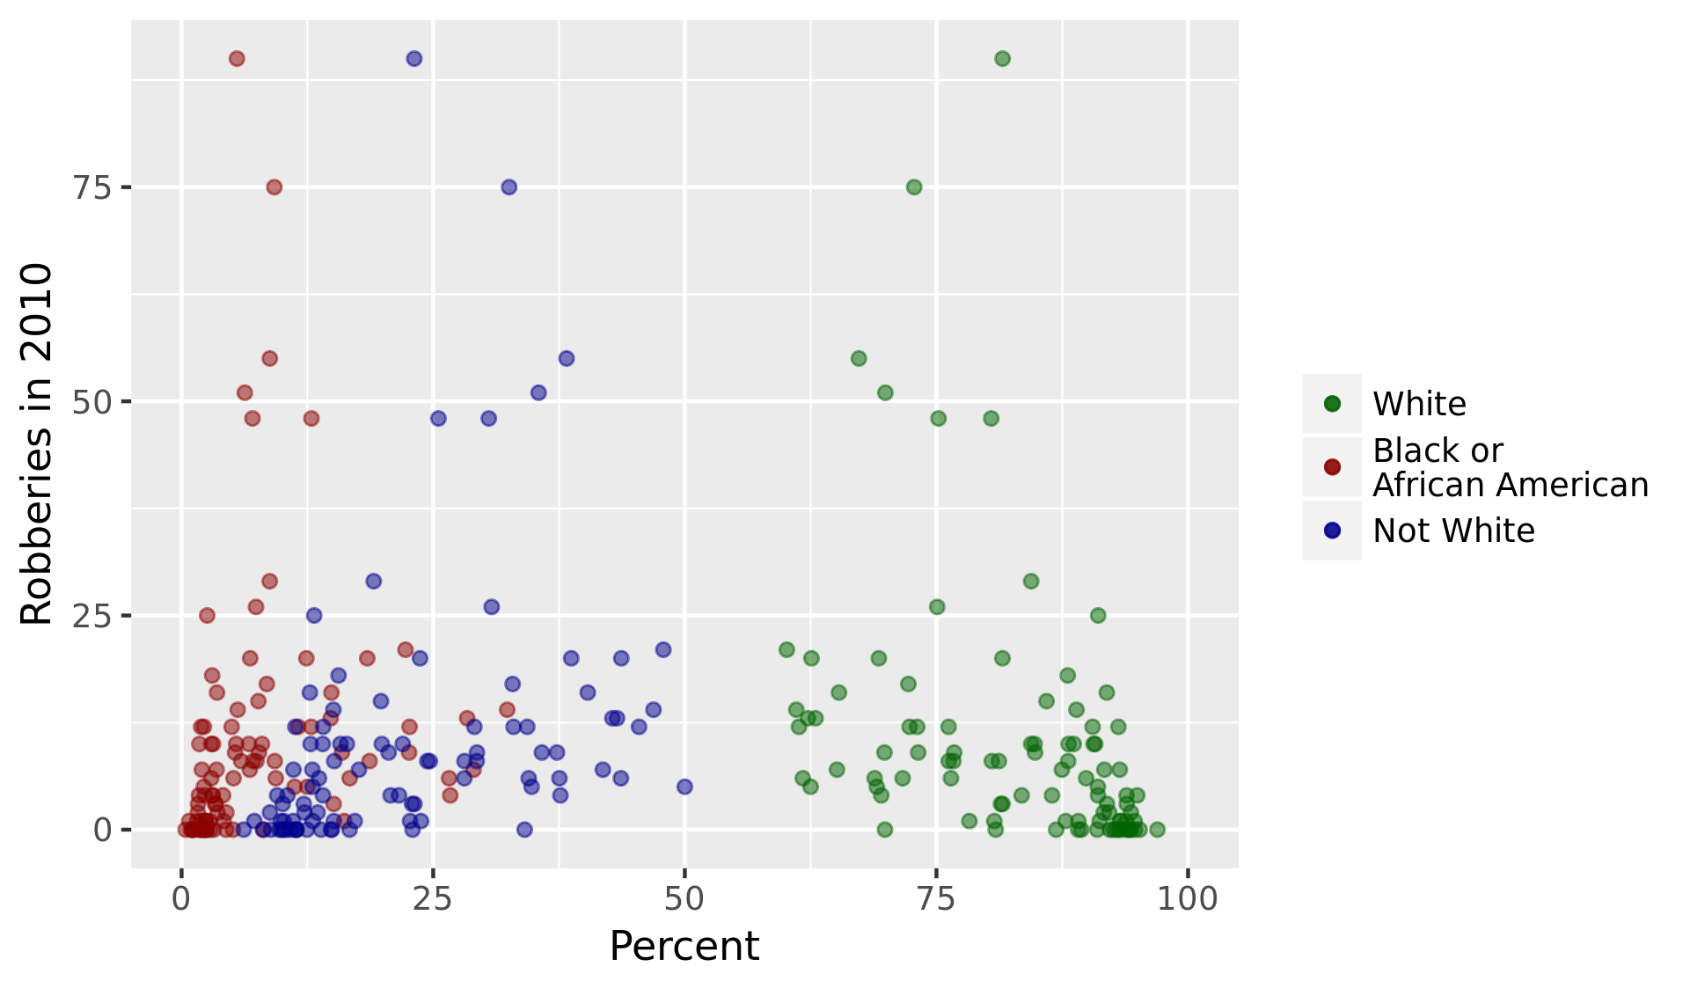
Effect of Neighborhood Racial Demographics
Correlation coefficient for percent white: -0.347
Correlation coefficient for percent black or African American: 0.169
Correlation coefficient for percent not white: 0.342

