Slide 1
Portland Crime Analysis: 2004-2014
Crime statistics from data gathered by the Portland Police Bureau

Slide 2
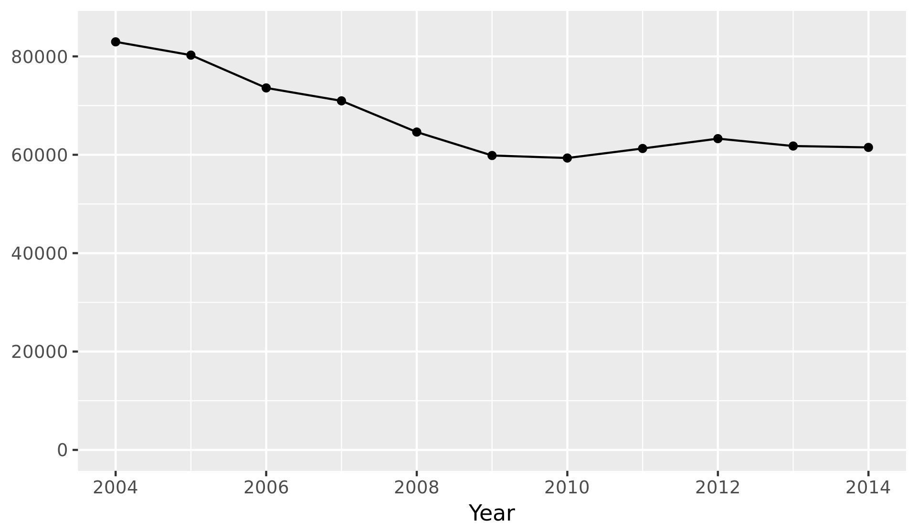
Crime Reports per Year

Slide 3
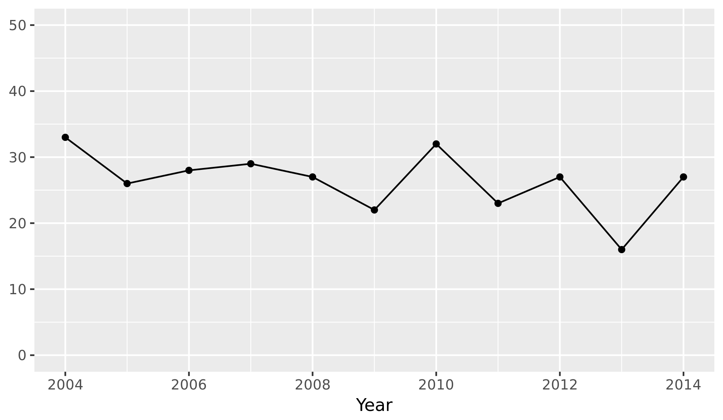
Homicides per Year
Mean homicides per year: 26.4
Standard deviation: 4.74

Slide 4
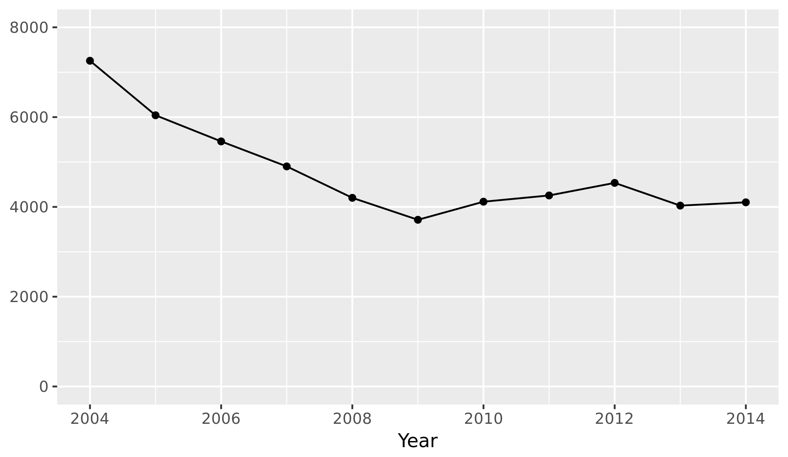
Burglaries per Year
Mean burglaries per year: 4783
Standard deviation: 1071

Slide 5
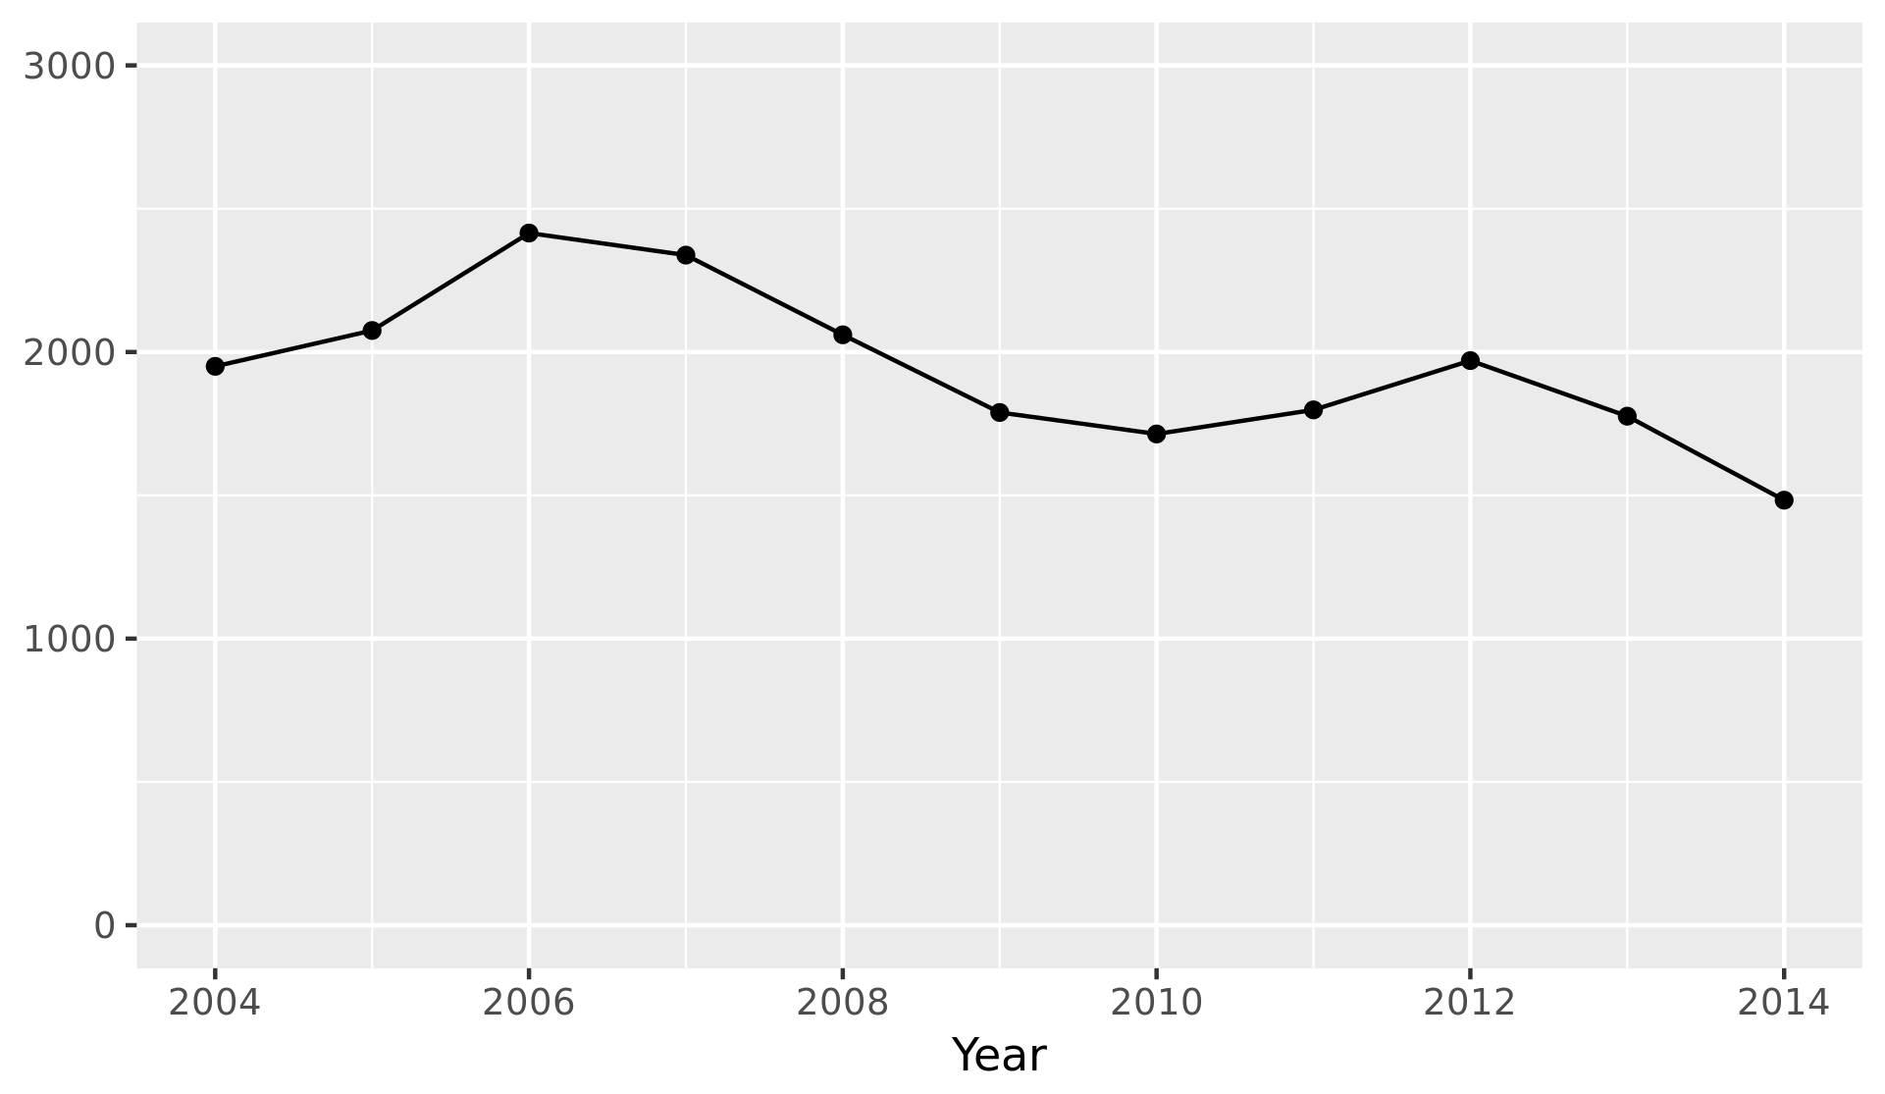
DUII Offenses per Year
Mean homicides per year: 1943
Standard deviation: 274

Slide 6
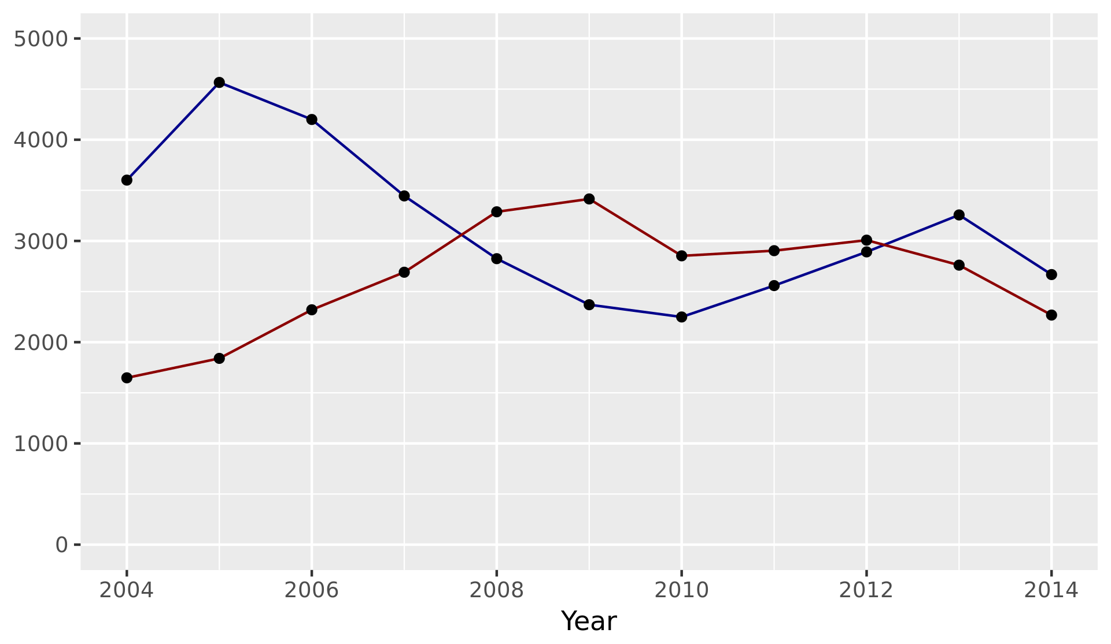
Liquor Law and Drug Offenses per Year

Slide 7
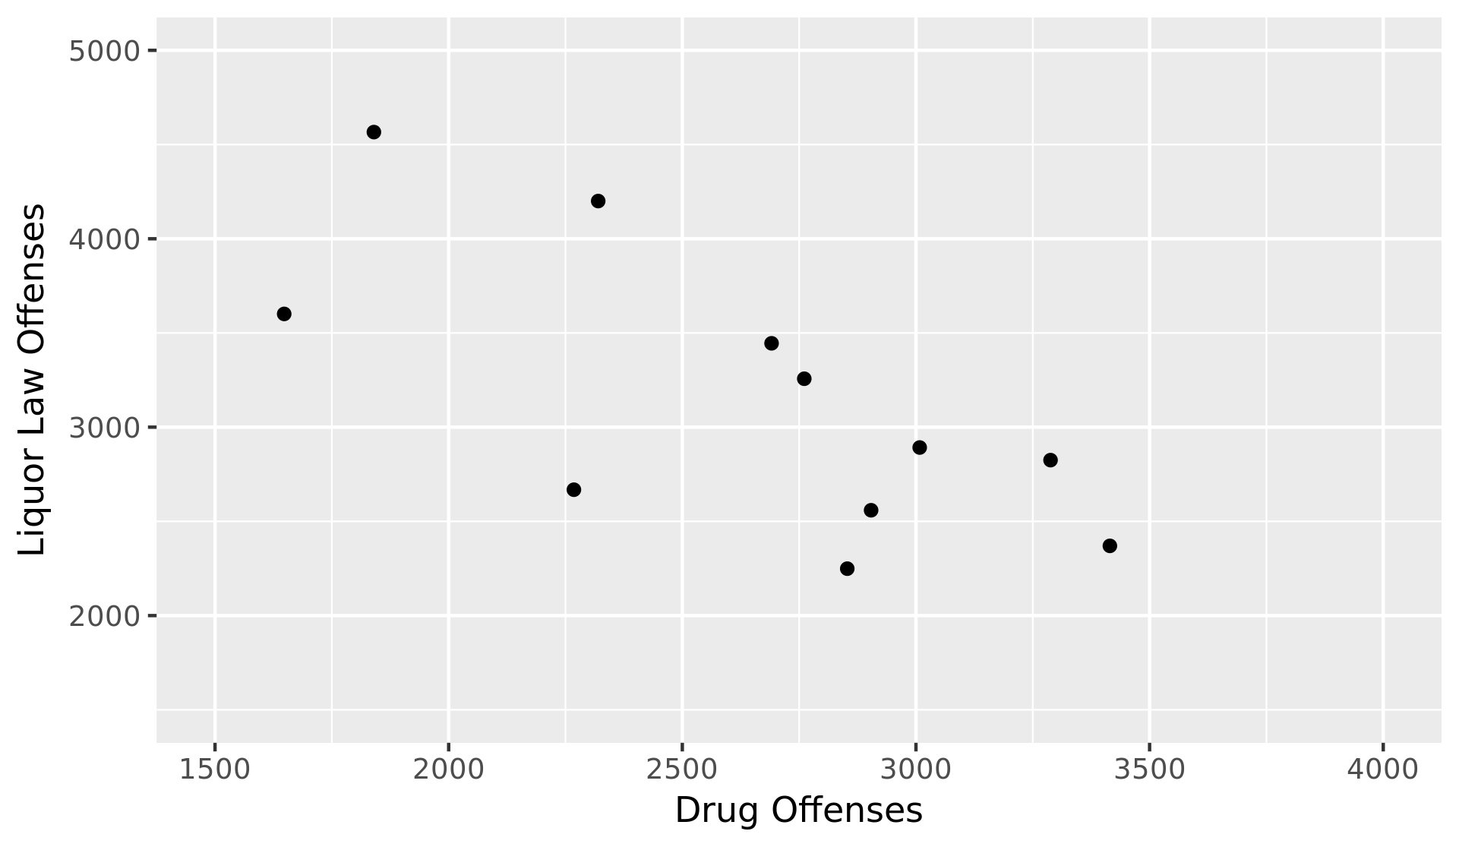
Correlation Between Liquor Law and Drug Offenses
r = -0.707

Slide 8
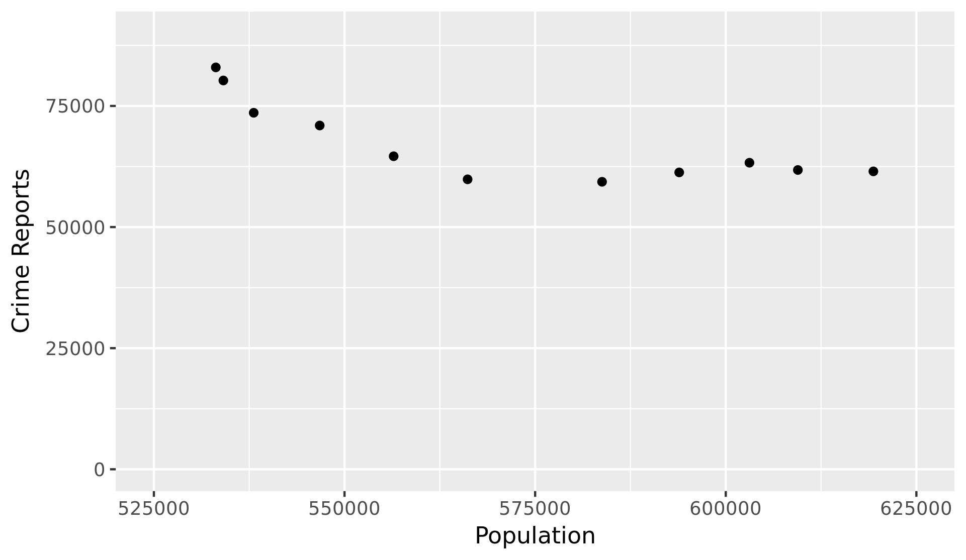
Correlation Between Population and Total Crime Reports
r = -0.799

Slide 9
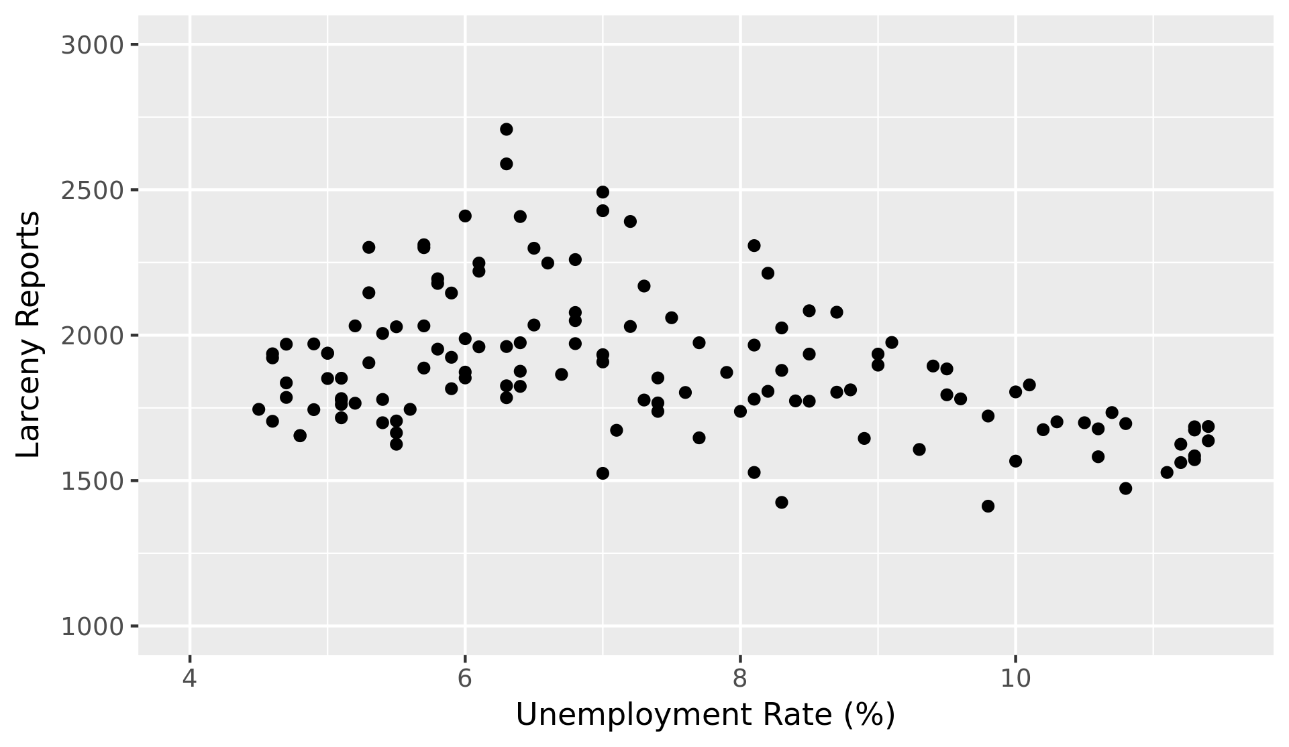
Relationship Between Unemployment and Larceny
r = -0.382

Slide 10
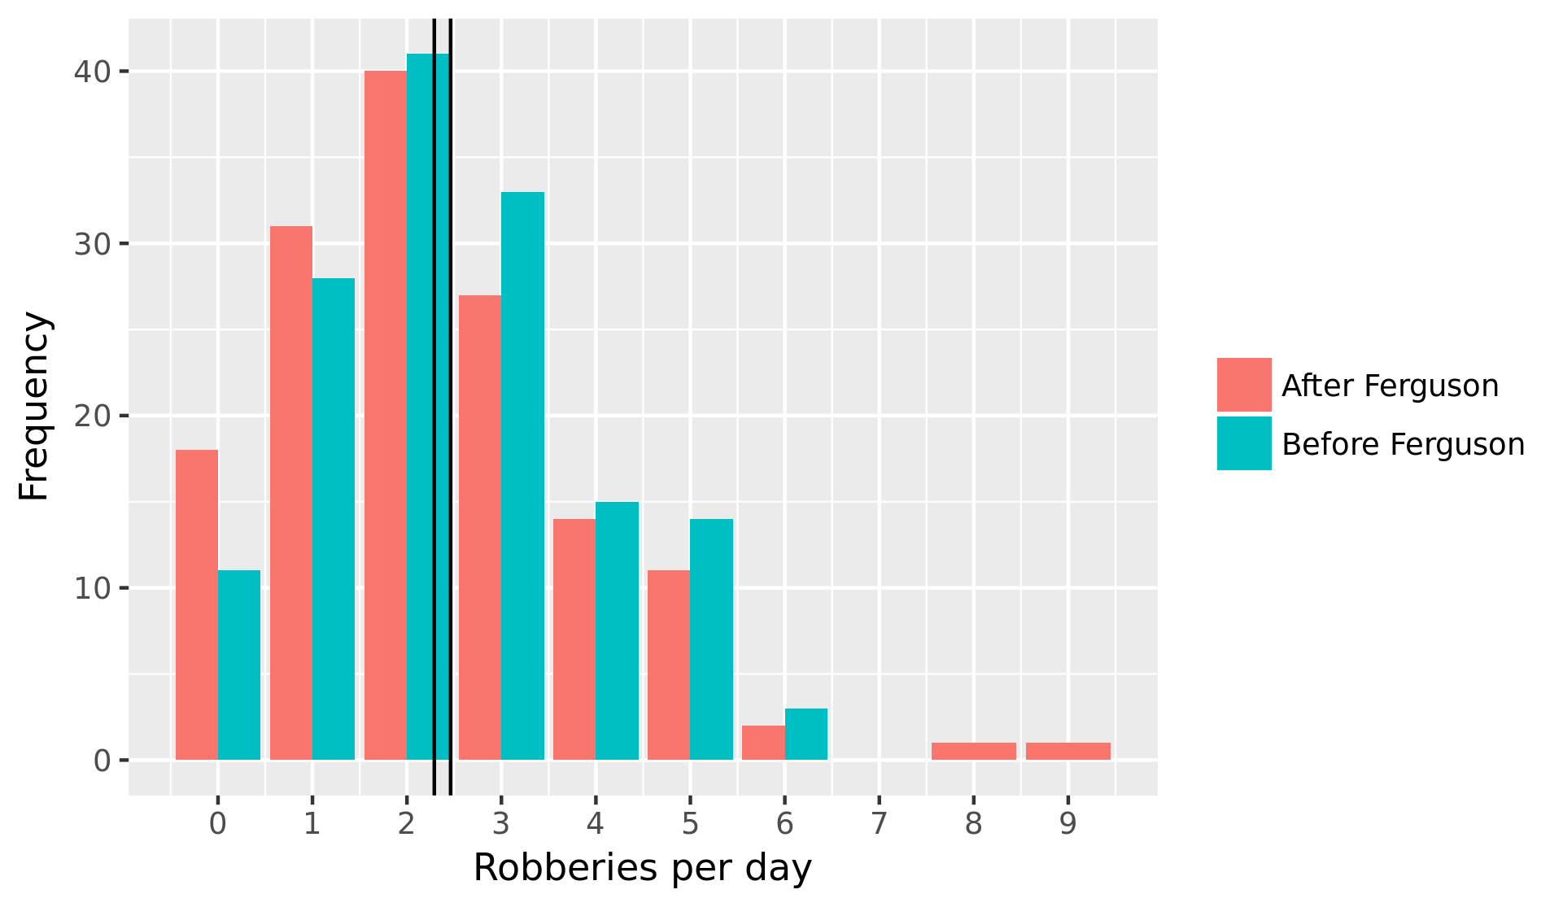
The “Ferguson Effect”
Pre-Ferguson mean: 2.46 robberies per day
Post-Ferguson mean: 2.29 robberies per day

Slide 11
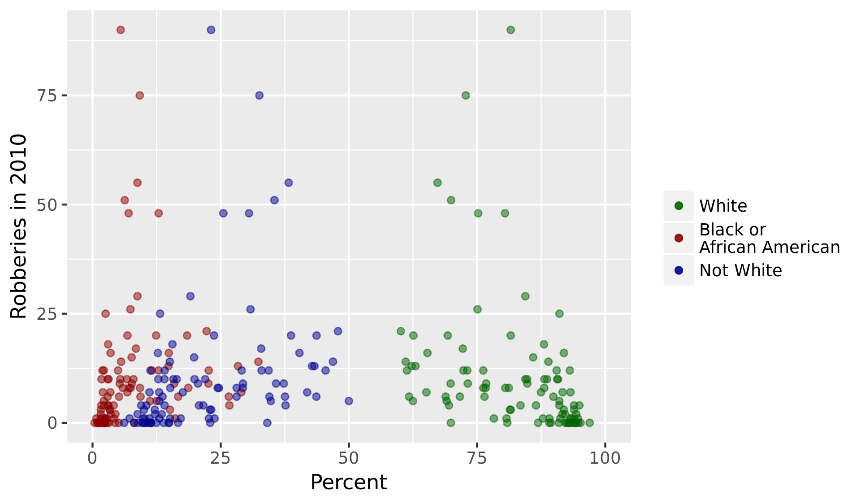
Effect of Neighborhood Racial Demographics
Correlation coefficient for percent white: -0.347
Correlation coefficient for percent black or African American: 0.169
Correlation coefficient for percent not white: 0.342

