Slide 1
Portland Crime Analysis:
2004-2014
Crime statistics from data gathered by the Portland Police Bureau

Slide 2
Questions:
How has crime changed?
What factors have a significant effect on these changes?
Do different types of crime change differently?
How does geography and neighborhood composition affect crime rates?
What questions about crime might we be able to answer with more information?

Slide 3
Data Sources
http://www.civicapps.org/datasets
This is the source of crime-related data for the project. It is recorded by the Portland Police Bureau, cleaned, and made available to the public with identifying information removed from each record. Variables such as the date and time of report, major offense type, and location information for each incident are provided.
https://data.bls.gov/pdq
This dataset includes unemployment information for Portland from January 2004 to December 2014.
https://www.biggestuscities.com/city/portland-oregon
Source for population (estimates) for Portland for January 1 of each year of interest. No source of information or margin of error is given with the data, so it is accepted without total confidence in its veracity.
https://www.portlandoregon.gov/oni/56897
Neighborhood information on Portland’s 95 neighborhoods gathered from the 2010 US Census. In particular, the data on racial composition of the various neighborhoods was utilized for this project.

Slide 4
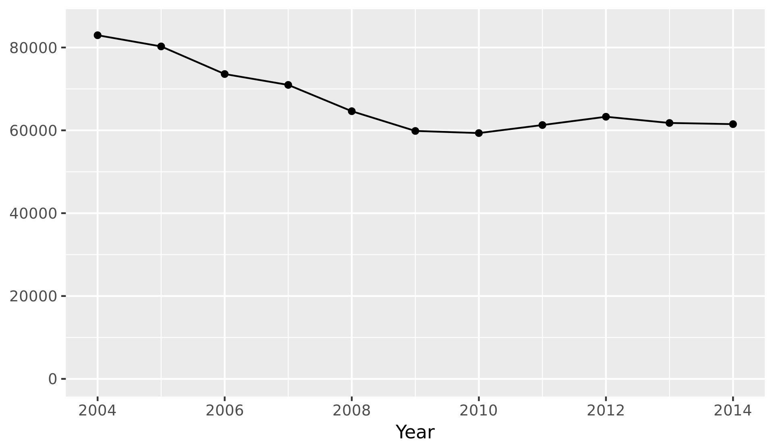
Crime Reports per Year
Correlation coefficient: r = -0.848

Slide 5
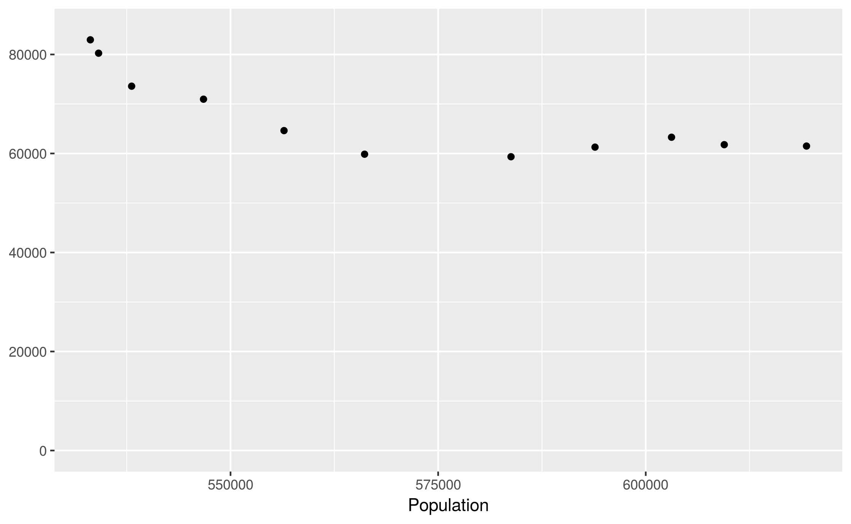
Correlation Between
Crime and Population
r = -0.799

Slide 6
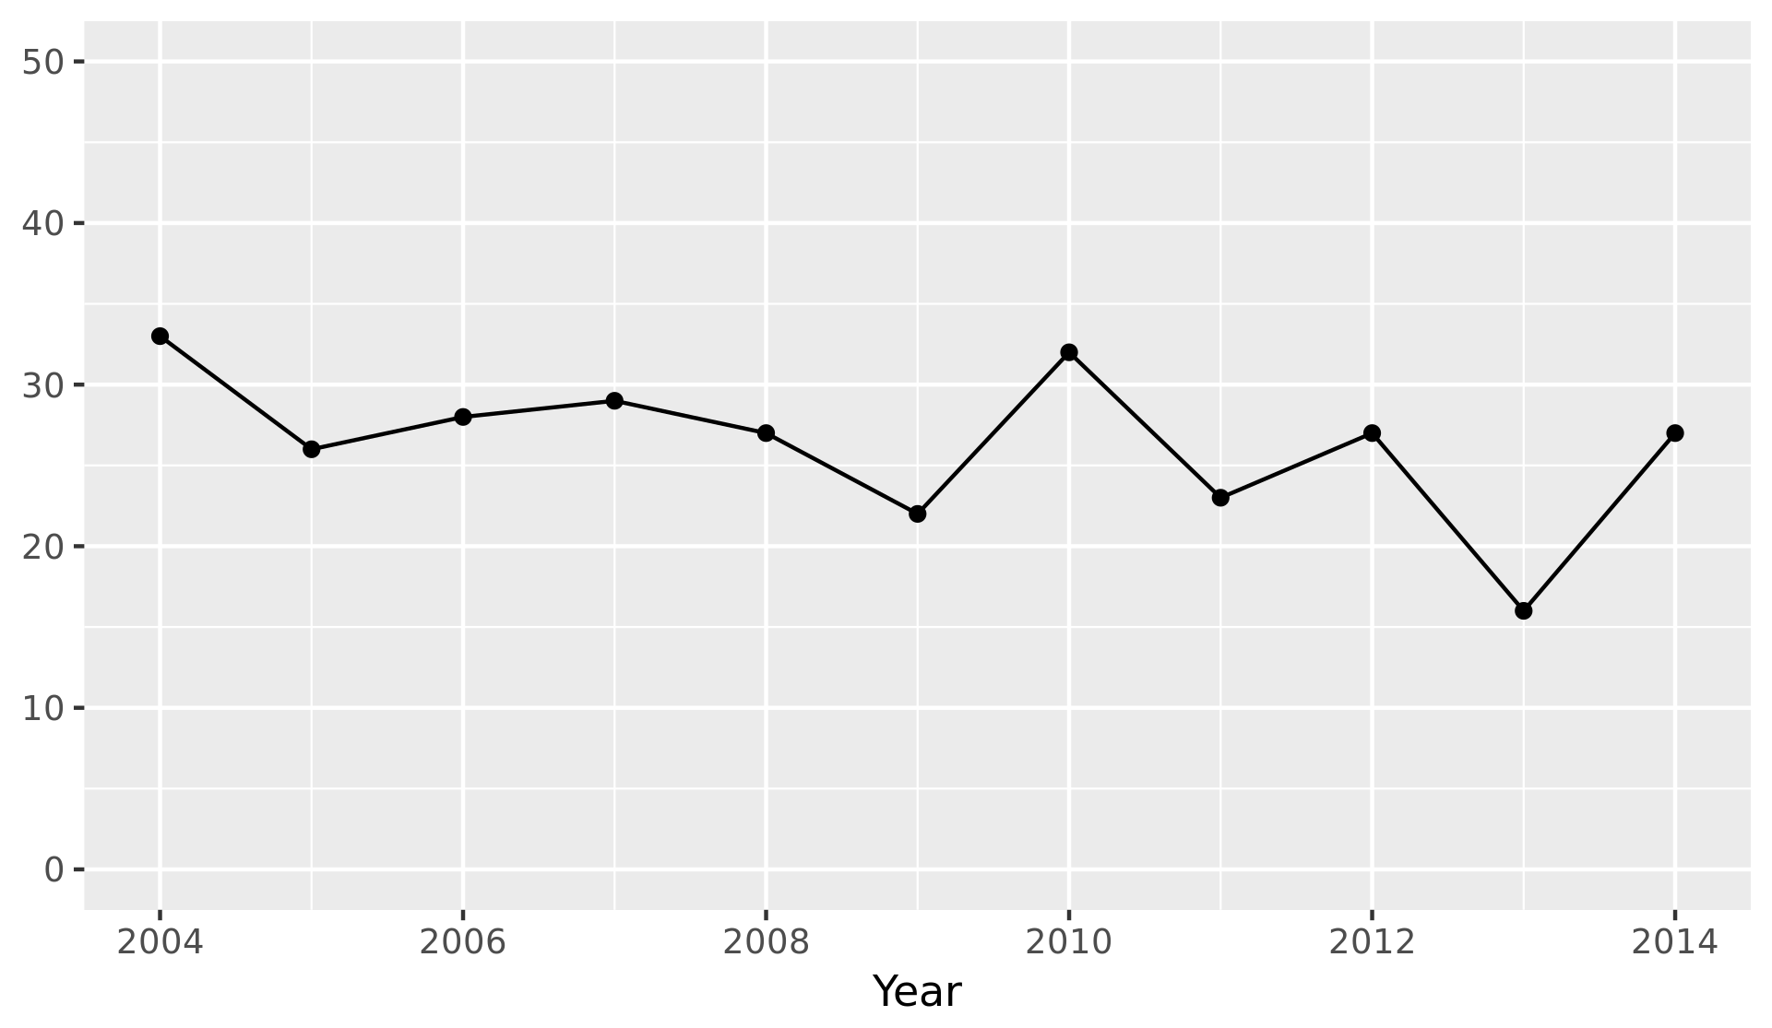
Homicides per Year
r = -0.509
Mean homicides per year: 26.4
Standard deviation: 4.74

Slide 7
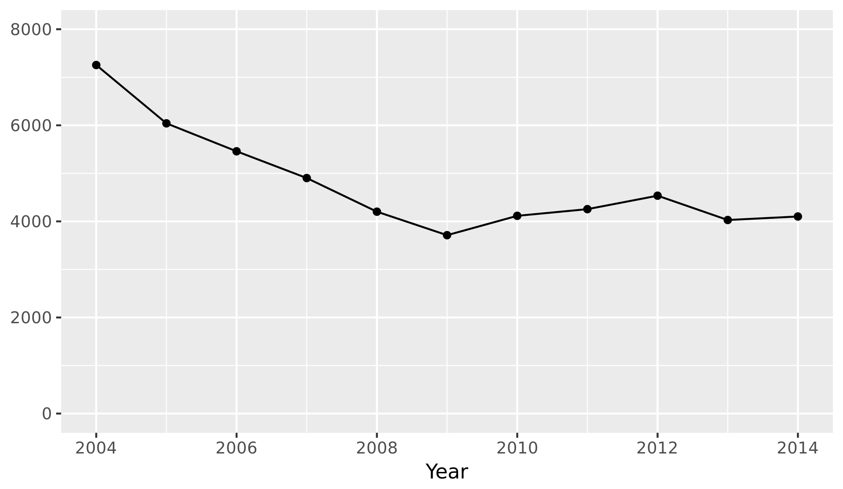
Burglaries per Year
r = -0.787
Mean burglaries per year: 4783
Standard deviation: 1071

Slide 8
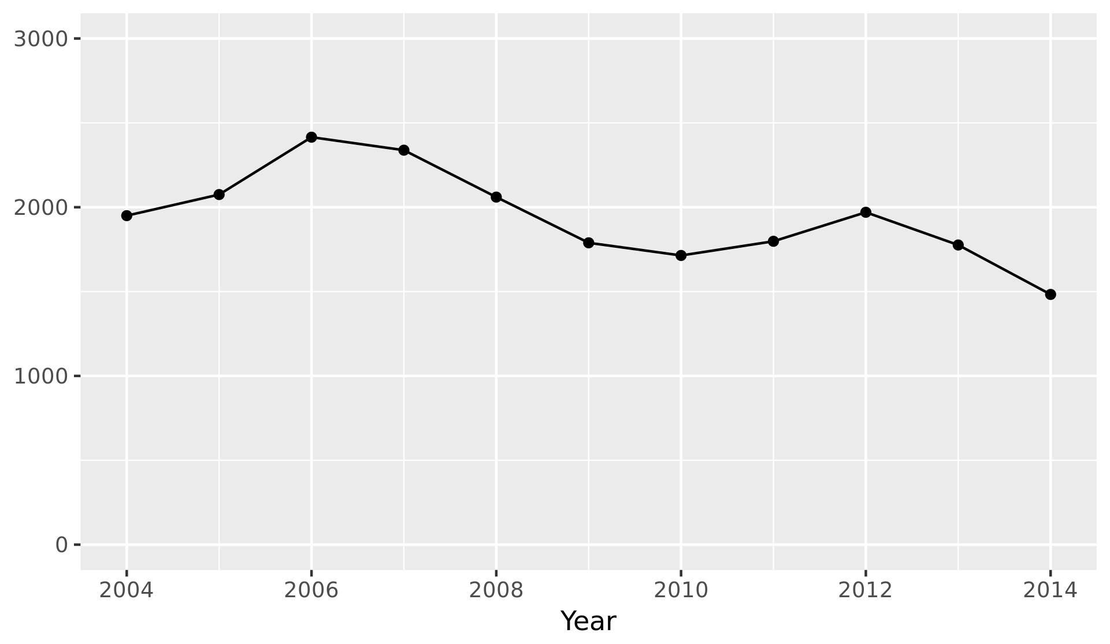
DUII Offenses per Year
r = -0.694
Mean DUII offenses per year: 1943
Standard deviation: 274

Slide 9
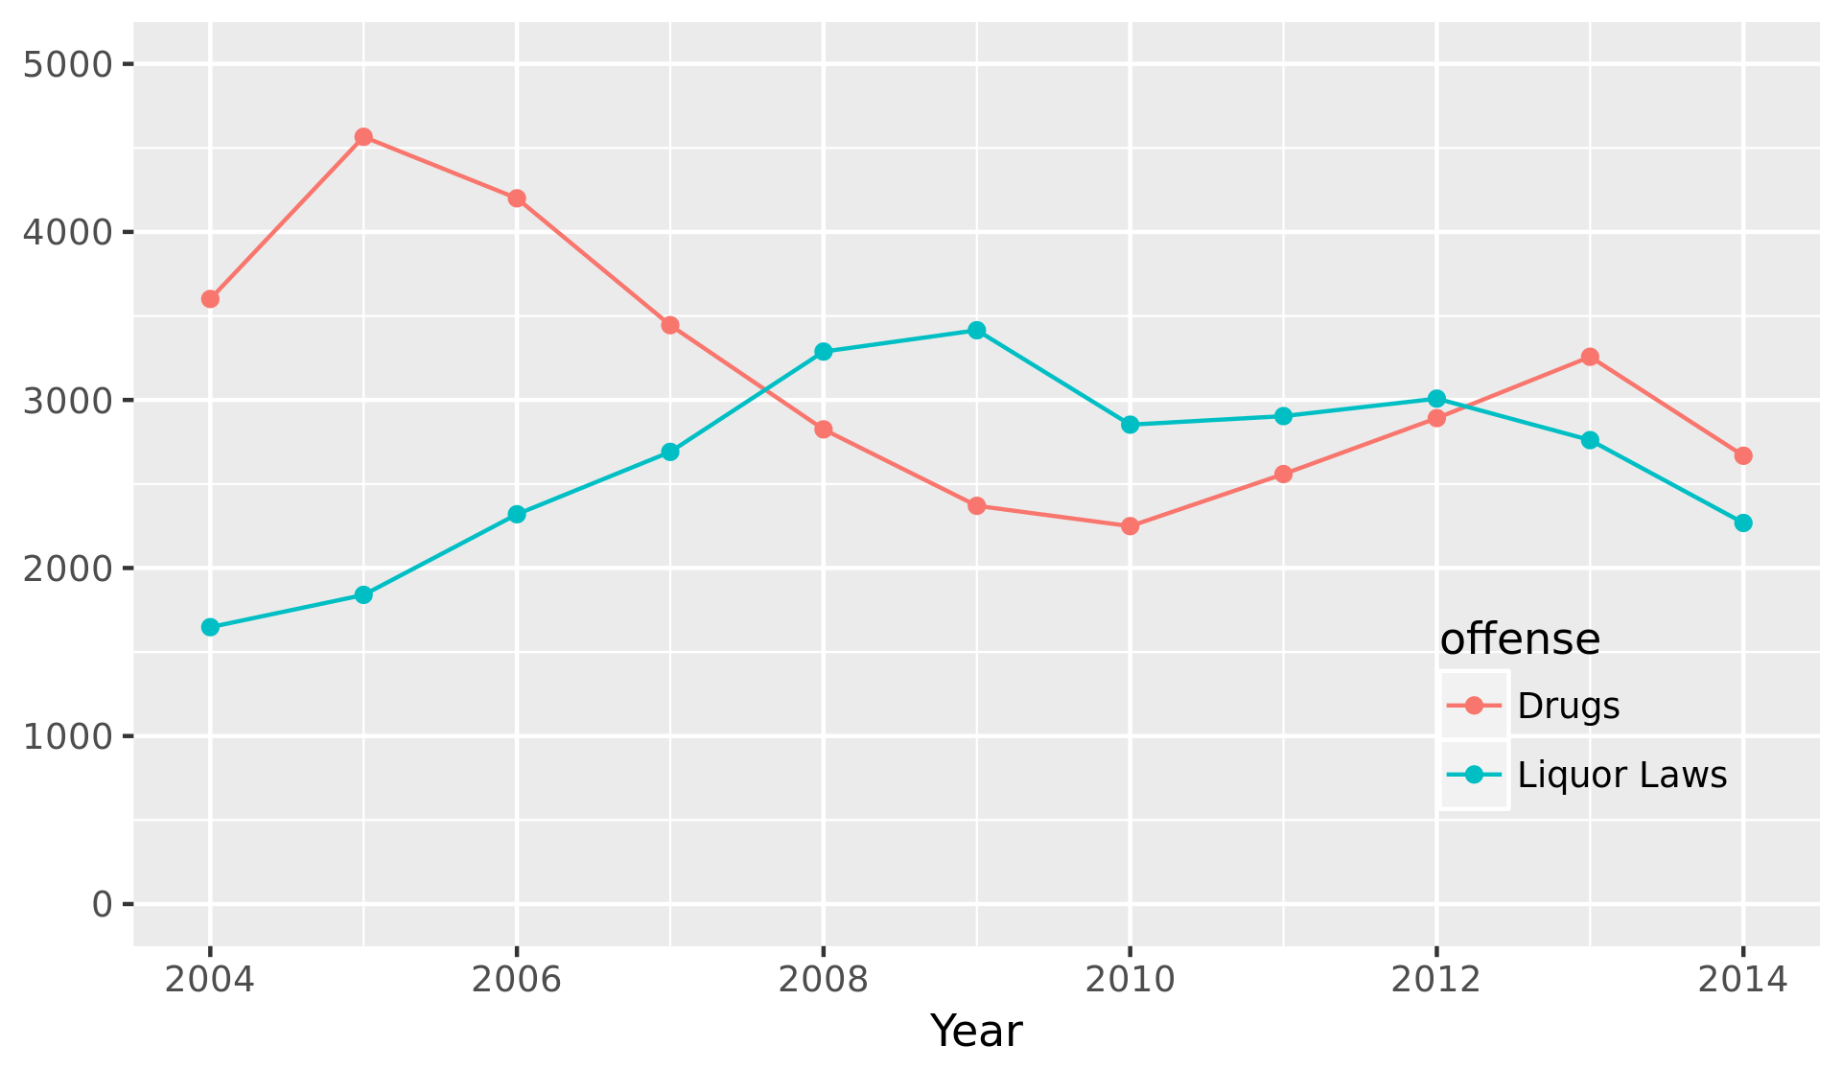
Liquor Law and Drug Offenses per Year

Slide 10
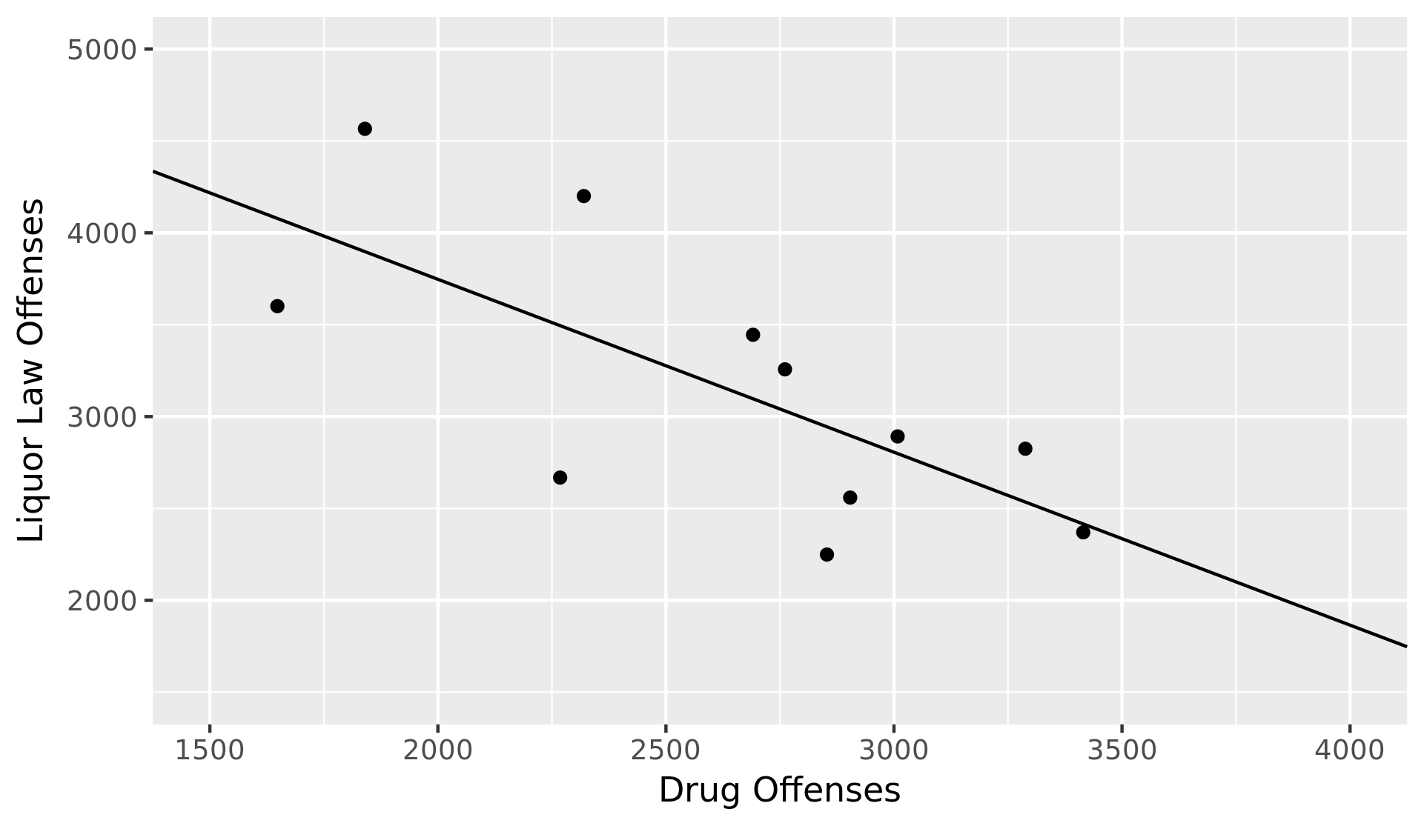
Correlation Between Liquor
Law and Drug Offenses
r = -0.707

Slide 11
How does unemployment affect the crime rate?

Slide 12
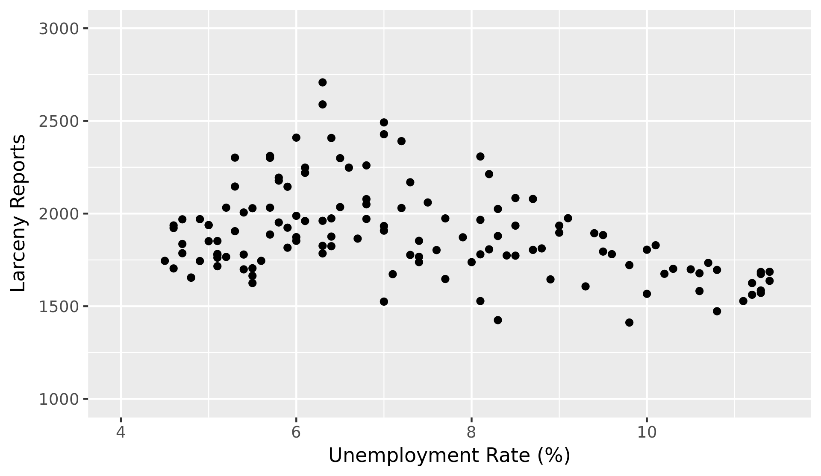
Relationship Between Unemployment and Larceny
r = -0.382

Slide 13
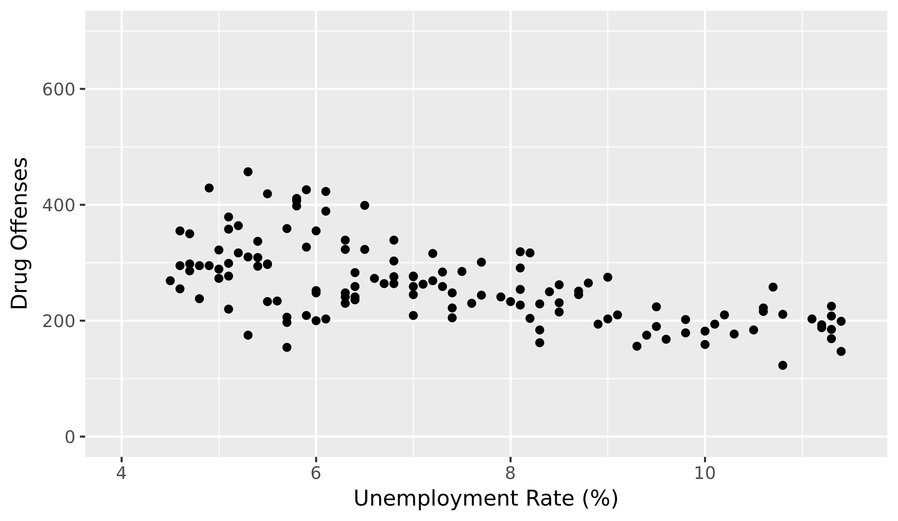
Relationship Between Unemployment and Drugs
r = -0.615

Slide 14
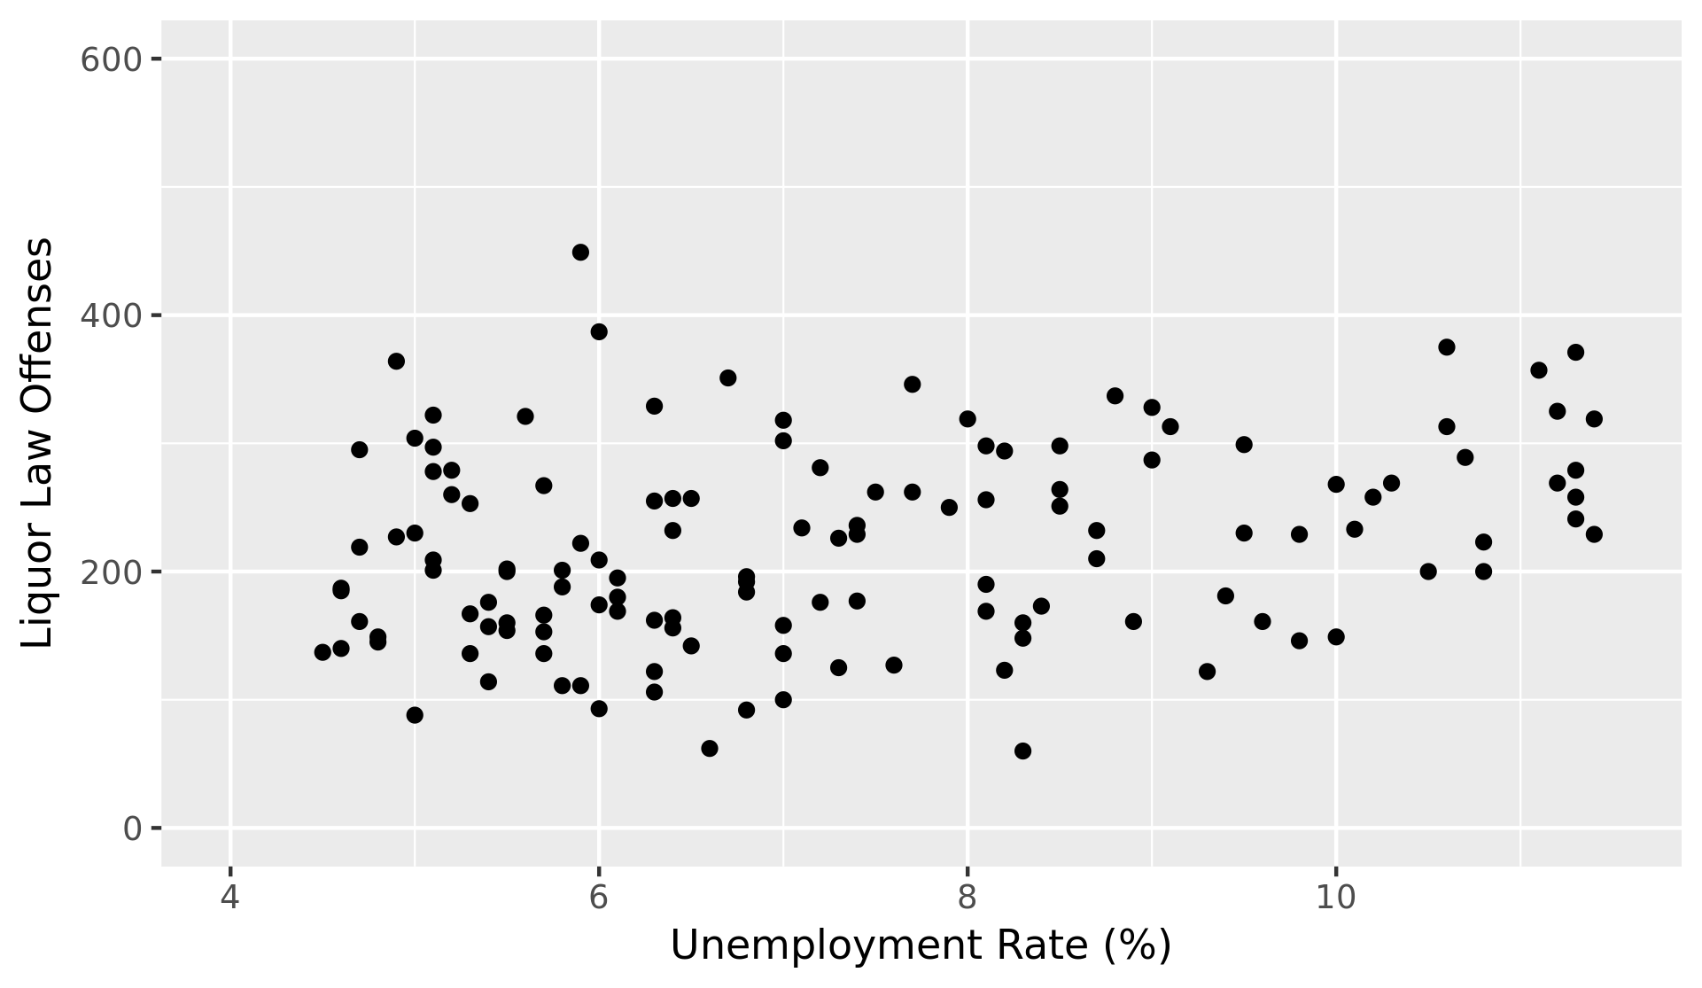
Relationship Between Unemployment and Liquor
r = 0.277

Slide 15
The Ferguson Effect

Slide 16
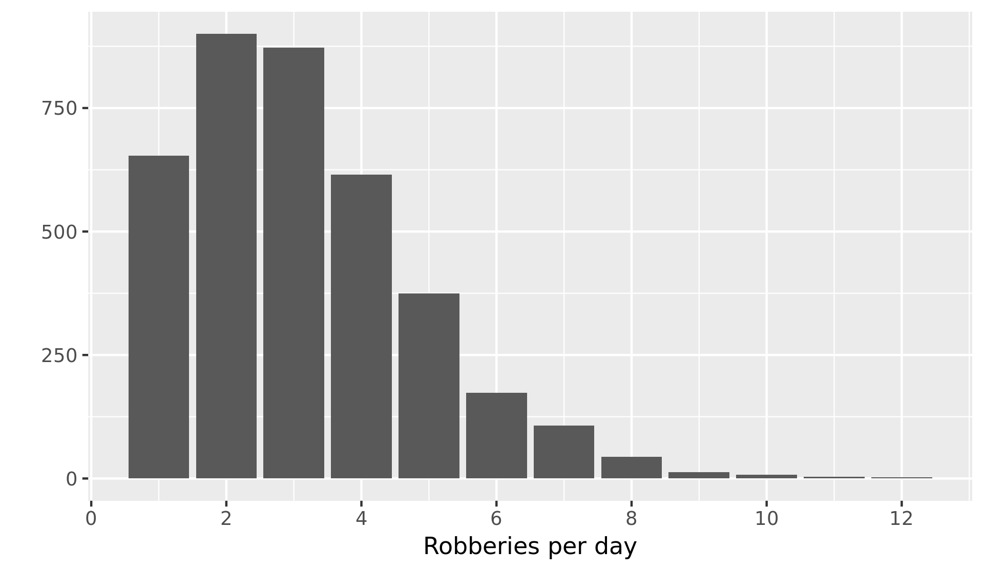
Distribution of Robbery Offenses, 2004 - 2014
Mean robberies per day: 3.13
Standard deviation: 1.72

Slide 17
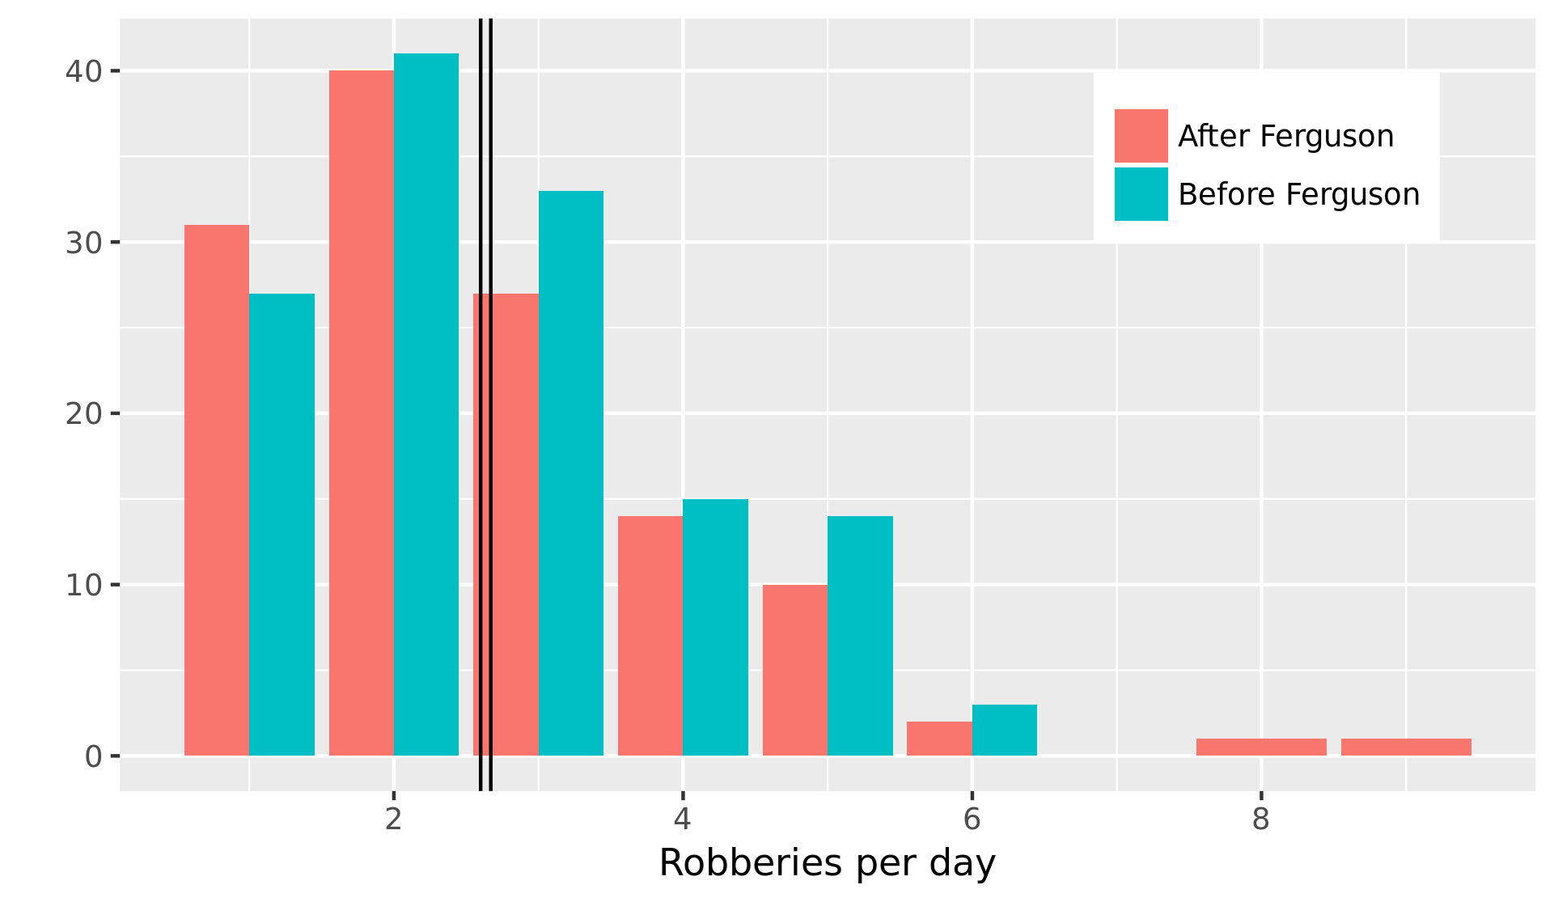
The Ferguson Effect
Pre-Ferguson mean: 2.46 robberies per day
Post-Ferguson mean: 2.29 robberies per day

Slide 18
Neighborhood Demographics

Slide 19
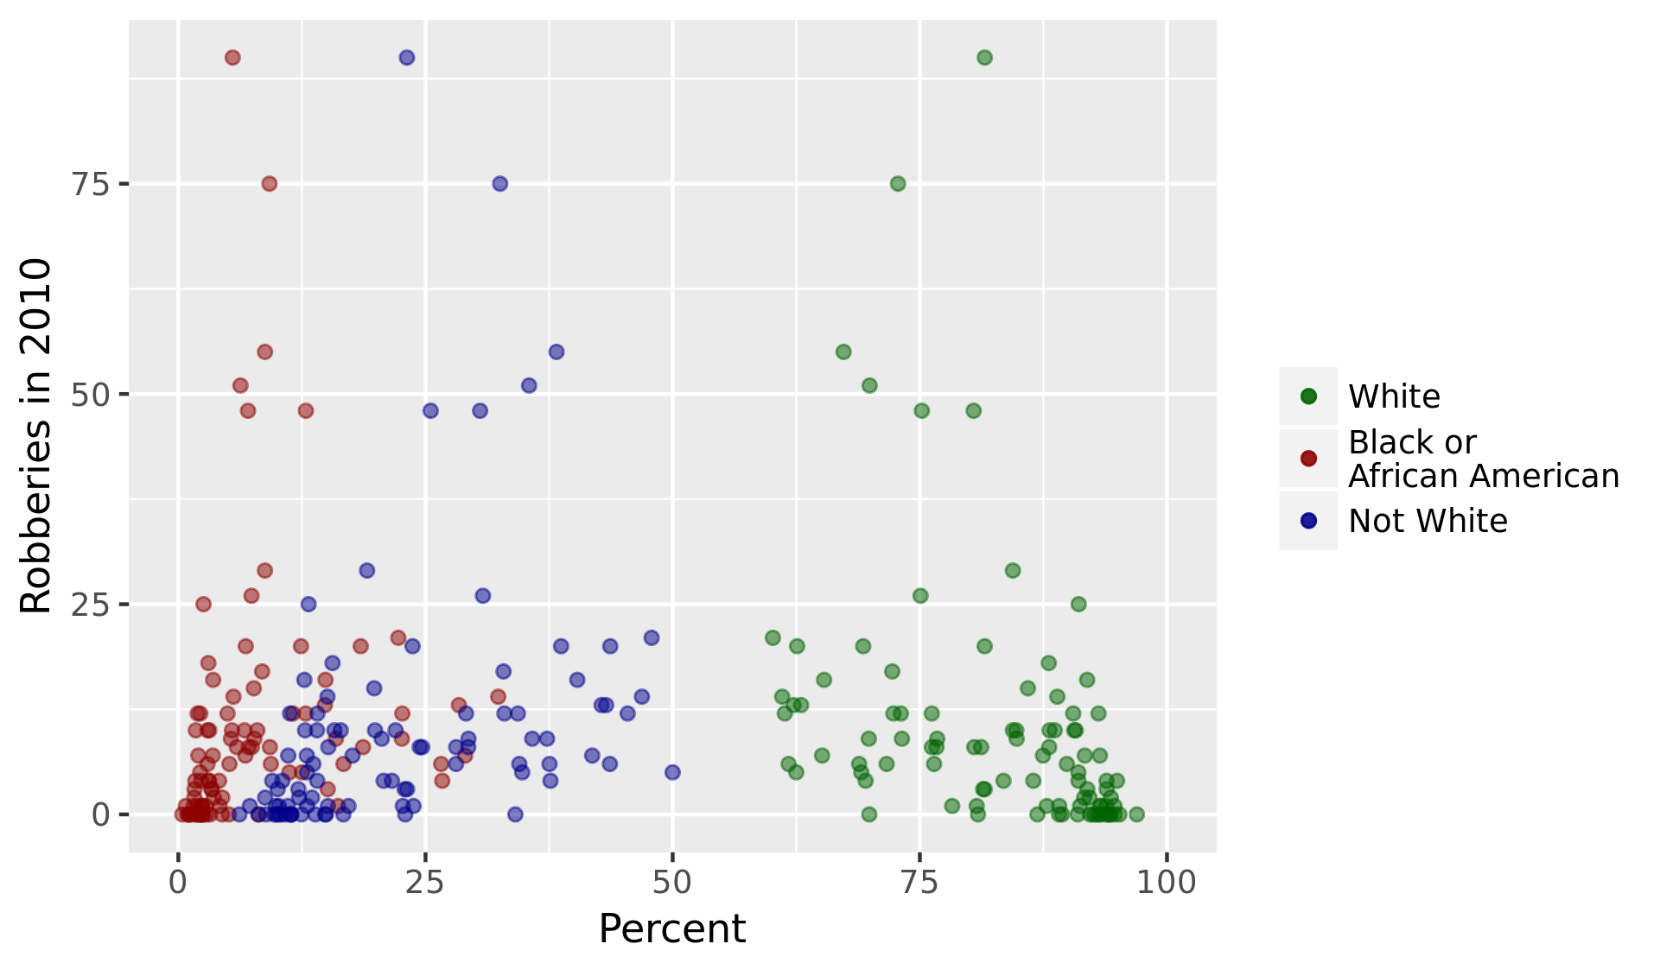
Effect of Neighborhood Racial Demographics
Correlation coefficient for percent white: -0.347
Correlation coefficient for percent black or African American: 0.169
Correlation coefficient for percent not white: 0.342

