Slide 1
BeamDyn
Cp-Lambda
HAWC2
Fx = -1.e+7 N
Fz = -1.e+7 N
Fy = -1.e+7 N
u_z =
u_y =
u_y =
u_z
u_x
x
u_x =
z
u_x =
u_z =
y
u_y
z
x
z
y
y
x

Slide 2
BeamDyn
Cp-Lambda
x
z
z
x
y
y
K11 = 7.8747e+09 (shear stiffness x)
K22 = 8.2641e+09 (shear stiffness y)
K33 = 2.5000e+10 (axial stiffness)
K44 = 5.2083e+08 (bending stiffness, Eixx/edge)
K55 = 1.3021e+08 (bending stiffness, Eiyy/flap)
K66 = 1.4179e+08 (torsional stiffness)
AxialStiffness : 2.5000e+10
BendingStiffnesses : 5.2083e+08 , 1.3021e+08 , 0.0e+0
TorsionalStiffness : 1.4179e+08
ShearingStiffnesses : 7.8747e+09 , 8.2641e+09, 0.0e+0

Slide 3
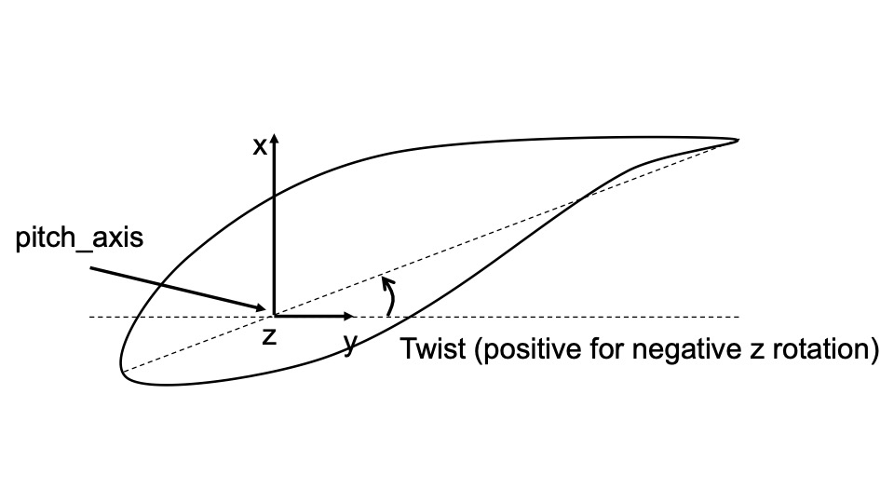
BeamDyn
Cp-Lambda
HAWC2
Fx = -1.e+7 N
Fz = 1.e+7 N
Fy = -1.e+7 N
u_z =
u_y =
u_y =
u_z
u_x
x
u_x =
z
u_x =
u_z =
y
u_y
z
x
z
y
y
x

Slide 4
BeamDyn
Cp-Lambda (tip view)
x
z
z
x
y
y
K11 = 7.8747e+09 (shear stiffness x)
K22 = 8.2641e+09 (shear stiffness y)
K33 = 2.5000e+10 (axial stiffness)
K44 = 5.2083e+08 (bending stiffness, Eixx/edge)
K55 = 1.3021e+08 (bending stiffness, Eiyy/flap)
K66 = 1.4179e+08 (torsional stiffness)
AxialStiffness : 2.5000e+10
BendingStiffnesses : 1.3021e+08 , 5.2083e+08 , 0.0e+0
TorsionalStiffness : 1.4179e+08
ShearingStiffnesses : 8.2641e+09, 7.8747e+09 , 0.0e+0

Slide 5
StiffnessMatrix:
7.035621611000000e+09, 0.000000000000000e+00, 0.000000000000000e+00, 0.000000000000000e+00, 7.949782169000000e+08, 2.516675710000000e+08,
4.125637530000000e+08, 7.176032704999999e+06, -5.619387813000000e+07, 0.000000000000000e+00, 0.000000000000000e+00,
1.318328051000000e+08, -1.917282781000000e+06, 0.000000000000000e+00, 0.000000000000000e+00,
7.521699149000000e+07, 0.000000000000000e+00, 0.000000000000000e+00,
4.653744807000000e+08, 2.321238779000000e+07,
1.728407654000000e+09;

