Slide 1


Example 1
It is a rectangular cross section with 2 inches along x3 and 1 inch along x2. It is meshed with two eight-noded quadrilateral elements. The input file name is isorect.dat.
9
8
4
10
7
2
13
11
6
12
1
5
1
3
2

Slide 2
Example 1.2
It is the same rectangular cross section as example 1. Instead, it is meshed with 6 six-noded triangular elements. The input file name is isorectTri.dat.
9
18
8
20
4
6
4
19
10
5
7
21
13
11
6
15
2
17
12
5
1
3
1
3
16
2
14

Slide 3
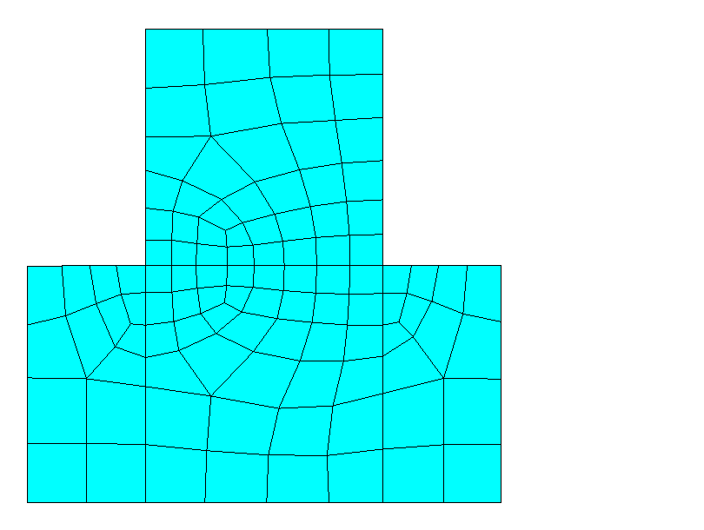
Example 2: it is an arbitrary cross section for an isotropic beam meshed by ANSYS. The corresponding input file is rectvary.dat
2 in.
1 in.
1 in.
2 in.
4 in.

Slide 4
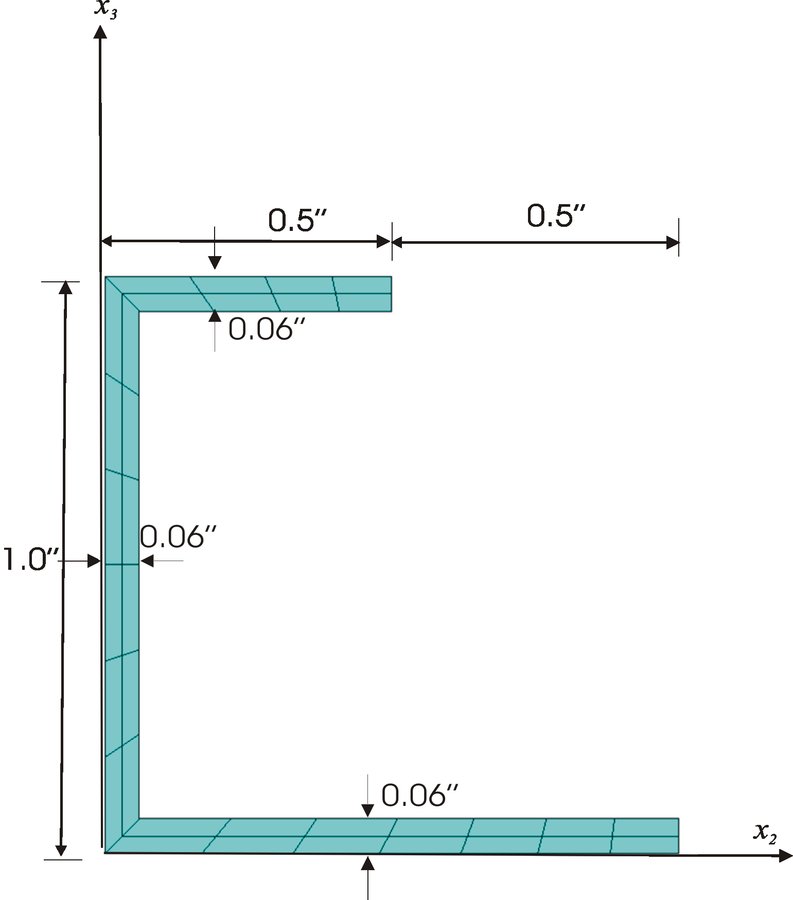
Example 3: it is an isotropic channel section. The corresponding input file is channel.dat.

Slide 5
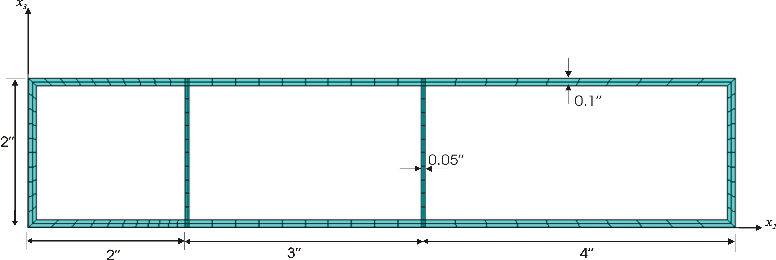
Example 4: it is a single-walled beam with close section for the purpose of calculation of shear center. The corresponding input file is 3cells.dat.

Slide 6
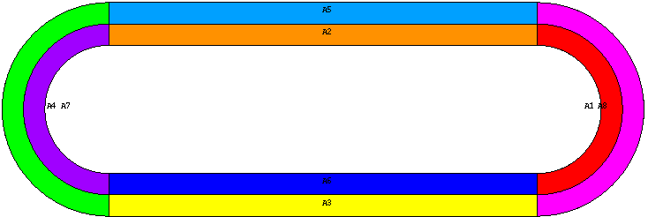
Example 5: it is composite pipe with different layups. The corresponding input file is anisopipe.dat.
The diagonal terms:
Extension: 1.0389 10^7
Shear in x2: 7.84299 10^5
Shear in x3: 3.29002 10^5
Torsion: 6.86973 10^5
Bending in x2: 1.88236 10^6
Bending in x3: 5.38972 10^6
The coupling terms:
Extension-twist: 9.82878 10^4
Shear-bending (2-2): -8.18782 10^3
Shear-bending(3-3): -5.18541 10^4

Slide 7
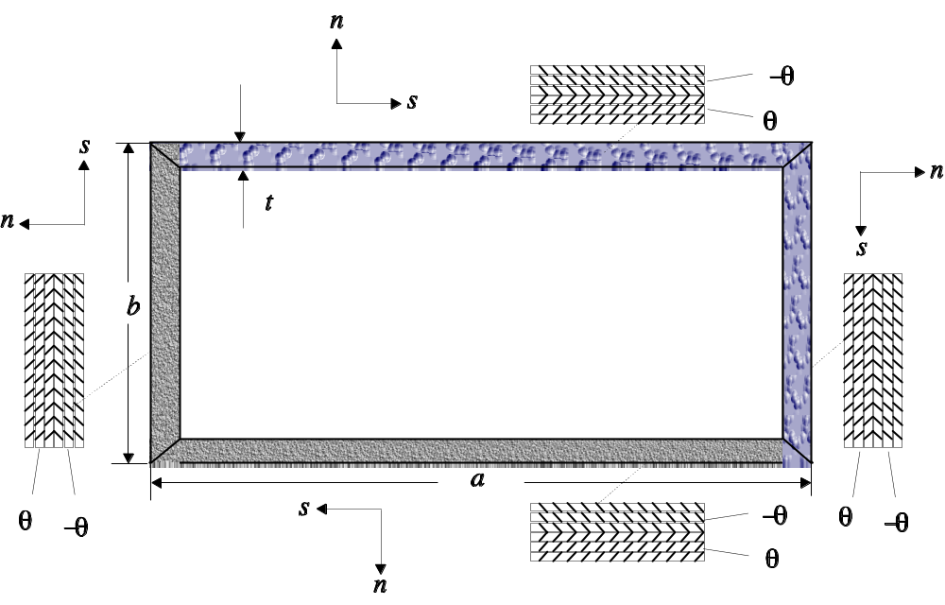
Figure 6: it is a general sketch for composite beam cases such as cas.dat, cus.dat with different layup orientations.

