Slide 1

Applied Geometry and special effects
2010
By Pål Trefall

Slide 2
Introduction
Architecture
Curves
Triangulation
Quad-tree
Project
Demo

Slide 3
Architecture
Modular
  Component-driven Objects, build objects from pieces of logic (aggregation) instead of inheritance.
Data-driven
  Script
    Define components in Lua script
      Curve evaluation components, special effects components, etc.
    C++ engine exposure via intuitive syntax
    Scene initialization definition
  XML
    Define entities
      Aggregation of components
      Set initial property values
    Engine configuration

Slide 4
Architecture
Multi-threaded curve evaluation
  Parametric curve points are independent
  Potentially millions of points on curve to evaluate
  Spawn worker-thread pool equal to number of cores
  Each evaluation is a job on a job-queue
  Workers pop jobs from queue
  Evaluate curve in parallel

Slide 5
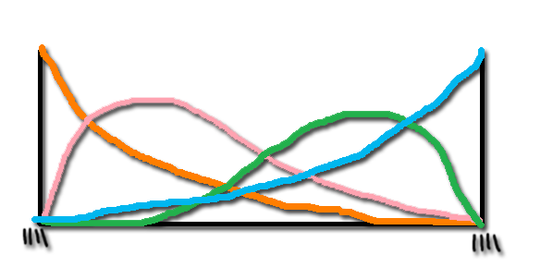
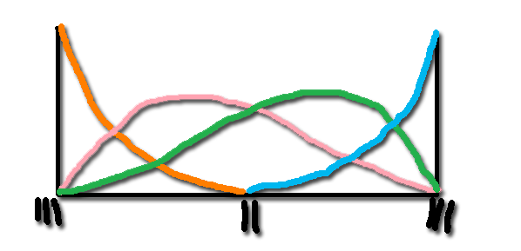
Curves
B-Spline
  n+1 control points cpts
  Degree d
  n+d+2 knots
  t is the interpolated parametric value between start and end of the paramertric interval (the curve).
  Generate Bernstein-Hermite matrix, BHM, that holds the polynomials based on t.
  The pointset p is the point on the curve at t and all its derivatives.
  We find p on the B-Spline curve by using the BHM to weight the cpts

Slide 6
Curves
Expo-Rational B-Spline (ERBS)
  C∞-Smooth (can never derivate to 0)
  Construction
    Define number of local curves, nlc, and the degree of the polynomials d
    Look at nlc number of points, pi, on input curve and the d-1 derivatives of each pi to define the local pointset p.
    For each p, we multiply by the inverse Bernstein-Hermite matrix to find the control-points, cpts, for each local curve of the ERBS.
  Evaluate curve by blending two local curves for each pointset based on the t interval

Slide 7
Quad-tree evaluation
Organization of data in quadrants
Can be used to, for example, look up a specific pixel in a 2D image
Each node in tree represent a region
Split when maximum capacity of region is reached
Splits in four children at each level of the Quad-tree
Steiner product

Slide 8
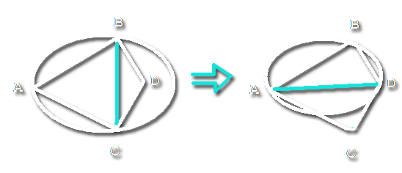
Triangulation
Delaunay
  Triangulates a set of points
  Must adher to the Delaunay condition
    The circle x through abc can not contain any points
    If sum of the angle of the adjacent point in the new triangle is lequal to 180 degrees.
    FLIP

Slide 9
Project
Input curve of ERBS specified via lua script component
  Rose, Butterfly, Spiral
Special effects written in lua script component
Curves defined in XML
Scene defined in Script
Curve, Bezier and ERBS PCurve objects defined in C++, and inherits from Ientity
Very easy to define new input curves in script
Very easy to add new special effects in script
Little to no recompilation of code required to expand project!

Slide 10
DEMO

