Slide 1
Lending Case Study
Poornima T A, Jagadeesh Manepalli

Slide 2
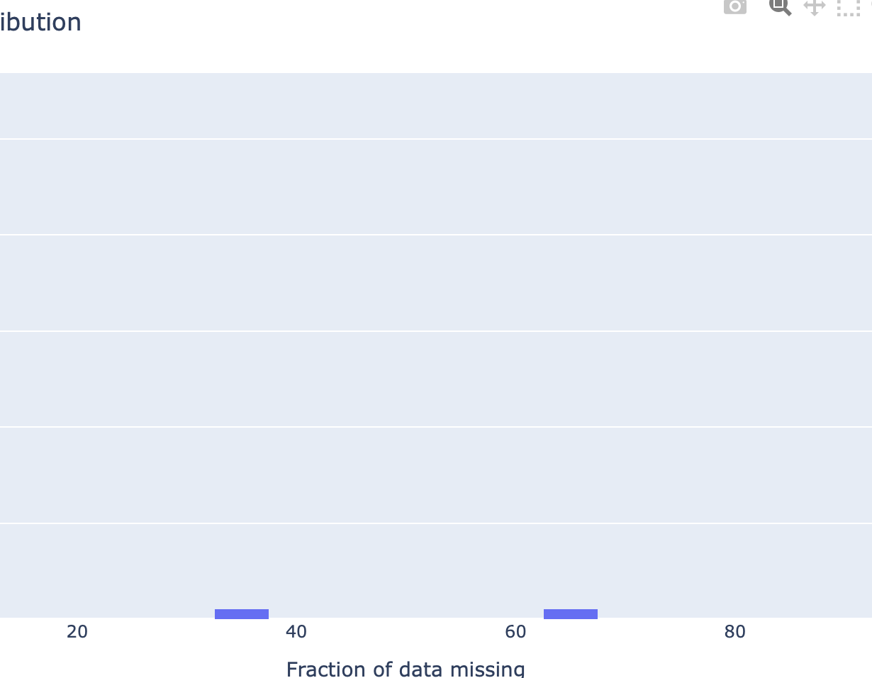
Data Cleanup
It was observed that 50+ features had complete null and nan values
The feaure which had more than 30% nan values were dropped

Slide 3
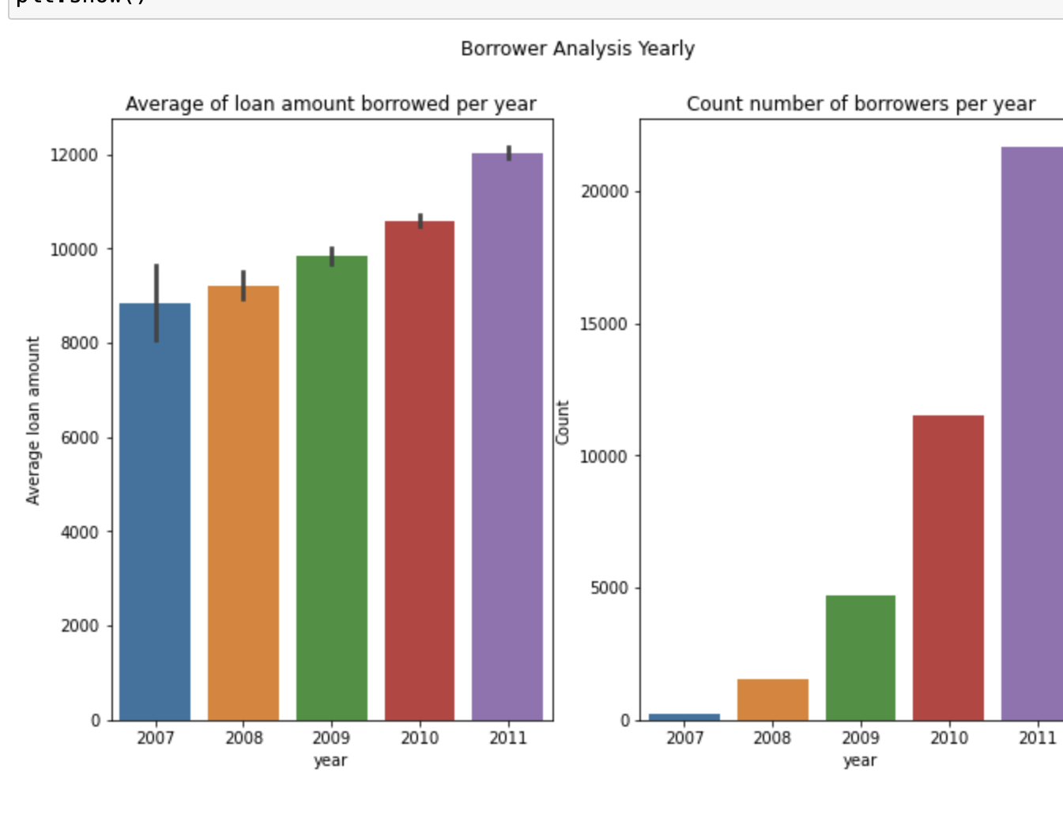
Yearly Analysis
Average loan amount has increased every year
Number of borrowers have increased drastically in 2010 - could be due to the great recession in year 2010

Slide 4
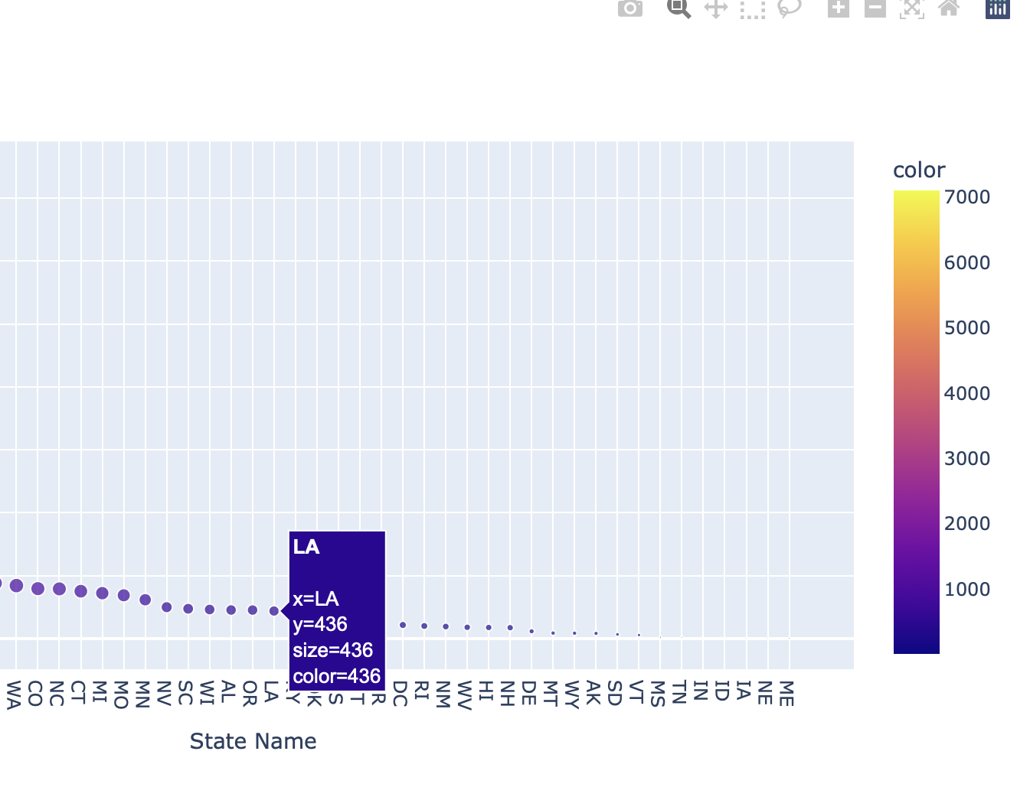
Area-wise analysis
Higher number of borrowers from metro cities like California(CA), New York(NA), Florida(FL), Texas(TX) etc.
This may be due to higher population count in metro cities.

Slide 5
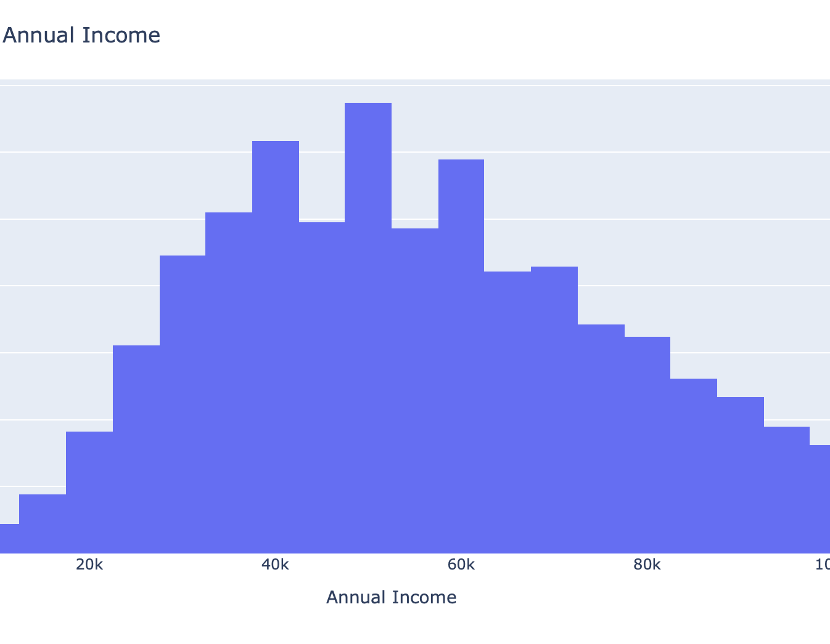
Annual Income
The annual income of most borrowers is $54,844

Slide 6
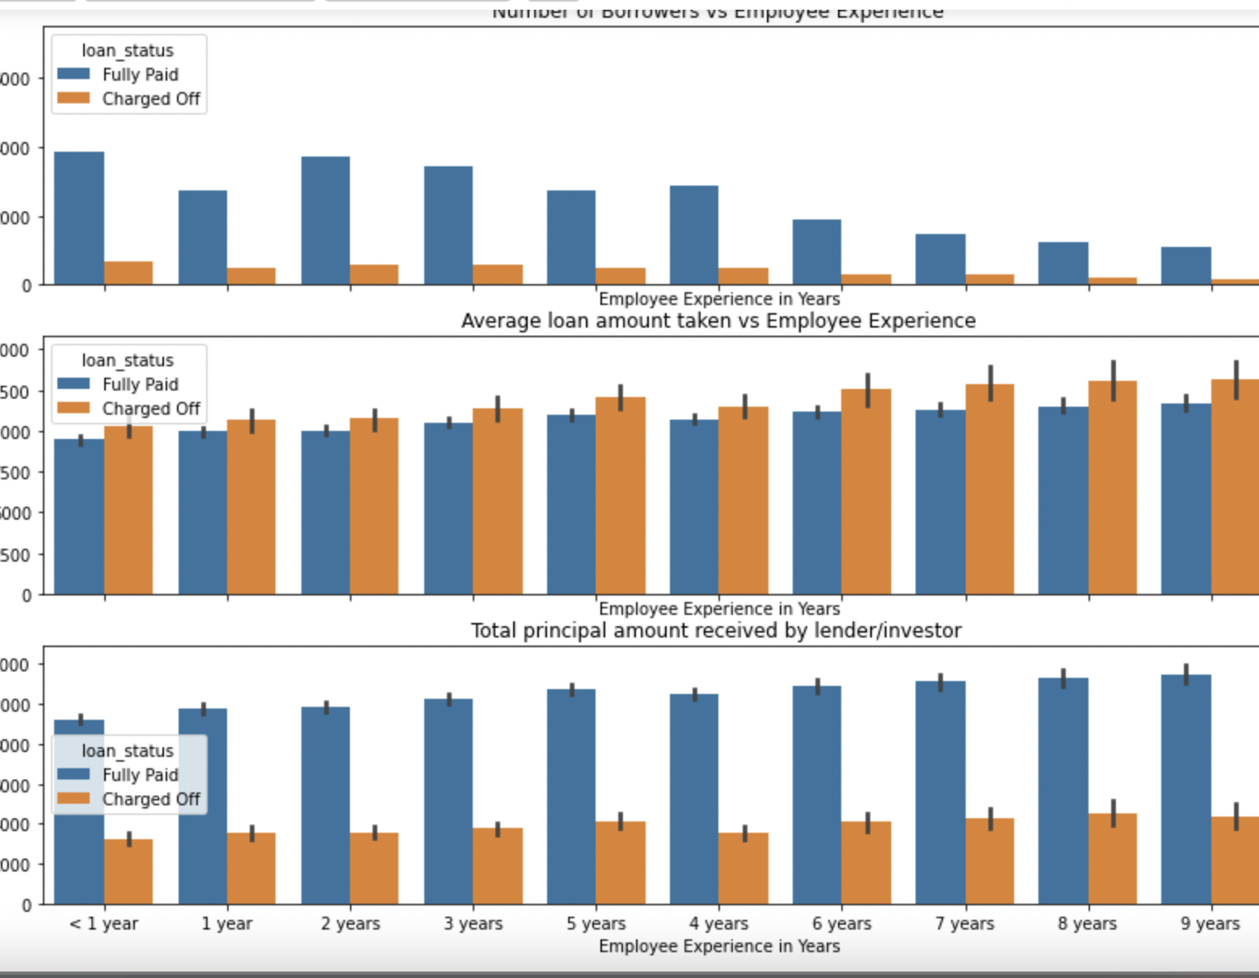
Employee experience, Loan Status, Principal Amount
People with lot of experience or very low experience seem to default more
Employees with mid-level experience default lesser
Lenders collect almost double the principal amount from the borrower, hence investors have a high profit over the years.

Slide 7
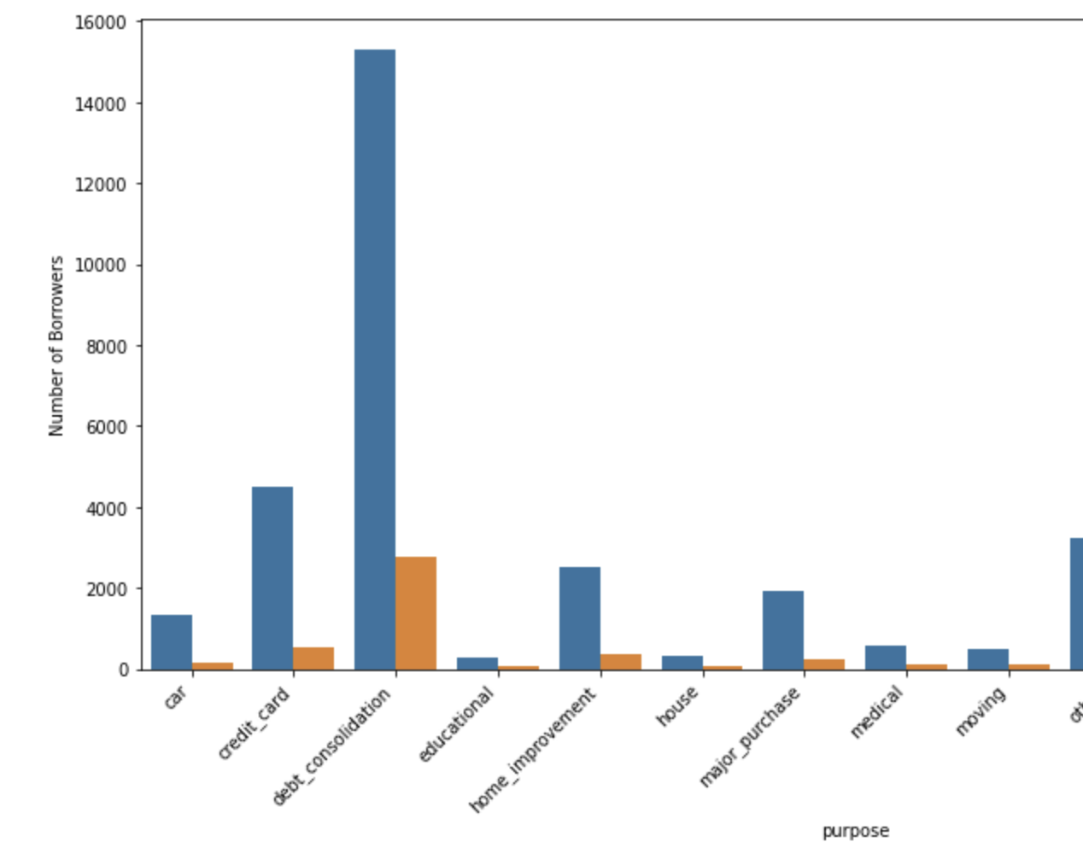
Loan Purpose vs Default
People who borrow money for
debt consolidation
credit card repayment
Small Businesses
are high defaulters

Slide 8
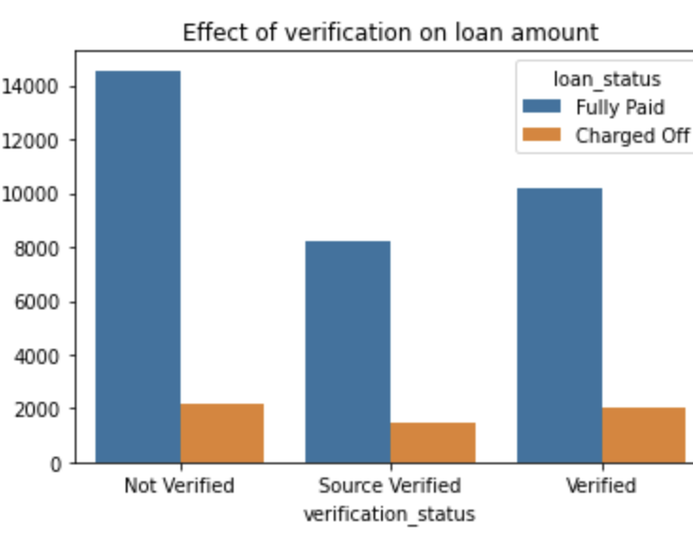
Verification Status
Non verified borrowers default more

Slide 9
Conclusion
The main feature to be considered are
Loan Amount
Loan Purpose
Employee Experience
Term
Loan Status
People with higher experience default
People in metros have more borrowers
Interest rate for defaulters is more than that for fully paid
Defaulters take loan for Small Businesses, Credit Card Payment and Debt Consolidation

