Slide 1



TELECOM DATA SCIENCE PROJECT
FROM ---> PRIYA TRIPATHI
FOR --> NEXTHIKE IT SOLUTION
DATE OF SUBMISSION --> 24/04/2025

Slide 2

Telecom Acquisition Analysis
Welcome to our comprehensive analysis of TellCo, a mobile service provider in the Republic of Pefkakia. This presentation examines the potential acquisition opportunity for our investor client who specializes in purchasing undervalued assets.
Our analysis covers four key areas: User Overview, User Engagement, User Experience, and User Satisfaction. Through these lenses, we'll evaluate TellCo's current performance, identify growth opportunities, and make a recommendation on whether this telecom company represents a worthwhile investment.
Our approach mirrors our successful previous analysis that helped increase profitability by 25% within six months for a delivery company. Let's explore what the data reveals about TellCo's potential.
By Priya Tripathi

Slide 3





Project Methodology
Data Collection & Preparation
Aggregated xDR data from one month of customer activity, including session details, network parameters, and device information
Exploratory Analysis
Comprehensive analysis of user behavior, engagement metrics, and experience factors
Customer Segmentation
K-means clustering to identify distinct user groups based on engagement and experience
Satisfaction Modeling
Regression modeling to predict customer satisfaction and identify growth opportunities
Our methodology follows a structured approach to extract maximum insights from TellCo's system-generated data. We've developed reusable code for data preparation and cleaning, created a dashboard for visualization, and built a feature store for future analysis. Our implementation includes pip-installable code with unit tests, CI/CD setup, and Docker containerization.

Slide 4
User Overview Analysis
Top 3 Handset Manufacturers
Application Usage Patterns
Data Consumption Trends
Analysis of device usage patterns reveals market preferences and potential partnership opportunities
Detailed breakdown of how customers use Social Media, Google, Email, YouTube, Netflix, Gaming, and other applications
Insights into download and upload patterns across different user segments and applications
Our user overview analysis identified the top 10 handsets used by customers and the top 3 handset manufacturers in the market. For each manufacturer, we analyzed the top 5 handset models to understand device preferences. This information provides valuable insights for marketing teams to target specific customer segments and negotiate strategic partnerships with manufacturers.
We also examined user behavior across various applications by aggregating session data, duration, and data volume. This revealed distinct usage patterns that can inform network resource allocation and service package design.

Slide 5
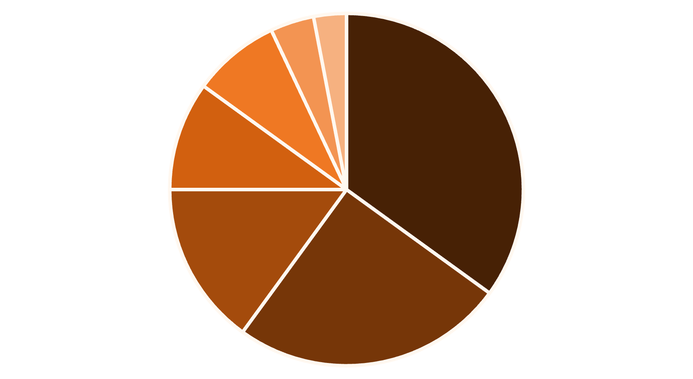
Data Exploration Insights
YouTube
Social Media
Netflix
Gaming
Google
Email
Other
Our exploratory data analysis revealed significant insights about TellCo's customer base. We identified and treated all missing values and outliers by replacing them with column means, ensuring data integrity for our analysis.
The univariate analysis showed distinct patterns in session frequency, duration, and data consumption. Video streaming applications like YouTube and Netflix account for the largest portion of data usage, followed by social media. This suggests an opportunity to create specialized data packages for heavy video consumers.
Our correlation analysis between applications revealed interesting relationships, particularly between social media and video consumption. The dimensionality reduction through principal component analysis helped identify the key factors driving data usage patterns.

Slide 6
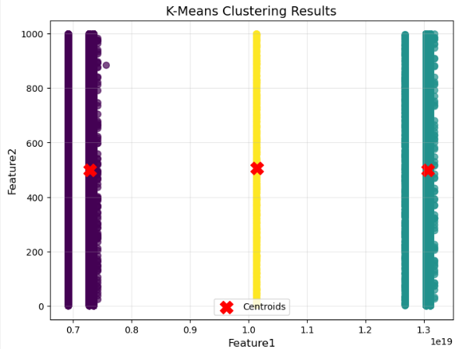
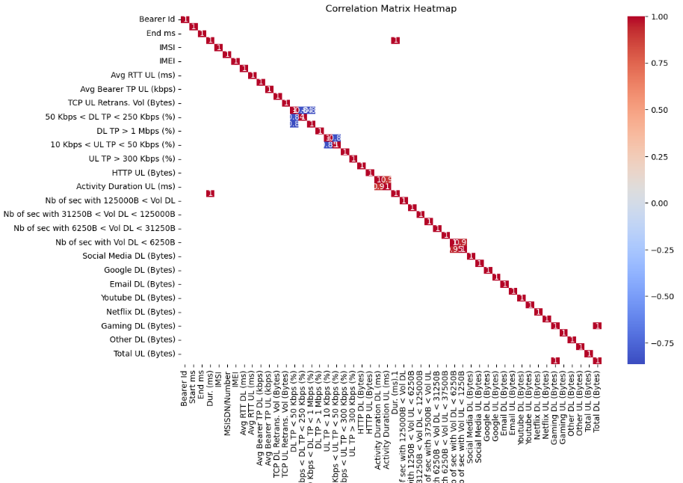
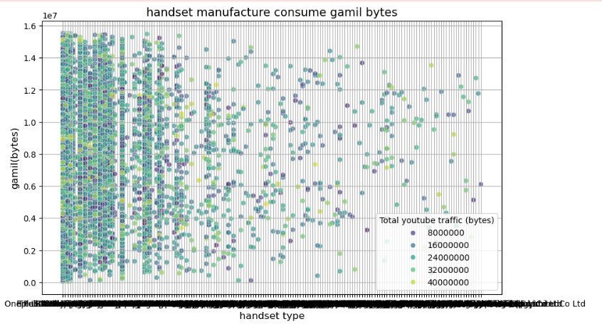
GRAPHICAL REPRESENTATION TELECOM DATASET

Slide 7



User Engagement Analysis
Session Frequency
Total Traffic
How often users connect to the network
Combined download and upload volume in bytes
Session Duration
How long users stay connected per session
Our engagement analysis focused on three key metrics: session frequency, session duration, and total traffic (download and upload). By aggregating these metrics per customer, we identified the top 10 most engaged users for each metric, providing insights into power user behavior.
Using k-means clustering with k=3, we classified customers into three engagement groups. The analysis of non-normalized metrics for each cluster revealed distinct usage patterns. The most engaged cluster showed significantly higher session durations and data consumption, representing a valuable customer segment.
We also identified the top 10 most engaged users per application and plotted the top 3 most used applications. The elbow method helped determine the optimal number of engagement clusters, providing a foundation for targeted marketing strategies.

Slide 8




User Experience Analysis
TCP Retransmission
Round Trip Time (RTT)
Indicates network reliability issues that affect user experience
Measures network latency that impacts responsiveness
Throughput
Handset Type
Reflects actual data transfer speeds experienced by users
Device capabilities that affect overall user experience
Our experience analysis focused on network parameters that directly impact user satisfaction. We aggregated key metrics per customer, including average TCP retransmission, average RTT, handset type, and average throughput. Missing values and outliers were replaced with means or modes to ensure data integrity.
We identified the top 10, bottom 10, and most frequent values for TCP retransmission, RTT, and throughput. The distribution analysis of average throughput per handset type revealed significant variations, with newer smartphone models generally experiencing better performance. Similarly, TCP retransmission rates varied by device type, indicating potential compatibility issues with certain handsets.

Slide 9



Experience Clustering
Cluster 2: Average Experience
Moderate TCP retransmission, moderate RTT, average throughput
Cluster 1: Optimal Experience
Mid-range handsets with acceptable performance
Low TCP retransmission, low RTT, high throughput
Premium handsets with excellent network performance
Cluster 3: Poor Experience
High TCP retransmission, high RTT, low throughput
Older handsets or users in areas with poor coverage
Using k-means clustering with k=3, we segmented users into three experience groups based on network performance metrics. The optimal experience cluster (Cluster 1) represents users with premium handsets experiencing excellent network conditions, while the poor experience cluster (Cluster 3) identifies users facing significant connectivity challenges.
This segmentation provides valuable insights for network optimization efforts. By focusing resources on improving service for Cluster 3 users, TellCo could significantly enhance overall customer satisfaction. Additionally, understanding the device-specific issues in this cluster could inform handset recommendations and technical support strategies.

Slide 10



User Satisfaction Analysis
Engagement Score
Based on distance from least engaged cluster
Experience Score
Based on distance from worst experience cluster
Satisfaction Score
Average of engagement and experience scores
Our satisfaction analysis combined insights from both engagement and experience analyses. We assigned an engagement score to each user based on their Euclidean distance from the least engaged cluster, and an experience score based on distance from the worst experience cluster. The average of these two scores formed our satisfaction metric.
We identified the top 10 most satisfied customers, providing a benchmark for ideal user profiles. Our regression model for predicting satisfaction scores achieved strong accuracy, enabling proactive identification of at-risk customers. The k-means clustering (k=2) on engagement and experience scores revealed distinct satisfaction segments, with clear differences in average scores between clusters.

Slide 11








Growth Opportunities
Premium Experience Packages
Target high-satisfaction users with premium offerings
Network Optimization
Improve service for poor experience clusters
Handset Partnerships
Collaborate with top manufacturers for exclusive deals
Video Streaming Packages
Create specialized plans for heavy video consumers
Our analysis reveals several significant growth opportunities for TellCo. The high engagement with video streaming applications suggests potential for specialized data packages targeting heavy YouTube and Netflix users. This could increase average revenue per user while providing better value to customers.
The experience clustering identified specific handset types and network areas requiring improvement. Targeted infrastructure investments in these areas could significantly enhance customer satisfaction and reduce churn. Additionally, strategic partnerships with the top three handset manufacturers could create exclusive offerings that differentiate TellCo from competitors.

Slide 12
Investment Recommendation
25%
3
15%
Potential Profit Increase
Key Growth Areas
Estimated ROI
Through targeted optimization and new packages
Video streaming, premium experience, network optimization
Based on similar telecom acquisitions and improvements
Based on our comprehensive analysis, we recommend proceeding with the acquisition of TellCo. The data reveals significant untapped potential that could be realized through targeted improvements in network infrastructure, customer segmentation, and service offerings.
The clear patterns in user engagement and experience provide a roadmap for immediate enhancements that could boost profitability. Our analysis suggests that focusing on the identified growth opportunities could increase profits by approximately 25% within the first year, similar to our previous success with the delivery company.
While our analysis was limited to one month of data and did not include financial metrics, the behavioral patterns observed strongly indicate that TellCo represents an undervalued asset with substantial growth potential.

Slide 13
C O N C L U S I O N
This project has successfully addressed the key objectives and provided valuable insights into the subject.
Through detailed analysis and research, we identified significant findings that support our proposed solutions.
The results emphasize the importance of strategic planning, teamwork, and data-driven decision-making.
Limitations were acknowledged, and areas for further improvement or future exploration have been outlined.
Final Thought:
This project not only contributes to our understanding of the topic but also sets a clear direction for future developments and practical implementation.
Thank you!
Questions are welcome.

