Slide 1

Experimental Design of Accumulators’ Aging and Remaining Lifetime Estimation
Department of Electrical Engineering and Information
Systems
Patrik Dósa | VS42ZH
Independent Laboratory Work | 2018
Supervisor: Dr. Attila Magyar
Notes:
Good morning / Good afternoon / Good day!
I am Patrik Dósa.
My topic is ‘Experimental Design of Accumulators’ Aging and Remaining Lifetime Estimation‘.
My supervisor is Dr. Attila Magyar.

Slide 2
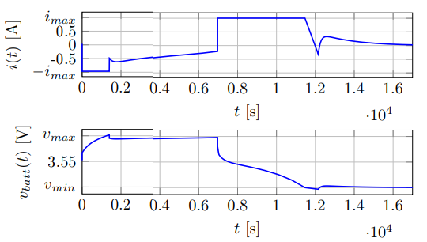
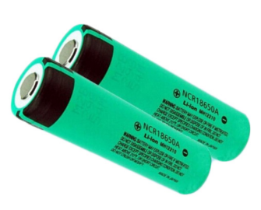
Contents
Introduction
Applied Devices
System Design
Tests
Summary
Vehicle Battery
Battery Model
Parameter estimation
Constant Current – Constant Voltage
Notes:
These topics will be affected:
Introduction
Applied Devices
System Design
Tests
And Summary.

Slide 3
Introduction
Notes:
Introduction

Slide 4
Introduction
Task
Experimental design of parameter estimation
Determining measurement
CC-CV model
Test
MATLAB programming environment should be used for the development
Lithium-ion batteries:
Popular energy sources
Basic element of EVs
Life and health:
Cannot measure directly
Possible estimation
Several modeling techniques
Notes:
I think lithium-ion batteries are the most popular batteries right now.
We use these batteries in mobile phones, laptops, electronic tools and in the vehicles.
These are the central element of the electric vehicles.
Since battery life and health cannot be measured directly, information about the re-estimated parameters of the electric system obtain the health.
There are several modeling techniques for testing, but in my case we are used the constant current constant voltage model, only an experimental design of the parameter estimation.

Slide 5
Applied devices
Notes:
Applied devices

Slide 6
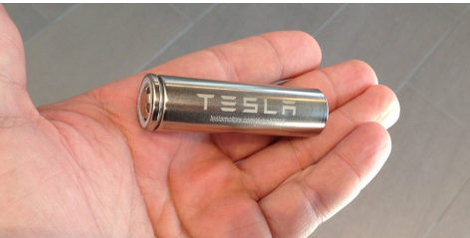
Vehicle Battery
Different battery usage in different vehicles
EV batteries different from standard batteries
Deep cycle batteries
High Ah capacity
High power-to-weight ratio
High energy-to-weight ratio
Energy density
Smaller
Lighter
Widely know from laptop batteries
80 – 90% charge/discharge efficiency
Notes:
Vehicle batteries are usually secondary batteries only, but other vehicle systems, like forklifts, golf carts, electric cars and others are using batteries to traction.
These batteries differ from the standard batteries because they are designed to give power over sustained periods of time. We call them: deep-cycle batteries.
Deep-cycle batteries must be designed with high ampere-hour capacity, high power-to-weight and energy-to-weight ratio and energy density: smaller, lighter with 80-90% charge/discharge efficiency.

Slide 7
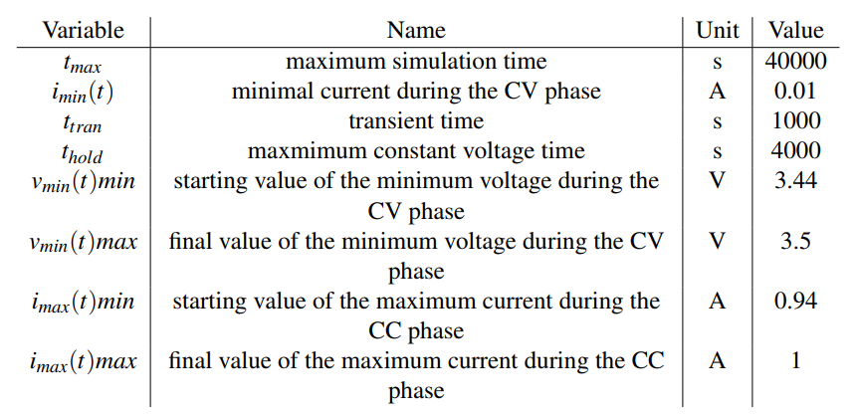
Battery Model
CC-CV test:
CC phase: 0.94 A – 1.00 A
CV phase: 3.44 V – 3.50 V
Tests based on A.I.Pozna’s and A. Magyar’s study and model about the parameter estimation of lithium-ion batteries
Battery parameters shall be added to the MATLAB model before we use the model
Notes:
In the MatLab model some battery parameters shall be added before we use the Simulink CC-CV model.
The default parameters are defined in that table.
The Test based on Anna Pozna’s and Attila Magyar’s study and model about the parameter estimation of lithium-ion batteries.
The simulation is running in the CC phase from 0.94 ampere to 1 ampere and during the CV phase from 3.44 voltage to 3.5 voltage to estimate the parameters and to calculate the ellipse.
I will show the test results later.

Slide 8
System Design
Notes:
System Design

Slide 9
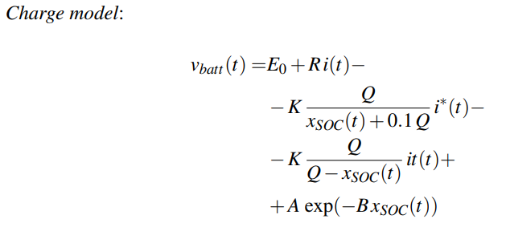
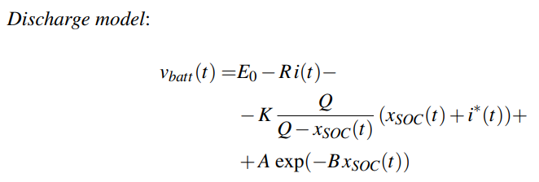
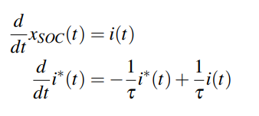
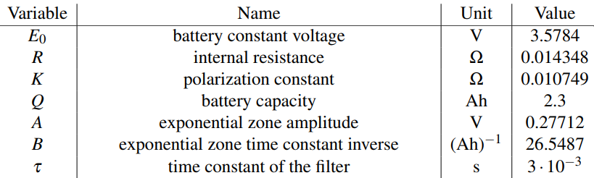

Parametic Battery Model
Two models, that differ in their nonlinear terms
i*(t) and x_{soc}(t) change according to state equations
Nominal parameters in the table
θ˜ is the perturbed parameter vector in the cost function
With the ±10% value change we get the highly sensitive parameters: E₀, K, Q, R.
Notes:
The battery voltage during charging and discharging can be expressed with two models that differ in their nonlinear terms in the equations Charge model and Discharge model.
We can see the variables and parameters to the experiment model in the table.
Changing the parameters values with +- 10%. It is apparent that the battery model is highly sensitive for the battery constant voltage E0, and K, Q, R as well.
Most significantly changing parameters are the capacity and the internal resistance.

Slide 10
Parameter Estimation with CC-CV
Constant current – constant voltage for chargin/discharging applications
Inputs: v_{min}, v_{max}, i_{max}, i_{trickle}, t_{hold}
Experimental design purposes:
i_{trickle} and t_{hold} are constants
Parameter estimation:
Capacity and Internal resistance should be the changing parameters
E0 and K are estimated once before use
Trace norm of the covariance matrix estimation:
Tr(cov) ≈ a + b
Sum of the semi-minor and the semi-major axes
Approximation of the bias:
d = sqrt( (R − R_{est})² + (Q − Q_{est})² )
Euclidean distance of the actual parameter pair and the estimated one
Notes:
So we should use capacity and internal resistance as the changing parameters.
E0 and K should be estimated once before use.
The constant current-constant voltage cycle used for battery charging/discharging applications.
The parameters of its input are the voltages: minimum and maximum. Currents: maximum and trickle, and time: t hold
For the experiment purposes thold and itrickle supposed to be constant.
The sum of the semi-minor and the semi-major axes is used as an approximation of the trace norm of the covariance matrix.
And the Euclidean distance of the actual parameter pair and the estimated is used as an approximation the bias.

Slide 11
Tests
Notes:
Tests

Slide 12
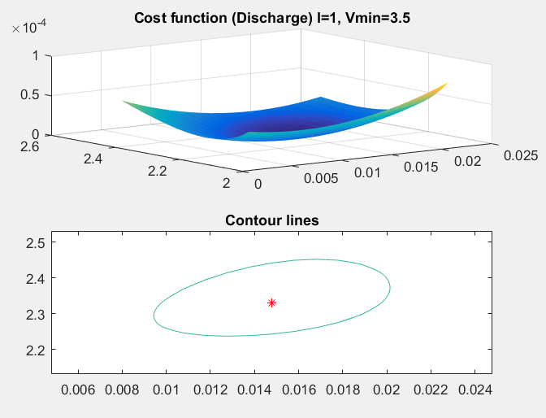
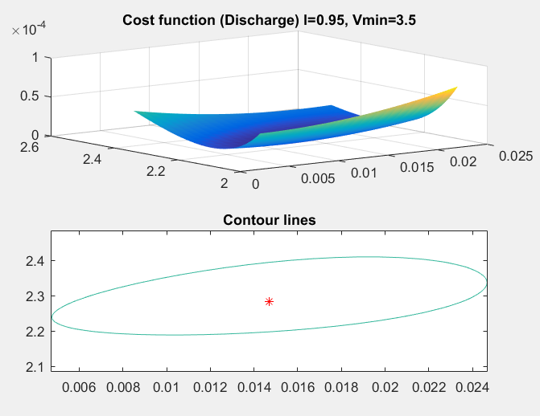
Original Test
I_{max} = 1.00 A
V_{min} = 3.50 V
I_{max} = 0.95 A
V_{min} = 3.50 V
Notes:
In the original test cases we can see the cost functions and contour lines with different maximum current and minimum voltage values.
In the first case 1 ampere and 3.5 voltage with a small contour line.
In the second case 0.95 ampere and 3.5 voltage.

Slide 13
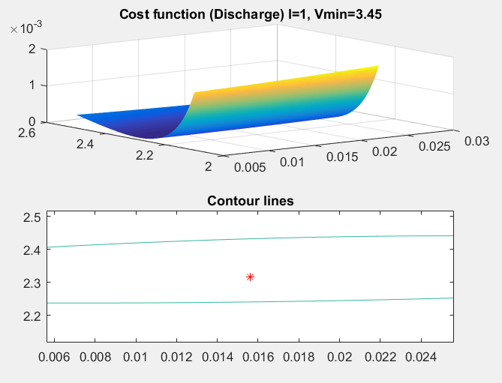
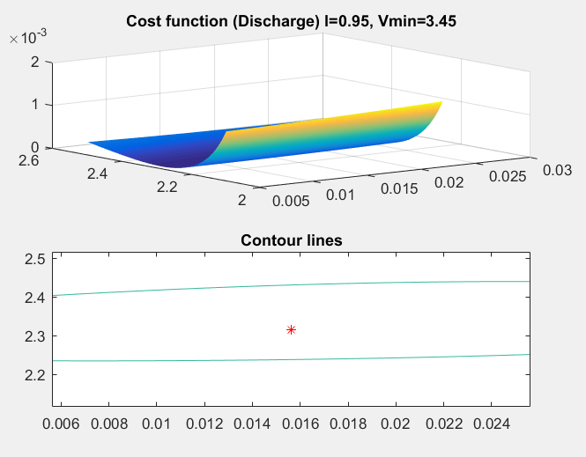
Original Test
I_{max} = 1.00 A
V_{min} = 3.45 V
I_{max} = 0.95 A
V_{min} = 3.45 V
Notes:
Third case: 1 ampere and 3.45 voltage
And in the last case 0.95 ampere and 3.45 voltage.
We can see that just a 0.05 (five-hundredth) change has a lot difference in the cost function and in the contour line too.

Slide 14
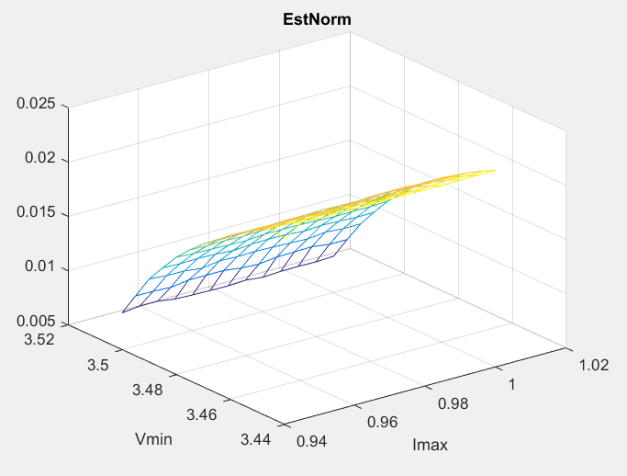
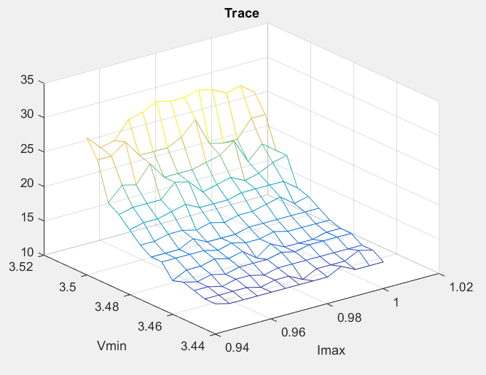
New Test
0.94 A <= I_{max} <= 1.00 A
3.44 V <= V_{min} <= 3.50 V
0.005 accuracy steps
Notes:
In the new test cases, we try to test a lot more and get better results.
So If we try to run a test with the following parameters:
From 0.94 ampere to 1 ampere and from 3.44 voltage to 3.5 voltage with fivethousandth accuracy. We can see the minimum voltage changes are more sensitive.

Slide 15
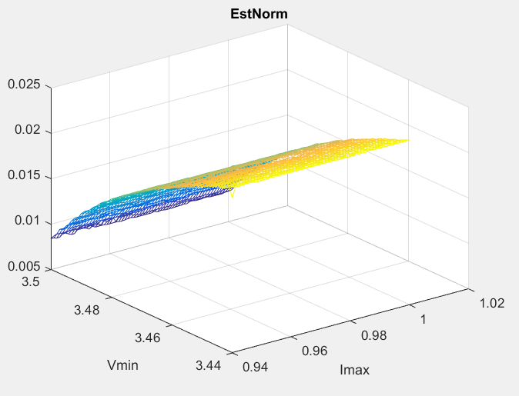
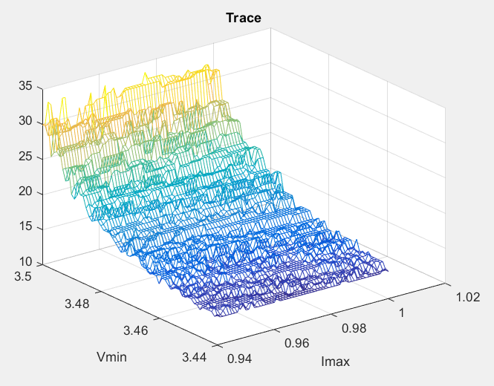
New Test
0.94 A <= I_{max} <= 1.00 A
3.44 V <= V_{min} <= 3.50 V
0.001 accuracy steps
Notes:
If we try the same values but with thousandth accuracy we get a lot better result.
The result is the same. The system is more sensitive to the minimum voltage change than the maximum current change.

Slide 16
Summary
Notes:
Summary

Slide 17
Conclusion and further work
Conclusion:
Simulation improvement based on CC-CV model
Discharge model can be used with higher estimation accuracy
The results show, that only v_{min} has any effect in the norm estimation during the CC-CV cycle
Otherhand: CC-CV is better than other (PRBS) model (PRBS estimation will be presented by Gabor Benyo!)
Further work:
Future work is twofold
Involve parameters (E0 and K) to experiment design
Other: it cannot be stated that this is the best way to estimate parameters for a half-used than a new battery
Notes:
The optimality of the experiment design has been investigated with respect to the estimated trace of the covariance matrix and the measure of nonlinear least squares parameter estimation.
The results show us that only minimum voltage has any effect in the CC-CV cycle. In otherhand: CC-CV is better than PRBS model, which will be presented by Gabor Benyo)
Future work is twofold:
One of the possible directions is to involve parameters E0 and K to the experiment design.
Other possible direction: it cannot be stated that this is the best way to estimate parameters for a half-used than a new battery. So we can improve our experiment design with this change.

Slide 18
Thank you for your attention
Notes:
Thank you for your attention.

