Slide 1
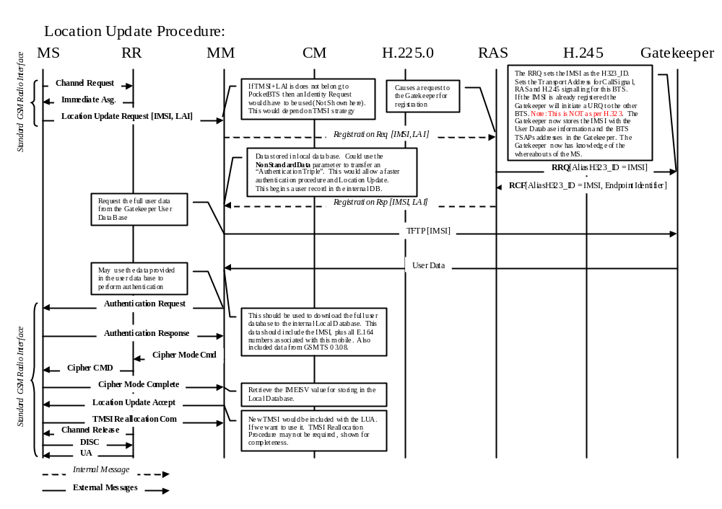

Slide 2
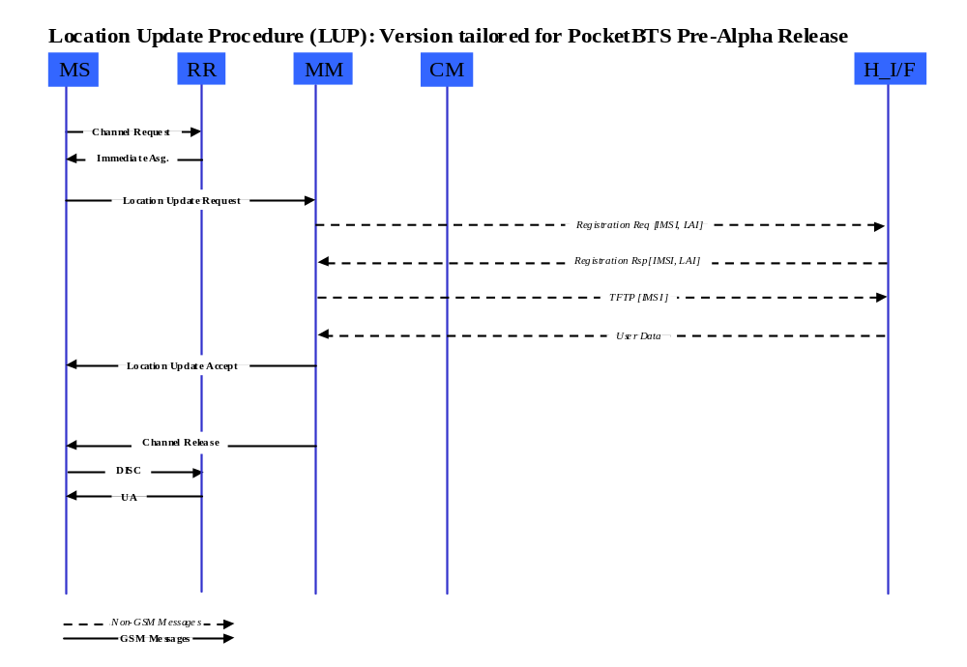
Here the RR should register an entry in the IRT with the new LAPDm channel (SACCH and SDCCH). In there the MM entry should be the MM task. Note that the IRT entry does NOT have to change on a per call basis. The LAPDm instance which was created may be fixed during channel configuration phase.
MD looks into the IRT entry indexed by the LAPDm OID, and found the MM task. It will deliver the LU-Req to MM task.
Pre-Alpha, the data should be stored in the local database (VLR-like) and in the current BTS. No TFTP is needed.
As noted earlier, the LAPDm instance can stay the same for the physical channel and the IRT entry can stay without change. No need to create/delete instance on a per-call basis. So, the IRT entry is intact.

Slide 3
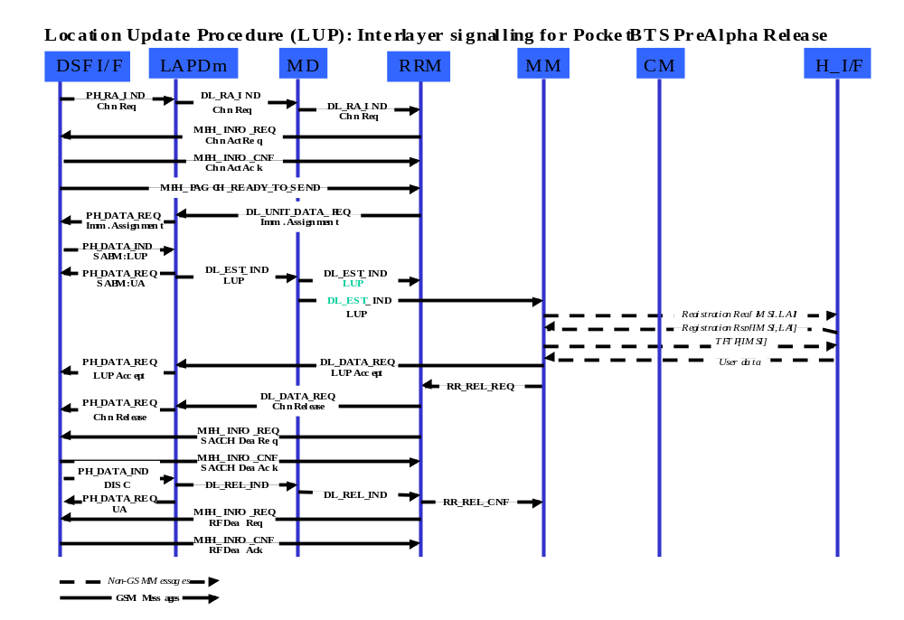
IRT entry for the RACH channel (LAPDm OID) should exist
already. The MM task must already in the entry (pre-configured).
This message will be ignored by the Pre-Alpha Release. Its presence is a reminder for future pages grouping in RRM.
LAPDm deliver the Immediate Assignment via a UI frame
upon receiving PH-READY-TO-SEND from layer-1. No need
for MPH-READY-TO-SEND between layer-1 and layer-3.
Messages flowing between MD, RM, MM
and CM/MCSM always contain module ID and IRT
entry ID except paging requests.
Same comment
Information field in SABM is optional. This only happens
MD decode the L3 PD and found out that this is MM message. Otherwise, the EST_IND only sent to RRM.
Generic comments: LAPDm only sends the
frame out upon soliciting from layer-1
via the receiving of PH-READY-TO-SEND

Slide 4
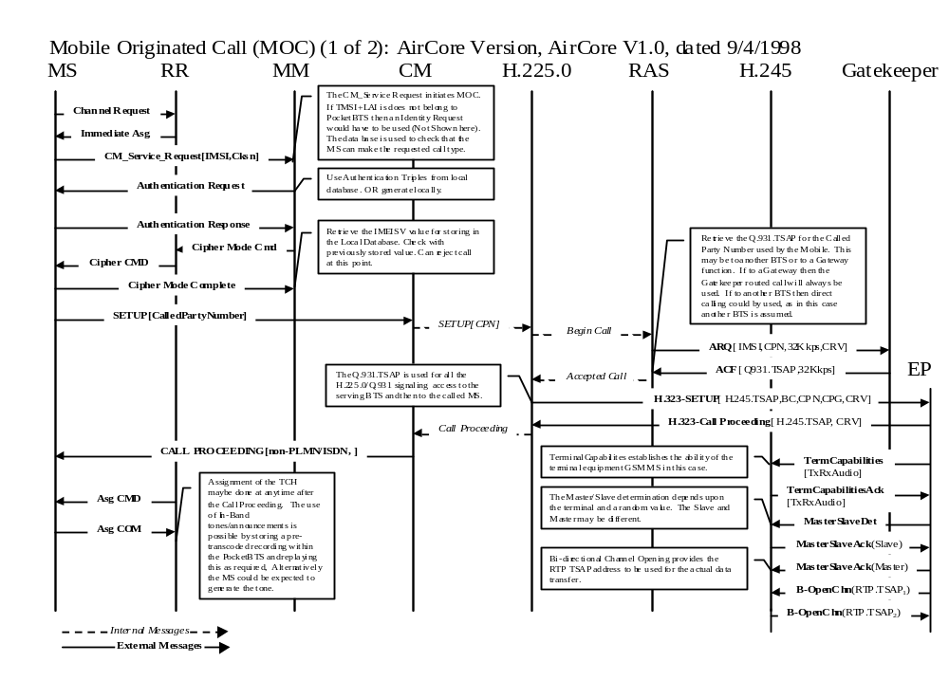

Slide 5
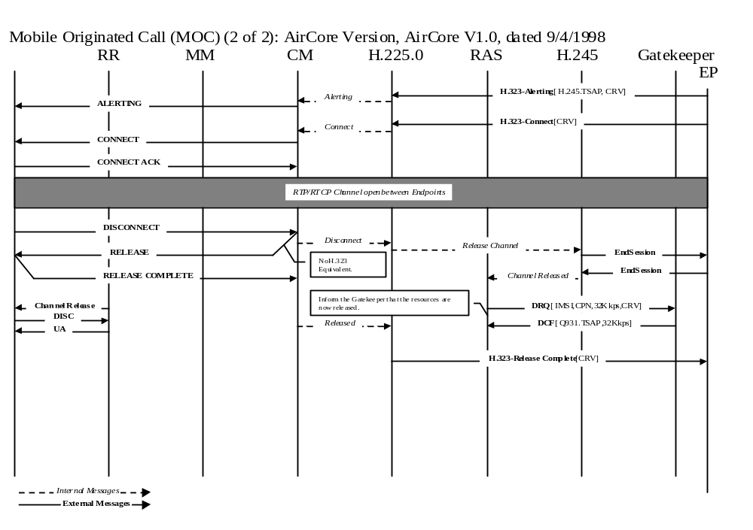

Slide 6
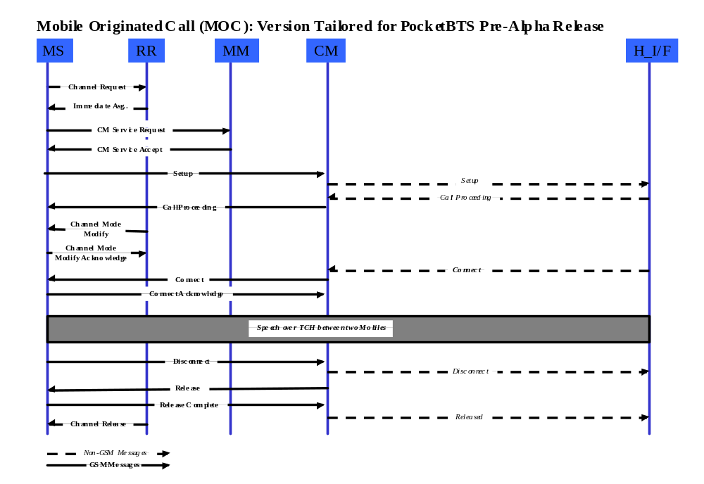
Disconnect from GSM domain.

Slide 7
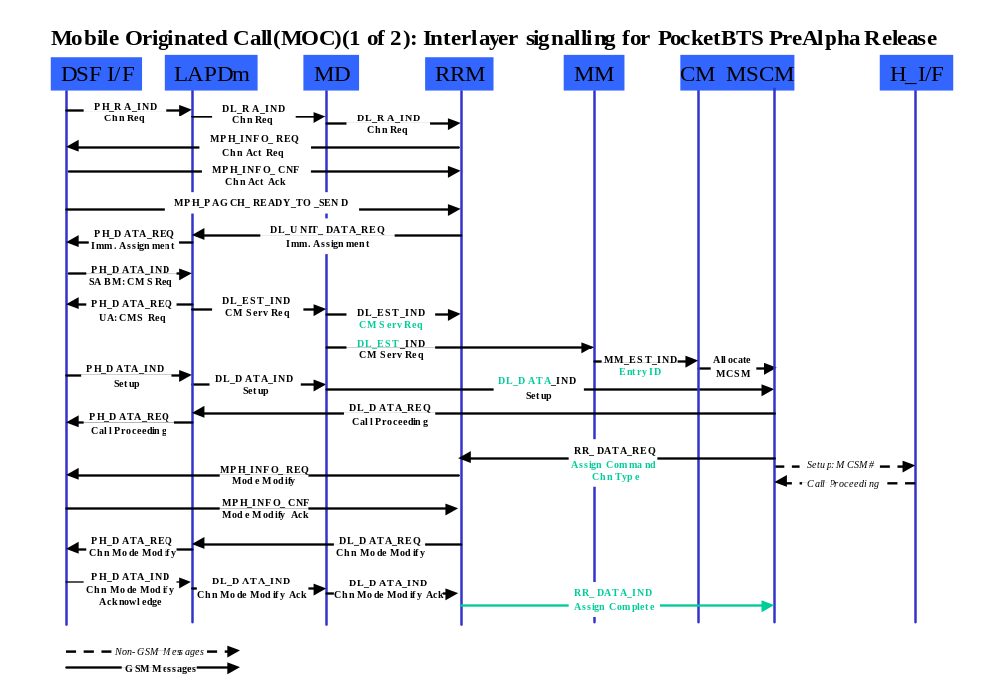
Same
comments
Information field in SABM is optional. This only happens
MD decode the L3 PD and found out that this is CM message. Otherwise, the EST_IND only sent to RRM.
CM should update the IRT entry to indicate the new MSCM’s task ID in the entry. This allows MD to send the SETUP message directly to the newly allocated MSCM.
Same
comments
regarding
L1/L2
interface

Slide 8
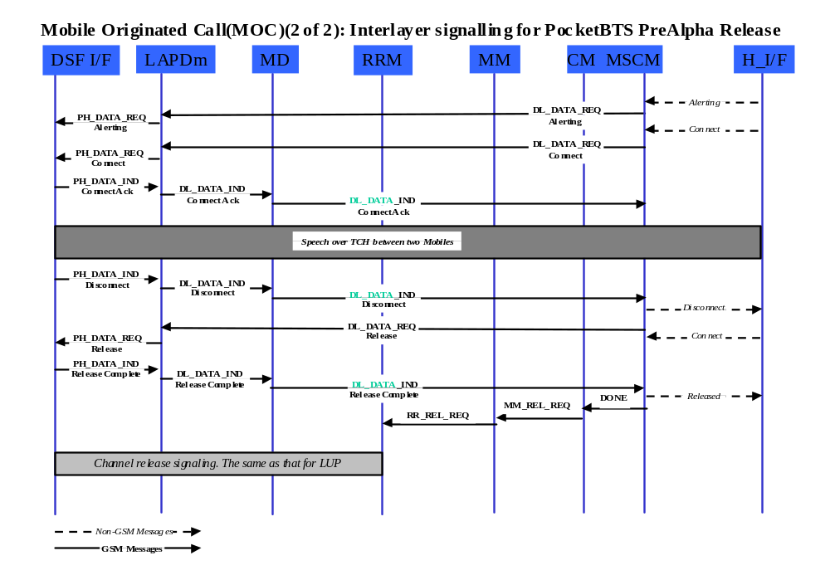
Either CM or MSCM should modify the IRT entry so that the CM messages will be delivered to the CM task by MD for the associated LAPDm channels.

Slide 9
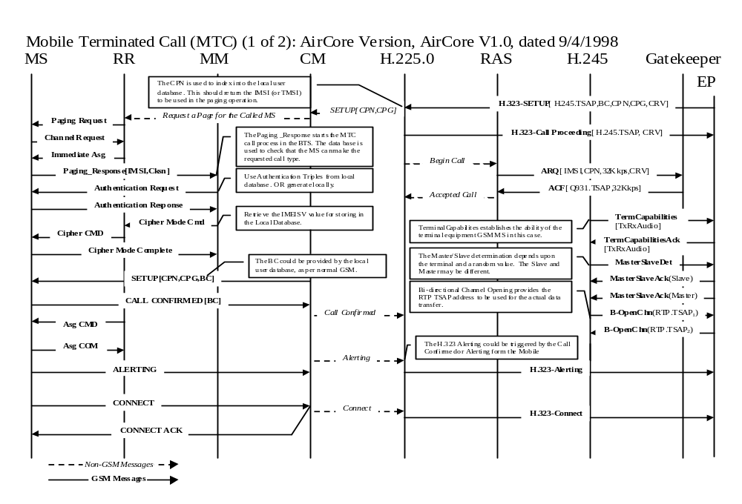

Slide 10
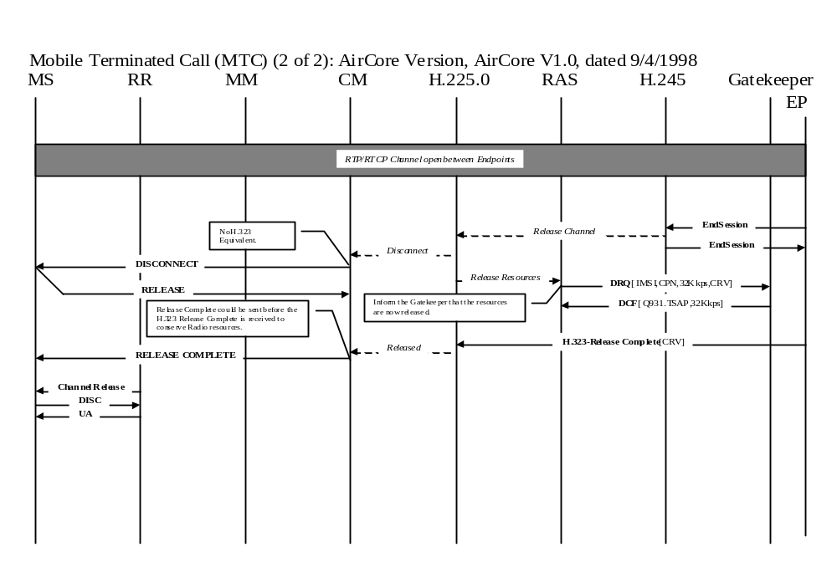

Slide 11
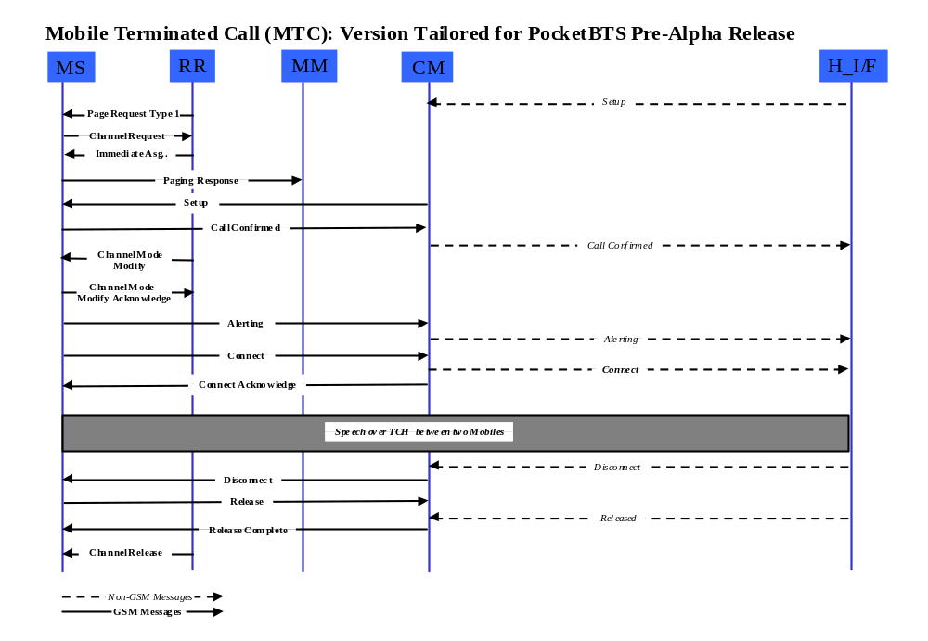
Disconnect from H domain.

Slide 12
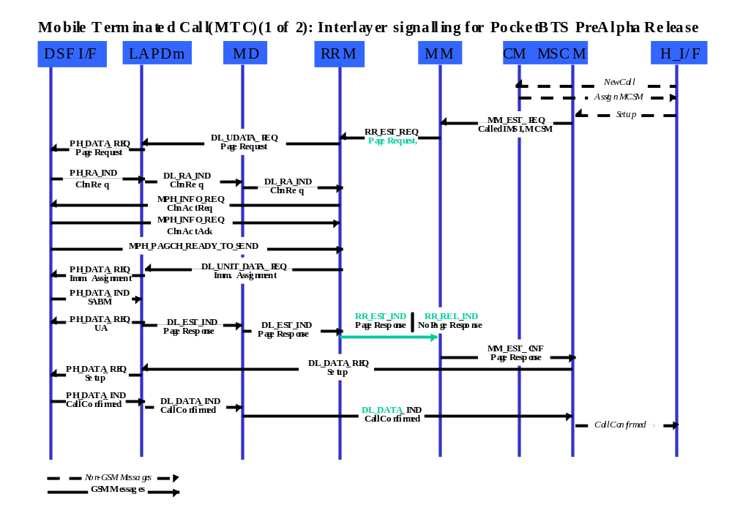
RRM shall associate the MSCM’s task ID with the TMSI or IMST in the paging request locally.
Since CM and MSCM does not know the LAPDm channel yet. SO it has no way of putting itself to the IRT table. The assigned MSCM’s ID should be transported via MM-EST-REQ and RR-EST-REQ
RRM knows which LAPDm channels it assigned for this particular MS. So, it should update the IRT table with the correct MSCM task ID under the CM entry. So that when the MS established the connection, CM messages will be sent to the allocated MSCM by MD
Another way to make sure the IRT entry is correct is for RRM to embed LAPdm channel OID in the RR_EST_CNF and MM_EST_CNF message, and let MSCM do the IRT table update.

Slide 13
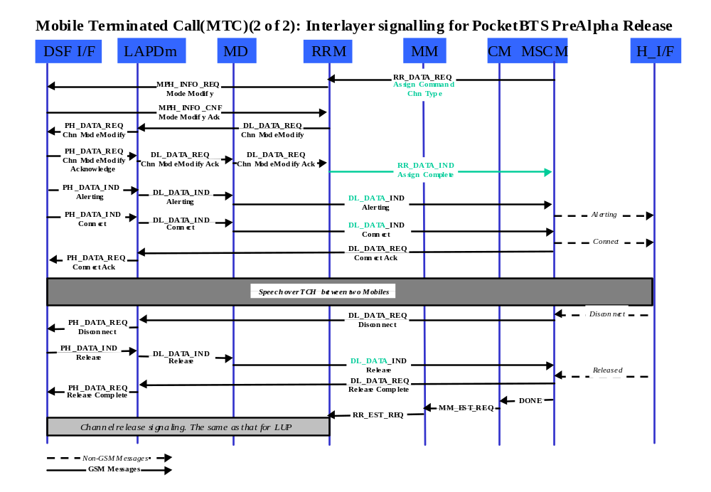
Same
comments
as in page
7 and 8

