Slide 1
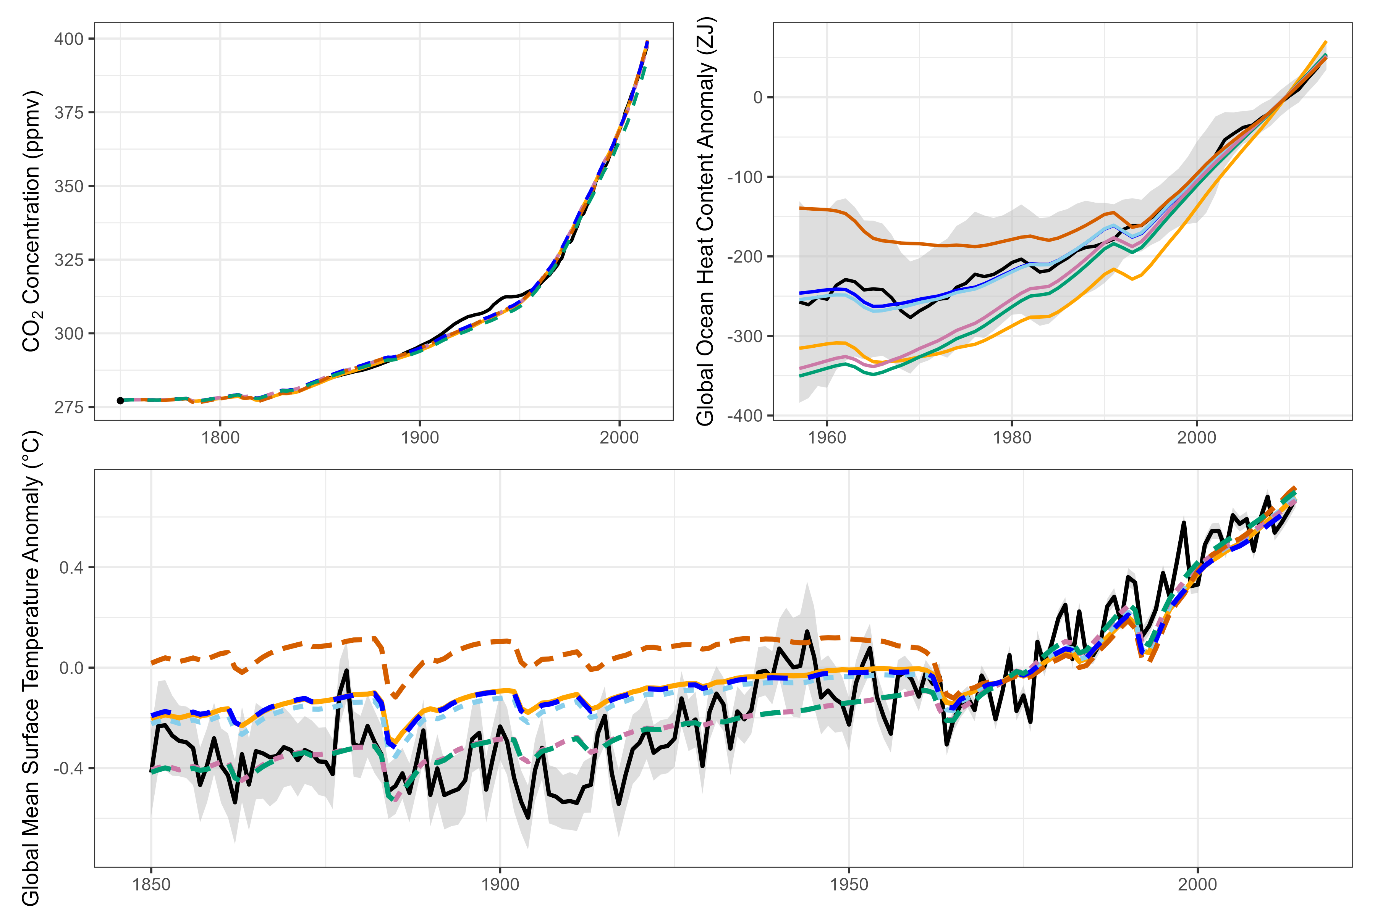
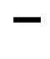
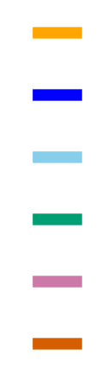
Observations
Meinshausen et al. 2017
Kuhlbrodt et al. 2023
Hector
V3.2.0
E₁
E₂
E_{3, unc}
E_{4, unc}
E₅
Morice et al. 2021

Slide 2
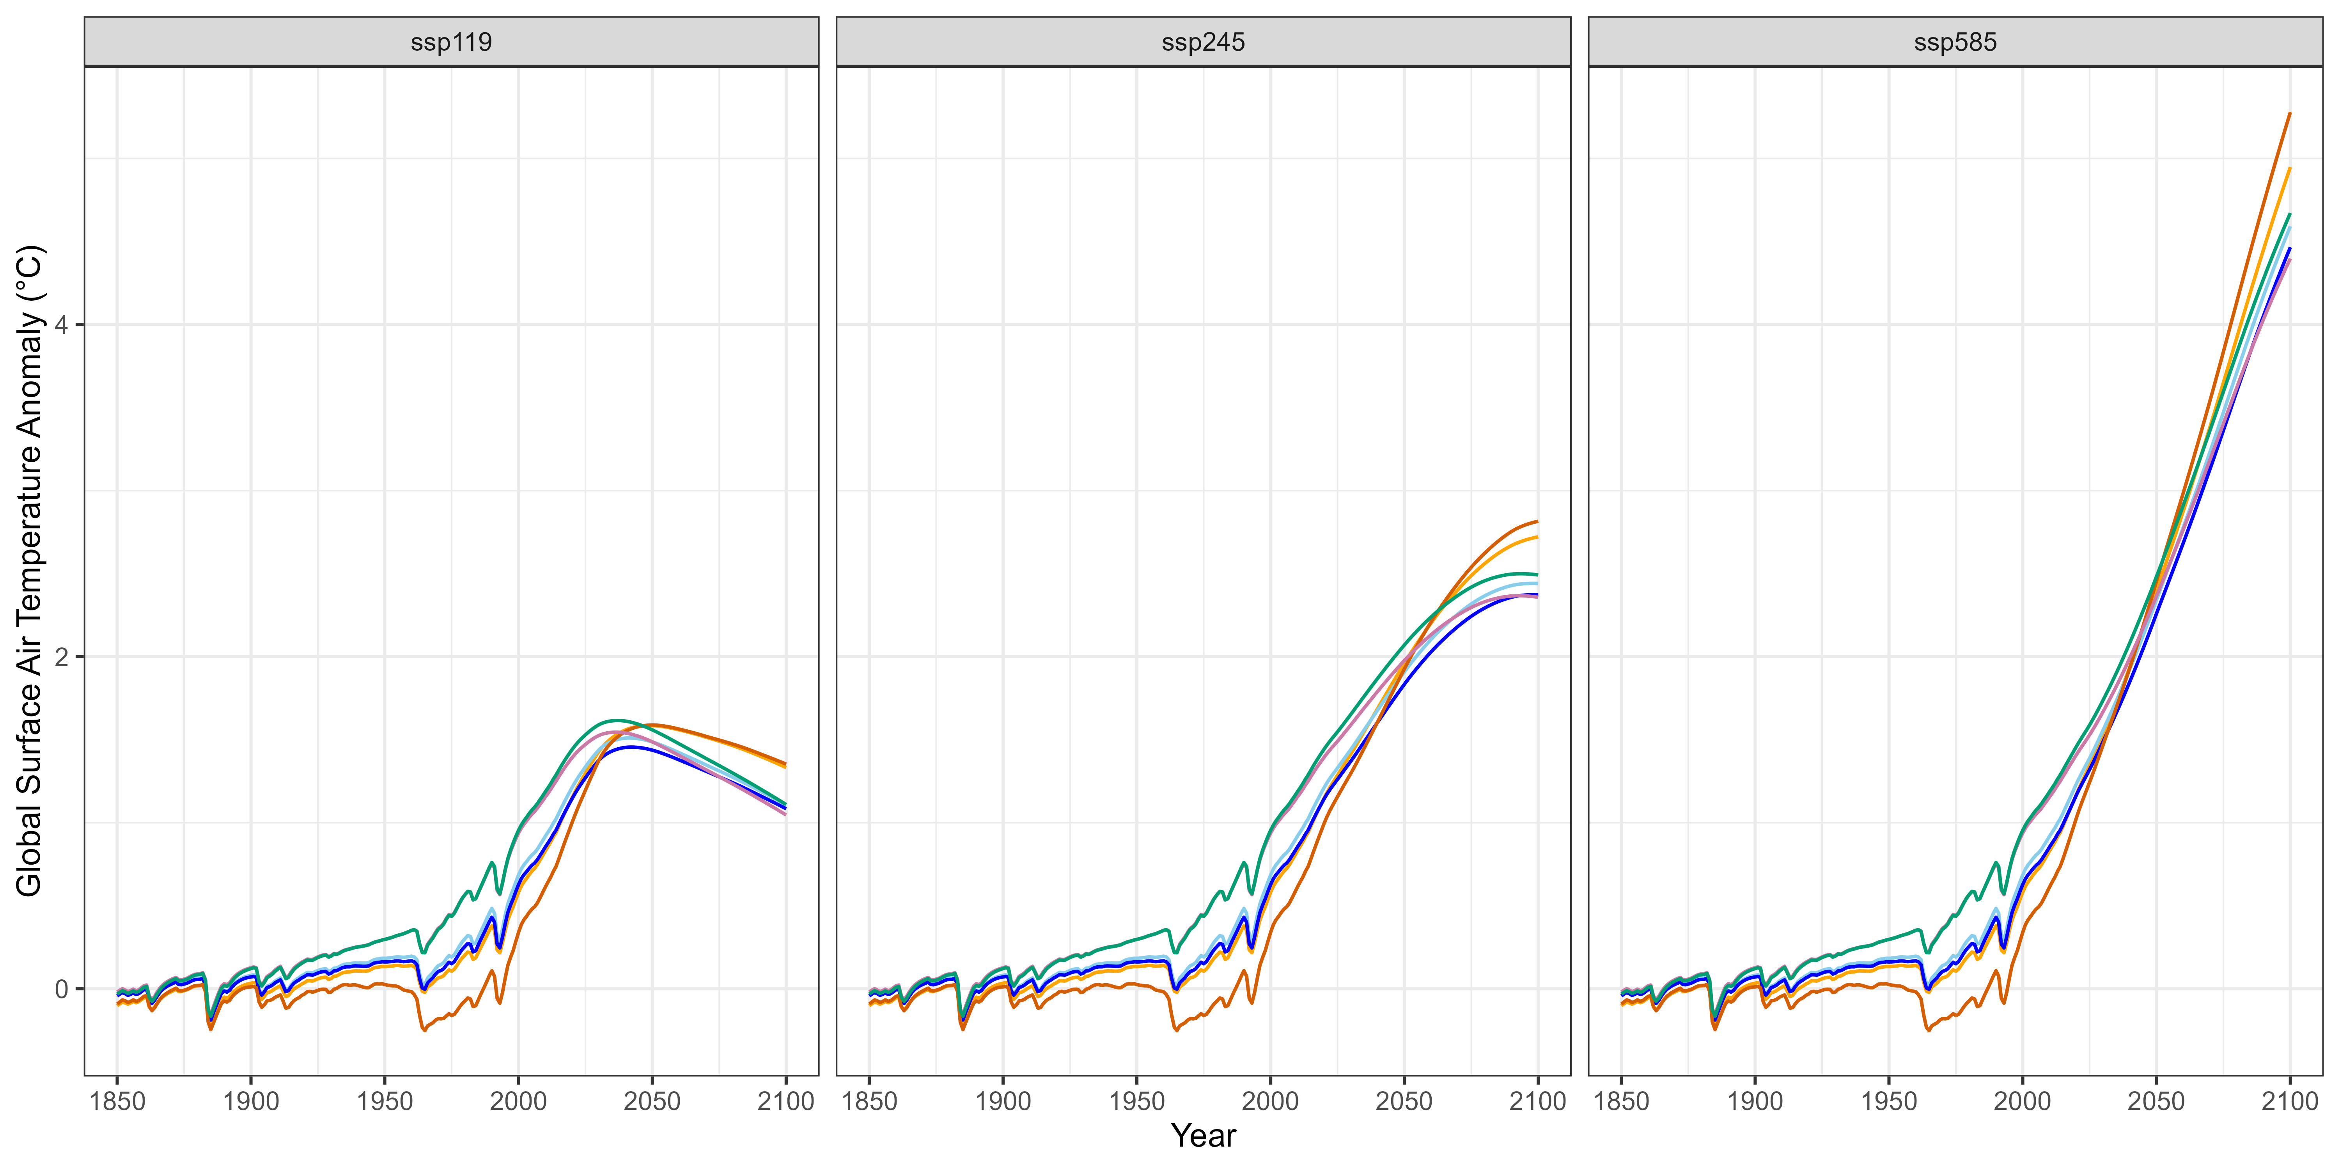
V3.2.0
E₁
E₂
E_{3, unc}
E_{4, unc}
E₅

