Slide 1
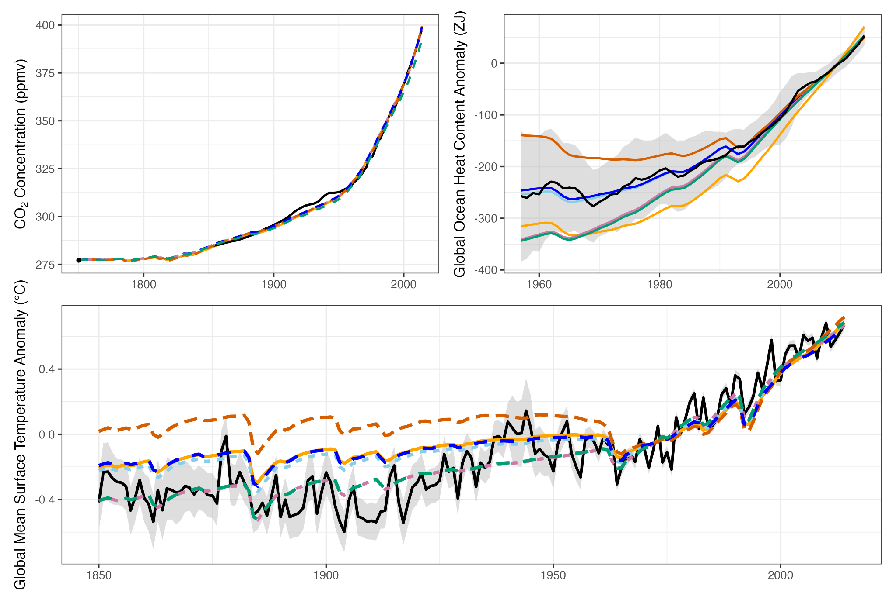
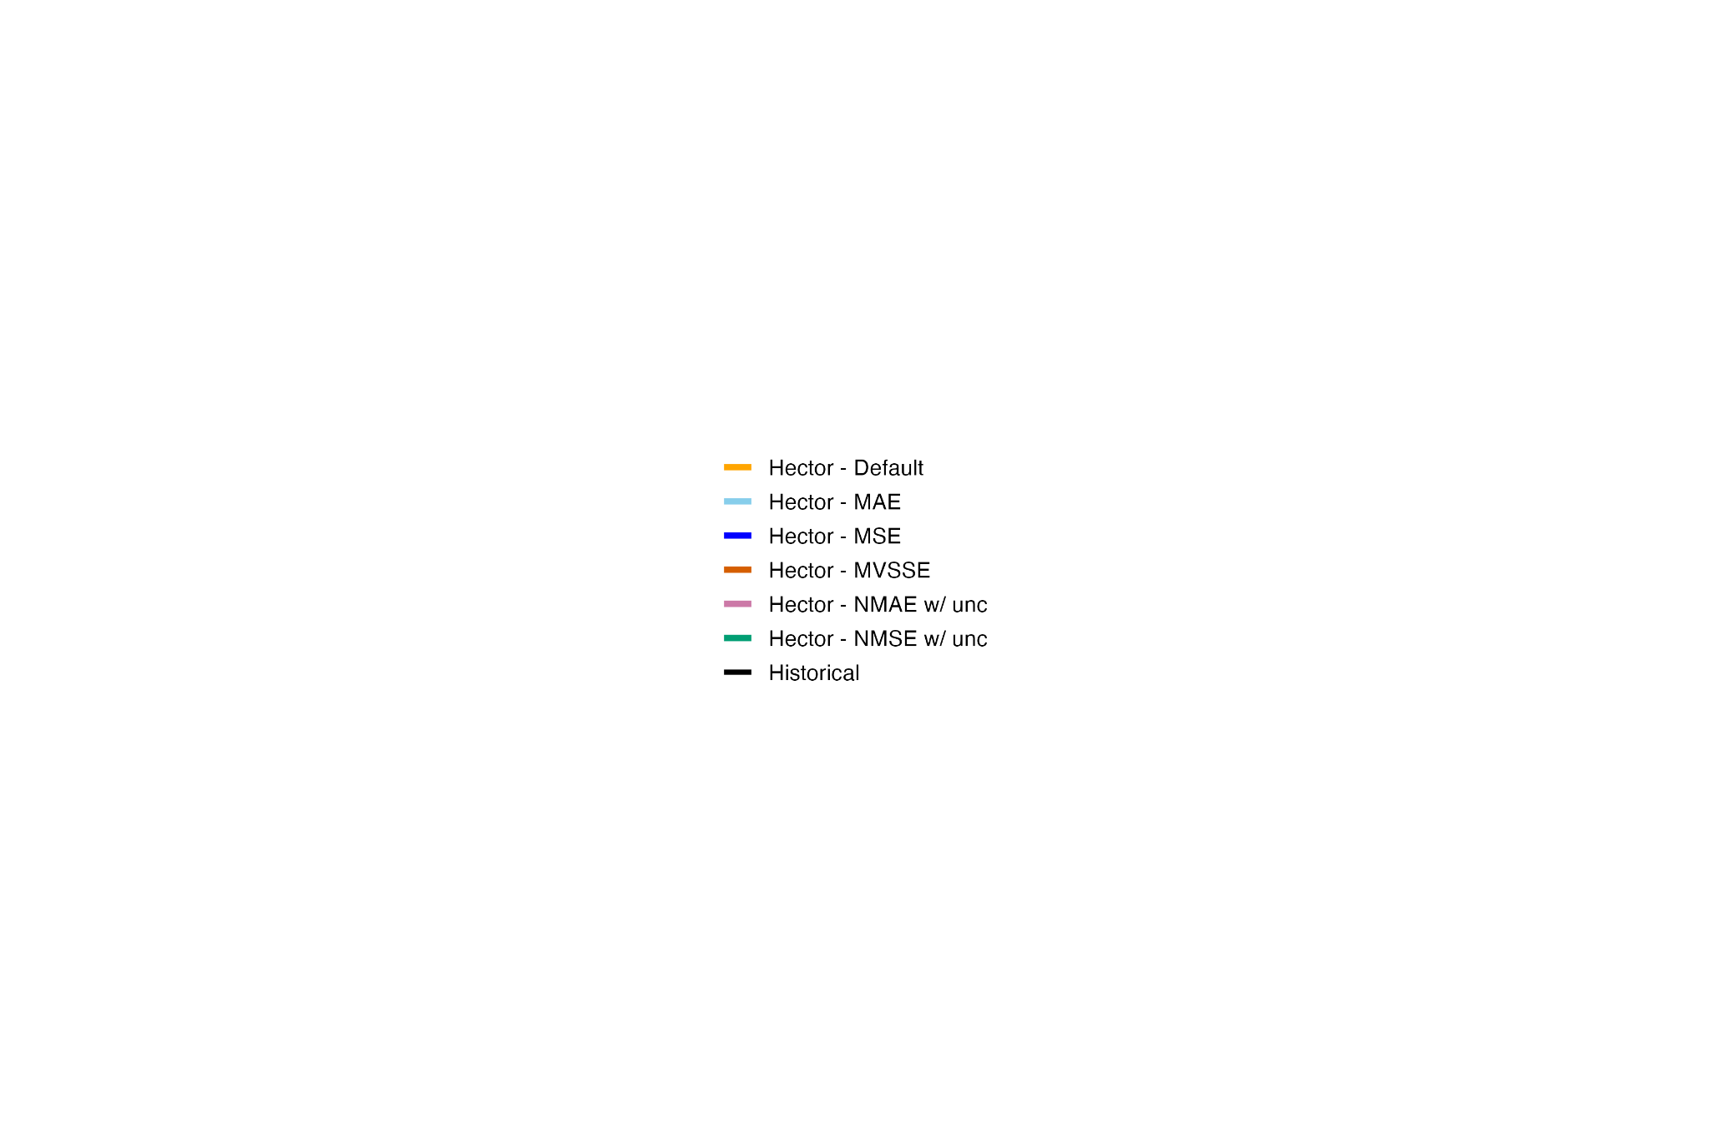
Observations
Meinshausen et al. 2017
Kuhlbrodt et al. 2023
Hector
Default
MAE
MSE
MVSSE
NMAE w/ unc
NMSE w/ unc
Morice et al. 2021

Slide 2
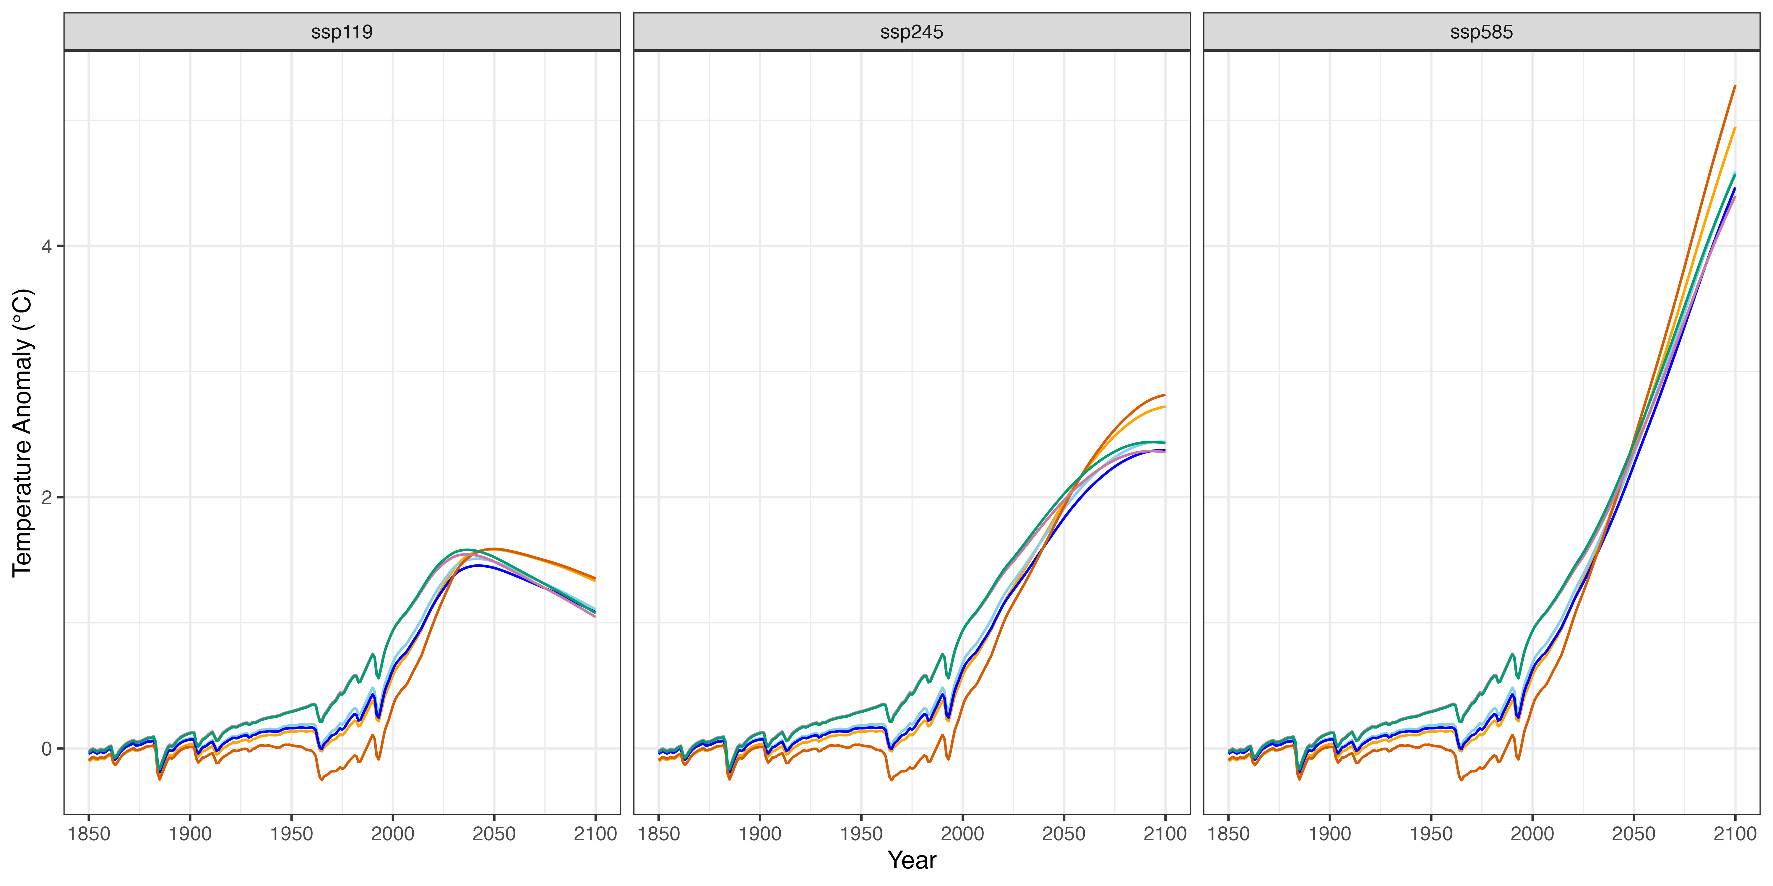
Default
MAE
MSE
MVSSE
NMAE w/ unc
NMSE w/ unc

