Slide 1
Case Study 02: DDSAnalytics
MSDS 6306:Doing Data Science
Phu Truong
Phu Truong

Slide 2
Introduction
DDSAnalytics is an analytics company that specializes in talent management solutions for Fortune 100 companies. To gain a competitive edge over its competition, DDSAnalytics is planning to conduct an analysis of existing employee data regarding:
Top three factors that contribute to Attrition
Build a model to predict Salary
Job role specific trends that may exist in the data set

Slide 3
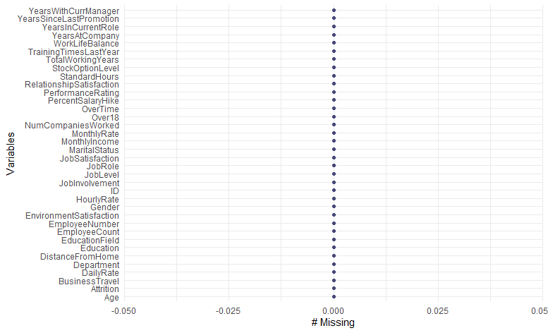
Missing values
There is no missing values in the data set.

Slide 4
Choosing variables for Attrition
After running Linear Regression Fit test for Attrition, there are four variables considered significant (alpha = 0.1):
JobSatisfaction
EnvironmentSatisfaction
JobInvolvement
MonthlyIncome

Slide 5
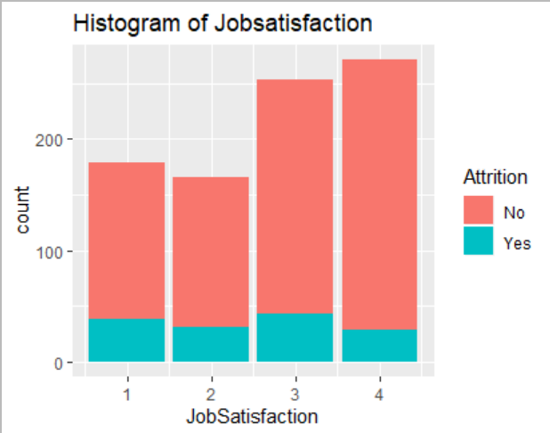
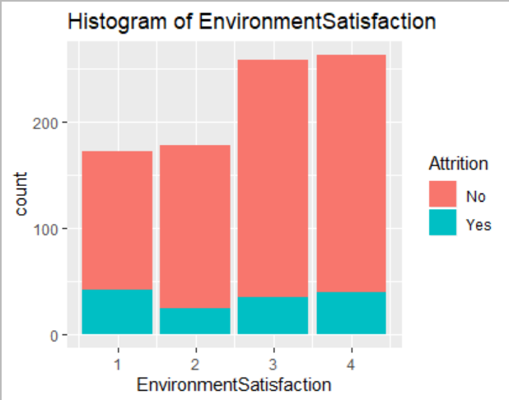
Analyzing variables
As JobSatisfaction levels increase, the Attrition cases decrease.
Increasing EnvironmentSatisfaction level results in less Attrition rate.

Slide 6
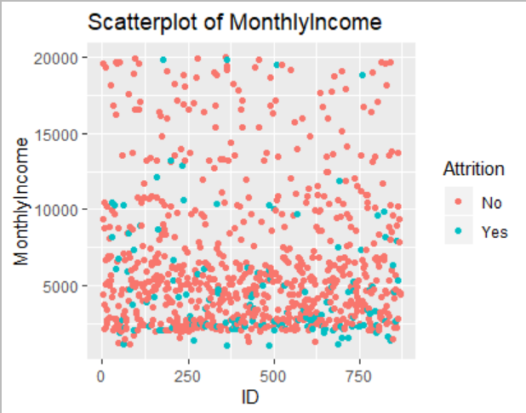
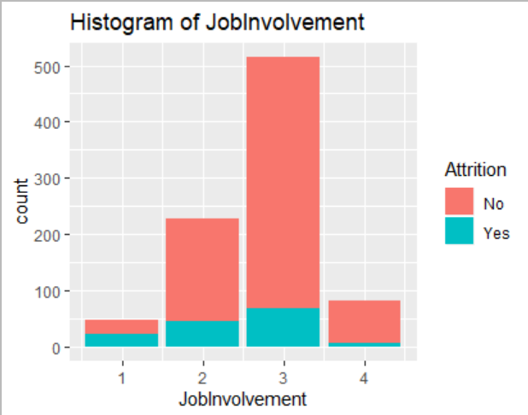
Analyzing Variables (cont.)
Higher income earners are associated with less Attrition.
Increasing JobInvolvement levels result in less Attrition rate.

Slide 7
Naïve Bayes classifiers
A Naïve Bayes model is created based on 4 variables (JobSatisfaction, EnvironmentSatisfaction, JobInvolvement, MonthlyIncome) to classify Attrition.
The data set is split into a training set (570 observations) and a test set (300 observations) to train the model, the mean Accuracy of the model is 83.9% for 100 iterations.
Conclusion: these variables are justified and provides decent accuracy in predicting Attrition for a data set of 300 observations.

Slide 8
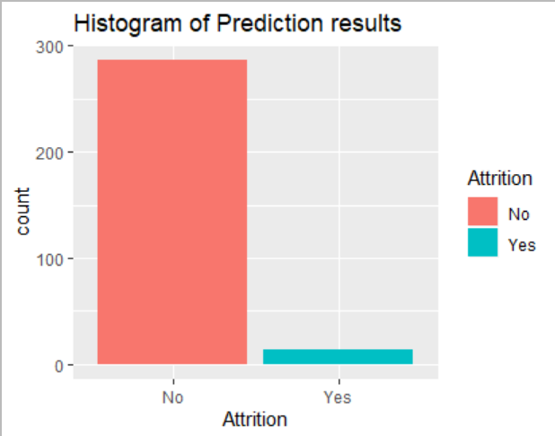

Predicting Attrition

Slide 9
Choosing variables for Salary
After running Linear Regression Fit test for Salary, there are four variables considered significant (alpha = 0.1):
Joblevels
TotalWorkingYears
YearsAtCompany
MonthlyRate

Slide 10
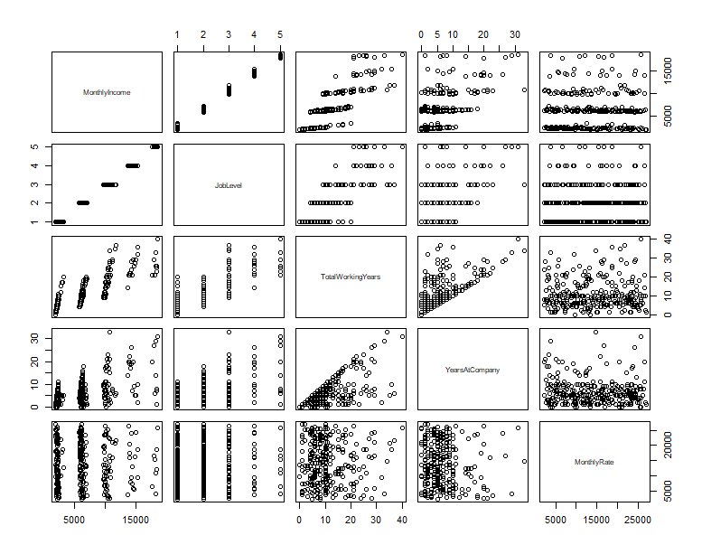
Visualizing data

Slide 11
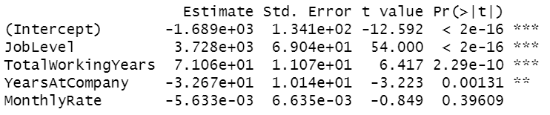
Predicting Salary
Multiple Linear Regression model for Salary:
Adjusted R-squared= 90.96%

Slide 12
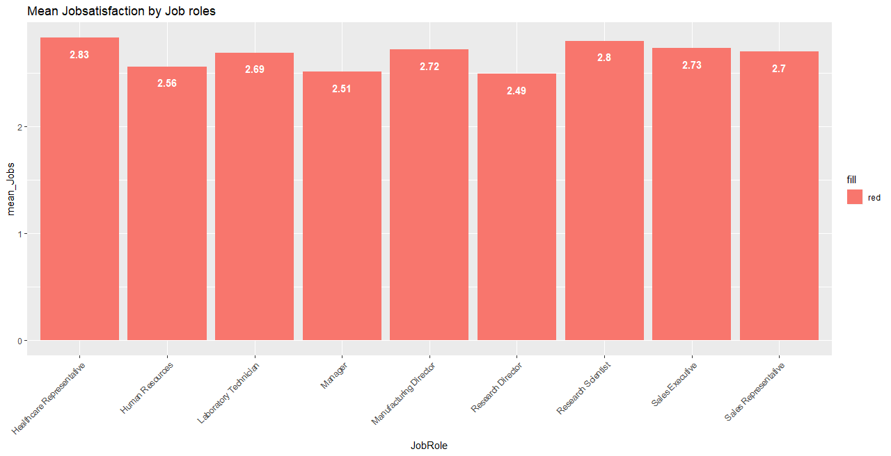
Job roles trend

Slide 13
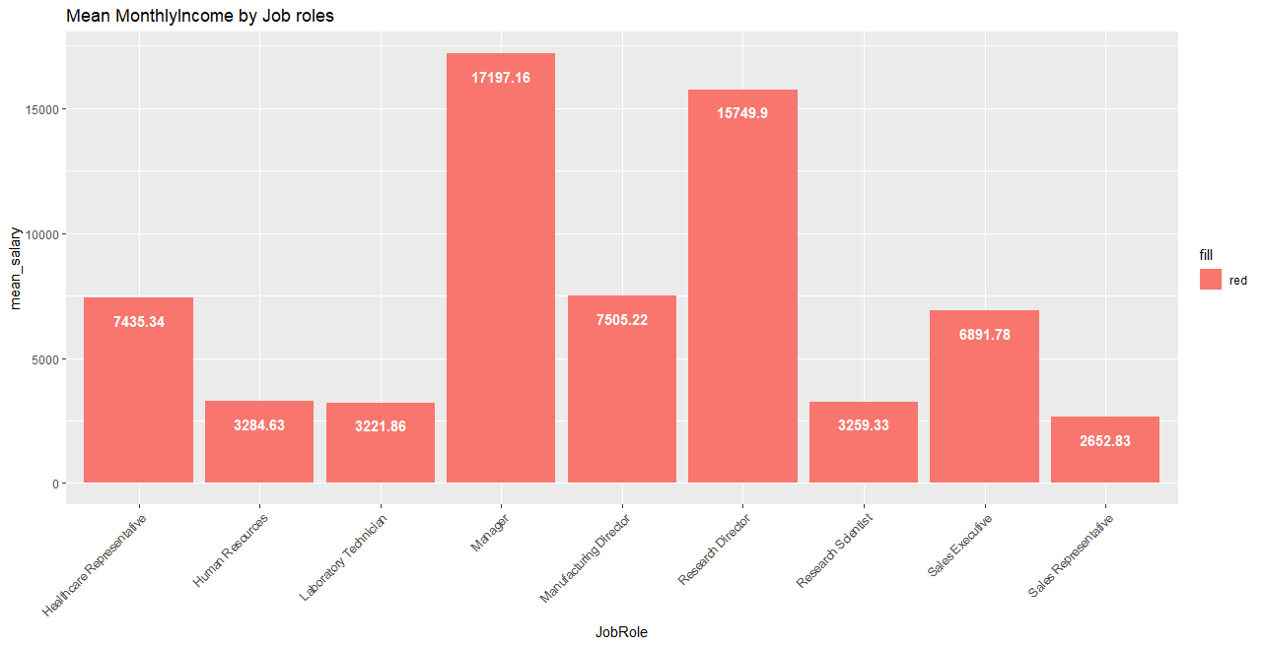
Job roles trend (cont.)

Slide 14
Conclusion
There are 4 factors in the data set that have a strong impact on Attrition: JobSatisfaction, EnvironmentSatisfaction, JobInvolvement ,MonthlyIncome.
Joblevels, TotalWorkingYears, YearsAtCompany, MonthlyRate are the best 4 significant variables in the regression model predicting Salary.
Healthcare Representative and Research Scientist are the most satisfied jobs at the moment with highest mean Jobsatisfaction scores. Manager and Research Director have the highest mean Salary.

Slide 15
VIDEO LINK
https://www.screencast.com/t/4BLLUKP56

