Slide 1
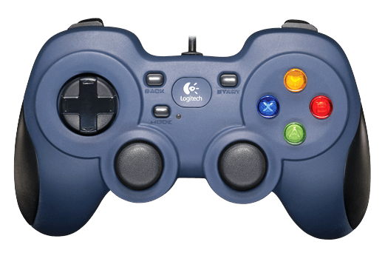
LT: Toggle Setpoint Printing On/Off
RT: Toggle Manual/Preset Mode
LB: Decrement Cup
Disable
Enable
RB: Increment Cup
Increment Angle
Increment Speed
Decrement Angle
Make sure green light Is on
Decrement Speed

