Slide 1


SMART INDIA HACKATHON 2024
Problem Statement ID – 1609
Problem Statement Title- Implementation of the Alumni Association platform for the University/Institute.
Theme- Smart Education
PS Category- Software
Team ID-
Team Name- Orbit Tech

Slide 2

ALUMNI CONNECT
Orbit
Tech
Explanation- The project involves developing a comprehensive Alumni Association platform for the Government Engineering College, available on both web and mobile applications. The platform will facilitate alumni registration, networking, donations, job postings, and event management. Additionally, it will feature advanced functionalities like AI-driven career services, a start-up incubator. The goal is to enhance alumni engagement, foster professional connections, and support college initiatives through an innovative and user-friendly platform.
How it addresses the problem- 1. Boosting Alumni engagement. 2. Facilitating donations 3. Enhancing career support. 4. Promoting achievements. 5. Building community.
Innovation and uniqueness of solution-
1.AI Powered personalization.
2. Alumni start up incubator.
3. Real time collaboration tools.
4. Integrated mentorship.
5. Career Advancement.

Slide 3
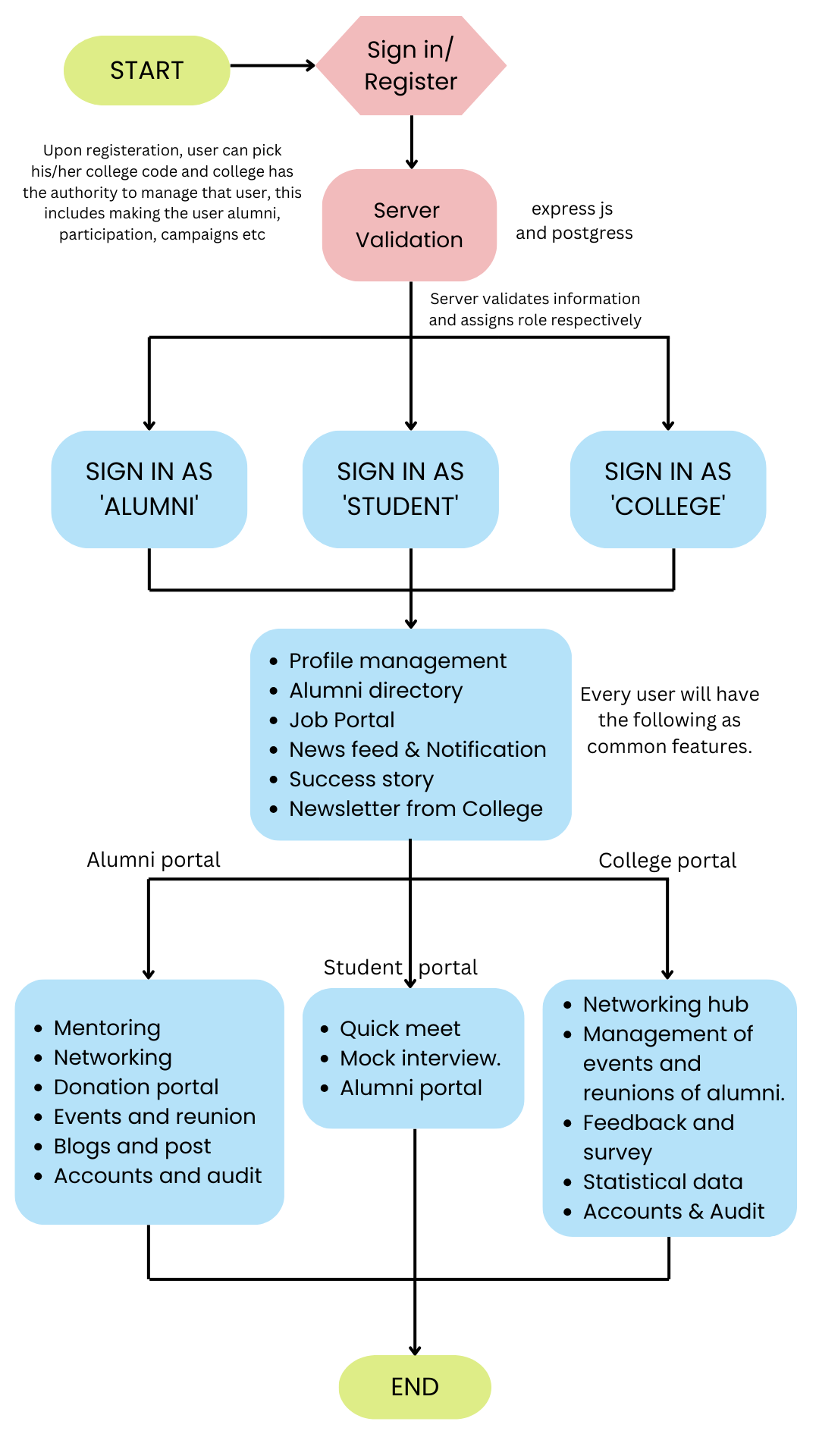
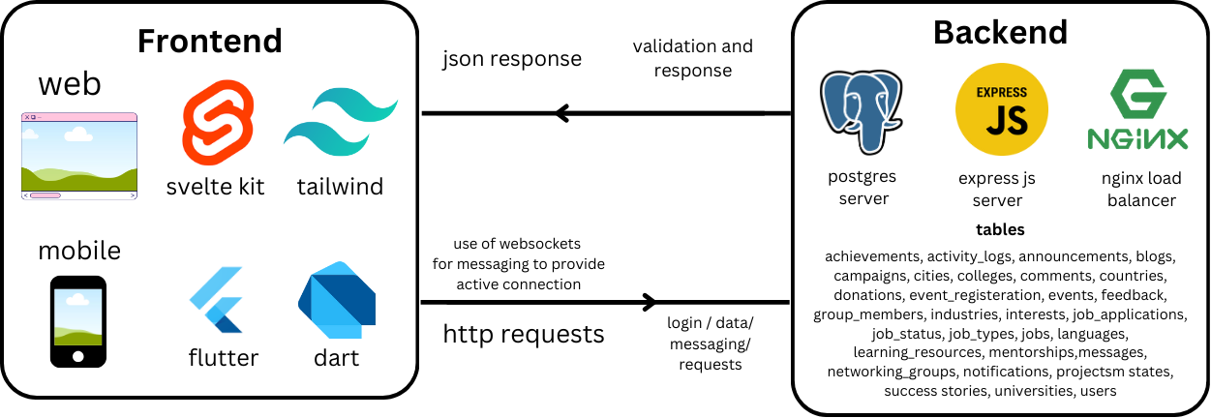
TECHNICAL APPROACH
Orbit
Tech
Client Side (Frontend)
Web App : Svelte Framework , Tailwind CSS classes , Axios library.
Mobile App : Flutter Framework http, file picker, packages
Express JS : For managing all the backend related task, with express validators, JWT and RESTful API.
PostgreSQL : For storing, managing information and handling the database.
NGINX : For load balancing so as to distribute incoming traffic across multiple server instances.
Server Side (Backend)

Slide 4
FEASIBILITY AND VIABILITY
Orbit
Tech
Analysis of the feasibility of idea
•Technological feasibility:
°Technology Stack
°Scalability-It can be designed to scale as the alumni base grows, with cloud hosting options.
°Security- Data encryption, secure payment gateways.
°Integration- The system can integrate with existing college databases for job listings and payment processing.
•Operational feasibility:
°Maintenance
°User Support
°Content management- (Success stories, events)
•Financial feasibility:
°Initial development cost
°Ongoing costs
°Revenue generation
•Legal feasibility:
°Data privacy
°Payment processing compliance
•User Adoption feasibility:
°User-friendly design
°Marketing and outreach
°Incentives for use
•Time feasibility:
°Development timeline
°Phased Rollout
Potential challenges and risks
1. Technical Complexity
2. User Adoption
3. Data Privacy
4. Maintenance Costs
5. Content Management
6. Security Risks
7. Timeline Delays
8. User Engagement
9. Financial Risks
Strategies for overcoming these challenges
1. Modular development, thorough testing
2. Incentives, targeted outreach, intuitive design
3. Strong encryption, regular audits, compliance
4. Budget allocation, sponsorships, prioritize essentials
5. Dedicated team or automate content updates
6. Regular security checks, strong authentication
7. Realistic timelines, agile approach
8. New features, active promotion, feedback loop
9. Financial contingency, diverse funding
10. Plan upgrades, monitor industry trends

Slide 5
IMPACT AND BENEFITS
Orbit
Tech
Impact and benefits to audience(Small,medium,big institutions)-
•Strengthens connections between alumni, students and the institution. •Provides job search tools, mentorship opportunities, and career advices. •Highlights notable alumni achievements •Promotes lifelong relationship among alumni and institutions. •Offers a platform for student entrepreneurs to find resources and investors. •Regular updates and feedback integration ensure the platform evolves with user needs.
•Increased philanthropic contributions.
•Facilitates meaningful professional and personal connections. •Offers a modern, engaging user experience.

Slide 6
RESEARCH AND REFERENCES
Orbit
Tech
Papers:
SciELO - Brazil - PROPOSITION OF AN ALUMNI PORTAL BASED ON BENCHMARKING AND INNOVATIVE PROCESS PROPOSITION OF AN ALUMNI PORTAL BASED ON BENCHMARKING AND INNOVATIVE PROCESS
(PDF) Bridging the Gap Between Universities and Alumni: A User-Centered Evaluation of a Digital Alumni Engagement Platform (researchgate.net)
Market Research about other applications:
Vaave: Vaave - Alumni Engagement Programs for Educational Institutions
Almashines: For Colleges & Universities - AlmaShines
Other sources:
ChatGPT | OpenAI
Google Scholar
ResearchGate | Find and share research
Best Alumni Management Software 2024 - Reviews on 60+ Tools | GetApp

