Slide 1
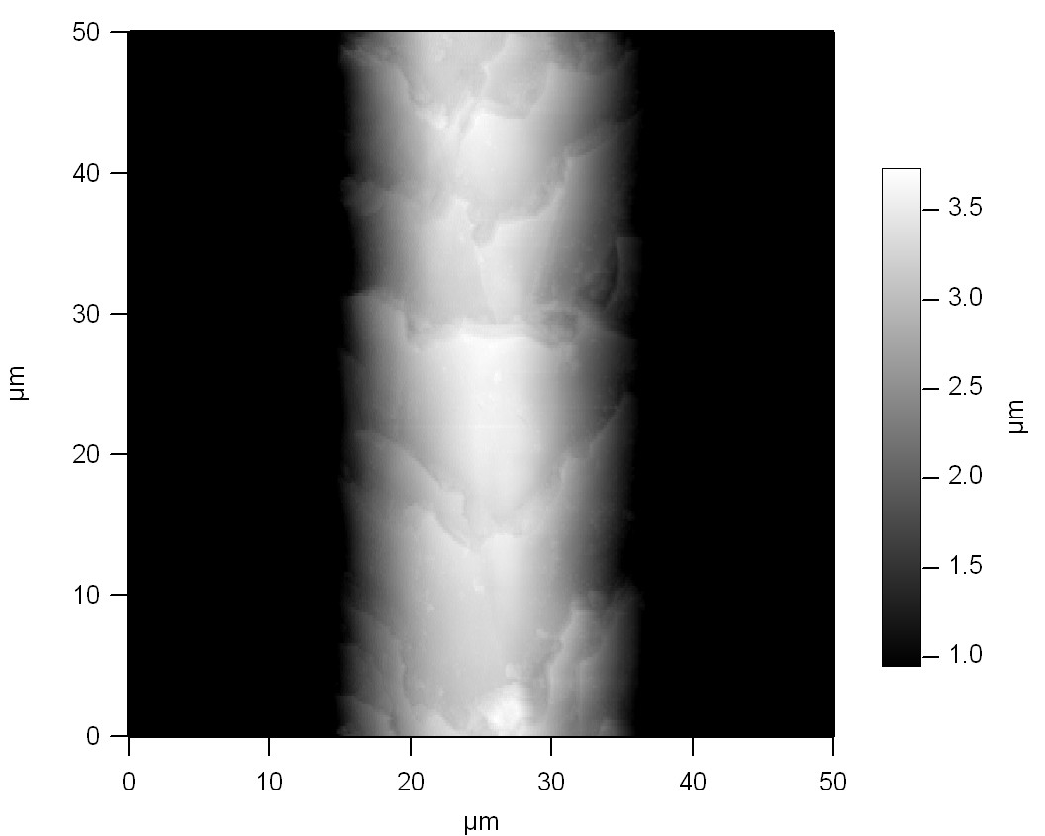
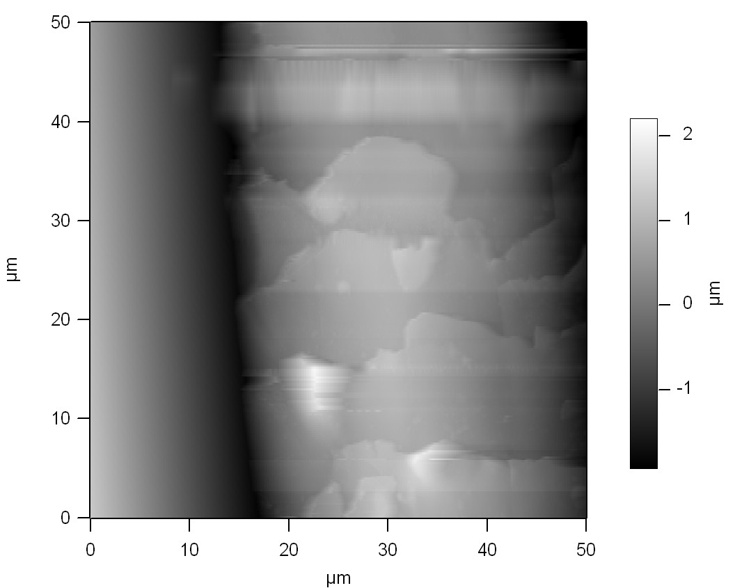
Human vs. Dog Hair
50 µm scan
The dog hair is clearly thicker. It appears to have a diameter of ~30µm while the human hair is ~25µm thick. The segments of the dog hair appear to be smaller. They appear to be about 10µm while the human hair is ~15µm. Also the human hair appears to have more uniform segments than that of the dog hair. The human hair has higher roughness of 2.398 µm, while the dog hair has a roughness of 618.3 nm.

Slide 2
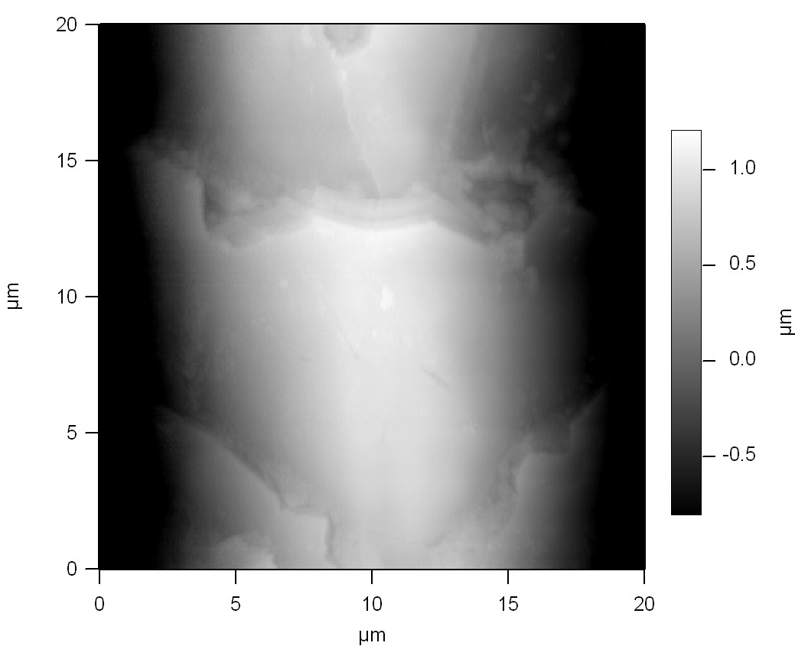
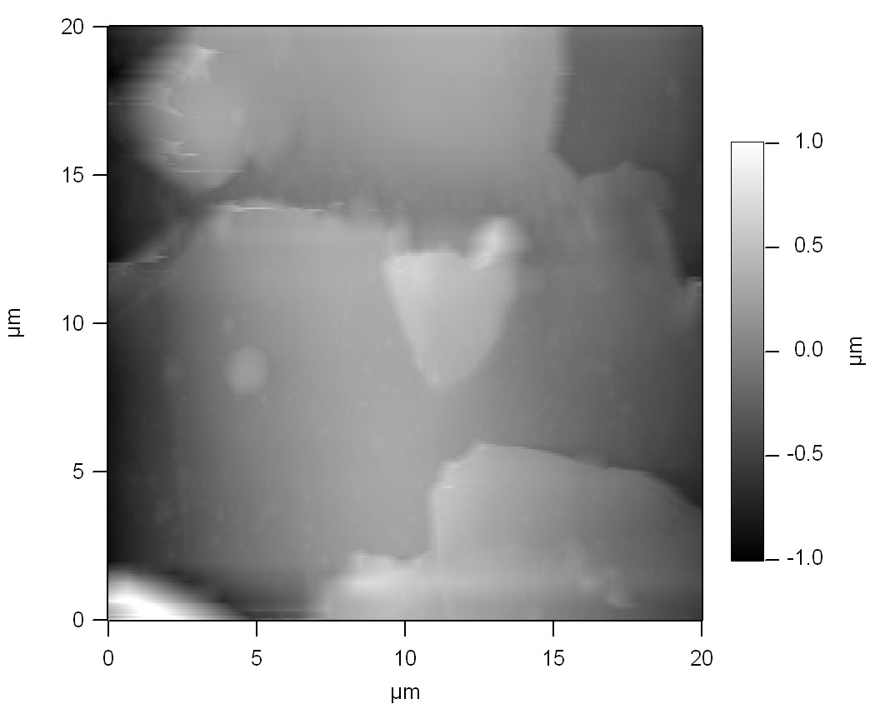
Human vs. Dog Hair
20 µm scan
The human hair has a roughness of 762.6 nm and the dog hair has a roughness of 328.7nm. Once again we can see the dog hair has larger segments that are more chaotic than those of the human. It is also still thicker than then human hair.

Slide 3
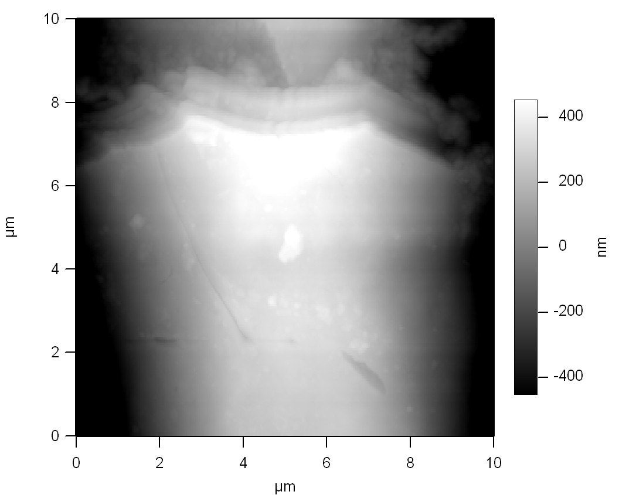
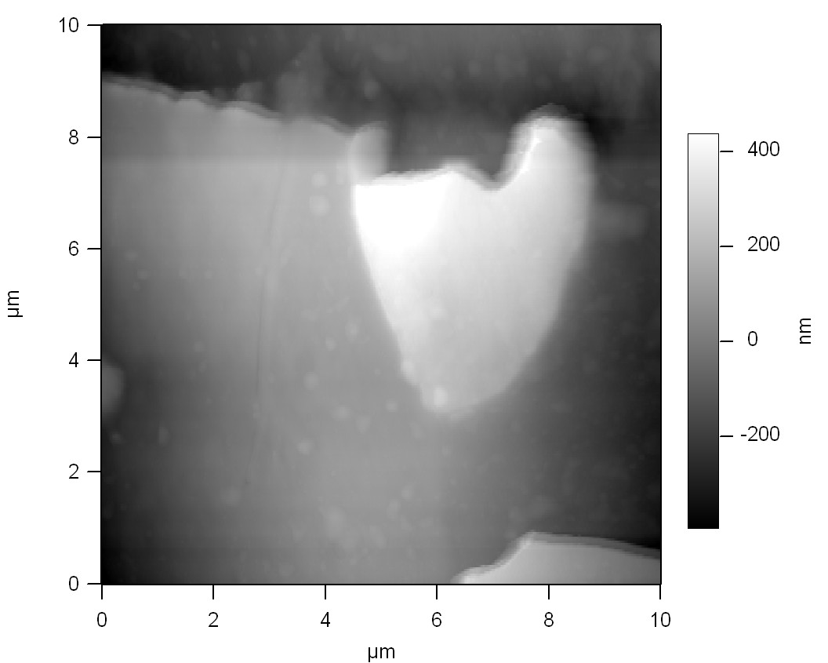
Human vs. Dog Hair
10 µm scan
The human hair has a roughness of 310.5nm, while the dog hair roughness is still less at 183.4 nm,

Slide 4
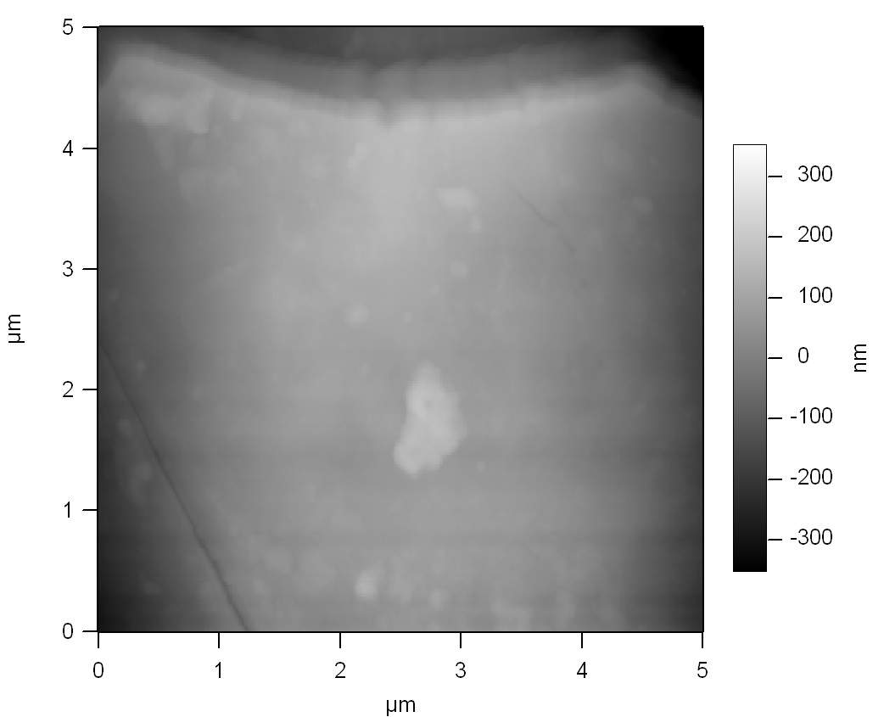
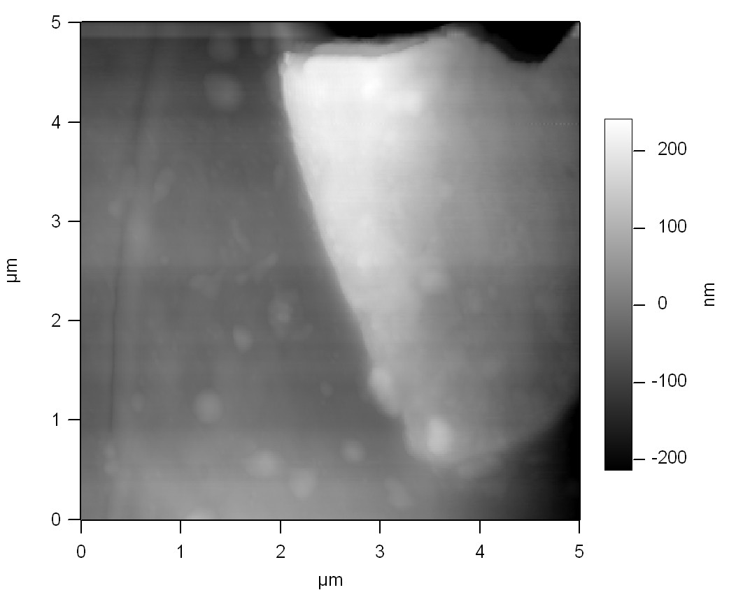
Human vs. Dog Hair
5 µm scan
The human hair has a roughness of 99.9 nm and the dog hair has a roughness of 89 nm.

Slide 5
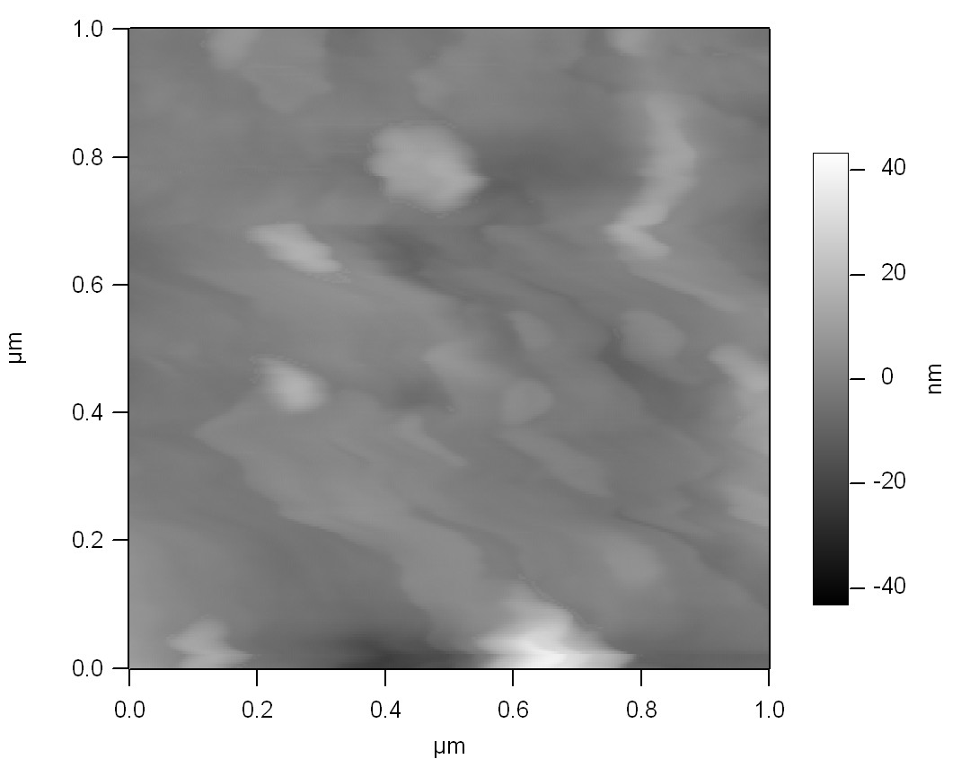
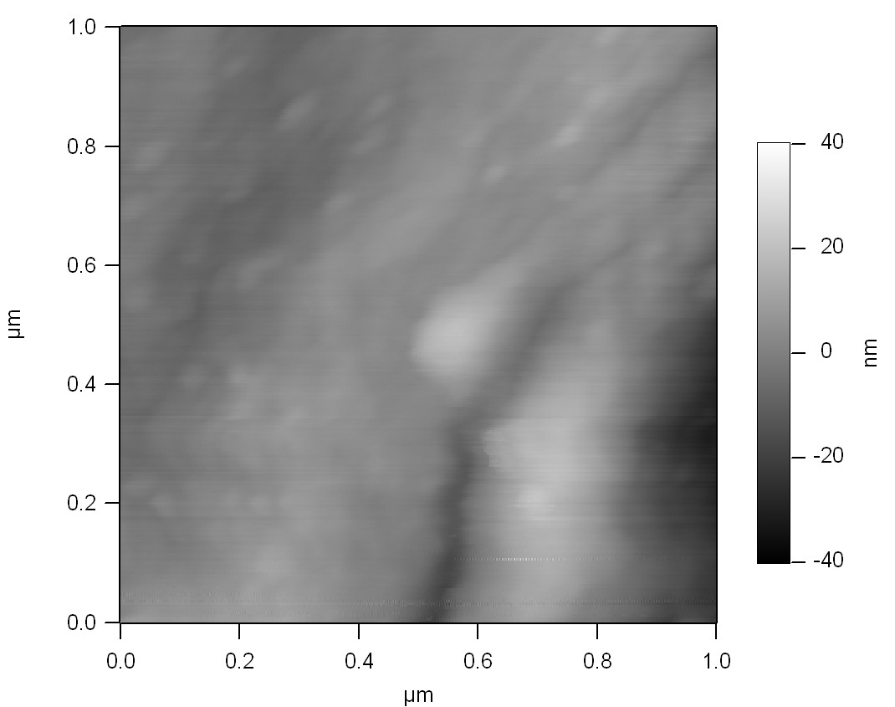
Human vs. Dog Hair
1 µm scan
The human hair has a roughness of 5.7 nm while the dog hair’s roughness of 5.6 nm

Slide 6
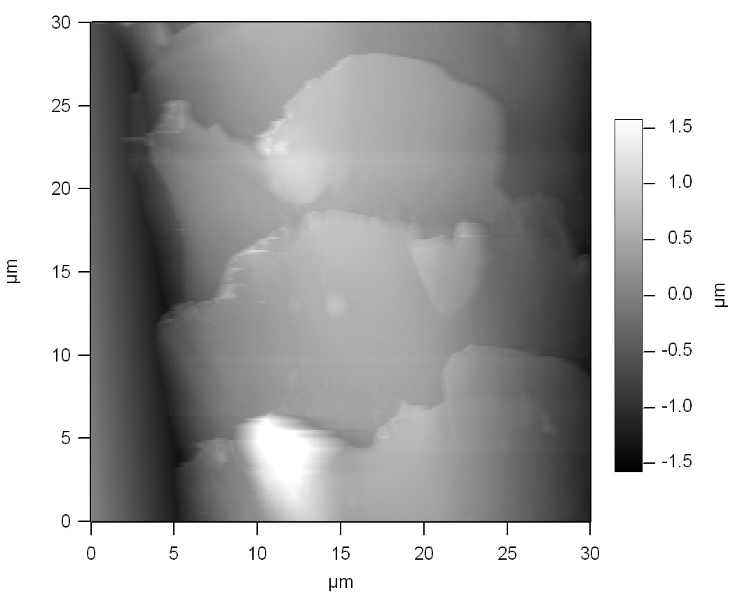
Honorable Mention
Image of 30µm Dog hair

Slide 7
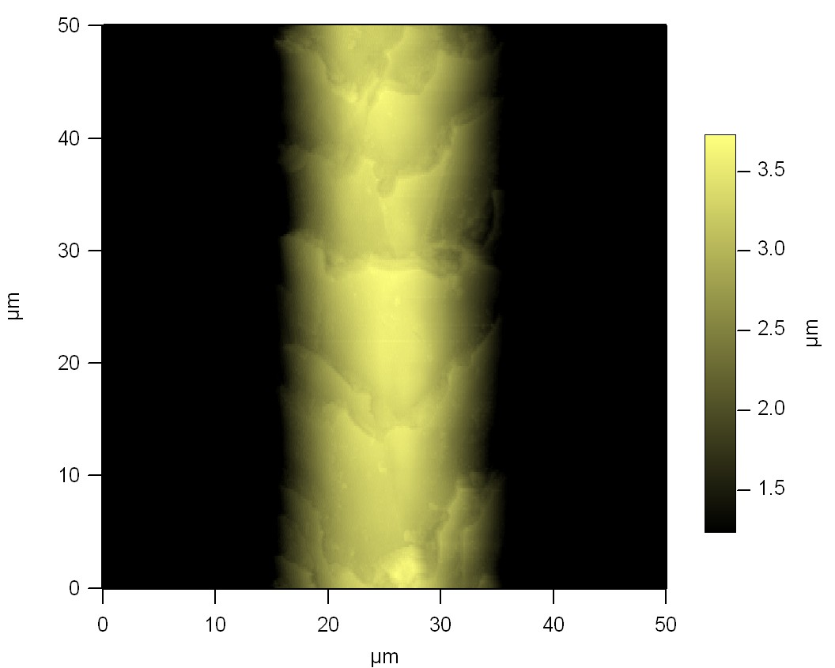
Color Pictures (Human)

Slide 8
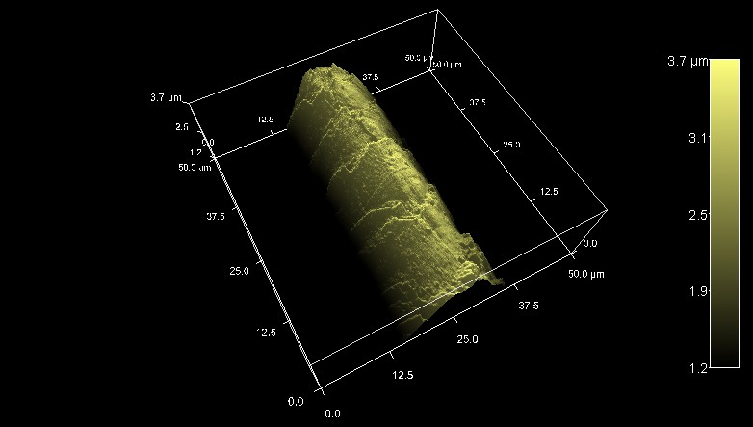
Color Pictures( 3D Human)

Slide 9
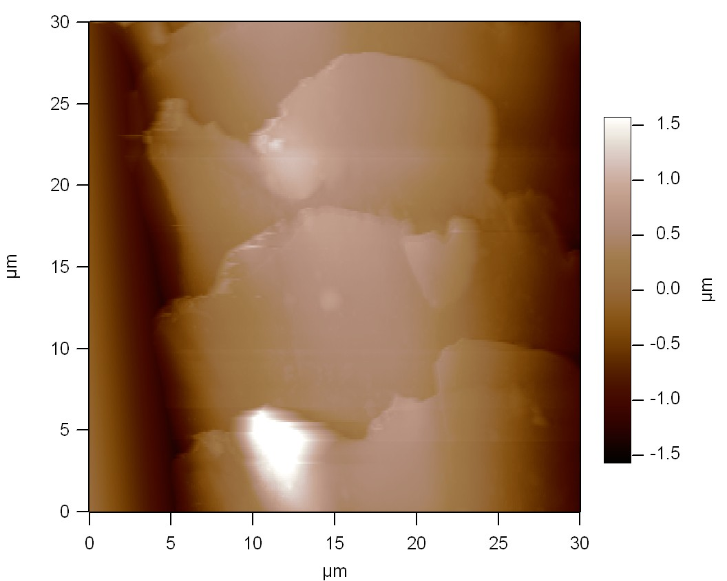
Color Picture (Dog)

Slide 10
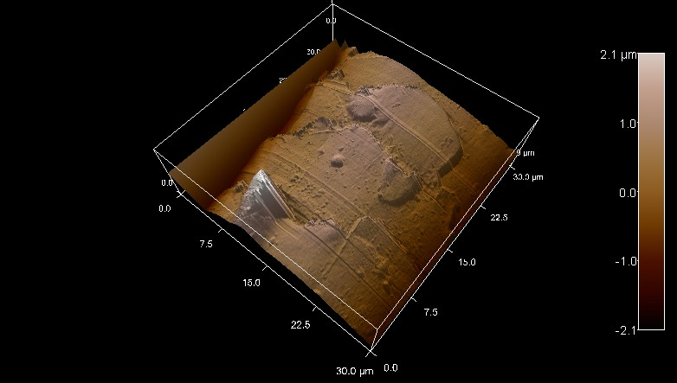
Color Pictures (3D Dog)

Slide 11
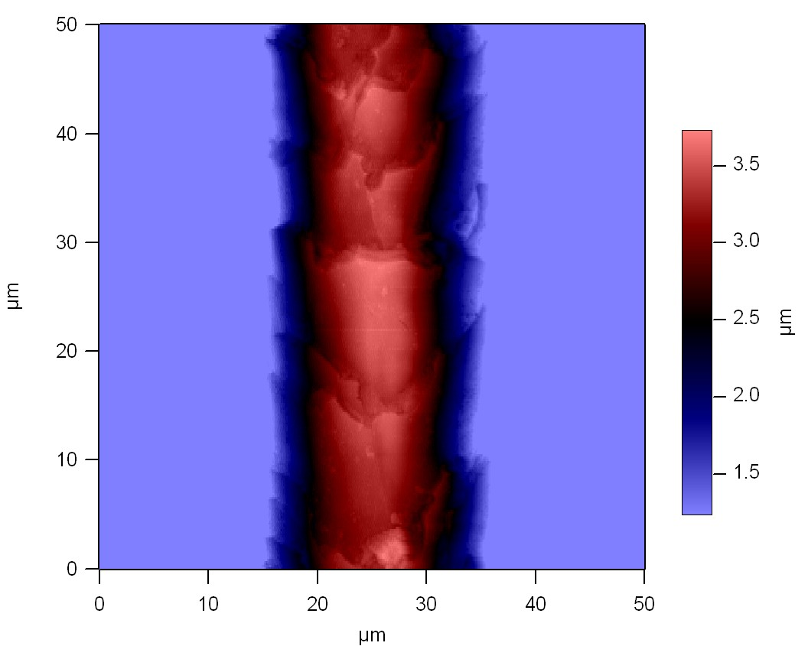
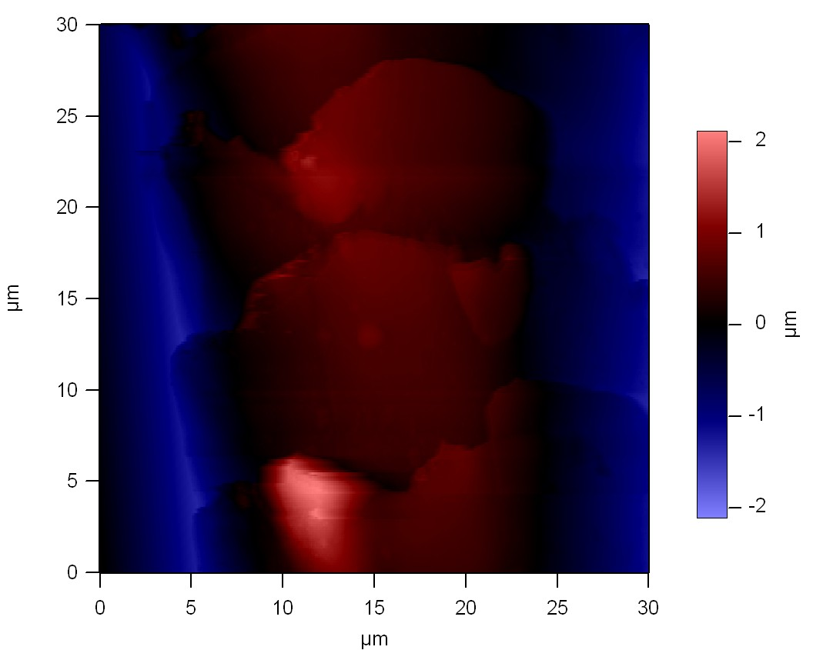
More Cool Human vs. Dog

