Slide 1
PPTX2MD
A presentation!
Notes:
# PPTX2 MD
This is a test preso for PPTX2MD.
To use it the program:
- Make slides with lots of notes, like this.
- Use CommonMark formatting in the notes for best results

Slide 2
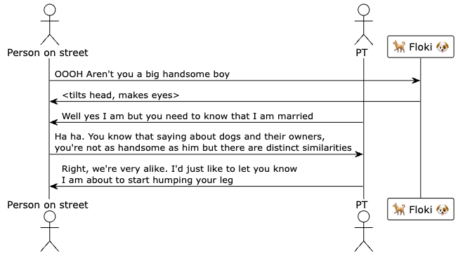
Notes:
Here’s the plantuml source for the diagram above.
```
@startuml
!theme plain
actor "Person on street" as Person
actor PT
participant "🐕 Floki 🐶" as Floki
Person -> Floki: OOOH Aren't you a big handsome boy
Floki -> Person: <tilts head, makes eyes>
PT -> Person : Well yes I am but you need to know that I am married
Person -> PT : Ha ha. You know that saying about dogs and their owners,\nyou're not as handsome as him but there are distinct similarities
PT -> Person : Right, we're very alike. I'd just like to let you know\nI am about to start humping your leg
@enduml
```

