Slide 1
OPJECT-ORIENTED PYTHON

Slide 2
06
OBJECT-ORIENTED PYGAME

Slide 3
Building the Screensaver Ball with OOP Pygame
In Chapter 5, we created an old-school screensaver where a ball bounced around inside a window
(Listing 5-6, if you need to refresh your memory).
That code works, but the data for the ball and the code to manipulate the ball are intertwined, meaning there’s a lot of initialization code, and the code to update and draw the ball are embedded in the 12-step framework.
A more modular approach is to split the code into a Ball class and a main program that instantiates a Ball object and makes calls to its methods.
In this section we’ll make this split, and I’ll show you how to create multiple balls from the Ball class.

Slide 4
Creating a Ball Class
Start by extracting all code relating to the ball from the main program and moving it into a separate Ball class. Looking at the original code, we can see that the sections that deal with the ball are:
Section #4, which loads the image of the ball
Section #5, which creates and initializes all the variables that havesomething to do with the ball
Section #8, which includes code for moving the ball, detecting an edgebounce, and changing speed and direction
Section #10, which draws the ball
From this we can conclude that our Ball class will require the following methods:
create() Loads an image, sets a location, and initializes all instance variables
update() Changes the location of the ball in every frame, based on the x speed and y speed of the ball
draw() Draws the ball in the window
The first step is to create a project folder, in which you need a Ball.py for the new Ball class, the main code file Main_BallBounce.py, and an images folder containing the ball.png image file.

Slide 5
Listing 6-1: The Ball class
import pygame
from pygame.locals import *
import random
class Ball:
def __init__(self, window, windowWidth, windowHeight):
self.window = window # remember the window, so we can draw later
self.windowWidth = windowWidth
self.windowHeight = windowHeight
self.image = pygame.image.load('images/ball.png’)
# A rect is made up of [x, y, width, height]
ballRect = self.image.get_rect()
self.width = ballRect.width
self.height = ballRect.height
self.maxWidth = windowWidth - self.width
self.maxHeight = windowHeight - self.height
# Pick a random starting position
self.x = random.randrange(0, self.maxWidth)
self.y = random.randrange(0, self.maxHeight)
# Choose a random speed between -4 and 4, but not zero,
# in both the x and y directions
speedsList = [-4, -3, -2, -1, 1, 2, 3, 4]
self.xSpeed = random.choice(speedsList)
self.ySpeed = random.choice(speedsList)

Slide 6
Listing 6-1 (con.)
def update(self):
# Check for hitting a wall. If so, change that direction.
if (self.x < 0) or (self.x >= self.maxWidth):
self.xSpeed = -self.xSpeed
if (self.y < 0) or (self.y >= self.maxHeight):
self.ySpeed = -self.ySpeed
# Update the Ball's x and y, using the speed in two directions
self.x = self.x + self.xSpeed
self.y = self.y + self.ySpeed
def draw(self):
self.window.blit(self.image, (self.x, self.y))

Slide 7
Using the Ball Class
Now all functionality associated with a ball has been placed in the Ball class code. All the main program needs to do is create the ball, then call its update() and draw() methods in every frame.
Listing 6-2: The new main program that instantiates a Ball and makes calls to its methods
# pygame demo 6(a) - using the Ball class, bounce one ball
# 1 - Import packages
import pygame
from pygame.locals import *
import sys
import random
from Ball import * # bring in the Ball class code
# 2 - Define constants
BLACK = (0, 0, 0)
WINDOW_WIDTH = 640
WINDOW_HEIGHT = 480
FRAMES_PER_SECOND = 30
# 3 - Initialize the world
pygame.init()
window = pygame.display.set_mode((WINDOW_WIDTH, WINDOW_HEIGHT))
clock = pygame.time.Clock()

Slide 8
Listing 6-2 (con.)
# 4 - Load assets: image(s), sound(s), etc.
# 5 - Initialize variables
oBall = Ball(window, WINDOW_WIDTH, WINDOW_HEIGHT)
# 6 - Loop forever
while True:
# 7 - Check for and handle events
for event in pygame.event.get():
if event.type == pygame.QUIT:
pygame.quit()
sys.exit()
# 8 - Do any "per frame" actions
oBall.update() # tell the Ball to update itself
# 9 - Clear the window before drawing it again
window.fill(BLACK)
# 10 - Draw the window elements
oBall.draw() # tell the Ball to draw itself
# 11 - Update the window
pygame.display.update()
# 12 - Slow things down a bit
clock.tick(FRAMES_PER_SECOND)

Slide 9
Creating Many Ball Objects
To create three balls, we only have to instantiate three Ball objects from the Ball class. Here we’ll use a basic approach and build a list of Ball objects. In each frame, we’ll iterate through the list of Ball objects, tell each one to update its location, then iterate again to tell each one to draw itself.
Listing 6-3: Creating, moving, and displaying three balls
# pygame demo 6(b) - using the Ball class, bounce many balls
# 1 - Import packages
import pygame
from pygame.locals import *
import sys
import random
from Ball import * # bring in the Ball class code
# 2 - Define constants
BLACK = (0, 0, 0)
WINDOW_WIDTH = 640
WINDOW_HEIGHT = 480
FRAMES_PER_SECOND = 30
N_BALLS = 3

Slide 10
Listing 6-3 (con.)
# 3 - Initialize the world
pygame.init()
window = pygame.display.set_mode((WINDOW_WIDTH, WINDOW_HEIGHT))
clock = pygame.time.Clock()
# 4 - Load assets: image(s), sound(s), etc.
# 5 - Initialize variables
ballList = []
for oBall in range(0, N_BALLS):
# Each time through the loop, create a Ball object
oBall = Ball(window, WINDOW_WIDTH, WINDOW_HEIGHT)
ballList.append(oBall) # append the new Ball to the list of Balls

Slide 11
Listing 6-3 (con.)
# 6 - Loop forever
while True:
# 7 - Check for and handle events
for event in pygame.event.get():
if event.type == pygame.QUIT:
pygame.quit()
sys.exit()
# 8 - Do any "per frame" actions
for oBall in ballList:
oBall.update() # tell each Ball to update itself
# 9 - Clear the window before drawing it again
window.fill(BLACK)
# 10 - Draw the window elements
for oBall in ballList:
oBall.draw() # tell each Ball to draw itself
# 11 - Update the window
pygame.display.update()
# 12 - Slow things down a bit
clock.tick(FRAMES_PER_SECOND)

Slide 12
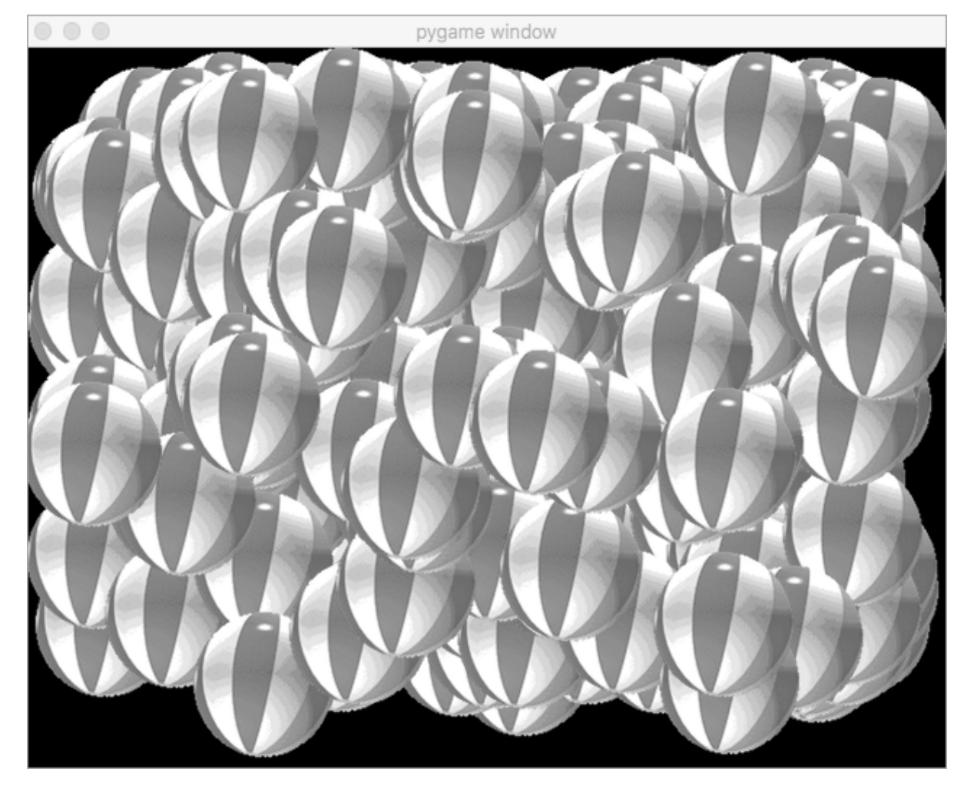
Creating Many, Many Ball Objects
We can change the value of the constant N_BALLS from 3 to some much larger value, like 300, to quickly create that many balls. By changing just a single constant, we make a major change to the behavior of the program. Each ball maintains its own speed and location and draws itself.
Figure 6-1:
Creating, updating, and drawing 300 Ball objects
We can instantiate any number of objects from a single script will be vital not only in defining game objects like spaceships, zombies, bullets, treasures, and so on, but also in building GUI controls such as buttons, checkboxes, text input fields, and text outputs.

Slide 13
Building a Reusable Object-Oriented Button
The standard behaviour of a button consists of the user using their mouse to click down on the button image and then releasing it.
Buttons typically consist of at least two images:
to represent the up or normal state of the button and
to represent the down or pressed state of the button.

Slide 14
The sequence of a click can be broken down into the following steps:
. User moves the mouse pointer over the button
. User presses the mouse button down
. Program reacts by changing the image to the down state
. User releases the mouse button
. Program reacts by showing the up image of the button
. Program performs some action based on the button click
If the user clicks down on a button but then rolls the mouse off and lifts up on the mouse button, that is not considered a click.
This means the program takes action only when the user presses down and releases while the mouse is positioned over the image of a button.
Notes:
Good GUIs also allow the user to click down on a button, temporarily roll off the button, changing the button to the up state, and then, with the mouse button still down, roll back over the image so the button changes back to the down image. If the user clicks down on a button but then rollsthe mouse off and lifts up on the mouse button, that is not considered a click. This means the program takes action only when the user presses down and releases while the mouse is positioned over the image of a button.

Slide 15
Building a Button Class
The button behavior should be common and consistent for all buttons used in a GUI, so we’ll build a class that takes care of the behavior details. Once we’ve built a simple button class, we can instantiate any number of buttons and they’ll all work exactly the same way.
Let’s consider what behaviors our button class must support. We’ll need methods to:
Load the images of the up and down states, then initialize any instance variables needed to track the button’s state.
Tell the button about all events that the main program has detected and check whether there are any that the button needs to react to.
Draw the current image representing the button.

Slide 16
Listing 6-4 presents the code of a SimpleButton class. (We’ll build a more complicated button class in Chapter 7.) This class has three methods,
__init__(), handleEvent(), and draw(), that implement the behaviors mentioned.
Listing 6-4: The SimpleButton class
# SimpleButton class
#
# Uses a "state machine" approach
#
import pygame
from pygame.locals import *
class SimpleButton():
# Used to track the state of the button
STATE_IDLE = 'idle' # button is up, mouse not over button
STATE_ARMED = 'armed' # button is down, mouse over button
STATE_DISARMED = 'disarmed' # clicked down on button, rolled off
Notes:
__init__(), handleEvent(), and draw(), that implement the behaviors mentioned. The code of the handleEvent() method does get a little tricky, but once you have it working, it’s incredibly easy to use. Feel free to work your way through it, but know that the implementation of the code is not that relevant. The important thing here is to understand the purpose and usage of the different methods.

Slide 17
Listing 6-4 (con.)
def __init__(self, window, loc, up, down):
self.window = window
self.loc = loc
self.surfaceUp = pygame.image.load(up)
self.surfaceDown = pygame.image.load(down)
# Get the rect of the button (used to see if the mouse is over the button)
self.rect = self.surfaceUp.get_rect()
self.rect[0] = loc[0]
self.rect[1] = loc[1]
self.state = SimpleButton.STATE_IDLE

Slide 18
Listing 6-4 (con.)
A state machine has a set of states, one variable to keep track of which state the program is in, and a set of events that cause the program to transition from one state to another.
Since there is a single variable that keeps track of the state, the program can be in only one of the states at any time.
Different actions that the user takes (clicking a button, pressing a key, dragging an item, and so on) or other events (such as a timer running out) can cause the program to transition from one state to another.
Depending on which state it is in, the program may listen for different events and will typically execute different code.
def handleEvent(self, eventObj):
# This method will return True if user clicks the button.
# Normally returns False.
if eventObj.type not in (MOUSEMOTION, MOUSEBUTTONUP, MOUSEBUTTONDOWN):
# The button only cares about mouse-related events
return False
eventPointInButtonRect = self.rect.collidepoint(eventObj.pos)
if self.state == SimpleButton.STATE_IDLE:
if (eventObj.type == MOUSEBUTTONDOWN) and eventPointInButtonRect:
self.state = SimpleButton.STATE_ARMED
elif self.state == SimpleButton.STATE_ARMED:
if (eventObj.type == MOUSEBUTTONUP) and eventPointInButtonRect:
self.state = SimpleButton.STATE_IDLE
return True # clicked!
if (eventObj.type == MOUSEMOTION) and (not eventPointInButtonRect):
self.state = SimpleButton.STATE_DISARMED
elif self.state == SimpleButton.STATE_DISARMED:
if eventPointInButtonRect:
self.state = SimpleButton.STATE_ARMED
elif eventObj.type == MOUSEBUTTONUP:
self.state = SimpleButton.STATE_IDLE
return False

Slide 19
Listing 6-4 (con.)
def draw(self):
# Draw the button's current appearance to the window
if self.state == SimpleButton.STATE_ARMED:
self.window.blit(self.surfaceDown, self.loc)
else: # IDLE or DISARMED
self.window.blit(self.surfaceUp, self.loc)

Slide 20
Main Code Using a SimpleButton
To use a SimpleButton in the main code, we first instantiate one from the SimpleButton class before the main loop starts with a line like this:
oButton = SimpleButton(window, (150, 30), 'images/buttonUp.png', 'images/buttonDown.png')
This line creates a SimpleButton object, specifying a location to draw it (as usual, the coordinates are for the top-left corner of the bounding rectangle) and providing the paths to both the up and down images of the button.
Notes:
In the main loop, any time any event happens we need to call the handleEvent() method to see if the user has clicked the button. If the user clicks the button, the program should perform some action. Also in the main loop, we need to call the draw() method to make the button show in the window.

Slide 21

We’ll build a small test program, which will generate a user interface like Figure 6-2, to incorporate one instance of a SimpleButton.
Figure 6-2: The user interface of a program with a
single instance of a SimpleButton
Whenever the user completes a click on the button, the program outputs a line of text in the shell saying that the button has been clicked. Listing 6-5 contains the main program code.

Slide 22
Listing 6-5: The main program that creates and reacts to a SimpleButton
# Pygame demo 7 - SimpleButton test
# 1 - Import packages
import pygame
from pygame.locals import *
import sys
import random
from SimpleButton import *
# 2 - Define constants
BLACK = (0, 0, 0)
GRAY = (200, 200, 200)
WINDOW_WIDTH = 640
WINDOW_HEIGHT = 480
FRAMES_PER_SECOND = 30
N_BALLS = 3
# 3 - Initialize the world
pygame.init()
window = pygame.display.set_mode((WINDOW_WIDTH, WINDOW_HEIGHT))
clock = pygame.time.Clock()
# 4 - Load assets: image(s), sound(s), etc.
# 5 - Initialize variables
# Create an instance of a SimpleButton
oButton = SimpleButton(window, (150, 30), 'images/buttonUp.png', 'images/buttonDown.png')

Slide 23
Listing 6-5 (con.)
# 6 - Loop forever
while True:
# 7 - Check for and handle events
for event in pygame.event.get():
if event.type == pygame.QUIT:
pygame.quit()
sys.exit()
# Pass the event to the button, see if it has been clicked on
if oButton.handleEvent(event):
print('User has clicked the button’)
# 8 - Do any "per frame" actions
# 9 - Clear the window
window.fill(GRAY)
# 10 - Draw all window elements
oButton.draw() # draw the button
# 11 - Update the window
pygame.display.update()
# 12 - Slow things down a bit
clock.tick(FRAMES_PER_SECOND)

Slide 24
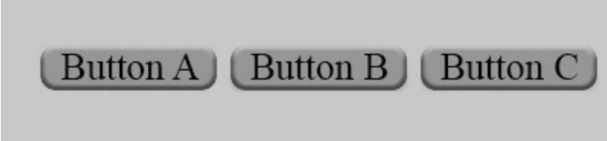
Creating a Program with Multiple Buttons
With our SimpleButton class, we can instantiate as many buttons as we wish. For example, we can modify our main program to incorporate three SimpleButton instances, as shown in Figure 6-3.
Figure 6-3: The main program with three SimpleButton objects
We don’t need to make any changes to the SimpleButton class file to do this. We simply modify our main code to instantiate three SimpleButton objects instead of one.

Slide 25
oButtonA = SimpleButton(window, (25, 30), 'images/buttonAUp.png', 'images/buttonADown.png')
oButtonB = SimpleButton(window, (150, 30), 'images/buttonBUp.png', 'images/buttonBDown.png')
oButtonC = SimpleButton(window, (275, 30), 'images/buttonCUp.png', 'images/buttonCDown.png')
We now need to call the handleEvent() method of all three buttons:
# Pass the event to each button, see if one has been clicked
if oButtonA.handleEvent(event):
print('User clicked button A.')
elif oButtonB.handleEvent(event):
print('User clicked button B.')
elif oButtonC.handleEvent(event):
print('User clicked button C.')
Finally, we tell each button to draw itself:
oButtonA.draw()
oButtonB.draw()
oButtonC.draw()

Slide 26
When you run the program, you’ll see a window with three buttons. Clicking any of the buttons prints a message showing the name of the button that was clicked.
The key idea here is: Since we are using three instances of the same SimpleButton class, the behavior of each button will be identical. An important benefit of this approach is that any change to the code in the
SimpleButton class will affect all buttons instantiated from the class.
The main program does not need to worry about any details of the inner workings of the button code, needing only to call the handleEvent() method of each button in the main loop. Each button will return True or False to say that it has or has not been clicked.

Slide 27
Building a Reusable Object-Oriented Text Display
There are two different types of text in a pygame program: display text and input text.
Display text is output from your program, equivalent to a call to the print() function, except it’s displayed in a pygame window.
Input text is string input from the user, equivalent to a call to input().
Steps to Display Text
Displaying text in a window is a fairly complicated process in pygame because it’s not simply displayed as a string in the shell, but requires you to choose a location, fonts and sizes, and other attributes.

Slide 28
For example, you might use code like the following:
pygame.font.init()
myFont = pygame.font.SysFont('Comic Sans MS', 30)
textSurface = myfont.render('Some text', True, (0, 0, 0))
window.blit(textSurface, (10, 10))
Font loading
Text rendering
Drawing the text
This code works well to show the provided text in the window at the given location.
However, if the text doesn’t change, there will be a lot of wasted work done re-creating the textSurface on each iteration through the main loop. There are also a lot of details to remember, and you must get them all correct to draw the text properly.
We can hide most of this complexity by building a class.
Notes:
Explain code: We start by initializing the font system within pygame; we do this before the main loop starts. Then we tell pygame to load a particular font from the system by name. Here, we request Comic Sans with a font size of 30. The next step is the key one: we use that font to render our text, which creates a graphical image of the text, called a surface in pygame. We supply the text we want to output, a Boolean that says whether we want our text to be anti-aliased, and a color in RGB format. Here, (0, 0, 0) indicates that we want our text to be black. Finally, using blit(), we draw the image of the text into the window at some (x, y) location.

Slide 29
Creating a SimpleText Class
To build a set of methods that take care of font loading and text rendering in pygame, we no longer have to remember the details of the implementation.
Listing 6-6: The SimpleText class for displaying text
import pygame
from pygame.locals import *
class SimpleText:
def __init__(self, window, loc, value, textColor):
pygame.font.init()
self.window = window
self.loc = loc
self.font = pygame.font.SysFont(None, 30) # None indicates the use of the standard system font
self.textColor = textColor
self.text = None # so that the call to setText below will
# force the creation of the text image
self.setValue(value) # set the initial text for drawing
def setValue(self, newText):
if self.text == newText:
return # nothing to change
self.text = newText # save the new text
self.textSurface = self.font.render(self.text, True,self.textColor)
def draw(self): # This method should be called in every frame.
self.window.blit(self.textSurface, self.loc)

Slide 30
Demo Ball with SimpleText and SimpleButton
What does the program Listing 6-7 do?
Listing 6-7: An example main program to show Ball, SimpleText, and SimpleButton
# pygame demo 8 - SimpleText, SimpleButton, and Ball
# 1 - Import packages
import pygame
from pygame.locals import *
import sys
import random
from Ball import * # bring in the Ball class code
from SimpleText import *
from SimpleButton import *

Slide 31
Listing 6-7 (con.)
# 2 - Define constants
BLACK = (0, 0, 0)
WHITE = (255, 255, 255)
WINDOW_WIDTH = 640
WINDOW_HEIGHT = 480
FRAMES_PER_SECOND = 30
# 3 - Initialize the world
pygame.init()
window = pygame.display.set_mode((WINDOW_WIDTH, WINDOW_HEIGHT))
clock = pygame.time.Clock()
# 4 - Load assets: image(s), sound(s), etc.
# 5 - Initialize variables
oBall = Ball(window, WINDOW_WIDTH, WINDOW_HEIGHT)
oFrameCountLabel = SimpleText(window, (60, 20), 'Program has run through this many loops: ', WHITE)
oFrameCountDisplay = SimpleText(window, (500, 20), '', WHITE)
oRestartButton = SimpleButton(window, (280, 60), 'images/restartUp.png', 'images/restartDown.png')
frameCounter = 0

Slide 32
Listing 6-7 (con.)
# 6 - Loop forever
while True:
# 7 - Check for and handle events
for event in pygame.event.get():
if event.type == pygame.QUIT:
pygame.quit()
sys.exit()
if oRestartButton.handleEvent(event):
frameCounter = 0 # clicked button, reset counter
# 8 - Do any "per frame" actions
oBall.update() # tell the ball to update itself
frameCounter = frameCounter + 1 # increment each frame
oFrameCountDisplay.setValue(str(frameCounter))
# 9 - Clear the window before drawing it again
window.fill(BLACK)
# 10 - Draw the window elements
oBall.draw() # tell the ball to draw itself
oFrameCountLabel.draw()
oFrameCountDisplay.draw()
oRestartButton.draw()
# 11 - Update the window
pygame.display.update()
# 12 - Slow things down a bit
clock.tick(FRAMES_PER_SECOND)

Slide 33
Interface vs. Implementation
The SimpleButton and SimpleText examples bring up the important topic of interface versus implementation.
The interface refers to how something is used.
The implementation refers to how something works (internally).
In an OOP environment,
The interface is the set of methods in a class and their related parameters—also known as the application programming interface (API).
The implementation is the actual code of all the methods in the class.
An external package such as pygame and pygwidgets will most likely come with documentation of the API that explains the calls that are available and the arguments you are expected to pass with each call.
References:
https://www.pygame.org/docs/.
https://pygwidgets.readthedocs.io/en/latest/.

Slide 34
Interface vs. Implementation
When you write code that makes calls to pygame, you don’t need to worry about the implementation of the methods you are using.
For example,when you make a call to blit() to draw image, you really don’t care how blit() does what it does; you just need to know what the call does and what arguments need to be passed in.
On the other side, you can trust that the implementer(s) who wrote the blit() method have thought extensively about how to make blit() work most efficiently.
We often wear two hats as both the implementer and the application developer.
So, we need to make an effort to design APIs that not only make sense in the current situation, but also are general enough to be used by future programs of our own and by programs written by other people.
Our SimpleButton and SimpleText classes are good examples, as they are written in a general way so that they can be reused easily.

Slide 35
Callbacks
When using a SimpleButton object, we handle checking for and reacting to a button click like this:
if oButton.handleEvent(event):
print('The button was clicked')
This approach to handling events works well with the SimpleButton class.
However, some other Python packages and many other programming languages handle events in a different way: with a callback.
Callback: A function or method of an object that is called when a
particular action, event, or condition happens.

Slide 36
Creating a Callback
As an example, consider a button object that is initialized to have a callback. When the user clicks the button, the button will call the callback function or method. That function or method executes whatever code is needed to react to the button click.
To set up a callback, when you create an object or call one of an object’s methods, you pass the name of a function or a method of an object to be called.
import tkinter
def myFunction():
print('myCallBackFunction was called’)
oButton = tkinter.Button(text='Click me', command=myFunction)
When you create a button with tkinter, you must pass in a function (or a method of an object), which will be called back when the user clicks the button. Here, we are passing myFunction as the function to be called back.
You can also use a callback when you initiate some action that may take some time. Instead of waiting for the action to finish and causing the program appear to freeze for a period of time, you provide a callback to be called when the action is completed. This often involves multiple Python threads.
Notes:
As an example, there is a standard GUI package for Python called tkinter. The code needed to create a button with this package is very different from what I have shown—here’s an example:

Slide 37
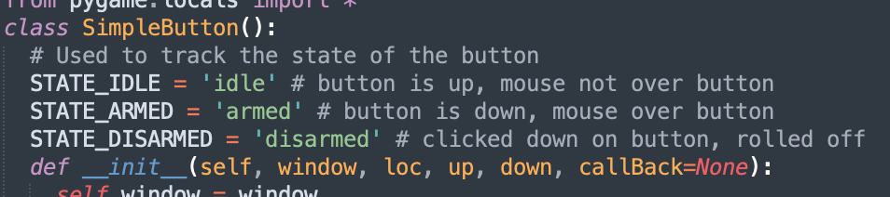
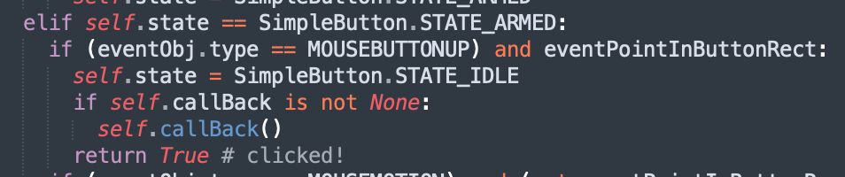
Using a Callback with SimpleButton
To demonstrate this concept, we’ll make a minor modification to the SimpleButton class to allow it to accept a callback.
The main program in Listing 6-8 creates three instances of the SimpleButton class, each of which handles the button click in a different way. The first button, oButtonA, provides no callback; oButtonB provides a
callback to a function; and oButtonC specifies a callback to a method of an object.
Listing 6-8: A version of the main program that handles button clicks three different ways
# pygame demo 9 - 3-button test with callbacks
# 1 - Import packages
import pygame
from pygame.locals import *
from SimpleButtonV2 import *
import sys
Notes:
As an additional optional parameter, the caller can provide a function or method of an object to be called back when a click on a SimpleButton object happens. Each instance of SimpleButton remembers the callback in an instance variable. When the user completes a click, the instance of SimpleButton calls the callback.

Slide 38
Listing 6-8 (con.)
# #2 - Define constants
GRAY = (200, 200, 200)
WINDOW_WIDTH = 400
WINDOW_HEIGHT = 100
FRAMES_PER_SECOND = 30
# Define a function to be used as a "callback"
def myCallBackFunction():
print('User pressed Button B, called myCallBackFunction’)
# Define a class with a method to be used as a "callback"
class CallBackTest():
# --- snipped any other methods in this class ---
def myMethod(self):
print('User pressed ButtonC, called myMethod of the CallBackTest object')

Slide 39
Listing 6-8 (con.)
# 3 - Initialize the world
pygame.init()
window = pygame.display.set_mode((WINDOW_WIDTH, WINDOW_HEIGHT))
clock = pygame.time.Clock()
# 4 - Load assets: image(s), sound(s), etc.
# 5 - Initialize variables
oCallBackTest = CallBackTest()
# Create instances of SimpleButton
# No call back
oButtonA = SimpleButton(window, (25, 30), 'images/buttonAUp.png', 'images/buttonADown.png’)
# Specifying a function to call back
oButtonB = SimpleButton(window, (150, 30), 'images/buttonBUp.png', 'images/buttonBDown.png’, callBack=myCallBackFunction)
# Specifying a method of an object to call back
oButtonC = SimpleButton(window, (275, 30), 'images/buttonCUp.png', 'images/buttonCDown.png’, callBack=oCallBackTest.myMethod)
counter = 0

Slide 40
Listing 6-8 (con.)
# 6 - Loop forever
while True:
# 7 - Check for and handle events
for event in pygame.event.get():
if event.type == pygame.QUIT:
pygame.quit()
sys.exit()
# Pass the event to the button, see if it has been clicked on
if oButtonA.handleEvent(event):
print('User pressed button A, handled in the main loop’)
# oButtonB and oButtonC have callbacks,
# no need to check result of these calls
oButtonB.handleEvent(event)
oButtonC.handleEvent(event)
# 8 - Do any "per frame" actions
counter = counter + 1
# 9 - Clear the window
window.fill(GRAY)
# 10 - Draw all window elements
oButtonA.draw()
oButtonB.draw()
oButtonC.draw()
# 11 - Update the window
pygame.display.update()
# 12 - Slow things down a bit
clock.tick(FRAMES_PER_SECOND) # make pygame wait

Slide 41
summary
In this chapter,
We turned procedural code into a class, like the Ball class, simplifying our main code. This approach enables us to manage multiple objects effortlessly.
We crafted the SimpleButton and SimpleText classes for reusable, streamlined code.
We introduced callbacks, where functions or methods are triggered when events or actions occur.

Slide 42
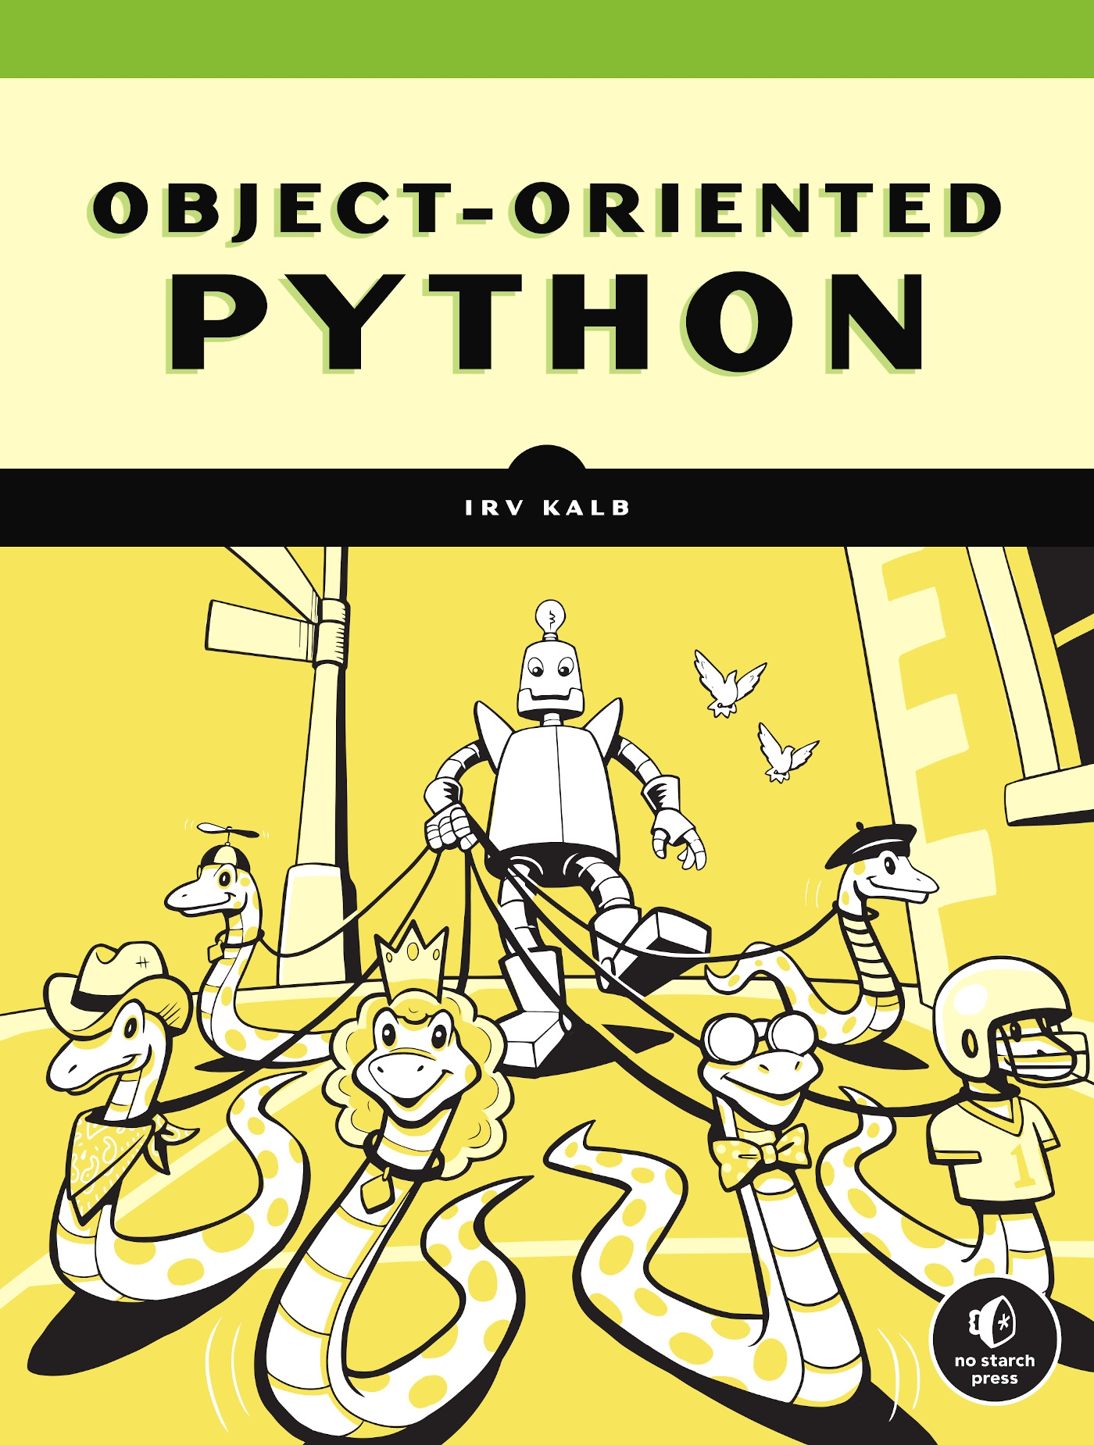
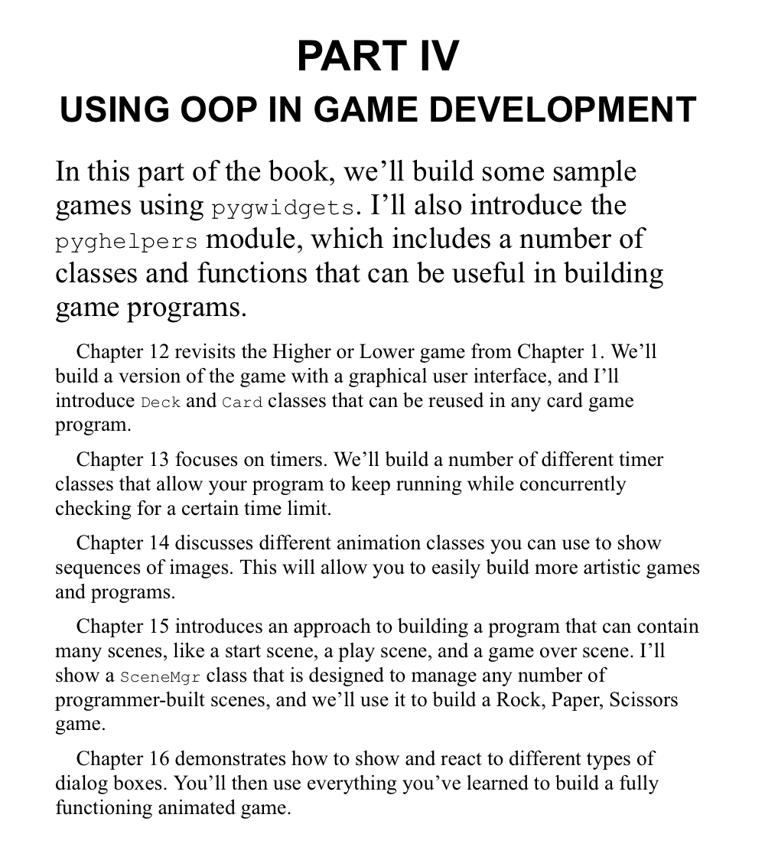

Slide 43
Reference
OBJECT-ORIENTED PYTHON
MASTER OOP BY
BUILDING GAMES AND GUIS,
IRV KALB

