Slide 1
OPJECT-ORIENTED PYTHON

Slide 2
05
INTRODUCTION TO PYGAME

Slide 3
What is pygame?
pygame is a free open-source external package that was designed to extend Python to allow programmers to build game programs.
You can also use pygame to build other kinds of interactive programs with a graphical user interface (GUI).
It adds the ability to create windows, show images, recognize mouse movements and clicks, play sounds, and more.
It is not my intent to turn you all into game programmers—even though that might be a fun outcome. Rather, I’ll use the pygame environment to make certain object-oriented programming techniques clearer and more visual.

Slide 4
Installing pygame
python3 -m pip install -U pip --user
python3 -m pip install -U pygame --user
The first command ensures that you have the latest version of the pip program.
The second line installs the most recent version of pygame.
If you have any problems installing pygame, consult the pygame documentation at https://www.pygame.org/wiki/GettingStarted.
To test that pygame has been installed correctly, open IDLE and in the shell window enter:
import pygame
If you see a message saying something like “Hello from the pygame community” or if you get no message at all, then pygame has been installed correctly.

Slide 5
Two Main Concepts:
Pixels
Event-driven programs

Slide 6
Window Details
A computer screen is made up of many rows and columns of small dots called pixels.
A user interacts with a GUI program through one or more windows; each window is a rectangular portion of the screen.
Programs can control the color of any individual pixel in their window(s). If you’re running multiple GUI programs, each program is typically displayed in its own window.
Notes:
A computer screen is made up of a large number of rows and columns of small dots called pixels (from the words picture element). A user interacts with a GUI program through one or more windows; each window is a rectangular portion of the screen. Programs can control the color of any individual pixel in their window(s). If you’re running multiple GUI programs, each program is typically displayed in its own window.
In this section, We will discuss how you address and alter individual pixels in a window. These concepts are independent of Python; they are common to all computers and are used in all programming languages.

Slide 7
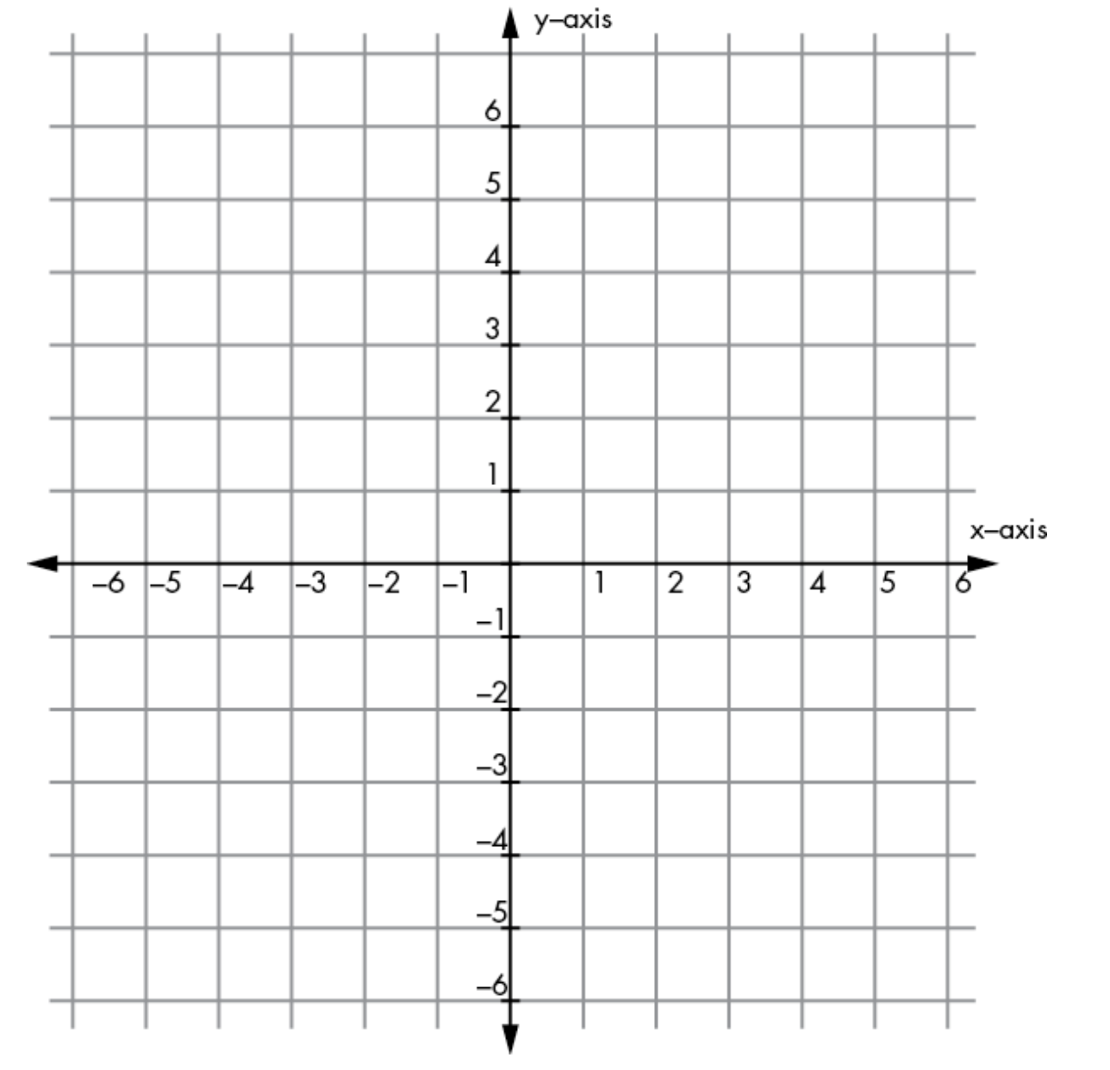
The Catesian Coordinate System
Any point in a Cartesian grid can be located by specifying its x- and y- coordinates.
The origin is the point specified as (0, 0) and is found in the center of the grid.
Notes:
You are probably familiar with Cartesian coordinates in a grid like this.
Any point in a Cartesian grid can be located by specifying its x- and y- coordinates (in that order). The origin is the point specified as (0, 0) and is found in the center of the grid.

Slide 8
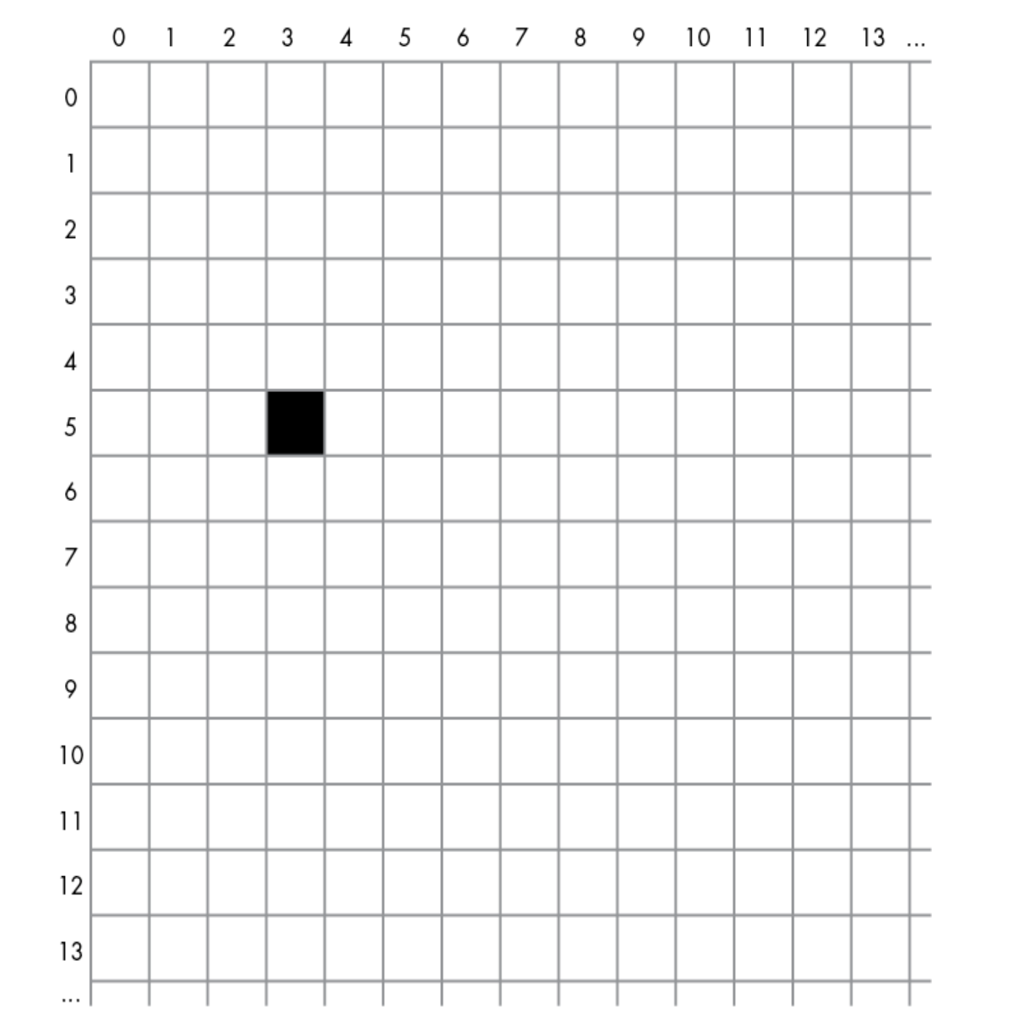
The Window Coordinate System
The origin (0, 0) point is in the upper-left corner of the window.
The y-axis is reversed so that y values start at zero at the top of the window and increase as you go down.
The x and y values are always positive integers.
Each (x, y) pair specifies a single pixel in the window. These values are always specified as relative to the upper-left corner of the window, not the screen. That way, the user can move the window anywhere on the screen without affecting the coordinates of the elements of the program displayed in the window.
The full computer screen has its own set of (x, y) coordinates for every pixel and uses the same type of coordinate system, but programs rarely, if ever, need to deal with screen coordinates.
When we write a pygame application, we need to specify the width and height of the window we want to create. Within the window, we can address any pixel using its x- and y-coordinates.
Figure shows a black pixel at position (3, 5). That is an x-value of 3 and a y value of 5
Notes:
Figure shows a black pixel at position (3, 5). That is an x-value of 3 (note that this is actually the fourth column, since coordinates start at 0) and a y value of 5 (actually the sixth row). Each pixel in a window is commonly referred to as a point. To reference a point in a window, you would typically use a Python tuple. For example, you might have an assignment statement like this, with the x value first:
To show an image in a window, we need to specify the coordinates of its starting point—always the upper-left corner of the image—as an (x, y) pair, as in the figure, where we draw the image at location (3, 5).

Slide 9
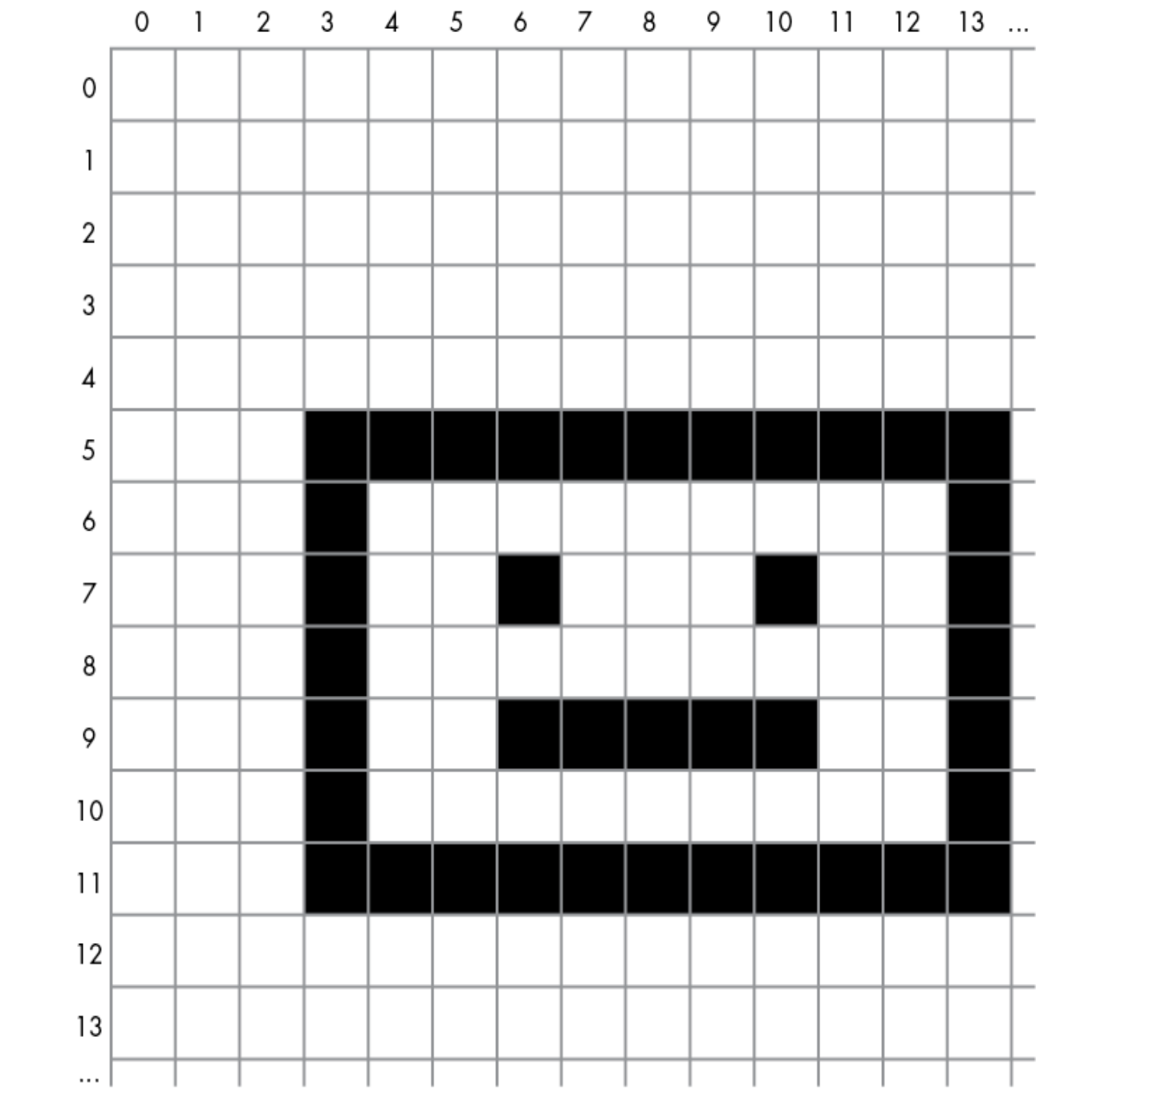
The Window Coordinate System
To show an image in a window, we need to specify the coordinates of its starting point. In this case, we draw the image at location (3,5).
When working with an image, you’ll often need to deal with the bounding rectangle, which is the smallest rectangle that can be made that surrounds all pixels of the image.
A rectangle is represented in pygame by a set of four values: x, y, width, height. The rectangle for the image in this figure has values of 3, 5, 11, 7.
Even if your image is not rectangular (for example, if it’s a circle or an ellipse), you still have to consider its bounding rectangle for positioning and collision detection.

Slide 10
Pixel Colors
Each pixel on the screen is made up of a combination of three colors: red, green, and blue, often referred to as RGB.
The color displayed in any pixel is composed of some amount of red, green, and blue, where the amount of each is specified as a value from 0, meaning none, to 255, meaning full intensity.
Therefore, there are 256 × 256 × 256 possible combinations, or 16,777,216 (often referred to as just “16 million”) possible colors, for each pixel.
Notes:
Let’s explore how colors are represented on the computer screen. If you have experience with a graphics program like Photoshop, you probably already know how this works, but you may want a quick refresher anyway.
Each pixel on the screen is made up of a combination of three colors: red, green, and blue, often referred to as RGB. The color displayed in any pixel is composed of some amount of red, green, and blue, where the amount of each is specified as a value from 0, meaning none, to 255, meaning full intensity. Therefore, there are 256 × 256 × 256 possible combinations, or 16,777,216 (often referred to as just “16 million”) possible colors, for each pixel.

Slide 11
Colors in pygame are given as RGB values, and we write them as Python tuples of three numbers. Here is how we create constants for the main colors:
RED = (255, 0, 0) # full red, no green, no blue
GREEN = (0, 255, 0) # no red, full green, no blue
BLUE = (0, 0, 255) # no red, no green, full blue
Here are the definitions of a few more colors. You can create a color using any combination of three numbers between 0 and 255:
BLACK = (0, 0, 0) # no red, no green, no blue
WHITE = (255, 255, 255) # full red, full green, full blue
DARK_GRAY = (75, 75, 75)
MEDIUM_GRAY = (128, 128, 128)
LIGHT_GRAY = (175, 175, 175)
TEAL = (0, 128, 128) # no red, half-strength green, half-strength blue
YELLOW = (255, 255, 0)
PURPLE = (128, 0, 128)
Notes:
In pygame, you’ll need to specify colors when you want to fill the background of a window, draw a shape in a color, draw text in a color, and so on. Defining colors up front as tuple constants makes them very easy to spot later in code.

Slide 12
Event-Driven Programs
In interactive GUI programs, it introduces a new model of computing known as the event-driven model.
Event-driven programs don’t rely on input() and print(); instead, the user interacts with elements in a window at will using a keyboard and/or mouse or other pointing device.
Event: Something that happens while your program is running that your program wants to or needs to respond to. Most events are generated by user actions.
An event-driven GUI program runs constantly in an infinite loop.
Each time through the loop, the program checks for any new events it needs to react to and executes appropriate code to handle those events. Also, each time through the loop, the program needs to redraw all the elements in the window to update what the user sees.
Notes:
In most of the programs in the book so far, the main code has lived in a while loop. The program stops at a call to the built-in input() function and waits for some user input to work on. Program output is typically handled using calls to print().
In interactive GUI programs, this model no longer works. GUIs introduce a new model of computing known as the event-driven model.
Event-driven programs don’t rely on input() and print(); instead, the user interacts with elements in a window at will using a keyboard and/or mouse or other pointing device. They may be able to click various buttons or icons, make selections from menus, provide input in text fields, or give commands via clicks or key presses to control some avatar in the window.
Central to event-driven programming is the concept of an event. Events are difficult to define and are best described with examples, such as a mouse click and a key press (each of which is actually made up of two events: mouse down and mouse up and key down and key up, respectively).

Slide 13
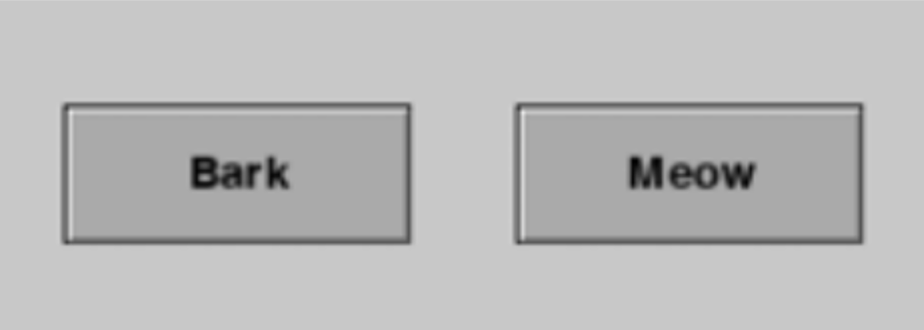
For example, say we have a simple GUI program that displays two buttons: Bark and Meow.
To handle the user’s actions, the program runs in a loop and constantly checks to see if either button has been clicked:
When it receives a mouse down event on a button, the program remembers that the button has been clicked and draws the depressed image of that button.
When it receives a mouse up event on the button, it remembers the new state and redraws the button with its original appearance, and it plays the appropriate sound.
Because the main loop runs so quickly, the user perceives that the sound plays immediately after they click the button.
Each time through the loop, the program redraws both buttons with an image matching each button’s current state.
Notes:
An event-driven GUI program runs constantly in an infinite loop. Each time through the loop, the program checks for any new events it needs to react to and executes appropriate code to handle those events. Also, each time through the loop, the program needs to redraw all the elements in the window to update what the user sees.
For example, say we have a simple GUI program that displays two buttons: Bark and Meow. When clicked, the Bark button plays a sound of a dog barking and the Meow button plays a sound of a cat meowing as shown in the figure below
The user can click these buttons in any order and at any time. To handle the user’s actions, the program runs in a loop and constantly checks to see if either button has been clicked. When it receives a mouse down event on a button, the program remembers that the button has been clicked and draws the depressed image of that button. When it receives a mouse up event on the button, it remembers the new state and redraws the button with its original appearance, and it plays the appropriate sound. Because the main loop runs so quickly, the user perceives that the sound plays immediately after they click the button. Each time through the loop, the program redraws both buttons with an image matching each button’s current state.

Slide 14
Using Pygame
To introduce pygame, here is the template that you can use for all pygame programs you create.
In the following sections, I’ll show you how to:
Bring up a blank window
Show an image
Detect a mouse click
Detect both single and continuous key presses
Create a simple animation
Play sound effects and background sounds
Draw shapes
Animate many objects
Build and react to a button
Create a text display field
Notes:
At first, pygame may seem like an overwhelmingly large package with many different calls available. Although it is large, there’s actually not a lot that you need to understand to get a small program up and running. To introduce pygame, I’ll first give you a template that you can use for all pygame programs you create. Then I’ll build on that template, adding key pieces of functionality little by little.

Slide 15
Bringing Up a Blank Window
Things are drawn in layers from background to frontmost
Pygame programs run constantly in a loop, checking for events.
Listing 5-1 is a generic template that you can use as a starting point for all your pygame programs. This program opens a window and paints the entire contents black.
The only thing the user can do is click the close button to quit the program.
Listing 5-1: A template for creating pygame programs
# pygame demo 0 - window only
# 1 - Import packages
import pygame
from pygame.locals import *
import sys
# 2 - Define constants
BLACK = (0, 0, 0)
WINDOW_WIDTH = 640
WINDOW_HEIGHT = 480
FRAMES_PER_SECOND = 30
# 3 - Initialize the world
pygame.init()
window = pygame.display.set_mode((WINDOW_WIDTH, WINDOW_HEIGHT))
clock = pygame.time.Clock()
# 4 - Load assets: image(s), sound(s), etc.
# 5 - Initialize variables
# 6 - Loop forever
while True:
# 7 - Check for and handle events
# Iterate over list of the events
for event in pygame.event.get():
# Clicked the close button?
# Quit pygame and end the program
if event.type == pygame.QUIT:
pygame.quit() # frees up any using resources
sys.exit()
# 8 - Do any "per frame" actions
# 9 - Clear the window
window.fill(BLACK) # or draw a background pic
# 10 - Draw all window elements
# 11 - Update the window
pygame.display.update()
# 12 - Slow things down a bit
clock.tick(FRAMES_PER_SECOND)
Event loop
Ensure the program runs at a consistent rate, independent of the speed of the computer on which it’s running.
Notes:
Pygame programs run constantly in a loop, checking for events. It might help to think of your program as an animation, where each pass through the main loop is one frame. The user may click on something during any frame, and your program must not only respond to that input but also keep track of everything it needs to draw in the window. For instance, in one example program later in this chapter, we’ll move a ball across the window so in each frame the ball is drawn in a slightly different position.

Slide 16
Drawing an Image
There are two parts to showing a graphic image:
Load the image into the computer’s memory
Display the image in the application window.
All images (and sounds) need to be kept in files external to your code. Pygame supports many standard graphic file formats, including .png, .jpg, and .gif.

Slide 17
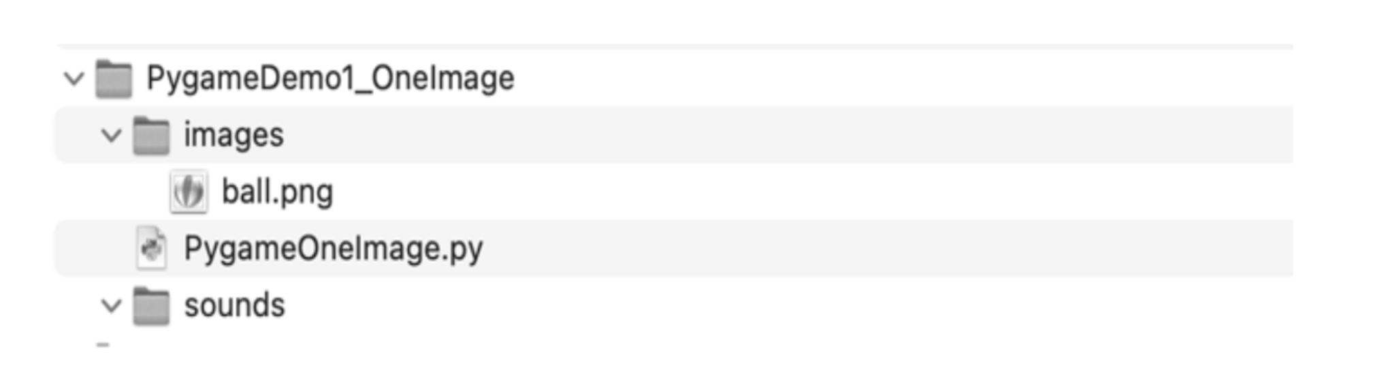
Create a “project” folder. Place your main program in that folder, along with any related files containing Python classes and functions.
Create an “images” folder into which you’ll place any image files you want to use in your program. Also create a “sounds” folder and place any sound files you want to use there.
Figure shows the suggested structure.
Best practice:
to use a consistent approach to handling graphic and sound files
In this example we’ll load a picture of a ball from the file ball.png. As a reminder, the code and assets associated with all the major listings in this book are available for download at
https://www.nostarch.com/objectorientedpython/ or
https://github.com/IrvKalb/Object-Oriented-Python-Code/.
Notes:
First, create a project folder. Place your main program in that folder, along with any related files containing Python classes and functions. Then, inside the project folder, create an images folder into which you’ll place any image files you want to use in your program. Also create a sounds folder and place any sound files you want to use there.

Slide 18
A path (also called a pathname) is a string that uniquely identifies the location of a file or folder on a computer. There are two types of paths: relative and absolute.
The relative path for a graphic file (for example, ball.png) in the same folder as your main Python file would be just the filename as a string (for example, 'ball.png'). Using the suggested project structure, the relative path would be 'images/ball.png'.
If you expect to run your program from the command line, then you need to construct absolute paths for all files.
from pathlib import Path
# Place this in section #2, defining a constant
BASE_PATH = Path(__file__).resolve().parent
# Build a path to the file in the images folder
pathToBall = BASE_PATH + 'images/ball.png'
Notes:
A path (also called a pathname) is a string that uniquely identifies the location of a file or folder on a computer. To load a graphic or sound file into your program, you must specify the path to the file. There are two types of paths: relative and absolute.
A relative path is a relative to the current folder, often called the current working directory. When you run a program using an IDE such as IDLE or PyCharm, it sets the current folder to the one containing your main Python program so you can use relative paths with ease. In this book, I will assume you’re using an IDE and will represent all paths as relative paths.
The relative path for a graphic file (for example, ball.png) in the same folder as your main Python file would be just the filename as a string (for example, 'ball.png'). Using the suggested project structure, the relative path would be 'images/ball.png’.
This says that inside the project folder will be another folder named images, and inside that folder is a file named ball.png. In path strings, folder names are separated by the slash character.

Slide 19
Now we’ll create the code of the ball program, starting with the earlier 12-step template and adding just two new lines of code, as shown in Listing 5-2.
Listing 5-2: Load one image and draw it in every frame.
# pygame demo 1 – draw one image
# 1 - Import packages
import pygame
from pygame.locals import *
import sys
# 2 - Define constants
BLACK = (0, 0, 0)
WINDOW_WIDTH = 640
WINDOW_HEIGHT = 480
FRAMES_PER_SECOND = 30
# 3 - Initialize the world
pygame.init()
window = pygame.display.set_mode((WINDOW_WIDTH,WINDOW_HEIGHT))
clock = pygame.time.Clock()
# 4 - Load assets: image(s), sound(s), etc.
ballImage = pygame.image.load('images/ball.png')
# 5 - Initialize variables
# 6 - Loop forever
while True:
# 7 - Check for and handle events
for event in pygame.event.get():
# Clicked the close button?
# Quit pygame and end the program
if event.type == pygame.QUIT:
pygame.quit()
sys.exit()
# 8 - Do any "per frame" actions
# 9 - Clear the window
window.fill(BLACK)
# 10 - Draw all window elements
# draw ball at position
# 100 across (x) and 200 down (y)
window.blit(ballImage, (100, 200))
# 11 - Update the window
pygame.display.update()
# 12 - Slow things down a bit
clock.tick(FRAMES_PER_SECOND)
Notice that this assignment statement is only executed once, before the main loop starts.

Slide 20
Detecting a Mouse Click
Listing 5-3: Detecting a mouse click and acting on it
# pygame demo 2 - one image, click and move
# 1 - Import packages
import pygame
from pygame.locals import *
import sys
import random
# 2 - Define constants
BLACK = (0, 0, 0)
WINDOW_WIDTH = 640
WINDOW_HEIGHT = 480
FRAMES_PER_SECOND = 30
BALL_WIDTH_HEIGHT = 100
MAX_WIDTH = WINDOW_WIDTH - BALL_WIDTH_HEIGHT
MAX_HEIGHT = WINDOW_HEIGHT - BALL_WIDTH_HEIGHT
# 3 - Initialize the world
pygame.init()
window = pygame.display.set_mode((WINDOW_WIDTH, WINDOW_HEIGHT))
clock = pygame.time.Clock()
To ensure that our ball image will always appear fully within the window
Notes:
Next, Allow our program to detect and react to a mouse click. The user will be able to click on the ball to make it appear somewhere else in the window. When the program detects a mouse click on the ball, it randomly picks new coordinates and draws the ball at that new location. Instead of using hardcoded coordinates of (100, 200), we’ll create two variables, ballX and ballY, and refer to the coordinates of the ball in the window as the tuple (ballX, ballY). Listing 5-3 provides the code.

Slide 21
Listing 5-3 (con)
# 4 - Load assets: image(s), sound(s), etc.
ballImage = pygame.image.load('images/ball.png')
# 5 - Initialize variables
ballX = random.randrange(MAX_WIDTH)
ballY = random.randrange(MAX_HEIGHT)
ballRect = pygame.Rect(ballX, ballY, BALL_WIDTH_HEIGHT, BALL_WIDTH_HEIGHT)
# 6 - Loop forever
while True:
# 7 - Check for and handle events
for event in pygame.event.get():
# Clicked the close button? Quit pygame and end the program
if event.type == pygame.QUIT:
pygame.quit()
sys.exit()
# See if user clicked
if event.type == pygame.MOUSEBUTTONUP:
# mouseX, mouseY = event.pos # Could do this if we needed it
# Check if the click was in the rect of the ball
# If so, choose a random new location
if ballRect.collidepoint(event.pos):
ballX = random.randrange(MAX_WIDTH)
ballY = random.randrange(MAX_HEIGHT)
ballRect = pygame.Rect(ballX, ballY, BALL_WIDTH_HEIGHT, BALL_WIDTH_HEIGHT)

Slide 22
Listing 5-3 (con)
# 8 Do any "per frame" actions
# 9 - Clear the window
window.fill(BLACK)
# 10 - Draw all window elements
# Draw the ball at the randomized location
window.blit(ballImage, (ballX, ballY))
# 11 - Update the window
pygame.display.update()
# 12 - Slow things down a bit
clock.tick(FRAMES_PER_SECOND) # make pygame wait

Slide 23
Handling the Keyboard
Allows the user to control some aspect of the program through the keyboard.
Recognizing Individual Key Presses
Like the mouse clicks, each key press generates two events: key down and key up. The two events have different event types: pygame.KEYDOWN and pygame.KEYUP.
Notes:
The next step is to allow the user to control some aspect of the program through the keyboard. There are two different ways to handle user keyboard interactions: as individual key presses, and when a user holds down a key to indicate that an action should happen for as long as that key is down (known as continuous mode).

Slide 24
Listing 5-4: Detecting and acting on single key presses, allows the user to move the ball image in the window using the keyboard. The program also shows a target rectangle in the window.
The user’s goal is to move the ball image so that it overlaps with the target image.
# pygame demo 3(a) - one image, move by keyboard
# 1 - Import packages
import pygame
from pygame.locals import *
import sys
import random
# 2 - Define constants
BLACK = (0, 0, 0)
WINDOW_WIDTH = 640
WINDOW_HEIGHT = 480
FRAMES_PER_SECOND = 30
BALL_WIDTH_HEIGHT = 100
MAX_WIDTH = WINDOW_WIDTH - BALL_WIDTH_HEIGHT
MAX_HEIGHT = WINDOW_HEIGHT - BALL_WIDTH_HEIGHT
TARGET_X = 400
TARGET_Y = 320
TARGET_WIDTH_HEIGHT = 120
N_PIXELS_TO_MOVE = 3

Slide 25
Listing 5-4 (con)
# 3 - Initialize the world
pygame.init()
window = pygame.display.set_mode((WINDOW_WIDTH, WINDOW_HEIGHT))
clock = pygame.time.Clock()
# 4 - Load assets: image(s), sound(s), etc.
ballImage = pygame.image.load('images/ball.png')
targetImage = pygame.image.load('images/target.jpg')
# 5 - Initialize variables
ballX = random.randrange(MAX_WIDTH)
ballY = random.randrange(MAX_HEIGHT)
targetRect = pygame.Rect(TARGET_X, TARGET_Y, TARGET_WIDTH_HEIGHT, TARGET_WIDTH_HEIGHT)

Slide 26
Listing 5-4 (con)
while True:
# 7 - Check for and handle events
for event in pygame.event.get():
# Clicked the close button? Quit pygame and end the program
if event.type == pygame.QUIT:
pygame.quit()
sys.exit()
# See if the user pressed a key
elif event.type == pygame.KEYDOWN:
if event.key == pygame.K_LEFT:
ballX = ballX - N_PIXELS_TO_MOVE
elif event.key == pygame.K_RIGHT:
ballX = ballX + N_PIXELS_TO_MOVE
elif event.key == pygame.K_UP:
ballY = ballY - N_PIXELS_TO_MOVE
elif event.key == pygame.K_DOWN:
ballY = ballY + N_PIXELS_TO_MOVE

Slide 27
Listing 5-4 (con)
# 8 Do any "per frame" actions
# Check if the ball is colliding with the target
ballRect = pygame.Rect(ballX, ballY, BALL_WIDTH_HEIGHT, BALL_WIDTH_HEIGHT)
if ballRect.colliderect(targetRect):
print('Ball is touching the target')
# 9 - Clear the window
window.fill(BLACK)
# 10 - Draw all window elements
window.blit(targetImage, (TARGET_X, TARGET_Y)) # draw the target
window.blit(ballImage, (ballX, ballY)) # draw the ball
# 11 - Update the window
pygame.display.update()
# 12 - Slow things down a bit
clock.tick(FRAMES_PER_SECOND) # make pygame wait

Slide 28
Dealing with Repeating Keys in Continuous Mode
The second way to handle keyboard interactions in pygame is to poll the keyboard. This involves asking pygame for a list representing which keys are currently down in every frame using the following call:
<aTuple> = pygame.key.get_pressed()
This call returns a tuple of 0s and 1s representing the state of each key: 0 if the key is up, 1 if the key is down. You can then use constants defined within pygame as an index into the returned tuple to see if a particular key
is down. For example, the following lines can be used to determine the state of the A key:
keyPressedTuple = pygame.key.get_pressed()
# Now use a constant to get the appropriate element of the tuple
aIsDown = keyPressedTuple[pygame.K_a]
The full listing of constants representing all keys defined in pygame can be found at https://www.pygame.org/docs/ref/key.html

Slide 29
The code in Listing 5-5 shows how we can use this technique to move an image continuously rather than once per key press. In this version, we move the keyboard handling from section 7 to section 8. The rest of the code is identical to the previous version in Listing 5-4.
Listing 5-5: Handling keys being held down
# pygame demo 3(b) - one image, continuous mode, move as long as a key is down
# 1 - Import packages
import pygame
from pygame.locals import *
import sys
import random
# 2 - Define constants
BLACK = (0, 0, 0)
WINDOW_WIDTH = 640
WINDOW_HEIGHT = 480
FRAMES_PER_SECOND = 30
BALL_WIDTH_HEIGHT = 100
MAX_WIDTH = WINDOW_WIDTH - BALL_WIDTH_HEIGHT
MAX_HEIGHT = WINDOW_HEIGHT - BALL_WIDTH_HEIGHT
TARGET_X = 400
TARGET_Y = 320
TARGET_WIDTH_HEIGHT = 120
N_PIXELS_TO_MOVE = 3

Slide 30
Listing 5-5 (con)
# 3 - Initialize the world
pygame.init()
window = pygame.display.set_mode((WINDOW_WIDTH, WINDOW_HEIGHT))
clock = pygame.time.Clock()
# 4 - Load assets: image(s), sound(s), etc.
ballImage = pygame.image.load('images/ball.png')
targetImage = pygame.image.load('images/target.jpg')
# 5 - Initialize variables
ballX = random.randrange(MAX_WIDTH)
ballY = random.randrange(MAX_HEIGHT)
targetRect = pygame.Rect(TARGET_X, TARGET_Y, TARGET_WIDTH_HEIGHT, TARGET_WIDTH_HEIGHT)
# 6 - Loop forever
while True:
# 7 - Check for and handle events
for event in pygame.event.get():
# Clicked the close button? Quit pygame and end the program
if event.type == pygame.QUIT:
pygame.quit()
sys.exit()

Slide 31
Listing 5-5 (con)
The keyboard-handling code does not rely on events, so we place the new code outside of the for loop that iterates through all events
# 8 - Do any "per frame" actions
# Check for user pressing keys
keyPressedTuple = pygame.key.get_pressed()
if keyPressedTuple[pygame.K_LEFT]: # moving left
ballX = ballX - N_PIXELS_TO_MOVE
if keyPressedTuple[pygame.K_RIGHT]: # moving right
ballX = ballX + N_PIXELS_TO_MOVE
if keyPressedTuple[pygame.K_UP]: # moving up
ballY = ballY - N_PIXELS_TO_MOVE
if keyPressedTuple[pygame.K_DOWN]: # moving down
ballY = ballY + N_PIXELS_TO_MOVE
# Check if the ball is colliding with the target
ballRect = pygame.Rect(ballX, ballY, BALL_WIDTH_HEIGHT, BALL_WIDTH_HEIGHT)
if ballRect.colliderect(targetRect):
print('Ball is touching the target')
# 9 - Clear the window
window.fill(BLACK)
# 10 - Draw all window elements
window.blit(targetImage, (TARGET_X, TARGET_Y)) # draw the target
window.blit(ballImage, (ballX, ballY)) # draw the ball
# 11 - Update the window
pygame.display.update()
# 12 - Slow things down a bit
clock.tick(FRAMES_PER_SECOND) # make pygame wait
This approach allows you to check for multiple keys being down at the same time.
Because we are doing this check in every frame, the movement of the ball will appear to be continuous as long as the user holds down a key.
Notes:
However, the number of simultaneous key presses that can be detected is limited by the operating system, the keyboard hardware, and many other factors. The typical limit is around four keys, but your mileage may vary.

Slide 32
Creating a Location-Based Animation
Build a location-based animation.
Change the location of our image slightly in every frame.
Check if the result of that movement would place any part of the image outside one of the window boundaries and, if so,
Reverse the movement in that direction.
Notes:
Next, we’ll build a location-based animation. This code will allow us to move an image diagonally and then have it appear to bounce off the edges of the window. This was a favorite technique of screensavers on old CRT-based monitors, to avoid burning in a static image.
We’ll change the location of our image slightly in every frame. We’ll also check if the result of that movement would place any part of the image outside one of the window boundaries and, if so, reverse the movement in that direction. For example, if the image was moving down and would cross the bottom of the window, we would reverse the direction and make the image start moving up.

Slide 33
We’ll again use the same starting template.
Listing 5-6: A location-based animation, bouncing a ball around the window
# pygame demo 4(a) - one image, bounce around the window using (x, y) coords
# 1 - Import packages
import pygame
from pygame.locals import *
import sys
import random
# 2 - Define constants
BLACK = (0, 0, 0)
WINDOW_WIDTH = 640
WINDOW_HEIGHT = 480
FRAMES_PER_SECOND = 30
BALL_WIDTH_HEIGHT = 100
N_PIXELS_PER_FRAME = 3
# 3 - Initialize the world
pygame.init()
window = pygame.display.set_mode((WINDOW_WIDTH,
WINDOW_HEIGHT))
clock = pygame.time.Clock()
# 4 - Load assets: image(s), sound(s), etc.
ballImage = pygame.image.load('images/ball.png')
# 5 - Initialize variables
MAX_WIDTH = WINDOW_WIDTH - BALL_WIDTH_HEIGHT
MAX_HEIGHT = WINDOW_HEIGHT - BALL_WIDTH_HEIGHT
ballX = random.randrange(MAX_WIDTH)
ballY = random.randrange(MAX_HEIGHT)

Slide 34
Listing 5-6 (con)
xSpeed = N_PIXELS_PER_FRAME
ySpeed = N_PIXELS_PER_FRAME
# 6 - Loop forever
while True:
# 7 - Check for and handle events
for event in pygame.event.get():
# Clicked the close button? Quit pygame and end the program
if event.type == pygame.QUIT:
pygame.quit()
sys.exit()
# 8 - Do any "per frame" actions
if (ballX < 0) or (ballX >= MAX_WIDTH):
xSpeed = -xSpeed # reverse X direction
if (ballY < 0) or (ballY >= MAX_HEIGHT):
ySpeed = -ySpeed # reverse Y direction
# Update the ball's location, using the speed in two directions
ballX = ballX + xSpeed
ballY = ballY + ySpeed
# 9 - Clear the window before drawing it again
window.fill(BLACK)
# 10 - Draw the window elements
window.blit(ballImage, (ballX, ballY))
# 11 - Update the window
pygame.display.update()
# 12 - Slow things down a bit
clock.tick(FRAMES_PER_SECOND)

Slide 35
Using Pygame rects
Present a different way to achieve the same result, rather than keeping track of the current x- and y-coordinates of the ball in separate variables
When you create a rect object, in addition to remembering the left, top, width, and height as attributes of the rectangle, that object also calculates and maintains a number of other attributes for you. You can
access any of these attributes directly by name using dot syntax, as shown in Table 5-1.
Notes:
Next I’ll present a different way to achieve the same result. Rather than keeping track of the current x- and y-coordinates of the ball in separate variables, we’ll use the rect of the ball, update the rect every frame, and check if performing the update would cause any part of the rect to move outside an edge of the window. This results in fewer variables, and because we’ll start by making a call to get the rect of an image, it will work with images of any size.

Slide 36
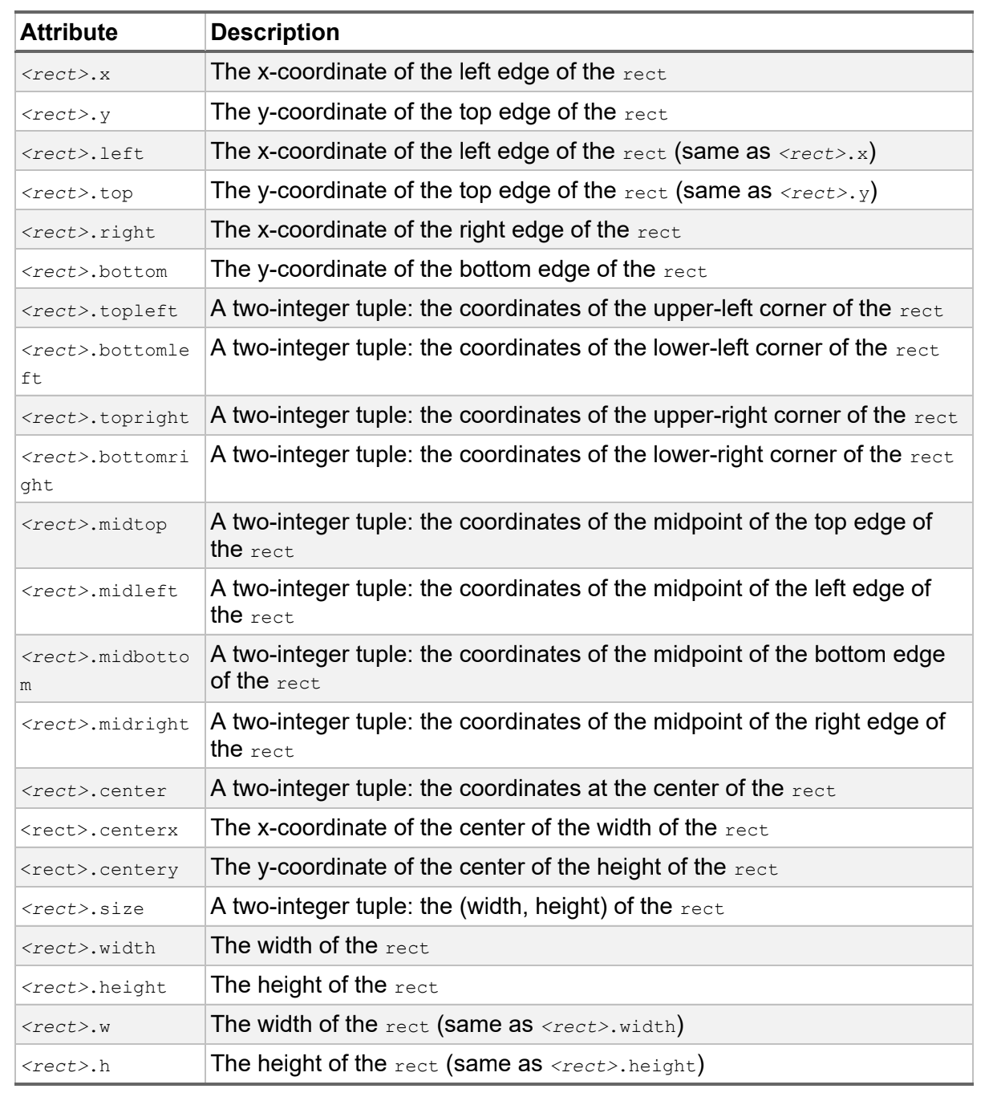
Table 5-1: Direct Access to Attributes of a rect
For instance, using the ballRect, the individual elements can be accessed as:
ballRect[0] is the x value
(but you could also use ballRect.left)
ballRect[1] is the y value
(but you could also use ballRect.top)
ballRect[2] is the width
(but you could also use ballRect.width)
ballRect[3] is the height
(but you could also use ballRect.height)
Notes:
A pygame rect also can be thought of, and accessed as, a list of four elements. Specifically, you can use an index to get or set any individual part of a rect.

Slide 37
Listing 5-7 is an alternative version of our bouncing ball program that maintains all the information about the ball in a rectangle object.
Listing 5-7: A location-based animation, bouncing a ball around the window, using rects
# pygame demo 4(b) - one image, bounce around the window using rects
# 1 - Import packages
import pygame
from pygame.locals import *
import sys
import random
# 2 - Define constants
BLACK = (0, 0, 0)
WINDOW_WIDTH = 640
WINDOW_HEIGHT = 480
FRAMES_PER_SECOND = 30
N_PIXELS_PER_FRAME = 3
# 3 - Initialize the world
pygame.init()
window = pygame.display.set_mode((WINDOW_WIDTH,
WINDOW_HEIGHT))
clock = pygame.time.Clock()
# 4 - Load assets: image(s), sound(s), etc.
ballImage = pygame.image.load('images/ball.png')
# 5 - Initialize variables
ballRect = ballImage.get_rect()
MAX_WIDTH = WINDOW_WIDTH - ballRect.width
MAX_HEIGHT = WINDOW_HEIGHT - ballRect.height
ballRect.left = random.randrange(MAX_WIDTH)
ballRect.top = random.randrange(MAX_HEIGHT)

Slide 38
Listing 5-7 (con)
xSpeed = N_PIXELS_PER_FRAME
ySpeed = N_PIXELS_PER_FRAME
# 6 - Loop forever
while True:
# 7 - Check for and handle events
for event in pygame.event.get():
# Clicked the close button? Quit pygame and end the program
if event.type == pygame.QUIT:
pygame.quit()
sys.exit()
# 8 - Do any "per frame" actions
if (ballRect.left < 0) or (ballRect.right >= WINDOW_WIDTH):
xSpeed = -xSpeed # reverse X direction
if (ballRect.top < 0) or (ballRect.bottom >= WINDOW_HEIGHT):
ySpeed = -ySpeed # reverse Y direction
# Update the ball's rectangle using the speed in two directions
ballRect.left = ballRect.left + xSpeed
ballRect.top = ballRect.top + ySpeed
# 9 - Clear the window before drawing it again
window.fill(BLACK)
# 10 - Draw the window elements
window.blit(ballImage, ballRect)
# 11 - Update the window
pygame.display.update()
# 12 - Slow things down a bit
clock.tick(FRAMES_PER_SECOND)

Slide 39
Playing Sounds
There are two types of sounds that you might want to play in your programs:
short sound effects and background music.
Playing Sound Effects
All sound effects must live in external files and must be in either .wav or .ogg format. Playing a relatively short sound effect consists of two steps:
load the sound from an external sound file once; then
at the appropriate time(s), play your sound.
To load a sound effect into memory, you use a line like this:
<soundVariable> = pygame.mixer.Sound(<path to sound file>)

Slide 40
To play the sound effect, you only need to call its play() method:
<soundVariable>.play()
We’ll modify Listing 5-7 to add a “boing” sound effect whenever the ball bounces off a side of the window.
# 4 - Load assets: image(s), sound(s), etc.
ballImage = pygame.image.load('images/ball.png')
bounceSound = pygame.mixer.Sound('sounds/boing.wav')
To play the “boing” sound effect whenever we change either the horizontal or vertical direction of the ball, we modify section 8 to look like this:
# 8 - Do any "per frame" actions
if (ballRect.left < 0) or (ballRect.right >= WINDOW_WIDTH):
xSpeed = -xSpeed # reverse X direction
bounceSound.play()
if (ballRect.top < 0) or (ballRect.bottom >= WINDOW_HEIGHT):
ySpeed = -ySpeed # reverse Y direction
bounceSound.play()
** find details in the official documentation at https://www.pygame.org/docs/ref/mixer.html.
Notes:
We’ll modify Listing 5-7 to add a “boing” sound effect whenever the ball bounces off a side of the window. There is a sounds folder in the project folder at the same level as the main program. Right after loading the ball image, we load the sound file by adding this code:
When you find a condition that should play a sound effect, you add a call to the play() method of the sound. There are many more options for controlling sound effects; you can find details in the official documentation at https://www.pygame.org/docs/ref/mixer.html.

Slide 41
Playing Background Music
Playing background music involves two lines of code using calls to the pygame.mixer.music module. First, you need this to load the sound file into memory:
pygame.mixer.music.load(<path to sound file>)
The <path to sound file> is a path string where the sound file can be found. You can use .mp3 files, which seem to work best, as well as .wav or .ogg files. When you want to start the music playing, you need to make this call:
pygame.mixer.music.play(<number of loops>, <starting position>)
To play some background music repeatedly, you can pass in a -1 for <number of loops> to run the music forever.
The <starting position> is typically set to 0 to indicate that you want to play the sound from the beginning.

Slide 42
There is a downloadable, modified version of the bouncing ball program that properly loads the sound effect and background music files and starts the background sound playing. The only changes are in section 4, as shown here.
# 4 - Load assets: image(s), sound(s), etc.
ballImage = pygame.image.load('images/ball.png')
bounceSound = pygame.mixer.Sound('sounds/boing.wav')
pygame.mixer.music.load('sounds/background.mp3')
pygame.mixer.music.play(-1, 0.0)
Pygame allows for much more intricate handling of background sounds.
You can find the full documentation at
https://www.pygame.org/docs/ref/music.html#module-pygame.mixer.music.

Slide 43
Drawing Shapes
Pygame offers a number of built-in functions that allow you to draw certain shapes known as primitives, which include lines, circles, ellipses, arcs, polygons, and rectangles.
There are two key advantages to using these drawing functions:
They execute extremely quickly, and
They allow you to draw simple shapes without having to create or load images from external files.

Slide 44
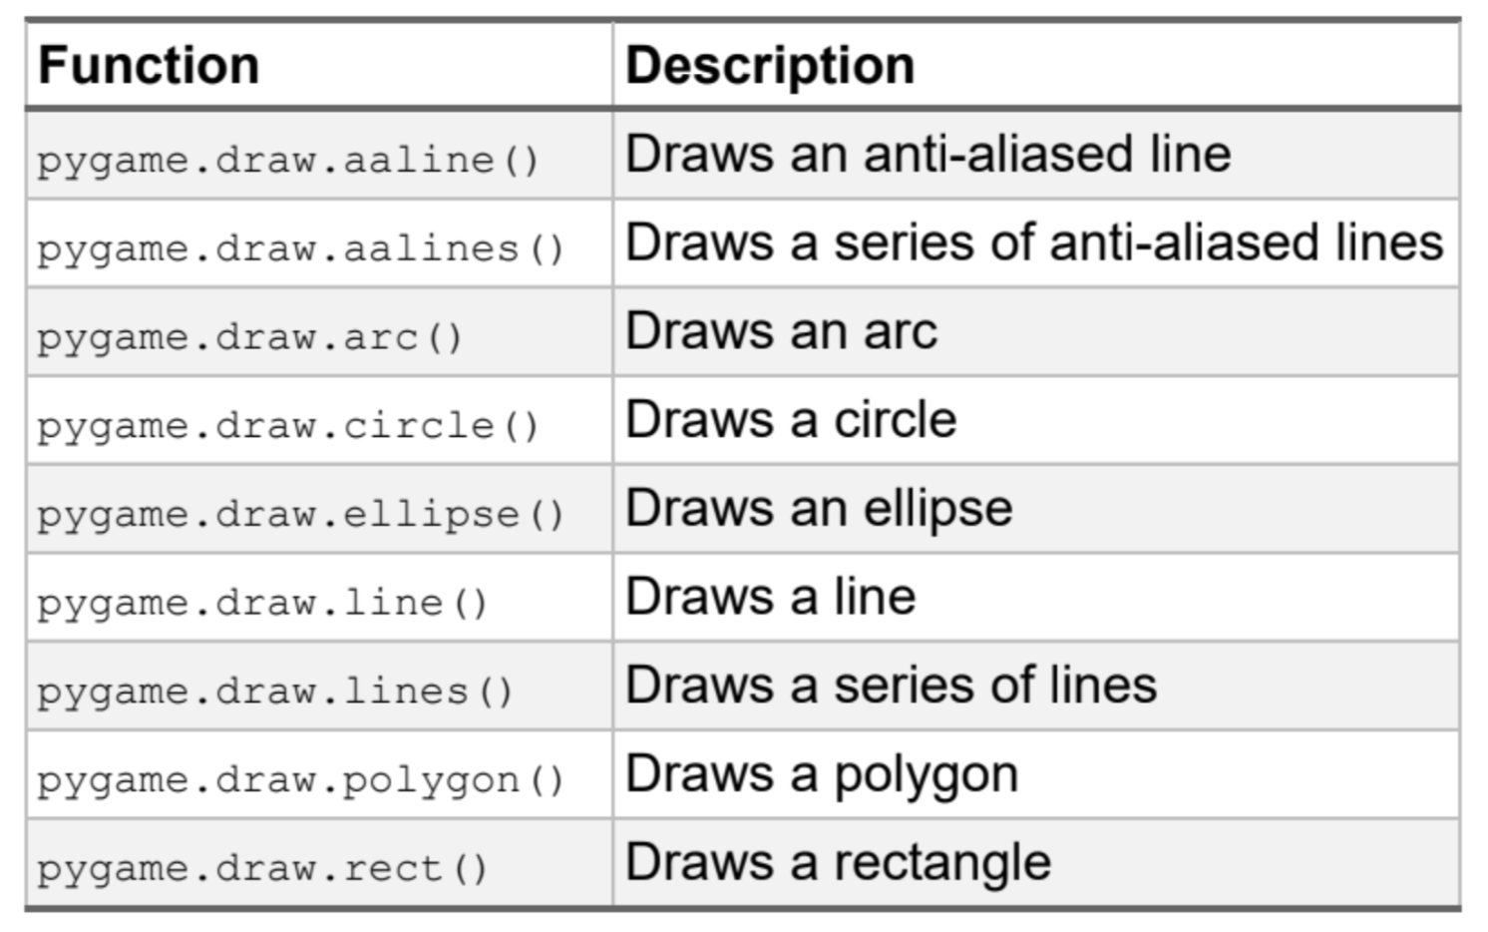
Table 5-2: Functions for Drawing Shapes

Slide 45
Reference for Primitive Shapes
For your reference, here is the documentation for the pygame methods to draw these primitives. In all of the following, the color argument expects you to pass in a tuple of RGB values:
Anti-aliased line
Draws an anti-aliased line in the window. If blend is True, the shades will be blended with existing pixel shades instead of overwriting pixels.
pygame.draw.aaline(window, color, startpos, endpos, blend=True)

Slide 46
Anti-aliased lines
Draws a sequence of anti-aliased lines in the window. The closed argument is a simple Boolean; if it’s True, a line will be drawn between the first and last points to complete the shape. The points argument is a list or tuple of (x, y) coordinates to be connected by line segments (there must be at least two). The Boolean blend argument, if set to True, will blend the shades with existing pixel shades instead of overwriting them.
pygame.draw.aaline(window, color, startpos, endpos, blend=True)
Arc
Draws an arc in the window. The arc will fit inside the given rect. The two angle arguments are the initial and final angles (in radians, with zero on the right). The width argument is the thickness to draw the outer edge.
pygame.draw.arc(window, color, rect, angle_start, angle_stop, width=0)

Slide 47
Circle
Draws a circle in the window. The pos is the center of the circle, and radius is the radius. The width argument is the thickness to draw the outer edge. If width is 0, then the circle will be filled.
pygame.draw.circle(window, color, pos, radius, width=0)
Ellipse
Draws an ellipse in the window. The given rect is the area that the ellipse will fill. The width argument is the thickness to draw the outer edge. If width is 0, then the ellipse will be filled.
pygame.draw.ellipse(window, color, rect, width=0)
Line
Draws a line in a window. The width argument is the thickness of the line.
pygame.draw.line(window, color, startpos, endpos, width=1)

Slide 48
Lines
Draws a sequence of lines in the window. The closed argument is a simple Boolean; if it’s True, a line will be drawn between the first and last points to complete the shape. The points argument is a list or tuple of (x, y)
coordinates to be connected by line segments (there must be at least two). The width argument is the thickness of the line. Note that specifying a line width wider than 1 does not fill in the gaps between the lines. Therefore,
wide lines and sharp corners won’t be joined seamlessly.
pygame.draw.lines(window, color, closed, points, width=1)
Polygon
Draws a polygon in the window. The pointslist specifies the vertices of the polygon. The width argument is the thickness to draw the outer edge. If width is 0, then the polygon will be filled.
pygame.draw.polygon(window, color, pointslist, width=0)
Rectangle
Draws a rectangle in the window. The rect is the area of the rectangle. The width argument is the thickness to draw the outer edge. If width is 0, then the rectangle will be filled.
pygame.draw.rect(window, color, rect, width=0)

Slide 49
Listing 5-8 is the code of the sample program, using the same 12-step template that produced the output in the previous figure
Listing 5-8: A program to demonstrate calls to primitive drawing functions in pygame
# pygame demo 5 - drawing
# 1 - Import packages
import pygame
from pygame.locals import *
import sys
import random
# 2 - Define constants
BLACK = (0, 0, 0)
BLUE = (0, 0, 255)
GREEN = (0, 255, 0)
RED = (255, 0, 0)
YELLOW = (255, 255, 0)
GRAY = (160, 160, 160)
TEAL = (0, 128, 128)
WINDOW_WIDTH = 640
WINDOW_HEIGHT = 480
FRAMES_PER_SECOND = 30
N_PIXELS_PER_FRAME = 3

Slide 50
Listing 5-8 (con)
# 3 - Initialize the world
pygame.init()
window = pygame.display.set_mode((WINDOW_WIDTH, WINDOW_HEIGHT))
clock = pygame.time.Clock()
# 4 - Load assets: image(s), sound(s), etc.
ballImage = pygame.image.load('images/ball.png')
# 5 - Initialize variables
ballRect = ballImage.get_rect()
MAX_WIDTH = WINDOW_WIDTH - ballRect.width
MAX_HEIGHT = WINDOW_HEIGHT - ballRect.height
ballRect.left = random.randrange(MAX_WIDTH)
ballRect.top = random.randrange(MAX_HEIGHT)
xSpeed = N_PIXELS_PER_FRAME
ySpeed = N_PIXELS_PER_FRAME
# 6 - Loop forever
while True:
# 7 - Check for and handle events
for event in pygame.event.get():
# Clicked the close button? Quit pygame and end the program
if event.type == pygame.QUIT:
pygame.quit()
sys.exit()
# 8 - Do any "per frame" actions
# 9 - Clear the window
window.fill(GRAY)

Slide 51
Listing 5-8 (con)
# 10 - Draw all window elements
# Draw a box
pygame.draw.line(window, BLUE, (20, 20), (60, 20), 4) # top
pygame.draw.line(window, BLUE, (20, 20), (20, 60), 4) # left
pygame.draw.line(window, BLUE, (20, 60), (60, 60), 4) # right
pygame.draw.line(window, BLUE, (60, 20), (60, 60), 4) # bottom
# Draw an X in the box
pygame.draw.line(window, BLUE, (20, 20), (60, 60), 1)
pygame.draw.line(window, BLUE, (20, 60), (60, 20), 1)
# Draw a filled circle and an empty circle
pygame.draw.circle(window, GREEN, (250, 50), 30, 0) # filled
pygame.draw.circle(window, GREEN, (400, 50), 30, 2) # 2 pixel edge
# Draw a filled rectangle and an empty rectangle
pygame.draw.rect(window, RED, (250, 150, 100, 50), 0) # filled
pygame.draw.rect(window, RED, (400, 150, 100, 50), 1) # 1 pixel edge
# Draw a filled ellipse and an empty ellipse
pygame.draw.ellipse(window, YELLOW, (250, 250, 80, 40), 0) # filled
pygame.draw.ellipse(window, YELLOW, (400, 250, 80, 40), 2) # 2 pixel edge
# Draw a six-sided polygon
pygame.draw.polygon(window, TEAL, ((240, 350), (350, 350), (410, 410), (350,470), (240, 470), (170, 410)))
# Draw an arc
pygame.draw.arc(window, BLUE, (20, 400, 100, 100), 0, 2, 5)
# Draw anti-aliased lines: a single line, then a list of points
pygame.draw.aaline(window, RED, (500, 400), (540, 470), 1)
pygame.draw.aalines(window, BLUE, True, ((580, 400), (587, 450), (595, 460), (600, 444)), 1)
# 11 - Update the window
pygame.display.update()
# 12 - Slow things down a bit
clock.tick(FRAMES_PER_SECOND) # make pygame wait

Slide 52
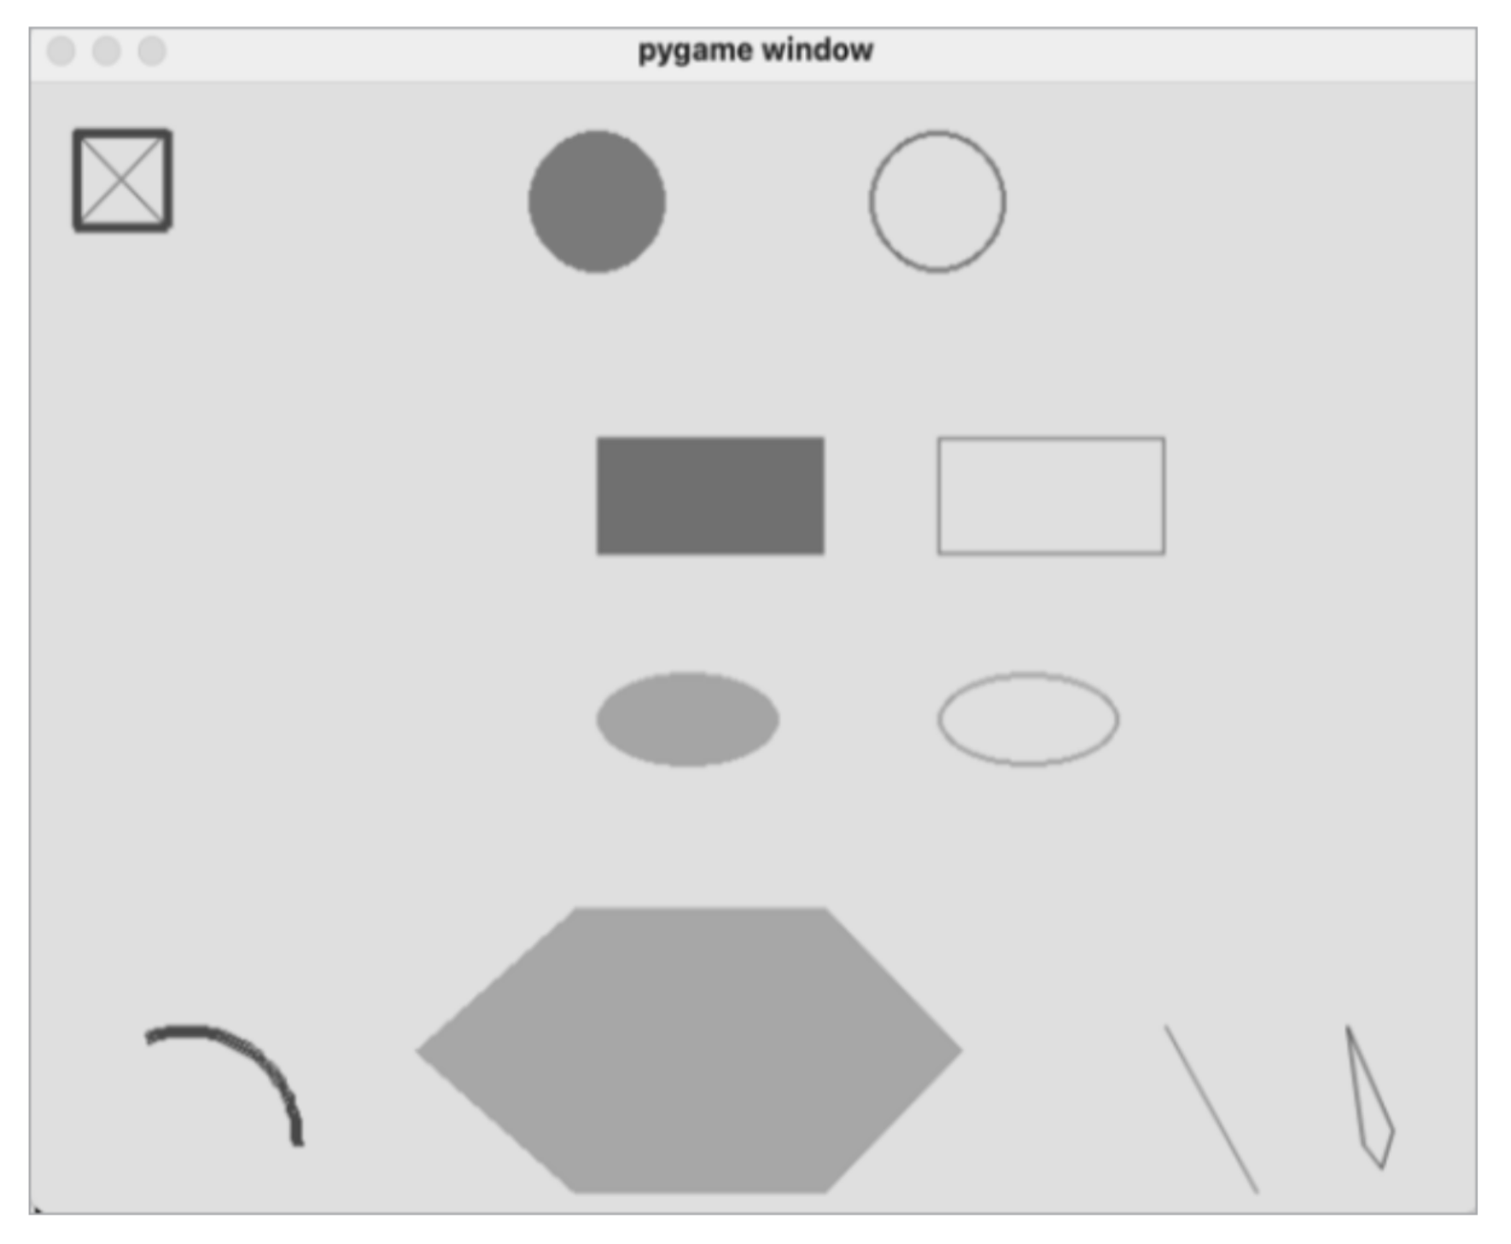
Figure shows the output of a sample program that demonstrates calls to these primitive drawing functions.

Slide 53
summary
The chapter introduces pygame basics, including installation, event-driven programming, and the pixel coordinate system in windows. It explains the concept of events, highlighting the difference from text-based programming and color representation in code.
A 12-section template for pygame-based programs is presented, enabling the creation of windowed applications. Sample programs demonstrate image drawing, mouse event detection, keyboard input handling, and location-based animations.
The chapter emphasizes the significance of rectangles in pygame, detailing their attributes and usage. It also provides examples of playing sound effects and background music to enhance user experiences.
While the chapter primarily focuses on procedural programming, it briefly touches on object-oriented code within pygame, exemplified by the rect object.

Slide 54
07
PYGAME GUI WIDGETS

Slide 55
Passing Arguments into a Function or Method
Python (and some other languages) allows you to make some of the arguments optional. If an optional argument isn’t provided in a call, we can provide a default value to use in the function or method instead.
If you order a hamburger at a Burger King restaurant, your burger will come with ketchup, mustard, and pickles. But Burger King is famous for saying, “You can have it your way.” If you want some other combination of
condiments, you must say what you want (or don’t want) when you make your order.
Start by writing an orderBurgers() function that simulates making a burger order in the regular way we’ve been defining functions, without implementing default values:
def orderBurgers(nBurgers, ketchup, mustard, pickles):
Notes:
The arguments in a call to a function and the parameters defined in the function have a one-to-one relationship, so that the value of the first argument is given to the first parameter, the value of the second argument is given to the second parameter, and so on.

Slide 56
You must specify the number of hamburgers you want to order, but ideally, if you want the defaults of True for adding ketchup, mustard, and pickles, you shouldn’t need to pass in any more arguments. So, to order two hamburgers with the standard defaults, you might think your call should look like this:
orderBurgers(2) # with ketchup, mustard, and pickles
However, in Python, this will trigger an error because there is a mismatch between the number of arguments in the call and the number of parameters specified in the function:
TypeError: orderBurgers() missing 3 required positional
arguments: 'ketchup', 'mustard', and 'pickles'

Slide 57
Positional and Keyword Parameters
Python has two different types of parameters: positional parameters and keyword parameters. Positional parameters are the type that we’re already familiar with, where each argument in a call has a matching parameter in the function or method definition.
A keyword parameter allows you to specify a default value. You write a keyword parameter as a variable name, an equal sign, and a default value, like this:
def someFunction(<keywordParameter>=<default value>):
You can have multiple keyword parameters, each with a name and a default value.
A function or method can have both positional parameters and keyword parameters, in which case you must specify all positional parameters before any keyword parameters:
def someOtherFunction(positionalParam1, positionalParam2, ...
<keywordParameter1>=<default value 1>,
<keywordParameter2>=<default value 2>, ...):

Slide 58
Let’s rewrite orderBurgers() to use one positional parameter and three keyword parameters with default values, like this:
def orderBurgers(nBurgers, ketchup=True, mustard=True, pickles=True):
When we make a call to this function, nBurgers is a positional parameter and therefore must be specified as an argument in every call. The other three are keyword parameters. If no values are passed for ketchup, mustard, and pickles, the function will use the default value of True for each of those parameter variables. Now we can order two burgers with all the condiments like this:
orderBurgers(2)

Slide 59
If we want something other than a default value, we can specify the name of the keyword parameter and a different value in our call. For example, if we only want ketchup on our two burgers, we can make the call this way:
orderBurgers(2, mustard=False, pickles=False)
When the function runs, the values of the mustard and pickles variables are set to False. Since we did not specify a value for ketchup, it is given the default of True.
You can also make the call specifying all arguments positionally, including those written as keyword parameters. Python will use the ordering of your arguments to assign each parameter the correct value:
orderBurgers(2, True, False, False)
In this call, we are again specifying two burgers with ketchup, no mustard, and no pickles.

Slide 60
Additional Notes on Keyword Parameters
When using keyword parameters and keywords with arguments, the equal sign between the keyword and the value should not have spaces around it, here is to show that these are not typical assignment statements.
def orderBurgers(nBurgers, ketchup=True, mustard=True,pickles=True):
...
orderBurgers(2, mustard=False)
These lines will also work fine, but they don’t follow the formatting convention and are less readable:
def orderBurgers(nBurgers, ketchup = True, mustard = True, pickles = True):
...
orderBurgers(2, mustard = False)

Slide 61
When calling a function that has both positional parameters and keyword parameters, you must provide values for all the positional parameters first, before any optional keyword parameters.
Keyword arguments in calls can be specified in any order. Calls to our orderBurgers() function could be made in various ways, such as:
orderBurgers(2, mustard=False, pickles=False) # only ketchup
orderBurgers(2, pickles=False, mustard=False, ketchup=False) # plain
All keyword parameters will be given the appropriate values, independent of the order of the arguments.
While all the default values in the orderBurgers() example were Boolean values, a keyword parameter can have a default value of any data type. For example, we could write a function to allow a customer to make an ice cream order like this:
def orderIceCream(flavor, nScoops=1, coneOrCup='cone',sprinkles=False):

Slide 62
Using None as a Default Value
It’s helpful to know whether the caller passed in a value for a keyword parameter or not.
For this example, the caller orders a pizza.
Specify a size, a style that defaults to 'regular' but could be 'deepdish’ and optionally pass in a single desired topping. If the caller wants a topping, we must charge them extra.
In Listing 7-1, we’ll use a positional parameter for the size and keyword parameters for the style and topping. The default for style is the string 'regular'. Since the topping choice is optional, we’ll use the special Python value of None as the default, but the caller may pass in the topping of their choice.
Listing 7-1: A function with a keyword parameter defaulting to None
def orderPizza(size, style='regular', topping=None):
# Do some calculations based on the size and style
# Check if a topping was specified

Slide 63
Listing 7-1 (con.)
PRICE_OF_TOPPING = 1.50 # price for any topping
if size == 'small’:
price = 10.00
elif size == 'medium’:
price = 14.00
else: # large
price = 18.00
if style == 'deepdish’:
price = price + 2.00 # charge extra for deepdish
line = 'You have ordered a ' + size + ' ' + style + 'pizza with ‘
if topping is None: # check if no topping was passed in
print(line + 'no topping’)
else:
print(line + topping)
price = price + PRICE_OF_TOPPING
print('The price is $', price)
print()
# You could order a pizza in the following ways:
orderPizza('large') # large, defaults to regular, no topping
orderPizza('large', style='regular') # same as above
orderPizza('medium', style='deepdish', topping='mushrooms')
orderPizza('small', topping='mushrooms') # style defaults to regular

Slide 64
Choosing Keywords and Default Values
Your choice of each keyword for keyword parameters is very important.
Once programmers start making calls that override default values, it’s very difficult to change the name of a keyword parameter because that name must be changed in all calls to the function or method in lockstep.
Otherwise, code that was working will break. For more widely distributed code, this can potentially cause a great deal of pain to programmers using your code. Bottom line, don’t change the name of a keyword parameter unless it is absolutely necessary.
It’s also very important to use default values that should suit the widest possible range of users.

Slide 65
Default Values in GUI Widgets
Next is to present a collection of classes that you can use to easily create GUI elements such as buttons and text fields within pygame.
For an in-depth example, we’ll look at a widget to display text in the application’s window. Text can be shown in a variety of fonts, font sizes, colors, background colors, and so on.
We’ll build a DisplayText class that will have default values for all of these attributes but will give client code the option of specifying different values.
Notes:
These classes will each be initialized using a few positional parameters but will also have assorted optional keyword parameters, all with reasonable defaults to allow programmers to create GUI widgets by specifying only a few positional arguments. More precise control can be obtained by specifying values to overwrite the default values of keyword parameters.

Slide 66
The pygwidgets Package
The rest of this chapter will focus on the pygwidgets (pronounced “pig wijits”) package, which was written with two goals in mind:
To demonstrate many different object-oriented programming techniques
To allow programmers to easily create and use GUI widgets in pygame programs
The pygwidgets package contains the following classes:
TextButton
Button built with standard art, using a text string
CustomButton
Button with custom artwork
TextCheckBox
Checkbox with standard art, built from a text string

Slide 67
CustomCheckBox
Checkbox with custom artwork
TextRadioButton
Radio buttons with standard art, built from a text string
CustomRadioButton
Radio buttons with custom artwork
DisplayText
Field used to display output text
InputText
Field where the user can type text
Dragger
Allows the user to drag an image
Image
Displays an image at a location
ImageCollection
Displays one of a collection of images at a location
Animation
Displays a sequence of images
SpriteSheetAnimation
Displays a sequence of images from a single larger image

Slide 68
Setting Up
To install pygwidgets, open the command line and enter the following:
python3 -m pip install -U pip --user
python3 -m pip install -U pygwidgets --user
These commands download and install the latest version of pygwidgets from the Python Package Index (PyPI). Once installed, you can use pygwidgets by including the following statement at the beginning of your programs:
import pygwidgets
After importing, you can instantiate objects from its classes and call the methods of those objects. The most current documentation of pygwidgets is at
https://pygwidgets.readthedocs.io/en/latest/.
If you’d like to view the source code for the package, it’s available via GitHub repository at https://github.com/IrvKalb/pygwidgets/.

Slide 69
Overall Design Approach
As shown in Chapter 5, one of the first things you do in every pygame program is to define the window of the application. The following line creates an application window and saves a reference to it in a variable named window:
window = pygame.display.set_mode((WINDOW_WIDTH, WINDOW_HEIGHT))
As we will soon see, whenever we instantiate any widget, we will need to pass in the window variable so the widget can draw itself in the application’s window.
Most widgets in pygwidgets work in a similar way, typically involving these three steps:
Step 1 in using any widget is to instantiate one with a line like this:
oWidget = pygwidgets.<SomeWidgetClass>(window, loc, <other arguments as needed>)

Slide 70
Step 2 is to handle any event that could affect the widget by calling the object’s handleEvent() method inside the event loop. If any event (like a mouse click or button press) happens and the widget handles the event, this call will return True. The code at the top of the main while loop generally looks like this:
while True:
for event in pygame.event.get():
if event.type == pygame.QUIT:
pygame.quit()
sys.exit()
if oWidget.handleEvent(event):
# The user has done something to oWidget that we should respond to
# Add code here
Step 3 is to add a line near the bottom of the while loop to call the draw() method of the widget, to make it appear it in the window:
oWidget.draw()
Since we specified the window to draw into, the location, and any details that affect the appearance of the widget in step 1, we don’t pass anything in the call to draw().

Slide 71
Adding an Image
We will use the Image class to display an image in a window. When you instantiate an Image object, the only required arguments are the window, the location in the window to draw the image, and the path to the image file. Create the Image object before the main loop starts, like so:
oImage = pygwidgets.Image(window, (100, 200), 'images/SomeImage.png')
The path used here assumes that the project folder containing the main program also contains a folder named images, inside which is the SomeImage.png file. Then, in the main loop you just need to call the
object’s draw() method:
oImage.draw()

Slide 72
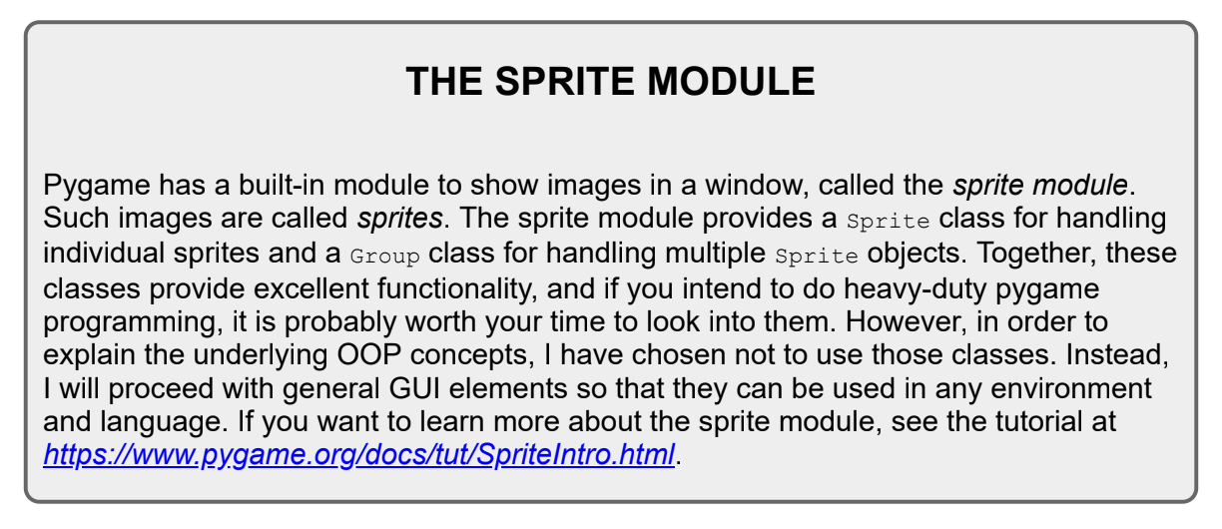
The draw() method of the Image class contains a call to blit() to actually draw the image, so you never need to call blit() directly. To move the image, you can call its setLoc() method (short for set location),
specifying the new x- and y-coordinates as a tuple:
oImage.setLoc((newX, newY))
The next time the image is drawn, it will show up at the new coordinates. The documentation lists many additional methods that you can call to flip, rotate, scale, get the image’s location and rectangle, and so on.

Slide 73
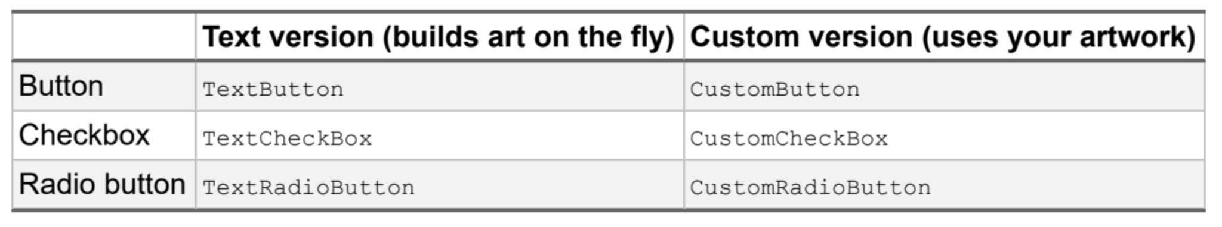
Adding Buttons, Checkboxes, and Radio Buttons
When you instantiate a button, checkbox, or radio button widget in pygwidgets, you have two options: instantiate a text version that draws its own art and adds a text label based on a string you pass in, or instantiate a custom version where you supply the art. Table 7-1 shows the different
button classes that are available.
Table 7-1: Text and Custom Button Classes in pygwidgets
The differences between the text and custom versions of these classes are only relevant during instantiation. Once you create an object from a text or custom button class, all the remaining methods of the pair of classes are identical. To make this clear, let’s take a look at the TextButton and CustomButton classes.

Slide 74
TextButtons
Here is the actual definition of the __init__() method of the TextButton class in pygwidgets:
def __init__(self, window, loc, text, width=None, height=40, textColor=PYGWIDGETS_BLACK, upColor=PYGWIDGETS_NORMAL_GRAY, overColor=PYGWIDGETS_OVER_GRAY,downColor=PYGWIDGETS_DO WN_GRAY, fontName=DEFAULT_FONT_NAME, fontSize=DEFAULT_FONT_SIZE, soundOnClick=None, enterToActivate=False, callback=None nickname=None):
Rather than reading through the code of a class, a programmer will typically refer to its documentation.
As mentioned earlier, you can find the complete documentation for pygwidgets at
https://pygwidgets.readthedocs.io/en/latest/.
You can also view documentation of a class by calling the built-in help() function in the Python shell like so:
>>> help(pygwidgets.TextButton)

Slide 75
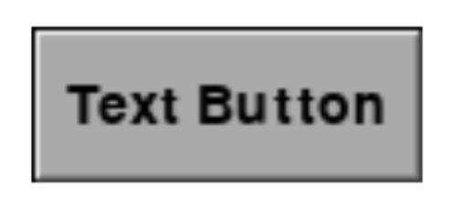
When you create an instance of a TextButton, you are only required to pass in the window, the location in the window, and the text to be shown on the button.
oButton = pygwidgets.TextButton(window, (50, 50), 'Text Button')
The code in the __init__() method of the TextButton class uses the pygame drawing methods to construct its own art for all four states (up, down, over, and disabled). The preceding line creates an “up” version of a button that looks like Figure 7-2.
Figure 7-2: A TextButton using defaults
Notes:
When you create an instance of a TextButton, you are only required to pass in the window, the location in the window, and the text to be shown on the button. If you only specify these positional parameters, your button willuse reasonable defaults for the width and height, the background colors for the four states of the button (different shades of gray), the font, and the font size. By default, no sound effect will be played when the user clicks on thebutton. The code to create a TextButton using all the defaults looks like this:

Slide 76
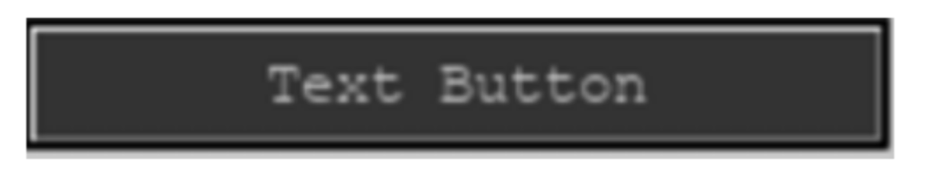
You can override any or all of the default parameters with keyword values like so:
oButton = pygwidgets.TextButton(window, (50, 50), 'Text Button’, width=200, height=30, textColor=(255, 255, 128), upColor=(128, 0, 0), fontName='Courier', fontSize=14, soundOnClick='sounds/blip.wav', enterToActivate=True)
This instantiation will create a button that looks like Figure 7-3.
Figure 7-3: A TextButton using keyword arguments for font, size, colors, and so on
The image-switching behavior of these two buttons would work exactly the same way; the only differences would be in the appearance of the images.

Slide 77
CustomButtons
The CustomButton class allows you to use your own art for a button. To instantiate a CustomButton, you need only pass in a window, a location, and a path to the image of the up state of the button. Here is an example:
restartButton = pygwidgets.CustomButton(window, (100, 430), 'images/RestartButtonUp.png')
The down, over, and disabled states are optional keyword arguments, and for any of these where no value is passed in, CustomButton will use a copy of the up image. It’s more typical (and strongly suggested) to pass in
paths for the optional images, like so:
restartButton = pygwidgets.CustomButton(window, (100, 430), 'images/RestartButtonUp.png’, down='images/RestartButtonDown.png', over='images/RestartButtonOver.png’, disabled='images/RestartButtonDisabled.png', soundOnClick='sounds/blip.wav’, nickname='restart')
Here we also specified a sound effect that should be played when the user clicks the button, and we provided an internal nickname we can use later.

Slide 78
Using Buttons
After instantiation, here’s some typical code to use a button object,
oButton, independent of it being a TextButton or a CustomButton:
while True:
for event in pygame.event.get():
if event.type == pygame.QUIT:
pygame.quit()
sys.exit()
if oButton.handleEvent(event):
# User has clicked this button
<Any code you want to run here when the button is clicked>
--- snip ---
oButton.draw() # at the bottom of the while loop, tell it to draw
Every time we detect an event, we need to call the handleEvent() method of the button to allow it to react to the user’s actions.
Notes:
Every time we detect an event, we need to call the handleEvent() method of the button to allow it to react to the user’s actions. >>> This call normally returns False but will return True when the user completes a click on the button. At the bottom of the main while loop, we need to call the draw() method of the button to allow it to draw itself.

Slide 79
Text Output and Input
Here is to introduce new classes for a text display field and an input text field.
Both of these classes have minimal required (positional) parameters, and they have reasonable defaults for other attributes (font, font size, color, and so on) that are easily overridden.
Text Output
The pygwidgets package contains a DisplayText class for showing text that is a more full-featured version of the SimpleText class from Chapter 6.
When you instantiate a DisplayText field, the only required arguments are the window and the location. The first keyword parameter is value, which may be specified with a string as starting text to be shown in the field. This is typically used for a default end user value or for text that never changes, like a label or instructions. Since value is the first keyword parameter, it can be given as either a positional or a keyword argument. For example:
oTextField = pygwidgets.DisplayText(window, (10, 400), 'Hello World')

Slide 80
This will work the same way as this:
oTextField = pygwidgets.DisplayText(window, (10, 400), value='Hello World')
You can also customize the look of the output text by specifying any or all of the optional keyword parameters.
oTextField = pygwidgets.DisplayText(window, (10, 400), value='Some title text', fontName='Courier', fontSize=40, width=150, justified='center', textColor=(255, 255, 0))
The DisplayText class has a number of additional methods, the most important of which is setValue(), which you call to change the text drawn in the field:
oTextField.setValue('Any new text you want to see')
At the bottom of the main while loop, you need to call the object’s draw() method:
oTextField.draw()
And of course, you can create as many DisplayText objects as you wish, each displaying different text and each with its own font, size, color, and so on.

Slide 81
Text Input
To get input from the user you would make a call to the input() function, which stops the program until the user enters text in the shell window. But in the world of event-driven GUI programs, the main loop never stops. Therefore, we must use a different approach.
The only required arguments to instantiate an InputText object are the window and a location:
oInputField = pygwidgets.InputText(window, (10, 100))
However, you can customize the text attributes of an InputText object by specifying optional keyword arguments:
oInputField = pygwidgets.InputText(window, (10, 400), value='Starting Text', fontName='Helvetica’, fontSize=40, width=150, textColor=(255, 255, 0))

Slide 82
After instantiating an InputText field, the typical code in the main loop would look like this:
while True:
for event in pygame.event.get():
if event.type == pygame.QUIT:
pygame.quit()
sys.exit()
if oInputField.handleEvent(event):
# User has pressed Enter or Return
userText = oInputField.getValue() # get the text the user entered
<Any code you want to run using the user's input>
--- snip ---
oInputField.draw() # at the bottom of the main while loop

Slide 83
Other pygwidgets Classes
The ImageCollection class allows you to show any single image from a collection of images. For example, suppose you have images of a character facing front, left, back, and right.
To represent all the potential images, you can build a dictionary like this:
imageDict = {'front':'images/front.png', 'left':'images/left.png’, 'back':'images/back.png', 'right':'images/right.png'}
You can then create an ImageCollection object, specifying this dictionary and the key of the image you want to start with. To change to a different image, you call the replace() method and pass in a different key.
Calling the draw() method at the bottom of the loop always shows the current image.

Slide 84
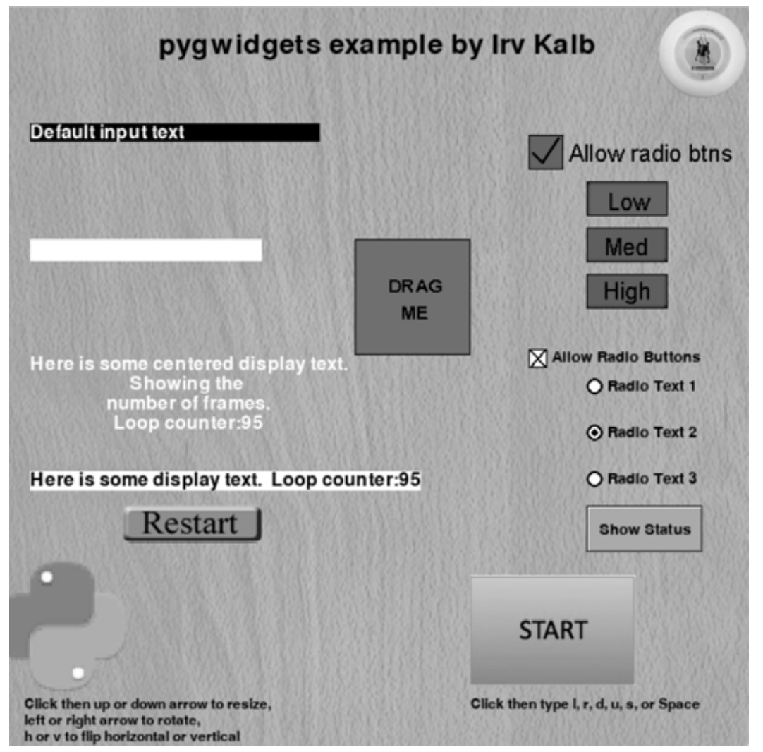
pygwidgets Example Program
Figure 7-4 shows a screenshot of a sample program that demonstrates objects instantiated from many of the classes in pygwidgets, including Image, DisplayText, InputText, TextButton, CustomButton,
TextRadioButton, CustomRadioButton, TextCheckBox, CustomCheckBox, ImageCollection, and Dragger.
The source of this example program can be found in the pygwidgets_test folder in my GitHub repository, https://github.com/IrvKalb/pygwidgets/.
Figure 7-4: The window of a program that demonstrates objects instantiated from a variety of pygwidgets classes

Slide 85
The Importance of a Consistent API
Note about building an API for a set of classes:
whenever possible, it’s a very good idea to build consistency into the parameters of methods in different, but similar, classes.
As a good example, the first two parameters to the __init__() method of every class in pygwidgets are window and loc, in that order. If these had been in a different order in some calls, using the package as a whole would be much more difficult.
Additionally, if different classes implement the same functionality, it’s a good idea to use the same method names.
For example, many of the classes in pygwidgets have a method named setValue() and another named getValue().
We’ll talk more about why this type of consistency in the next few weeks ...

Slide 86
summary
Positional and keyword parameters: This chapter explains the use of default values for method parameters, especially through keyword parameters.
Introduction to pygwidgets Module: The chapter showcases the pygwidgets module, including various prebuilt GUI widget classes, and offers practical usage examples.
Advantages of writing classes like pygwidgets: This section highlights two benefits of creating classes like those in pygwidgets: hiding complexity within methods and enabling code reusability through class instances with customizable default values.
Publishing class interfaces: The chapter encourages sharing class interfaces, emphasizing the importance of thorough documentation and code consistency for improved usability.

Slide 87
Reference
OBJECT-ORIENTED PYTHON
MASTER OOP BY
BUILDING GAMES AND GUIS,
IRV KALB

