Slide 1
Struts 2 framework

Slide 2
OVERVIEW
What is Struts?
Struts 2 Architecture
Request Lifecycle in Struts 2
Struts 2 Core components
Spring integration
Why we should use Struts 2?
Demo
Q&A

Slide 3
What is Struts?
An open source framework which makes building web applications easier, based on Java Servlets and JSP technologies
Action Based Framework
Create web application using MVC architecture
Apache Struts offer two major version ( Struts 1.x & Struts 2.x)

Slide 4
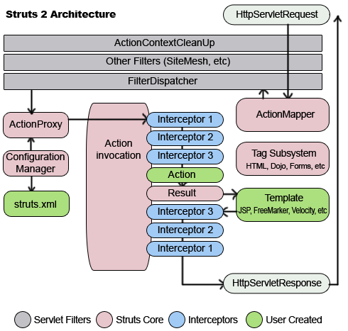
Struts 2 Architecture

Slide 5
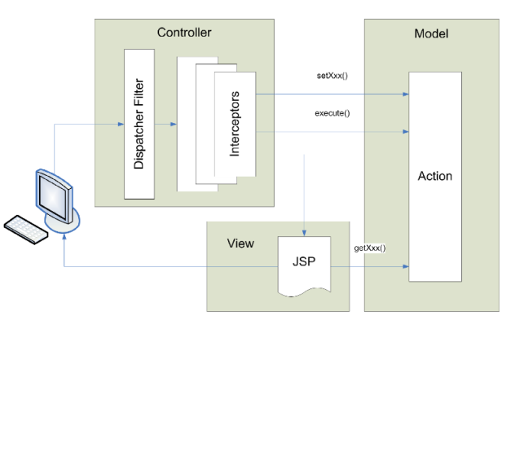
Struts 2 Architecture
implements MVC 2 design pattern

Slide 6
Struts 2 Architecture
Controller:
Filter Dispatcher:
First component that start processing that is why this type of MVC is called front controller MVC
Looks at the request and apply the appropriate action
Struts framework handles all of the controller work
Its configured in web.xml
Interceptors:
Can execute code before and after an Action is executed
They can be configured per action basis
Can be used for data validation, file upload, double submit guards

Slide 7
Struts 2 Architecture
Model:
Implemented by action class
For model you can use any data access technologies like JDBC,EJB,Hibernate
View:
Its your result part. It can be JSP,JSTL,JSF etc.
Presentation part of the MVC

Slide 8
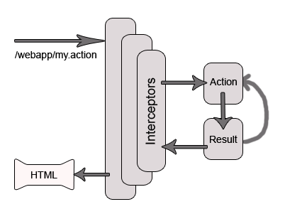
Request Lifecycle in Struts 2
User Sends Request
Filter Dispatcher determines the appropriate action
Interceptors are applied
Execution of action
Output Rendering
Return of Request
Display of result to user.

Slide 9
Struts 2 Core components
Action
Encapsulate the unit of work
The containment of business logic
Provide locus for data transfer
Return control string for result routing. Interface Action defines ERROR, INPUT, LOGIN, NONE, and SUCCESS
ActionSupport provides implementations of validation and i18n interfaces (Action, Validateable, ValidationAware, TextProvider, LocaleProvider, Serializable)

Slide 10
Struts 2 Core components
Interceptor
Comes from XWork framework. It has only 3 method: init, intercept, destroy
Provide a way to supply pre-processing and post-processing around the action
Provide cross-cutting application features
Built-in interceptors:
Utility interceptors: timer, logger
Data transfer interceptors: params, static-params, servlet config, fileupload
Workflow interceptors: workflow, validation, prepare

Slide 11
Struts 2 Core components
Interceptor
Built-in interceptors:
Miscellaneous interceptors: exception, token, token-session,…
Built-in stacks: defaultstack, basicstack,…
Declaring interceptor:
<action name="MyAction" class="org.actions.myactions.MyAction">
<interceptor-ref name="timer"/>
<interceptor-ref name=" exampleStack "/>
<result>Success.jsp</result>
</action>
,

Slide 12
Struts 2 Core components
Declaring interceptor:
<package name="struts-default">
<interceptors>
<interceptor name="exception" class="ExceptionMappingInterceptor"/>
<interceptor name="params" class="ParametersInterceptor"/>
…
<interceptor-stack name=“exampleStack">
<interceptor-ref name="params">
<param name="excludeParams">dojo\..*</param>
</interceptor-ref>
<interceptor-ref name="exception "/>
</interceptor-stack>
</interceptors>
<default-interceptor-ref name="defaultStack"/>
</package>

Slide 13
Struts 2 Core components
Building an interceptor:
Implement interceptor interface
public class ExampleInterceptor implements Interceptor{
public String intercept(ActionInvocation ai){
…
String result = ai.invoke();
….
return result;
}
}

Slide 14
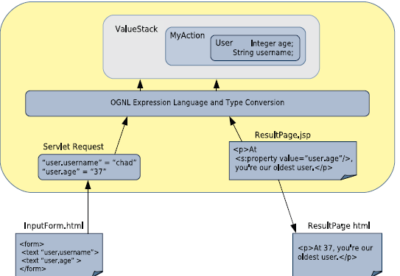
Struts 2 Core components
OGNL (Object-Graph Navigation Language)
Expression Language
Data transfer
Type Converter
,

Slide 15
Struts 2 Core components
OGNL (Object-Graph Navigation Language)
Built-in type converter:
String
Boolean/boolean
Char/Character
int/Interger, float/Float, long/Long, double/Double
Date
Array
List
Map
,

Slide 16
Struts 2 Core components
OGNL (Object-Graph Navigation Language)
Customizing type conversion:
Extends base class StrutsTypeConverter
Implement methods: convertFromString, convertToString
Configure xwork-conversion.properties (exp: manning.utils.Circle=manning.utils.CircleTypeConverter)
,

Slide 17
Struts 2 Core components
Result Type
Dispatcher
Redirect (<result type='redirect' >http://www.google.com/?myParam=${defaultUsername}</result>)
Redirect-action (<result type="redirectAction"><param name="actionName">AdminPortfolio</param><param name="namespace">/chapterEight/secure</param></result>)
Plugin: tiles, json, jasper
Stream
Velocity
Freemarker
Xlst

Slide 18
Struts 2 Core components
Struts Tags
Data tag:
Property tag: <s:property value="user.username"/>
Set tag:
<s:set name="username" value="user.username"/>
Hello, <s:property value="#username"/>. How are you?
Push tag:
<s:push value="user">This is the "<s:property value="username"/>"</s:push>
Bean tag:
<s:bean name="org.apache.struts2.util.Counter" var="counter">
<s:param name="last" value="7"/>
</s:bean>
<s:iterator value="#counter"><li><s:property/></li></s:iterator>

Slide 19
Struts 2 Core components
Struts Tags
Control tag:
Iterator tag:
<s:iterator value="users" status="itStatus">
<li><s:property value="#itStatus.count" />
<s:property value="portfolioName"/></li>
</s:iterator>
if and else tags:
<s:if test="user.age > 35">This user is too old.</s:if>
<s:elseif test="user.age < 35">This user is too young</s:elseif>
<s:else>This user is just right</s:else>

Slide 20
Struts 2 Core components
Struts Tags
Miscellaneous tags:
URL Tag:
<s:url action="IteratorTag" var="myUrl">
<s:param name="id" value="2"/>
</s:url>
<a href='<s:property value="#myUrl" />'> Click Me </a>
<a href='/manningHelloWorld/chapterSix/IteratorTag.action?id=2'>
Click Me</a>
I18n (internationalization) and text tags:
<s:i18n name="manning.chapterSix.myResourceBundle_vi">
In <s:text name="language"/>,
<s:text name="girl" var="foreignWord"/>
</s:i18n>

Slide 21
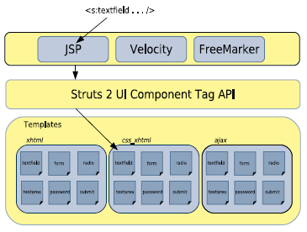
Struts 2 Core components
Struts Tags
UI component tags: <s:textfield … />, <s: select … />

Slide 22
Spring integration
Dependency injection (DI) or inversion of control (IoC) container for Struts2
Provide fully configured business service instances to actions

Slide 23
Why we should use Struts 2?
Simplified Design
Simplified Action
Simplified Testability
Better tag features
Annotation introduced
Easy plug-in
AJAX Support
Large User Community, Expert Developers and Committers
Notes:
Simplified Design - Programming the abstract classes instead of interfaces is one of design problem of struts1 framework that has been resolved in the struts 2 framework. Most of the Struts 2 classes are based on interfaces and most of its core interfaces are HTTP independent. Struts 2 Action classes are framework independent and are simplified to look as simple POJOs. Framework components are tried to keep loosely coupled. Simplified Actions - Actions are simple POJOs. Any java class with execute() method can be used as an Action class. Even we don't need to implement interfaces always. Inversion of Control is introduced while developing the action classes. This make the actions to be neutral to the
underlying framework . No more ActionForms - ActionForms feature is no more known to the struts2 framework. Simple JavaBean flavored actions are used to put properties directly. No need to use all String properties. Simplified testability - Struts 2 Actions are HTTP independent and framework neutral. This enables to test struts applications very easily without resorting to mock objects. Intelligent Defaults - Most configuration elements have a default value which can be set according to the need. Even there are xml-based default configuration files that can be overridden according to the need. Improved results - Unlike ActionForwards, Struts 2 Results provide flexibility to create multiple type of outputs and in actual it helps to prepare the response. Better Tag features - Struts 2 tags enables to add style sheet-driven markup capabilities, so that we can create consistent pages with less code. Struts 2 tags are more capable and result oriented. Struts 2 tag markup can be altered by changing an underlying stylesheet. Individual tag markup can be changed by editing a FreeMarker template. Both JSP and FreeMarker tags are fully supported. Annotations introduced : Applications in struts 2 can use Java 5 annotations as an alternative to XML and Java properties configuration. Annotations minimize the use of xml. Stateful Checkboxes - Struts 2 checkboxes do not require special handling for false values. QuickStart - Many changes can be made on the fly without restarting a web container. customizing controller - Struts 1 lets to customize the request processor per module, Struts 2 lets to customize the request handling per action, if desired. Easy Spring integration - Struts 2 Actions are Spring-aware. Just need to add Spring beans! Easy plugins - Struts 2 extensions can be added by dropping in a JAR. No manual configuration is required! AJAX support - The AJAX theme gives interactive applications a significant boost. The framework provides a set of tags to help you ajaxify your applications, even on Dojo. The AJAX features include: AJAX Client Side Validation
Remote form submission support (works with the submit tag as well)
An advanced div template that provides dynamic reloading of partial HTML
An advanced template that provides the ability to load and evaluate JavaScript remotely
An AJAX-only tabbed Panel implementation
A rich pub-sub event model
Interactive auto complete tag

Slide 24
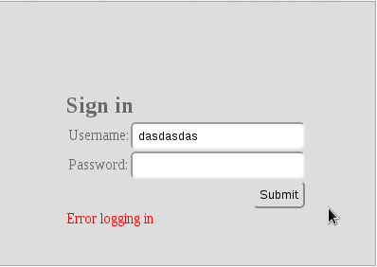
EXERCISES
Login form
Validate client by JQUERY
Validate server
Ajax submit
Submit form
No need database

Slide 25
REFERENCES
http://www.roseindia.net/struts/struts2/

