Slide 1

CÁC KiẾN THỨC CĂN BẢN LẬP TRÌNH WEB
NGUYỄN THANH NGA – P. PHÁT TRIỂN
ngant16@viettel.com.vn
TRUNG TÂM GIẢI PHÁP CNTT&VT VIETTEL

Slide 2

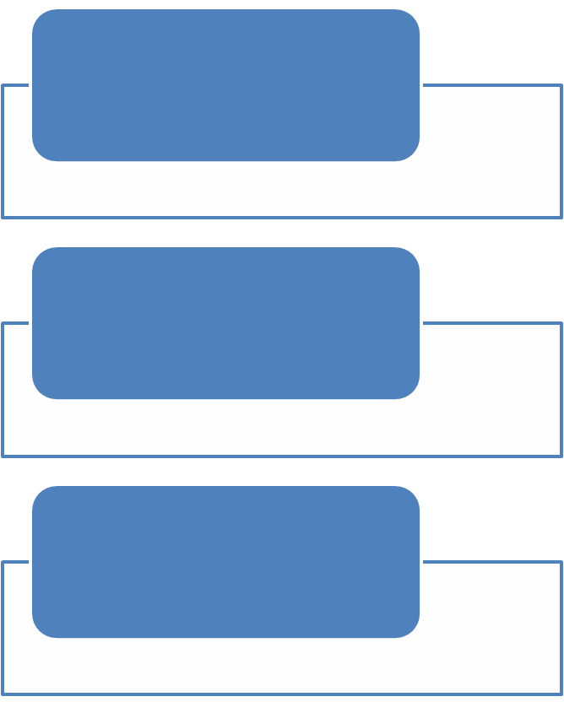

NỘI DUNG TRÌNH BÀY
1
HTML/ CSS
2
HTTP/SESSION/COOKIE
EXERCISES
4
TỔNG KẾT

Slide 3

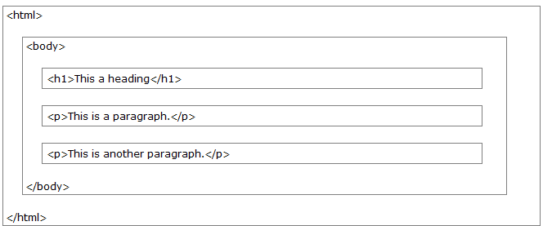
HTML - HTML stands for Hyper Text Markup Language
HTML Page Structure

Slide 4
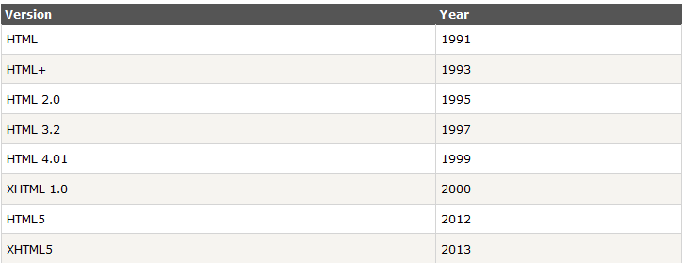
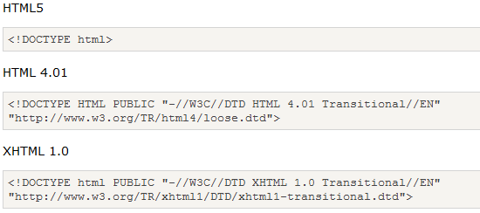
HTML(cont)
HTML Versions
The <!DOCTYPE> Declaration

Slide 5

HTML
Web Browsers
HTML Tags
  <tagname>content</tagname>
  http://www.w3schools.com/tags/

Slide 6
HTML – XHTML
XHTML stands for EXtensible HyperText Markup Language
XHTML is almost identical to HTML 4.01
XHTML is a stricter and cleaner version of HTML 4.01
XHTML is HTML defined as an XML application
XHTML is supported by all major browsers.
XML is a markup language where documents must be marked up correctly and "well-formed".
Differences from HTML
  Document Structure
    XHTML DOCTYPE is mandatory
    The XML namespace attribute in <html> is mandatory
    <html>, <head>, <title>, and <body> is mandatory
  XHTML Elements
    XHTML elements must be properly nested
    XHTML elements must always be closed
    XHTML elements must be in lowercase
    XHTML documents must have one root element
  XHTML Attributes
    Attribute names must be in lower case
    Attribute values must be quoted
    Attribute minimization is forbidden

Slide 7
HTML – XHTML
<b><i>This text is bold and italic</b></i>
<p>This is a paragraph
<p>This is another paragraph
A break: <br>
A horizontal rule: <hr>
An image: <img src="happy.gif" alt="Happy face">
<BODY>
<P>This is a paragraph</P>
</BODY>
<table WIDTH="100%">
<input checked>
<input readonly>
<input disabled>
<option selected>
<b><i>This text is bold and italic</i></b>
<p>This is a paragraph</p>
<p>This is another paragraph<
A break: <br />
A horizontal rule: <hr />
An image: <img src="happy.gif" alt="Happy face" /> /p
<body>
<p>This is a paragraph</p>
</body> >
<table width="100%">
<input checked="checked">
<input readonly="readonly">
<input disabled="disabled">
<option selected="selected">

Slide 8
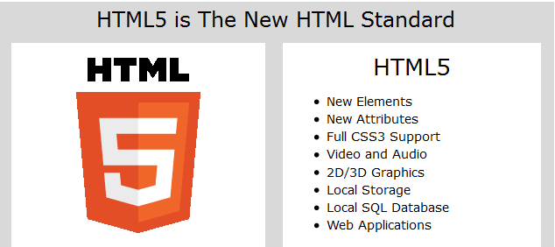
HTML5
http://www.w3schools.com/html/html5_intro.asp

Slide 9
CSS
CSS stands for Cascading Style Sheets
Styles define how to display HTML elements
Styles were added to HTML 4.0 to solve a problem
External Style Sheets can save a lot of work
External Style Sheets are stored in CSS files

Slide 10
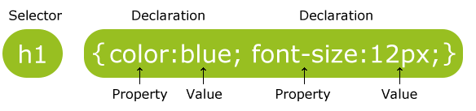
CSS
Syntax
  p {color:red;text-align:center;}
Comments
  begins with "/*", and ends with "*/"
  /*This is a comment*/
  p
  {
  text-align:center;
  /*This is another comment*/
  color:black;
  font-family:arial;
  }
http://www.w3schools.com/cssref/default.asp

Slide 11
CSS
Id Selectors
  #para1
  {
  text-align:center;
  color:red;
  }
Class selectors
.center {text-align:center;}

Slide 12
CSS
Insert CSS
  External style sheet
  <link rel="stylesheet" type="text/css" href="mystyle.css">
  Internal style sheet
  <head>
  <style>
  hr {color:sienna;}
  p {margin-left:20px;}
  body {background-image:url("images/back40.gif");}
  </style>
  </head>
  Inline style
<p style="color:sienna;margin-left:20px">This is a paragraph.</p>

Slide 13
CSS
Multiple Styles
  Browser default
  External style sheet
  Internal style sheet (in the head section)
  Inline style (inside an HTML element)

Slide 14
COOKIES
A cookie is a variable that is stored on the visitor's computer. Each time the same computer requests a page with a browser, it will send the cookie too.
Cookies were designed to be a reliable mechanism for websites to remember the state of the website or activity the user had taken in the past.
  Session cookie : When an expiry date or validity interval is not set at cookie creation time, a session cookie is created. Web browsers normally delete session cookies when the user closes the browser
  Persistent cookie : Max-Age set to 1 year
  Secure cookie : A secure cookie has the secure attribute enabled and is only used via HTTPS, ensuring that the cookie is always encrypted when transmitting from client to server
  HttpOnly cookie
  Third-party cookie
  Zombie cookie
  http://en.wikipedia.org/wiki/HTTP_cookie

Slide 15
SESSION
A session can be defined as a server-side storage of information that is desired to persist throughout the user's interaction with the web site or web application.
Instead of storing large and constantly changing information via cookies in the user's browser, only a unique identifier is stored on the client side (called a "session id"). This session id is passed to the web server every time the browser makes an HTTP request (ie a page link or AJAX request)

Slide 16
POST vs GET
Two commonly used methods for a request-response between a client and server are: GET and POST.
GET Method
  GET requests can be cached
  GET requests remain in the browser history
  GET requests can be bookmarked
  GET requests should never be used when dealing with sensitive data
  GET requests have length restrictions
  GET requests should be used only to retrieve data
POST Method
  POST requests are never cached
  POST requests do not remain in the browser history
  POST requests cannot be bookmarked
  POST requests have no restrictions on data length
/test/demo_form.asp?name1=value1&name2=value2
POST /test/demo_form.asp HTTP/1.1
Host: w3schools.com
name1=value1&name2=value2

Slide 17
POST vs GET
 | GET | POST
BACK button/Reload | Harmless | Data will be re-submitted (the browser should alert the user that the data are about to be re-submitted)
Bookmarked | Can be bookmarked | Cannot be bookmarked
Cached | Can be cached | Not cached
Encoding type | application/x-www-form-urlencoded | application/x-www-form-urlencoded or multipart/form-data. Use multipart encoding for binary data
History | Parameters remain in browser history | Parameters are not saved in browser history
Restrictions on data length | Yes, when sending data, the GET method adds the data to the URL; and the length of a URL is limited (maximum URL length is 2048 characters) | No restrictions
Restrictions on data type | Only ASCII characters allowed | No restrictions. Binary data is also allowed
Security | GET is less secure compared to POST because data sent is part of the URL Never use GET when sending passwords or other sensitive information! | POST is a little safer than GET because the parameters are not stored in browser history or in web server logs
Visibility | Data is visible to everyone in the URL | Data is not displayed in the URL

Slide 18

EXERCISES
References
  CSS3 : http://www.w3schools.com/css3/default.asp
  HTML5 : http://www.w3schools.com/html/html5_intro.asp
HTML
  http://www.w3schools.com/quiztest/result.asp
CSS
  http://www.w3schools.com/quiztest/quiztest.asp?qtest=CSS

Slide 19


