Slide 1

CÁC KiẾN THỨC CĂN BẢN LẬP TRÌNH WEB
NGUYỄN THANH NGA – P. PHÁT TRIỂN
ngant16@viettel.com.vn
TRUNG TÂM GIẢI PHÁP CNTT&VT VIETTEL

Slide 2

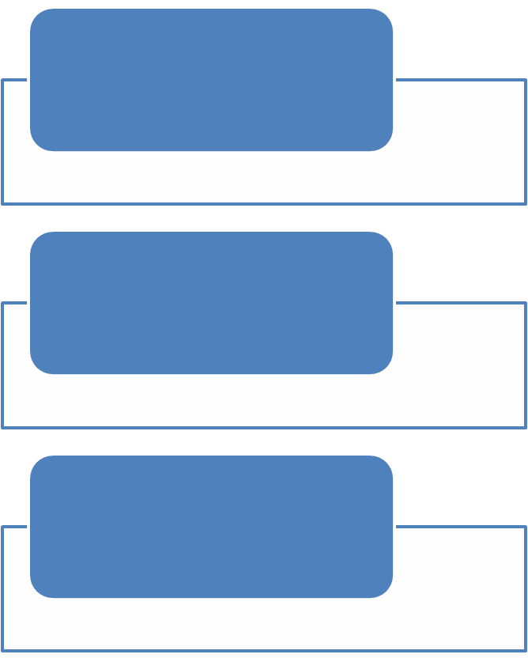

NỘI DUNG TRÌNH BÀY
1
JAVASCRIPT
2
JQUERY
EXERCISES
4
TỔNG KẾT

Slide 3

JAVASCRIPT
JavaScript is THE scripting language of the Web.
JavaScript is used in billions of Web pages to add functionality, validate forms, communicate with the server, and much more.
A JavaScript Function in <head>
<!DOCTYPE html>
<html><head>
<script>
function myFunction()
{
document.getElementById("demo").innerHTML="My First JavaScript Function";
}
</script>
</head>
<body>
<h1>My Web Page</h1>
<p id="demo">A Paragraph</p>
<button type="button" onclick="myFunction()">Try it</button>
</body>
</html>

Slide 4
JAVASCRIPT
A JavaScript Function in <body>
<!DOCTYPE html>
<html>
<body> <h1>My Web Page</h1>
<p id="demo">A Paragraph</p>
<button type="button" onclick="myFunction()">Try it</button>
<script>
function myFunction()
{
document.getElementById("demo").innerHTML="My First JavaScript Function";
}
</script>
</body>
</html>

Slide 5
JAVASCRIPT
External JavaScripts
<!DOCTYPE html>
<html>
<body>
<script src="myScript.js"></script>
</body>
</html>

Slide 6
JAVASCRIPT
JavaScript Statements
  sequence of statements to be executed by the browser.
document.getElementById("demo").innerHTML="Hello Dolly";
document.getElementById("myDIV").innerHTML="How are you?";
JavaScript is case sensitive.
  getElementById # getElementbyID
  myVariable # MyVariable
Comments
  Single line comments start with //.
  Multi line comments start with /* and end with */

Slide 7
JAVASCRIPT
Variables
  Variable names must begin with a letter
  Variable names can also begin with $ and _ (but we will not use it)
  Variable names are case sensitive (y and Y are different variables)
  Undefined : The variable carname will have the value undefined
  var lastname="Doe", age=30, job="carpenter";
  var lastname;

Slide 8
JAVASCRIPT
Data Types
  String, Number, Boolean, Array, Object, Null, Undefined.
  var answer="It's alright";
  var answer="He is called 'Johnny'";
  var person={
  firstname : "John",
  lastname : "Doe",
  id : 5566
  };
  name=person.lastname;
  name=person["lastname"];
  var x1=34.00; //Written with decimals
  var x2=34; //Written without decimals
  var x=true;
  var y=false;
  var cars=new Array();
  cars[0]="Saab";
  cars[1]="Volvo";
  cars[2]="BMW";
  var cars=new Array("Saab","Volvo","BMW");
  var cars=["Saab","Volvo","BMW"];

Slide 9
JAVASCRIPT
Objects
  "Everything" in JavaScript is an Object: a String, a Number, an Array, a Date....
  In JavaScript, an object is data, with properties and methods.
Function Syntax
  function myFunction(var1,var2)
  {
  some code
  }
  var myVar=myFunction();

Slide 10
JAVASCRIPT
Others
  JS Operators
  JS Comparisons
  JS Conditions
  JS Switch
  JS Loop For
  JS Loop While
  JS Breaks
  JS Errors
  It can be syntax errors, typically coding errors or typos made by the programmer.
  It can be misspelled or missing features in the language (maybe due to browser differences).
  It can be errors due to wrong input, from a user, or from an Internet server.
  And, of course, it can be many other unforeseeable things.
    http://www.w3schools.com/js/js_errors.asp
  try
  {
  //Run some code here
  }
  catch(err)
  {
  //Handle errors here
  }

Slide 11
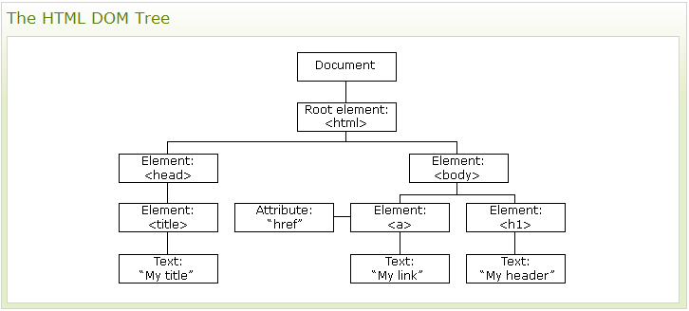
JAVASCRIPT
The HTML DOM (Document Object Model)
  JavaScript can change all the HTML elements in the page
  JavaScript can change all the HTML attributes in the page
  JavaScript can change all the CSS styles in the page
  JavaScript can react to all the events in the page
Document. getElementById
Document. getElementsByTagName

Slide 12
JAVASCRIPT
JavaScript HTML DOM Events
  When a user clicks the mouse
  When a web page has loaded
  When an image has been loaded
  When the mouse moves over an element
  When an input field is changed
  When an HTML form is submitted
  When a user strokes a key
Assign Events
  use event attributes.
  using JavaScript
<button onclick="displayDate()">Try it</button>
<script>
document.getElementById("myBtn").onclick=function(){displayDate()};
</script>

Slide 13
JAVASCRIPT
Window Object
  It represent the browsers window.
Window Screen
  contains information about the user's screen.
Window Location
  location.hostname returns the domain name of the web host
  location.pathname returns the path and filename of the current page
  location.port returns the port of the web host (80 or 443)
  location.protocol returns the web protocol used (http:// or https://)
  The location.href property returns the URL of the current page.
Window History
  history.back() - same as clicking back in the browser
  history.forward() - same as clicking forward in the browser
Window Navigator
  contains information about the visitor's browser.

Slide 14
JAVASCRIPT
JavaScript Libraries
  jQuery
  Prototype
  MooTools
  YUI - The Yahoo! User Interface Framework is a large library that covers a lot of functions, from simple JavaScript utilities to complete internet widgets.
  Ext JS - Customizable widgets for building rich Internet applications.
  Dojo - A toolkit designed around packages for DOM manipulation, events, widgets, and more.
  script.aculo.us - Open-source JavaScript framework for visual effects and interface behaviors.
  UIZE - Widgets, AJAX, DOM, templates, and more.
jQuery
  http://www.w3schools.com/jquery/default.asp
  http://jquery.com/

Slide 15
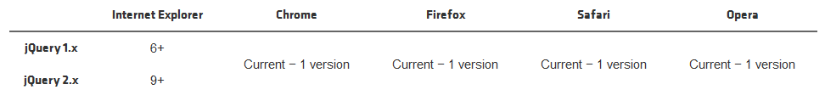
JQUERY
jQuery is a JavaScript Library.
jQuery greatly simplifies JavaScript programming.
jQuery is easy to learn.
jQuery Selectors
jQuery Events
Ajax
$(document).ready(function(){
$("p").click(function(){
$(this).hide();
});
});

Slide 16
JQUERY
$( "button.continue" ).html( "Next Step..." )
jQuery Selectors
jQuery Events
Ajax
var hiddenBox = $( "#banner-message" );
$( "#button-container button" ).on( "click", function( event ) {
hiddenBox.show();
});
$.ajax({
url: "/api/getWeather",
  data: {
  zipcode: 97201
},
success: function( data ) {
$( "#weather-temp" ).html( "<strong>" + data + "</strong> degrees" );
}
});

Slide 17
JQUERY
Jquery UI
  http://jqueryui.com/
jQuery References
  http://www.w3schools.com/jquery/jquery_ref_ajax.asp
  jQuery EasyUI
    http://www.jeasyui.com/
  KENDO
    http://www.kendoui.com/
Exercises:
  JS:
    http://www.w3schools.com/quiztest/quiztest.asp?qtest=JavaScript
  JQUERY
    http://www.w3schools.com/quiztest/quiztest.asp?qtest=jQuery

Slide 18


