Slide 1

Copy file
팜티투짱202139411
https://github.com/ptttrang1211/fileCopy.git

Slide 2
1. Requirement Analysis
Objective: Copy text content from the source file to the destination file.
Functions: Read - Write – Process
Specifications:
+ Supports copying a text file from one path to another.
+ Checks if the source file exists; if it does, copies it to the destination file.

Slide 3
2. System Design
FileCopy class
+ Source file path, destination file path
+ Read the entire content of the source file
+ Write the content to the destination file
+ Handle errors: source file does not exist, unable to create file, etc.

Slide 4
2. System Design
-Process Execution:
1. Check if the source file exists.
2. Open the source file and the destination file.
3. Read data from the source file.
4. Write data to the destination file.
5. Ensure that the files are properly closed.

Slide 5
3. Implemention
1. The copyFile method takes the source file path and destination file path as arguments.
2. The program checks if the source file exists. If not, an error message will be printed.
3. If the file exists, the program uses BufferedReader to read the source file line by line.
4. Each line read from the source file is written to the destination file using BufferedWriter.
5. Upon successful copying, a success message will be printed.

Slide 6
4.Testing(Test Cases)
Test case 1: Check if the program correctly copies the content when both files are valid.
Test case 2: Verify how the program handles the case when the source file does not exist.
- Test case 3: Test how the program handles errors related to I/O exceptions.

Slide 7
5.Conclusion
The FileCopy program copies content from one file to another, handling basic errors such as the source file not existing.

Slide 8
6. Code
package org.example;
import java.io.*;
public class FileCopy {
// method to copy file
public void copyFile(String readFile, String writeFile) {
File read = new File(readFile);
File write = new File(writeFile);
// check file
if (!read.exists()) {
System.out.println("Error: not file ");
return;
}
try (BufferedReader reader = new BufferedReader(new FileReader(read));
BufferedWriter writer = new BufferedWriter(new FileWriter(write))) {
// read, write
String line;
while ((line = reader.readLine()) != null) {
writer.write(line);
writer.newLine();
}
System.out.println("file copy success.");
} catch (IOException e) {
System.out.println("error while coping file : " + e.getMessage());
}
}

Slide 9
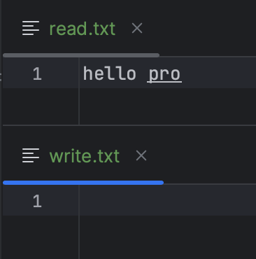
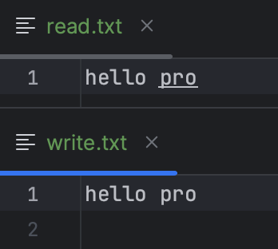
6. Code
  public static void main(String[] args) {
  FileCopy fileCopy = new FileCopy();
  // example usage
  fileCopy.copyFile(fileCopy.copyFile("src/main/java/org/example/read.txt", "src/main/java/org/example/write.txt” );
  }
  }
=>

Slide 10


