Slide 1

Password Generator
팜티투짱202139411- 컴퓨터공학과
https://github.com/ptttrang1211/password-generator.git

Slide 2
1. Requirement Anlysis
1.1: Functinal Requirement
Users can adjust the password length and the number of characters of each type.
Users can adjust the password length and the number of characters of each type.
Ensure the password is strong and not easy to guess.

Slide 3
1. Requirement Anlysis
1.2: Non-Functional Requirement
The password generation time must be fast.
It should be deployable on web or application platforms.

Slide 4
2. System design
Programming Language : python
Required Libraries : random và string
3 Functions :
+ generator_password_auto() : Automatically generates a password based on the length entered by the user.
+ generator_password_custom(): Allows the user to specify the desired number of each character type.
+main(): Displays the menu, receives user input, and processes it accordingly.
-Interface: Allows the user to input their desired password length.

Slide 5
3. Implemention
import string import random LETTERS = string.ascii_letters NUMBERS = string.digits PUNCTUATION = string.punctuation def password_generator_auto(password_length): if password_length < 8: raise ValueError("Password must be at least 8 character security.\n") printable = f'{LETTERS}{NUMBERS}{PUNCTUATION}' printable = list(printable) random.shuffle(printable) random_password = ''.join(random.choices(printable, k=password_length)) return random_password

Slide 6
3. Implemention
def password_generator_custom(n_letters, n_numbers, n_punctuation): total_lenght = n_letters + n_numbers + n_punctuation if total_lenght < 8: raise ValueError("Password must be at least 8 character security.\n") letters_part = random.choices(LETTERS, k=n_letters) numbers_part = random.choices(NUMBERS, k=n_numbers) punctuation_part = random.choices(PUNCTUATION, k=n_punctuation) total_password = letters_part + numbers_part + punctuation_part random.shuffle(total_password) return ''.join(total_password)

Slide 7
3. Implemention
def main(): print("=======Password Generator=======") while True: print("1.Password generator auto ") print("2. Password generator custom ") choice = input(" Choose 1 or 2: ") if choice == "1": while True: try: password_length = int(input("How long do you want your password\n")) password = password_generator_auto(password_length) break except ValueError as e: print (e) break

Slide 8
3. Implemention
elif choice == "2": while True: try: n_letters = int(input("How many letters you want in your password?\n")) n_numbers = int(input("How many number you want in your password?\n")) n_punctuation = int(input("How long punctuation you want in your password?\n")) password = password_generator_custom(n_letters, n_numbers, n_punctuation) break except ValueError as e: print(e) break else: print("Invalid choice. Please try again.\n") print("Generated password: ", password)
if __name__ == '__main__': main()

Slide 9
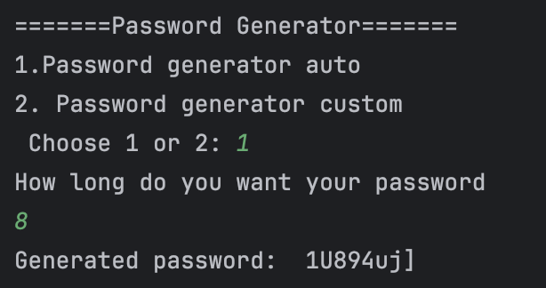
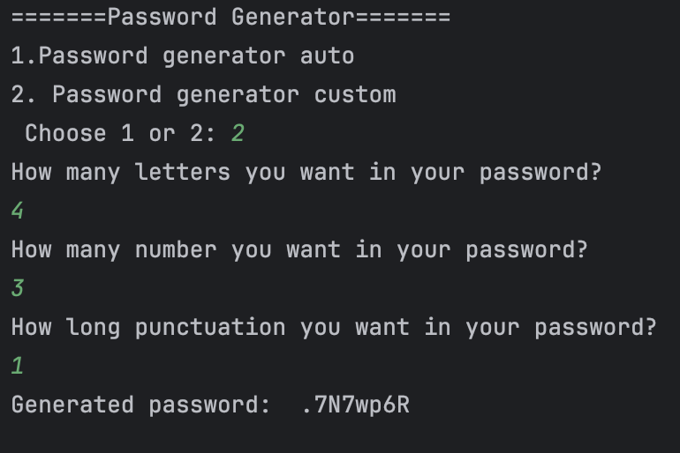
3. Implemention

Slide 10
4. Testing
Testcase 1: Check with valid input (password length >= 8)
Testcase 2: Check with invalid input (password length < 8)
Testcase 3: Check the total number of characters in custom mode
Testcase 4: Check invalid total number of characters in custom mode

Slide 11
5. Deploying
Run main in pyCharm
Can be integrated into a larger system such as an account management application or strong password generation software.

Slide 12
6. Maintenance
- Add graphical user interface
Ensure that each type of character is represented at least once in the password
Save the password to a file
Allow selection of password strength (weak, medium, strong)

Slide 13


