Slide 1
cddlib Reference Manual
When some strange behavior is observed, it is always wise to create a rationalization of the input (for example,one can replace 0.3333333 with 1/3) and to compute it with cddlib compiled with gmp rational to see what a correct behavior should be.

Slide 2
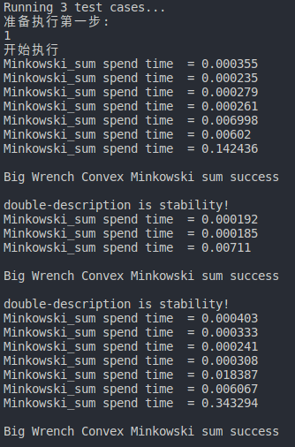
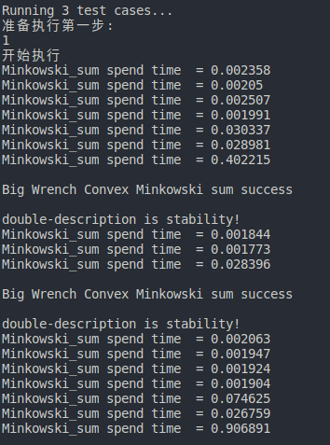
求闵氏和有点费事，尝试使用Gurobi而不是GLPK
但是Gurobi对于求解这个问题没有GLPK快

Slide 3
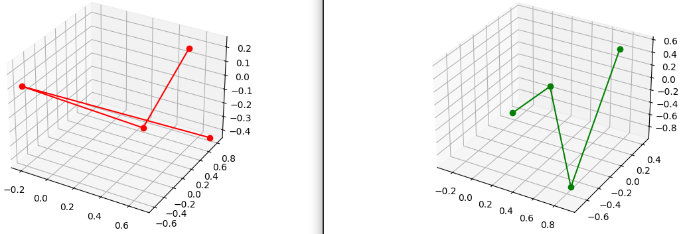
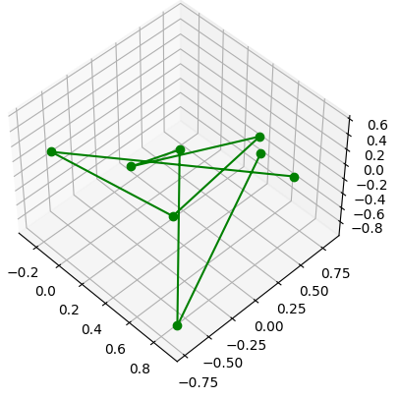
matplotlib-cpp

Slide 4
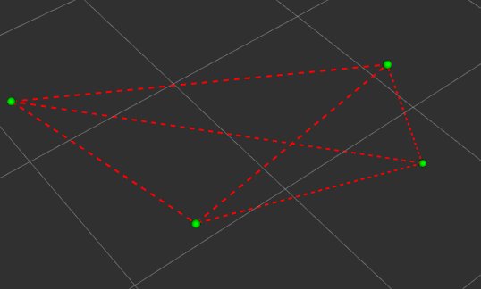
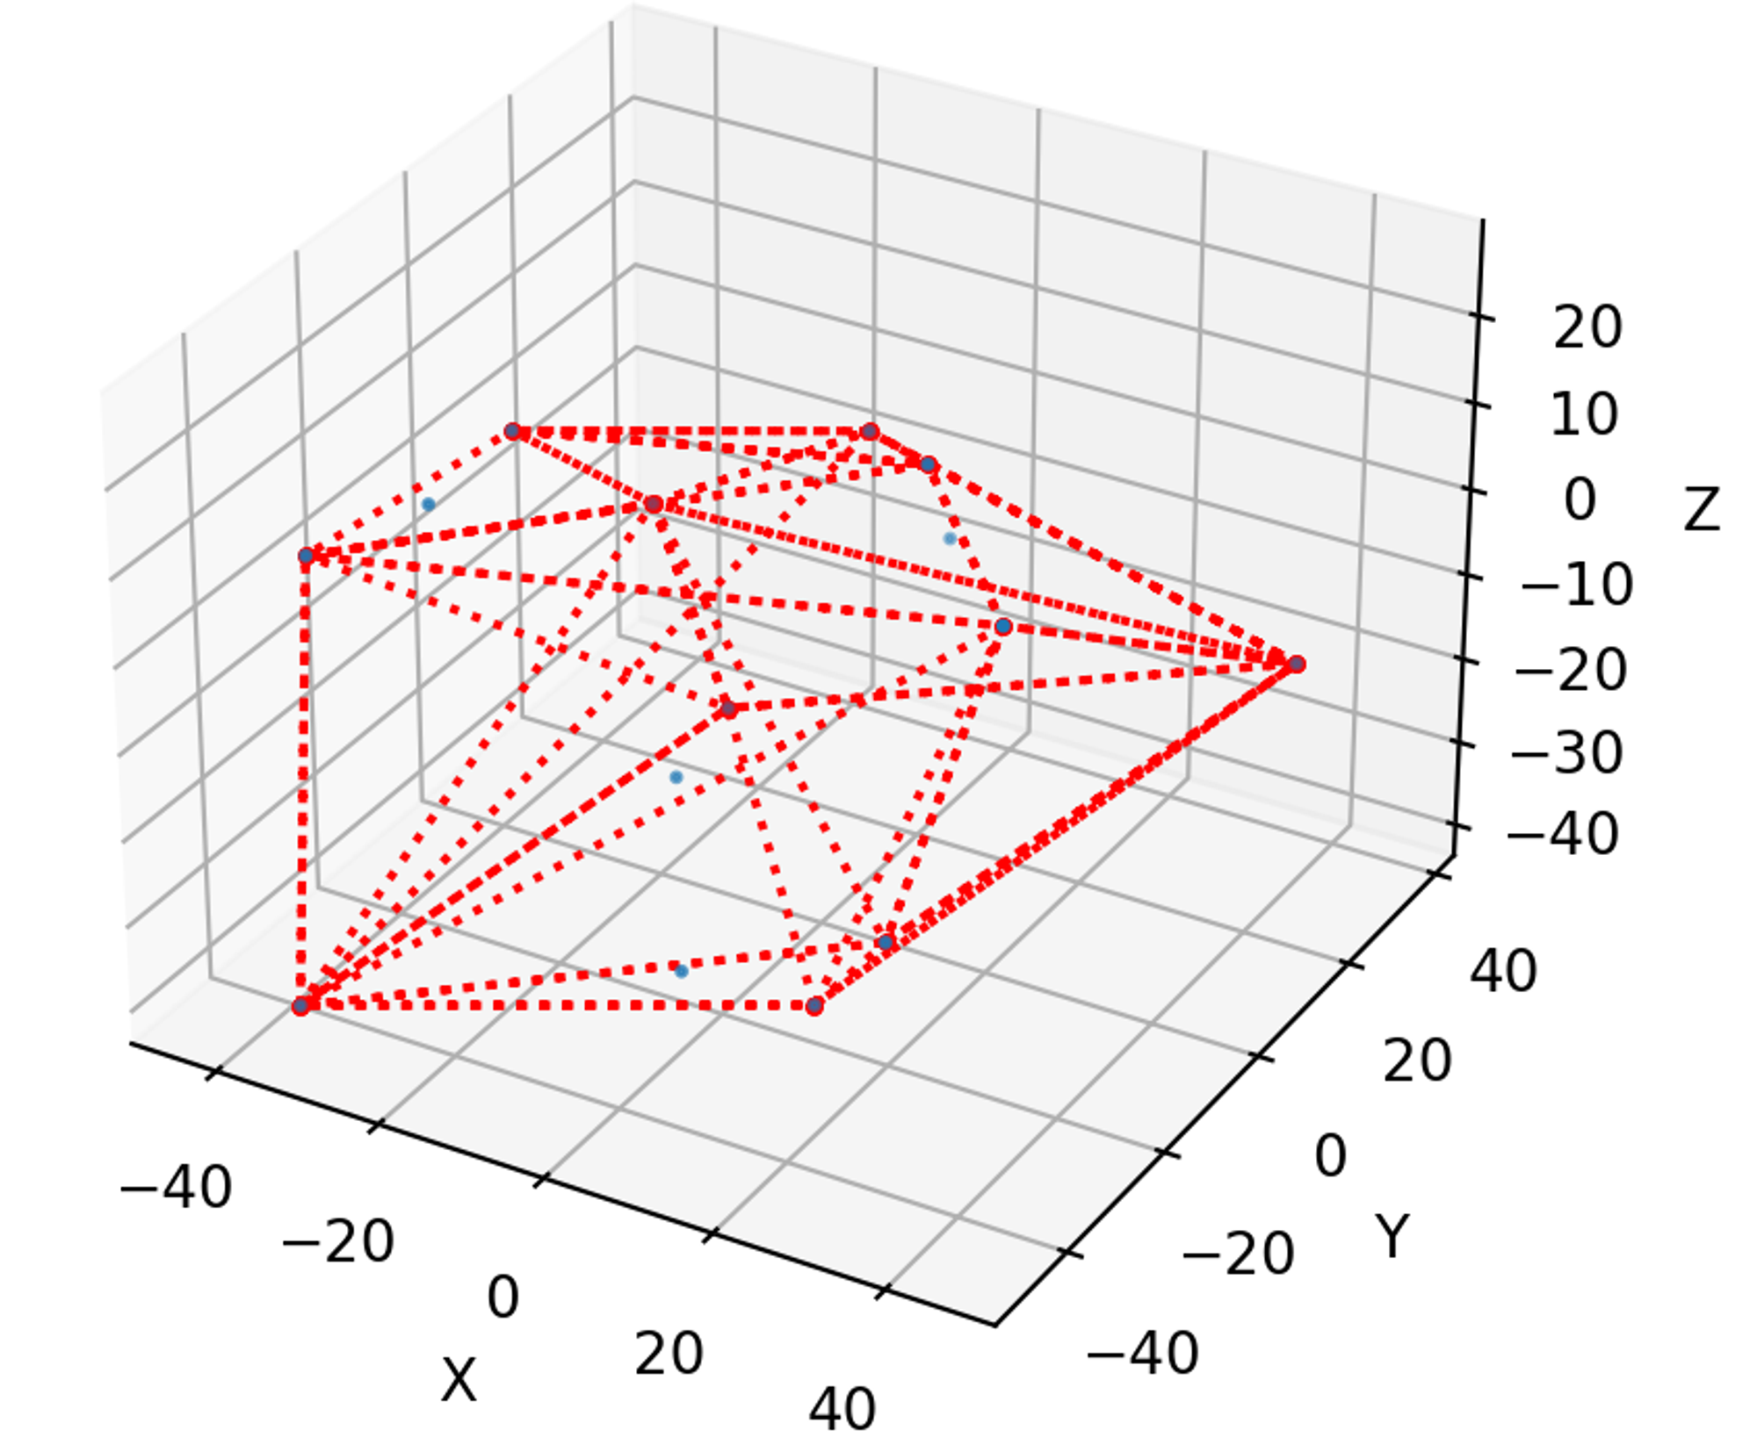
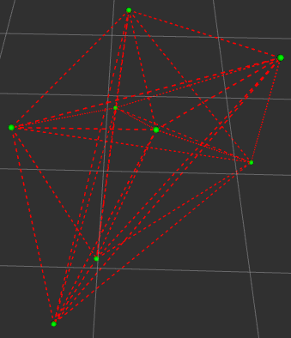
如何合理绘制多面体的棱

Slide 5
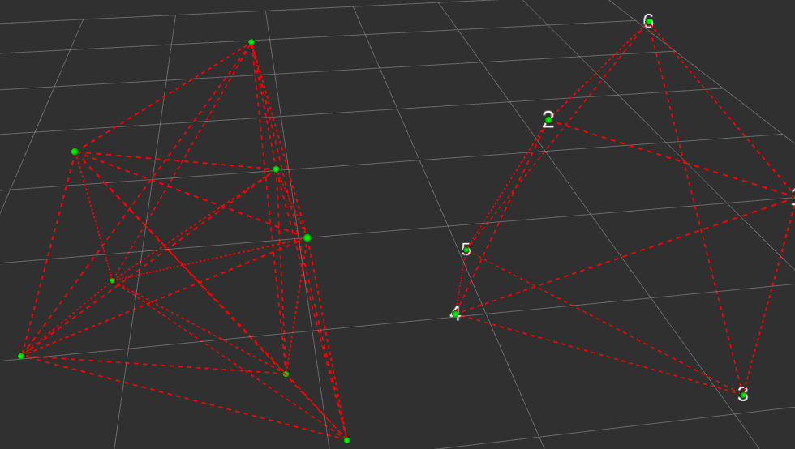
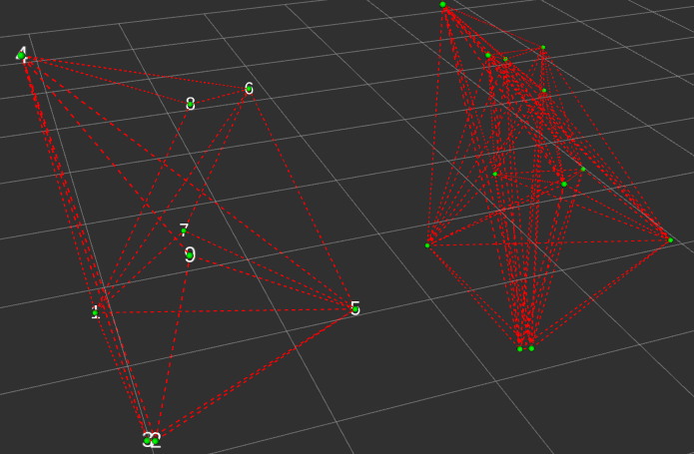
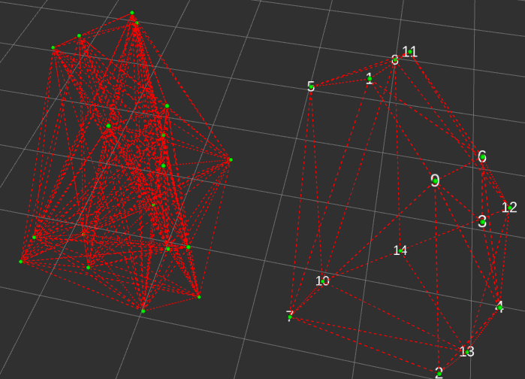

Slide 6
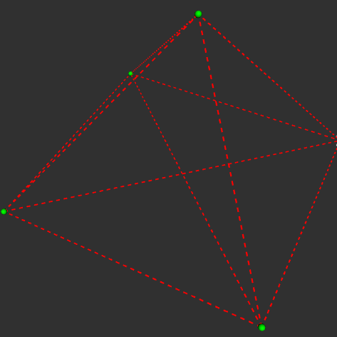
多点共面情况

Slide 7
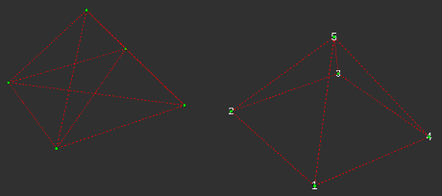
多点共面情况 √

Slide 8
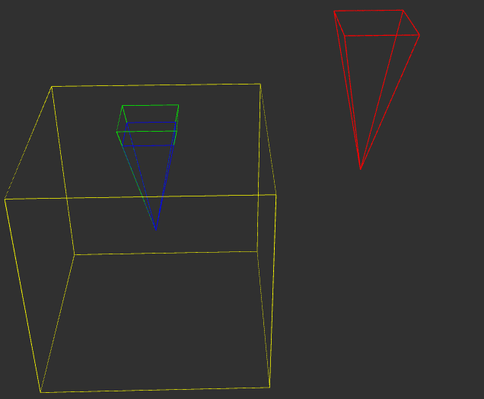

Slide 9
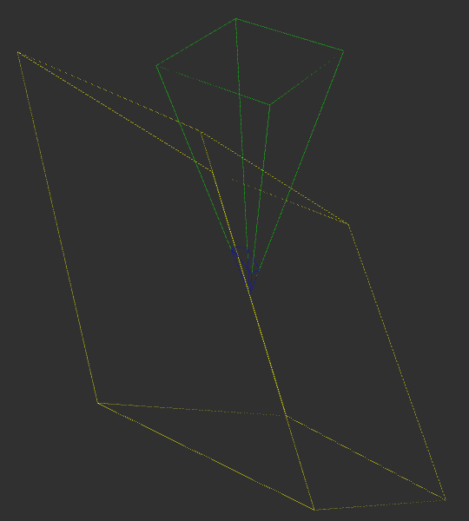
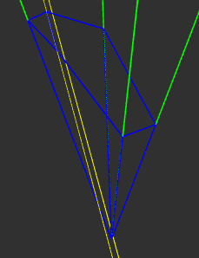

Slide 10
