Slide 1
StudentScheduler
Bresia, Eddie, Andrey, Saleha

Slide 2
Background & History

Slide 3
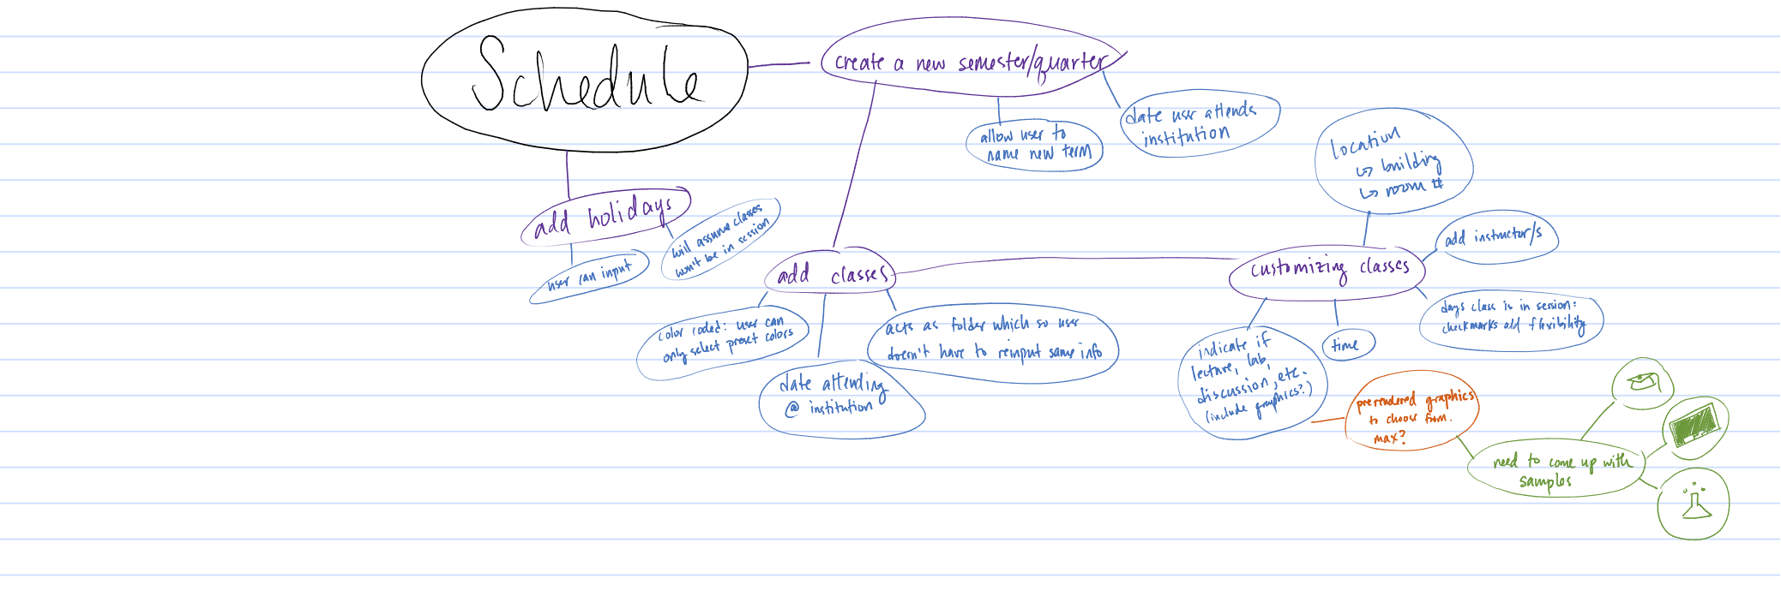
Concept

Slide 4
What is StudentScheduler?
Cross-platform application
User adds semester and classes accordingly
GPA calculator

Slide 5
Prototype
Notes:
Use overhead

Slide 6
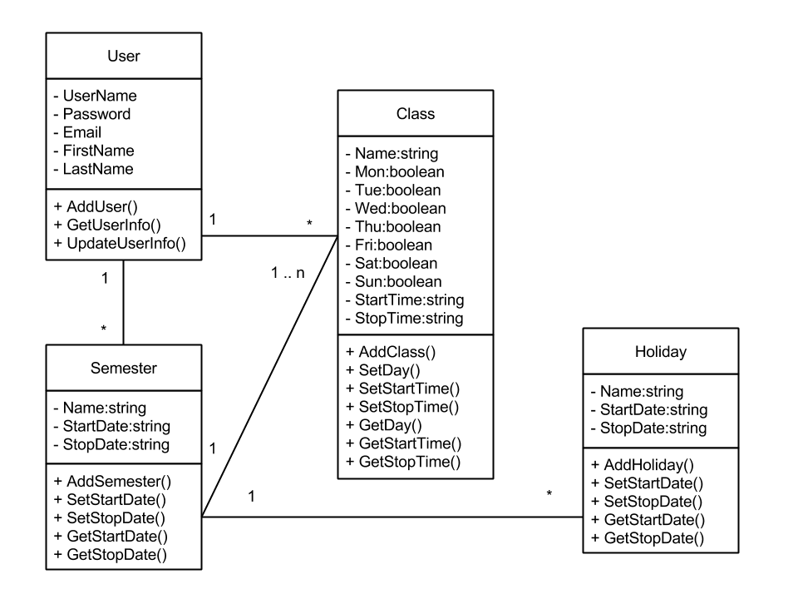
UML

Slide 7
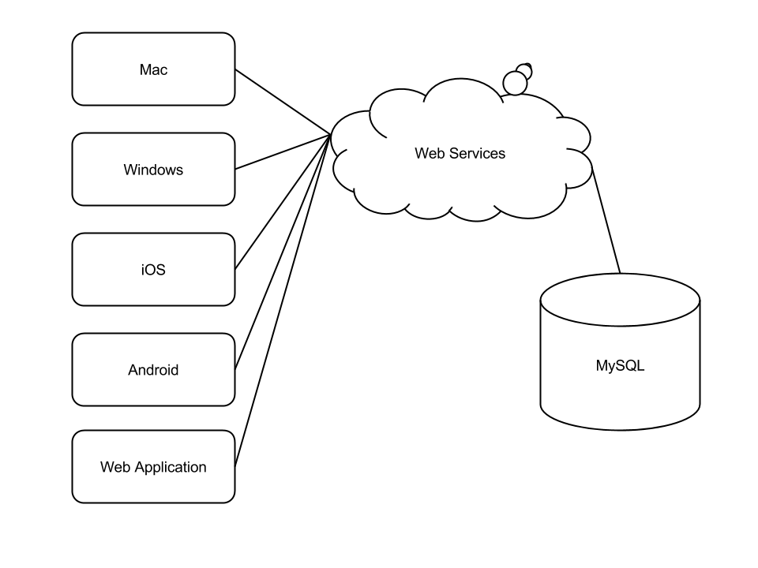
Cloud

Slide 8
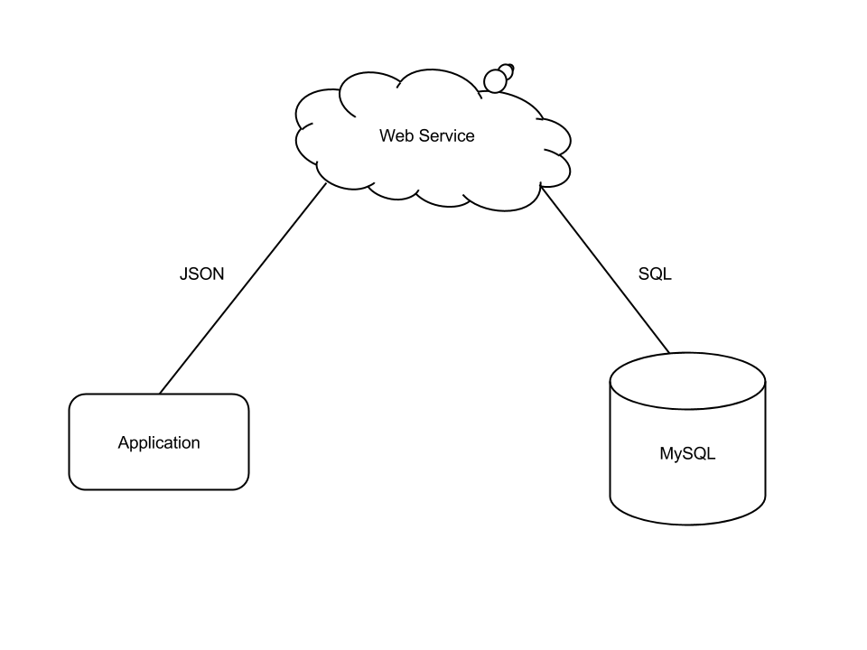
How it works?

Slide 9
Qt Network
#include <QNetworkAccessManager>
#include <QNetworkRequest>
#include <QNetworkReply>
#include <QJsonArray>
#include <QJsonDocument>
#include <QJsonObject>
#include <QJsonValue>

Slide 10
Current Progress

Slide 11
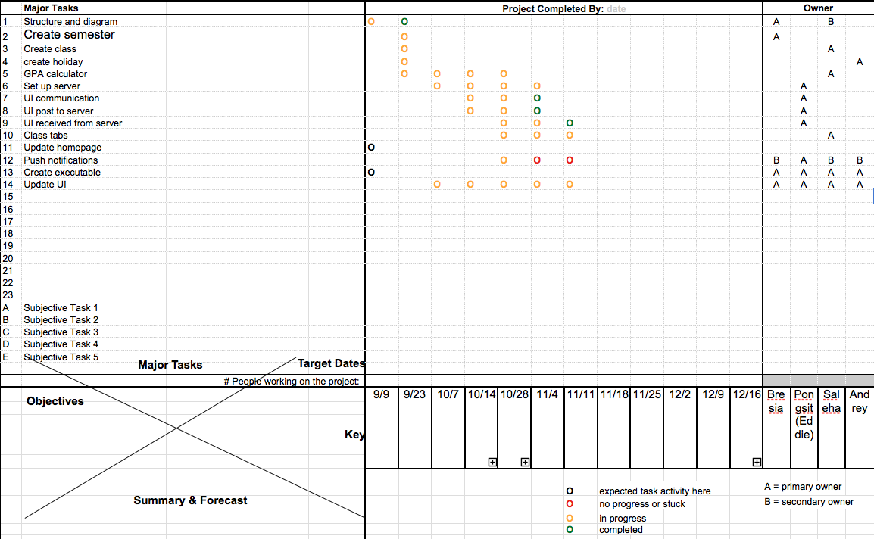
Notes:
Weeks are bi-weekly

Slide 12
Current Issues
push notifications
API

Slide 13
Questions/Suggestions?

