Slide 1
Student Scheduler
Bresia, Pongsit, Saleha, Andrey

Slide 2
What does it do?
Streamlines process of users creating their classes
Customization allows user to further personalize their scheduler
Holidays and events generated by the user is added to calendar
Organized
User is able to keep track of important dates
GPA calculator gives user their semester grade point average
Notes:
Bresia’s part

Slide 3
Documentation
Doxygen
Notes:
Bresia’s part

Slide 4
Supported Platforms
Desktop
Windows
Linux
OS
Android (tentative)
Notes:
Bresia’s part

Slide 5
Issues & Progress
Issues:
Time management
other school work
family & personal issues
Learning QT (all members were unfamiliar)
Server Downtime
GIT merging issues
Mixed programming backgrounds
C, Javascript, and HTML

Slide 6
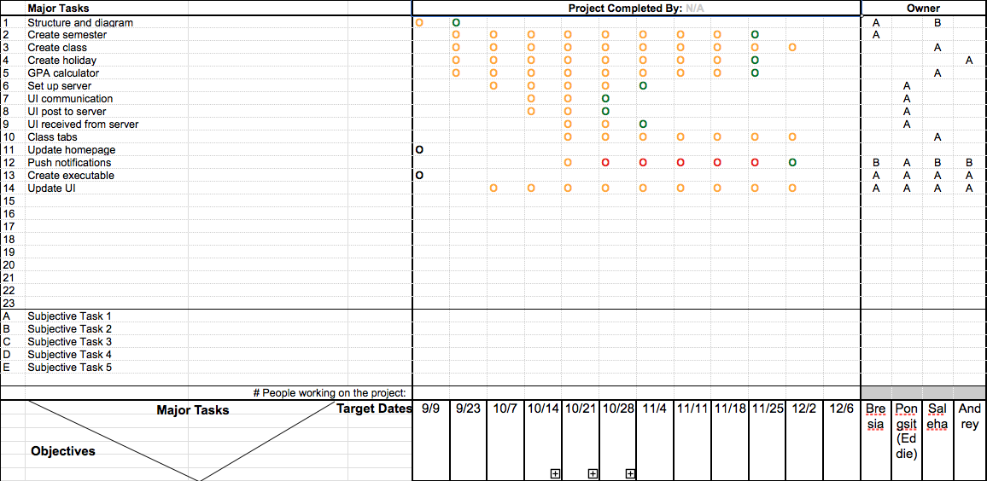
OPPM

Slide 7
DEMO

Slide 8
Questions? Comments?

