Slide 1
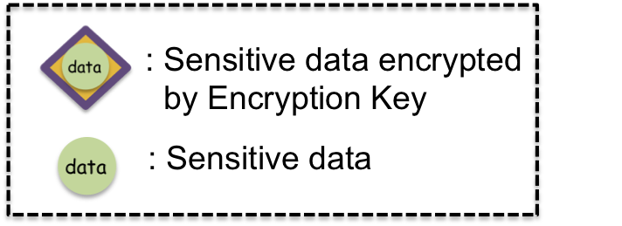


3
Encrypt
C
D
1
Quoting.C
4
Quoting.DB
2
5
Quoting.DB
Quoting.C
F
A
B
E
Secrets Management System
Data Base
Vault Client
Vault Server

Slide 2
3
Decrypt
C
D
5
Quoting.C
2
Quoting.DB
1
4
Quoting.DB
Quoting.C
F
A
B
E
Secrets Management System
Data Base
Vault Client
Vault Server

Slide 3
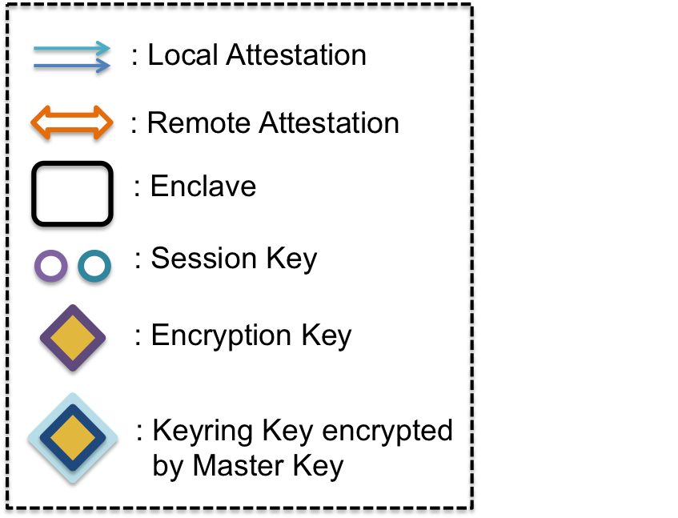
Encrypt
Decrypt
keyring
Quoting.C
Quoting.C
Quoting.DB
Secure Channel
Secure Channel
Quoting.DB
Vault Client
Secrets Management System
Data Base
Vault Server

Slide 4
Encrypt
Decrypt
keyring
Quoting.C
Quoting.C
Quoting.DB
Secure Channel
Secure Channel
Quoting.DB
Vault Client
Secrets Management System
Data Base
Vault Server

Slide 5
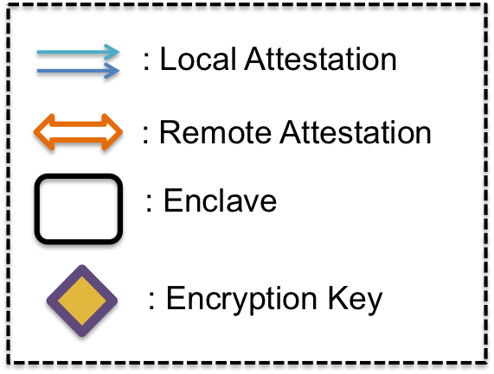


Encrypt
A
B
Secrets Management System
Local Attestation
Intel Attestation Service
(IAS)
Challenge Enclave B
Challenge Enclave C
Challenge Enclave A
Challenge Enclave D
Secure Channel
Secure Channel
A
B
C
D
Vault Client
Secrets Management System
Data Base
Vault Server
Remote Attestation

Slide 6
Encrypt
A
B
Secrets Management System
: Sensitive data encrypted
by Encryption Key
: Sensitive data
Vault Server

Slide 7
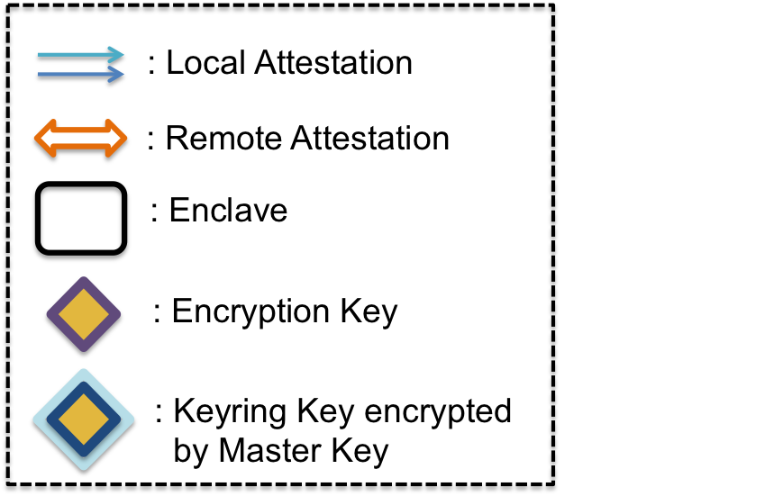
5.
2. Retrieve Master Key Back.
4. Decrypt the Cipher Keyring
Key.
B
A
1.
3.
keyring
Quoting.C
1.
Quoting.C
Quoting.DB
3.
Quoting.DB
Vault Client
Secrets Management System
Data Base
Vault Server

Slide 8
: Local Attestation
: Local Attestation
: Local Attestation
: Remote Attestation
: Remote Attestation
: Remote Attestation
: Enclave
: Enclave
: Enclave
: Session Key
: Encryption Key
: Encryption Key
: Encryption Key
: Keyring Key encrypted
by Master Key
: Keyring Key encrypted
by Master Key

Slide 9
Encrypt
Decrypt
keyring
Quoting.C
Quoting.C
Quoting.DB
Secure Channel
Secure Channel
Quoting.DB
Vault Client
Secrets Management System
Data Base
Vault Server

Slide 10

iv.
Decrypt
v.
keyring
iii.
Quoting.DB
i.
ii.
Quoting.DB
Secrets Management System
Data Base
Vault Server

Slide 11

Quoting.C
Quoting.C
Vault Client
Secrets Management System
Vault Server

Slide 12

Quoting.DB
i. Retrieve Data
Quoting.DB
ii. Transmit Data
Secrets Management System
Data Base
Vault Server

Slide 13
Quoting.DB
Quoting.DB
Secrets Management System
Data Base
Vault Server

Slide 14
keyring
Quoting.DB
Quoting.DB
Secrets Management System
Data Base
Vault Server

Slide 15
Encrypt
Decrypt
keyring
Quoting.C
Quoting.C
Quoting.DB
Secure Channel
Secure Channel
Quoting.DB
Vault Client
Security Management System
Data Base
Vault Server

Slide 16
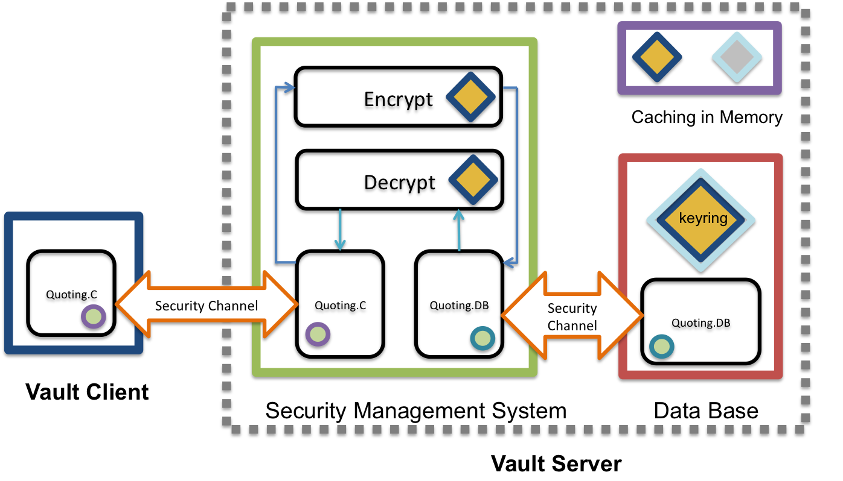

Slide 17
: Local Attestation
: Remote Attestation
: Enclave
: Session Key
: Keyring Key
: Master Key
data
: Sensitive data
: Keyring Key encrypted
by Master Key
: Data encrypted by
Session Key

Slide 18
: Local Attestation
: Remote Attestation
: Enclave
: Session Key
: Keyring Key
: Keyring Key encrypted
by Master Key

Slide 19
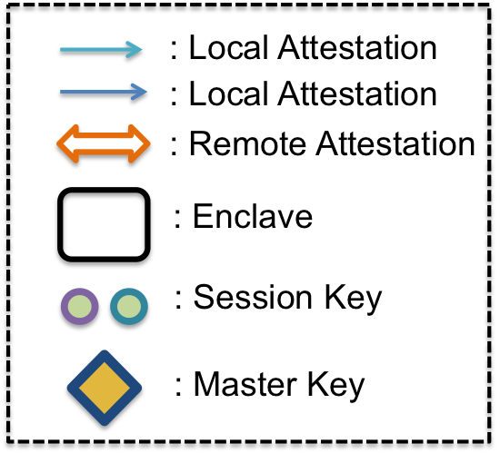
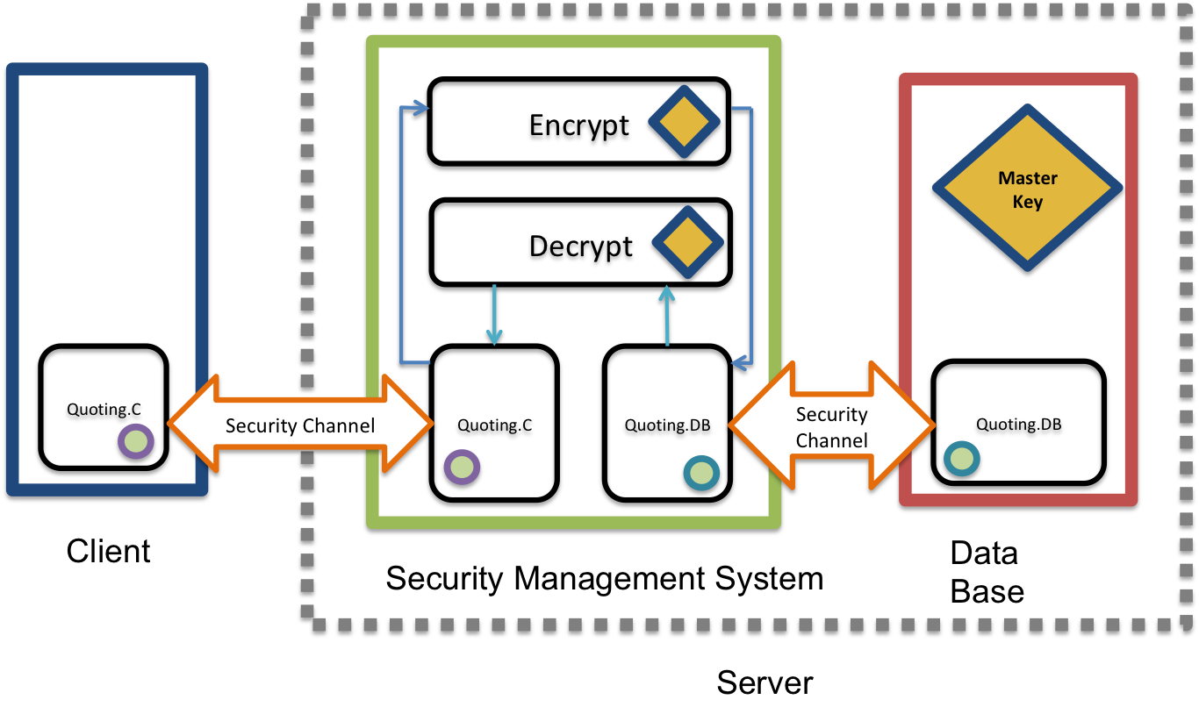
Storage System with SGX Prototype

Slide 20
Future Work

Slide 21
Cluster Deployment
MRENCLAVE – Enclave Identity
DB
Security Management System
Client
DB
Security Management System
Client
DB
Security Management System
DB

Slide 22
Failover Mechanism
MRSIGNER – Sealing Identity
DB
Security Management System
Client
DB
Security Management System
Client
DB
Security Management System
DB

