Slide 1
PIR Motion Sensor
Presenter: Nhu Phan

Slide 2
Why you need PIR Motion Sensor?
Notes:
https://lastminuteengineers.com/pir-sensor-arduino-tutorial/

Slide 3
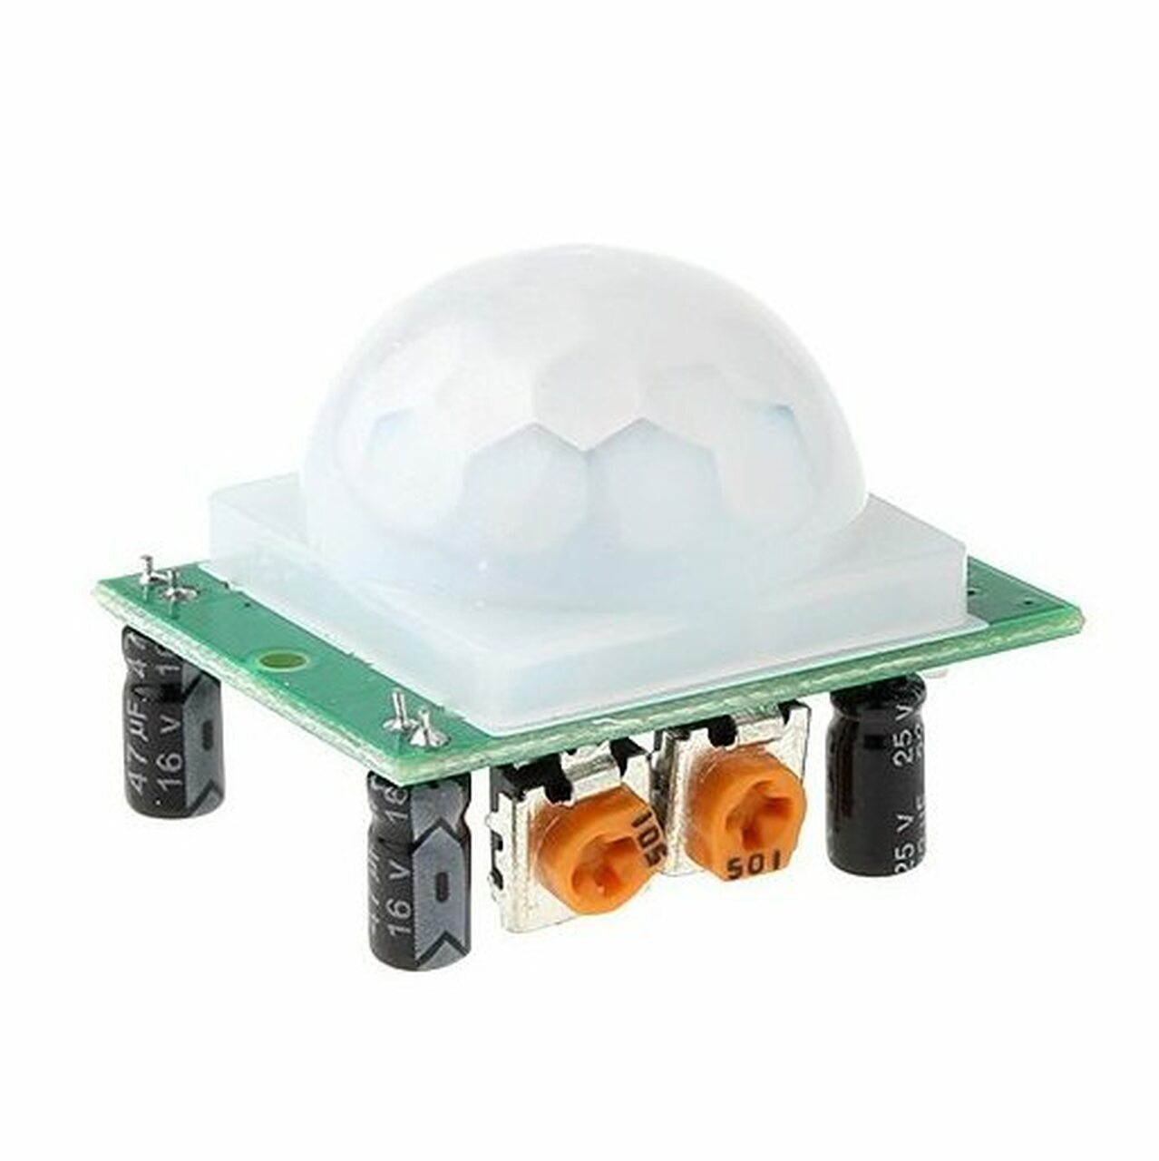
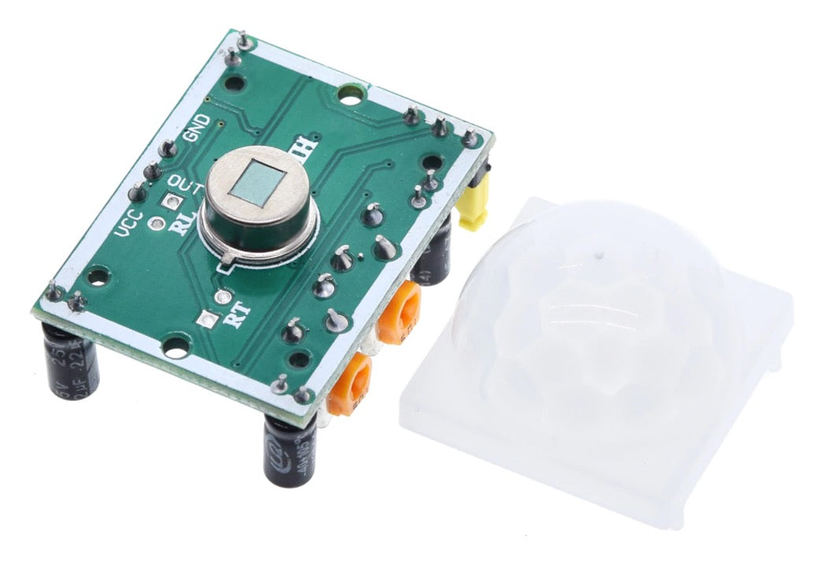
HC-SR501 PIR Sensor
Pyroelectric Sensor
Fresnel Lens
Notes:
How the sensor works: including the pyroelectric sensor and the Fresnel lense

Slide 4
PhotoElectric Sensor

Slide 5
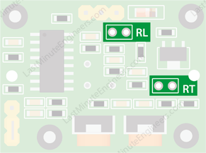
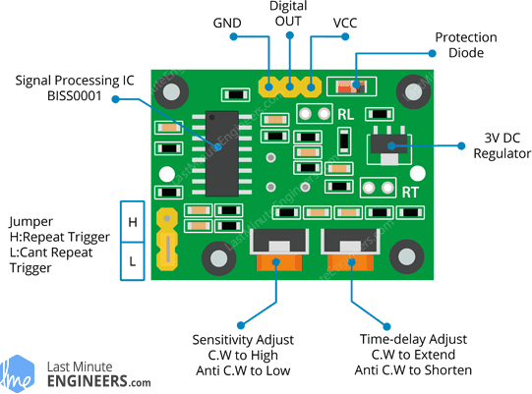
Functionalities

Slide 6
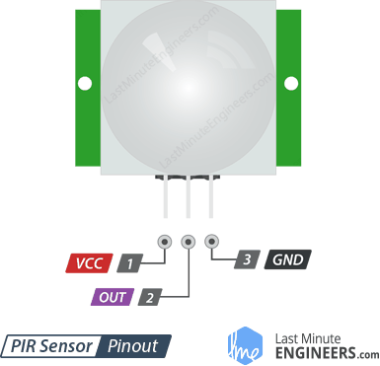
Connect with Arduino

Slide 7
HighLights
Fuctionalities: time delay, Light Dependant Resistor
Operating Voltage
Use Infrared Mechanism

