Slide 1
PIR Motion Sensor
Presenter: Nhu Phan

Slide 2
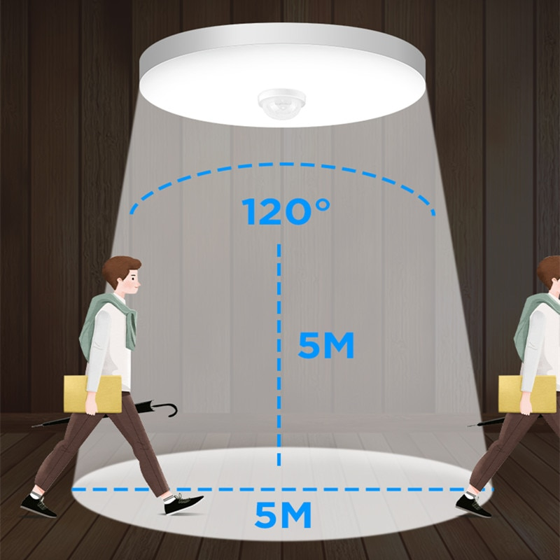

Why you need PIR Motion Sensor?
Notes:
https://lastminuteengineers.com/pir-sensor-arduino-tutorial/

Slide 3
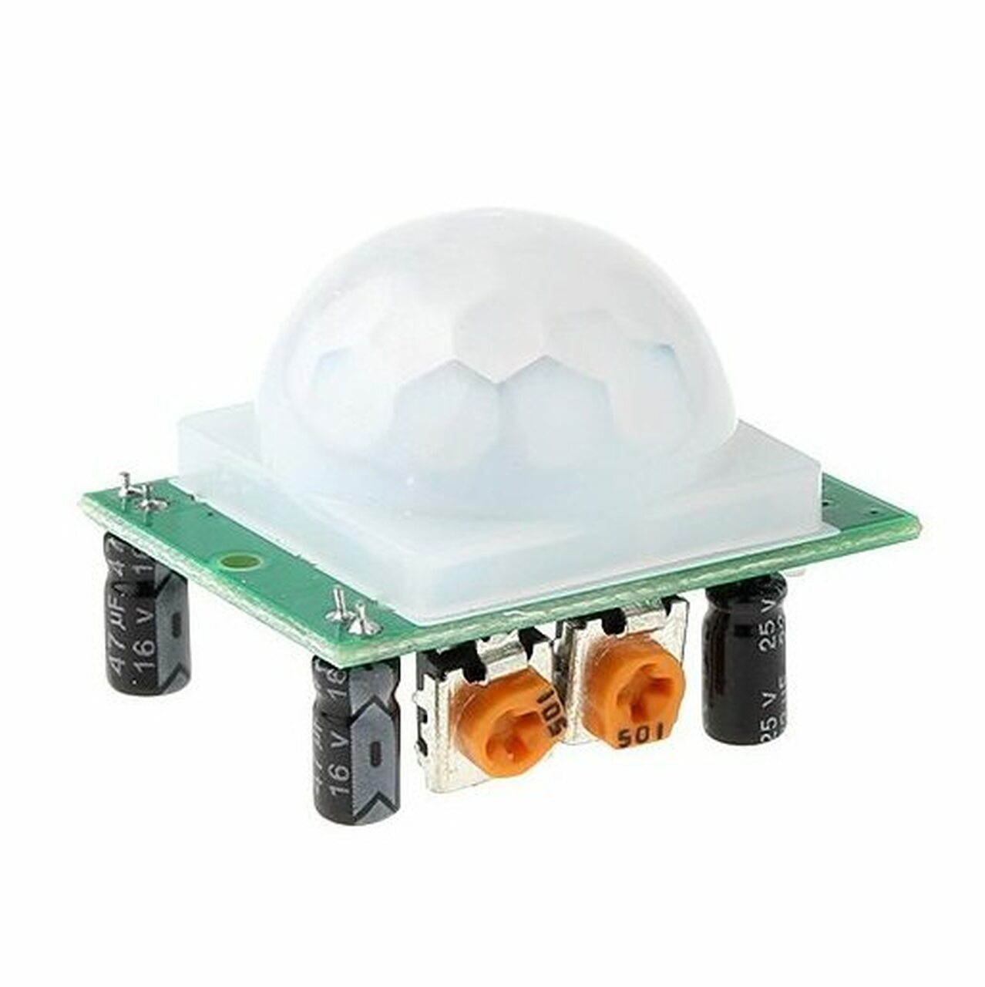
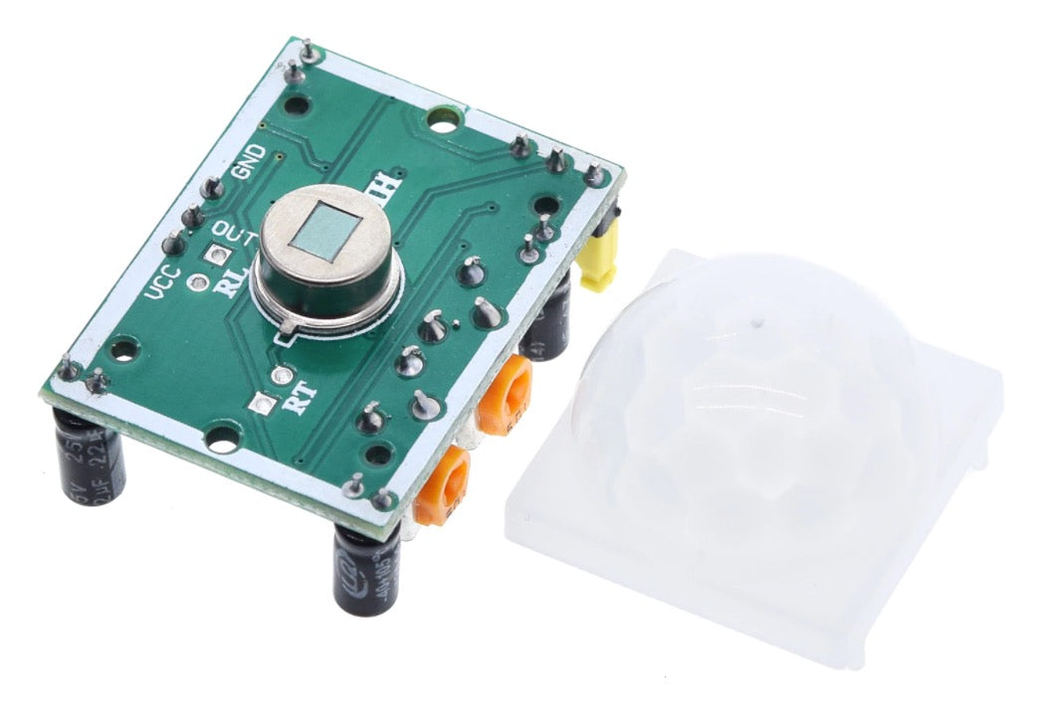
HC-SR501 PIR Sensor
Pyroelectric Sensor
Fresnel Lens
Notes:
https://lastminuteengineers.com/pir-sensor-arduino-tutorial/

Slide 4
Photoelectric Sensor

Slide 5
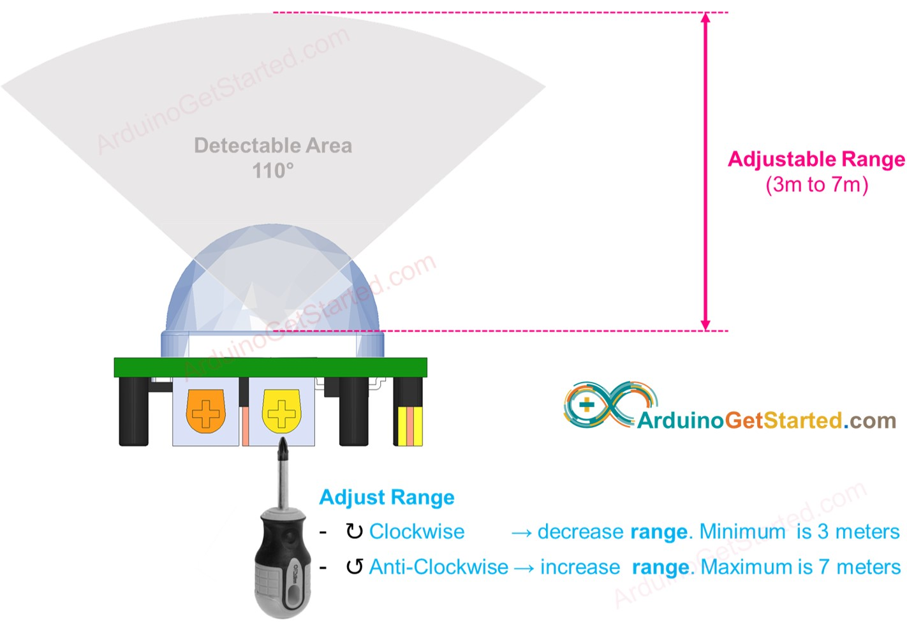
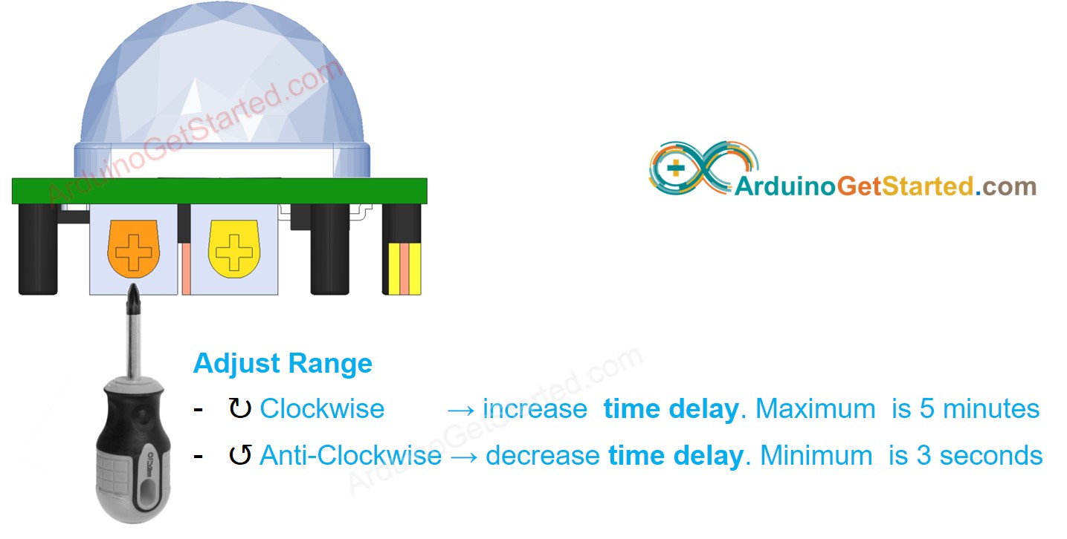
Functionalities

Slide 6
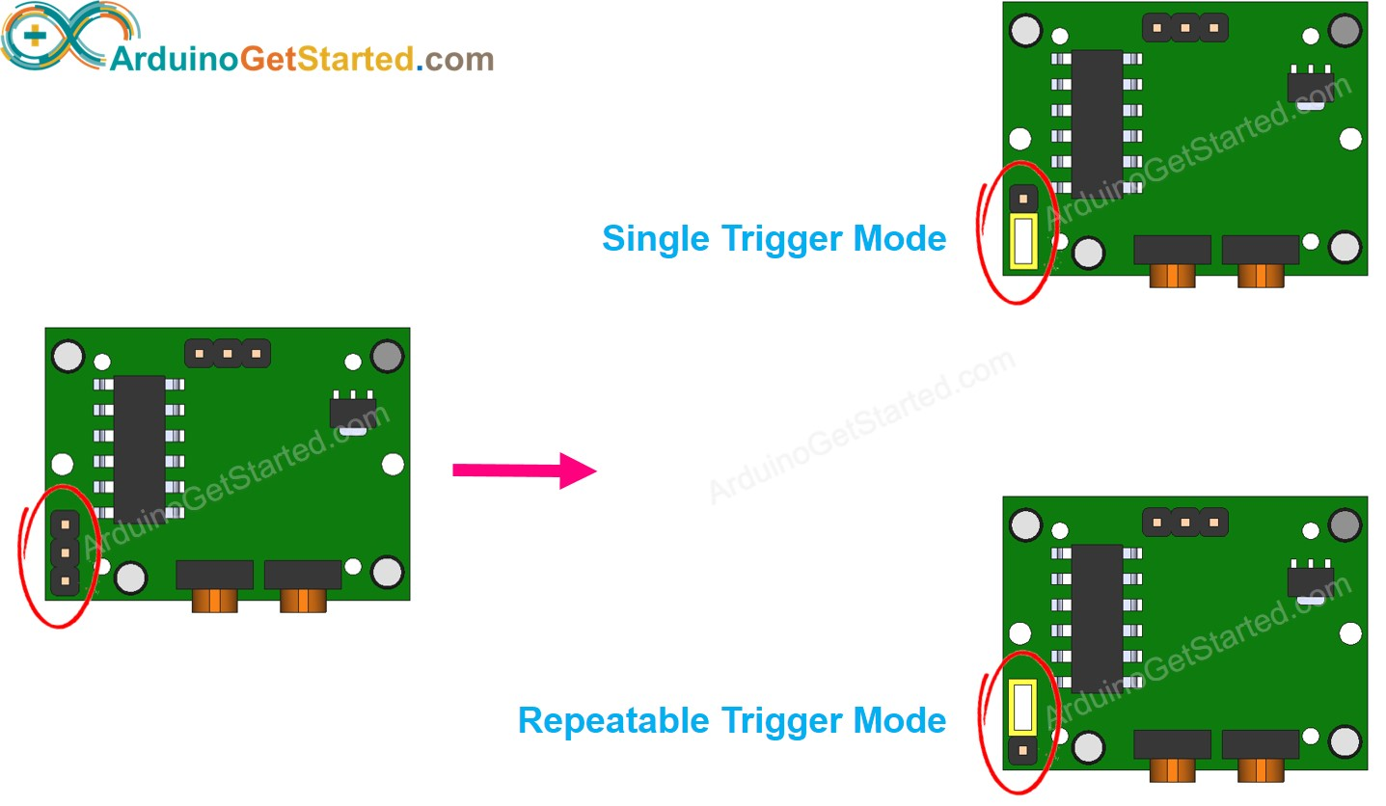
Functionalities

Slide 7
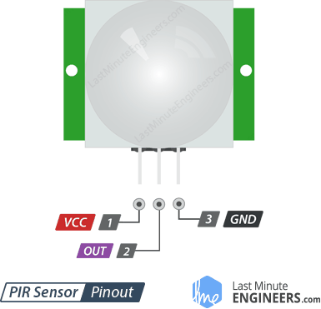
Interface with Arduino
5V

Slide 8
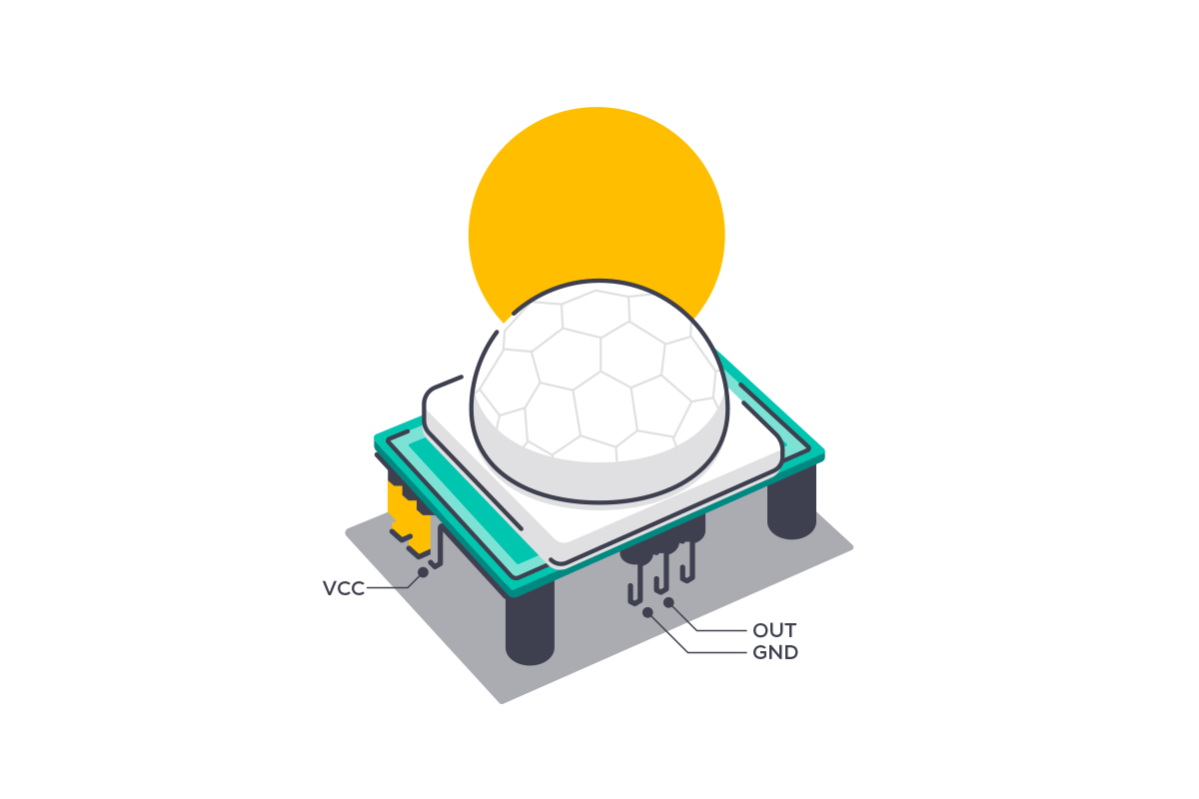
Highlights
→ HC-SR501 uses Infrared Mechanism to detect motion
→ Adjustable functionalities
Easy to interface with Arduino with 3 ports
Operating Voltage: 5V

Slide 9
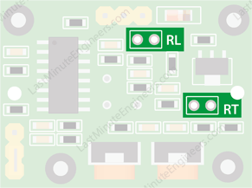
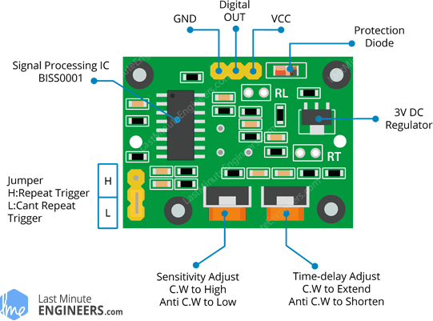
Functionalities
Notes:
https://arduinogetstarted.com/tutorials/arduino-motion-sensor

