Slide 1

English learning tips
—— Love-driven learning

Slide 2
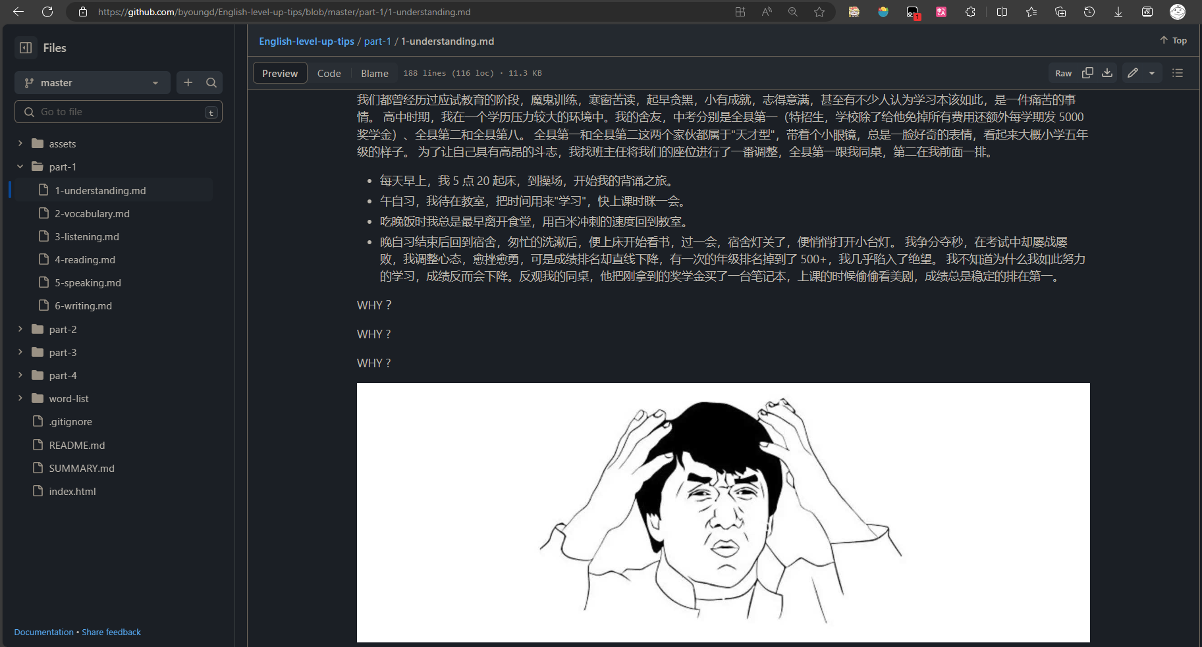
1. Intro: hard work & poor result
单击此处添加标题
春种一粒粟,秋收万颗籽，点滴进步，成就价值是我们的一贯的追求。
春种一粒粟,秋收万颗籽，点滴进步，成就价值是我们的一贯的追求。

Slide 3
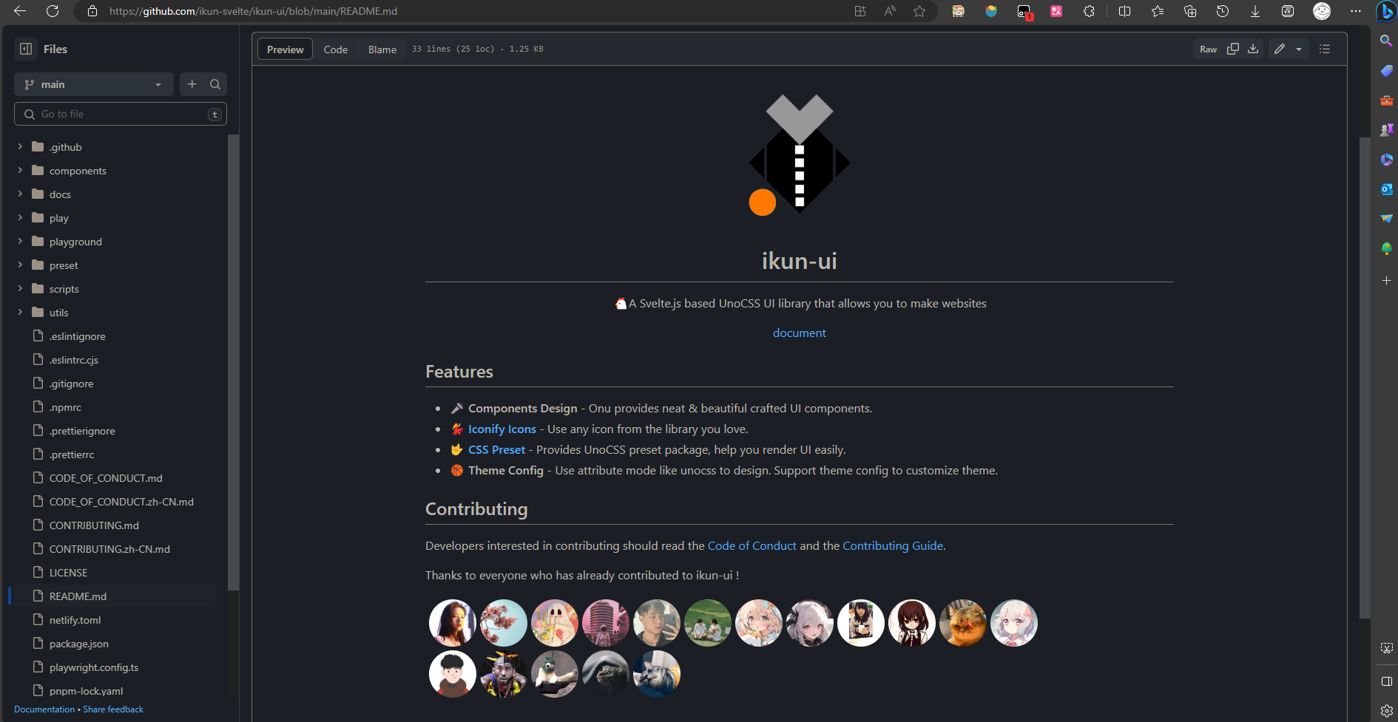
2. Sample: an interesting project
单击此处添加标题
春种一粒粟,秋收万颗籽，点滴进步，成就价值是我们的一贯的追求。
春种一粒粟,秋收万颗籽，点滴进步，成就价值是我们的一贯的追求。

Slide 4
3. Tips: Love-driven learning
Don't push yourself too hard
2. Enjoy what you are doing
3. Learning makes your life better
单击此处添加标题
春种一粒粟,秋收万颗籽，点滴进步，成就价值是我们的一贯的追求。
春种一粒粟,秋收万颗籽，点滴进步，成就价值是我们的一贯的追求。

Slide 5

4. Conclusion: Steve Jobs’s saying
The only way to do great work is to love what you do. If you haven't found it yet, keep looking. Don't settle. As with all matters of the heart, you'll know when you find it.
成就一番伟业的唯一途径就是热爱自己的事业。如果你还没能找到让自己热爱的事业，继续寻找，不要放弃。跟随自己的心，总有一天你会找到的。

Slide 6
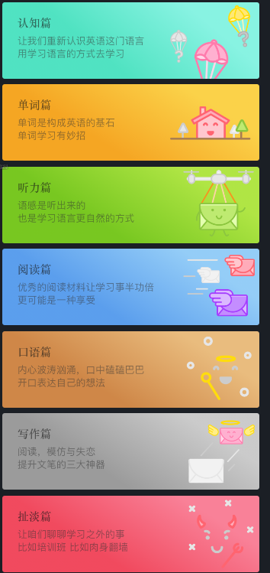
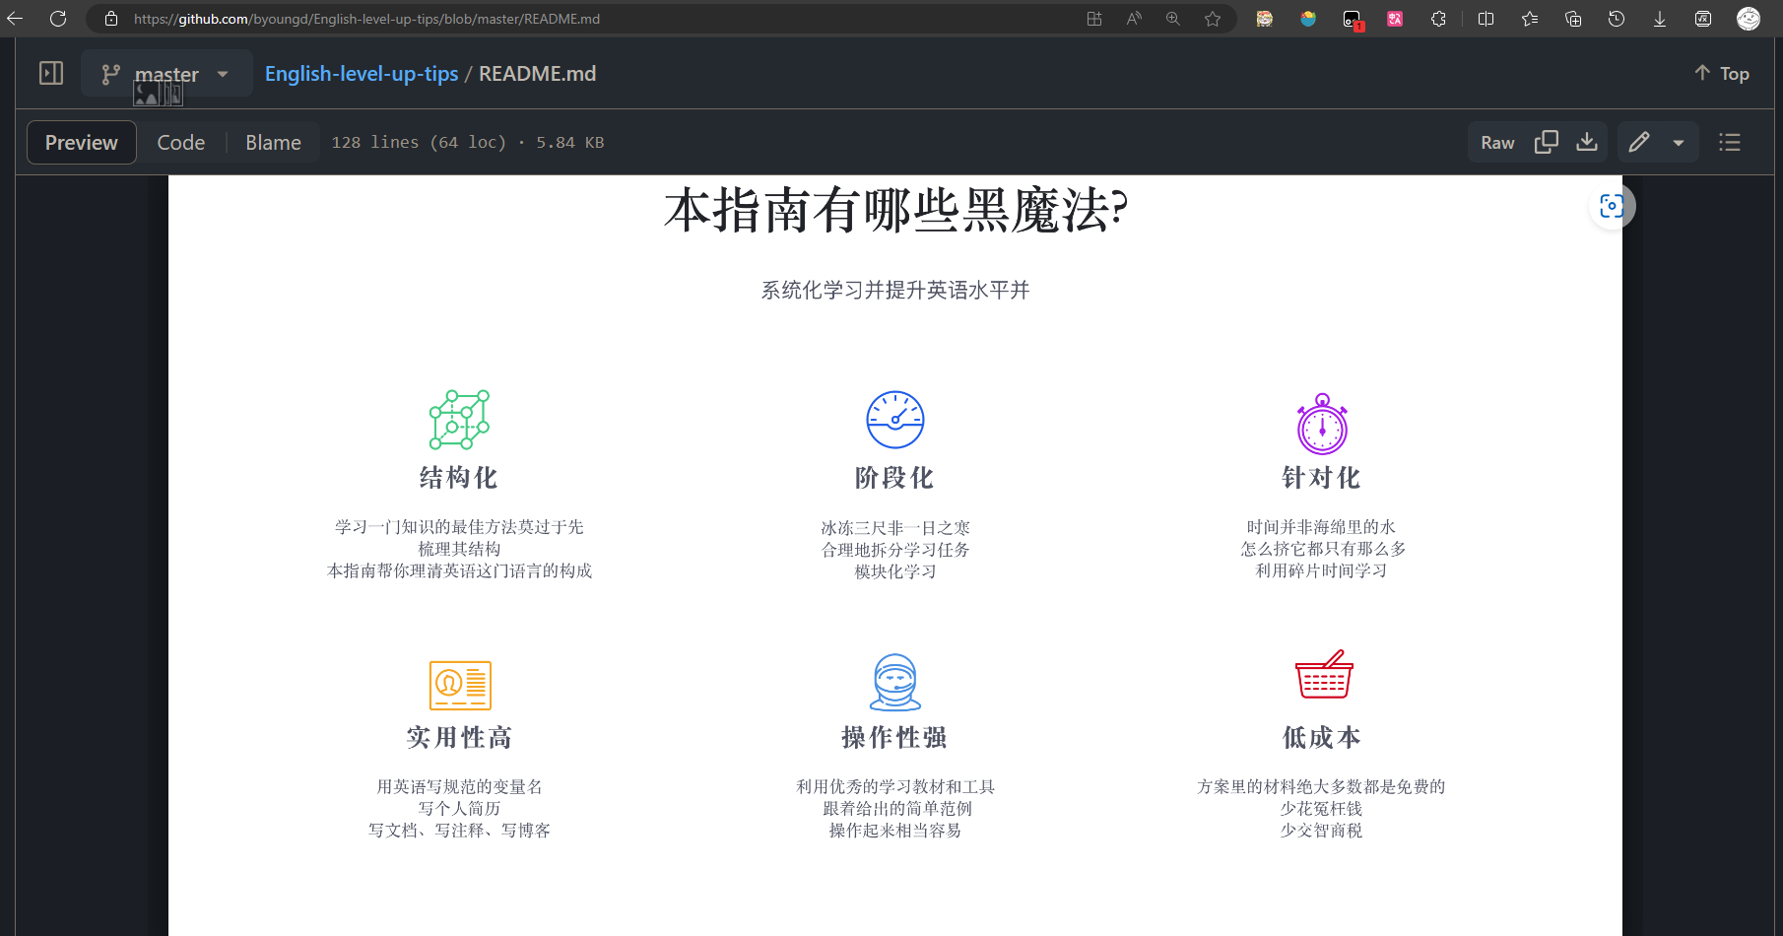
Thanks for listening
Author : Pu
Reference: English-level-up-tips (byoungd.github.io)

