Slide 1

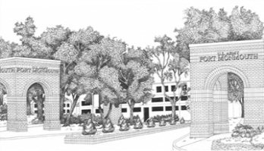
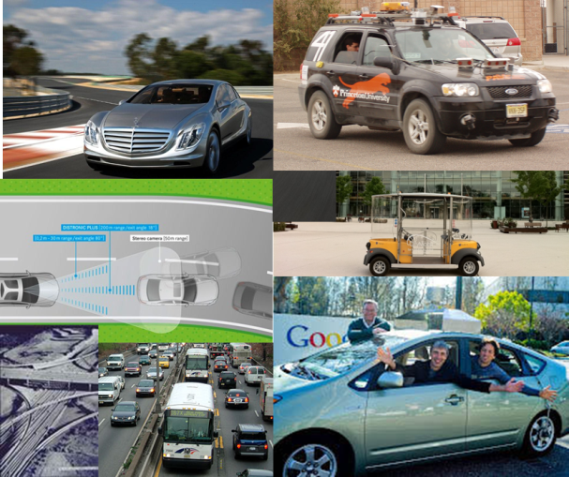
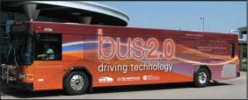
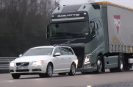
Disaggregated Pixel Views
A view of the New Jersey Data
by
Alain L. Kornhauser, PhD
Professor, Operations Research & Financial Engineering
Director, Program in Transportation
Faculty Chair, PAVE (Princeton Autonomous Vehicle Engineering)
Princeton University
Presented at
Orf 467
Nov. 3, 2014

Slide 2

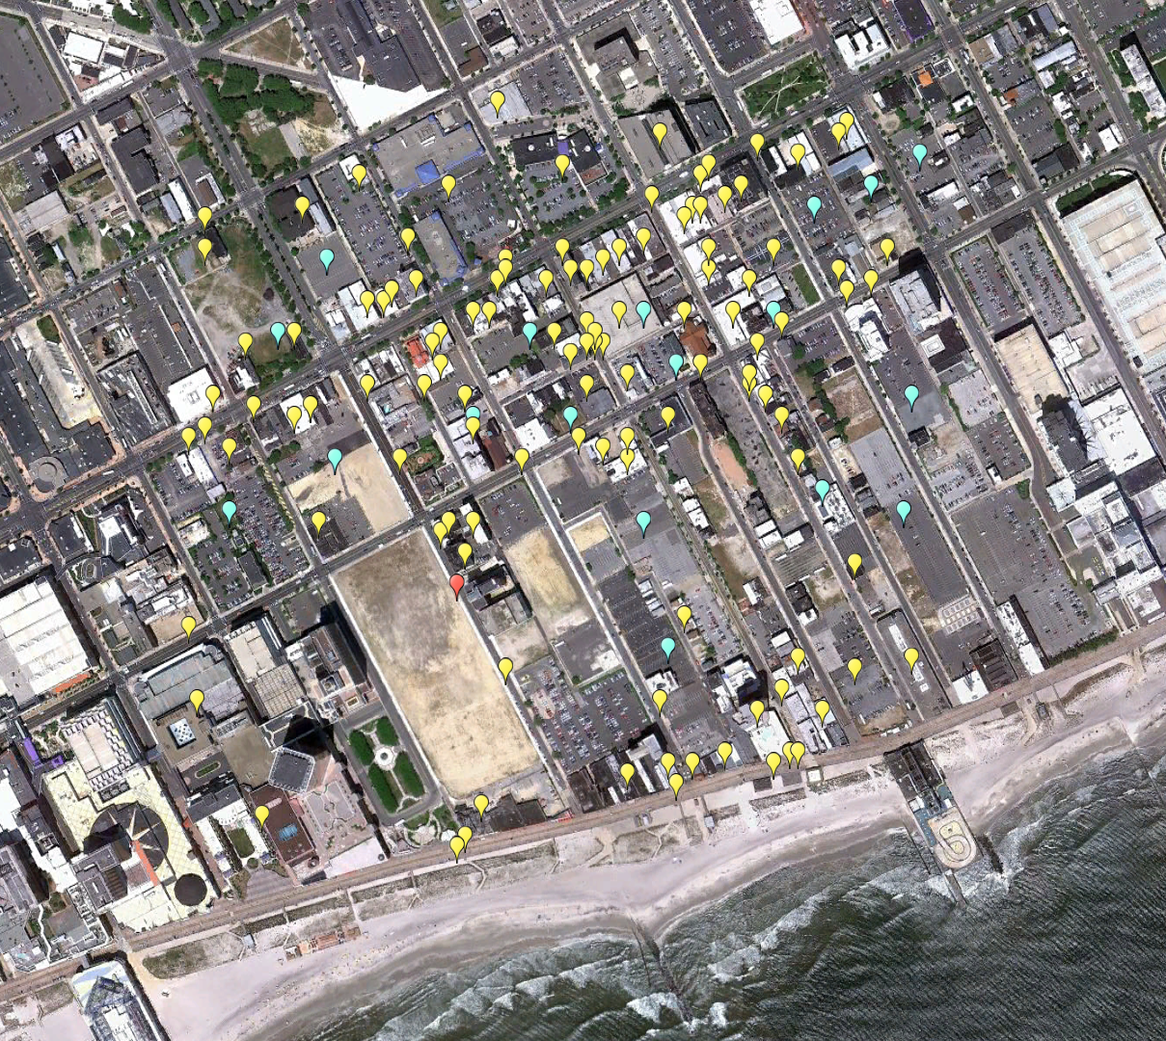
139 Activity Locations within Pixel {63,127} Atlantic County
Home
(Block Centroid)
Work
School

Slide 3
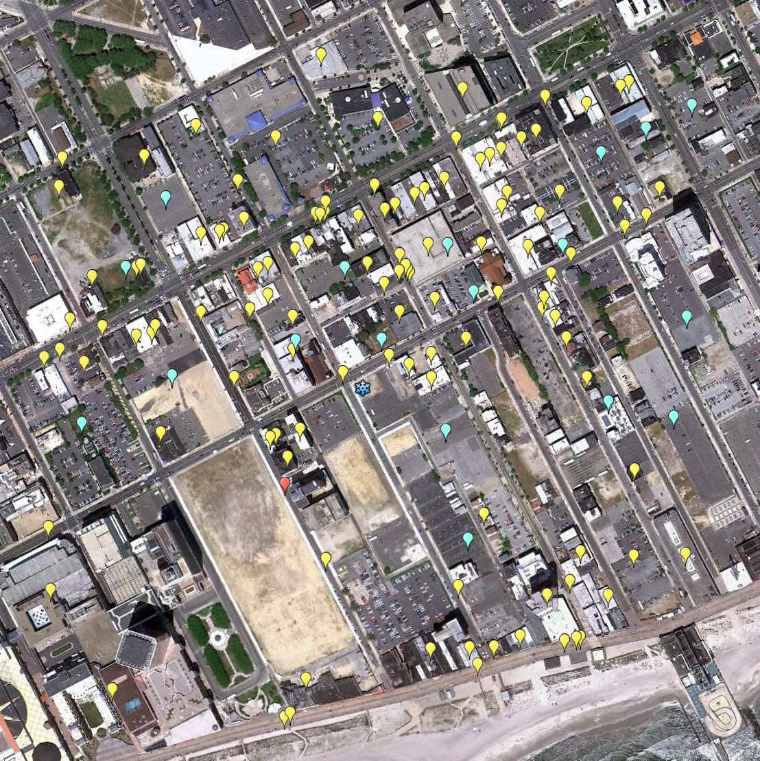
Pixel {63,127} Atlantic County
Item | Value
Activity Locations | 139
Employment | 3,960
Population | 1,243
School Enrollment | 26
Work
Home
(Block Centroid)
School
Pixel Centroid

Slide 4
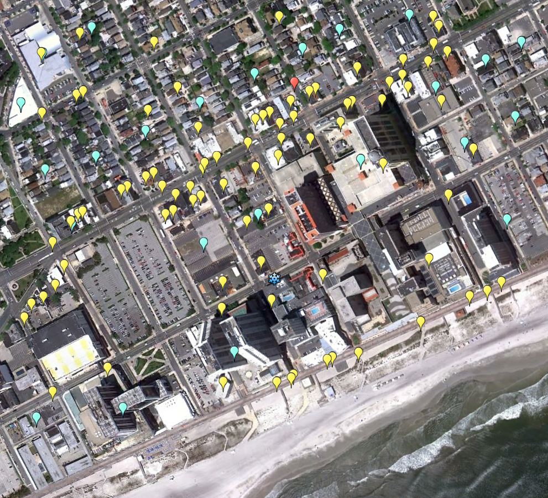
Pixel {62,125} Atlantic County
Item | Value
Activity Locations | 111
Employment | 3,430
Population | 3.614
School Enrollment | 743
Work
Home
(Block Centroid)
School
Pixel Centroid

Slide 5
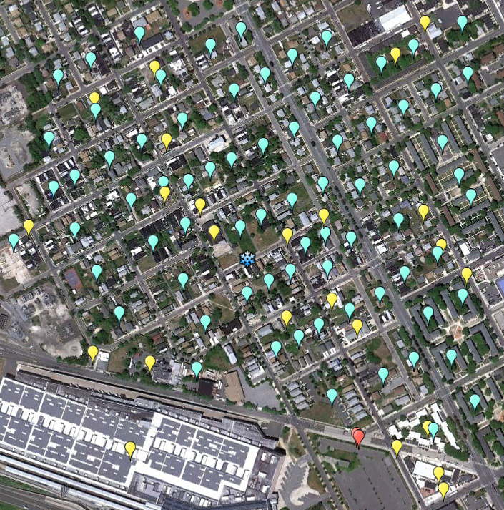
Pixel {64,126} Atlantic County
Item | Value
Activity Locations | 101
Employment | 265
Population | 3,099
School Enrollment | 2,650
Work
Home
(Block Centroid)
School
Pixel Centroid

Slide 6
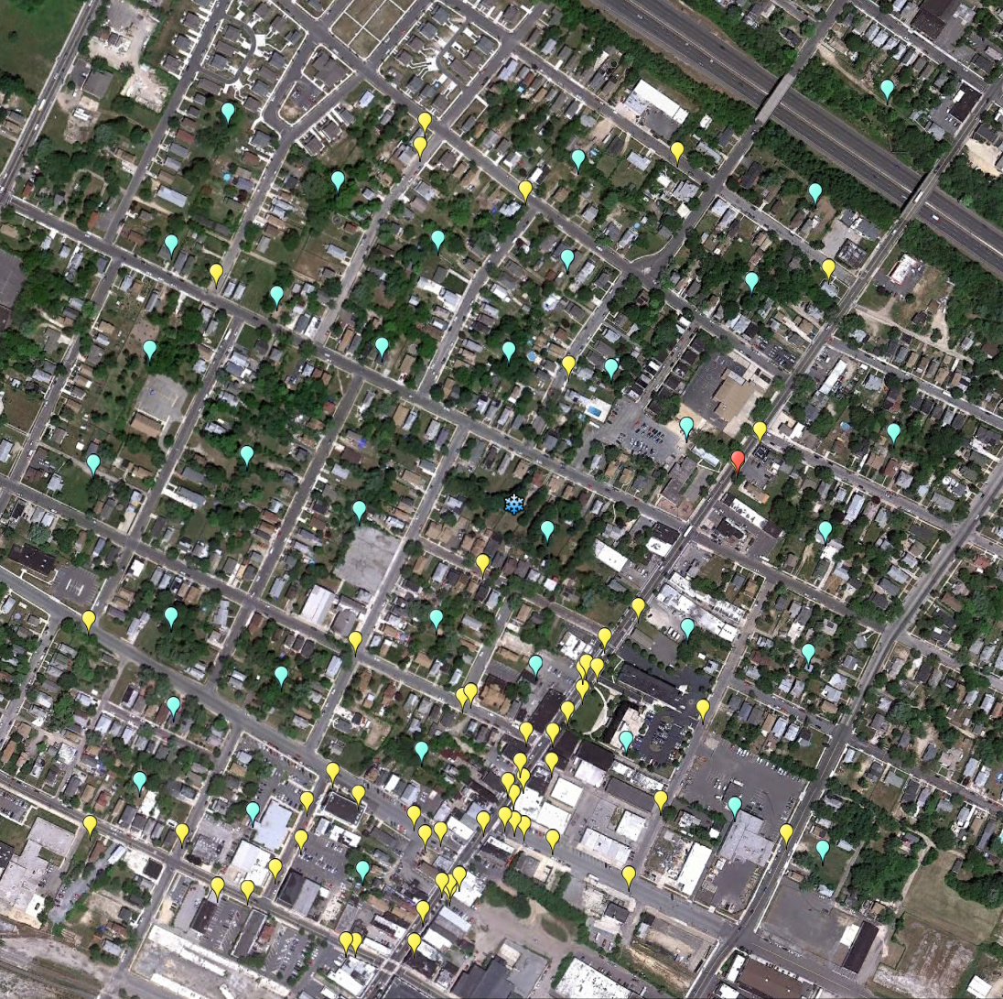
Pixel {68,117} Atlantic County
Item | Value
Activity Locations | 93
Employment | 1,827
Population | 2,253
School Enrollment | 292
Work
Home
(Block Centroid)
School
Pixel Centroid

Slide 7
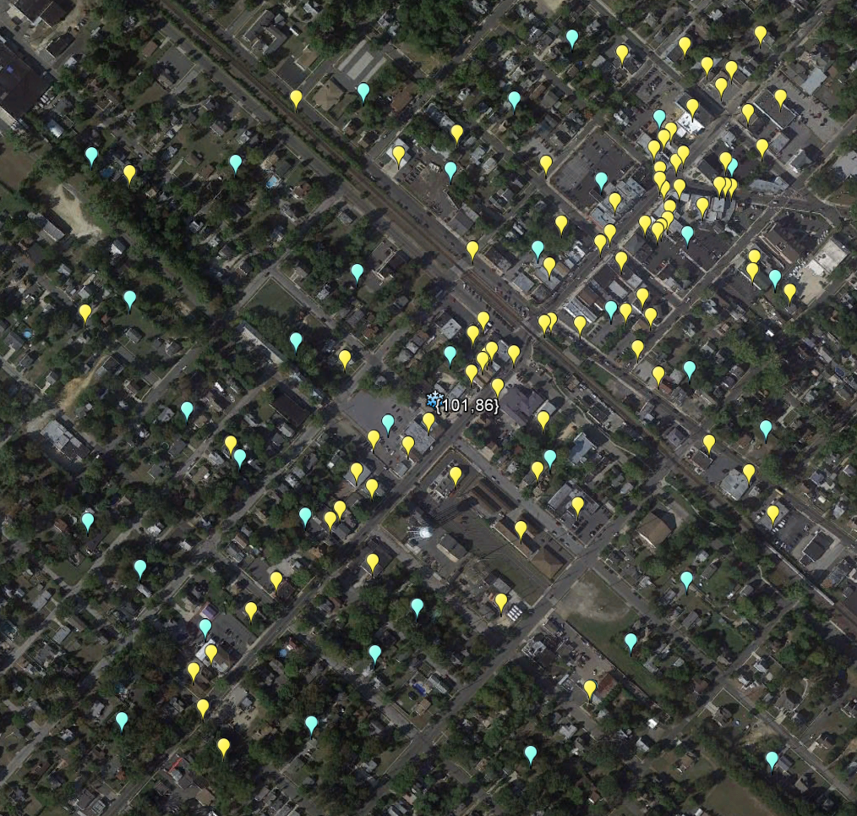
Pixel {101,86} Atlantic County
Item | Value
Activity Locations | 123
Employment | 1,219
Population | 1,294
School Enrollment | 0
Work
Home
(Block Centroid)
School
Pixel Centroid

Slide 8
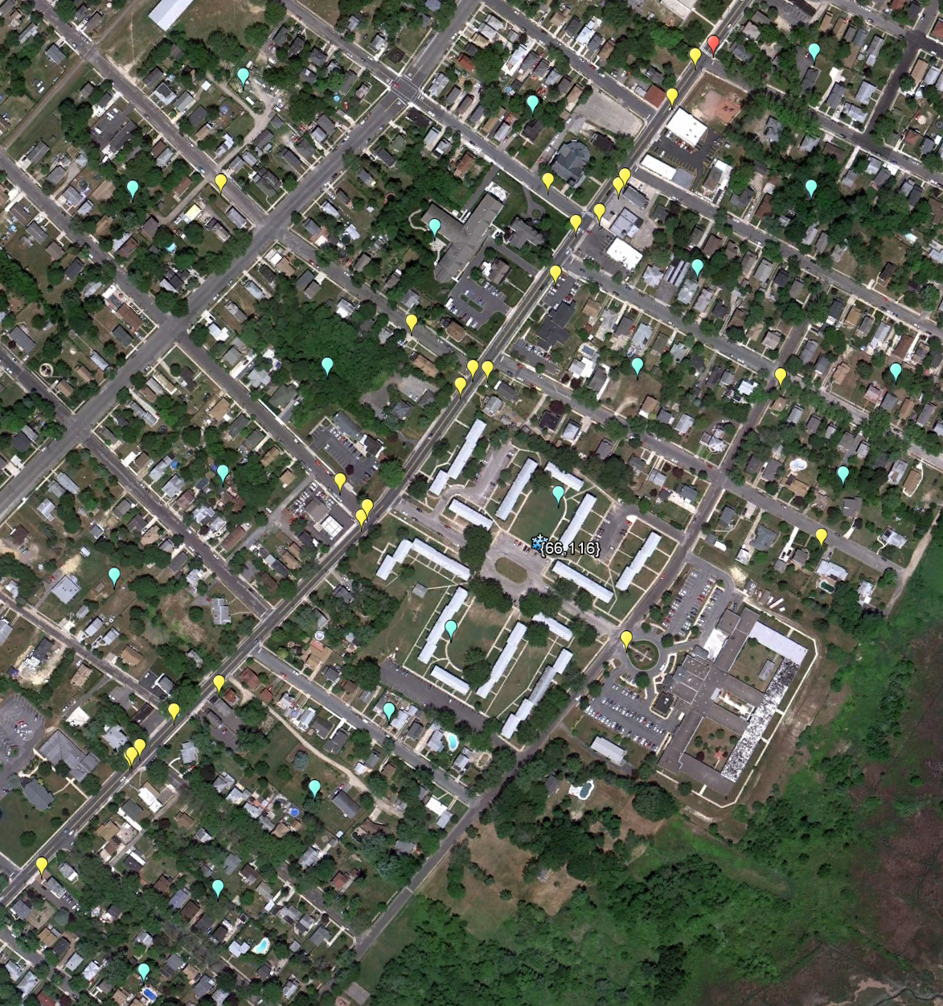
Pixel {66,116} Atlantic County
Item | Value
Activity Locations | 45
Employment | 375
Population | 1,567
School Enrollment | 369
Work
Home
(Block Centroid)
School
Pixel Centroid

Slide 9
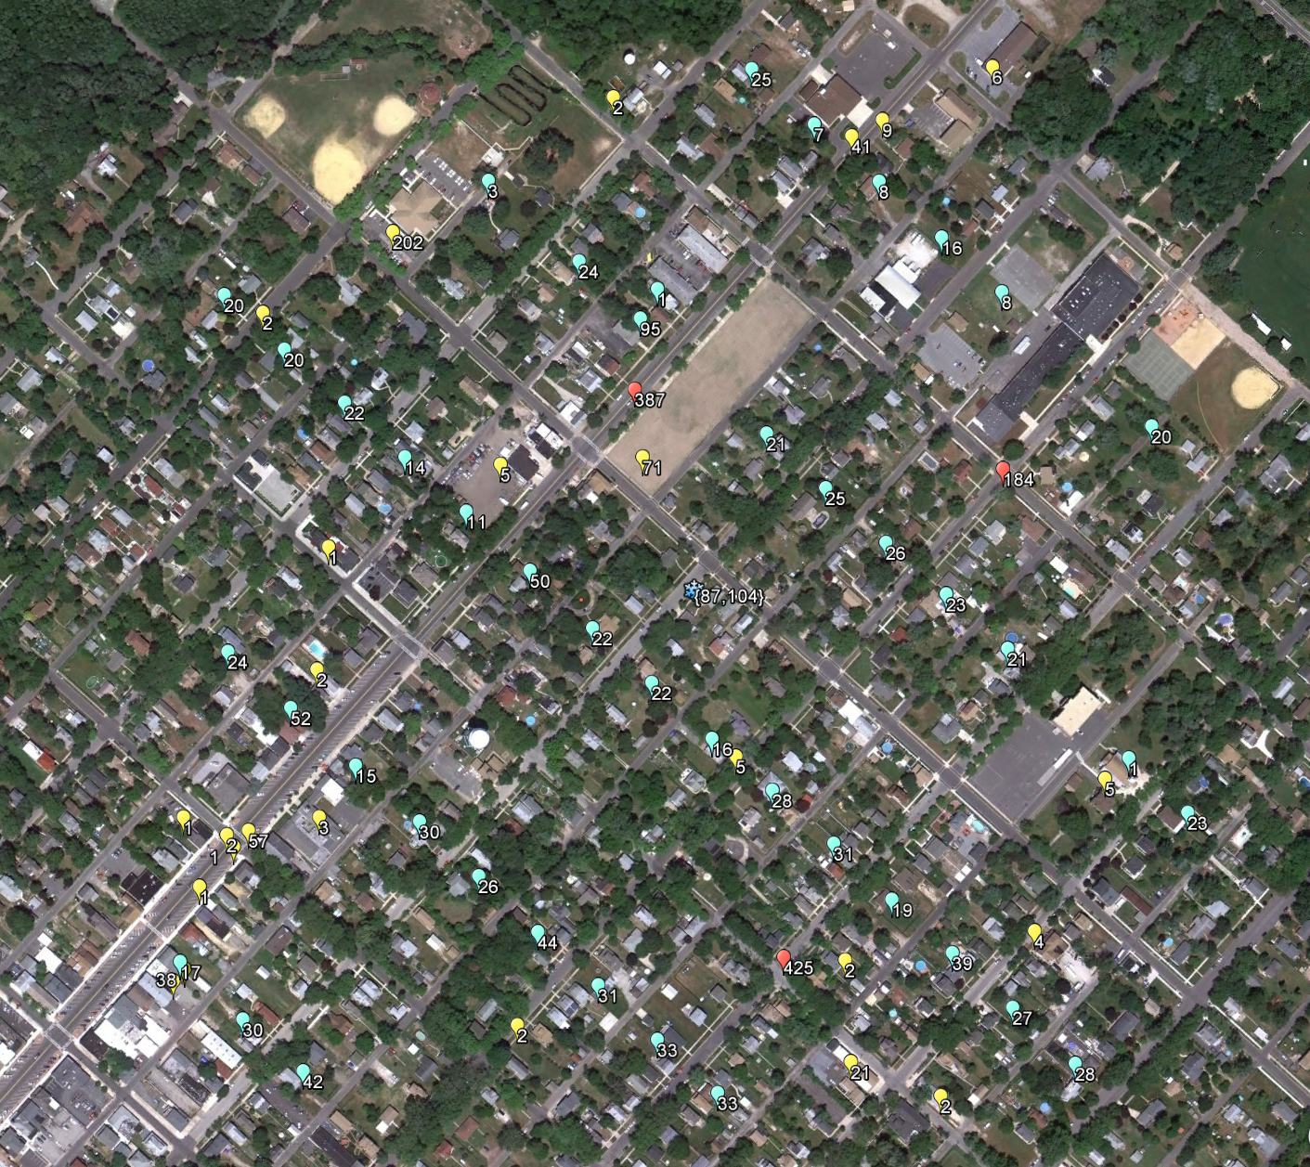
Pixel {87,104} Atlantic County
Item | Value
Activity Locations | 72
Employment | 487
Population | 1,092
School Enrollment | 996
Work
Home
(Block Centroid)
School
Pixel Centroid

Slide 10
Pixel {87,104} Atlantic County
Item | Value
Activity Locations | 72
Employment | 487
Population | 1,092
School Enrollment | 996

Slide 11
Pixel {87,104} Atlantic County
Item | Value
Activity Locations | 72
Employment | 487
Population | 1,092
School Enrollment | 996

Slide 12
Pixel {87,104} Atlantic County
Item | Value
Activity Locations | 72
Employment | 487
Population | 1,092
School Enrollment | 996

Slide 13
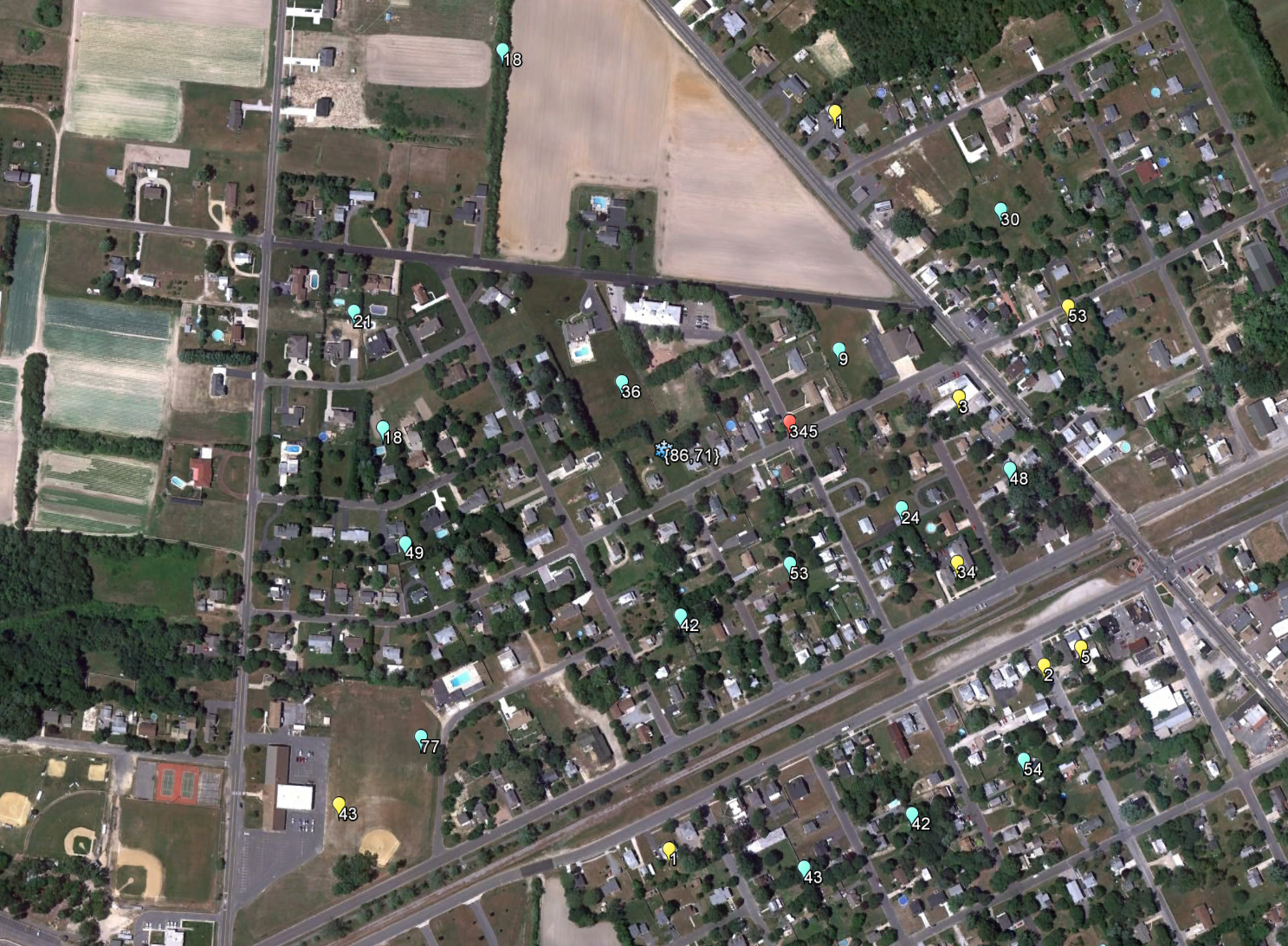
Pixel {86,71} Atlantic County
Item | Value
Activity Locations | 24
Employment | 142
Population | 564
School Enrollment | 345
Work
Home
(Block Centroid)
School
Pixel Centroid

Slide 14
Pixel {86,71} Atlantic County
Item | Value
Activity Locations | 24
Employment | 142
Population | 564
School Enrollment | 345
Work
Home
(Block Centroid)
School
Pixel Centroid

Slide 15
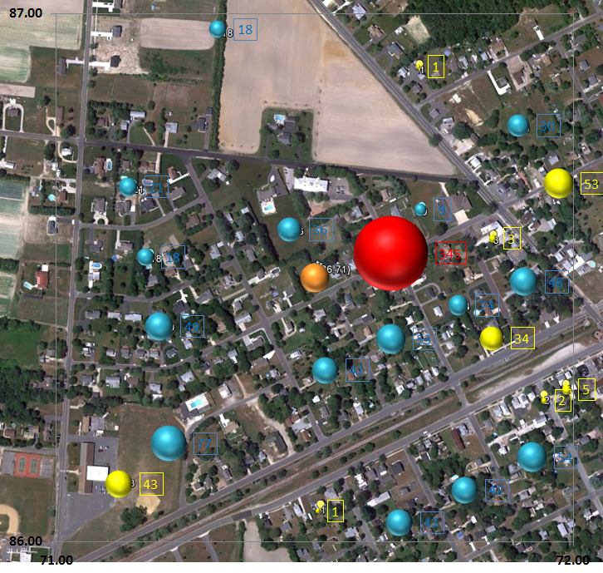
Pixel {86,71} Atlantic County
Item | Value
Activity Locations | 24
Employment | 142
Population | 564
School Enrollment | 345
Work
Home
(Block Centroid)
School
Pixel Centroid

Slide 16
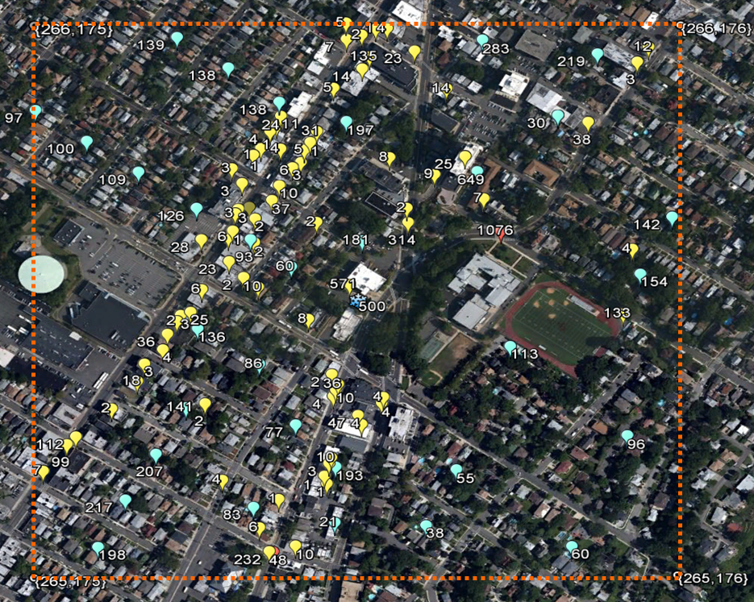
Bergen County Pixel {265,175}
Item | Value
Activity Locations | 115
Employment | 2,088
Population | 4,576
School Enrollment | 1,308
Work
Home
(Block Centroid)
School
Pixel Centroid

Slide 17
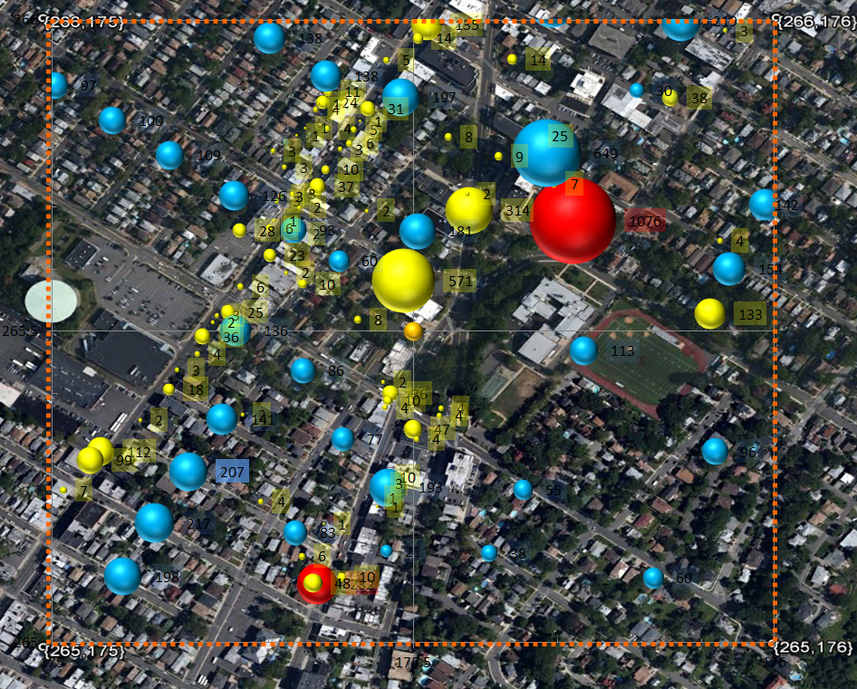
Bergen County Pixel {265,175}
Item | Value
Activity Locations | 115
Employment | 2,088
Population | 4,576
School Enrollment | 1,308
Work
Home
(Block Centroid)
School
Pixel Centroid

Slide 18
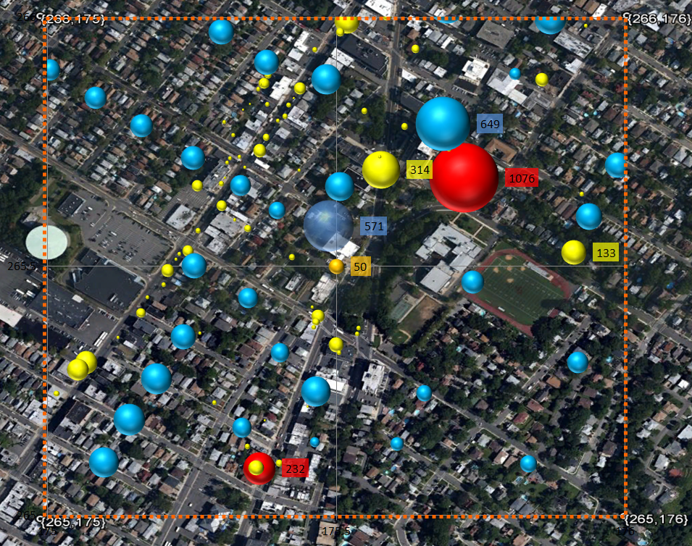
Bergen County Pixel {265,175}
Item | Value
Activity Locations | 115
Employment | 2,088
Population | 4,576
School Enrollment | 1,308
Work
Home
(Block Centroid)
School
Pixel Centroid

Slide 19
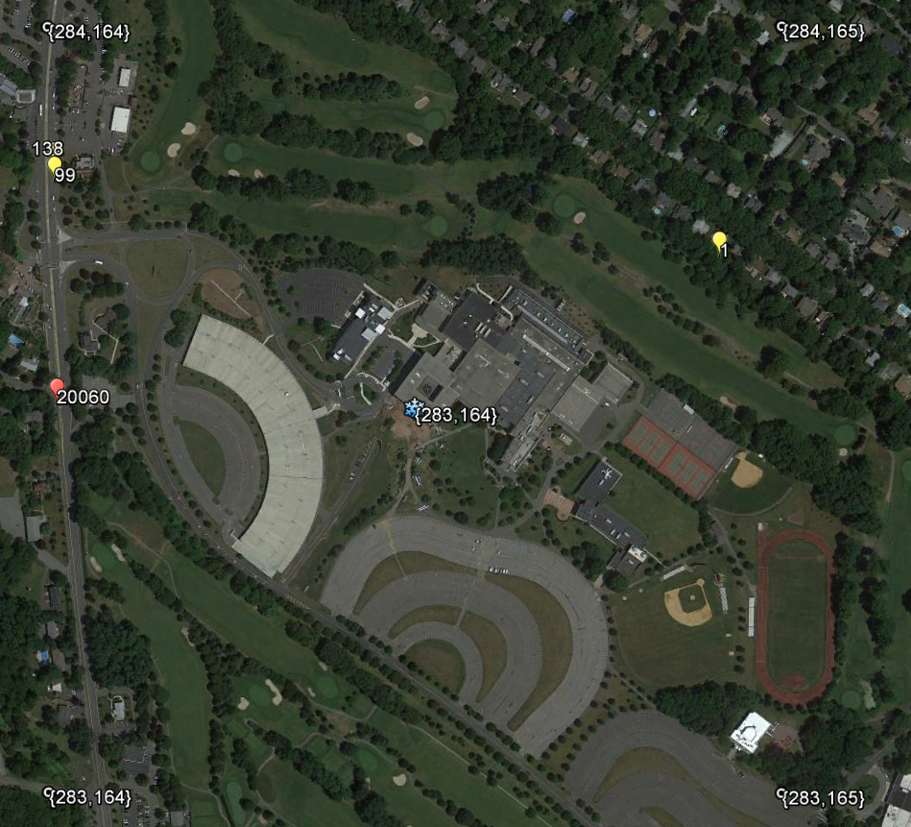
Bergen County Pixel {283,164}
Item | Value
Activity Locations | 4
Employment | 238
Population | 0
School Enrollment | 20,060
Work
Home
(Block Centroid)
Bergen Community College
School
Pixel Centroid

Slide 20
Bergen County Pixel {283,164}
Item | Value
Activity Locations | 4
Employment | 238
Population | 0
School Enrollment | 20,060
Work
Home
(Block Centroid)
Bergen Community College
School
Pixel Centroid

Slide 21
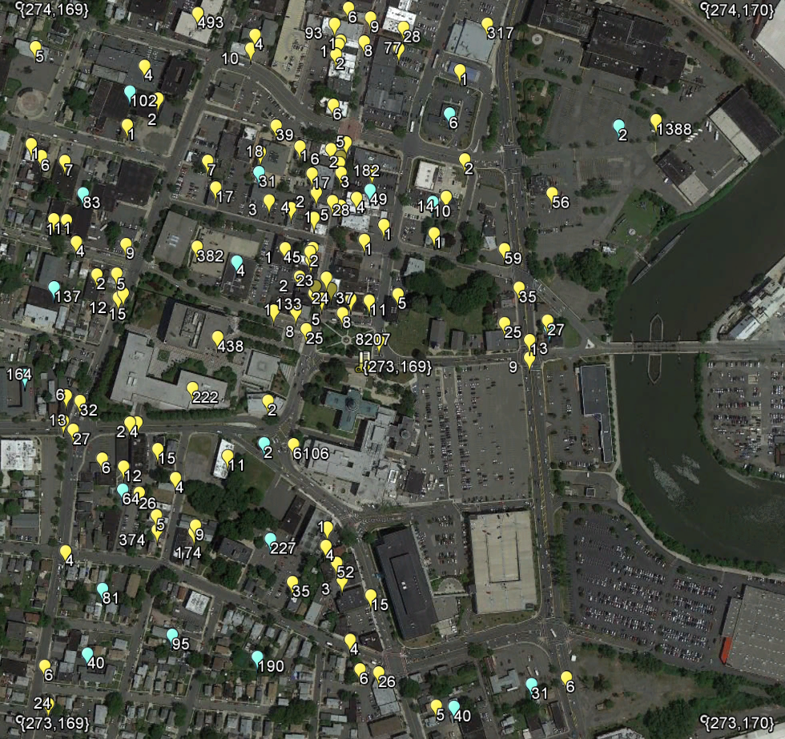
Bergen County Pixel {273,169}
Item | Value
Activity Locations | 135
Employment | 19,750
Population | 1,361
School Enrollment | 0
Work
Home
(Block Centroid)
School
Pixel Centroid

Slide 22
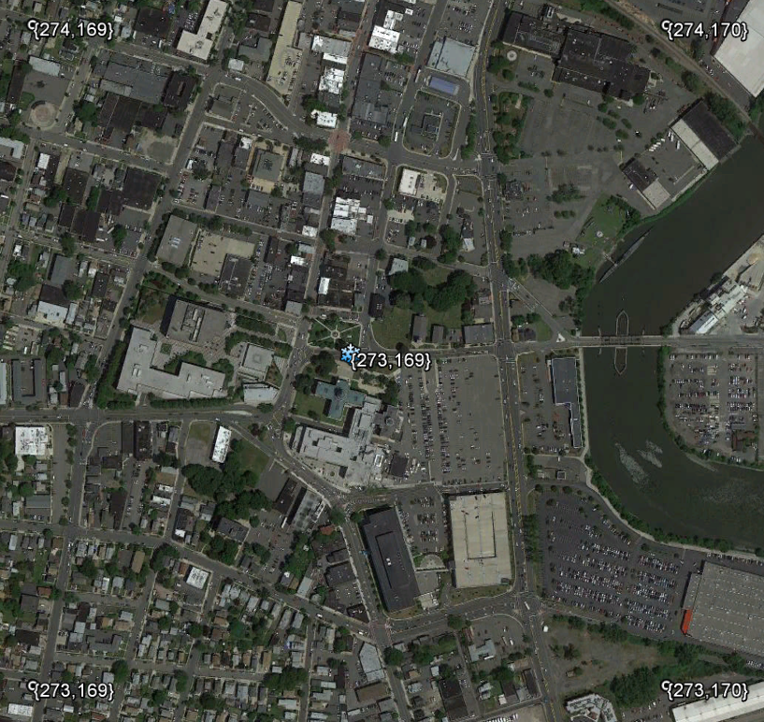
Bergen County Pixel {273,169}
Item | Value
Activity Locations | 135
Employment | 19,750
Population | 1,361
School Enrollment | 0
Work
Home
(Block Centroid)
School
Pixel Centroid

Slide 23
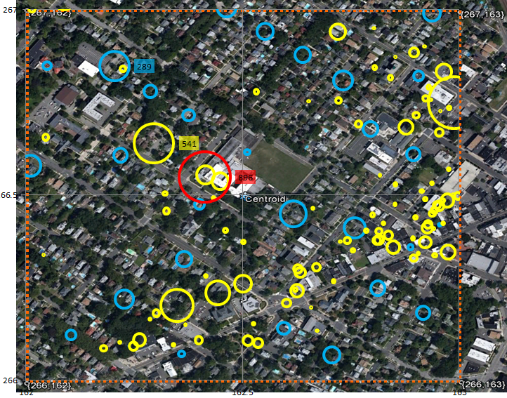
Bergen County Pixel {266,162} Rutherford
Item | Value
Activity Locations | 131
Employment | 3,809
Population | 2,352
School Enrollment | 896
Work
Home
(Block Centroid)
School
Pixel Centroid

Slide 24
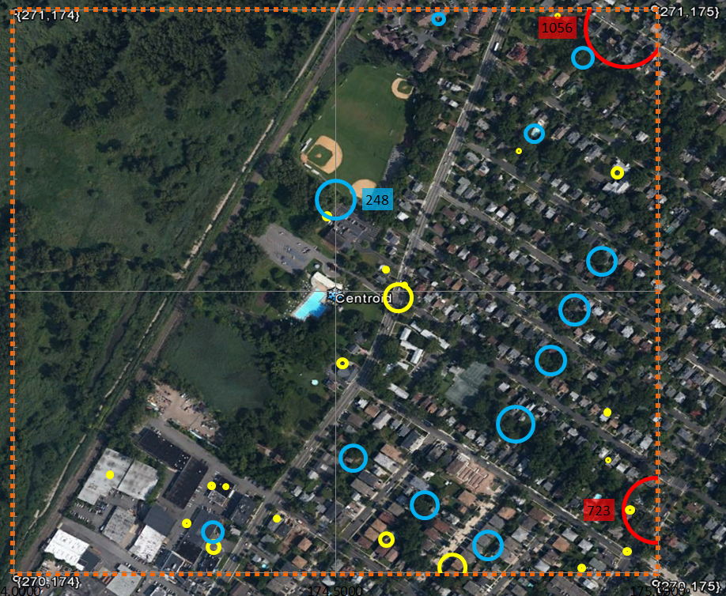
Bergen County Pixel {270,174} Leonia
Item | Value
Activity Locations | 35
Employment | 364
Population | 1,428
School Enrollment | 1,779
Work
Home
(Block Centroid)
School
Pixel Centroid

Slide 25
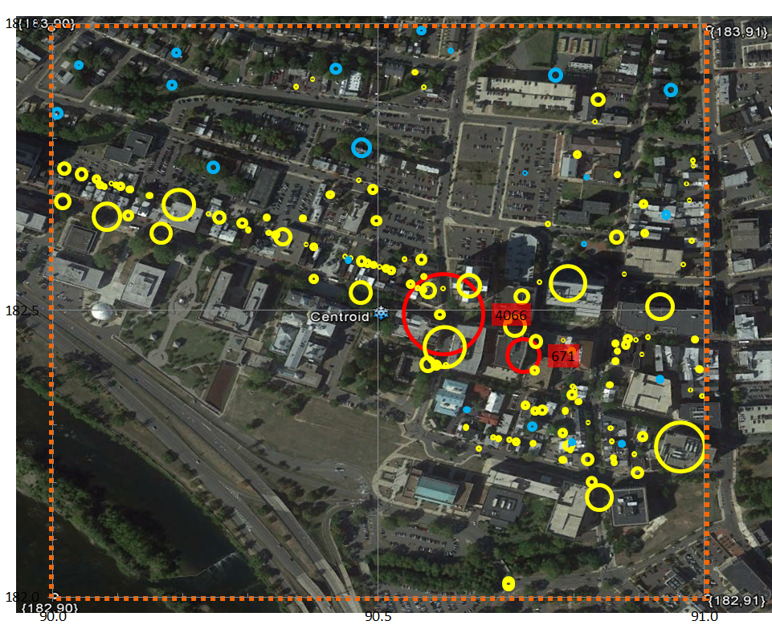
Mercer County Pixel {182,90} Trenton
Item | Value
Activity Locations | 135
Employment | 8,654
Population | 707
School Enrollment | 4,737
Work
Home
(Block Centroid)
School
Pixel Centroid

Slide 26
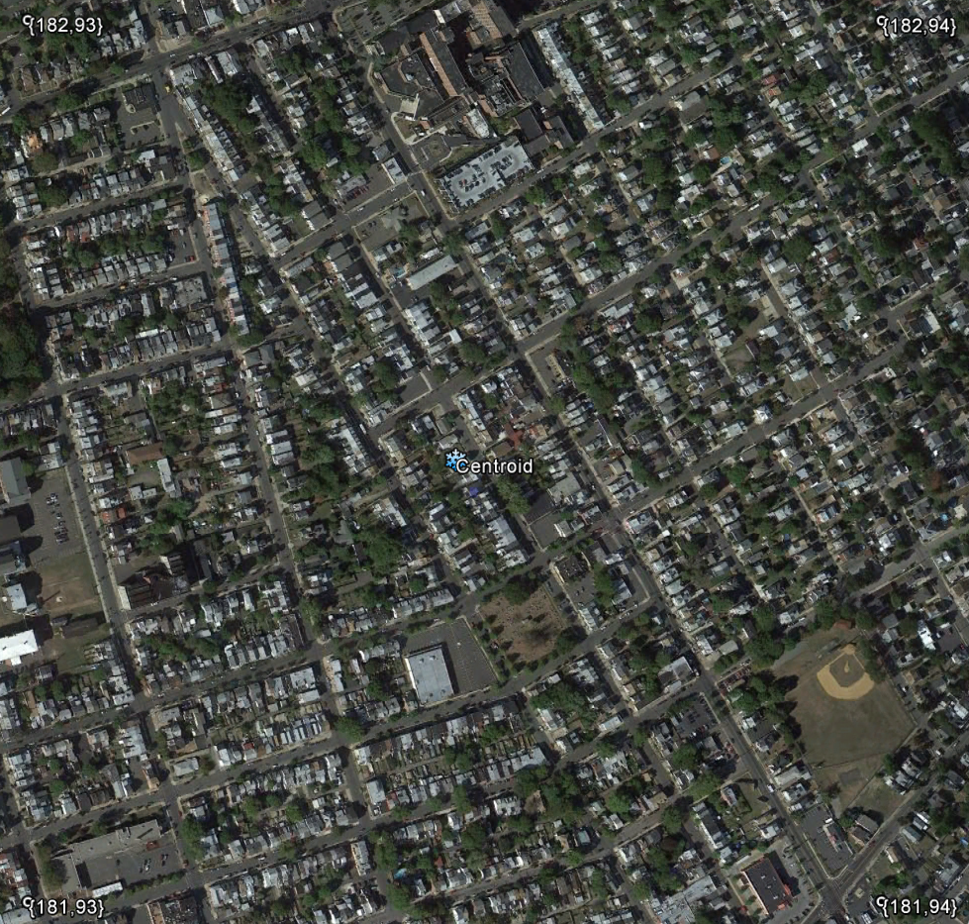
Mercer County Pixel {181,93} Chambersburg
Item | Value
Activity Locations | 113
Employment | 2,295
Population | 5,622
School Enrollment | 594
Work
Home
(Block Centroid)
School
Pixel Centroid

Slide 27
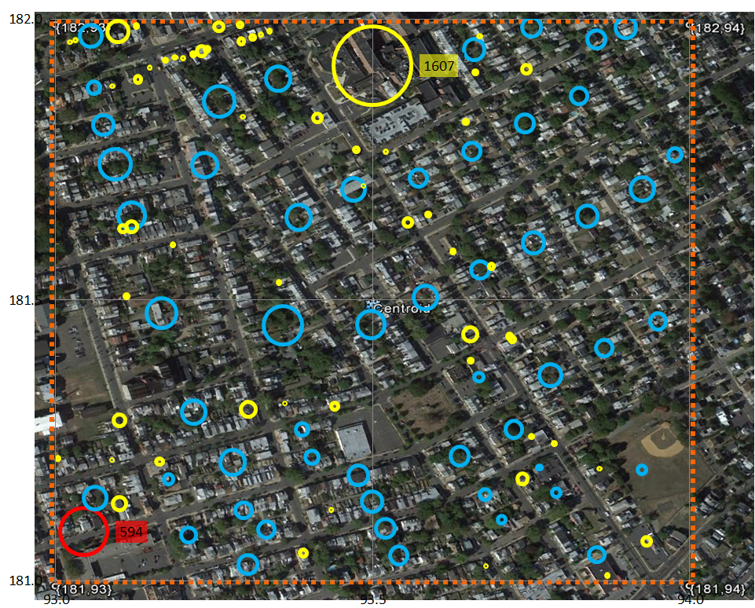
Mercer County Pixel {181,93} Chambersburg
Item | Value
Activity Locations | 113
Employment | 2,295
Population | 5,622
School Enrollment | 594
Work
Home
(Block Centroid)
School
Pixel Centroid

Slide 28
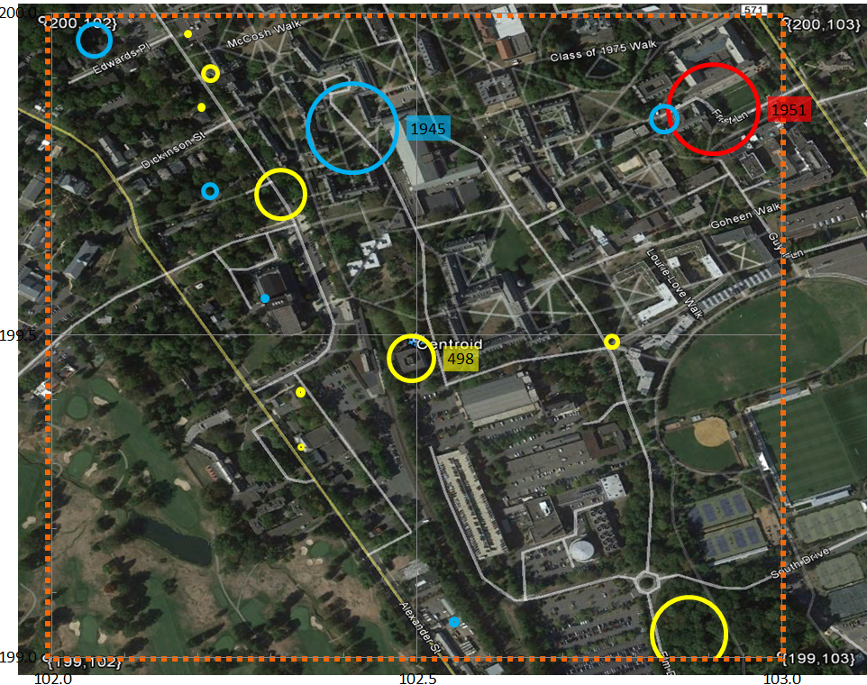
Mercer County Pixel {199,102} Princeton
Item | Value
Activity Locations | 16
Employment | 2,490
Population | 2,430
School Enrollment | 1,951
Work
Home
(Block Centroid)
School
Pixel Centroid

Slide 29
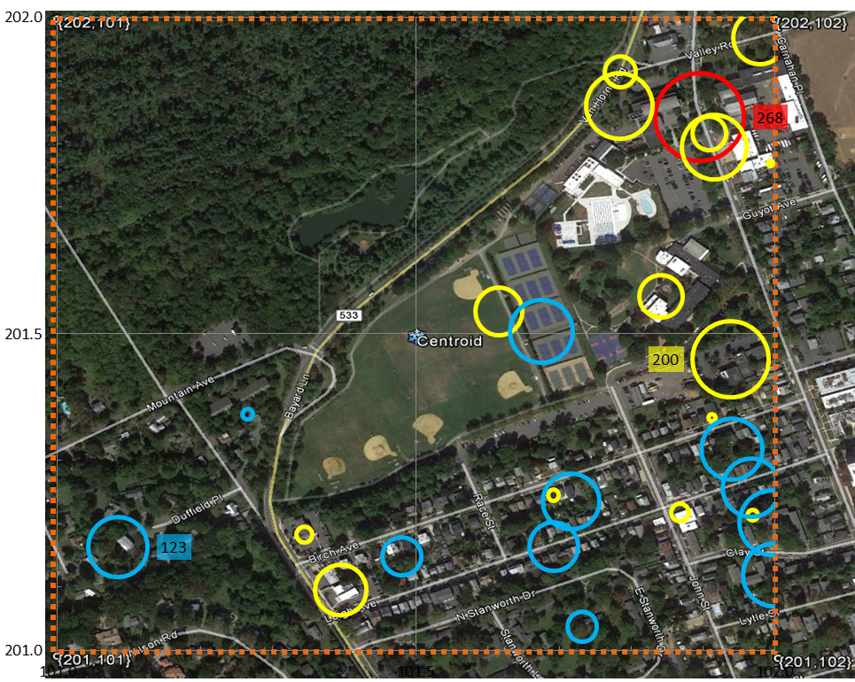
Mercer County Pixel {201,101} Princeton
Item | Value
Activity Locations | 27
Employment | 925
Population | 1,056
School Enrollment | 268
Work
Home
(Block Centroid)
School
Pixel Centroid

Slide 30
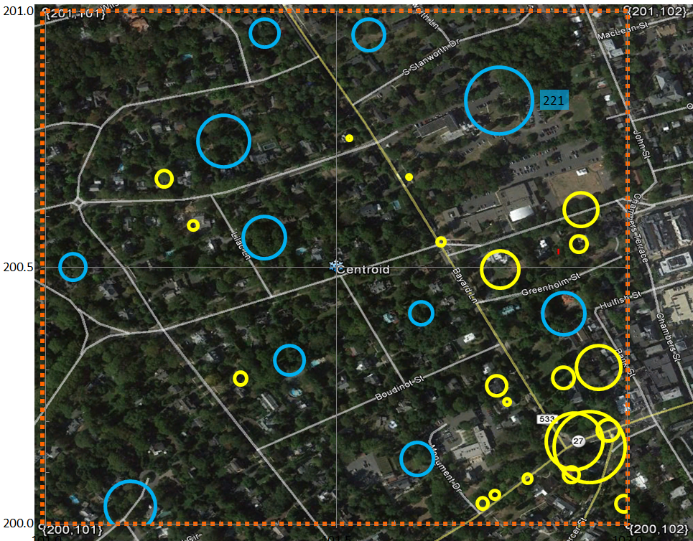
Mercer County Pixel {200,101} Princeton
Item | Value
Activity Locations | 32
Employment | 789
Population | 906
School Enrollment | 0
Work
Home
(Block Centroid)
School
Pixel Centroid

Slide 31
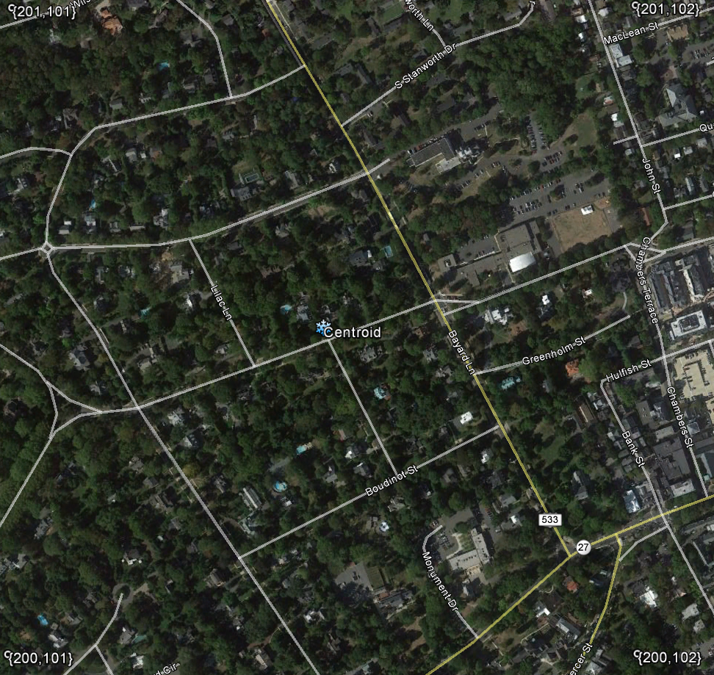
Mercer County Pixel {200,101} Princeton
Item | Value
Activity Locations | 32
Employment | 789
Population | 906
School Enrollment | 0
Work
Home
(Block Centroid)
School
Pixel Centroid

Slide 32
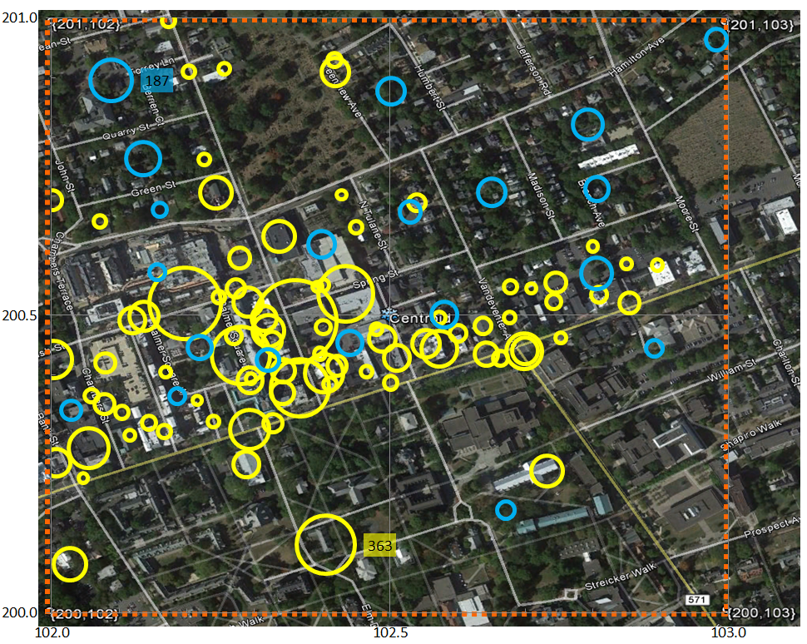
Mercer County Pixel {200,102} Princeton
Item | Value
Activity Locations | 165
Employment | 6,617
Population | 1,325
School Enrollment | 0
Work
Home
(Block Centroid)
School
Pixel Centroid

Slide 33
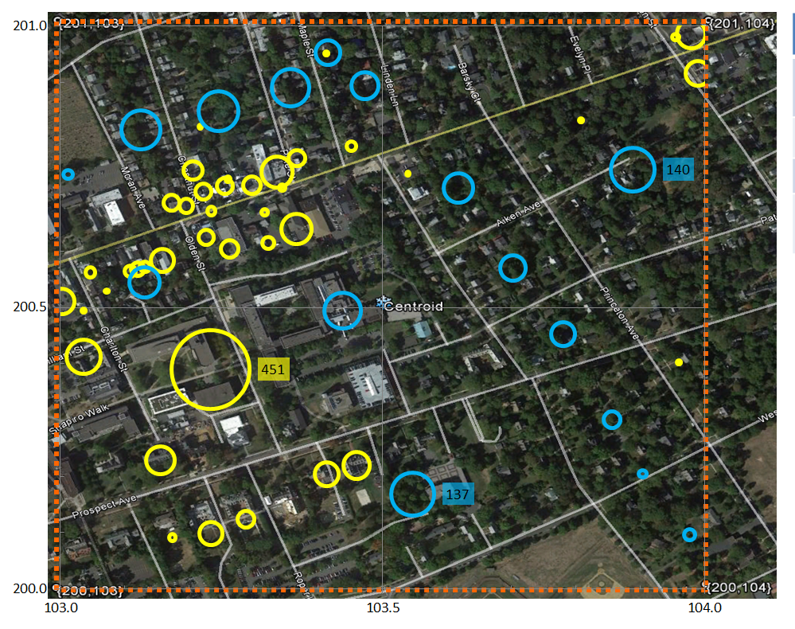
Mercer County Pixel {200,103} Princeton
Item | Value
Activity Locations | 57
Employment | 1,336
Population | 1,062
School Enrollment | 0
Work
Home
(Block Centroid)
School
Pixel Centroid

Slide 34
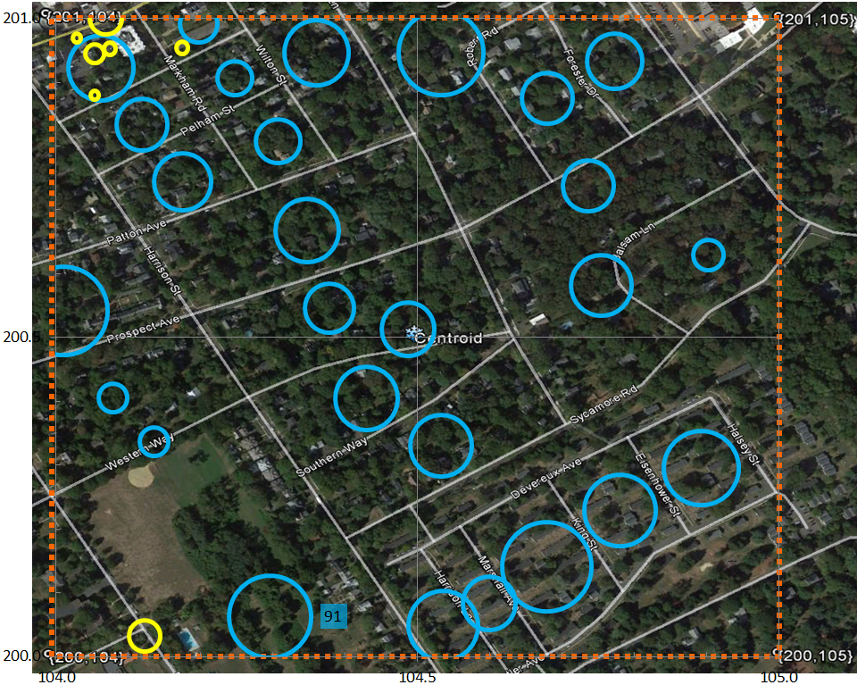
Mercer County Pixel {200,104} Princeton
Item | Value
Activity Locations | 34
Employment | 38
Population | 1,332
School Enrollment | 0
Work
Home
(Block Centroid)
School
Pixel Centroid

Slide 35
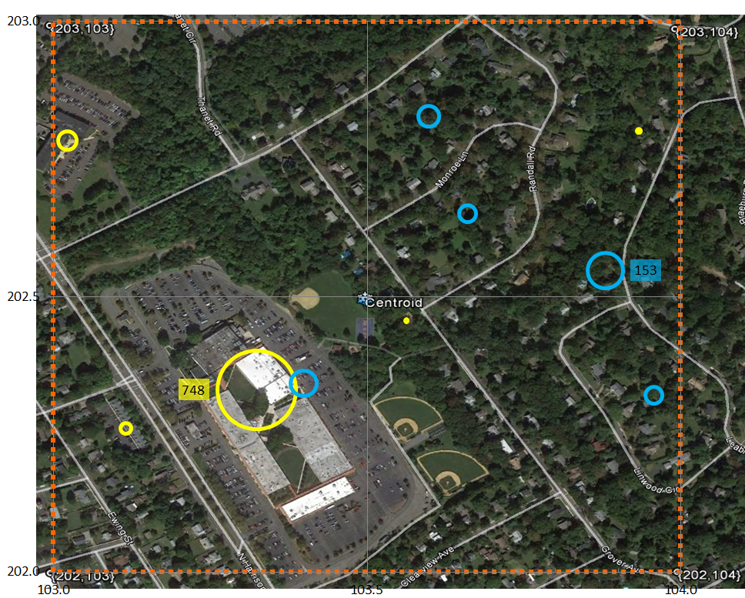
Mercer County Pixel {202,103} Princeton
Item | Value
Activity Locations | 10
Employment | 809
Population | 356
School Enrollment | 0
Work
Home
(Block Centroid)
School
Pixel Centroid

Slide 36
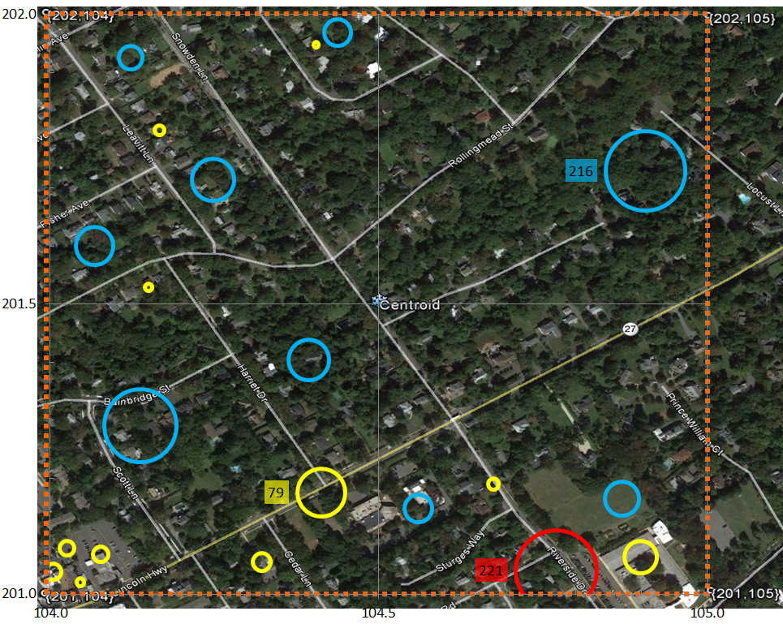
Mercer County Pixel {201,104} Princeton
Item | Value
Activity Locations | 21
Employment | 161
Population | 667
School Enrollment | 221
Work
Home
(Block Centroid)
School
Pixel Centroid

Slide 37
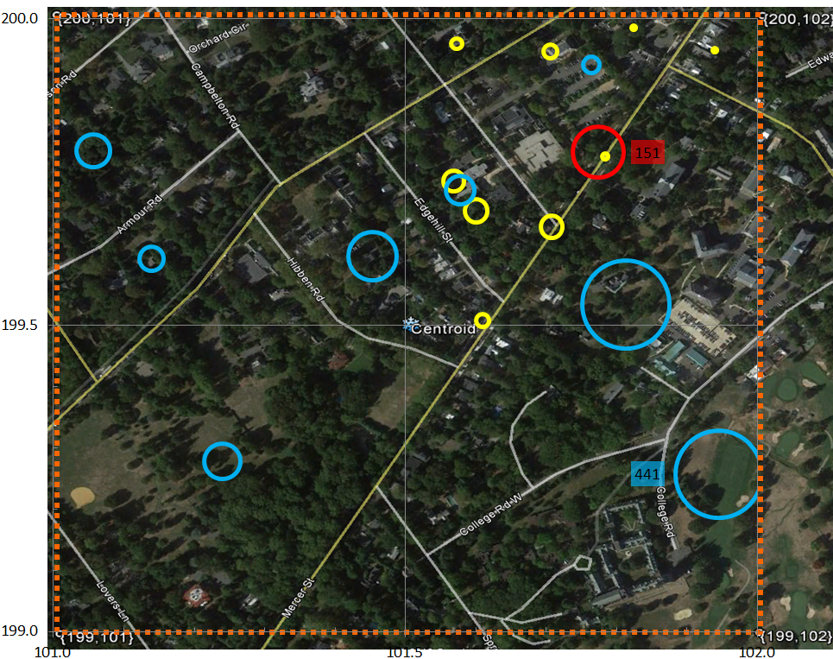
Mercer County Pixel {199,101} Princeton
Item | Value
Activity Locations | 18
Employment | 116
Population | 1,268
School Enrollment | 151
Work
Home
(Block Centroid)
School
Pixel Centroid

Slide 38
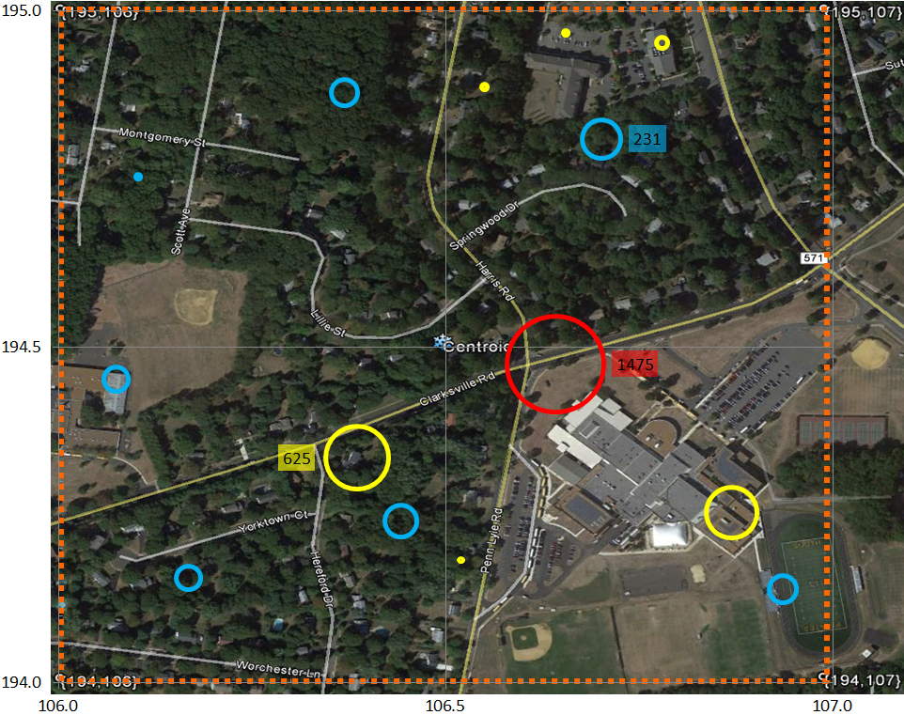
Mercer County Pixel {194,106} West Windsor
Item | Value
Activity Locations | 14
Employment | 1,065
Population | 811
School Enrollment | 1,475
Work
Home
(Block Centroid)
School
Pixel Centroid

Slide 39
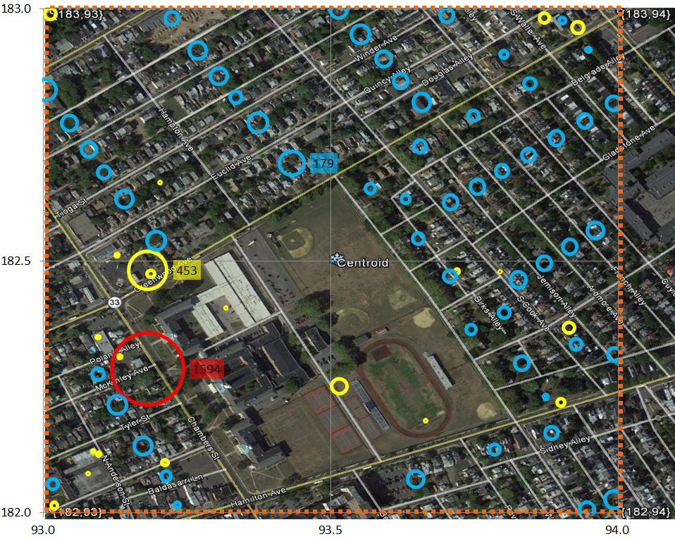
Mercer County Pixel {182,93} Trenton
Item | Value
Activity Locations | 78
Employment | 762
Population | 3,410
School Enrollment | 1,594
Work
Home
(Block Centroid)
School
Pixel Centroid

Slide 40
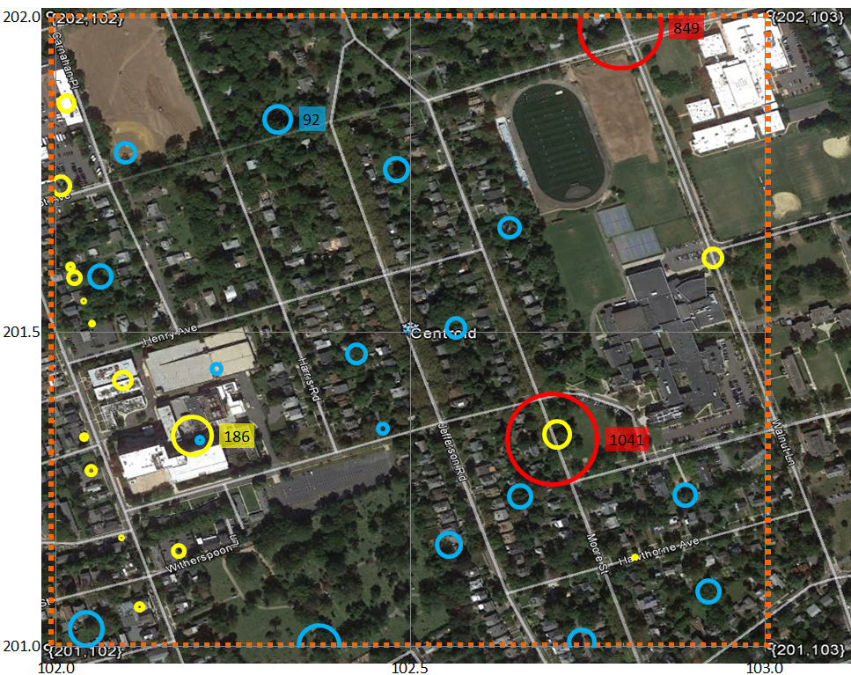
Mercer County Pixel {201,102} Princeton
Item | Value
Activity Locations | 35
Employment | 497
Population | 1,115
School Enrollment | 1,890
Work
Home
(Block Centroid)
School
Pixel Centroid

Slide 41
Mercer County Pixel {182,93} Trenton
Item | Value
Activity Locations | 78
Employment | 762
Population | 3,410
School Enrollment | 1,594
Work
Home
(Block Centroid)
School
Pixel Centroid

Slide 42
Mercer County Pixel {201,102} Princeton
Item | Value
Activity Locations | 35
Employment | 497
Population | 1,115
School Enrollment | 1,890
Work
Home
(Block Centroid)
School
Pixel Centroid

Slide 43
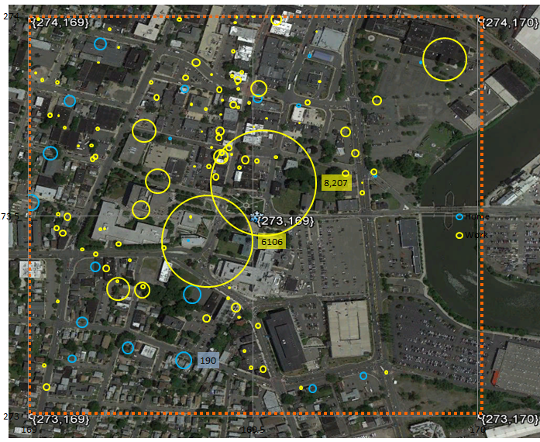
Bergen County Pixel {273,169}
Item | Value
Activity Locations | 135
Employment | 19,750
Population | 1,361
School Enrollment | 0
Work
Home
(Block Centroid)
School
Pixel Centroid

Slide 44
Bergen County Pixel {273,169}
Item | Value
Activity Locations | 135
Employment | 19,750
Population | 1,361
School Enrollment | 0
Work
Home
(Block Centroid)
School
Pixel Centroid

Slide 45
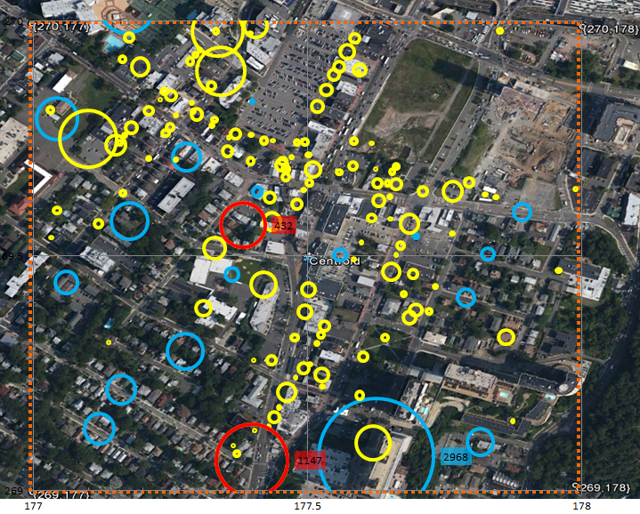
Bergen County Pixel {269,177}; Ft. Lee
Item | Value
Activity Locations | 157
Employment | 4,748
Population | 5,700
School Enrollment | 1,579
Work
Home
(Block Centroid)
School
Pixel Centroid

Slide 46
Bergen County Pixel {269,177}; Ft. Lee
Item | Value
Activity Locations | 157
Employment | 4,748
Population | 5,700
School Enrollment | 1,579
Work
Home
(Block Centroid)
School
Pixel Centroid

Slide 47
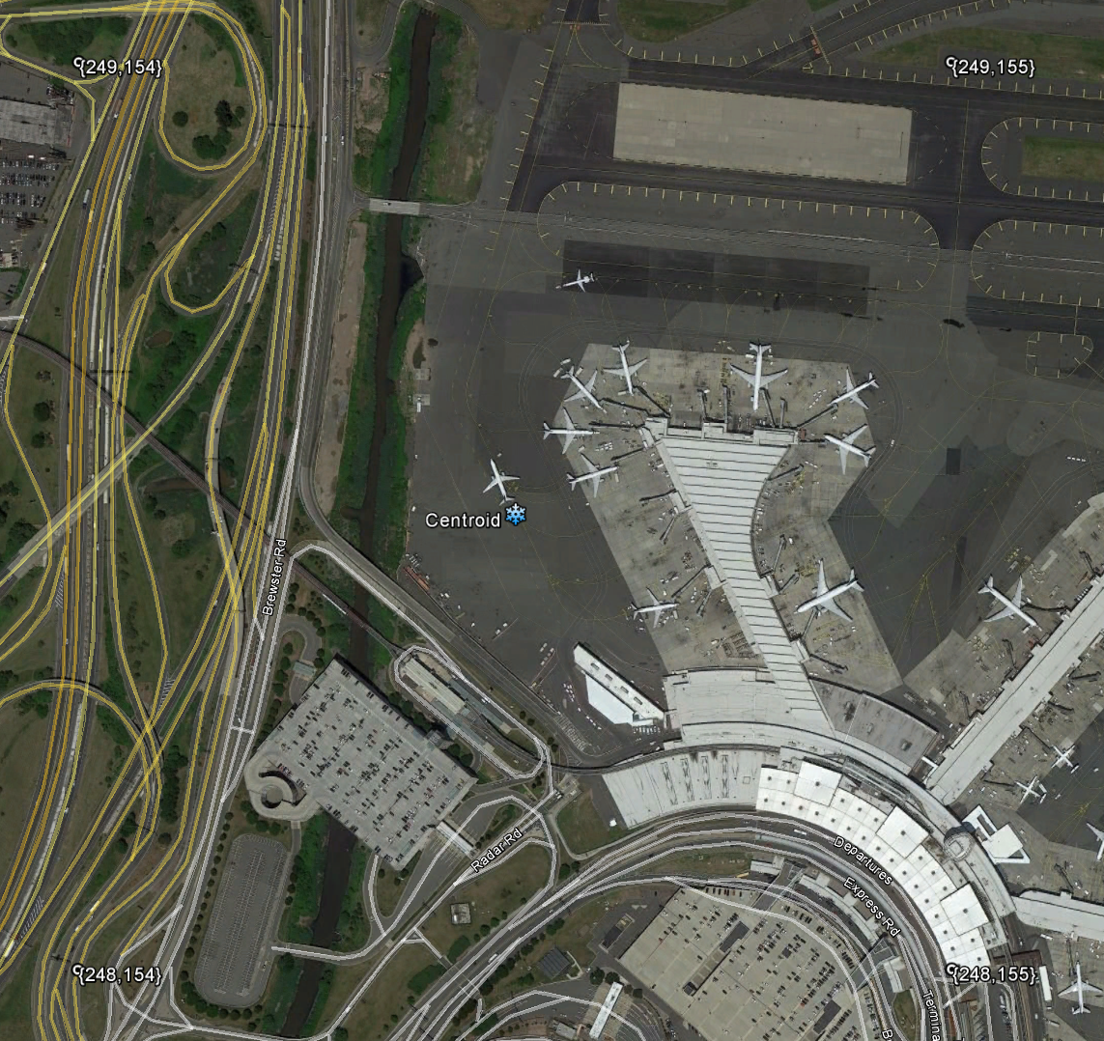
Newark Airport {248,154}
Item | Value
Activity Locations | 2
Employment | 6,212
Population | 0
School Enrollment | 0
Work
Home
(Block Centroid)
School
Pixel Centroid

Slide 48
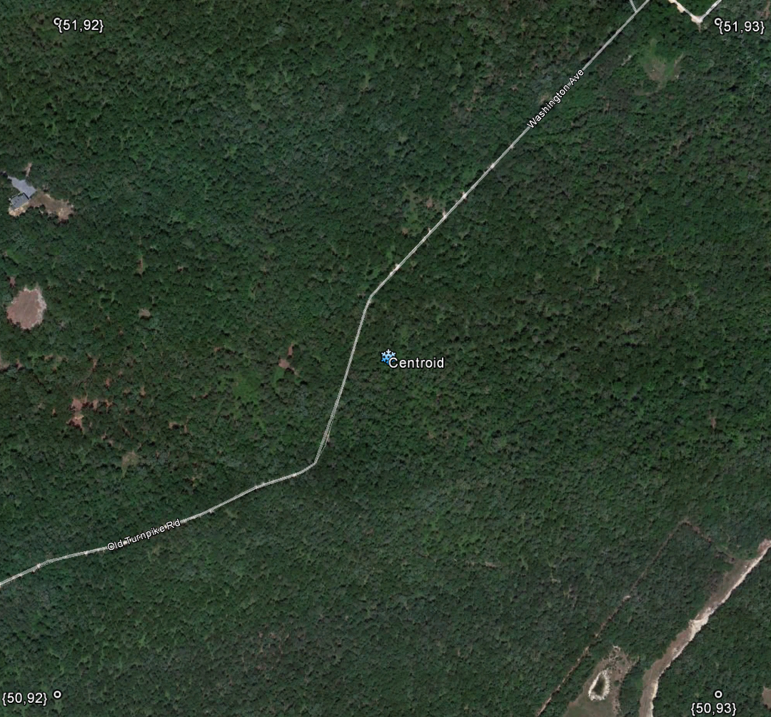
Cape May County Pixel {50,92}
Item | Value
Activity Locations | 0
Employment | 0
Population | 0
School Enrollment | 0
Work
Home
(Block Centroid)
School
Pixel Centroid

Slide 49
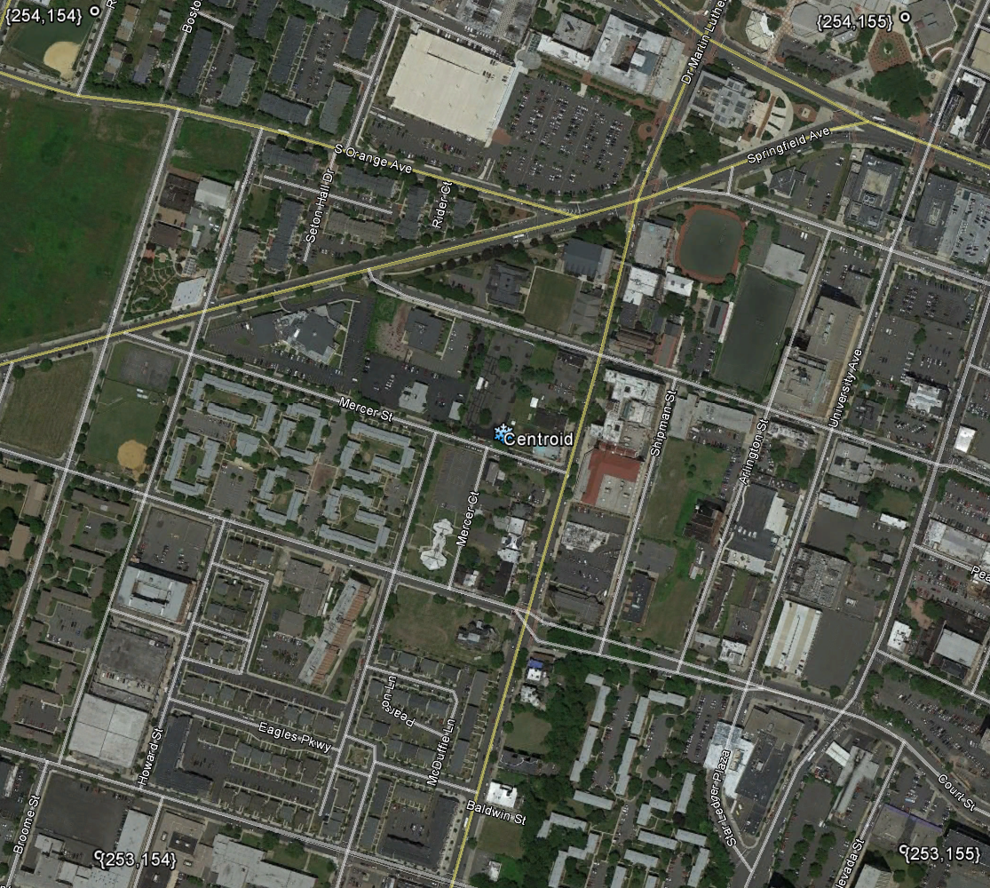
Newark {253,154}
Item | Value
Activity Locations | 61
Employment | 9,939
Population | 3,199
School Enrollment | 621
Work
Home
(Block Centroid)
School
Pixel Centroid

Slide 50
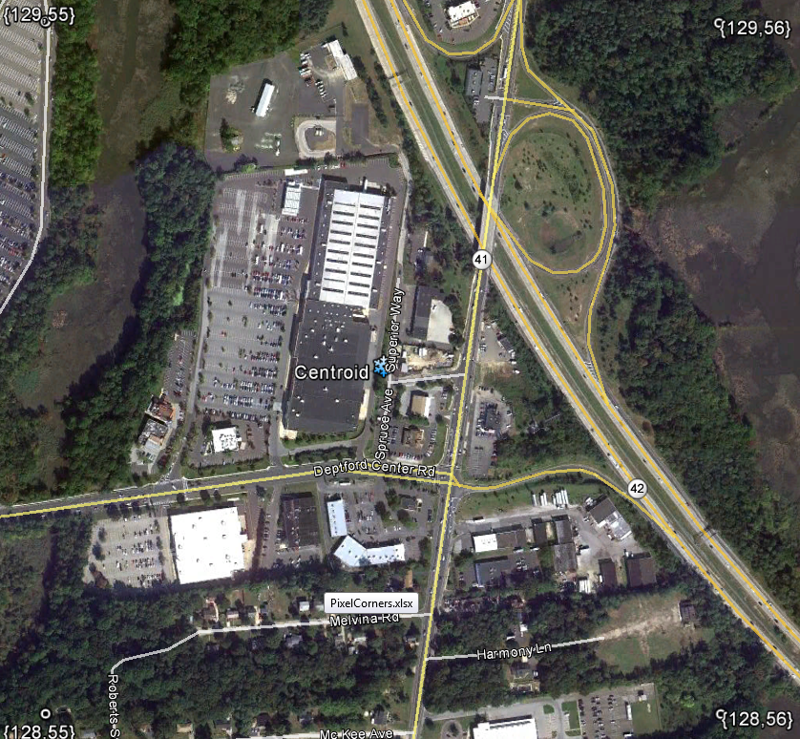
Deptford {128,55}
Item | Value
Activity Locations | 22
Employment | 1,878
Population | 87
School Enrollment | 0
Work
Home
(Block Centroid)
School
Pixel Centroid

Slide 51
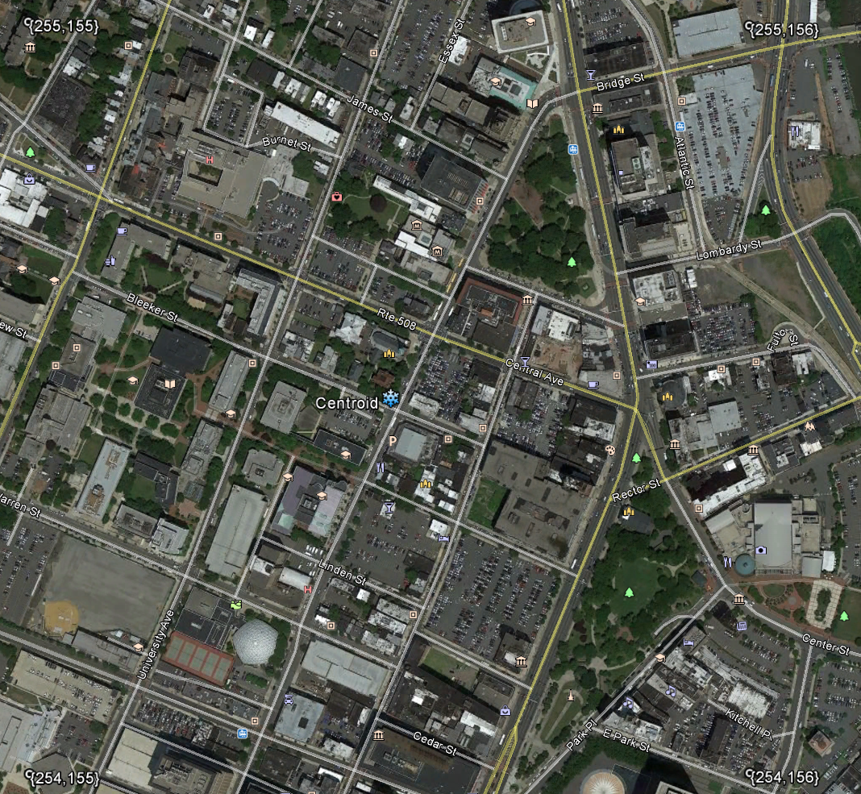
Newark {254,155}
Item | Value
Activity Locations | 169
Employment | 29,069
Population | 1,210
School Enrollment | 5,576
Work
Home
(Block Centroid)
School
Pixel Centroid

Slide 52
Newark Airport {248,154}
Item | Value
Activity Locations | 2
Employment | 6,212
Population | 0
School Enrollment | 0
Work
Home
(Block Centroid)
School
Pixel Centroid

Slide 53
Newark Pixel {253,154};

Slide 54
Newark Pixel {253,154};

Slide 55
Newark Pixel {253,154};

Slide 56
Newark Pixel {253,154};

