Slide 1

Radical Improvements for the Area's
Transportation System
Watch in “Slide Show” mode
Alain L. Kornhauser
Professor, Operations Research & Financial Engineering
Director, Transportation Program
Princeton University
Presented at Princeton Adult School
Friend Auditorium, Princeton NJ

Slide 2
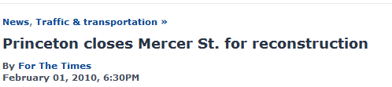
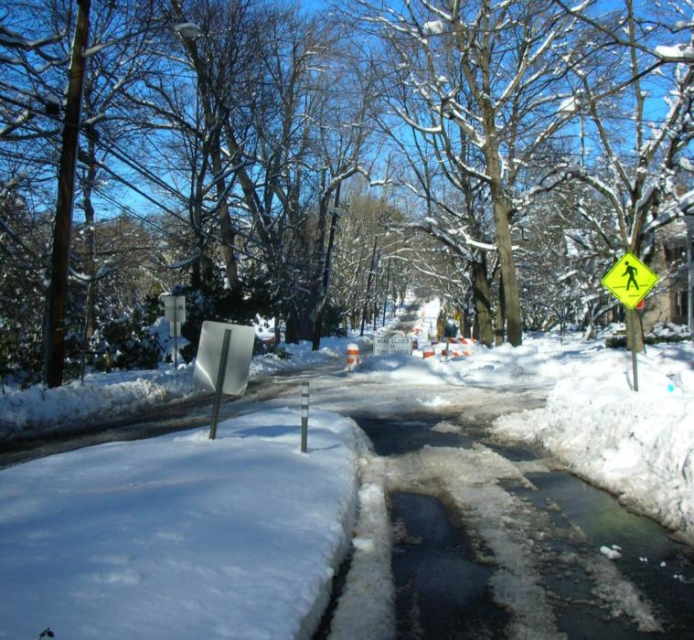
Local Road “Improvement”

Slide 3
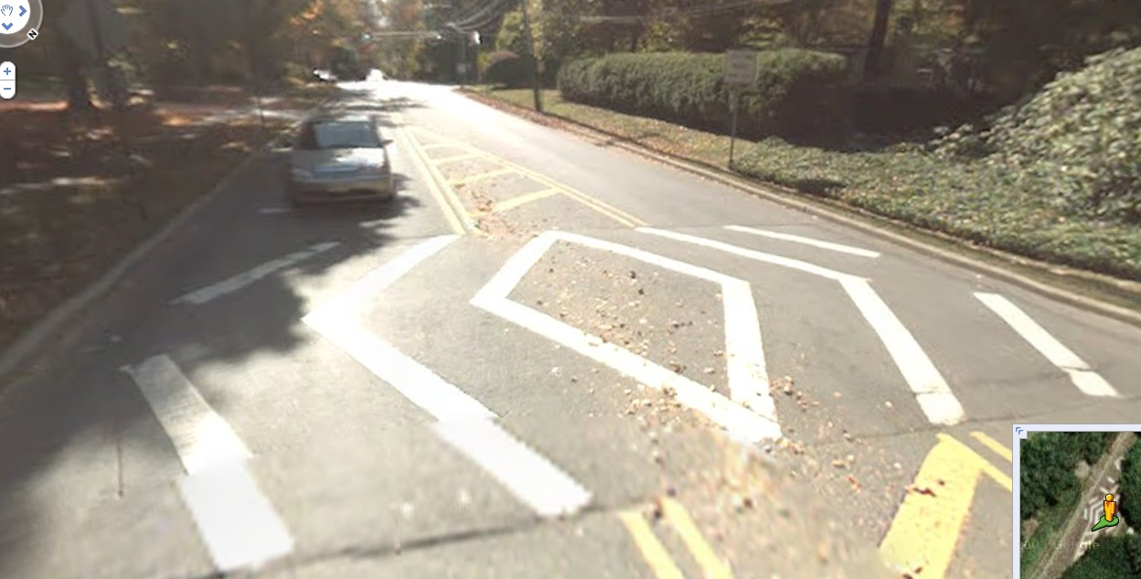
Previous Mercer Street Reconstruction
Added (Man-Made)“Traffic Calming” Feature

Slide 4
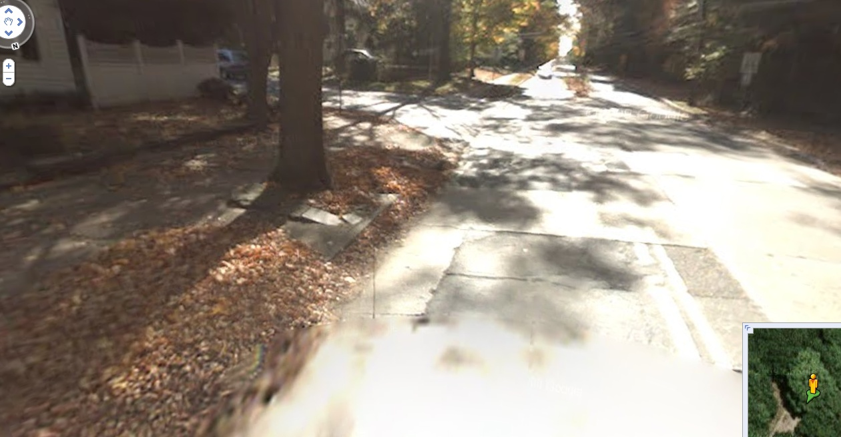
Shouldn’t We Stick with
Organic (Mother nature-Made)“Traffic Calming” Features ?

Slide 5
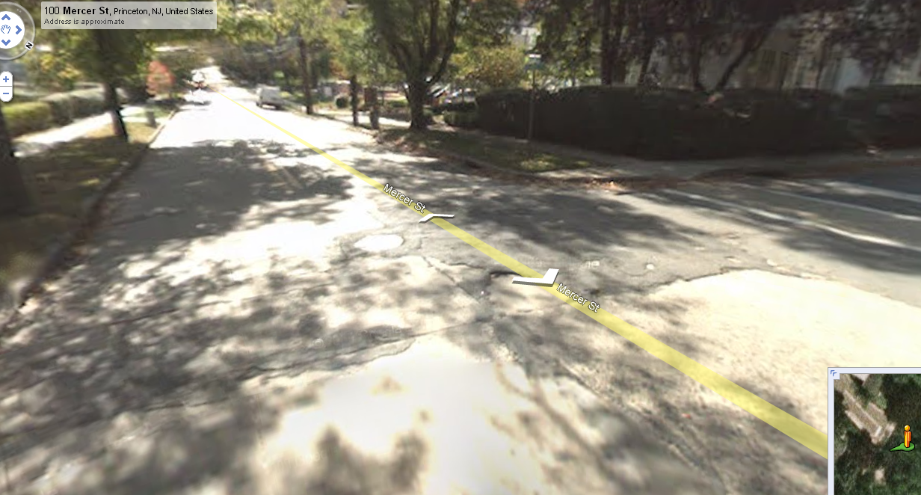
Shouldn’t We Stick with
Organic (Mother nature-Made)“Traffic Calming” Features ?
Why spend the $$$ for non-organic man-made traffic calming features???

Slide 6
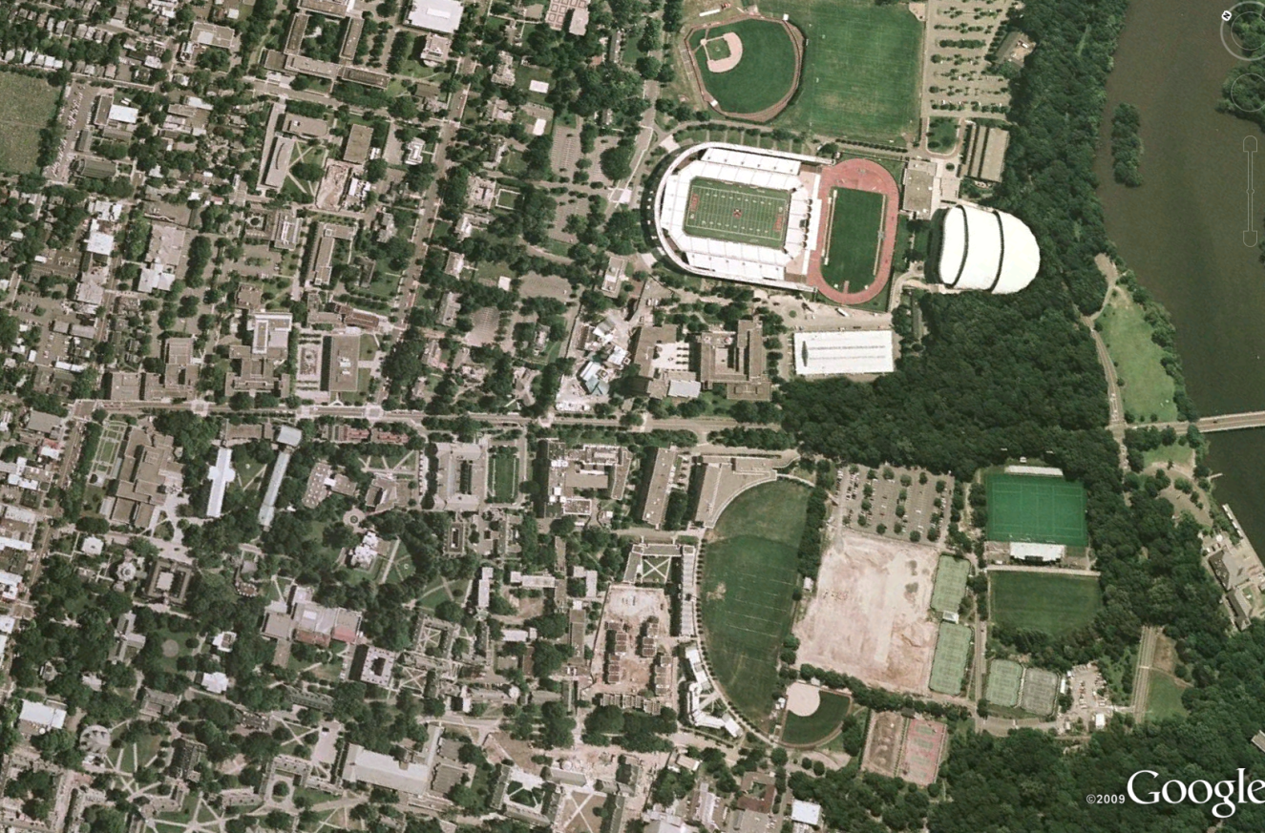
Washington Road
“The Great Divider”
Splits the campus in half (one side v. other side of the “tracks”)
Washington Road
New bridge to Nowhere?

Slide 7
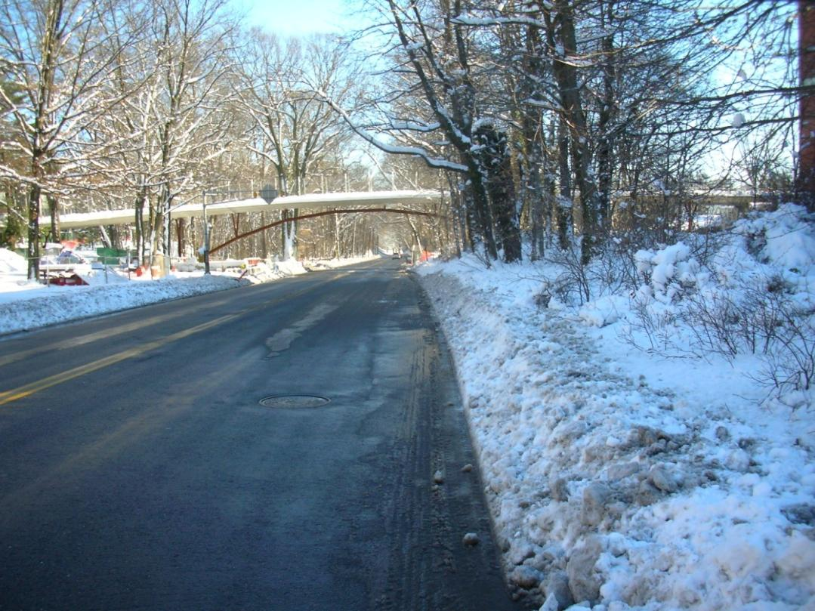
Princeton’s “Bridge to Nowhere”?

Slide 8
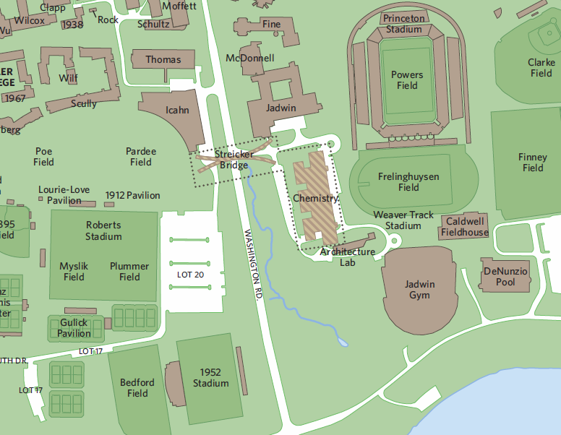
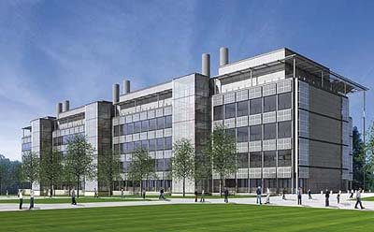
Princeton’s Bridge to Somewhere!
Accessibility to the
New Chemistry Bldg.

Slide 9
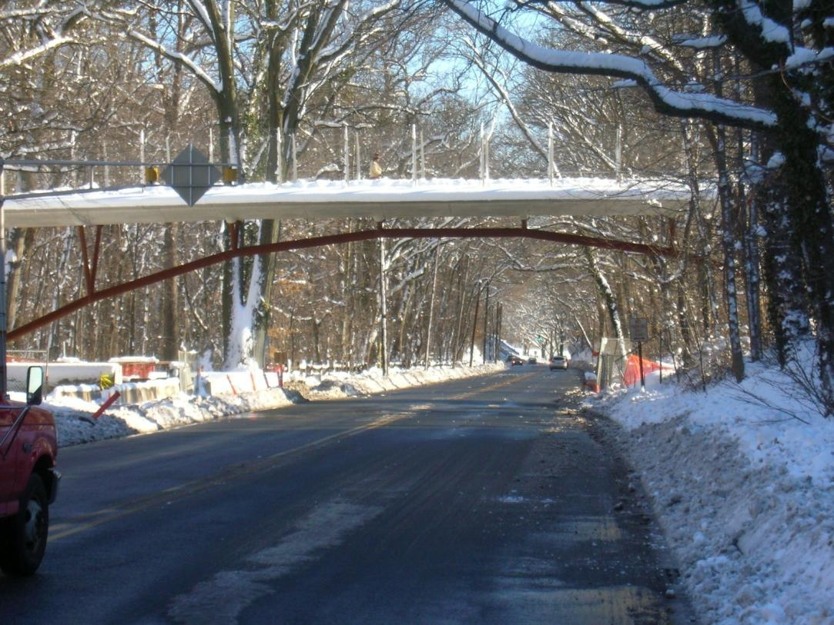
Princeton’s “Bridge to the New Chemistry Bldg.”

Slide 10
Washington Road
The Great Divider Persists for Most of the Campus
Washington Road
Washington Road

Slide 11
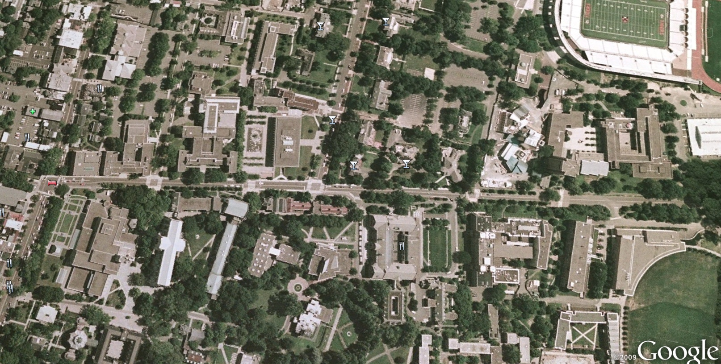

Look More Closely at the Critical Portion of Washington Road
Washington Road

Slide 12
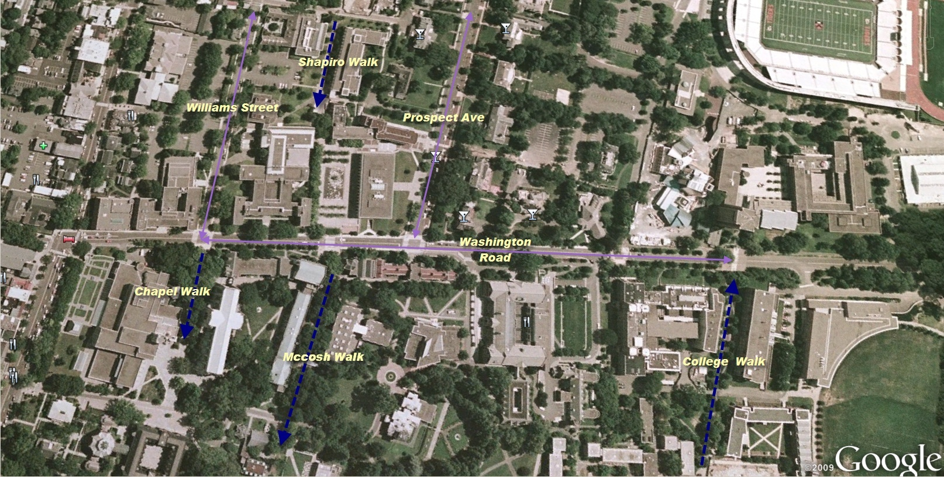
Washington Road
Streets & Walks
Washington Road

Slide 13
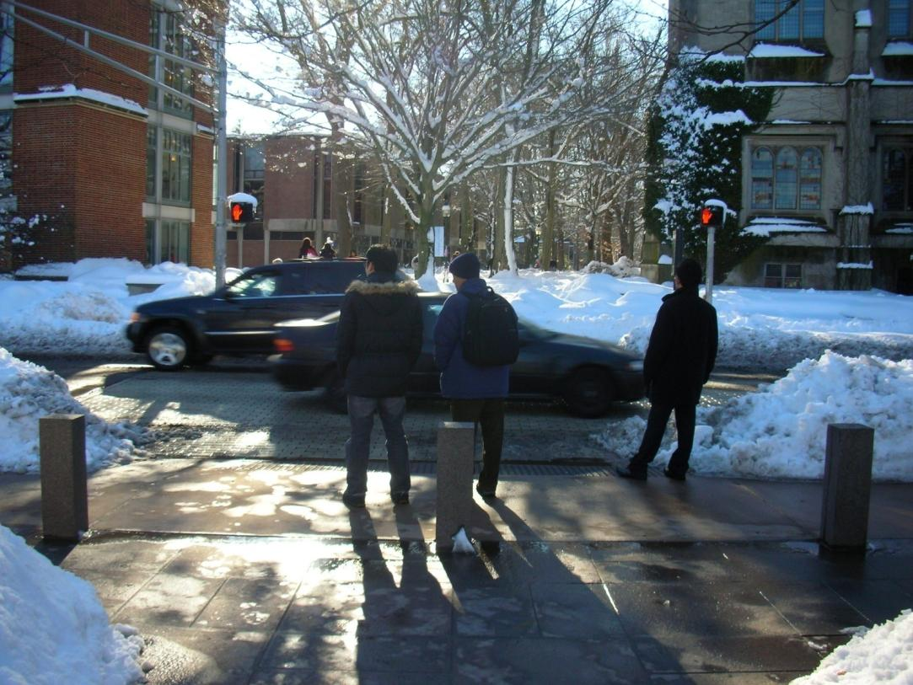
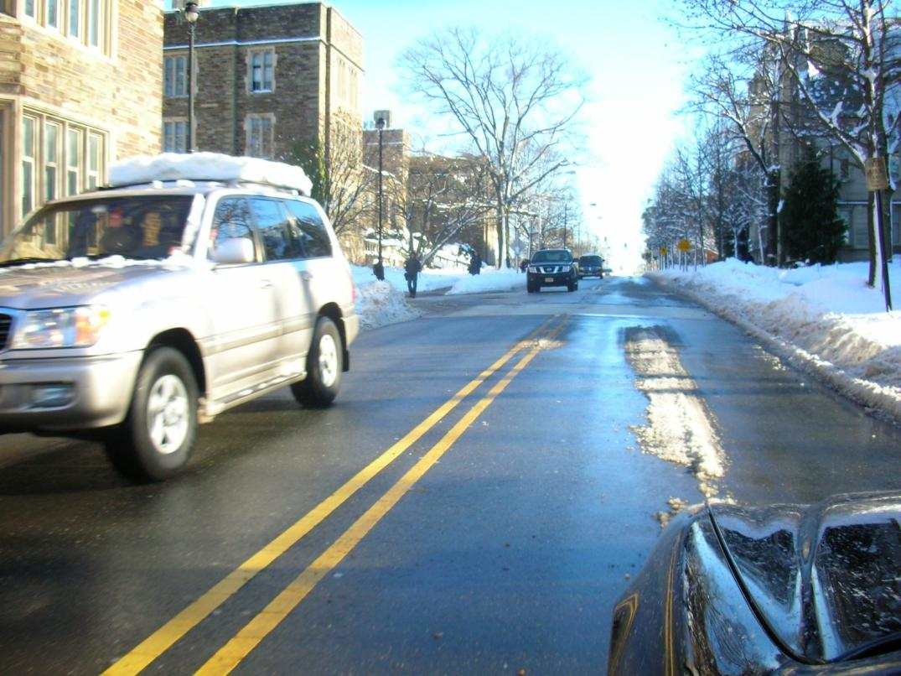
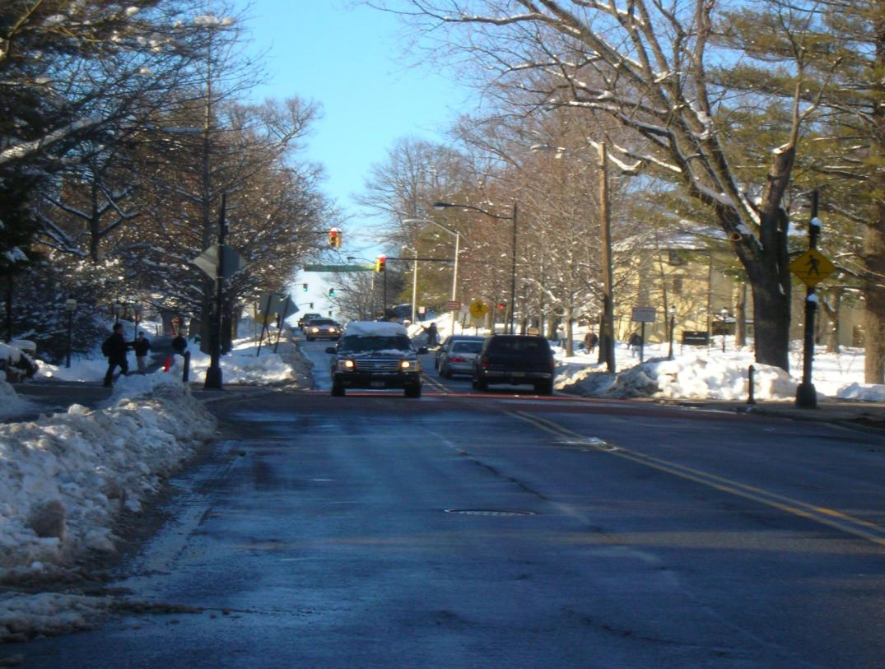
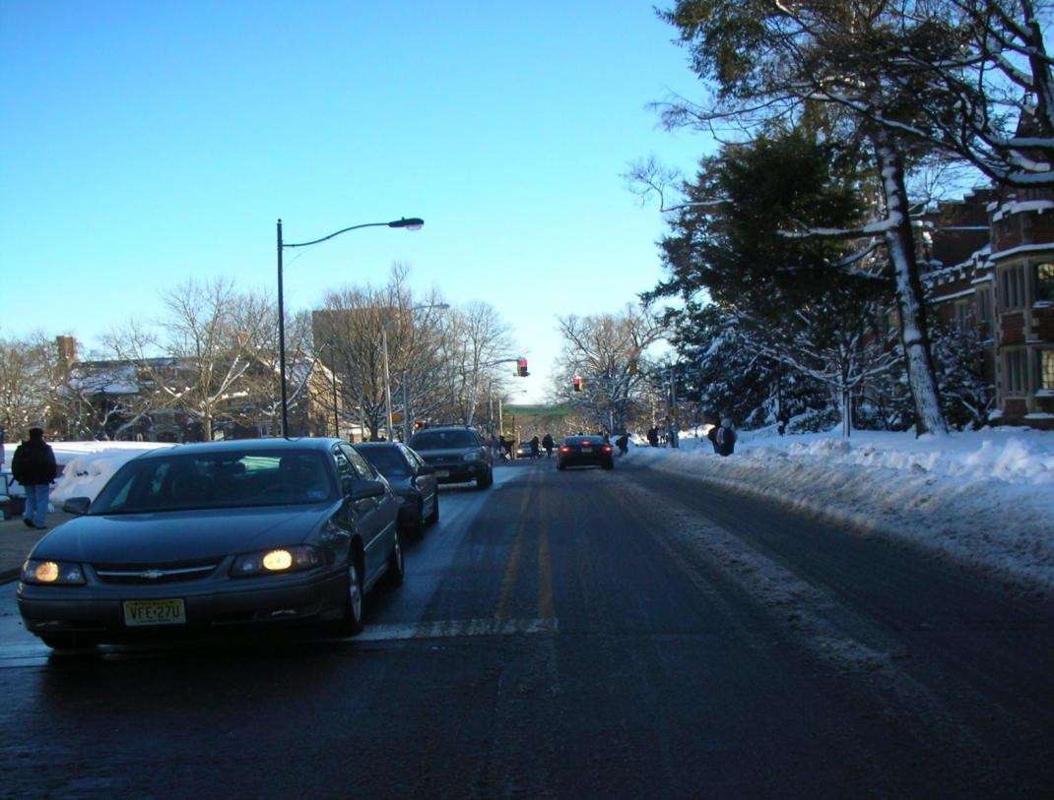
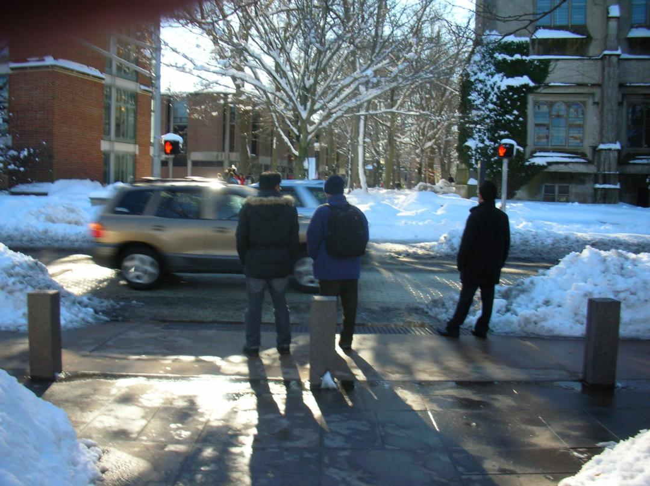
Bridge Doesn’t Eradicate the remaining “Cancer to the Campus”

Slide 14
Washington Road
Let’s look at Elevations
206
feet
199
feet
188
feet
132
feet
120
feet

Slide 15
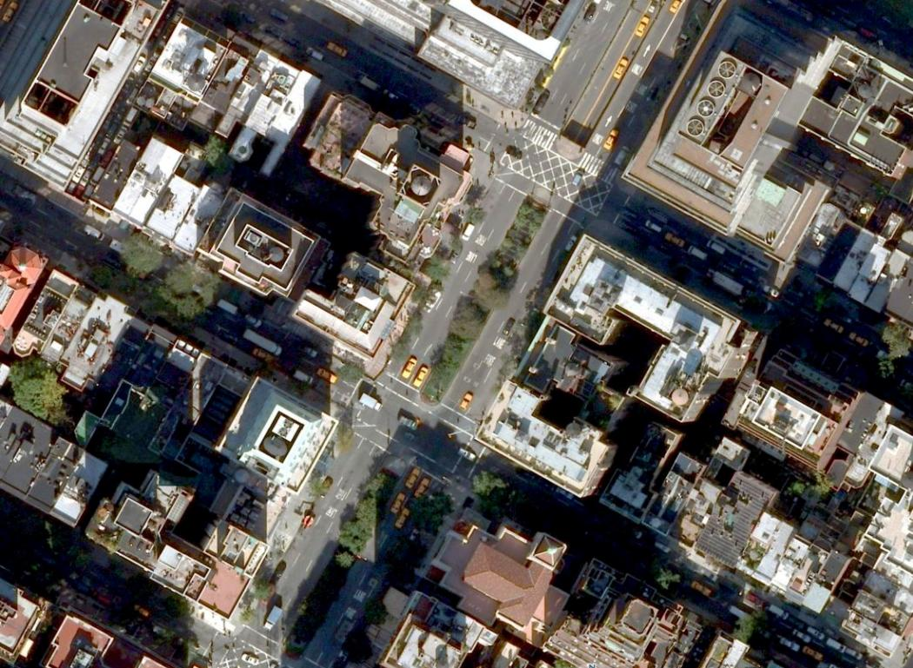
Ideas from Park Avenue ,NYC
Nice Median! Where did the traffic go??

Slide 16
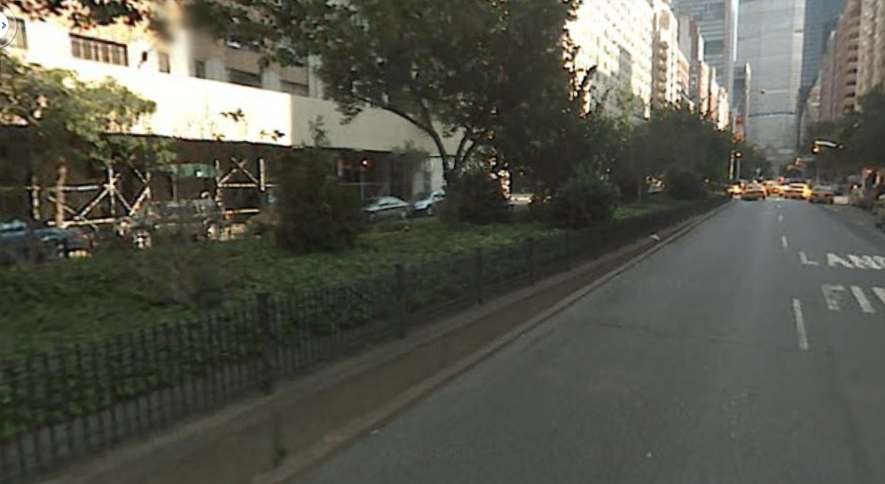
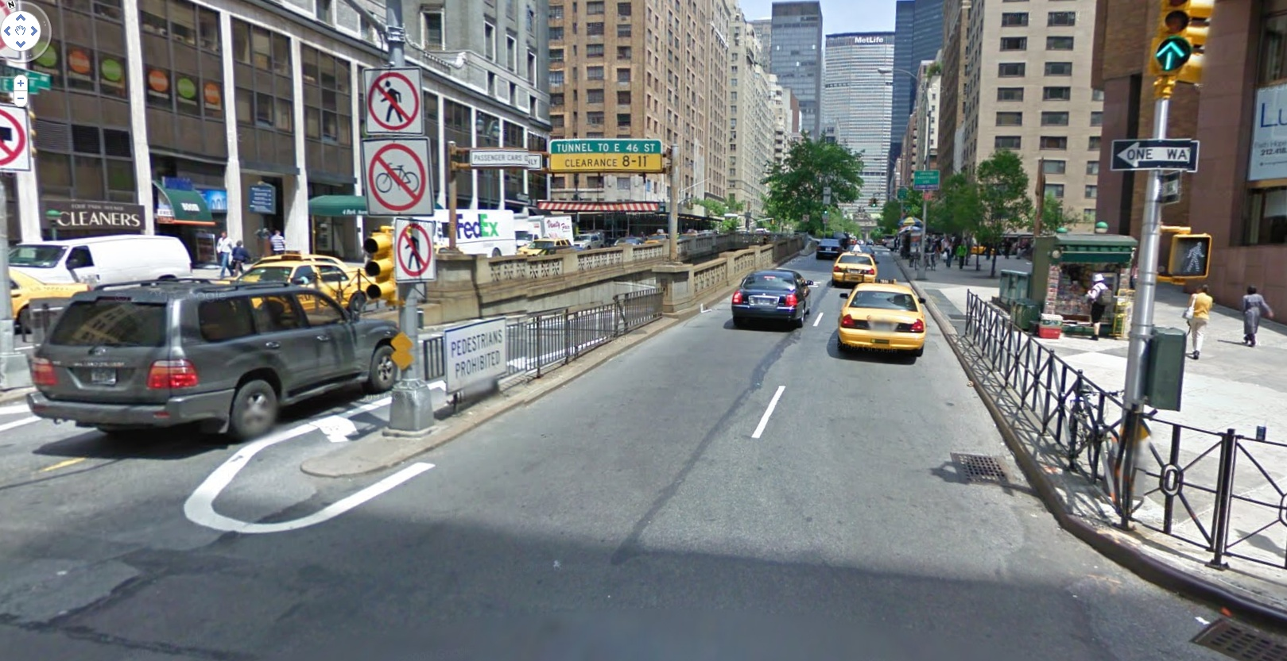
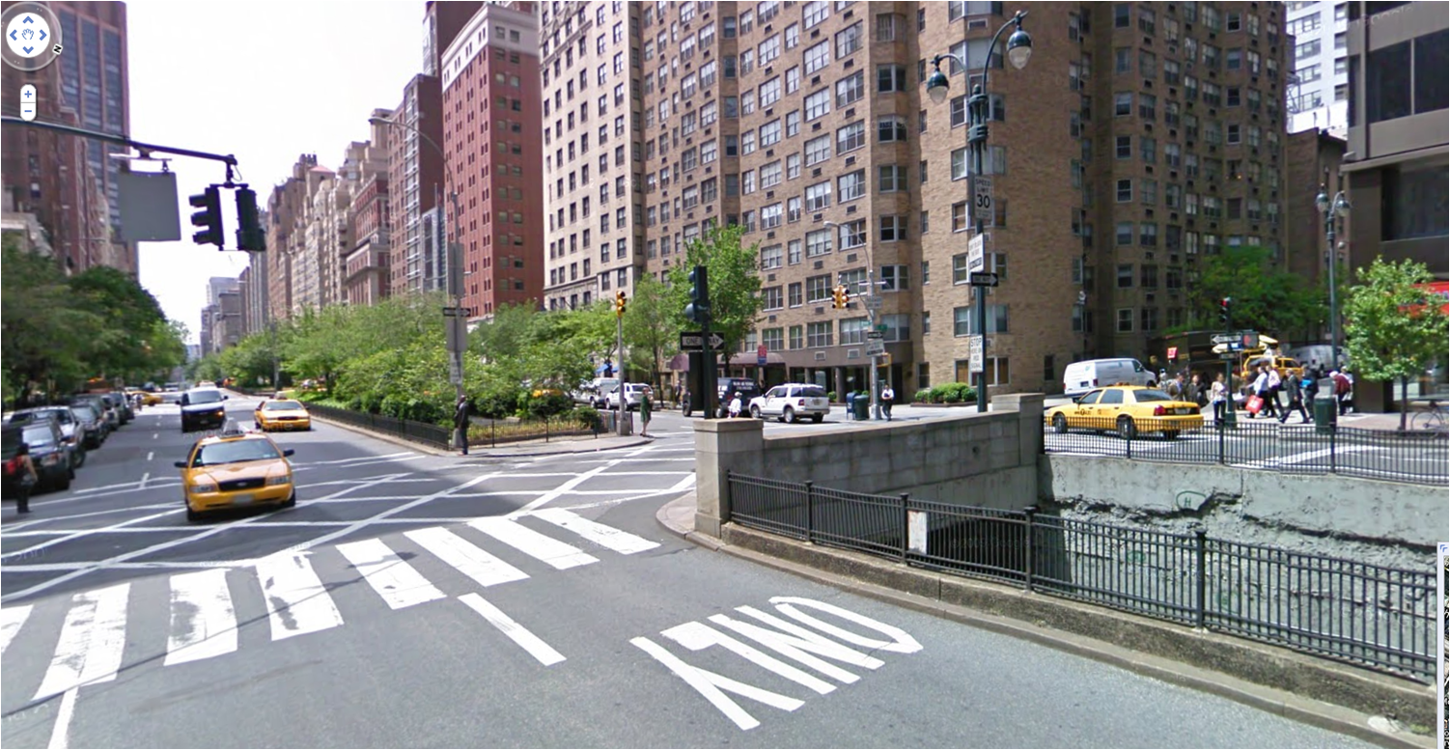
Ideas from Park Avenue ,NYC
Nice Median! Where did the traffic go??

Slide 17
Washington Road
Elevations & Distances
How about a “Park Ave. Cut & Caver “ for 1,700 ft with 350 ft Approaches
188
feet
199
feet
206
feet
132
feet
120
feet
350
feet
1,700
feet
350
feet

Slide 18
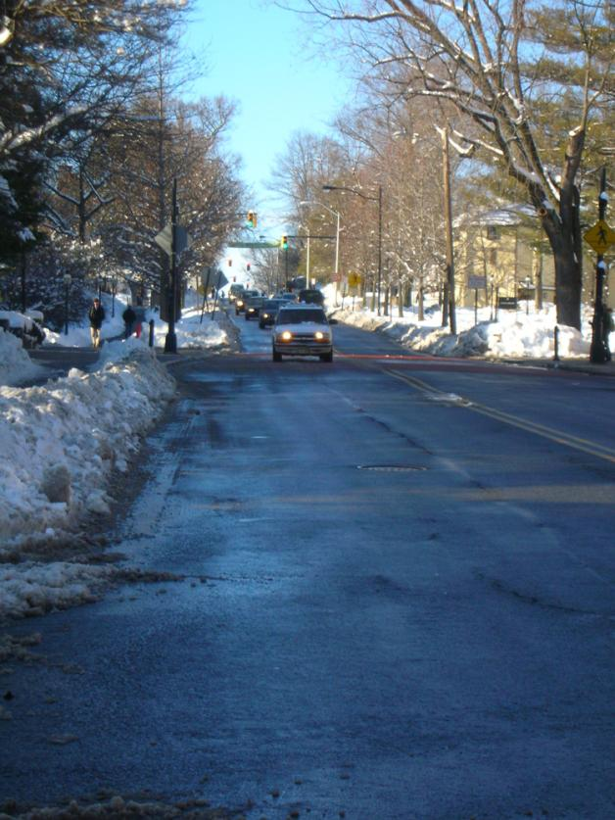
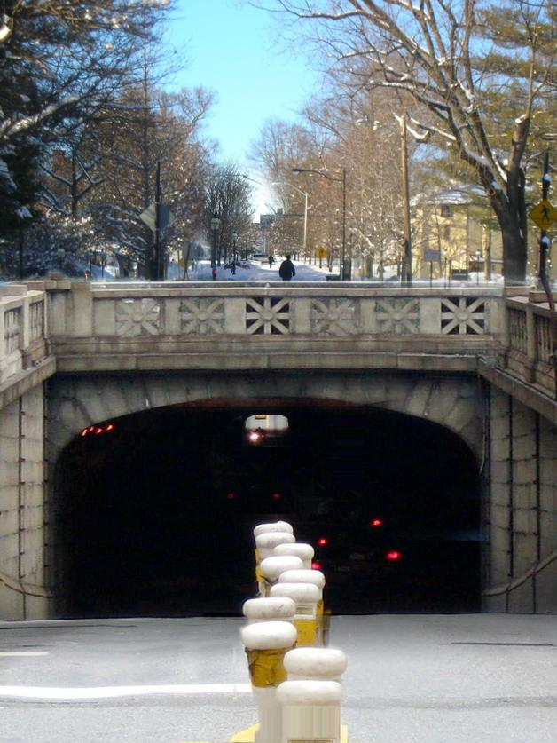
Just East of College Walk
Now
After

Slide 19
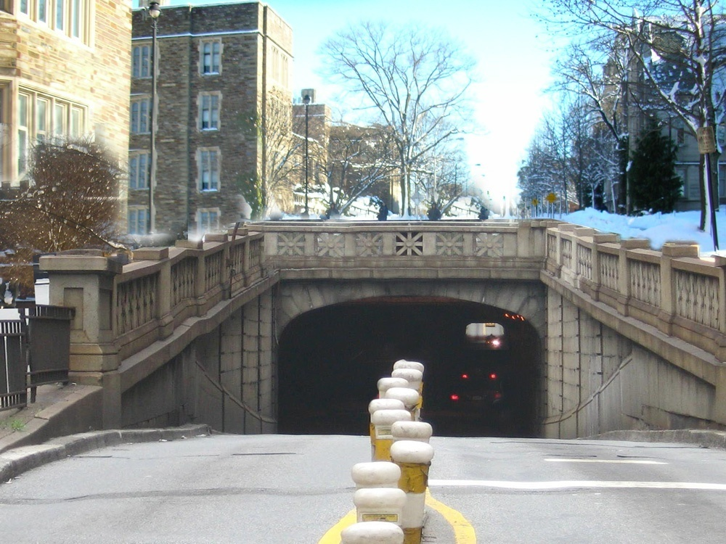

Just West of Williams Street
After
Now

Slide 20
Before: Washington Road
Washington Road

Slide 21
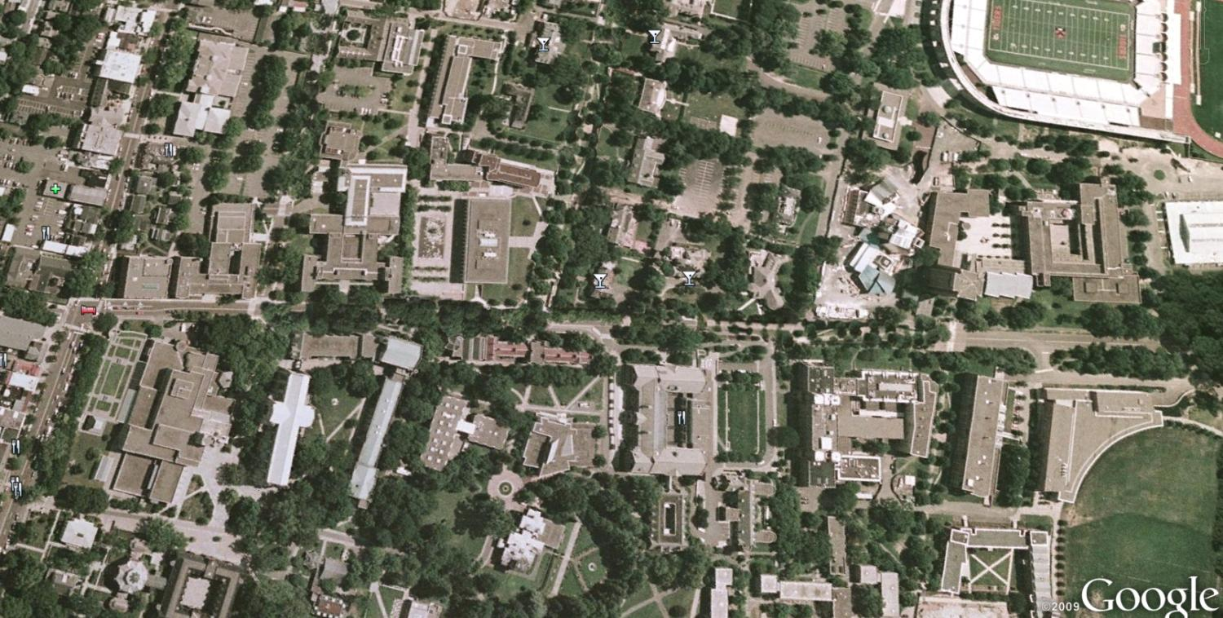
After: Washington Walk

Slide 22
Washington Walk along with
Williams Walk and Prospect Walk
Williams Walk
Prospect Walk
Washington Walk

Slide 23
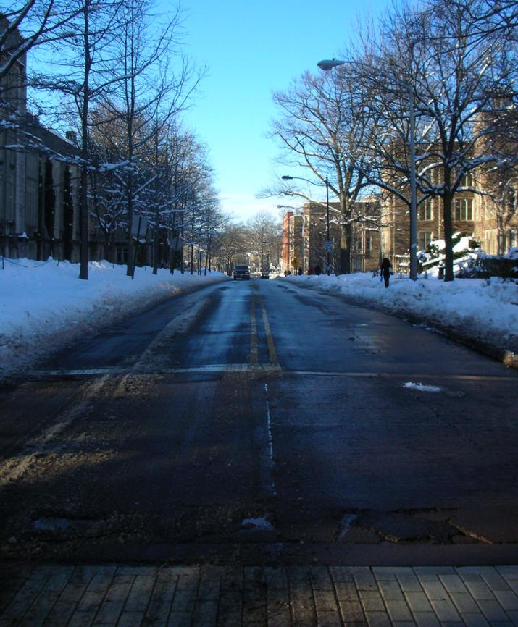
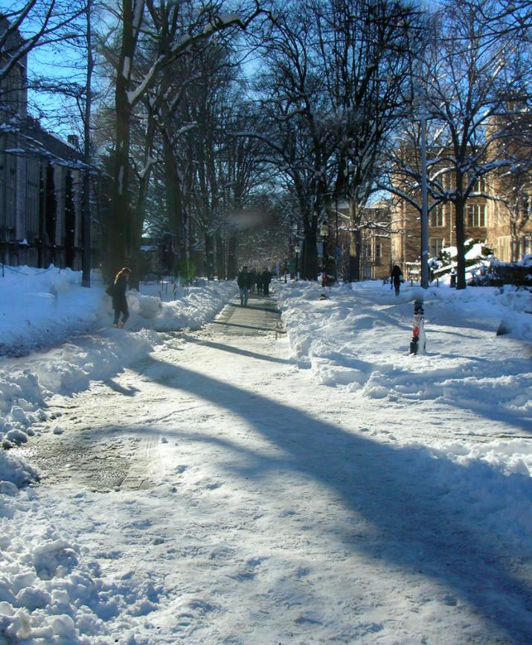
On Washington Walk
Toward Nassau St.
After
Now

Slide 24
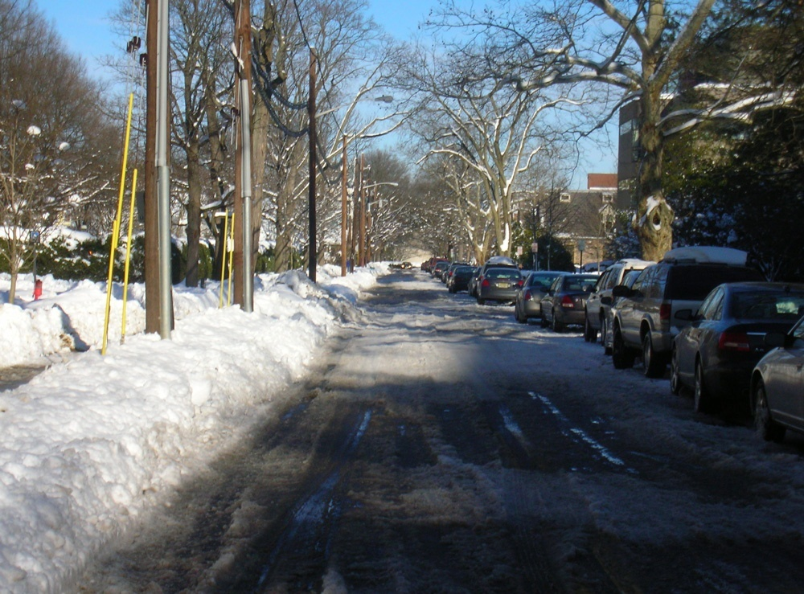
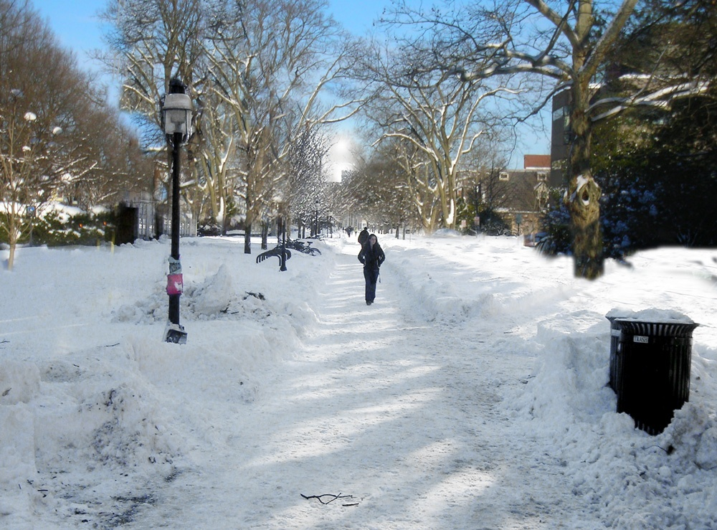
Williams Walk
After
Now

Slide 25
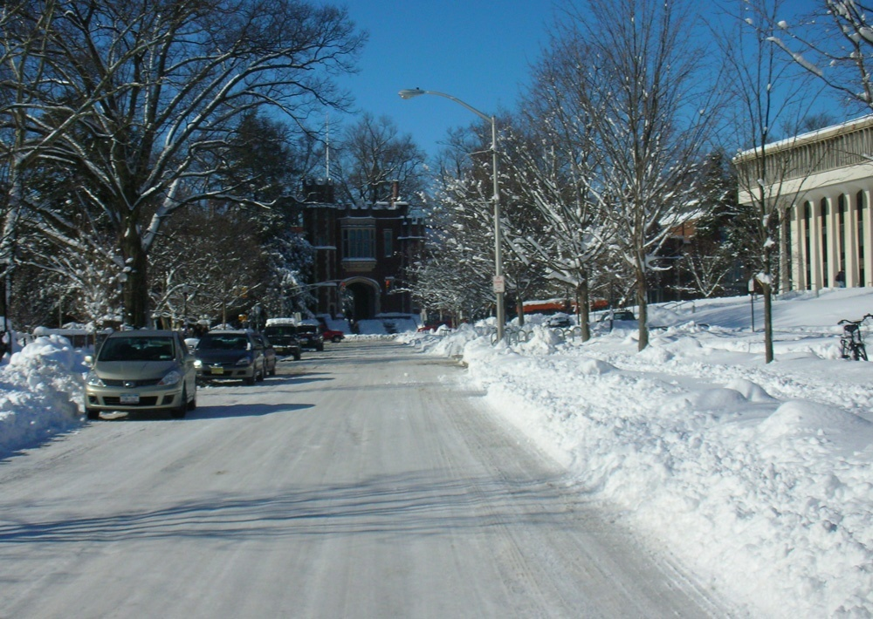
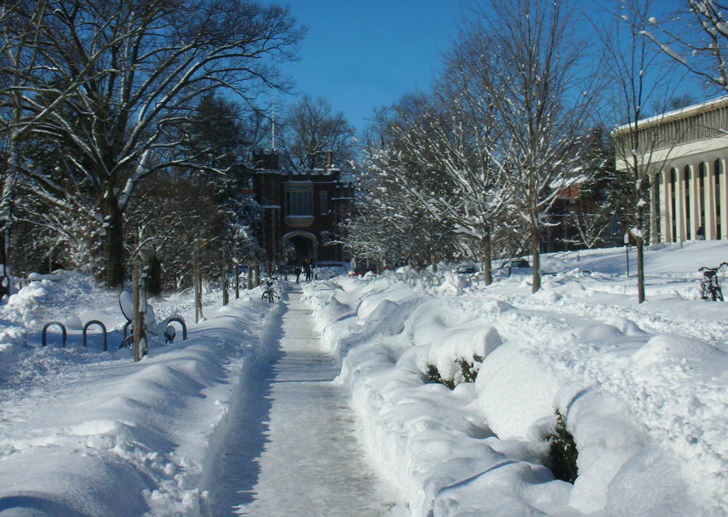
Prospect Walk
Now
After

Slide 26
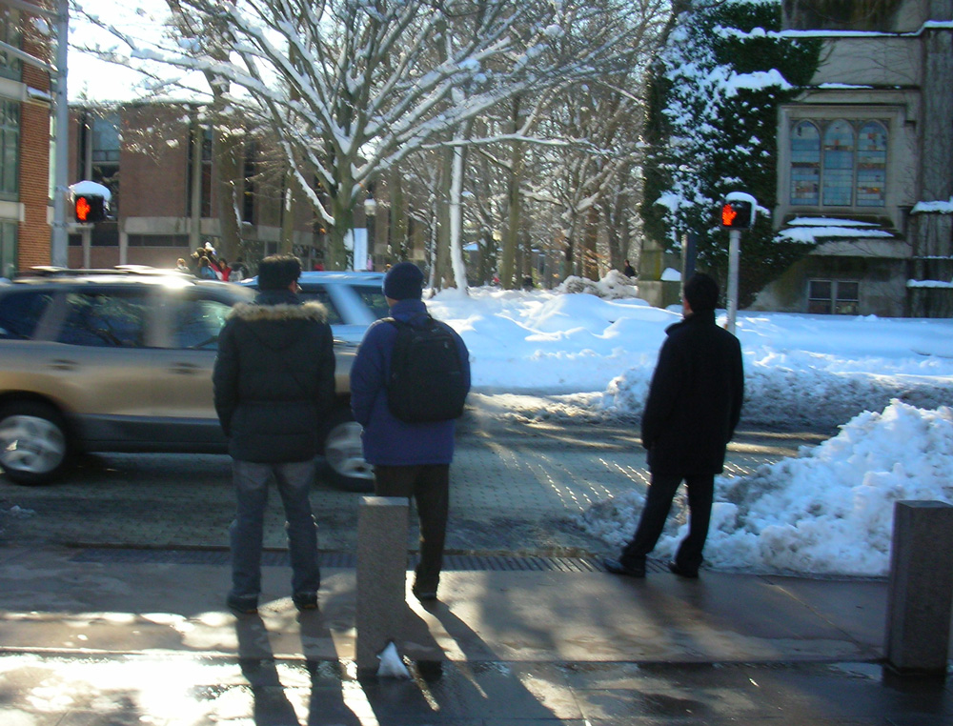
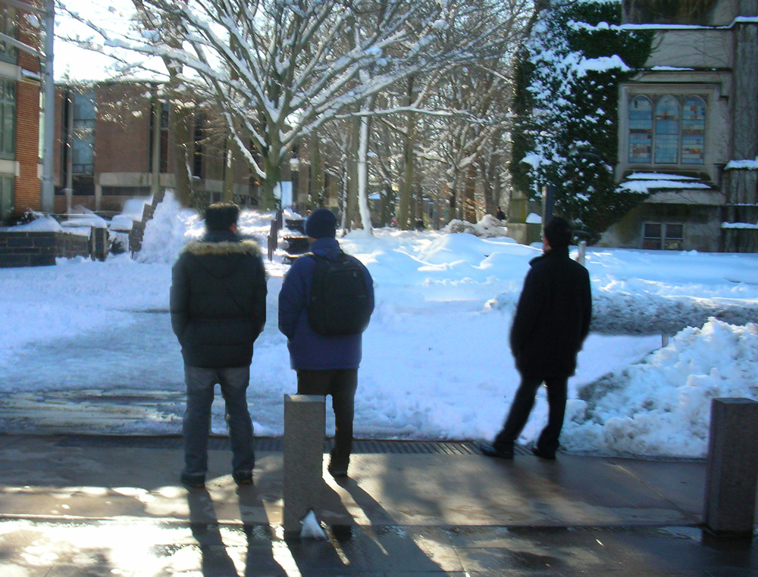
The Cancer has been Eradicated
After
Now

Slide 27
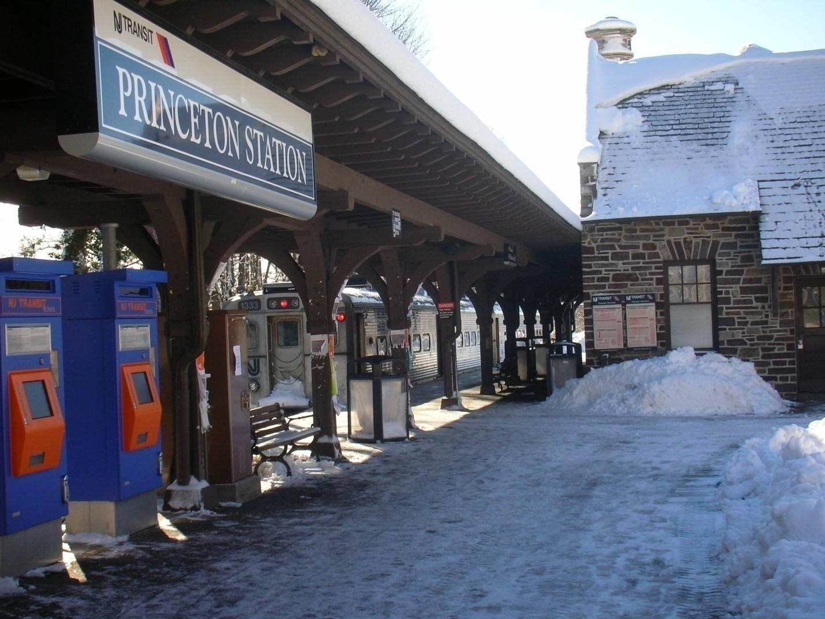
The Dinky

Slide 28
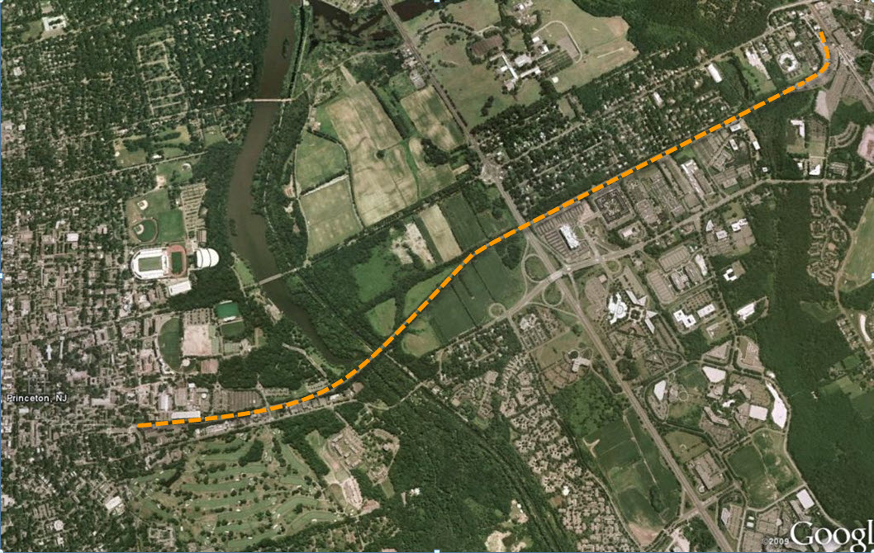
Princeton – Princeton Jct.

Slide 29
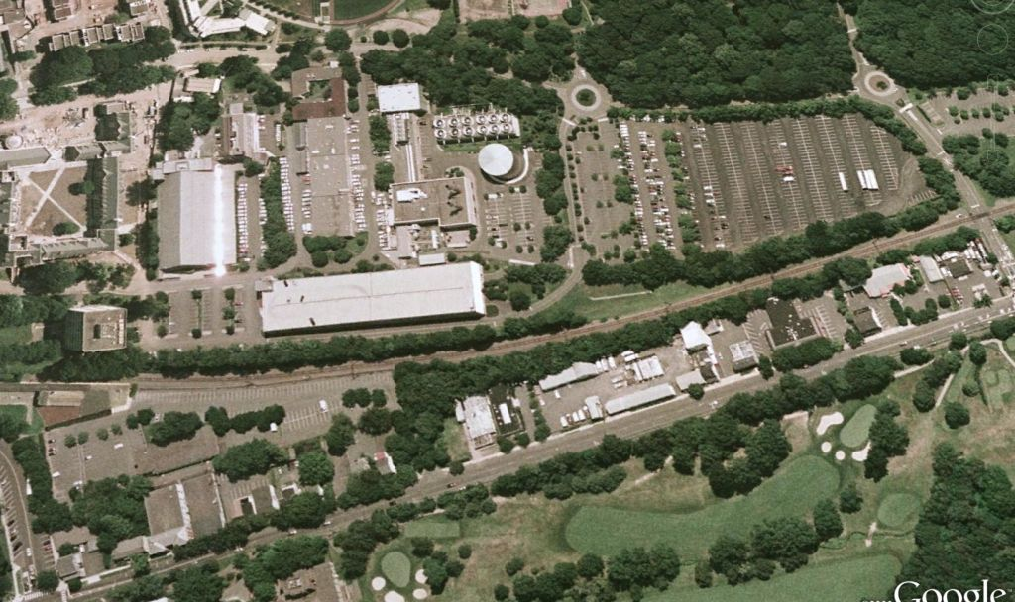
Current Dinky Station Location
Parking Garage
Faculty Road
Dinky Station
Alexander Road

Slide 30
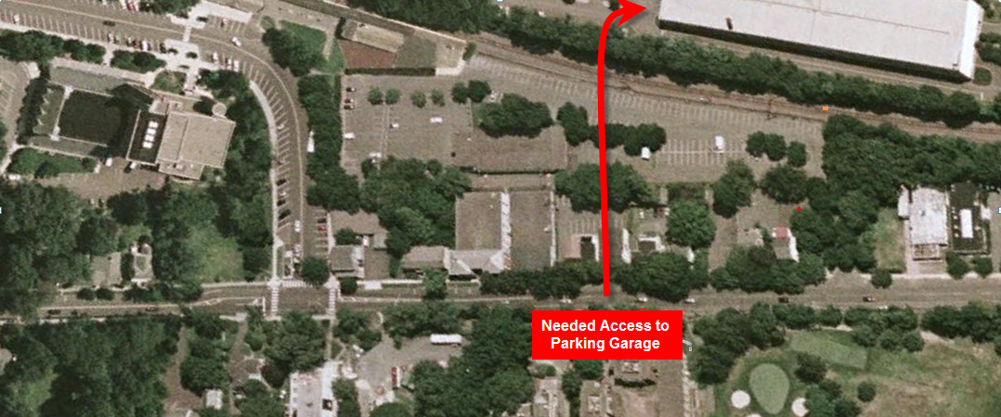
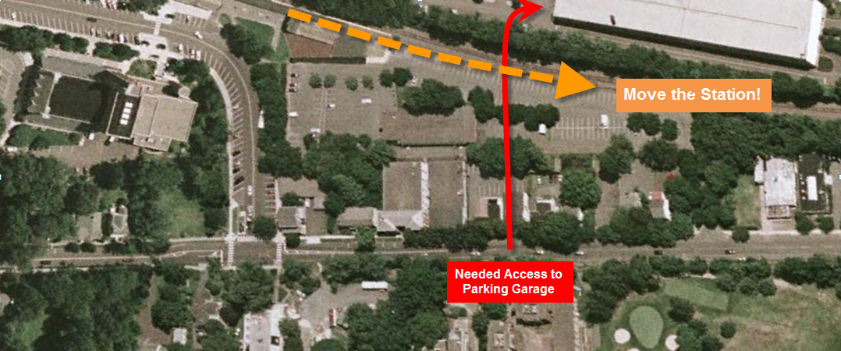
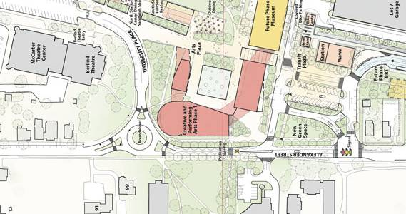
University Proposed Alteration

Slide 31
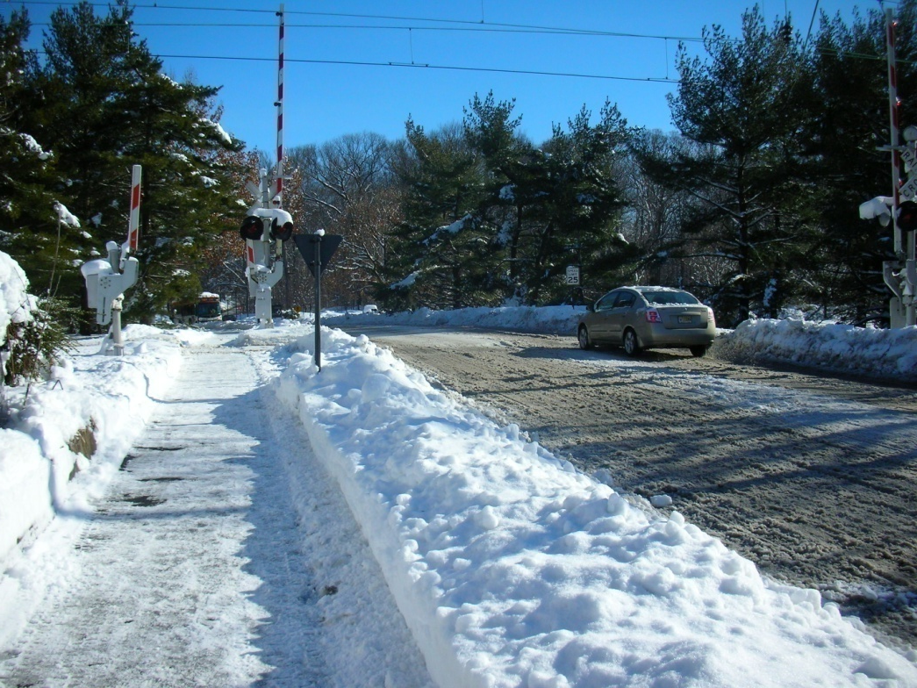
Any Other Ideas????
Faculty Road Xing

Slide 32
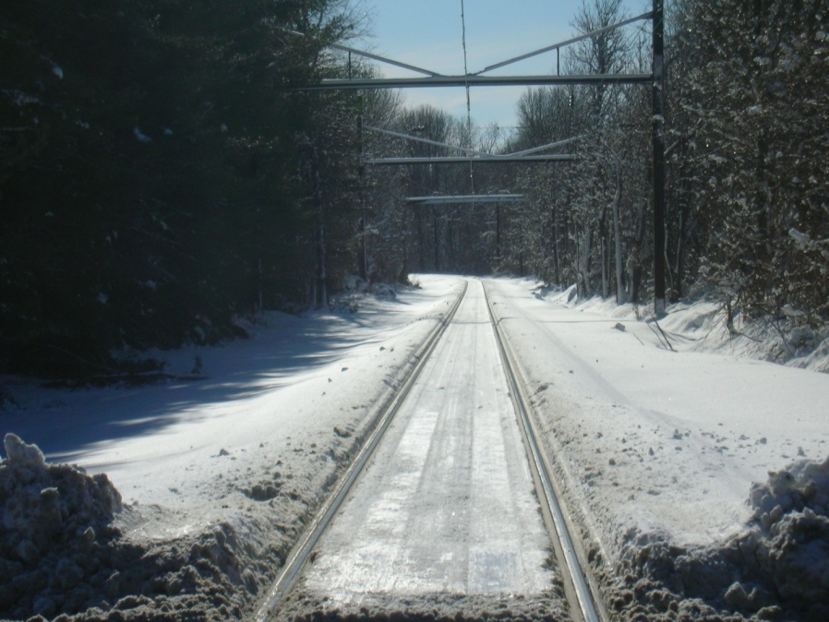
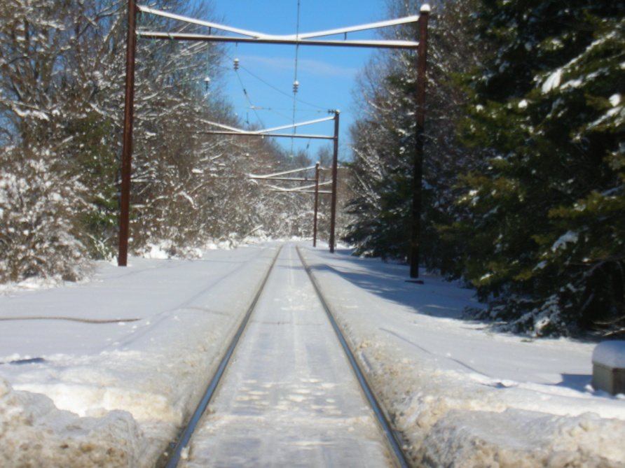
Any Other Ideas????
Looking Toward Canal
Looking Toward Campus

Slide 33
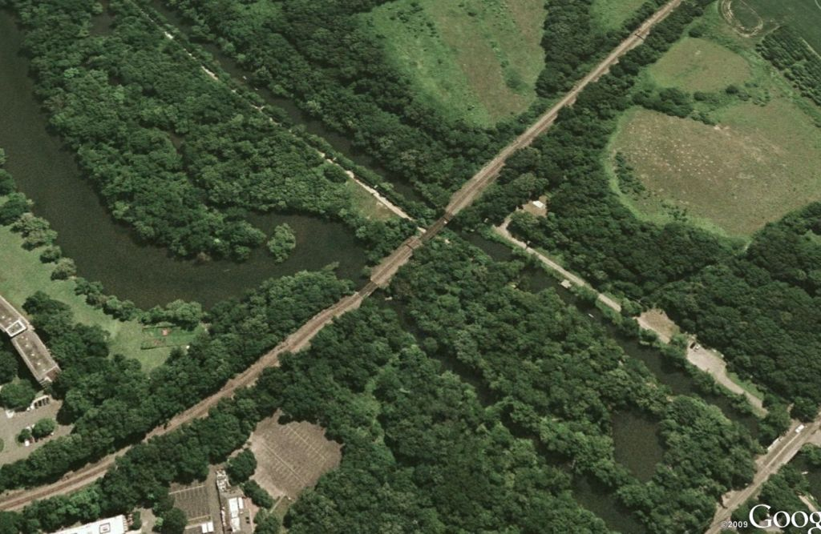
Inspect Elevation
42
feet

Slide 34
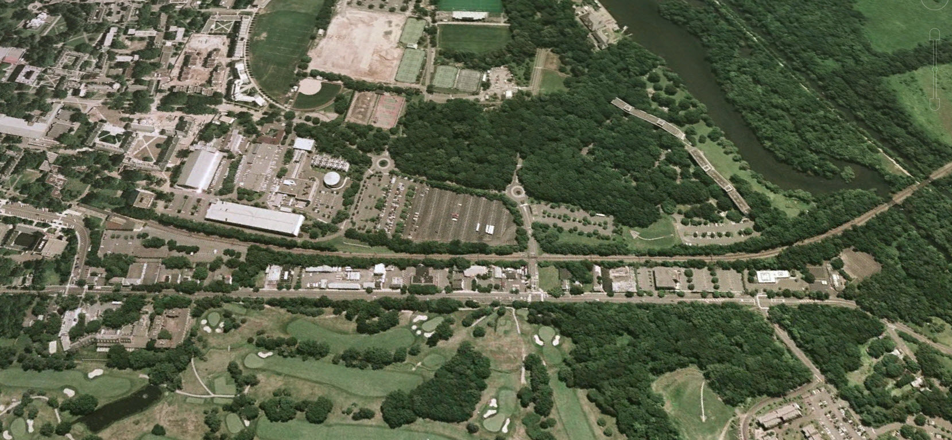
Inspect Elevation
Stop Going Up Hill!!
145
feet
42
feet
108
feet
Gradual Cut
~800 ft

Slide 35
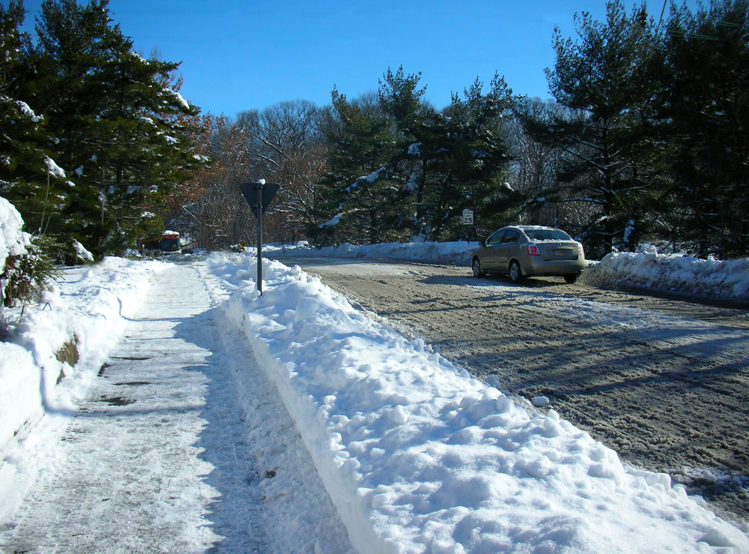
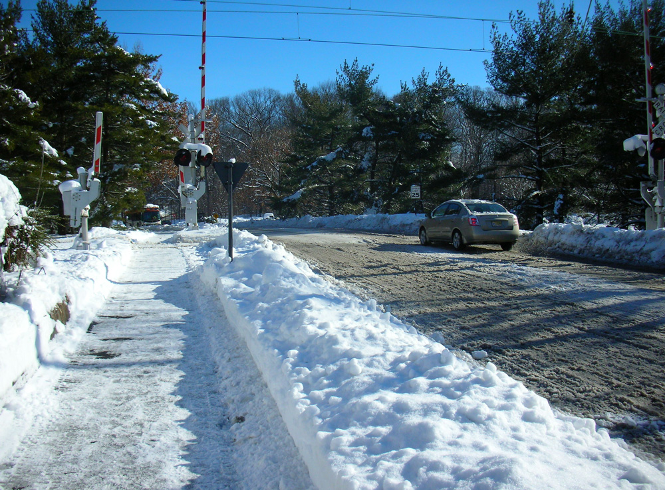
The Dinky’s Faculty Road “Underpass”
Now
After

Slide 36
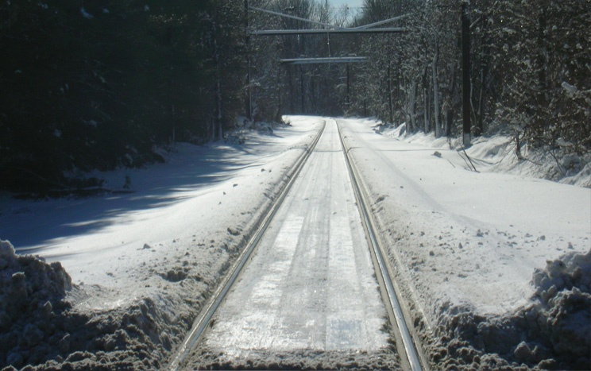
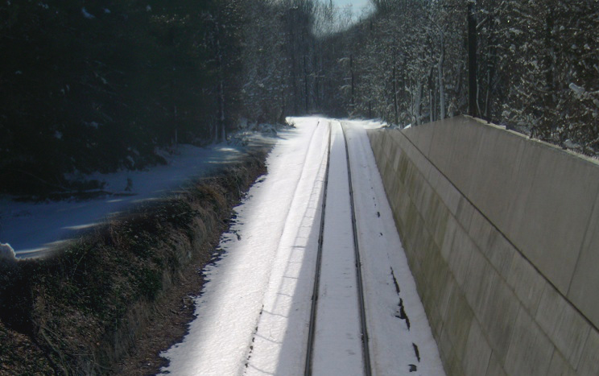
The Dinky’s Faculty Road “Underpass”
Now
After

Slide 37
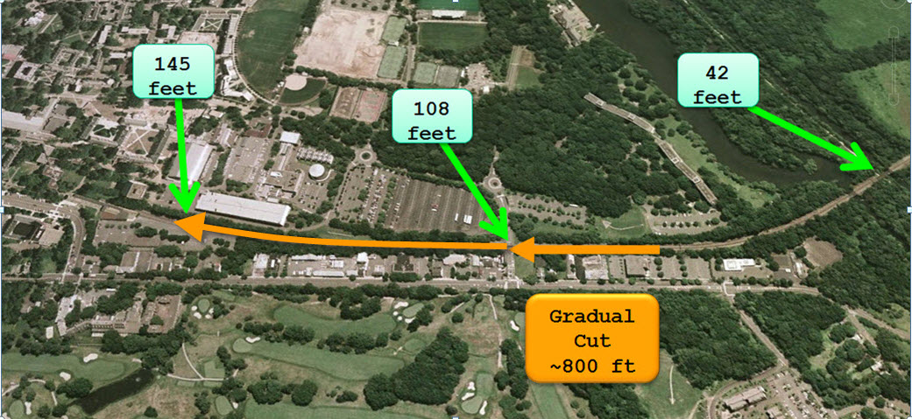
Extend Cut to Vicinity of Art Center
Extend Cut to
Art Center

Slide 38
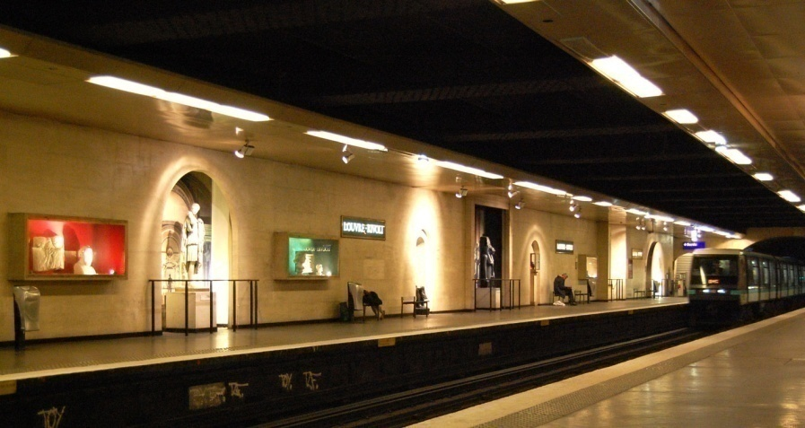

Integrate Dinky Station with
Basement Level of Arts Center and Cover It Over
Cover Over

Slide 39
Dinky in Cut
Allows for Unlocking of Development Opportunities
along Alexander Rd. & Access to the Parking Garage!
Development Opportunity
Development Opportunity
Cover Over

Slide 40

Faculty Road Underpass Also Allows:
Automation of the Dinky:
  Enabling 24-7 operation (if need be)
  Meet of all trains at Princeton Jct.
  5 minute headway integration with P. Jct. Transit Village
  Many proven technology options; for example:
    JFK Air Train Technology

Slide 41





JFK Air Train Technology
Linear Induction Motor Propulsion
Completely Automated
Other Implementations
  Vancouver, BC SkyTrain
    Largest system 1st opened in 1985
  Toronto (1985)
  Kuala Lumpur (1998)
  Detroit (1987))
  Beijing Airport Line (2008) Video Outside Video
  Yongin, South Korea (under construction)

Slide 42
Automation Would Enable Added Station
Allow Creation of Park&Ride Intercept close to US 1 &
Integration with Main Campus of Land btwn US1/Canal

Slide 43

Coup de Gras
188
feet

Slide 44

Coup de Gras

Slide 45
Coup de Gras
Tunnel 1,700 feet to Palmer Square
1,700
feet

Slide 46

Coup de Gras

Slide 47
What about the $$$$ ?
Mercer Street:
  We Probably should have saved them!
Washington Road:
  Since Wash. Rd. is the “Official Truck Access Road: Princeton from/to US1 & East”, Federal $$$ should be available for this safety/accessibility capital improvement. Typically FHWA (The Feds) pays 90%!
  This improvement take enormous traffic pressure away from Harrison St. & Alexander. Rd.
The Dinky:
  Eligible as a Mass Transit Capital Improvement & Road Safety Improvement (Elimination of at-grade crossing) Project and Eligible for Fed Transit Grant which typically pays 80%. (The grade crossing portion would be eligible for 90% Fed share.)
  Developers should contribute as they benefit from the substantially improved accessibility to Princeton and along US 1.
  This improvement also enhances the value of the new Rail Tunnels to Manhattan (Access to the Region’s Core). Dinky $$$ are a “rounding error” in the $8B+ cost of that project!
Rush Holt should get most of it for us!

Slide 48




What About
Personal Rapid Transit
(PRT)
  Small (4 – 8 passenger), Automated, Public Transit Vehicles
  Operating in Dedicated Guideways at Close Headways (1 sec)
  Key Technology: On-the-vehicle Switch

Slide 49
Background
I’ve been dabbling in PRT for almost 40 years
In many ways, I’m very disappointed in our lack of progress:
  A long time ago: Exec. Director of APTA said:
  “Alain: PRT is the transportation system of the future…
  And Always will be!!!”
But we have made progress:
  Morgantown has proven that it can be done
  APMs are a standard of every modern airport
  Automation and computer controls have become ubiquitous, reliable and cheap
  There is broad movement towards energy independence, alternatives to the petroleum economy
  Heathrowe is almost a Reality

Slide 50

Looking Back
let’s look at the automobile:
Daimler, 1888
In the beginning, it takes a while

Slide 51

Central Ave. Caldwell NJ c. 1910

Slide 52


Slide 53

Bloomfield Ave. & Academy Rd. c. 1910 Before it was paved

Slide 54

Muddy Bloomfield Ave. c. 1910

Slide 55

Finally:
Automobile Congestion 1968 - present

Slide 56
By Looking Back We Know:
NJ’s Mobility in 2010 is very different from NJ in 1910
What might be NJ’s Mobility in 2110 (or before)

Slide 57







Birth-Death Process of Transport Technology
In the beginning…
In the end…
“… [I]n capitalist reality…, it is not [price] competition which counts but the competition from the new commodity, the new technology…- competition which commands a decisive cost or quality advantage and which strikes not at the margins of the profits and the outputs of the existing firms but at their foundations and their very lives.” Joseph A Shumpeter (1883-1950)

Slide 58



Technological Innovation does take a long time…

Slide 59
Technological Innovation does take a long time…

Slide 60




Technological Innovation does take a long time…

Slide 61


Starting to Look Forward
Daimler, 1888
Morgantown, 1973
Heathrowe, 2010

Slide 62


Slide 63
PRT as the Dominant Mode. What would it take?
Had my undergrad Transportation Systems Analysis class (Orf 467) looking at this for each of the past 4 years
Def. “Dominant Mode”: Serve >90% of all intra NJ trips + access to existing mass transit serving NYC and Phila
Def. “Serve”: Less than 5 minute walk to a station; stations all interconnected; all existing rail mass transit connected/

Slide 64
Sketch Planning Process
Precisely geo-locate all trip ends by purpose
Extensive use Google Earth and Msft. Virtual Earth to provide spatial reality perspective to trip end concentrations and Physical constraints
Manually locate all stations and interconnection
Analytically assign the trip end demand to stations and flow the trips on the interconnected network.
Manually iterate the location of stations and interconnection

Slide 65
Basic NJ Transport Stats
Element | Value
Population (2009 est.) | 8.75 million
Growth rate | 3.7% (6.4% nationwide)
Population density | 1,134.5 ppsm (highest in US)
 | 190ppsm (Salem) – 12,800pps (Hudson)
Persons < 5 years old | 6%
Persons 5-17 | 18%
Persons 18-64 | 63%
Persons 65 and over | 13%
Total Person trips per day | 34M
2009 $ Spent on Personal Mobility by NJ Citizens (mostly on Automobile) | $25B
Source of Electricity Generation | Nuclear: 48%; Natural Gas: 41%; Renewables: < 0.2%

Slide 66
Briefly on Energy
http://www.eia.doe.gov/emeu/aer/pdf/pages/sec1_3.pdf

Slide 67


Mercer County

Slide 68

Ocean County

Slide 69
County | Stations | Miles | County | Stations | Miles
Atlantic | 191 | 526 | Middlesex | 444 | 679
Bergen | 1,117 | 878 | Monmouth | 335 | 565
Burlington | 597 | 488 | Morris | 858 | 694
Camden | 482 | 355 | Ocean | 540 | 1,166
Cape May | 976 | 497 | Passaic | 1185 | 1,360
Cumberland | 437 | 1,009 | Salem | 285 | 772
Essex | 595 | 295 | Somerset | 568 | 433
Gloucester | 412 | 435 | Sussex | 409 | 764
Hudson | 467 | 122 | Union | 577 | 254
Hunterdon | 405 | 483 | Warren | 484 | 437
Mercer | 413 | 403 | Total | 11,295 | 12,261

Slide 70
Bottom Line
Element | Value
PRT Trips per day (90%) | 26.51M
Peak hour trips (15%) | 3.98M
Fleet size | 530K
Fleet Cost $B | $53B @ $100K/vehicle
Stations | 11,295
Station Cost | $28B @ $2M/Station
Guideway | 12,265 miles
Guideway Cost | $61B @ $5M/mile
Total Capital Cost | $143B

Slide 71
Conclusions
It’s a lot
It does a lot
It’s one design focused on existing land use / mobility patterns
We should be able to do better
Thank you
alaink@princeton.edu
www.princeton.edu/~alaink

