Slide 1

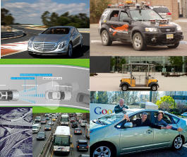


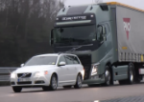
Average Vehicle Occupancy (AVO) Analysis
of aTaxis
Throughout New Jersey
by
Alain L. Kornhauser, PhD
Professor, Operations Research & Financial Engineering
Director, Program in Transportation
Faculty Chair, PAVE
(Princeton Autonomous Vehicle Engineering)
Princeton University
November 14, 2016

Slide 2
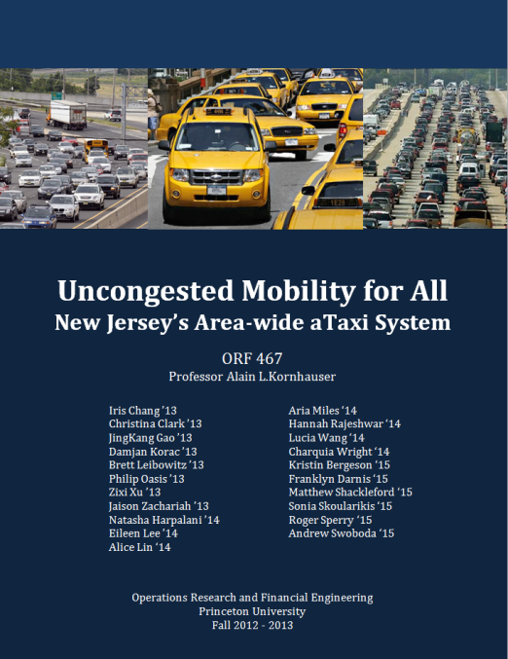

Slide 3
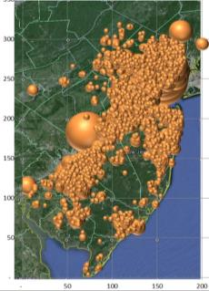
aTaxis and RideSharing
“AVO < 1” RideSharing
  Eliminate the “Empty Back-haul”; AVO Plus
“Organized” RideSharing
  Diverted to aTaxis
“Tag-along” RideSharing
  Only Primary trip maker modeled, “Tag-alongs” are assumed same after as before.
“Casual” RideSharing
  This is the opportunity of aTaxis
  How much spatial and temporal aggregation is required to create significant casual ride-sharing opportunities.

Slide 4
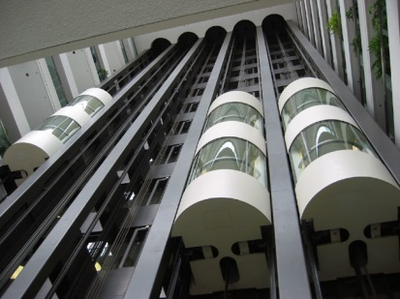
Spatial Aggregation
By walking to a station/aTaxiStand
  At what point does a walk distance makes the aTaxi trip unattractive relative to one’s personal car?
  ¼ mile ( 5 minute) max
Like using an Elevator!
Elevator

Slide 5
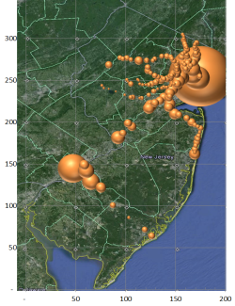
Spatial Aggregation
By walking to a station/aTaxiStand
  A what point does a walk distance makes the aTaxi trip unattractive relative to one’s personal car?
  ¼ mile ( 5 minute) max
By using the rail system for some trips
  Trips with at least one trip-end within a short walk to a train station.
  Trips to/from NYC or PHL

Slide 6
Spatial Aggregation
By walking to a station/aTaxiStand
  A what point does a walk distance makes the aTaxi trip unattractive relative to one’s personal car?
  ¼ mile ( 5 minute) max
By using the rail system for some trips
  Trips with at least one trip end within a short walk to a train station.
  Trips to/from NYC or PHL
By sharing rides with others that are basically going in my direction
  No trip has more than 20% circuity added to its trip time.

Slide 7
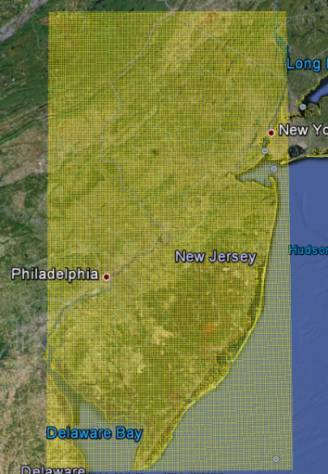
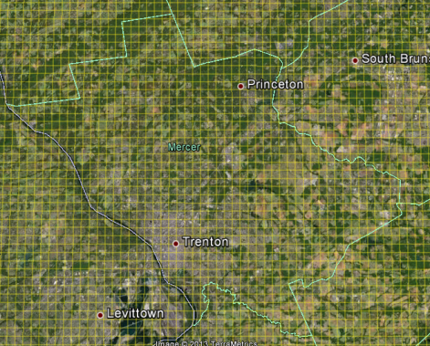
Pixelation of New Jersey
Zoomed-In Grid of Mercer
NJ State Grid

Slide 8
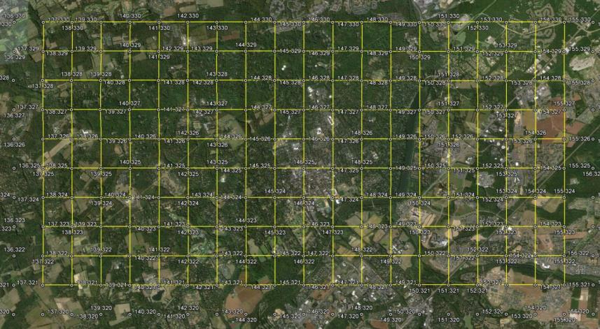
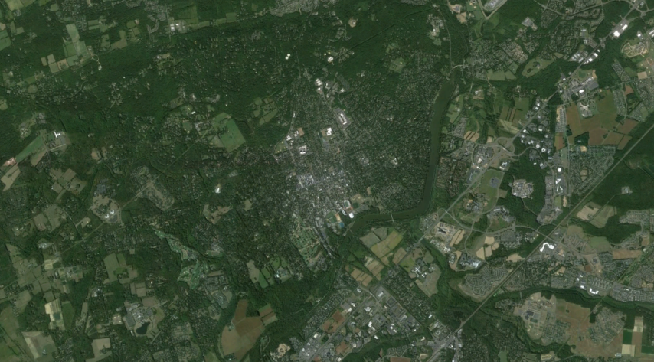
Pixelating the State
with half-mile Pixels
xPixel = floor{108.907 * (longitude + 75.6)}
yPixel = floor{138.2 * (latitude – 38.9))

Slide 9
An aTaxiTrip
{oYpixel, oXpixel, oTime (Hr:Min:Sec) , }
An aTaxiTrip
{oYpixel, oXpixel, oTime (Hr:Min:Sec) ,dYpixel, dXpixel, Exected: dTime}
a PersonTrip
{oLat, oLon, oTime (Hr:Min:Sec) ,dLat, dLon, Exected: dTime}
P₁
D
O
O

Slide 10
Common Destination (CD)
CD=1p: Pixel -> Pixel (p->p) Ride-sharing
P₁
O
TripMiles = L
TripMiles = 2L
TripMiles = 3L

Slide 11
P₁
O
PersonMiles = 3L
PersonMiles = 3L
aTaxiMiles = L
AVO = PersonMiles/aTaxiMiles = 3

Slide 12
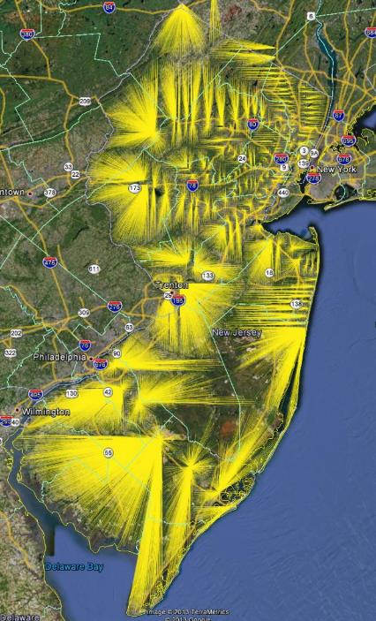
NJ Transit
Train Station
“Consumer-shed”

Slide 13
a PersonTrip from NYC
(or PHL or any Pixel containing a Train station)
An aTaxiTrip
{oYpixel, oXpixel, TrainArrivalTime, dYpixel, dXpixel, Exected: dTime}
NYC
NJ Transit Rail Line to NYC, next Departure
D
O
aTaxiTrip
Princeton Train Station

Slide 14

CD= 2p: Pixel ->2Pixels Ride-sharing
P₂
Scenario: L_{0->1} < L_{0->2}
Service Constraint:
{L_{0->1->2} / L_{0->2}} -1 < MaxCircuity
MaxCircuity is a service parameter; (say 0.2 or 0.3)
Improve Ride-Share constraint:
(AVO_{Rideshare} > AVO_{Alone} )
{N_{0->1} * L_{0->1} + N_{0->2} * L_{0->2}} / {L_{0->1->2} }
>
{N_{0->1} * L_{0->1} + N_{0->2} * L_{0->2}} / {L_{0->1} + L_{0->2}}
Numerators are identical; Therefore:
{L_{0->1} + L_{0->2}} > L_{0->1->2} Independent of N
O
P₁

Slide 15
CD= 3p: Pixel ->3Pixels Ride-sharing
P₅
P₁
O
P₃

Slide 16
CD= 3p: Pixel ->3Pixels Ride-sharing; P₃ New
P₃
P₁
P₂
O
Scenario: L_{0->1} < L_{0->2} < L_{0->3} ; P₃ new
Service Constraint:
{L_{0->1->2} / L_{0->2}} -1 < MaxCircuity
{L_{0->1->2->3} / L_{0->3}} -1 < MaxCircuity
MaxCircuity is a service parameter; (say 0.2 or 0.3)
Improve Ride-Share constraint:
(AVO_{Rideshare 1,2} > AVO_{Alone} )
{L_{0->1} + L_{0->2}} > L_{0->1->2}
(AVO_{Rideshare 1,2,3} > AVO_{Rideshare 1,2} + AVO_{3 Alone} );
{N_{0->1} * L_{0->1} + N_{0->2} * L_{0 ->2} + N_{0->3} * L_{0 ->3}} / {L_{0->1->2->3} }
> {N_{0->1} * L_{0->1} + N_{0->2} * L_{0 ->2} + N_{0->3} * L_{0 ->3}} / {L_{0->1->2} + L_{0->3}}
Numerators are identical; Therefore:
{L_{0->1->2} + L_{0->3}} > L_{0->1->2->3}

Slide 17
CD= 3p: Pixel ->3Pixels Ride-sharing; P₂ New
P₃
P₁
P₂
O
Scenario: L_{0->1} < L_{0->2} < L_{0->3} ; P₂ new
Service Constraint:
{L_{0->1->3} / L_{0->3}} -1 < MaxCircuity
{L_{0->1->2} / L_{0->2}} -1 < MaxCircuity
{L_{0->1->2->3} / L_{0->3}} -1 < MaxCircuity
MaxCircuity is a service parameter; (say 0.2 or 0.3)
Improve Ride-Share constraint:
(AVO_{Rideshare 1,3} > AVO_{Alone} )
{L_{0->1} + L_{0->3}} > L_{0->1->3}
(AVO_{Rideshare 1,2,3} > AVO_{Rideshare 1,3} + AVO_{2 Alone} );
{N_{0->1} * L_{0->1} + N_{0->2} * L_{0 ->2} + N_{0->3} * L_{0 ->3}} / {L_{0->1->2->3} }
> {N_{0->1} * L_{0->1} + N_{0->2} * L_{0 ->2} + N_{0->3} * L_{0 ->3}} / {L_{0->1->3} + L_{0->2}}
Numerators are identical; Therefore:
{L_{0->1->3} + L_{0->2}} > L_{0->1->2->3}

Slide 18
CD= 3p: Pixel ->3Pixels Ride-sharing; P₁ New
P₁
P₃
O
P₂
Scenario: L_{0->1} < L_{0->2} < L_{0->3} ; P₂ new
Service Constraint:
{L_{0->1->2} / L_{0->2}} -1 < MaxCircuity
{L_{0->1->2->3} / L_{0->3}} -1 < MaxCircuity
MaxCircuity is a service parameter; (say 0.2 or 0.3)
Improve Ride-Share constraint:
(AVO_{Rideshare 1,2} > AVO_{Alone} )
{L_{0->1} + L_{0->2}} > L_{0->1->2}
(AVO_{Rideshare 1,2,3} > AVO_{Rideshare 1,2} + AVO_{3 Alone} );
{N_{0->1} * L_{0->1} + N_{0->2} * L_{0 ->2} + N_{0->3} * L_{0 ->3}} / {L_{0->1->2->3} }
> {N_{0->1} * L_{0->1} + N_{0->2} * L_{0 ->2} + N_{0->3} * L_{0 ->3}} / {L_{0->1->2} + L_{0->3}}
Numerators are identical; Therefore:
{L_{0->1->2} + L_{0->3}} > L_{0->1->2->3}

Slide 19
CD= 4p: Pixel ->3Pixels Ride-sharing; P₄ New
P₄
P₁
P₃
O
P₂
Scenario: L_{0->1} < L_{0->2} < L_{0->3} < L_{0->4} ; P₄ new
Service Constraint:
{L_{0->1->2->3->4} / L_{0->4}} -1 < MaxCircuity
MaxCircuity is a service parameter; (say 0.2 or 0.3)
Improve Ride-Share constraint:
(AVO_{Rideshare 1,2,3,4} > AVO_{Rideshare 1,2,3} + AVO_{4 Alone} );
{N_{0->1} * L_{0->1} + N_{0->2} * L_{0 ->2} + N_{0->3} * L_{0 ->3} + N_{0->4} * L_{0 ->4}} / {L_{0->1->2->3->4} }
> {N_{0->1} * L_{0->1} + N_{0->2} * L_{0 ->2} + N_{0->3} * L_{0 ->3} + N_{0->4} * L_{0 ->4}} / {L_{0->1->2->3} + L_{0->4}}
Numerators are identical; Therefore:
{L_{0->1->2->3} + L_{0->4}} > L_{0->1->2->3->4}

Slide 20
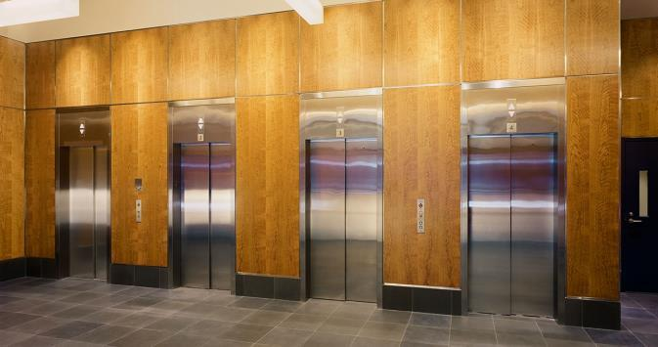
Elevator Analogy of an aTaxi Stand
Temporal Aggregation
Departure Delay: DD = 300 Seconds
Kornhauser
Obrien
Johnson
40 sec
Henderson
Lin
1:34
Popkin
3:47

Slide 21
Elevator Analogy of an aTaxi Stand
60 seconds later
Henderson
Lin
Young
0:34
Christie
Maddow
4:12
Samuels
4:50
Popkin
2:17

Slide 22
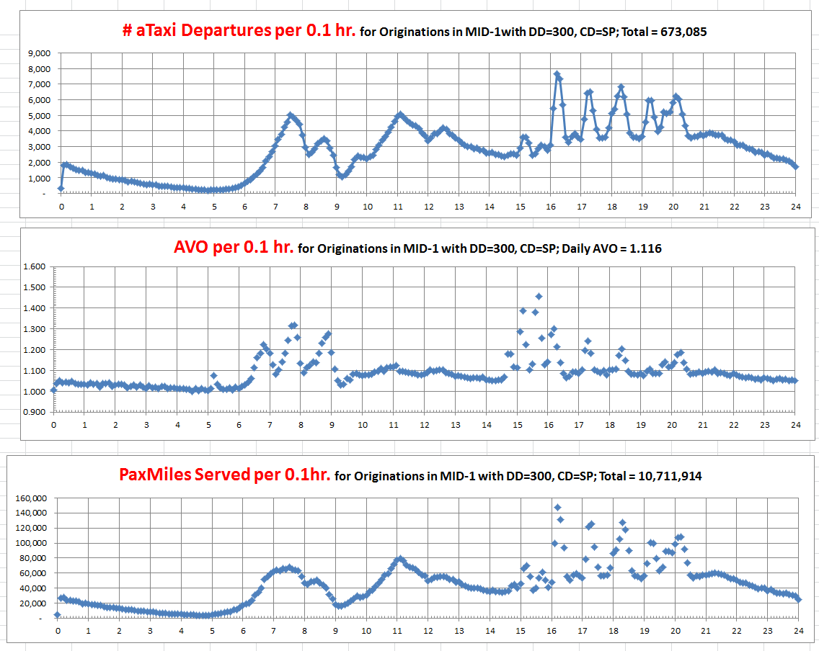
c
http://orfe.princeton.edu/~alaink/NJ_aTaxiOrf467F13/Orf467F13_NJ_TripFiles/MID-1_aTaxiDepAnalysis_300,SP.xlsx

Slide 23
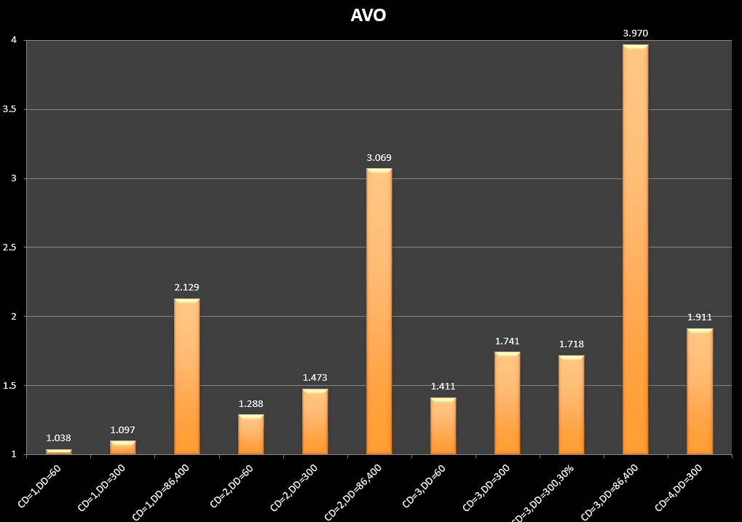
Typical Daily NJ-wide AVO
CD: Common Destinations; DD: Departure Delay (in Seconds)

Slide 24
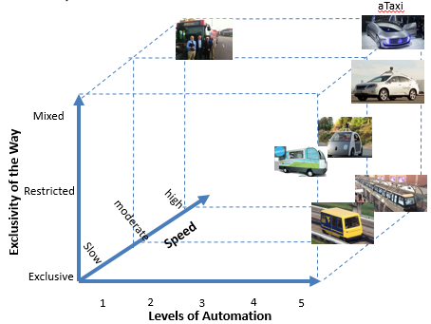
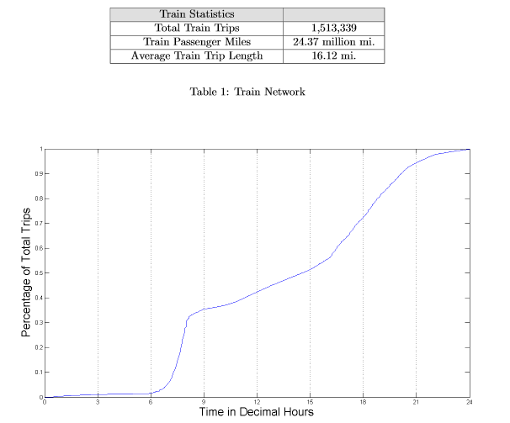
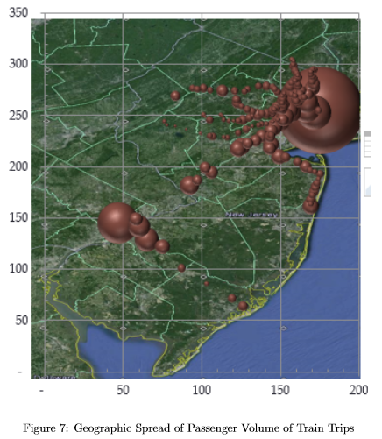
“Last Mile” Impact on NJ Transit Rail
(Today: 281,576, +537% ! )

Slide 25
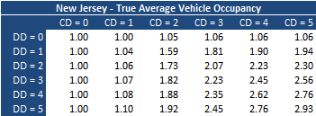
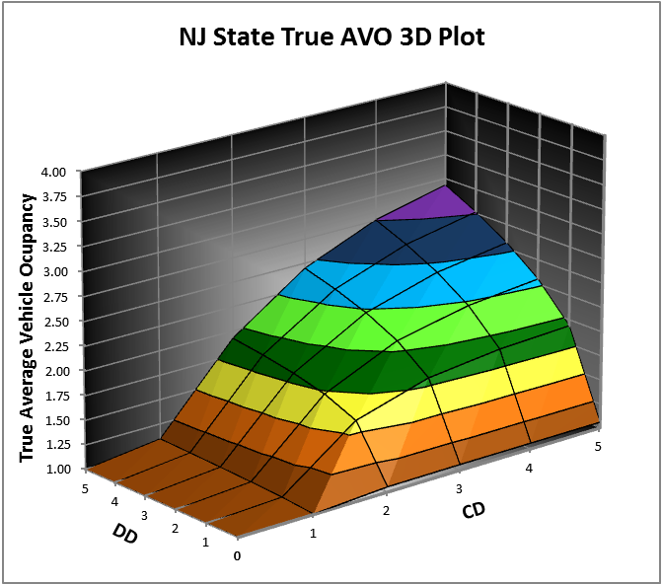
Results

Slide 26
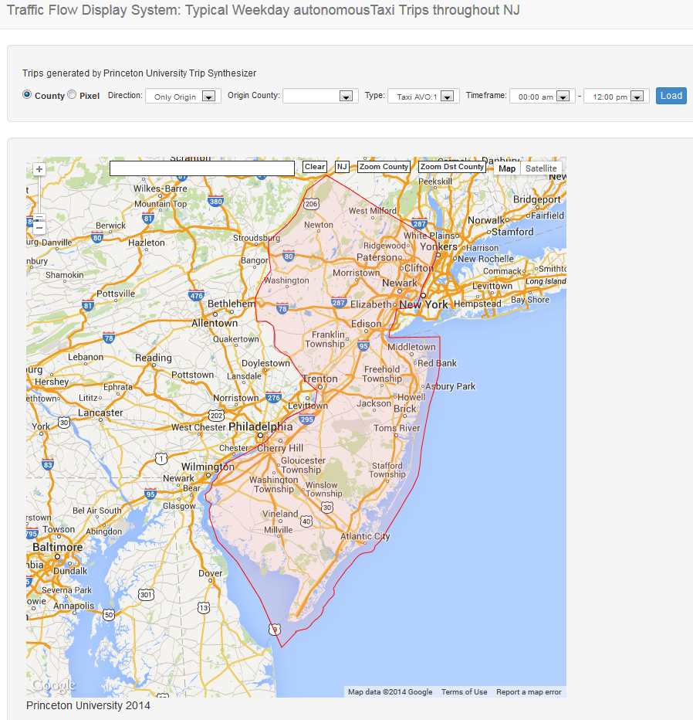
http://depler.no/route/#/

Slide 27
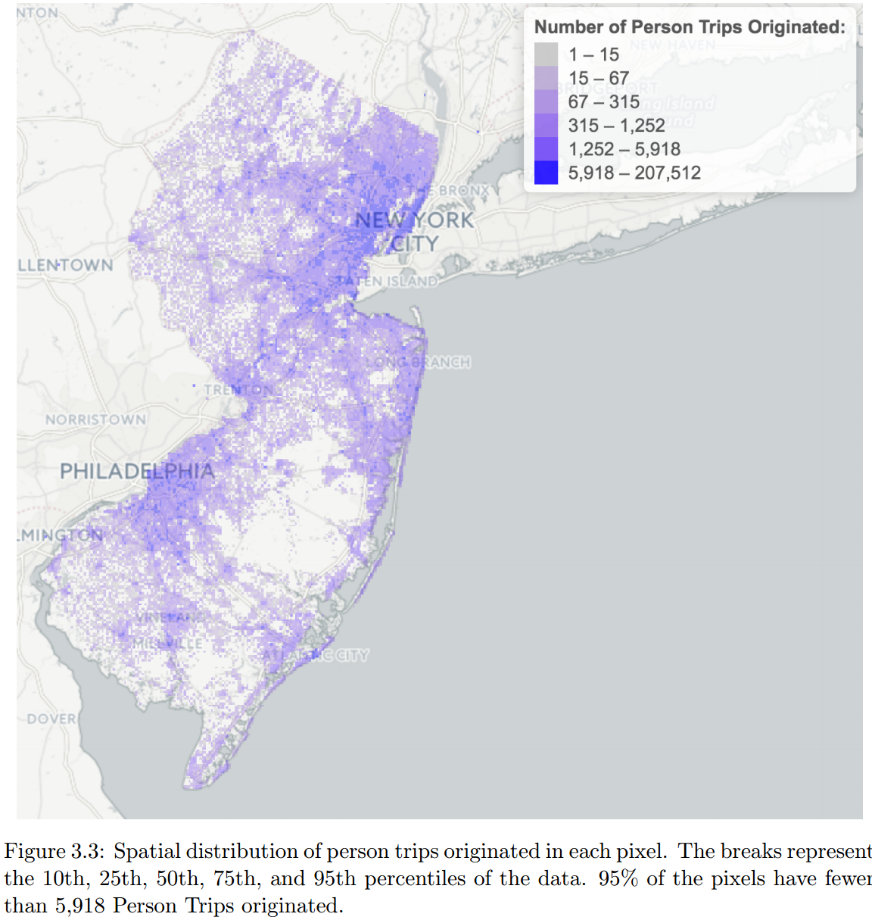

Slide 28
Discussion!
Thank You
alaink@princeton.edu
www.SmartDrivingCar.com

