Slide 1

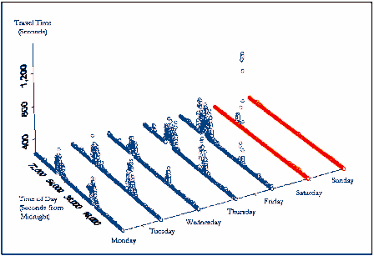
Addressing the Real-time Aspects
In Turn-by-turn Navigation
PROBLEM: How to get from A to B
Many Paths
  Each with a Different Value to the Decision Maker
  Each Segment Changing with Uncertainty over Time
2
6
3
1
6
1
3
A
2
A
9
B
B
8
2
5
8
5
6
3
3
1
6
1
4
4
Week 8

Slide 2
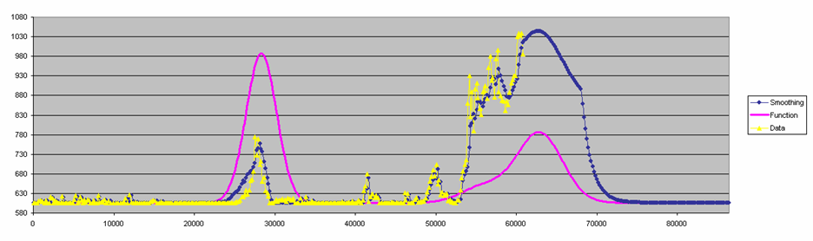
Link Travel Times
Historic, Actual & Forecast During Day
One week-day on one link
Things change!
Week 8

Slide 3
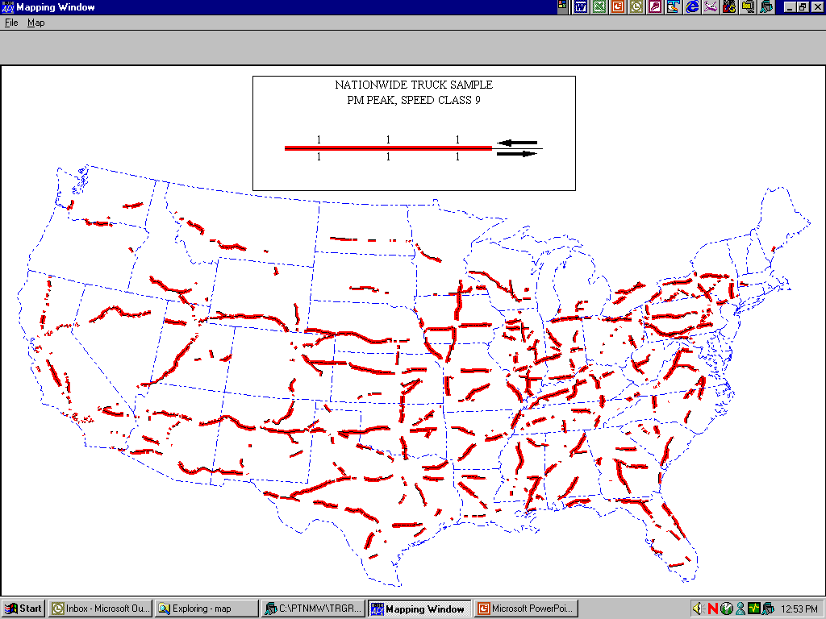
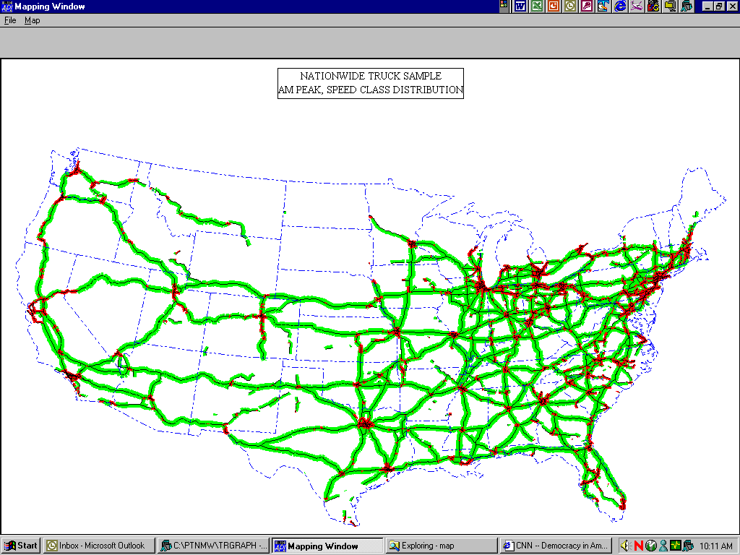
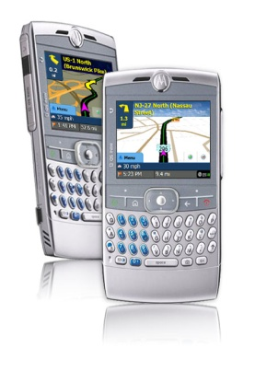
Median Speed (by direction) on National Highway Network
2:30pm 11/16/16
> 40 mph
< 40 mph
height ~ speed
2:30pm 11/16/16
11/21/2611/9/2008
Week 8

Slide 4
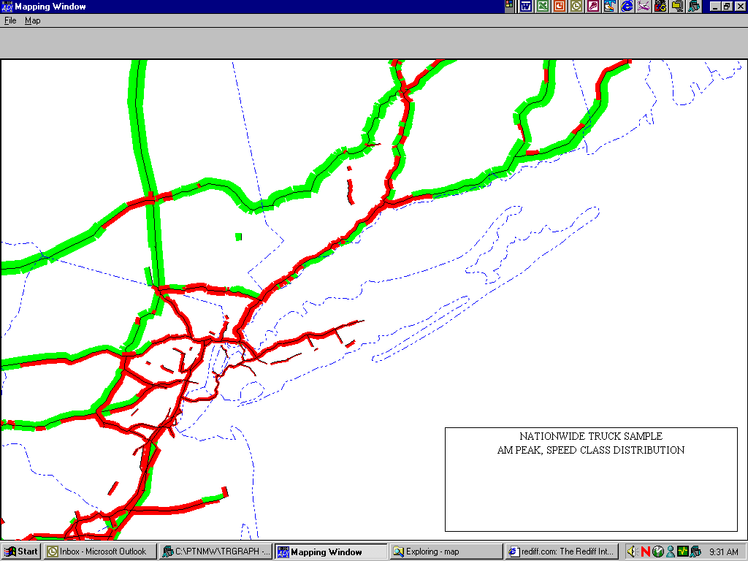

Average Speed (by direction) on National Highway Network
2:30pm 11/16/16
> 40 mph
< 40 mph
height ~ speed
2:30pm 11/16/16
11/21/2611/9/2008
Week 8

Slide 5
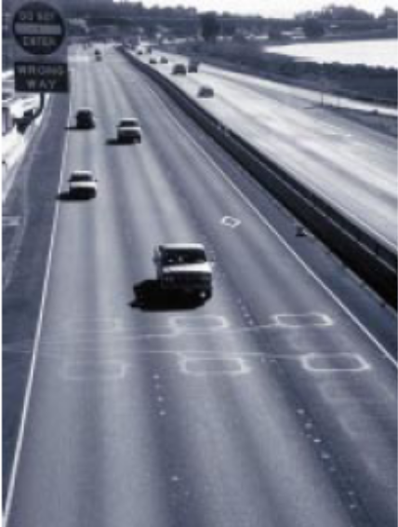
The Measurement Problem
How to collect the real time Speed Data?
  Incremental Infrastructure
    In pavement loop detectors (single point) (single loop)
    radar/laser/video signpost systems (single point)
    EZ Pass readers (2 point span measurement, Excellent)
    Bluetooth Readers
  CrowdSourced Data
    Map data: NYT article
    Wireless Location Technology (Cellular Probes, see Fontaine, et al)
      Cell-tower trilateration
        Yet to demonstrate sufficient accuracy
      Cell-handoff processing
        maybe OK for simple networks
    Floating Car (Vehicle Probe) data processing (see Demers et al)
Week 8

Slide 6
What about Travel Time Variability?
An excellent empirical study: Black, I, T. K. Chin “Forecasting Travel Time variability in Urban Areas”Rept # 0010-GD01017-TCF-02 Hyder Consulting (UK) Nov, 2007
Current Study: George List Presentation
Los Angeles Traffic Variability: Chason-Kornhauser
Canadian traffic Variability Kornhauser- Batchu
Week 8

Slide 7
Cell Probe Technology
Practical success requires more than cell phones
Cell phone movement based on cell location and “hand-offs” from one cell to another
Pattern recognition techniques filter out data from those not on the highway
Then traffic algorithms generate travel times and speeds on roadway links
Cell phones need to be turned on, but not necessarily in use
Full regional systems in place in Baltimore, Antwerp, and Tel Aviv = 4,600 miles, Shanghai
Cell Probe Technology Slides
Week 8

Slide 8
Vehicle Probes
INRIX a current leader
Google traffic; crowdSourcing
Assign Speed data to network segments of Digital Map database, or
Maintain travel times between strategically located virtual monuments
Week 8

Slide 9
Vehicle Probes
Assign Speed data to network segments of Digital Map database, or
Maintain travel times between strategically located virtual monuments
Week 8

Slide 10
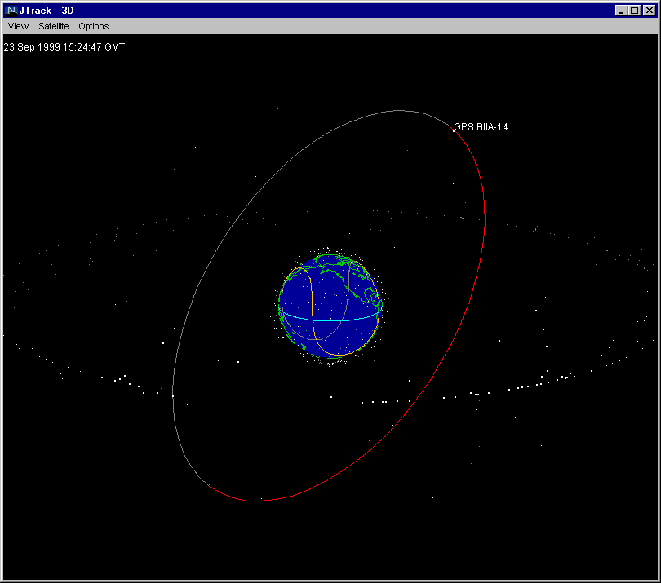
JTracks

Slide 11
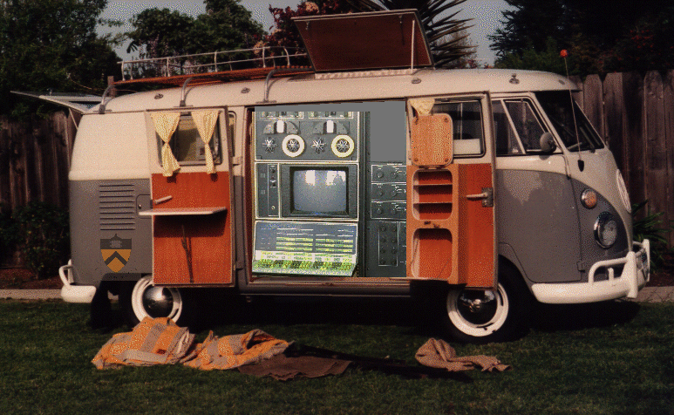
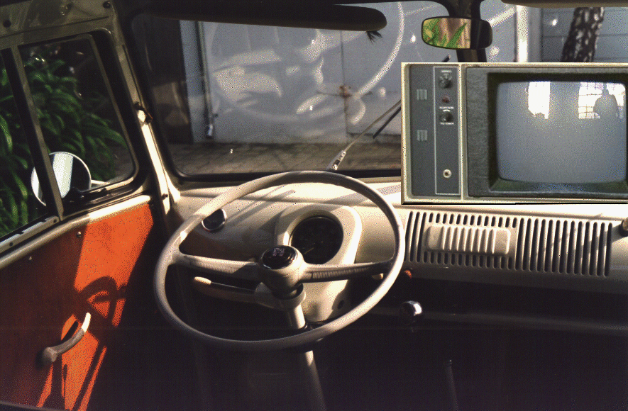

30 Years Ago

Slide 12
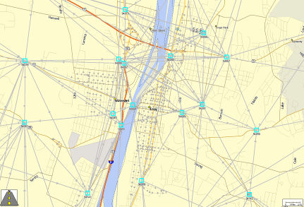
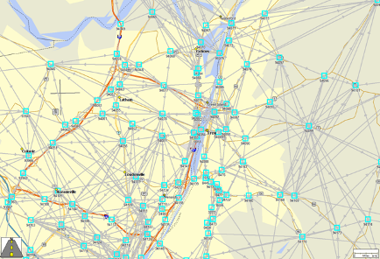
North American Monument Network
~125,000 North American “Monuments”
~10⁶ (m_{i}, m_{j})
Can create Median travel Tims by Time-of-Day
  For Example: AM Peak, Midday, PM Peak, Night, Weekend day
(mi, mj) near Troy
(mi, mj) larger area
Week 8

Slide 13
Secondary Uses for Probe Location Data
Alain L. Kornhauser
Professor, Operations Research & Financial Engineering
Director, Program in Transportation
Founder & Board Chair, ALK Technologies, Inc. and
Vice Chairman, New Jersey Commission on Science and Technology
Presented at
Transportation Research Board Workshop on
Data and Tools for Linking Goods Movement, Air Quality and Transportation Infrastructure
Beckman Center, Irvine, CA
June 2-3, 2009

Slide 14
Secondary Uses … Because…
Primary Uses (which provide the financial justification) :
  Mobile Resource Management
  Security
  Customer Service
  Anxiety Relief
add Archiving & Harvesting you get a view of:
  What has happened (Monitoring)
  What is happening (Operations)
  What will happen (Planning)
Becomes the data source for:
  Highway Performance Monitoring
  Travel Demand
  Routing Behavior
  Real-time Dynamic Route Guidance

Slide 15
…Probe… Can be…
Trucks
Cars
Ships
Planes
People
…

Slide 16
… Location Data
“GPS Tracks” (Bread crumbs)
  ID (can be anonymous, but must be unique)
  Position (lat, lon)
  Date
  UTC (time)
  Instantaneous velocity (speed and heading)
  Other attributes

Slide 17
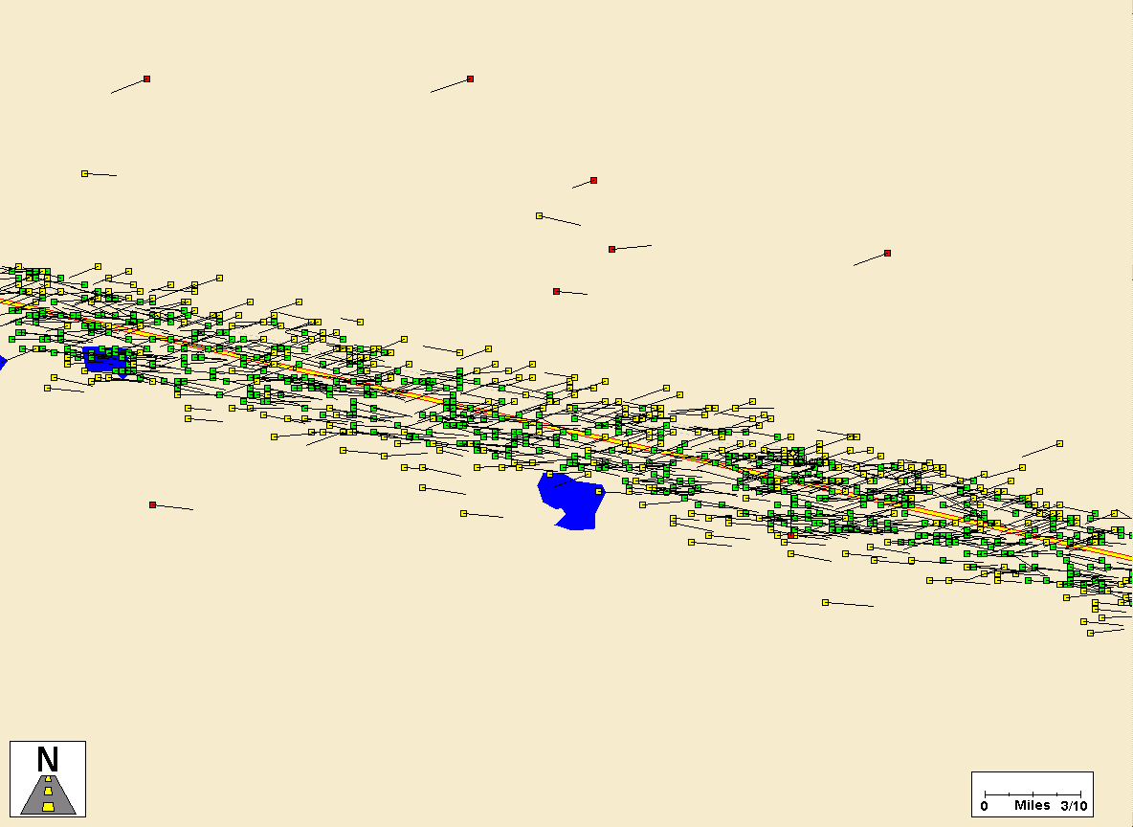
Position…
QASPR (Qualcomm Automated Satellite Position Reporting)
  Part of Qualcomm’s OmniTACS
    No instantaneous velocity
    Data rate ~ typically every 45 minutes
    Positional accuracy ~ ¼ mile

Slide 18
Position…
QASPR (Qualcomm Automated Satellite Position Reporting)
  Part of Qualcomm’s OmniTACS
    No velocity
    Data rate ~ typically every 45 minutes
    Positional accuracy ~ ¼ mile
    Standard of the long-haul trucking industry for more than 10 years; installed in over 300,000 trucks

Slide 19
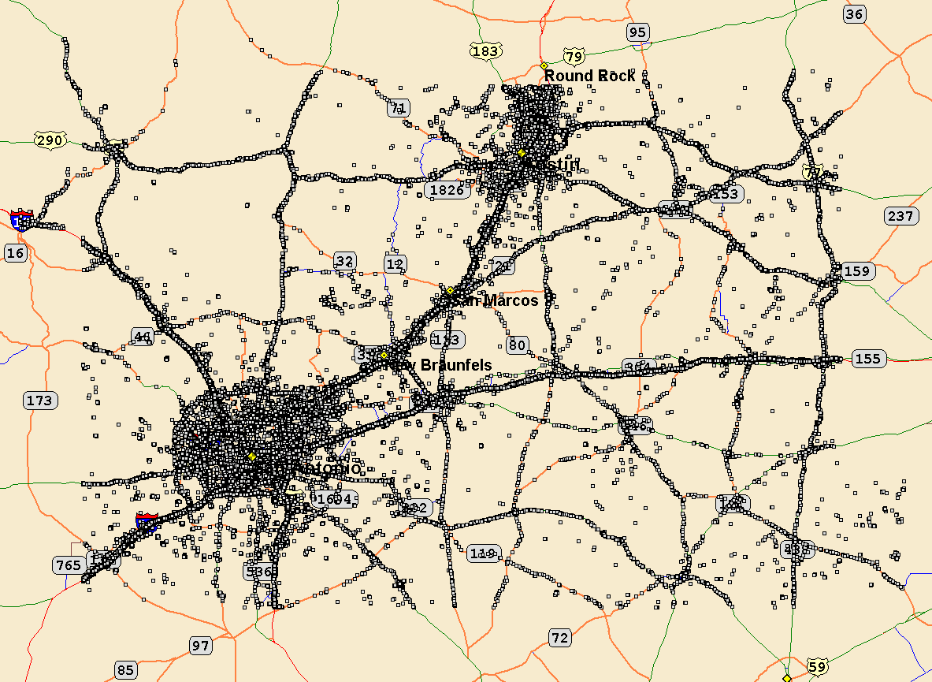
1st view of 300,000 trucks over 13 days

Slide 20
Data Processing Objectives
c
Display
  Individual trucks over time
  All trucks over time
  All trucks with geographic commonality
Latitude
Longitude
View
Time
B
Latitude
A
Longitude

Slide 21
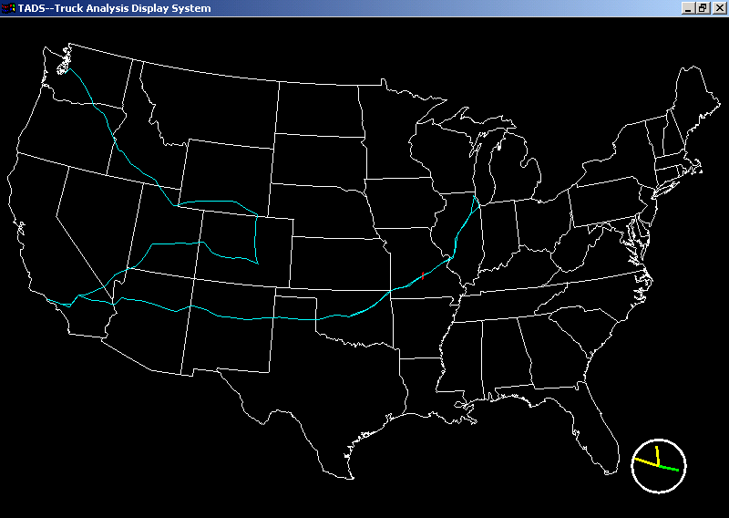
Path for one Week for Truck # 751 out of 27,417

Slide 22
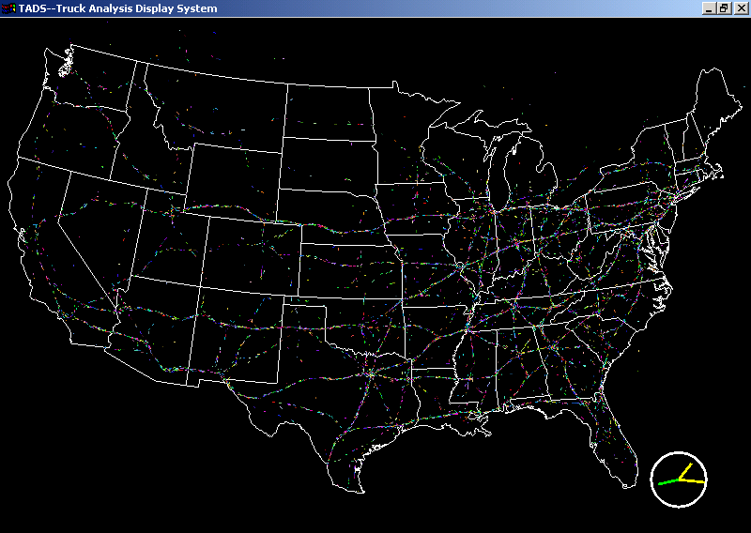
Instantaneous view of about a 10% sample

Slide 23
Position…
QASPR
WiFi… Good for pedestrians, otherwise ??

Slide 24
Position…
QASPR
WiFi… Good for pedestrian, otherwise ???
GPS
  Accuracy ~ 10 meters under most conditions
    Coord System important when fusing with other data.
  Can be as frequent as every second
  Has instantaneous velocity (heading unreliable at low speeds)

Slide 25
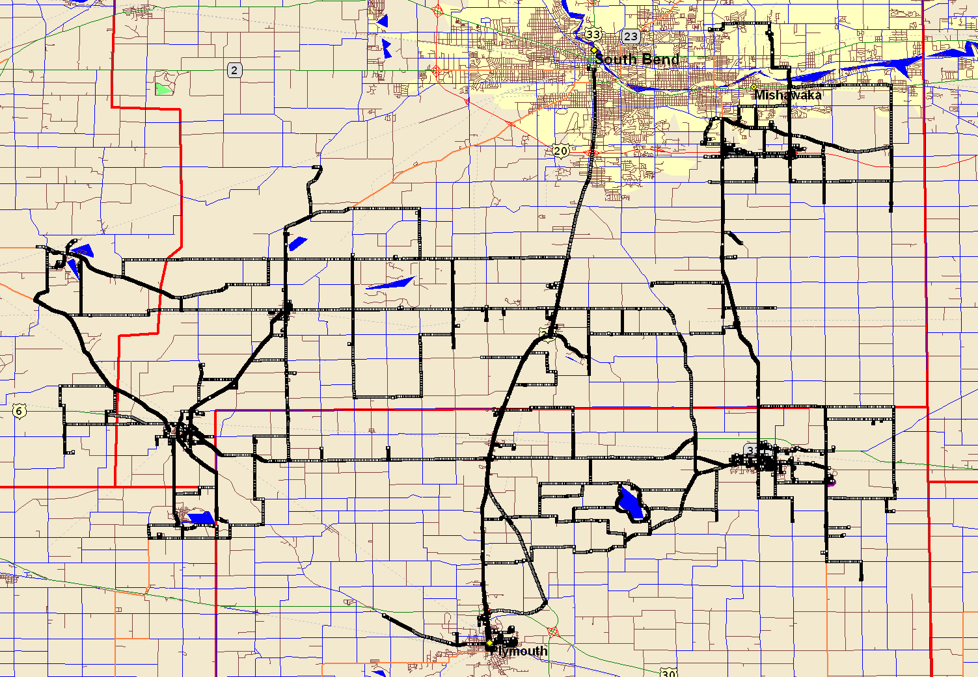
FedEx Contract Carrier (for one week) breadcrumb every 3 seconds

Slide 26
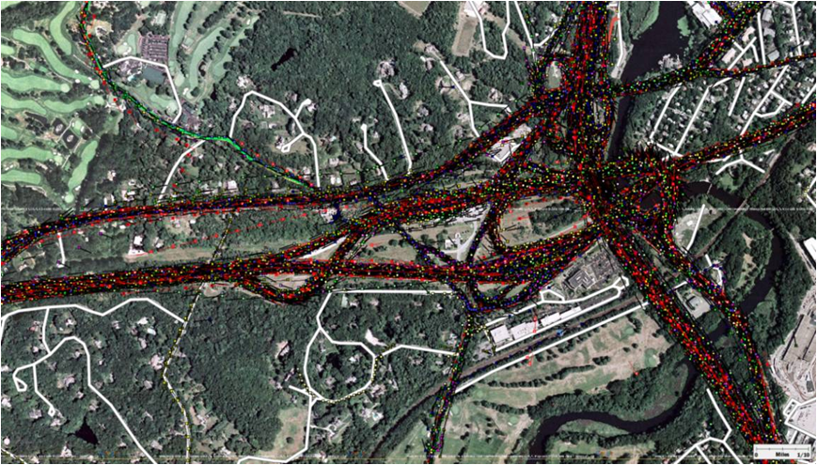
Typical view of GPS Tracks

Slide 27
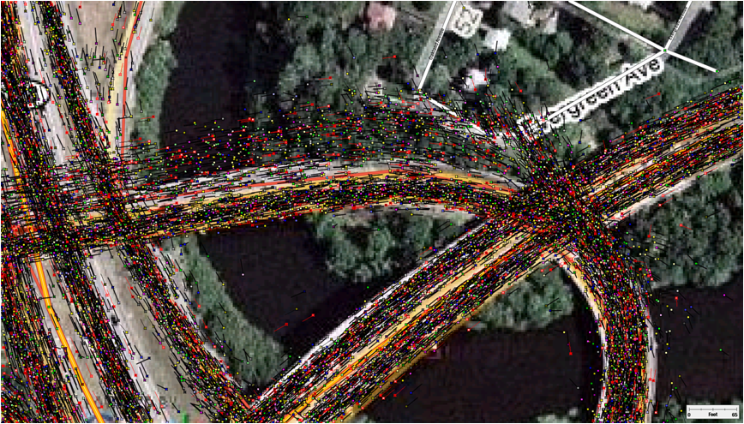
Scatter due to temporary obstructed line-of-sight

Slide 28
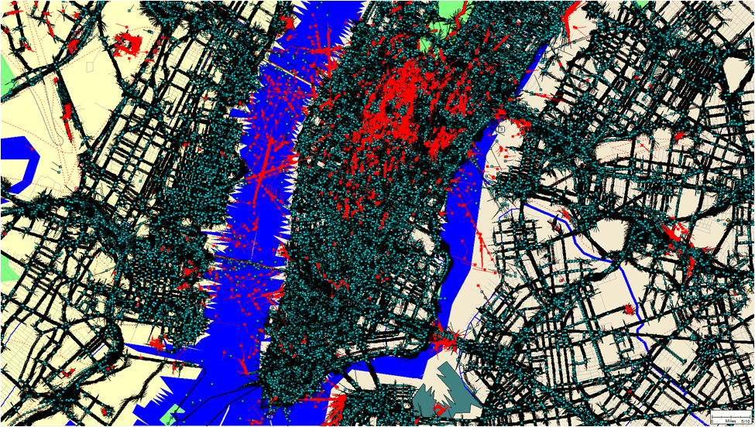
“Urban Canyon” Scatter

Slide 29
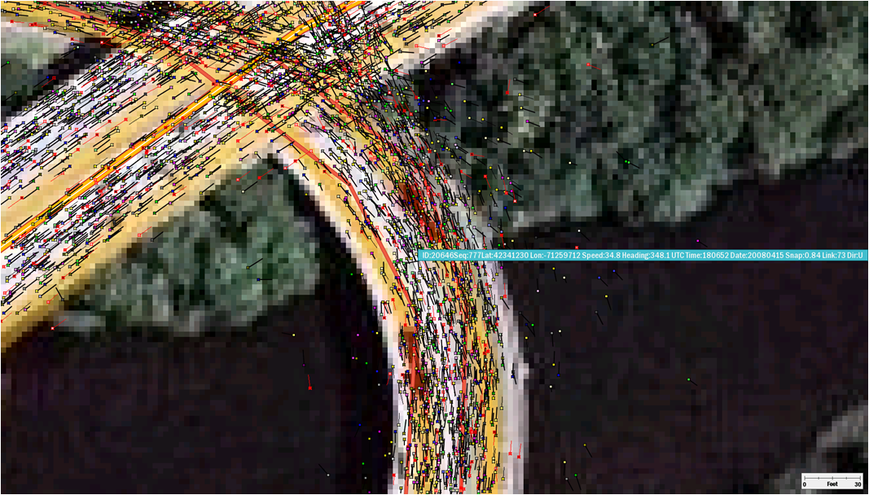
Map-matching {Link#, t, dir}

Slide 30
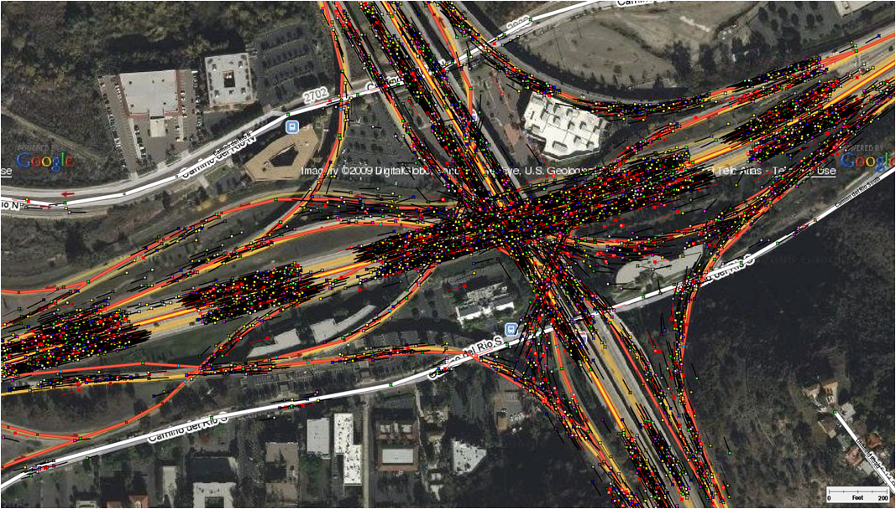
“OneMon”

Slide 31
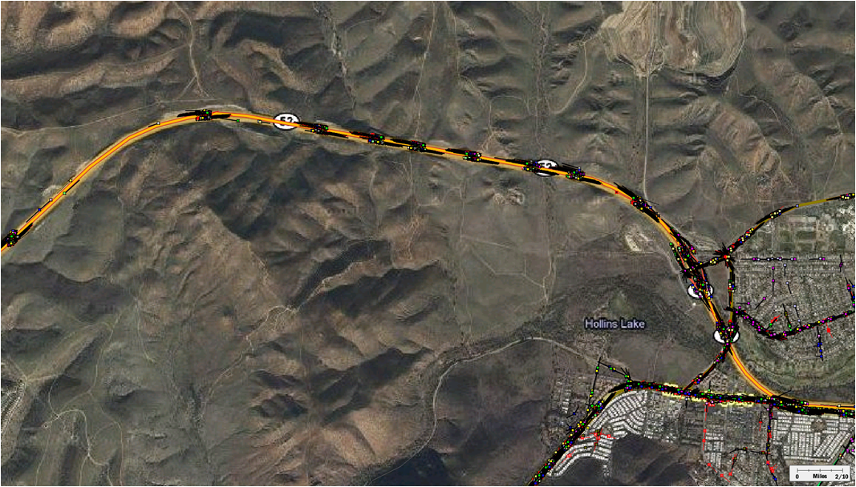
“OneMon”

Slide 32
Pair them up to get segment performance “Monument2Monument”

Slide 33
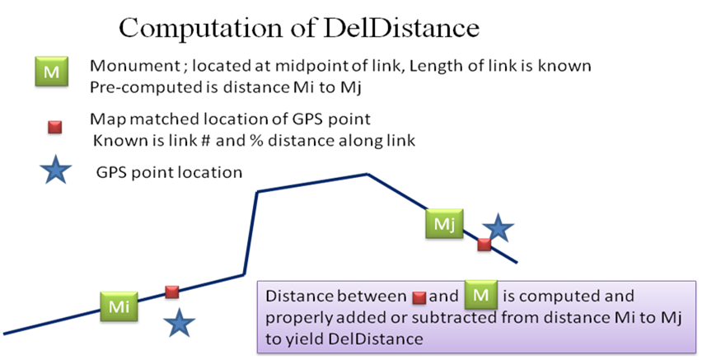

Slide 34
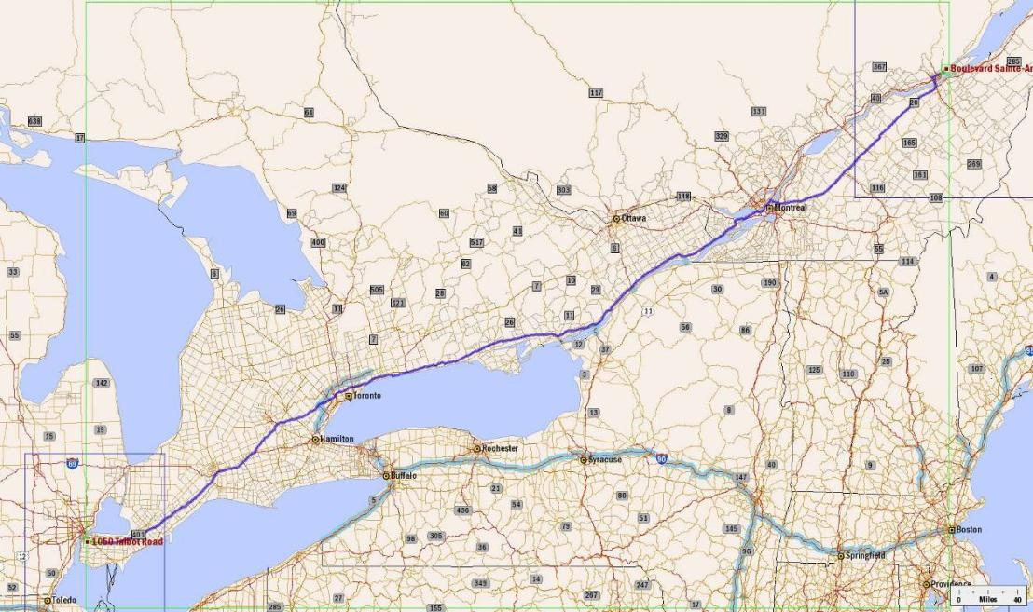
Monitoring speed performance using GPS Tracks
Québec-Montréal-Windsor corridor (1,127 km)

Slide 35
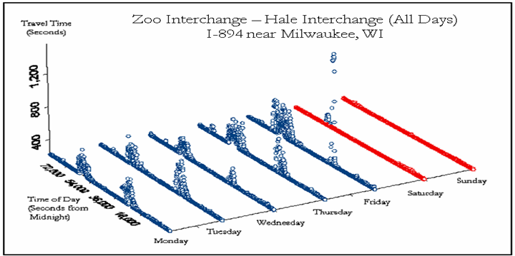
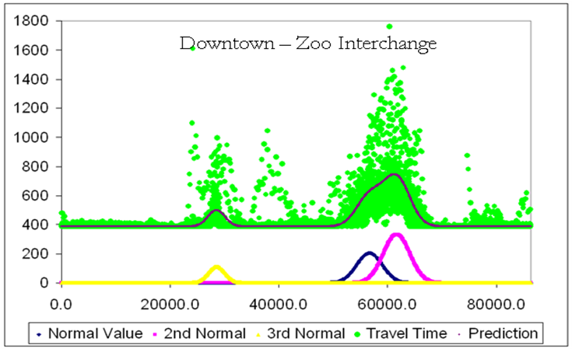
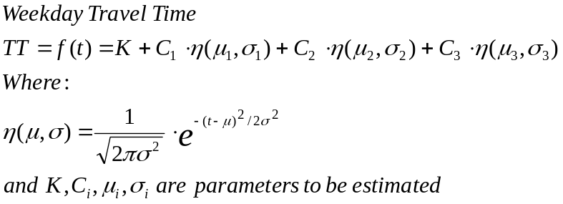
Traditionally done with roadside hardware
Loop Detector
Speed datapoint for each vehicle
Data at points not segments
Paired EZ-Pass Readers
Speed for a segment
Great near toll roads
Substantial infrastructure
requirement

Slide 36
Observation
  The dynamic, non-stationary aspect of transportation can have both positive and negative implications.
  Its stochastic volatility is what makes it really interesting.
  While there exists random variations, there also exist solid trends
  The fundamental Objective of Real-time:
    Limit the downside exposure of downward trends
    Take advantage of upside opportunities.

Slide 37
Route Choice in Real-Time
  All of this is most evident with respect to route choice.
  One can understand that for business purposes (costing, pricing, billing, driver pay )one wants one route from A to B. Simplicity, Transparency
  However, the real-time stochastic volatility of any route might suggest that at certain times, one should take another route so as to limit the negative exposure or take alternative route to capture the upside opportunity.

Slide 38
Route Choice in Real-Time
In general, there are many ways to go from A to B
  Some are longer than others: easy to compute these , Static by ToD
  Some have tolls that are greater than others: easy to compute these
  Some have limiting conditions such as legal, risk, environmental, physical: easy to consider these infeasibilities and avoid them; tend to not vary by ToD
  Some take longer than others: Has been hard to measure and compute, Some recurring ToD variation, Some Real-time

Slide 39
Important Elements of Real-Time Route Choice
  Real-time Information
  Computational capability to quantify the implications of the real-time information
  The “open-mindedness” to take advantage of alternatives
  Operational flexibility to implement alternative
  Don’t micro-manage centrally; enable distrinuted autonomy to do the right thing while making sure that everyone has the same concept of “right”.
  Manage the objectives and the constraints rather than micro-managing individual actions

Slide 40

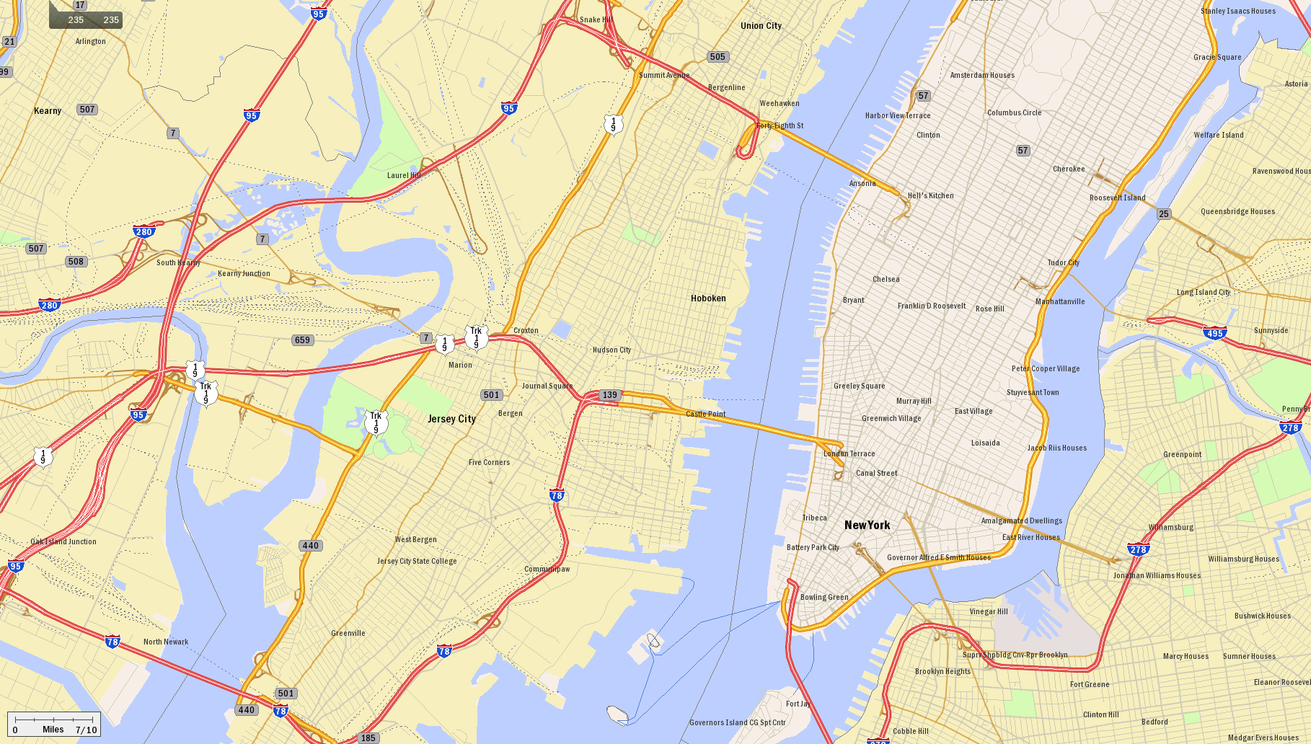




Let’s Look at Some Routes actually Taken:
Lincoln Tunnel Access to Manhattan by Time of Day (ToD)
Lincoln Tunnel
NJ Turnpike
495 Viaduct & Helix
Depot Locations

Slide 41

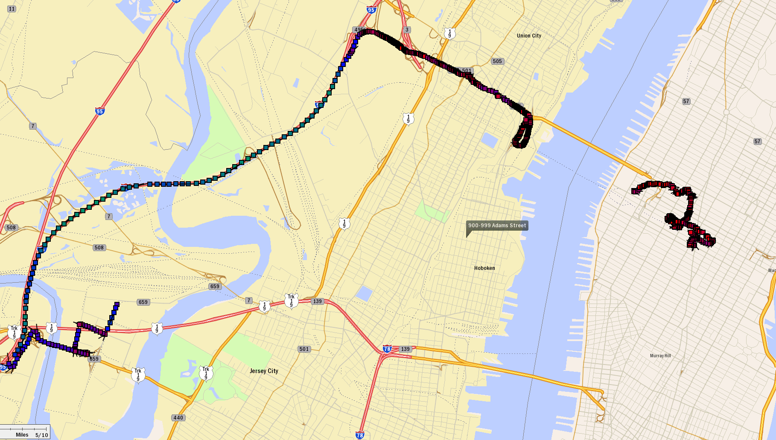




Lincoln Tunnel Access via NJ Turnpike (9.5mi)
Thursday 10/08/09
X16E: +12:17
LTin: +32:20
LTout: +6:55
Dep: 08:41:09
70 mph
35 mph
0 mph

Slide 42

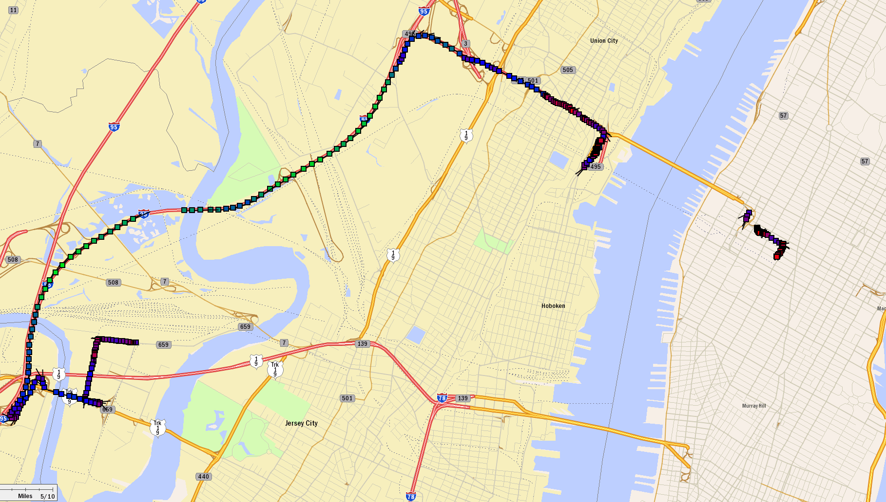



Lincoln Tunnel Access via NJ Turnpike (9.5mi)
Monday morning 10/19/09
X16E: +16:35
LTin: +11:02
LTout:+4:59
Dep: 07:47:36

Slide 43

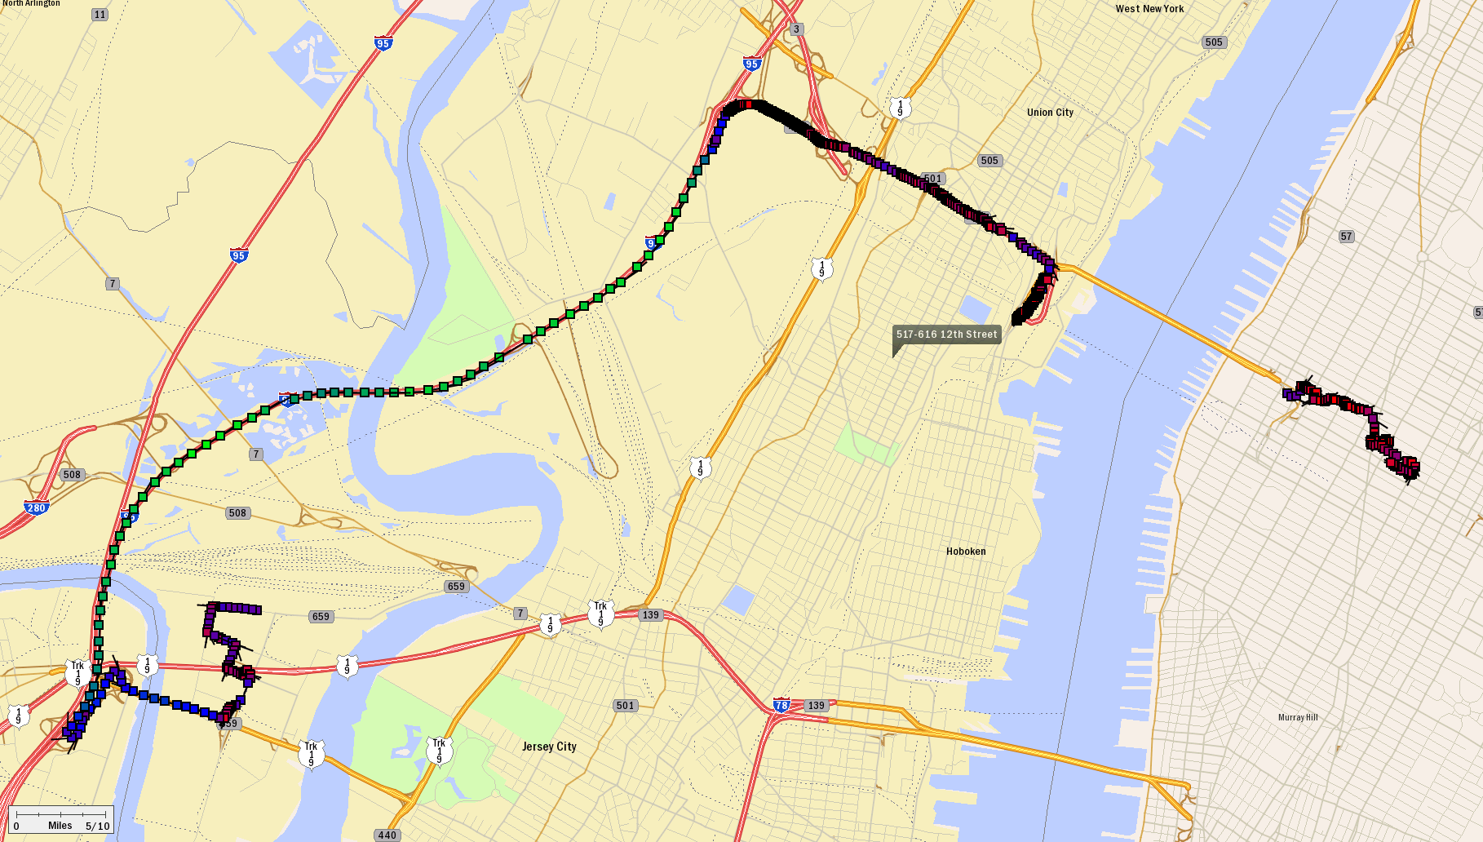


Lincoln Tunnel Access via NJ Turnpike (9.5mi)
Tuesday morning 10/20/09
X16E: +17:42
LTin: +38:42
LTout:+6:43
Dep: 07:53:37

Slide 44

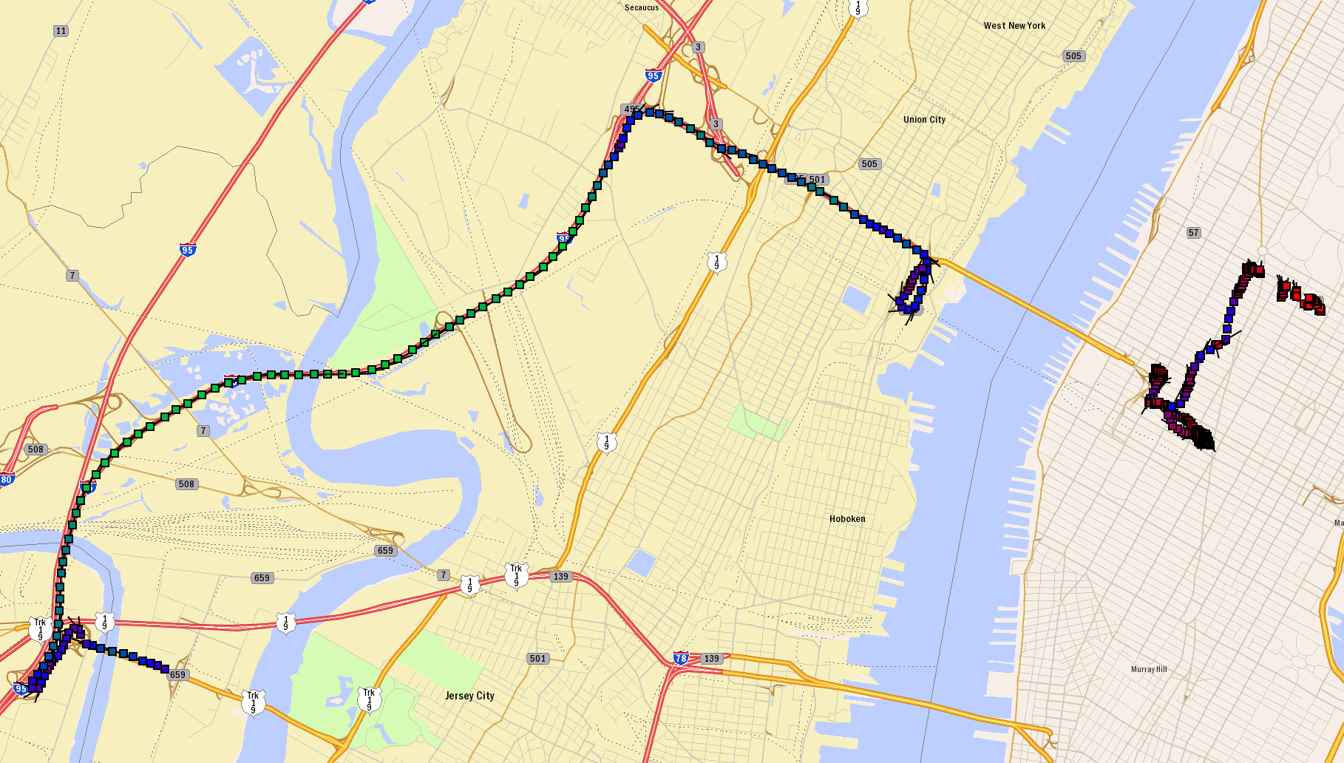

Lincoln Tunnel Access via NJ Turnpike (9.5mi)
Tuesday evening 10/13/09
X16E: +8:01
LTin: +4:30
LTout: +2:29
Dep: 19:14:04

Slide 45

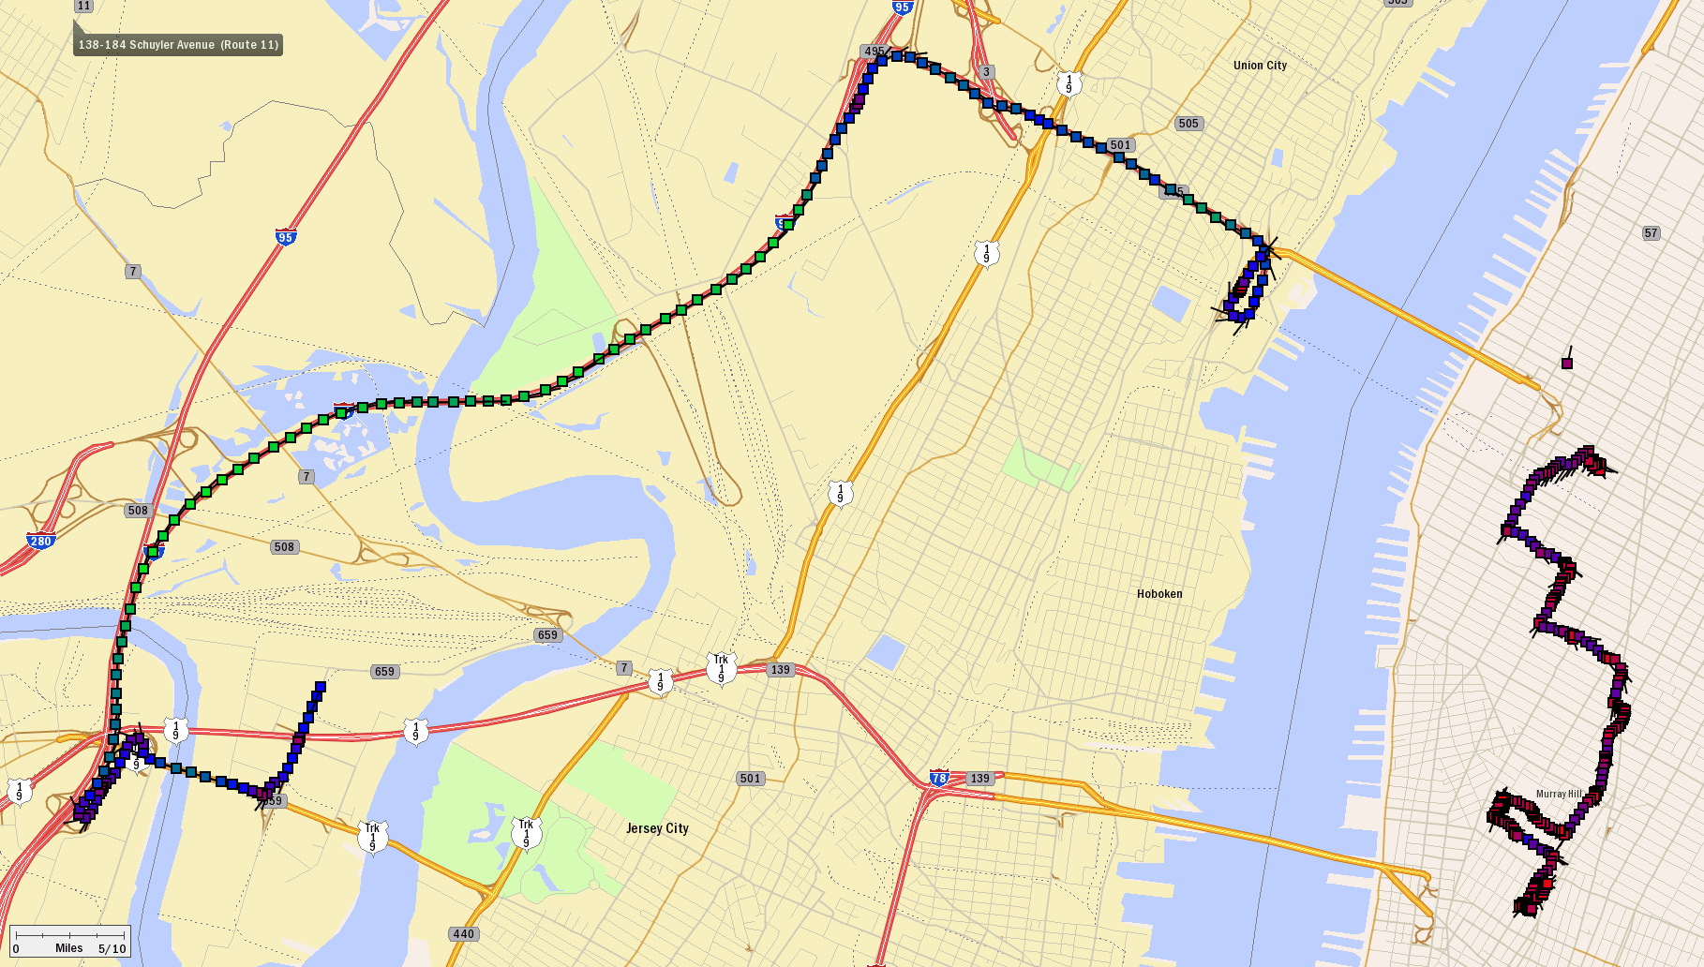
Lincoln Tunnel Access via NJ Turnpike (9.5mi)
Thursday evening 10/15/09
X16E: +9:55
LTin: +5:11
LTout: +1:51
Dep: 20:23:12

Slide 46

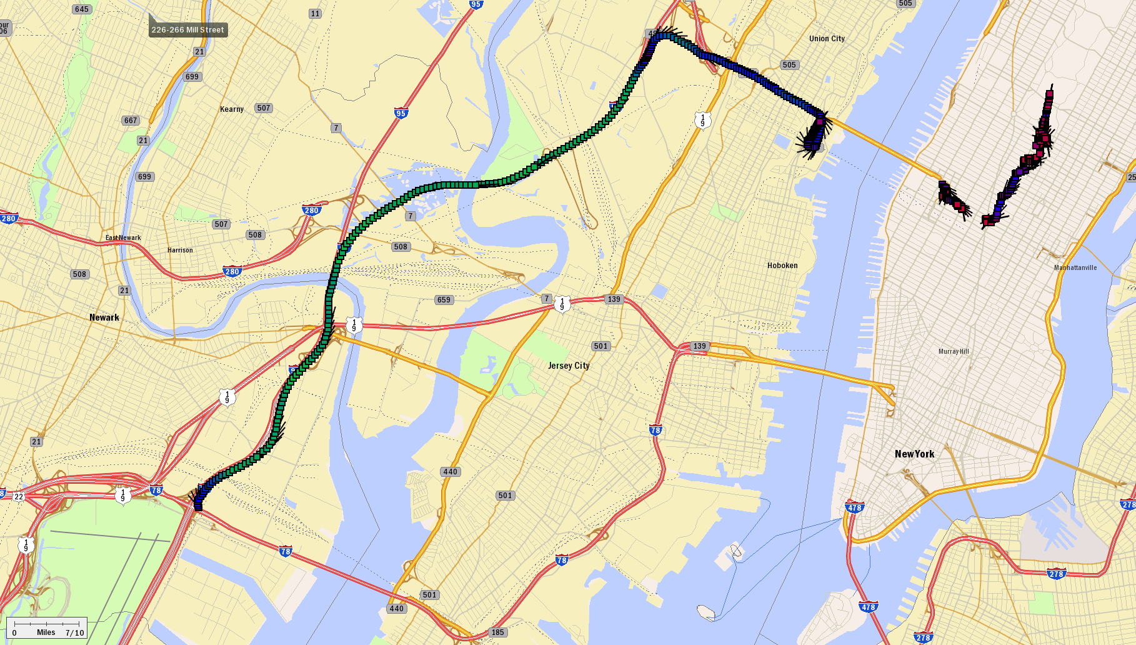
Lincoln Tunnel Access via NJ Turnpike (10.3mi)
Tuesday very early am 01/29/10
X16E: +08:12
LTin: +5:21
LTout: +02:46
Dep: 00:12:55

Slide 47

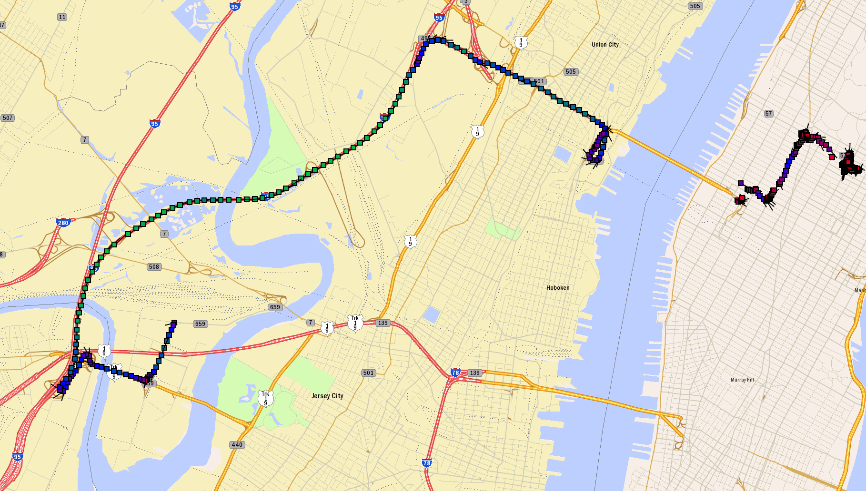
Lincoln Tunnel Access via NJ Turnpike (9.5mi)
Thursday evening 10/22/09
X16E: +9:20
LTin: +4:31
LTout: +2:15
Dep: 19:55:58

Slide 48

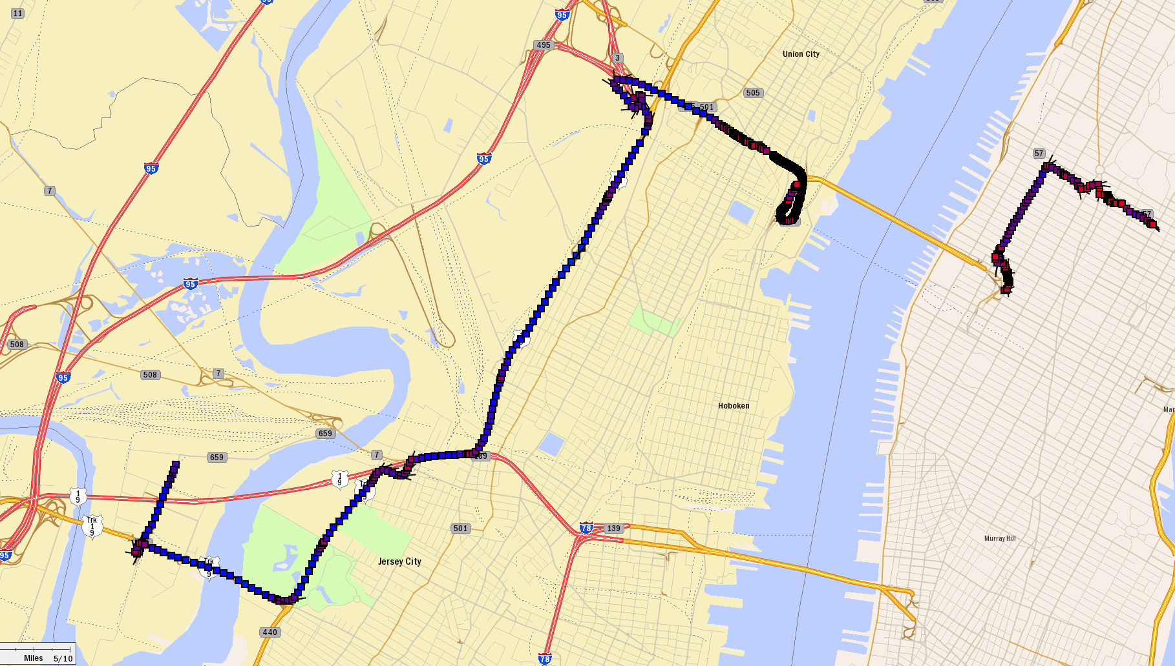

Lincoln Tunnel Access via Tonnely Ave. (8.4mi)
Friday evening 10/23/09
LTin: +43:30
LTout: +13:41
Dep: 20:05:51

Slide 49

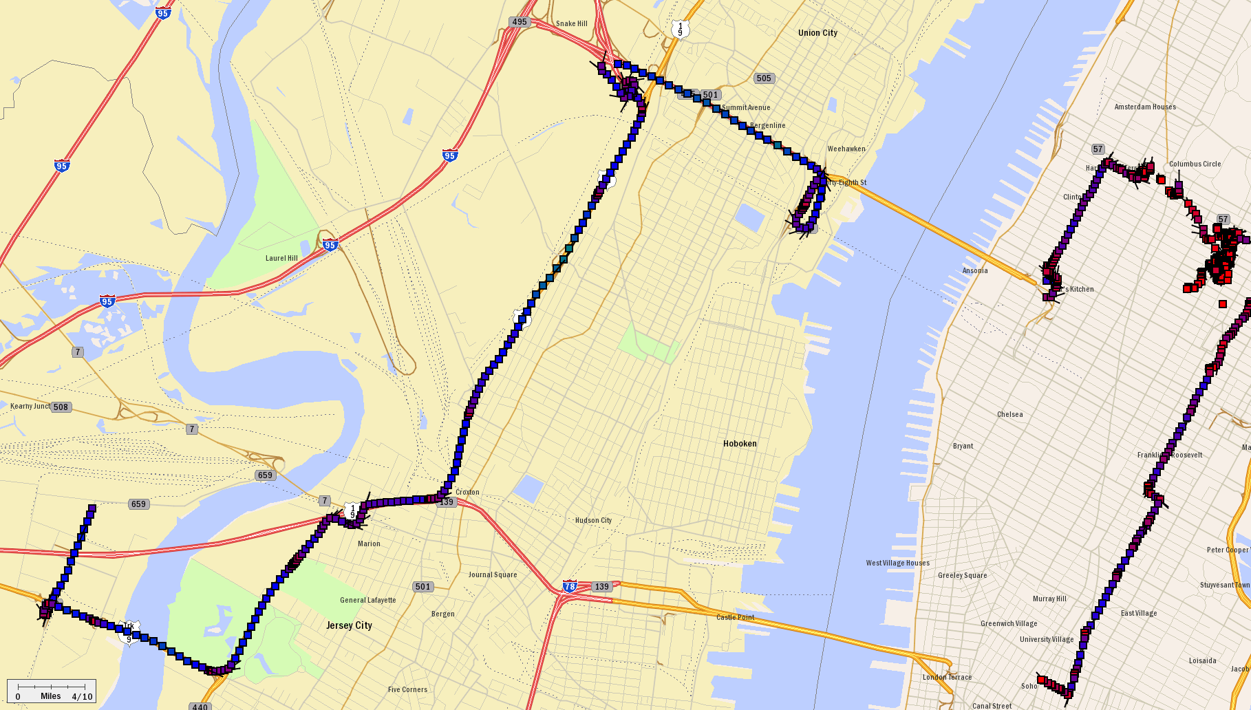
Lincoln Tunnel Access via Tonnely Ave. (8.4mi)
Tuesday evening 11/03/09
LTin: +22:46
LTout: +02:33
Dep: 20:12:03

Slide 50

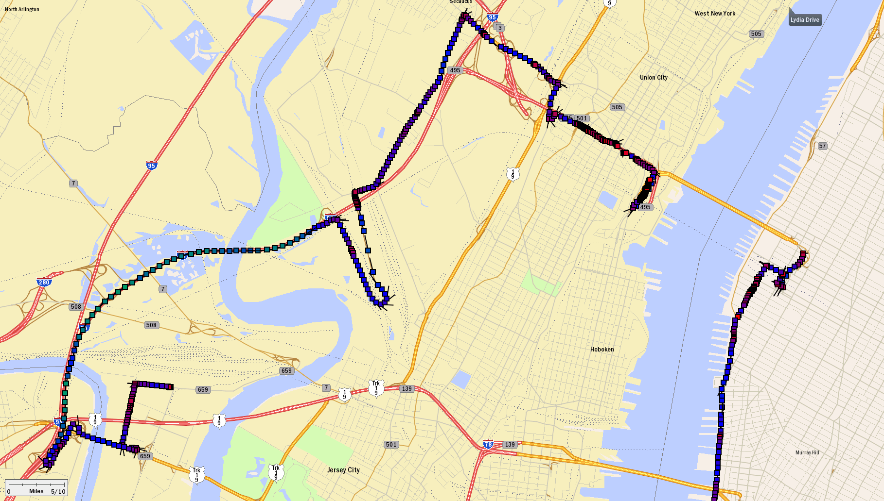


Lincoln Tunnel Access via County Ave. (12.2mi)
Wednesday morning 10/07/09
LTin: +48:22
LTout: +07:23
Dep: 08:09:05

Slide 51

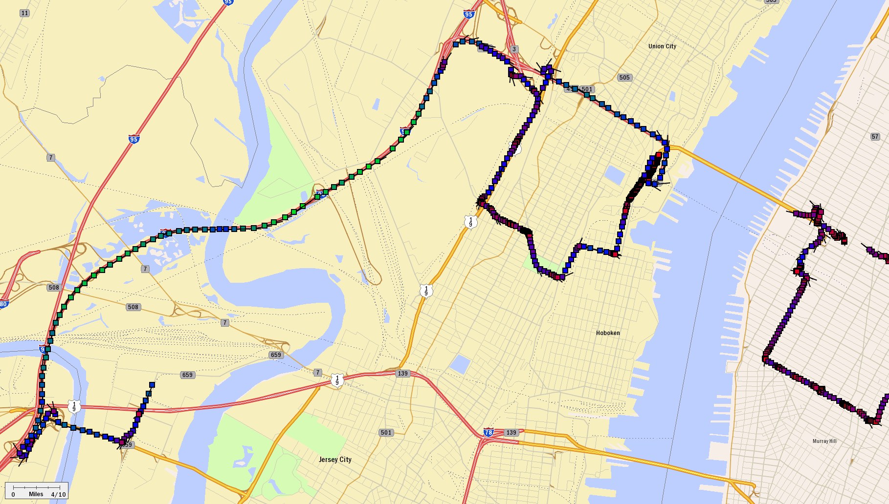



Lincoln Tunnel Access via Secaucus Rd.(11.8mi)
Wednesday evening 11/11/09
X16E: +9:31
LTin: +31:00
LTout: +07:01
Dep: 18:05:15

Slide 52






Late AM Peak & Early Evening
Lincoln Tunnel Access to Manhattan
Via | Departure Time | Travel Time Lincoln T (in) | Travel Time Lincoln T (out) | Distance 2 Lincoln Tunnel
NJ Turnpike | 08:41:09 Thursday, 10/08/09 | 44:37 | 06:55 | 9.5
NJ Turnpike | 07:47:36 Monday, 10/19/09 | 27:37 | 02:13 | 9.5
NJ Turnpike | 07:57:37 Tuesday, 10/20/09 | 56:22 | 06:43 | 9.5
NJ Turnpike | 19:14:04 Tuesday, 10/13/09 | 12:31 | 02:29 | 9.5
NJ Turnpike | 20:23:12 Thursday, 10/15/09 | 15:06 | 01:51 | 9.5
NJ Turnpike | 19:55:58 Thursday, 10/22/09 | 13:51 | 02:15 | 9.5
Tonnely Ave | 20:12:03 Tuesday, 11/03/09 | 22:46 | 02:33 | 8.4
Tonnely Ave | 20:05:51 Friday, 10/23/09 | 43:30 | 13:41 | 8.4
County Ave | 08:09:05 Wednesday, 10/07/09 | 48:22 | 07:23 | 12.2
Secaucus Rd. | 18:05:15 Wednesday, 11/11/09 | 40:31 | 07:01 | 11.8
Different Times of Day; Very Different Travel

Slide 53

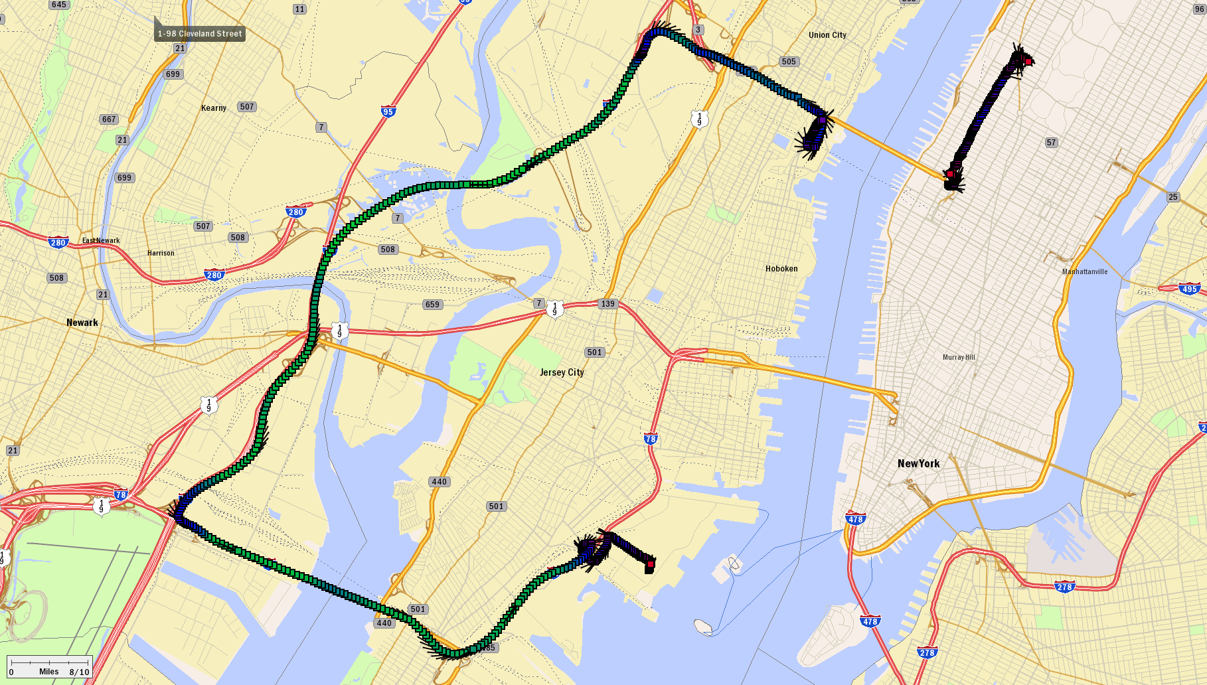
Lincoln Tunnel Access via NJ Turnpike (16.2mi)
Friday, very early morning, 02/12/10
X16E: +17:51
LTin: +04:42
LTout: +01:57
Dep: 02:08:54

Slide 54

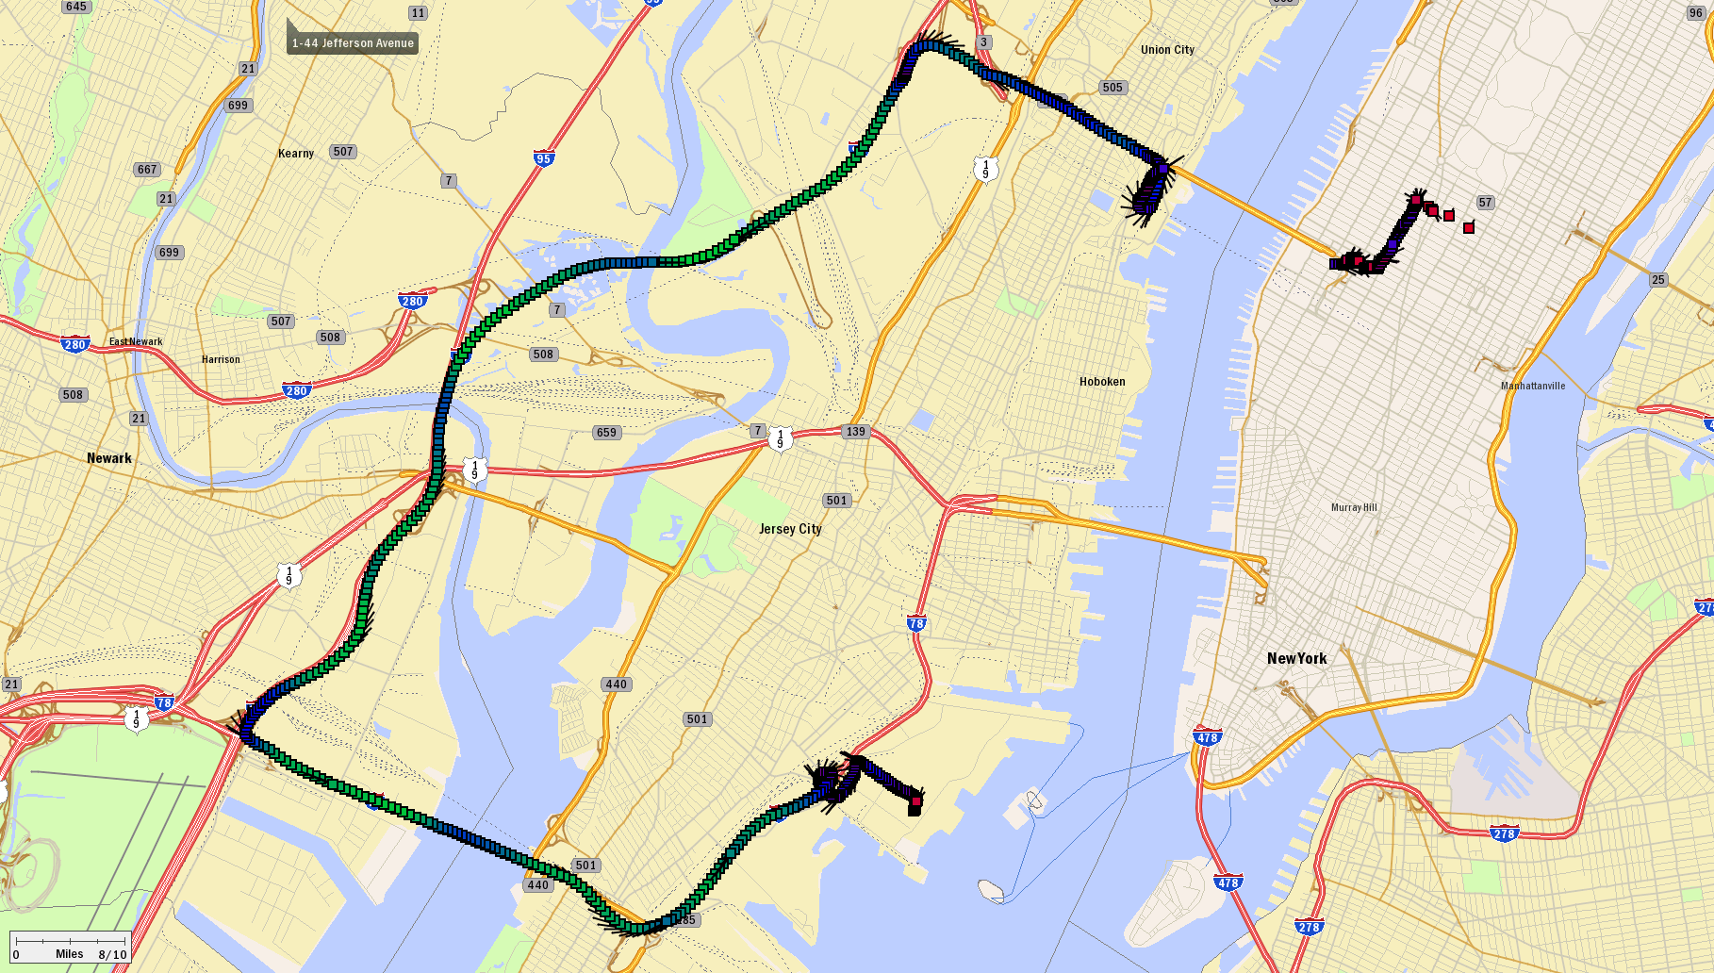
Lincoln Tunnel Access via NJ Turnpike (16.2mi)
Thursday, very late night, 01/21/10
X16E: +17:18
LTin: +05:00
LTout: +02:13
Dep: 23:47:21

Slide 55

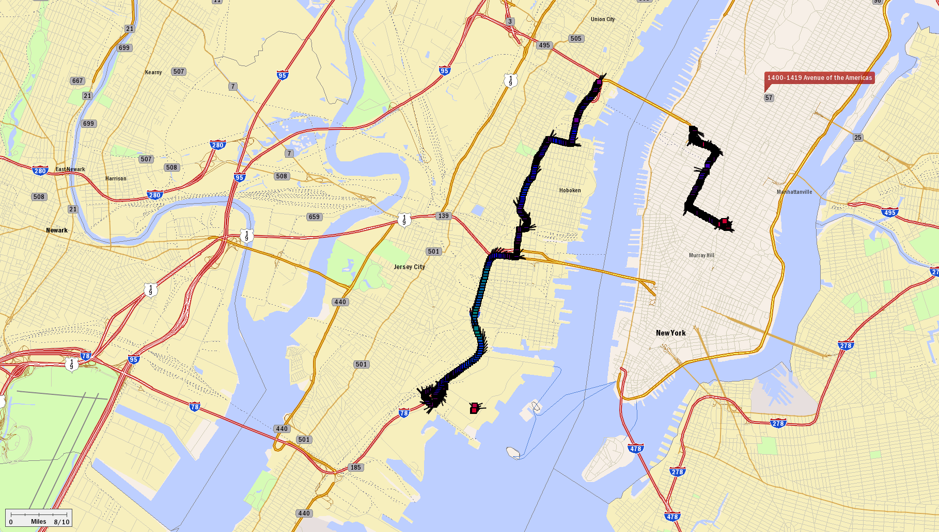
Lincoln Tunnel Access via NJ Turnpike (16.2mi)
Thursday, very early morning, 01/21/10
LTin: +19:20
LTout: +02:11
Dep: 00:44:09

Slide 56

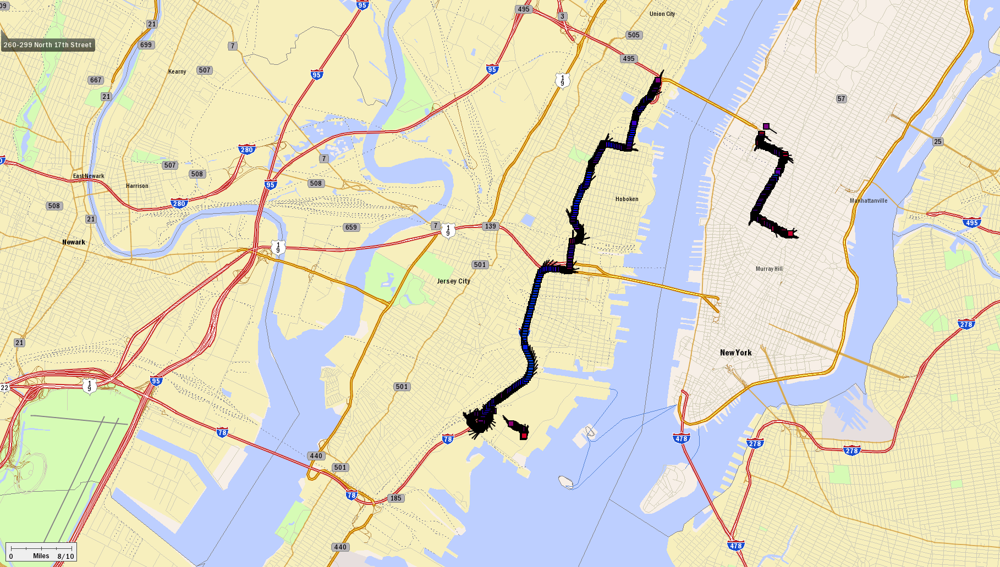
Lincoln Tunnel Access via NJ Turnpike (7.4mi)
Wednesday, very early morning, 01/20/10
LTin: +20:12
LTout: +02:05
Dep: 00:38:30

Slide 57




Middle of the Night
Lincoln Tunnel Access to Manhattan
Via | Departure Time | Travel Time Lincoln T (in) | Travel Time Lincoln T (out) | Distance 2 Lincoln T
NJ Turnpike | 02:08:54 02/12/10 | 22:33 | 01:57 | 16.2
NJ Turnpike | 23:47:21 01/21/10 | 22:18 | 02:13 | 16.2
Patterson Plank Rd. | 00:44:09 01/21/10 | 19:20 | 02:11 | 7.4
Patterson Plank Rd. | 00:38:30 01/20/10 | 20:12 | 02:05 | 7.4
Two vastly different routes; very similar travel times at this time of day

Slide 58

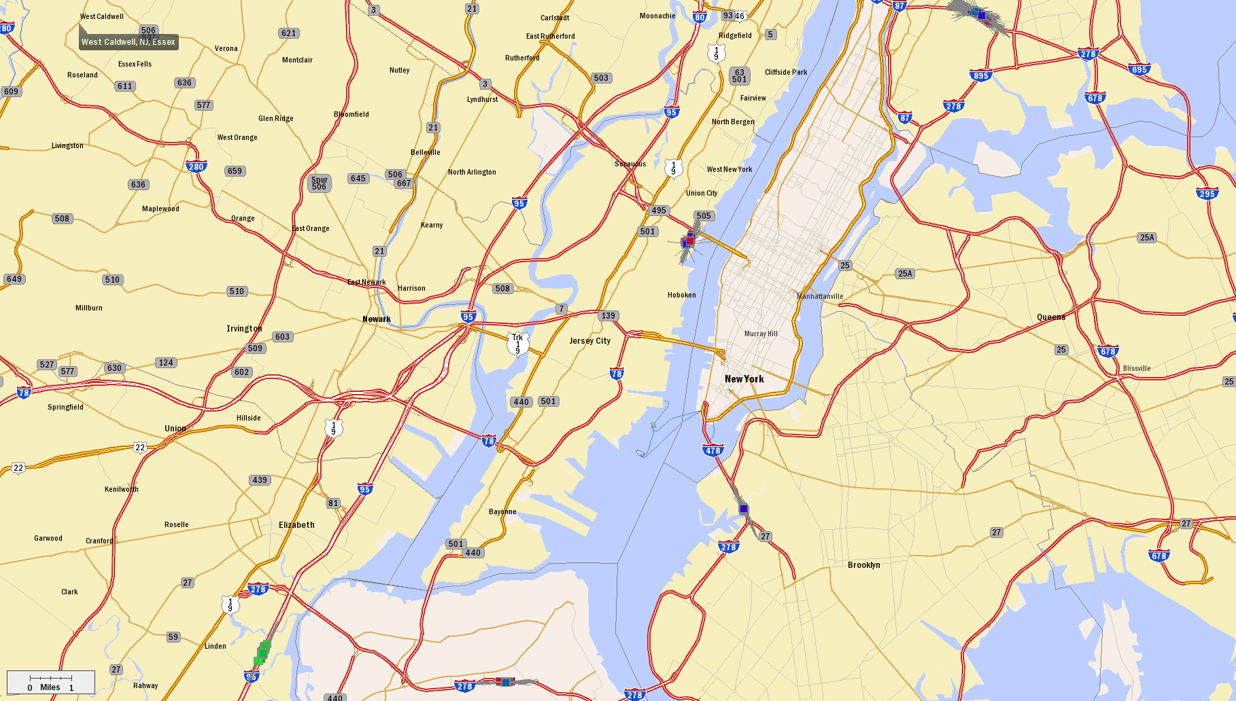




Let’s Look at a Couple of Route Segments:
Lincoln Tunnel Helix
Gowanus Exp
NJ Turnpike
Staten I Exp

Slide 59
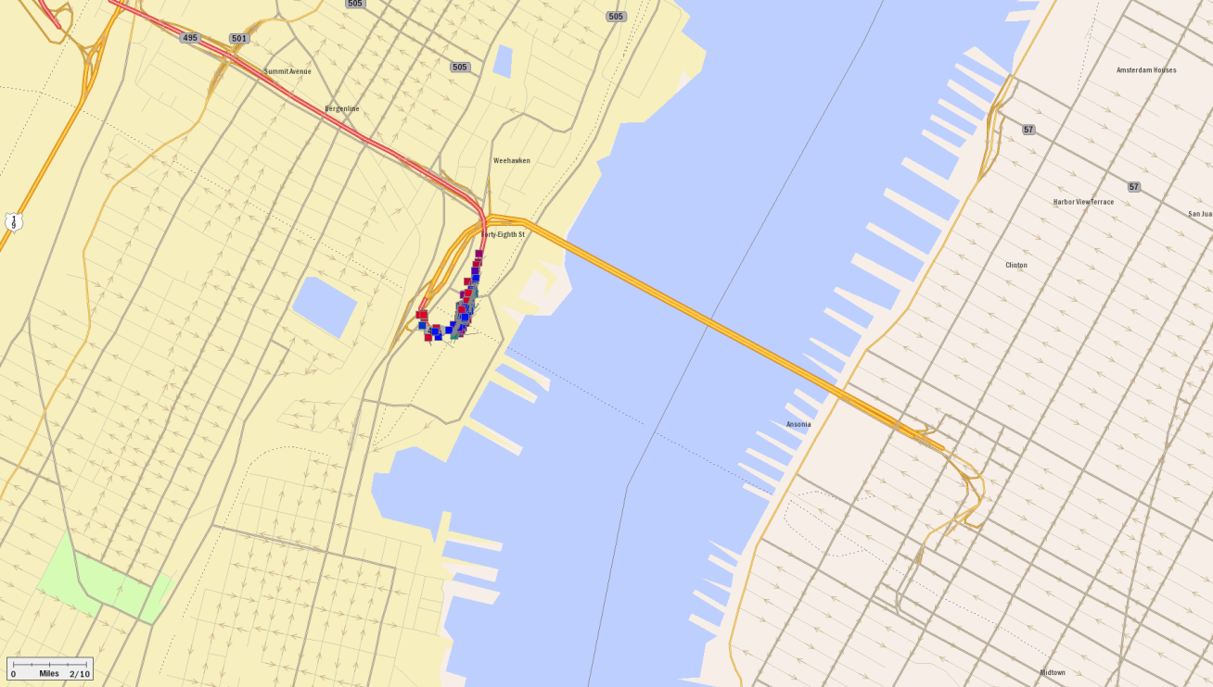

Let’s Look at a Couple of Route Segments:
Lincoln Tunnel Helix

Slide 60
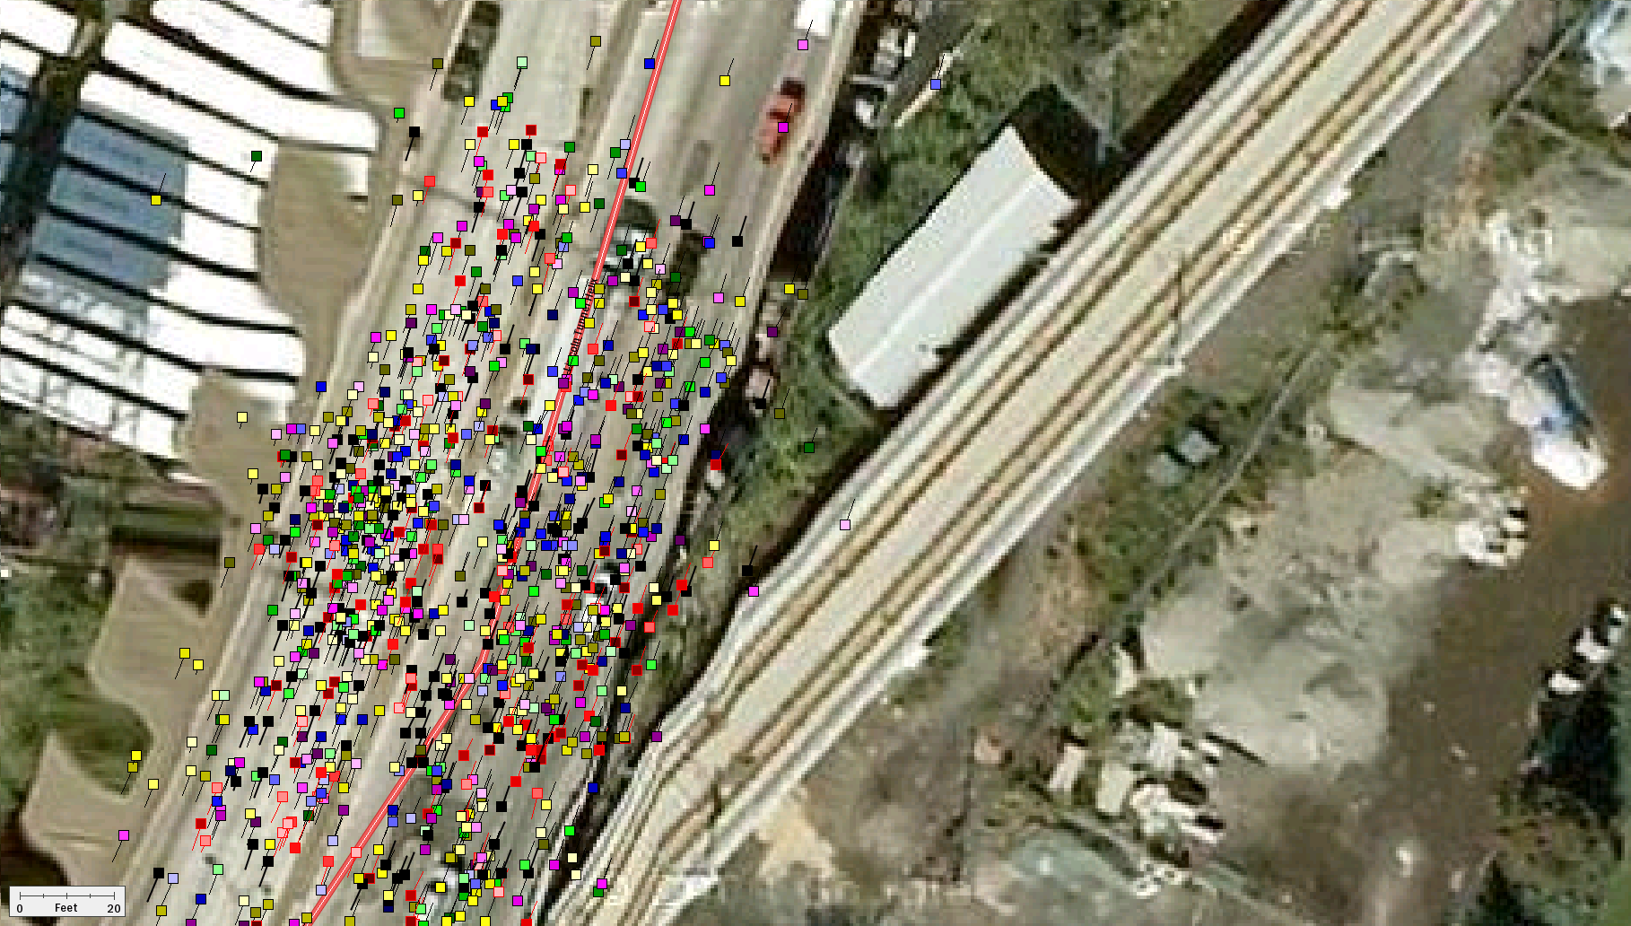
Let’s Look at a Couple of Route Segments:
Lincoln Tunnel Helix

Slide 61
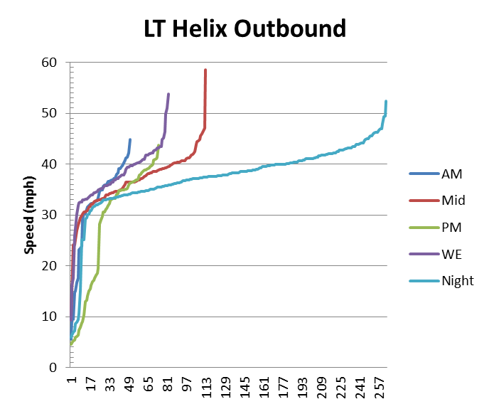
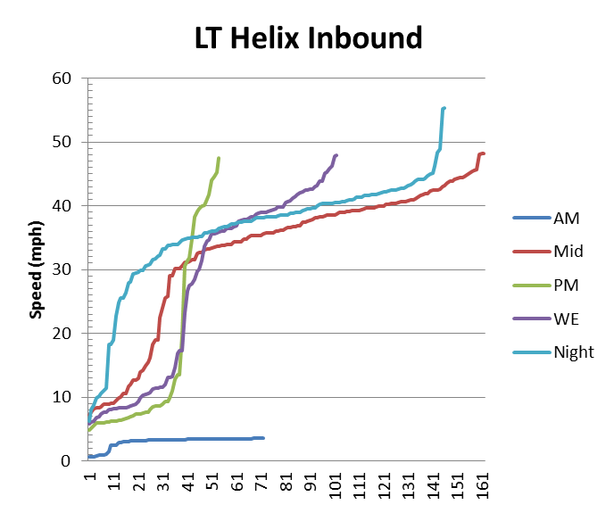
Let’s Look at a Couple of Route Segments:
Lincoln Tunnel Helix

Slide 62
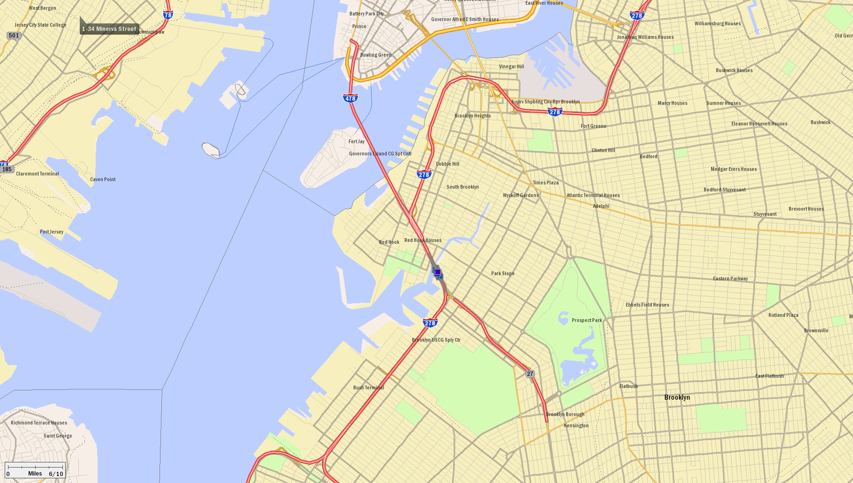

Let’s Look at a Couple of Route Segments:
Gawanus Expressway

Slide 63

Let’s Look at a Couple of Route Segments:
Gowanus Expressway

Slide 64


Let’s Look at a Couple of Route Segments:
Gowanus Expressway

Slide 65


Let’s Look at a Couple of Route Segments:
Staten Island Expressway

Slide 66


Let’s Look at a Couple of Route Segments:
Staten Island Expressway

Slide 67



Let’s Look at a Couple of Route Segments:
Staten Island Expressway

Slide 68


Let’s Look at a Couple of Route Segments:
Weekend Day (11-19) Speeds

Slide 69


Let’s Look at a Couple of Route Segments:
NJ Turnpike Truck Lanes

Slide 70



Let’s Look at a Couple of Route Segments:
NJ Turnpike

Slide 71
Link to GPS data pdf
Week 8

Slide 72




Nearby Manhattan Time-of-Day (ToD) Speeds
70 mph
35 mph
0 mph
AM Peak (6-9) Speeds

Slide 73



Nearby Manhattan Time-of-Day (ToD) Speeds
Mid-day (9-15) Speeds

Slide 74


Nearby Manhattan Time-of-Day (ToD) Speeds
PM Peak (15-19) Speeds

Slide 75


Nearby Manhattan Time-of-Day (ToD) Speeds
Overnight (20-6) Speeds

Slide 76



Nearby Manhattan Time-of-Day (ToD) Speeds
Weekends (11-18)

Slide 77


Nearby Manhattan Time-of-Day (ToD) Speeds
Median Speeds

Slide 78


NYC Met Area Nominal Speeds (Level 0)

Slide 79


NYC Met Area Nominal Speeds (Level 1)

Slide 80


NYC Met Area Nominal Speeds (Level 2)

Slide 81

NYC Met Area Nominal Speeds (Level 4)

Slide 82


Northeast Nominal Speeds (Level 0)

Slide 83

Northeast Nominal Speeds (Level 1)

Slide 84

Northeast Nominal Speeds (Level 2)

Slide 85


Northeast Nominal Speeds (Level 4)

Slide 86


Nationwide Nominal Speeds (Level 1)

Slide 87


Nationwide Nominal Speeds (Level 2)

Slide 88


Nationwide Nominal Speeds (Level 4)

Slide 89








Real-Time Dynamic Minimum ETA Sat/Nav
The late 90s
“Advance” project
&
Illinois Universities
Transportation Research Consortium
Conducted its version of the abandoned “ADVANCE” (Advanced Driver and Vehicle Advisory Navigation ConcEpt )project
  250 Volunteers using CoPilot|Live commuting to/from RPI
  CoPilot continuously shares real-time probe-based traffic data
  CoPilot continuously seeks a minimum ETA route
Won ITS America’s 2007
“Best Innovative Research” Award
11/21/2611/9/2008
Week 8

Slide 90
Project Objectives
Create: real-time data collection from vehicles and dissemination to vehicles of congestion avoidance information which is used to automatically reroute drivers onto the fastest paths to their destinations
Target locations: small to medium-sized urban areas
Aspects: operations, observability, controllability, users, information transfer to travelers
11/21/2611/9/2008
Week 8
Notes:
Concept of data sharing to improve everyone’s trips.
We are using the data collected for 1 purpose, but it can be used for many: planning, signal timing changes, others
Focus is on travelers, here drivers – helping them help themselves by enabling them to share information
Why small to medium urban areas? Because these areas tend to have pockets of congestion, unlike big cities which are congested everywhere. Also, better GPS reception (fewer urban canyons) and wireless connectivity (less callers).

Slide 91

Experiment Details
3-month field test
Capital District (Albany), NY, USA
Journey-to-work
200 participants
  80 Tech Park employees
  120 HVCC staff & students
  “Techy” travelers
Network:
  Freeways & signalized arterials
  Congested links
  Path choices exist
11/21/2611/9/2008
Week 8
Notes:
Participants were volunteers we screened to ensure they drove to school or work during the morning peak time of 7 to 9 a.m.

Slide 92






Basic Operational Architecture
Two-way cellular data communications between
Customized CoPilot|Live
In vehicles
Customized Live|Server
at ALK
6
2, 4
7
1
3
5
8
Destination
11/21/2611/9/2008
Week 8

Slide 93
Every Second
CoPilot|Live Determines “Where am I”,
Then…
If Momument, m_{j} , is passed
Send m_{i} , m_{j} , tt^{k}(m_{i}, m_{j} )= t(m_{i}) - t(m_{i})
(52 bytes)
Set i=j
ALK Server
Updates:
TT(m_{i}, m_{j} )
CoPilot|Live
“Where Am I”,
Then…
11/21/2611/9/2008
Week 8

Slide 94
Every “n” Minutes
CoPilot|Live …
Send… Current Location & Destination,
Last update time
(42 bytes)
ALK Server …
Determines U^{k} : set of TT(m_{i}, m_{j} ) within “bounding polygon” of (Location;Destination)^{k} that have changed more than “y%” since last update.
ALK Server …
Send… New TT(m_{i}, m_{j} ) for every (i,j) in U^{k}
(280 bytes/100arcs)
CoPilot|Live
Sends: “Where am I”, Dest., Last update
Receives/Posts: updates
Computes: MinETA Updates route, if better
ALK Server
Builds: set U^{k}
Sends: TT(m_{i}, m_{j} ) for every (i,j) in U^{k}
CoPilot|Live …
Updates TT(m_{i}, m_{j} ) in U^{k} , ETA on current route, Finds new MinETA route, if MinETA “substantially” better then… Adopt new route
11/21/2611/9/2008
Week 8

Slide 95
When Available
ALK Server …
Receives: Other congestion information from various source, blends them in TT(m_{i}, m_{j} )
ALK Server
Updates:
TT(m_{i}, m_{j} )
11/21/2611/9/2008
Week 8

Slide 96
What We Heard
I find it interesting how willing I am to listen to a machine tell me which route to take
I'm very impressed with the CoPilot program thus far. The directions are accurate and it adapts quickly to route changes.
I like using it for when I have no idea on how to get somewhere, and it is good for my normal route because it keeps me out of traffic on route 4.
This thing is awesome. I was a little skeptical at first but once i got the hang of it I don’t know how I went along without it. I think any student commuting to school will benefit from this.
It is great, it took a while to trust it telling me where to go, but i like it because i cant get lost! Thanks.
11/21/2611/9/2008
Week 8

Slide 97



also Can
Watch Vehicles
1
2
3
11/21/2611/9/2008
Week 8

Slide 98
Forecasting Travel Times Using Exponential Smoothig
11/21/2611/9/2008
Week 8

Slide 99

Historical Expectation: Concepts
Patterns Differ over Days & Time of Day
Most Significant Difference is Between Weekdays and Weekends
Zoo Interchange – Hale Interchange (All Days)
11/21/2611/9/2008
Week 8

Slide 100

Historical Expectation: Concepts
Two Peak Periods
Each appears to be Bell Shaped
Afternoon Peak Period Appears to have “Extra Hump”
11/21/2611/9/2008
Week 8

Slide 101

Historical Expectation: Solution
11/21/2611/9/2008
Week 8

Slide 102


Historical Expectation: Application
Downtown – Zoo Interchange
Minimize the SSE between Historical Estimation Function and actual data points
11/21/2611/9/2008
Week 8

Slide 103

Historical Expectation: Application
11/21/2611/9/2008
Week 8

Slide 104
Using Real-Time Information to Improve our Estimate
11/21/2611/9/2008
Week 8

Slide 105
Including Real-Time Information: Concepts
Real-Time Information
“Since a desirable route needs to be given when the driver asks for it, but the computation of such a route requires travel times which occur later, we need to be able to forecast such travel times.”
DEFINITION: A real-time travel time is a data point that can be received or constructed and measures the time it takes to traverse a specific route from one location to another location ending now.
11/21/2611/9/2008
Week 8

Slide 106


Including Real-Time Information: Concepts
Peak Hour Characteristics & Return to Normalcy
Burleigh - Zoo
Moorland - Downtown
During Peak Hours, Traffic Patterns Remain at a relatively constant distance to Historical Estimate
There will be a time at which traffic patterns will return to free flow conditions
11/21/2611/9/2008
Week 8

Slide 107



Including Real-Time Information: Concepts
Exponential Smoothing
Method of “smoothing” a time series of observations
Most recent observations are given a high weight and previous observations are given lower weights that decrease exponentially with the age of the observation
Single
Double
Triple
11/21/2611/9/2008
Week 8

Slide 108

Including Real-Time Information: Solution
During Peak Periods:
  Adaptation of Double Exponential Smoothing
  Trend is the Trend of the Historical Estimate
  Observation weighted with Most Recent Estimate + Slope for Smoothed Estimate
  Forecast done by adding trend to most recent estimate
11/21/2611/9/2008
Week 8

Slide 109

Including Real-Time Information: Solution
During Non-Peak Periods
  Adaptation of Double Exponential Smoothing
  Trend is decay to free flow Conditions
11/21/2611/9/2008
Week 8

Slide 110



Including Real-Time Information: Solution
Burleigh – Zoo (June 14)
11/21/2611/9/2008
Week 8

Slide 111





Including Real-Time Information: Application
11/21/2611/9/2008
Week 8

Slide 112

Progression Through Sample Day: Moorland – Downtown June 14, 2002
THETA | 0.3000 |  | Time Step | 0:03:00
PHE | 0.8000
CAI | 0.5000
C | 0.85
11/21/2611/9/2008
Week 8

Slide 113

Progression Through Sample Day: Moorland – Downtown June 14, 2002
THETA | 0.3000 |  | Time Step | 0:03:00
PHE | 0.8000
CAI | 0.5000
C | 0.85
11/21/2611/9/2008
Week 8

Slide 114

Progression Through Sample Day: Moorland – Downtown June 14, 2002
THETA | 0.3000 |  | Time Step | 0:03:00
PHE | 0.8000
CAI | 0.5000
C | 0.85
11/21/2611/9/2008
Week 8

Slide 115

Progression Through Sample Day: Moorland – Downtown June 14, 2002
THETA | 0.3000 |  | Time Step | 0:03:00
PHE | 0.8000
CAI | 0.5000
C | 0.85
11/21/2611/9/2008
Week 8

Slide 116

Progression Through Sample Day: Moorland – Downtown June 14, 2002
THETA | 0.3000 |  | Time Step | 0:03:00
PHE | 0.8000
CAI | 0.5000
C | 0.85
11/21/2611/9/2008
Week 8

Slide 117

Progression Through Sample Day: Moorland – Downtown June 14, 2002
THETA | 0.3000 |  | Time Step | 0:03:00
PHE | 0.8000
CAI | 0.5000
C | 0.85
11/21/2611/9/2008
Week 8

Slide 118

Progression Through Sample Day: Moorland – Downtown June 14, 2002
THETA | 0.3000 |  | Time Step | 0:03:00
PHE | 0.8000
CAI | 0.5000
C | 0.85
11/21/2611/9/2008
Week 8

Slide 119

Progression Through Sample Day: Moorland – Downtown June 14, 2002
THETA | 0.3000 |  | Time Step | 0:03:00
PHE | 0.8000
CAI | 0.5000
C | 0.85
11/21/2611/9/2008
Week 8

Slide 120

Progression Through Sample Day: Moorland – Downtown June 14, 2002
THETA | 0.3000 |  | Time Step | 0:03:00
PHE | 0.8000
CAI | 0.5000
C | 0.85
11/21/2611/9/2008
Week 8

Slide 121

Progression Through Sample Day: Moorland – Downtown June 14, 2002
THETA | 0.3000 |  | Time Step | 0:03:00
PHE | 0.8000
CAI | 0.5000
C | 0.85
11/21/2611/9/2008
Week 8

Slide 122

Progression Through Sample Day: Moorland – Downtown June 14, 2002
THETA | 0.3000 |  | Time Step | 0:03:00
PHE | 0.8000
CAI | 0.5000
C | 0.85
11/21/2611/9/2008
Week 8

Slide 123

Progression Through Sample Day: Moorland – Downtown June 14, 2002
THETA | 0.3000 |  | Time Step | 0:03:00
PHE | 0.8000
CAI | 0.5000
C | 0.85
11/21/2611/9/2008
Week 8

Slide 124

Progression Through Sample Day: Moorland – Downtown June 14, 2002
THETA | 0.3000 |  | Time Step | 0:03:00
PHE | 0.8000
CAI | 0.5000
C | 0.85
11/21/2611/9/2008
Week 8

Slide 125

Progression Through Sample Day: Moorland – Downtown June 14, 2002
THETA | 0.3000 |  | Time Step | 0:03:00
PHE | 0.8000
CAI | 0.5000
C | 0.85
11/21/2611/9/2008
Week 8

Slide 126

Progression Through Sample Day: Moorland – Downtown June 14, 2002
THETA | 0.3000 |  | Time Step | 0:03:00
PHE | 0.8000
CAI | 0.5000
C | 0.85
11/21/2611/9/2008
Week 8

Slide 127

Progression Through Sample Day: Moorland – Downtown June 14, 2002
THETA | 0.3000 |  | Time Step | 0:03:00
PHE | 0.8000
CAI | 0.5000
C | 0.85
11/21/2611/9/2008
Week 8

