Slide 1
ProjectChain
The blockchain of projects
Submitted by
MUHAMMED RAIHAN P A
21352030
Under the guidance of
Dr. M. Nandhini
Associate Professor

Slide 2
Project Overview
The ‘ProjectChain’ is a blockchain system that the scholars can upload their valuable projects.
Distributed file system based on blockchain technology.
This is an application that can be used inside the university campus.

Slide 3
Modules
Student :
Signup
Login
Upload
View ProjectChain & Blockchain

Slide 4
Requirements
Hardware Requirements :
Processor: intel core i3 or above
Hard Disk/SSD: 250GB
Network connection: LAN/MAN/WAN
Memory : 4GB RAM or HIGHER

Slide 5
Requirements
Software Requirements :
Front End: ReactJS, HTML, CSS
Back End: Solidity, Truffle Framework, Ganache, IPFS
IDE : Visual studio code and Powershell/Terminal
Operating system: Windows/ Linux/Mac OS
Web Browser : A blockchain browser (Metamask)

Slide 6
About the app
This is a react-based web app in which students can upload their projects
Whenever a user uploads the project in the system it’ll be stored on the IPFS
If 3 projects are uploaded to the system then those projects are mined into a block
All the users can view the the blocks and details of project.
Only the owner can access and view the project

Slide 7
Implementation
This react-based application was created in Visual Studio Code with Ganache.
Truffle is used to establish the blockchain.
An Ethereum simulator called Ganache offers some blockchain accounts with fake ETHs in their wallets.
The projects are kept in an IPFS (InterPlanetary File System) decentralized file storage system.
There is an upload box where students can enter project information and upload their projects for those scholars who choose to do so.

Slide 8
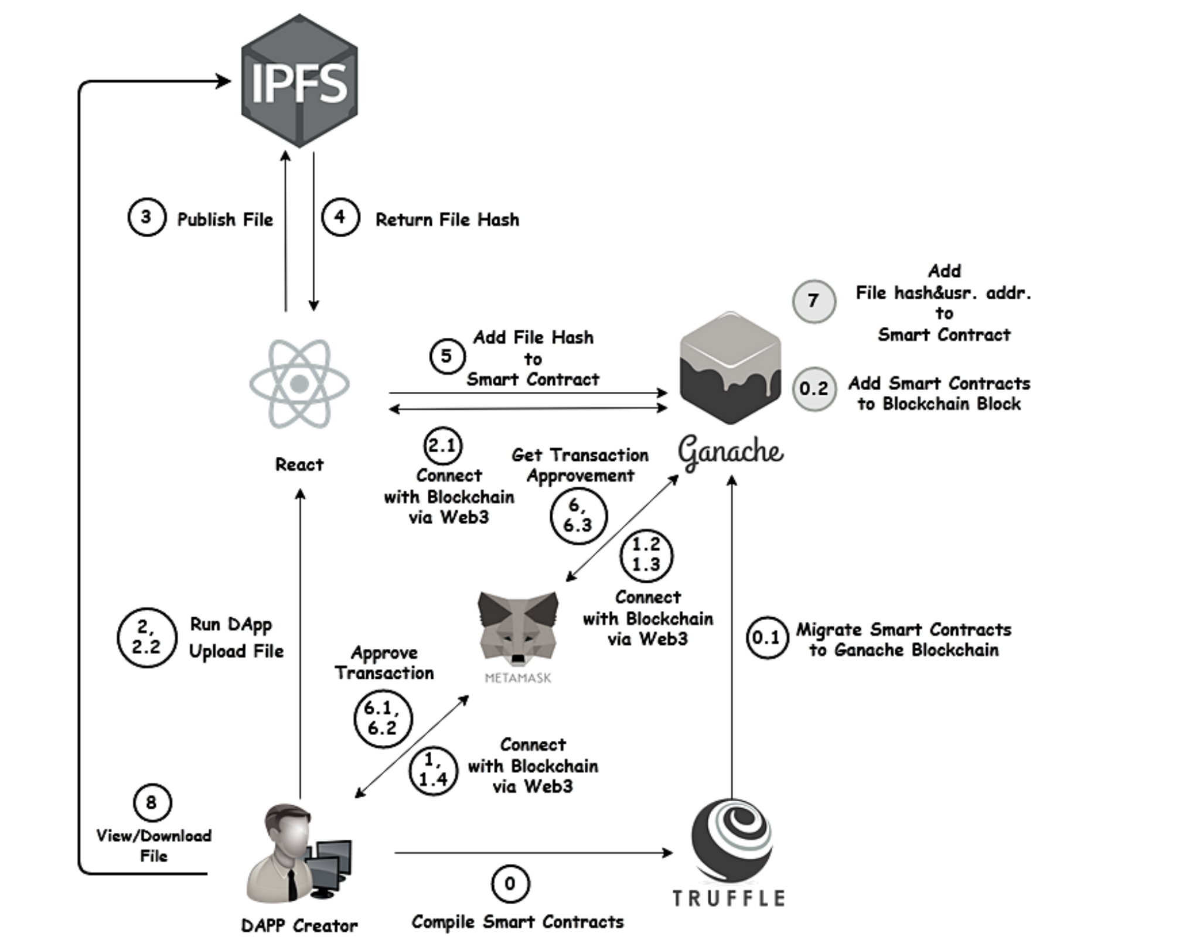
Architecture

Slide 9
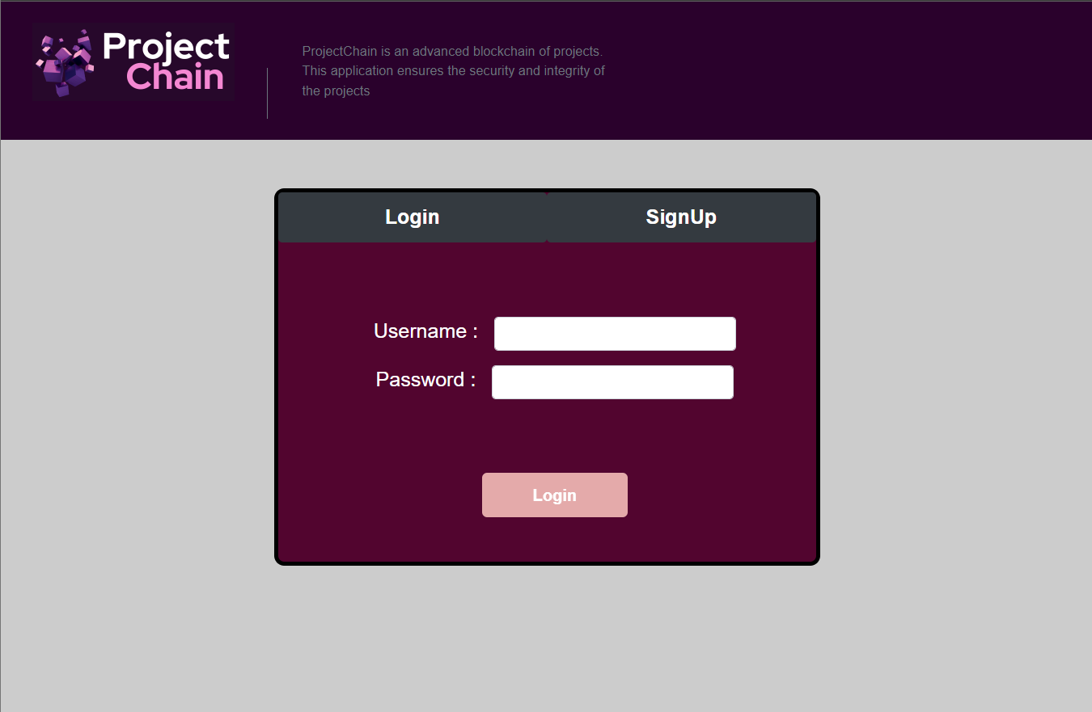
System Interface Snaps

Slide 10
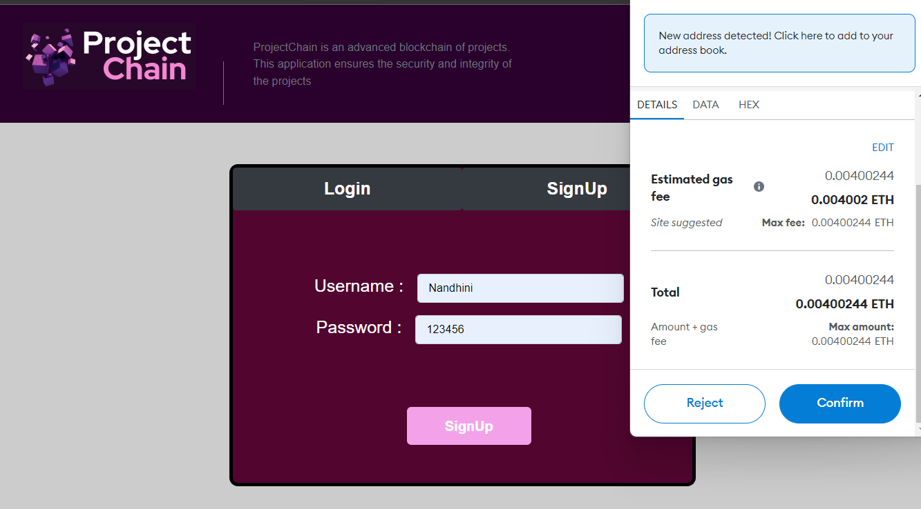

Slide 11
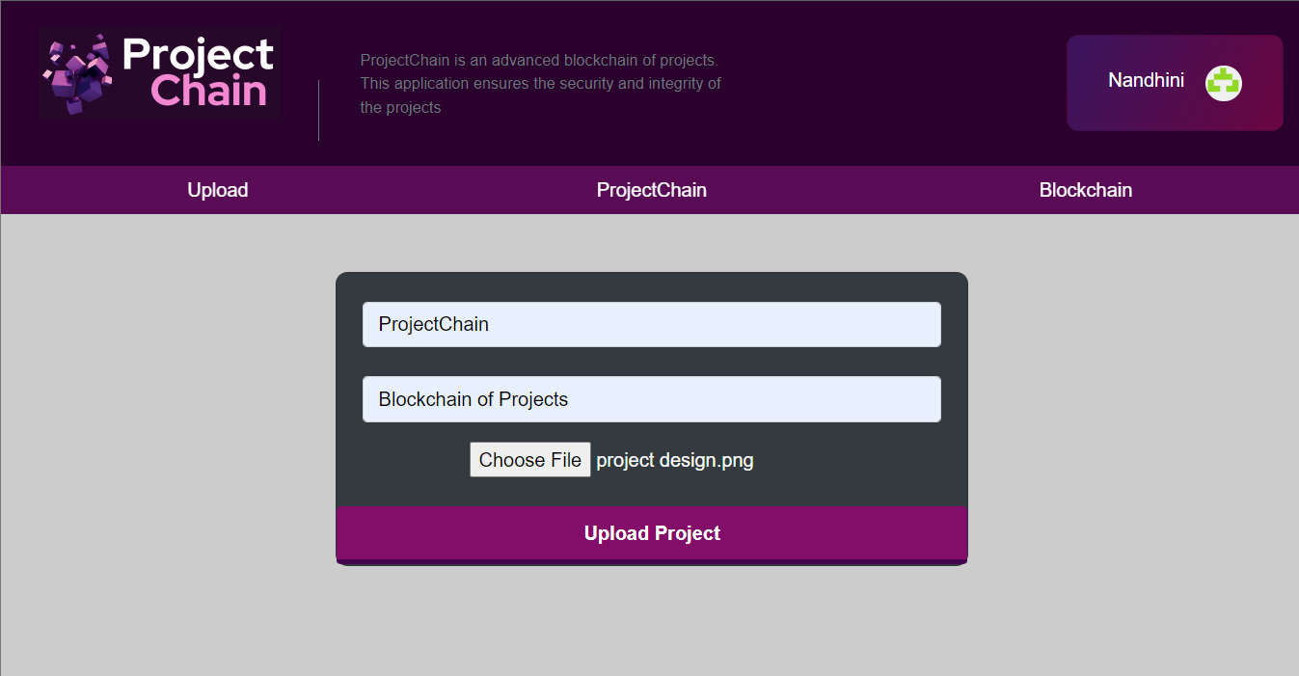

Slide 12
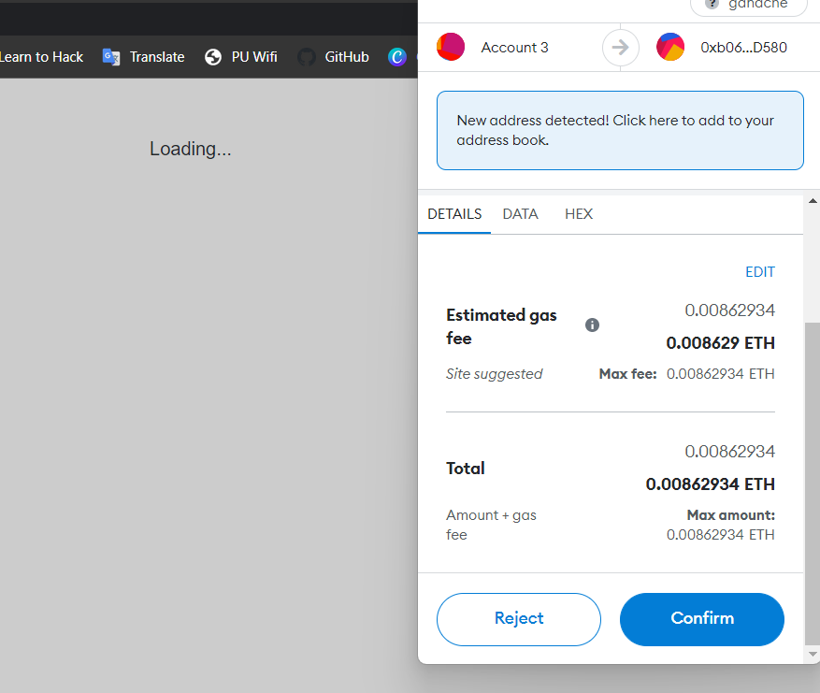

Slide 13
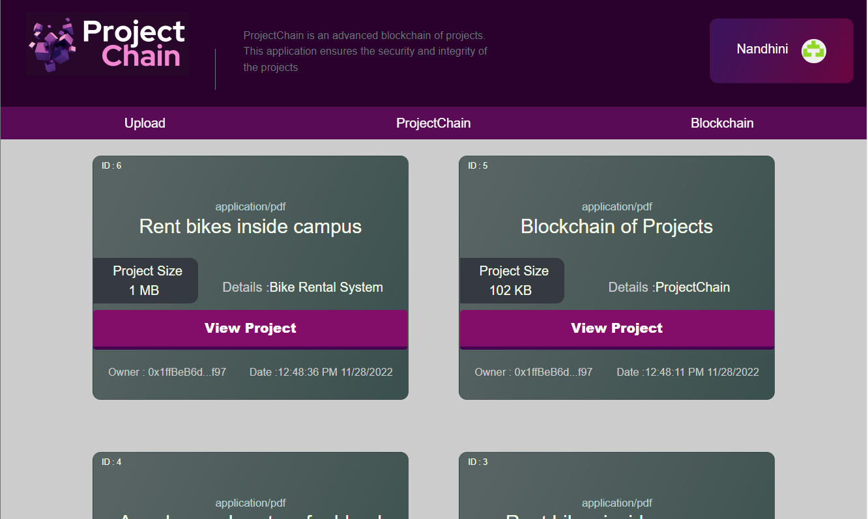

Slide 14
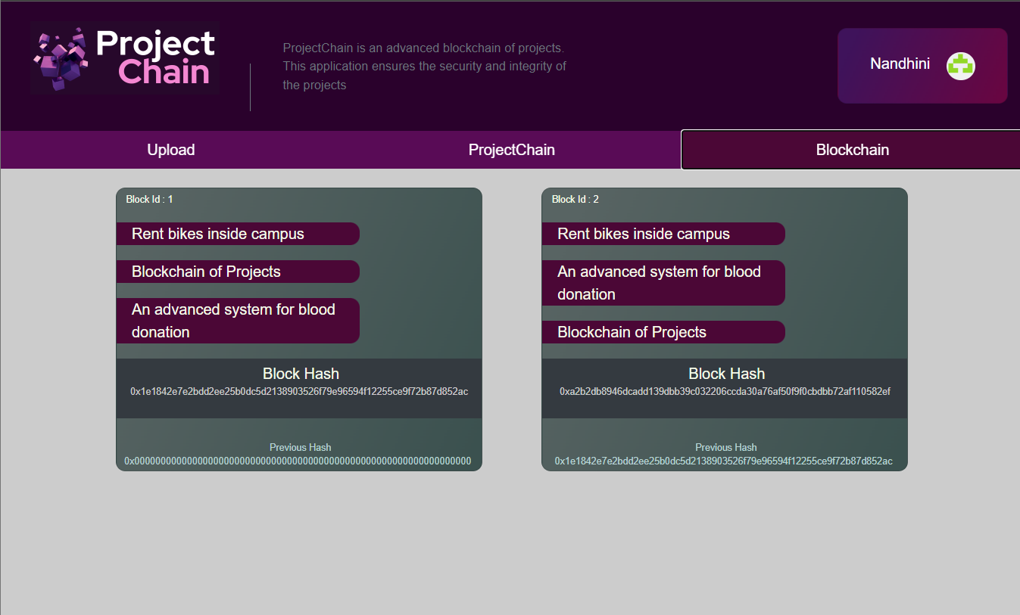

Slide 15
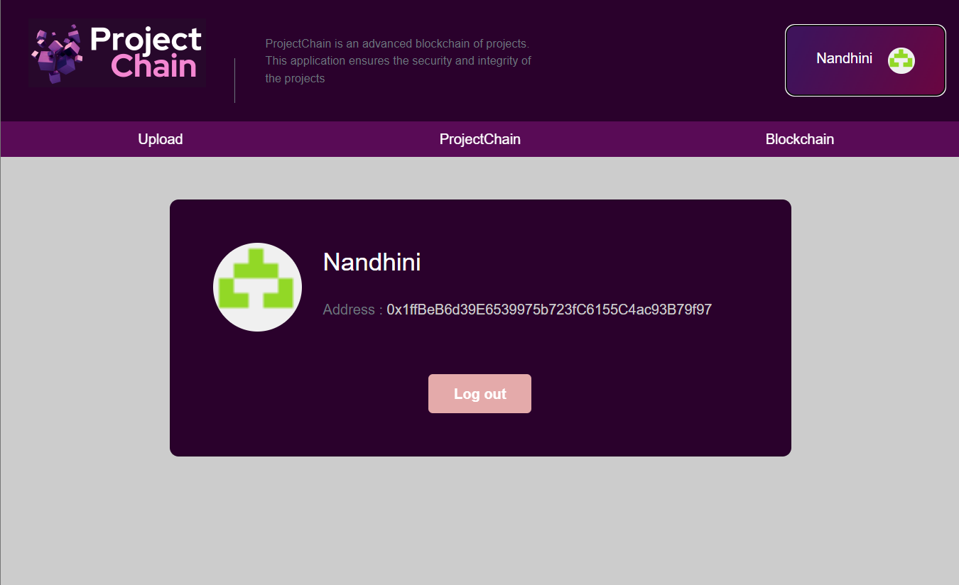

Slide 16
References
https://app.infura.io/
https://trufflesuite.com/
https://trufflesuite.com/ganache/
https://metamask.io/
https://github.com/kvutien/Tutorial-ipfs-dapp
https://itnext.io/storage-dapp-using-solidity-and-ipfs-62cf371b77dc
https://reactjs.org/tutorial/tutorial.html
https://ethereum.stackexchange.com/questions/64085/call-a-function-with-an-address-attached-solidity-react
https://github.com/bhflm/ipfs-proxy-api
https://www.becomebetterprogrammer.com/upload-files-using-react-ipfs-infura/

