Slide 1
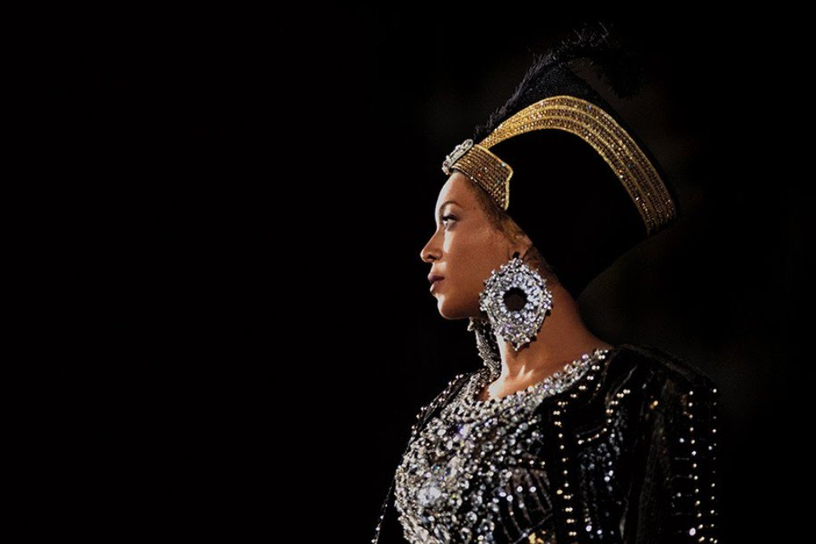
HOMECOMING
Coachella Performance by Beyoncé

Slide 2
Beyoncé’s Audience
Emotions
Talks to the audience
Dedicates a song for them
Interaction by pointing a mic to them

Slide 3
What struck you
Performance
Consistent energy
Diet
Beyoncé's journey
Organization

Slide 4
CELEBRITIES AND BODY IMAGE
Plastic Surgery
Tattooing
Piercing
Skin lightening
Dressing

Slide 5
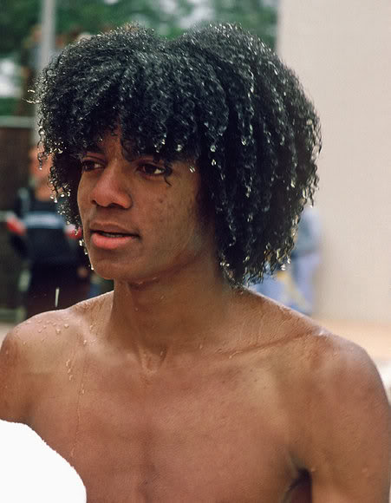
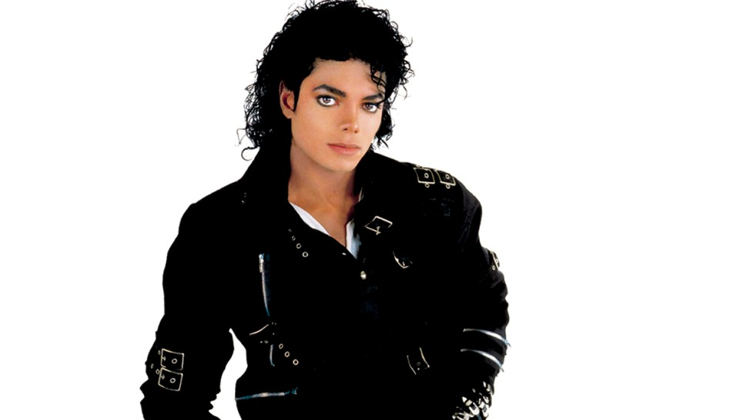

Slide 6
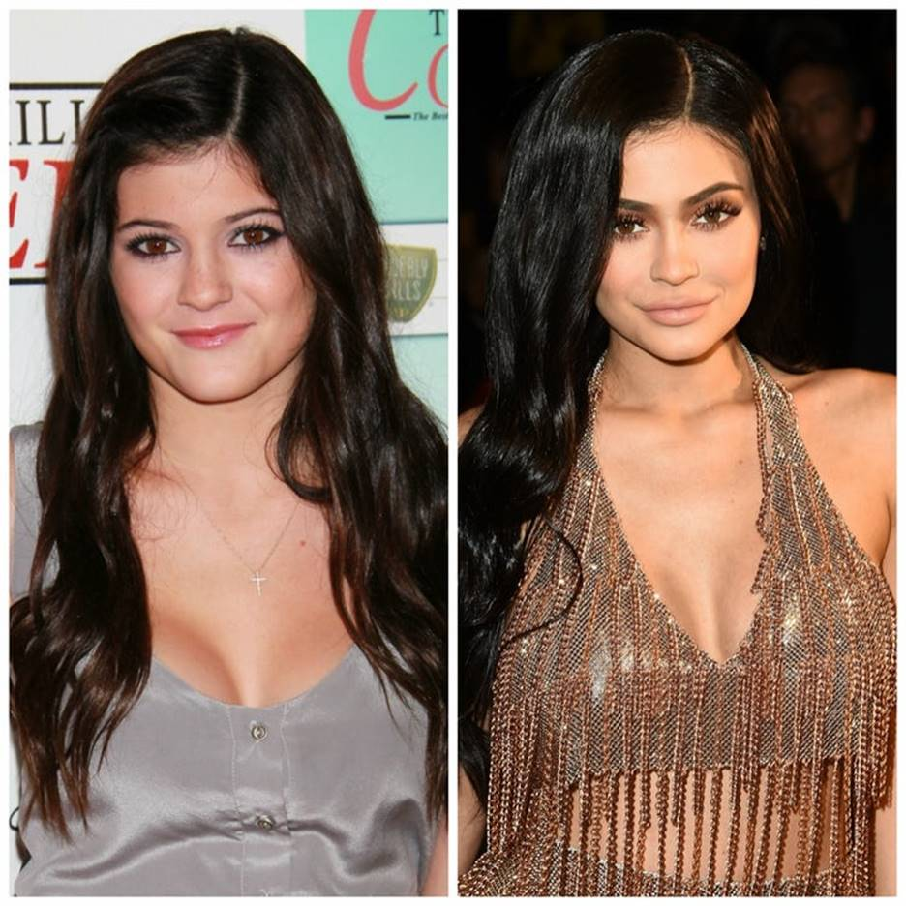
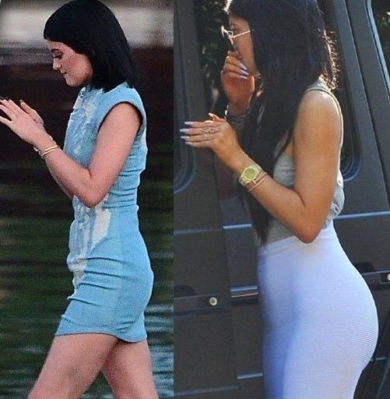
Plastic Surgery

Slide 7
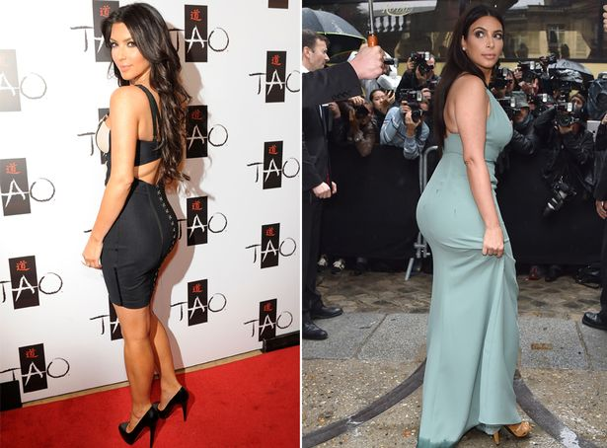

Slide 8
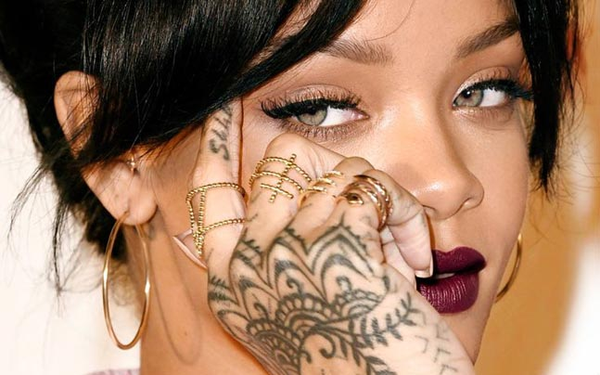
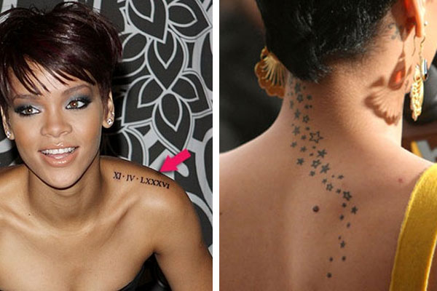

Slide 9
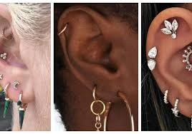
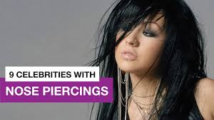

Slide 10
Social Issues

Slide 11
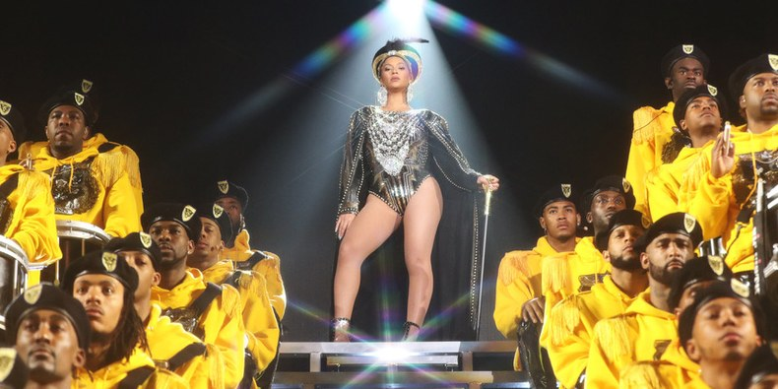
Women Should be given space in the society

Slide 12
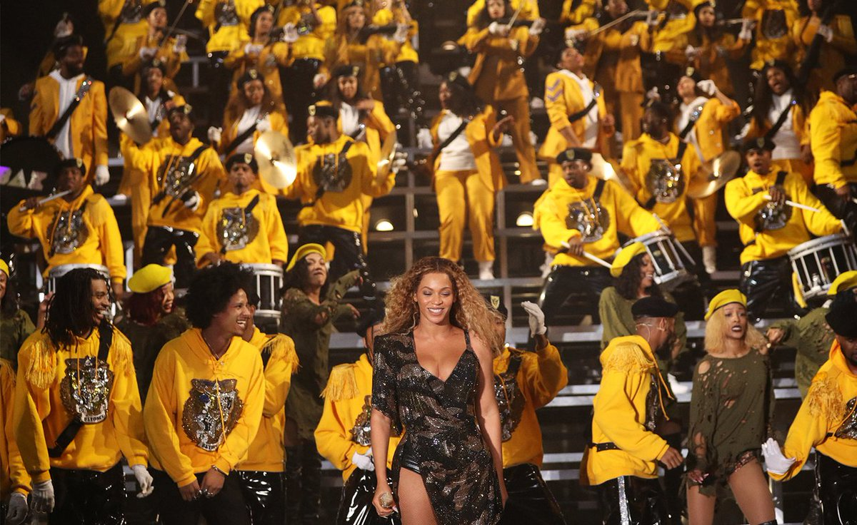
Teamwork

Slide 13
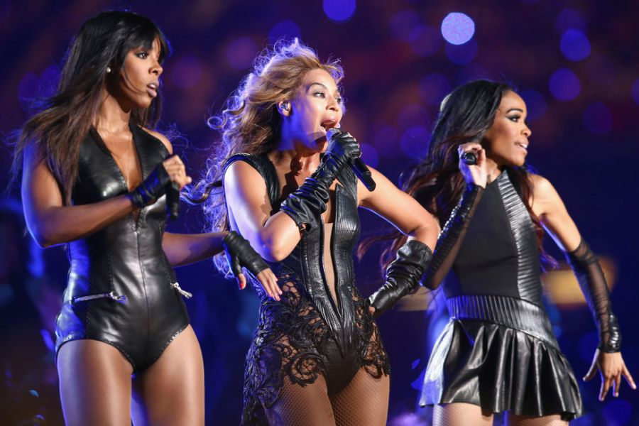
Long Lasting Friendship

Slide 14
CULTURAL ISSUES

Slide 15
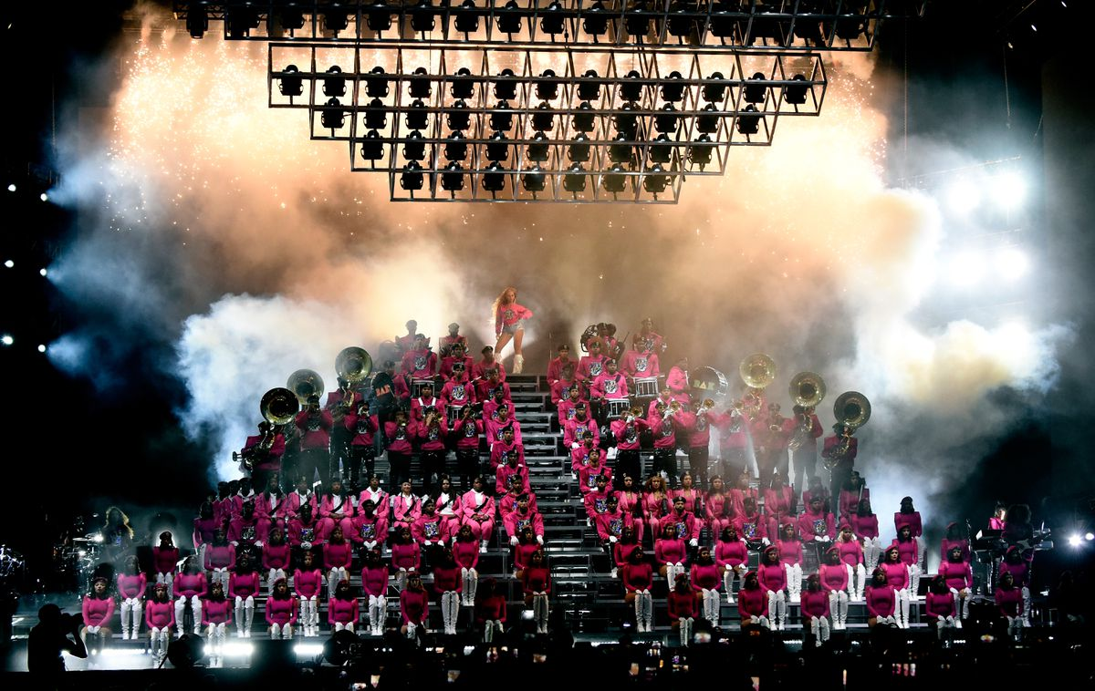
NEGROES
Their traditional entertainment system was brought out well. Blended voices, dancing vigorously without a song in the background.

Slide 16
POLITICAL ISSUES
Feminism
Racism
“As a black woman, I used to feel like the world wanted me to stay in my little box. And black woman often feel underestimated.”

Slide 17
ECONOMICAL ISSUES
Working hard to achieve.
“I respect things that take work. I respect things that are built from the ground up. I'm super specific about every detail. I personally selected each dancer, every light, the material on the steps, the height of the pyramid, the shape of the pyramid. Every patch was hand-sewn. Every tiny detail had an intention.”
By Beyonce (www.xonecole.com)

Slide 18
Pop Feminism
Women can attain equality with men through a positive, go-getting attitude
Enables women to plan their adult lives
Freedom to plan their families
Freedom to marital and parental rights
Teamwork
Cultural power
Determination

Slide 19
Value of the process
Study your journey
Recognize the sacrifice
Figure it out along the way
See how far you can go
Respect the work
Seek continuous improvement
Cultivate your values

Slide 20
Lessons from Beyoncé and Homecoming
Your work can leave an impact and remain relevant after it is produced
Women can have it all Personal boundaries and self assessment are a priority
Cultivate your values
Leave a legacy behind
Seek continuous improvement
Cultivate your values
Be grateful, be humble, and spark vision in others
Study your journey

