Slide 1
Adaptive Scenario Generation for Planning under Uncertainty
or why you should care about deep generative learning
Aron Brenner
MIT Laboratory for Information and Decision Systems

Slide 2
What are generative models*?
*for continuous random variables

Slide 3
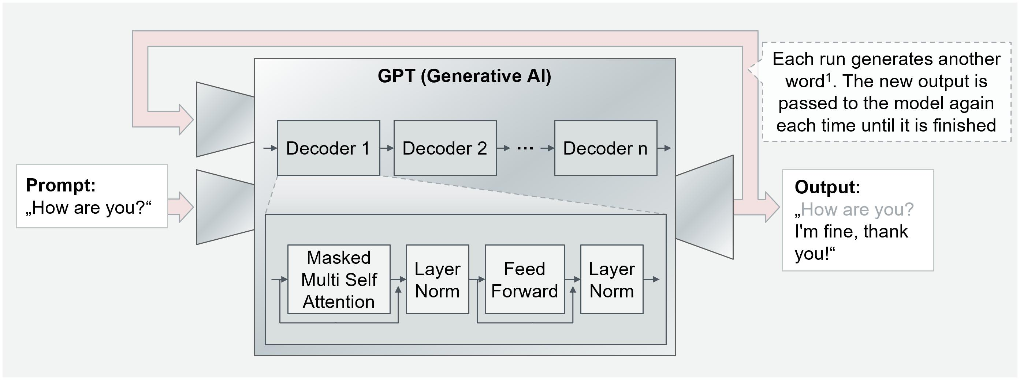
Disclaimer: NOT talking about LLMs

Slide 4
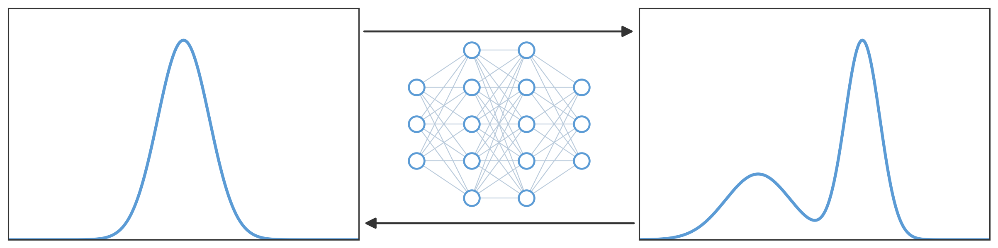


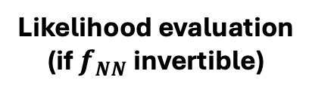
Deep generative models learn maps (neural networks) from tractable base distributions to complex data distributions
Sampling
$$f_{NN}$$
Likelihood evaluation
(if $f_{NN}$ invertible)
Base distribution $𝓝(0, I)$
Data distribution

Slide 5
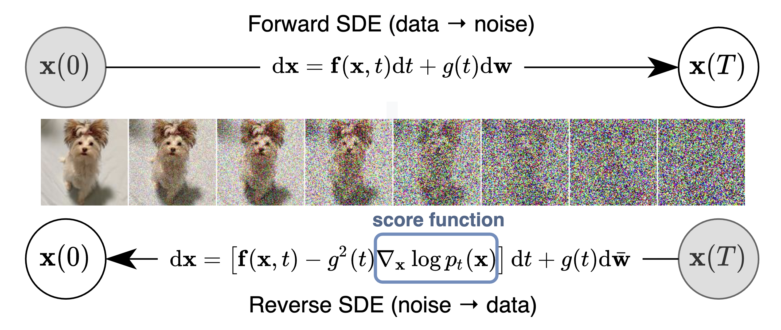

Deep generative models learn maps (neural networks) from tractable base distributions to complex data distributions
Base distribution $𝓝(0, I)$
Data distribution
Score-Based Generative Modeling through Stochastic Differential Equations (Song et al. 2021)

Slide 6
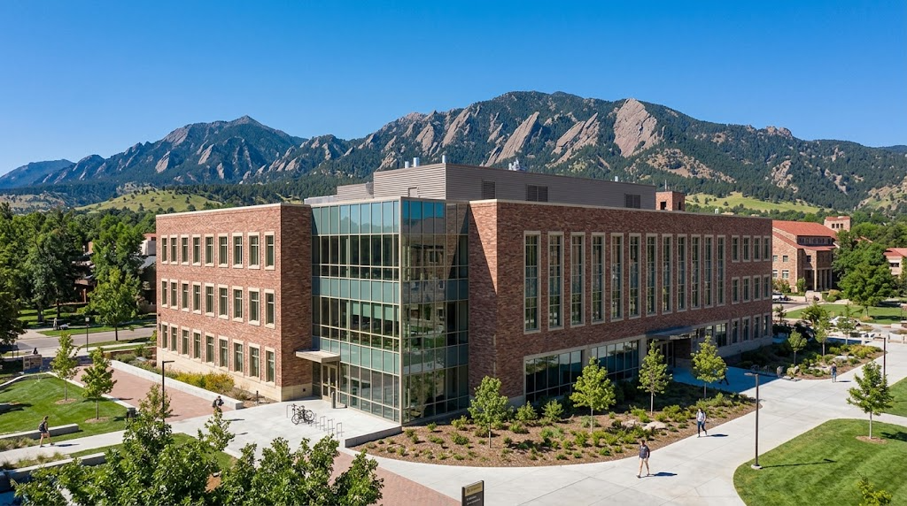
Generative models can perform realistic extrapolations
“Generate an image of CU Boulder's SEEC building exterior”

Slide 7
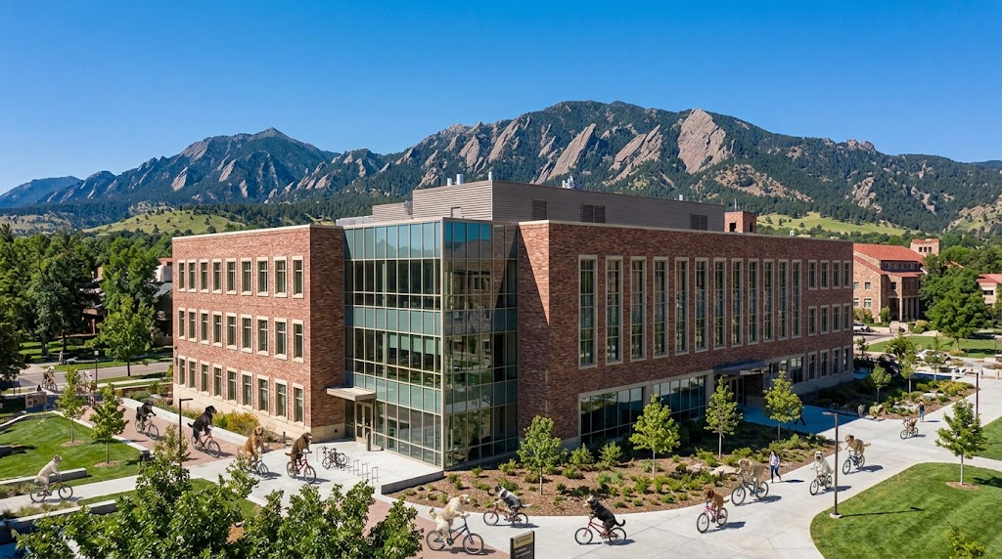
Generative models can perform realistic extrapolations
“Generate an image of CU Boulder's SEEC building exterior with dogs riding bikes”

Slide 8
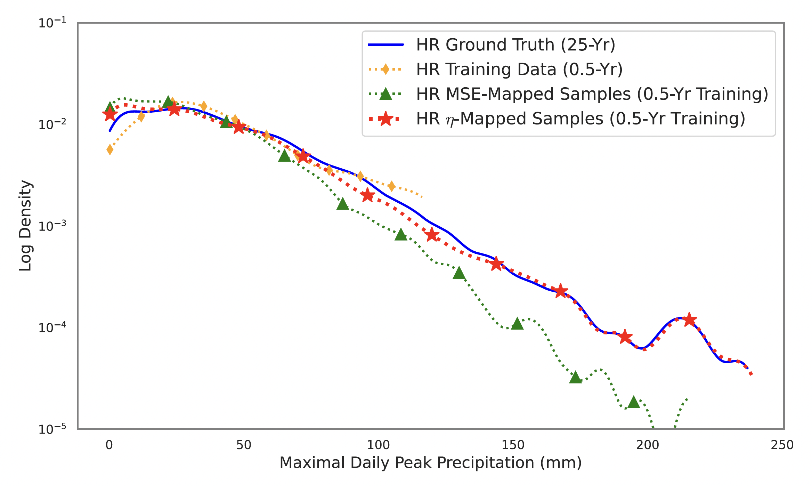
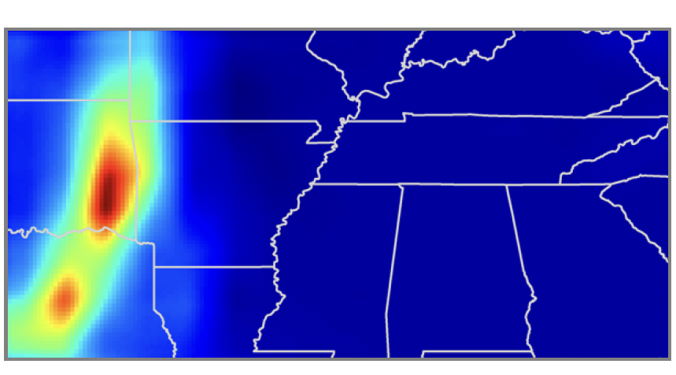
Generative models can perform realistic extrapolations in power systems-relevant settings
Extreme Event Aware ($η$-) Learning (Chang and Sapsis 2026)
Generative learning for precipitation downscaling recovers 25-year tail statistics with 6-months training data.

Slide 9
Now you understand deep generative modeling
Back to power systems

Slide 10
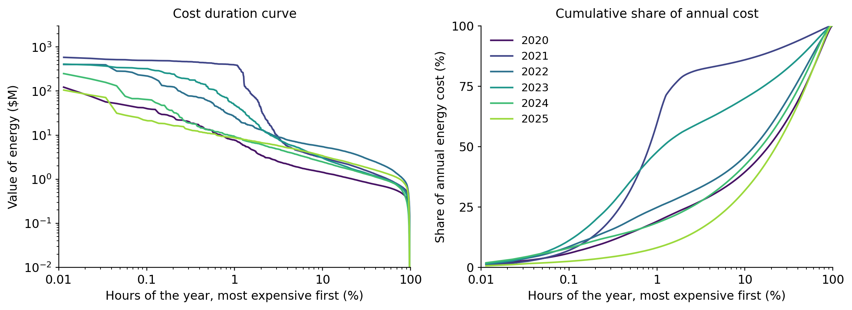
Extreme events dominate system planning
ERCOT: 1% of hours carry 10%-75% of annual energy cost (depending on year)

Slide 11
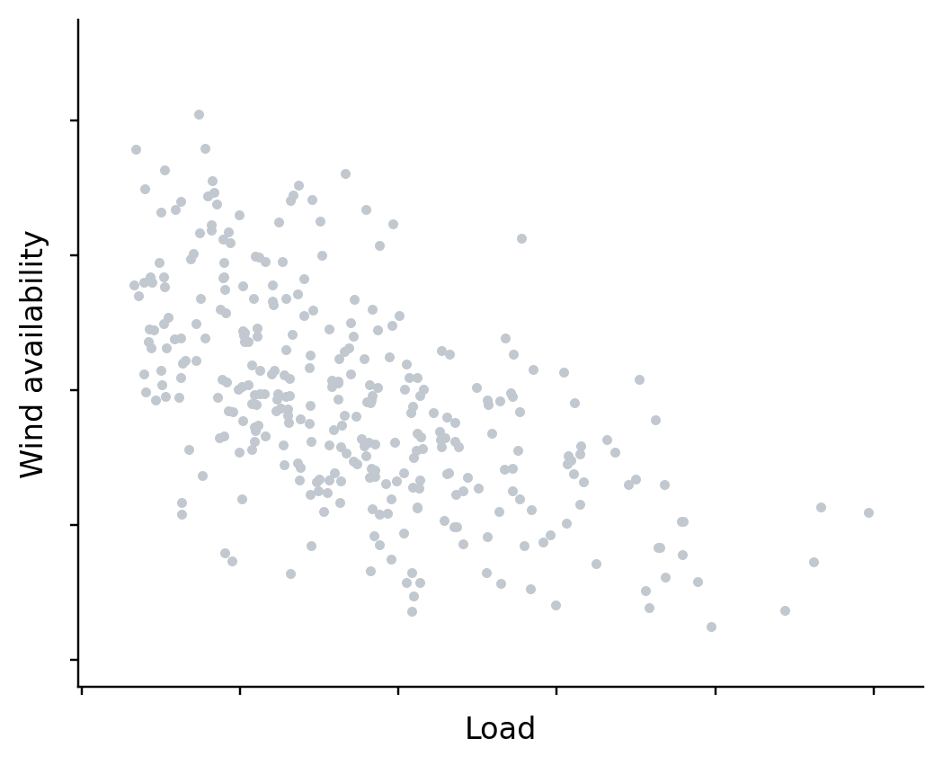
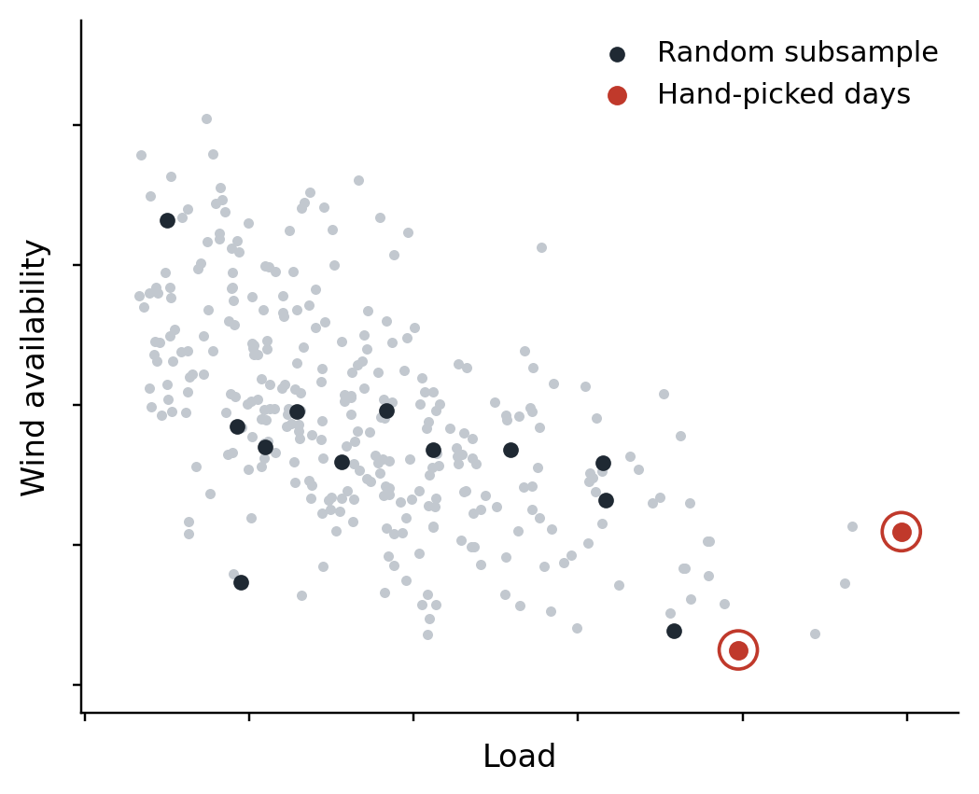
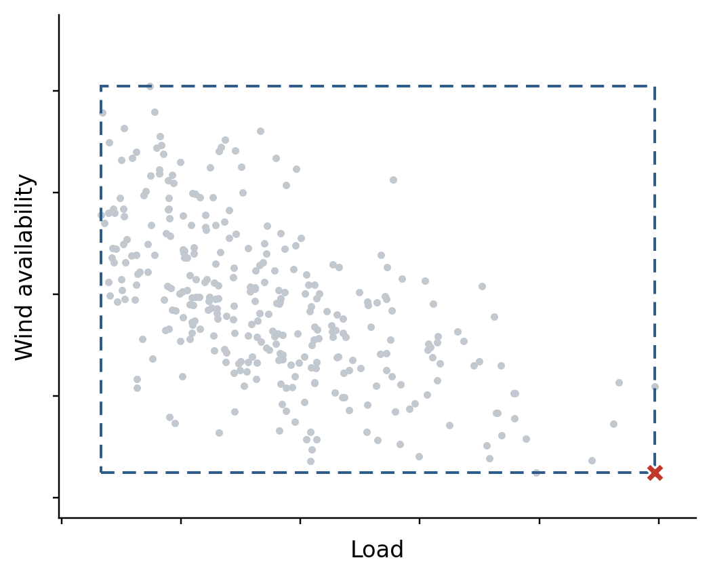
Stochastic and robust formulations exploit historical record to hedge with plausibility
Historical record
Selecting extreme periods for SP
Uncertainty set for RO
In both cases, hedge comes from imposing distributional assumptions
Extreme periods: “extremeness is one-dimensional”
Uncertainty set: “wind and load are independent”

Slide 12
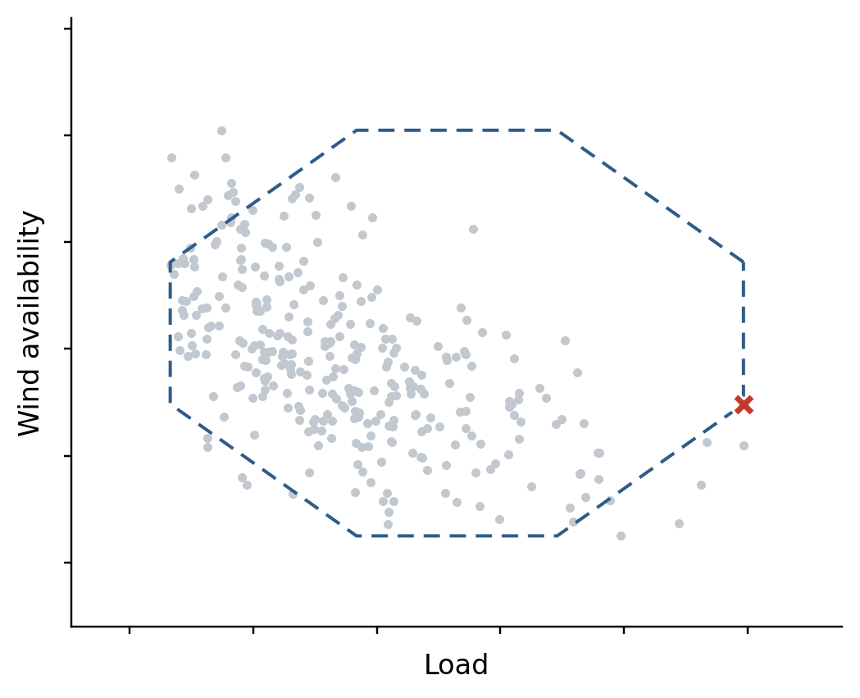
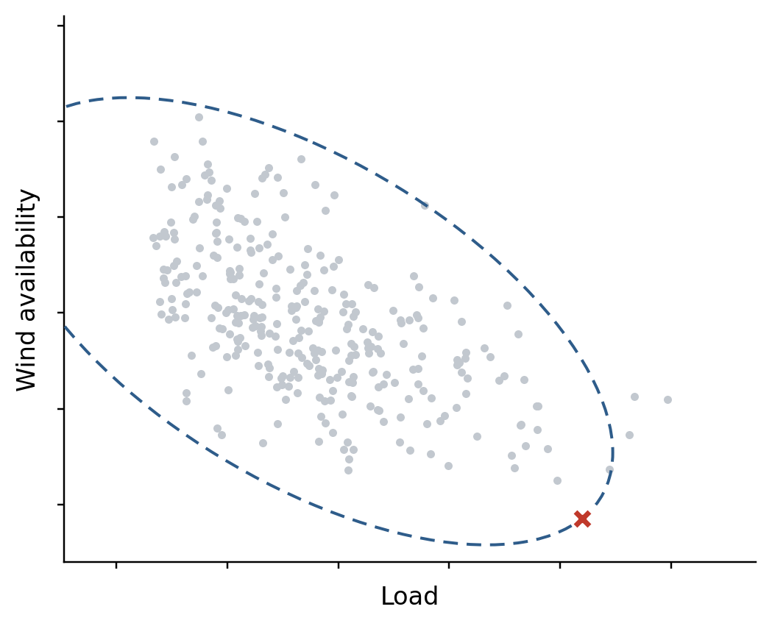
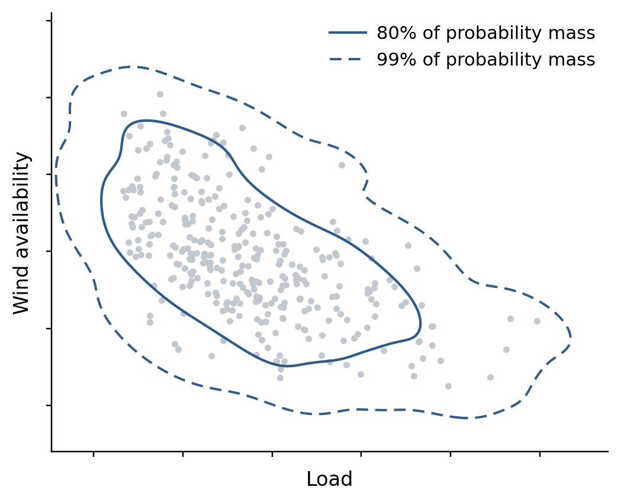
Towards minimal-assumption, physically consistent uncertainty sets with generative modeling
L1/budget uncertainty set
“Simultaneous extremes are unlikely”
L2/ellipsoid uncertainty set
“Wind and load are correlated”
Generative (KDE) uncertainty set
“The data determines the uncertainty”
Generative models extrapolate from data. How to integrate into planning pipeline?

Slide 13
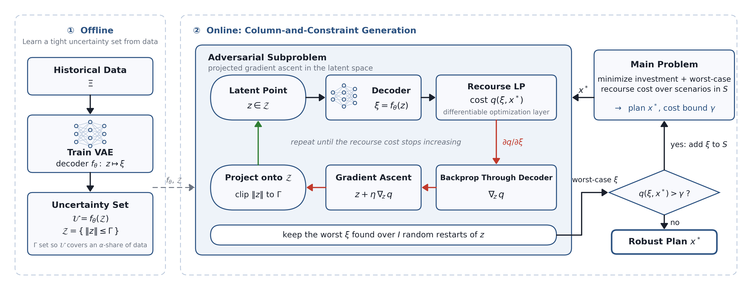
AGRO: Adversarial Generation for (Adaptive) RO
A Deep Generative Learning Approach for Two-Stage Adaptive Robust Optimization (ICLR 2025)
Aron Brenner, Rahman Khorramfar, Jennifer Sun, Saurabh Amin
Optimize portfolio → Generate realistic worst-case to stress incumbent portfolio → Repeat
AGRO planning solutions cut out-of-sample costs by 8% over budget-box uncertainty set.

Slide 14
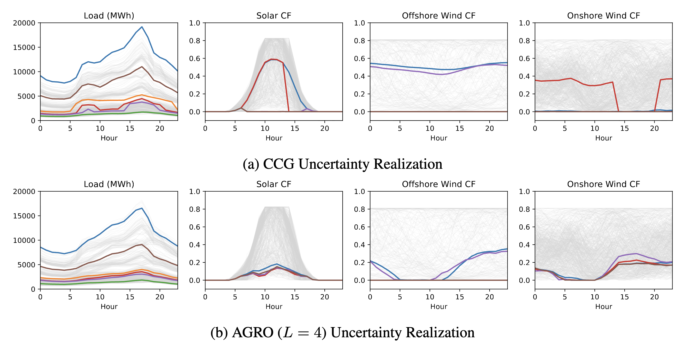
AGRO: Adversarial Generation for (Adaptive) RO
A Deep Generative Learning Approach for Two-Stage Adaptive Robust Optimization (ICLR 2025)
Aron Brenner, Rahman Khorramfar, Jennifer Sun, Saurabh Amin
AGRO discovers and hedges against plausible extremes

Slide 15
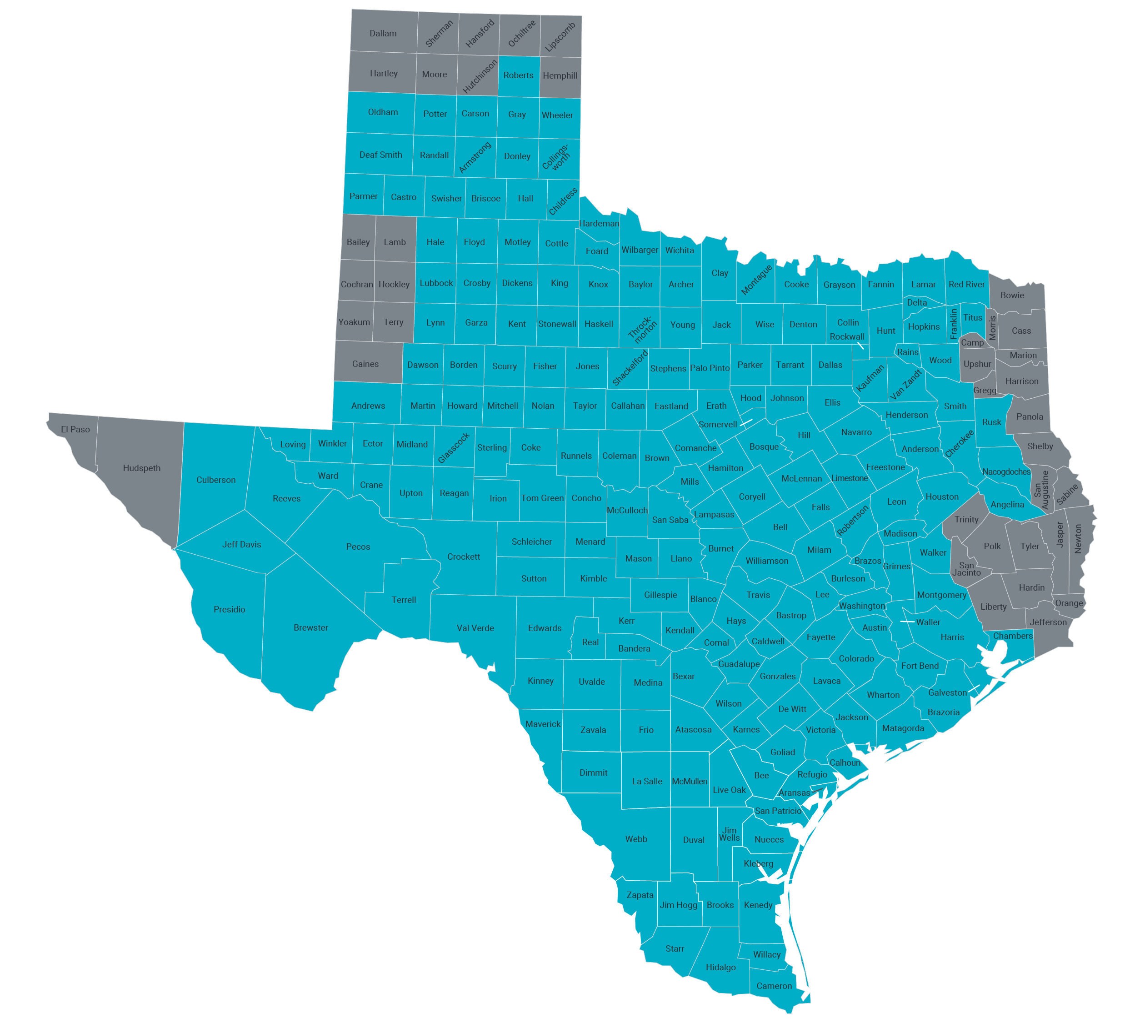
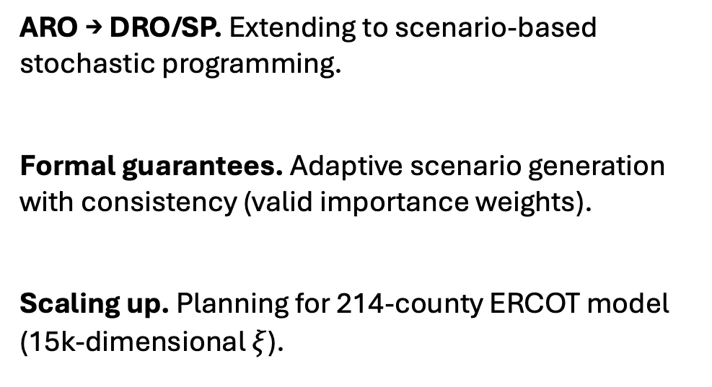
Ongoing work after AGRO
ARO → DRO/SP. Extending to scenario-based stochastic programming.
Formal guarantees. Adaptive scenario generation with consistency (valid importance weights).
Scaling up. Planning for 214-county ERCOT model (15k-dimensional $ξ$).

Slide 16
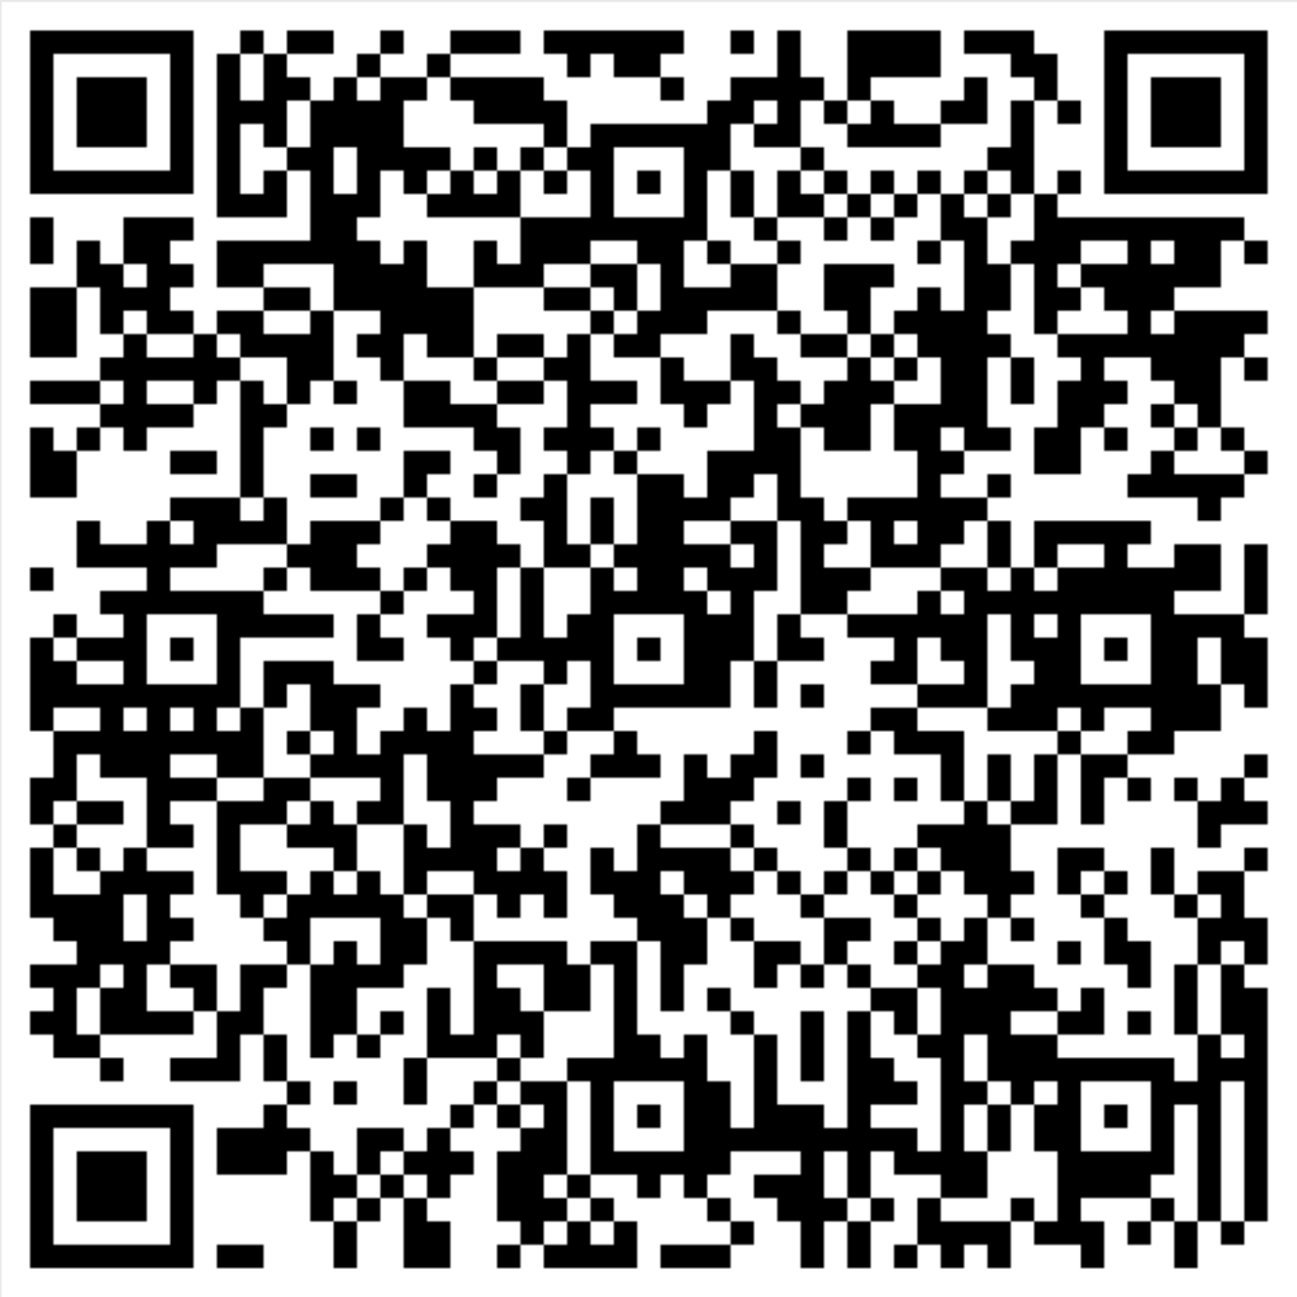
Conclusion
Planning is a tail problem. A few hours can carry annual costs.
Uncertainty is hedged with hard-coded assumptions. Boxes, budgets, ellipsoids, reserve margins.
Generative models for realistic stress-testing with minimal assumptions. AGRO yields 8% lower out-of-sample cost than budget-box.
Always new developments from ML community
  Diffusion tilting → steer generation towards decision-critical scenarios
  Extreme-event modeling → extrapolate deep into tails
  Thank you!
Read the AGRO paper

